Slide 1
Prof. Rajesh R M
Dept. of AIML
RV College of Engineering
Bengaluru

Slide 2
Outline
Getting Started
Introducing Python
Setting Up Python in windows
Setting Up Python in other Operating Systems
Introducing IDLE
Types, Variable, and Simple I/O
Using Quotes with Strings
Concatenating and Repeating Strings
Working with Numbers
Understanding the Variable
Getting User Input
Converting Values

Slide 3
Introduction to Python
Python is a powerful yet easy-to-use programming language
Developed by Guido van Rossum
First released in 1991.
With Python, you can quickly write a small project
But Python also scales up nicely and can be used for mission-critical, commercial applications

Slide 4
Introduction to Python (Contd.)
The major goal of any programming language is to bridge the gap between the programmer’s, brain and the computer

Slide 5
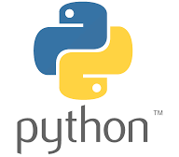
Introduction to Python (Contd.)
There are a lot of programming languages out there
What’s so great about Python?
Python Is Easy to Use
Python Is Powerful
Python Is Object-Oriented
Python Is a “Glue” Language
Python Runs Everywhere
Python Has a Strong Community
Python Is Free and Open Source

Slide 6
Introduction to Python (Contd.)
Python Is Easy to Use
Most of the popular languages you’ve probably heard of, like Visual Basic, C#, and Java, are considered high-level languages, which means that they’re closer to human language than machine language
But Python, with its clear and simple rules, is even closer to English
Creating Python programs is so straightforward that it’s been called “programming at the speed of thought”
Python programs are shorter and take less time to create than programs in many other popular languages

Slide 7
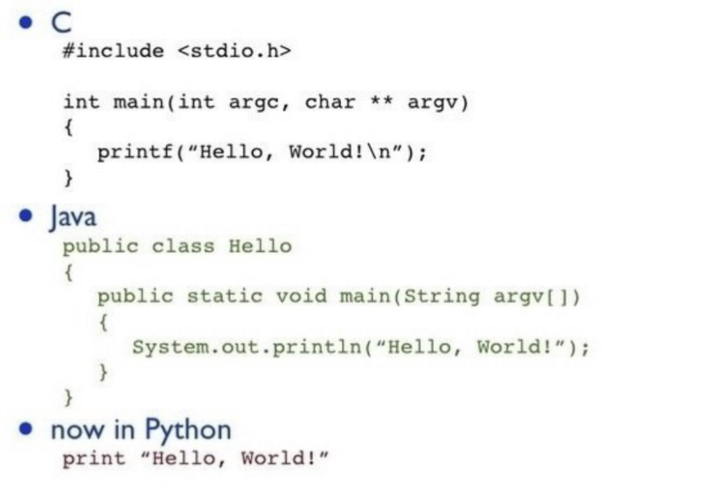
Introduction to Python (Contd.)
Python Is Easy to Use

Slide 8
Introduction to Python (Contd.)
Python Is Powerful
Python has all the power you’d expect from a modern programming language
Python employ a GUI, process files, and use a variety of data structures
Python is powerful enough to attract developers from around the world as well as companies such as
Google, IBM, Industrial Light + Magic, Microsoft, NASA, Red Hat, Verizon, Xerox, and Yahoo!
Python is also used as a tool by professional game programmers. Electronic Arts, Games, and the Disney Interactive Media Group all publish games that incorporate Python

Slide 9
Introduction to Python (Contd.)
Python Is Object-Oriented
Object-Oriented Programming (OOP) is a modern approach to solving problems with computers
It embodies an intuitive method of representing information and actions in a program
It’s certainly not the only way to write programs, but, for large projects, it’s often the best way to go
Languages like C#, Java, and Python are all object-oriented. But Python does them one better.
In C# and Java, OOP is not optional. This makes short programs unnecessarily complex
Python takes a different approach
In Python, using OOP techniques is optional
You have all of OOP’s power at your disposal, but you can use it when you need it

Slide 10
Introduction to Python (Contd.)
Python Is Object-Oriented

Slide 11
Introduction to Python (Contd.)
Python Is a “Glue” Language
Python can be integrated with other languages such as C, C++, and Java. This means that a programmer can take advantage of work already done in another language while using Python
It also means that he or she can leverage the strengths of other languages, such as the extra speed that C or C++ might offer, while still enjoying the ease of development that’s a hallmark of Python programming.
C
C++
JAVA
PYTHON

Slide 12
Introduction to Python (Contd.)
Python Runs Everywhere
You can run Python on Windows, Macintosh, or Linux machines
Python programs are platform independent, which means that regardless of the operating system you use to create your program, it’ll run on any other computer with Python
So if you write a program on your PC, you can e-mail a copy to your friend who runs Linux or to your aunt who has a Mac, and the program will work
Only condition Python installed on their computers

Slide 13
Introduction to Python (Contd.)
Python Has a Strong Community
Most programming languages have a dedicated newsgroup, but Python also has something called the Python Tutor mailing list, a more informal way for beginning programmers to ask those first questions
The list is at: http://mail.python.org/mailman/listinfo/tutor
Although the list is called Tutor, anyone, whether novice or expert, can answer questions
There are other Python communities focused on different areas, but the common element they share is that they tend to be friendly and open. That only makes sense since the language itself is so approachable for beginners

Slide 14
Introduction to Python (Contd.)
Python Is Free and Open Source
Python is free. You can install it on your computer and never pay a penny
But Python’s license lets you do much more than that. You can copy or modify Python. You can even resell Python
if you want (but don’t quit your day job just yet). Embracing open-source ideals like this is part of what makes Python so popular and successful.

Slide 15
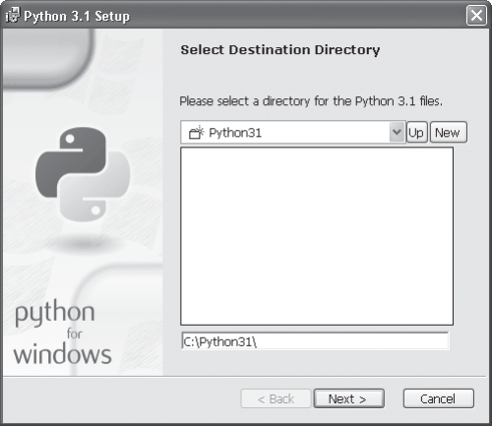
Setting Up Python in Windows
Before you can jump in and write your first Python program, you need to get the language on your computer
Installing Python on Windows
1. Download the Python Windows installer from the companion website (www.courseptr.com/downloads). The file is in the Software folder, inside the Python subfolder; the file name is python-3.1.msi.
2. Run the Python Windows Installer, python-3.1.msi. Figure 1.2 shows the installer in action.
3. Accept the default configuration. Once you’re done, you’ll have Python 3.1 on your system.

Slide 16
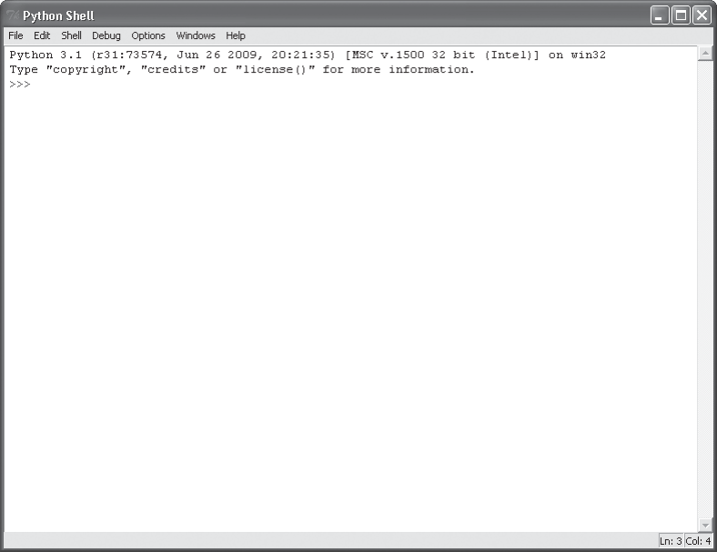
Introducing IDLE
Python comes with an Integrated Development Environment (IDE) called IDLE
A development environment is a set of tools that makes writing programs easier
You can think of it as a word processor for your programs. But it’s even more than a place to write, save, and edit your work
IDLE provides two modes in which to work
An interactive Mode
Script Mode
IDLE IDE

Slide 17
Introducing IDLE (Contd.)
Programming in Interactive Mode
Finally, it’s time to get your hands dirty with some actual Python programming.
The quickest way is to start Python in interactive mode. In this mode, you can tell Python what to do and it’ll respond immediately.
Writing Your First Program
To begin your interactive session, from the Start menu, choose All Programs, Python 3.1, IDLE (Python GUI)

Slide 18
Variable
A variable is the name of a memory location
Python is weakly typed, i.e., you don’t declare variables to be a specific type
A variable has the type that corresponds to the value you assign to it
Variable names begin with a letter or an underscore and can contain letters, numbers, and underscores
Python has reserved words that you can’t use as variable names
Example: class, def, else, except, try, if, while, etc.
Memory
x = 50
type(x)
10000
10004
10008 | 50
10012
10016
a = “Hello”
type(x)
x
y = ‘5.000’
type(x)

Slide 19
Python Data Types
Every value in Python has a datatype
In python, the interpreter implicitly binds the value with its type
We can use the type() function along with the variable to know the type of the data
Employee Details
Employee Id | 00001823
Name | Peter
Age | 42
Salary | 150000.68
Address | Jayanagar, Bangalore
Zip Code | 560 001
Python Data Types
Text Type
Numeric Type
Boolean Type
Sequence Types
None Type
Set Types
Binary Types
str
int
float
complex
list
tuple
Dictionaries
set
frozenset

Slide 20
Using Quotes With the Strings
You can use either a pair of single (' ') or double quotes (" ") to create string values
print(“Hello RVCE")
To print multiple values with a single call to the print() function—just list multiple argument values, separated by commas.
print("Same", "message", "as before")
print ("Just", "a bit", "bigger")

Slide 21
Using Quotes With the Strings (Contd.)
Text Type
Text type is a sequence characters
Strings start and end with quotation mark " or apostrophe ' characters
Examples: "hello" "This is a string" "This, too, is a string. It can be very long!“
Escape Sequence: An escape sequence is a sequence of characters that does not represent itself when used
Some String Operations
# Declaring & Printing the String
x = "RV College of Engineering"
print (x)
# Getting the length of the String
print(len(x))
# Concatenation Operation
print(x+"-"+“AIML")
# Concatenation Operation
print("Pie" * 10)

Slide 22
Using Quotes With the Strings (Contd.)
Specifying a Final String to Print
By default, the print() function prints a newline character as a final value. This means that a subsequent call to print() would display text on the following line
Generally, python allows you to specify your own final string to be printed
For Example: Specify that a space be the final character printed (instead of the newline) when you call the print() function. This would mean a subsequent print() statement would begin printing values right after that space.
print("Here", end=" ")
print("it is...")

Slide 23
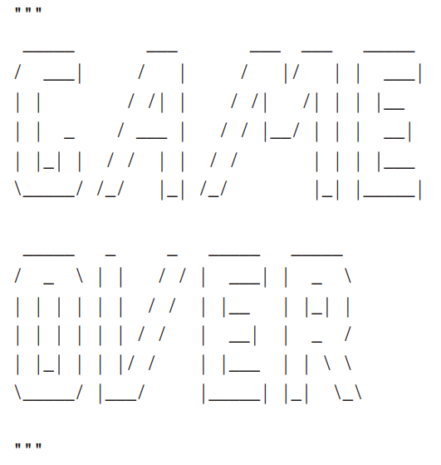
Using Quotes With the Strings (Contd.)
Creating Triple-Quoted Strings
Certainly, the coolest part of the program is that it prints out “Game Over” in a big block of text
my_str = """
I
am
a
Geek !
"""
# check data type of
print(type(my_str))
print(my_str)
Triple quotes are used for
Multi-line String Creation
Multi-line Commenting

Slide 24
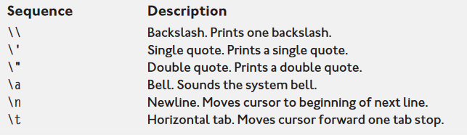
Using Quotes With the Strings (Contd.)
Using Escape Sequences with Strings
Escape sequences allow you to put special characters into your strings
They give you greater control and flexibility over the text you display

Slide 25
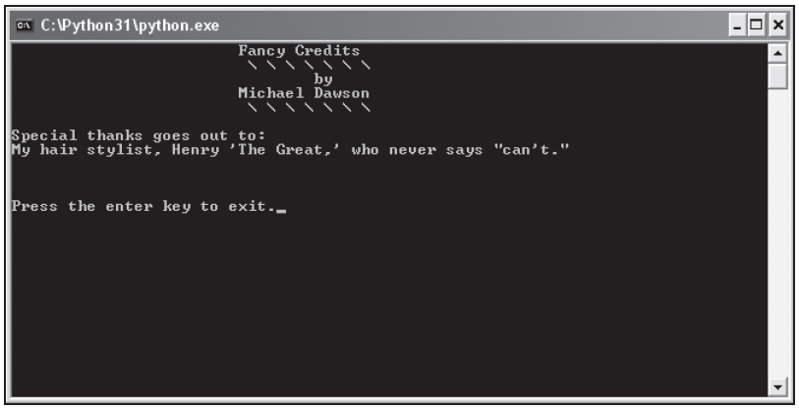
Using Quotes With the Strings (Contd.)
Introducing the Fancy Credits Program
Just telling a player that the game is over, a program often displays credits, a list of all the people who worked so hard to make it a reality.
Fancy Credits uses escape sequences to achieve some effects it just couldn’t without them

Slide 26
Using Quotes With the Strings (Contd.)
Introducing the Fancy Credits Program: Example
# Fancy Credits
# Demonstrates escape sequences
print("\t\t\t Fancy Credits")
print("\t\t\t \\ \\ \\ \\ \\ \\ \\")
print("\t\t\t\t by")
print("\t\t\t Michael Dawson")
print("\t\t\t \\ \\ \\ \\ \\ \\ \\")
print("\n Special thanks goes out to:")
print("My hair stylist, Henry \'The Great,\' who never says \"can\'t.\"")
# sound the system bell
print("\a")
input("\n\n Press the enter key to exit.")

Slide 27
Using Quotes With the Strings (Contd.)
Moving Forward a Tab Stop
Sometimes you’ll want to set some text off from the left margin where it normally prints. In a word processor, you could use the Tab key
With strings, you can use the escape sequence for a tab, \t
print("\t\t\t Fancy Crédits")
Here, \t is used three times in a row. So, when the program prints the string, it prints three tabs and then Fancy Credits.
This makes Fancy Credits look nearly cantered in the console window
The Tab sequences are good for setting off text, as in this program, but they’re also perfect for arranging text into columns

Slide 28
Using Quotes With the Strings (Contd.)
Printing a Backslash
If you’ve thought ahead, you may be wondering how you can print a backslash if the computer always interprets a backslash as the beginning of an escape sequence
Well, the solution is pretty simple: just use two backslashes in a row. Each of the following lines prints three tabs followed by seven backslashes (as a result of the seven \\ sequences), separated by spaces:
print("\t\t\t \\ \\ \\ \\ \\ \\ \\")
print("\t\t\t \\ \\ \\ \\ \\ \\ \\")

Slide 29
Using Quotes With the Strings (Contd.)
Inserting a Newline
One of the most useful sequences at your disposal is the newline sequence. It’s represented by \n
By using this sequence, python insert a newline character into your strings for a blank line where you need it. You can use a newline right at the beginning of a string to separate
It from the text last printed. That’s what I did in the line:
print("\n Special thanks goes out to:")
The computer sees the \n sequence, prints a blank line, then prints Special thanks goes out to

Slide 30
Using Quotes With the Strings (Contd.)
Inserting a Quote
Inserting a quote into a string, even the type of quote you use to bookend it, is simple. Just use the sequence \' for a single quote and \" for a double quote. They mean “put a quote here,” and won’t be mistaken by the computer as a marker for the end of your string.
This is what I used to get both kinds of quotes in one line of text:
print("My hair stylist, Henry \'The Great,\' who never says \"can\'t.\"")
The pair of double quotes at both ends are the bookends, defining the string. To make the string easier to understand, look at it in parts:

Slide 31
Using Quotes With the Strings (Contd.)
Inserting a Quote
\'The Great\' prints as 'The Great'
Each \' sequence is printed as a single quote
\"can\'t\" prints as "can't"
Both \" sequences print as double quotes
The lone \' sequence prints as a single quote

Slide 32
Using Quotes With the Strings (Contd.)
Sounding the System Bell
The below statement sounds the system bell of your computer. It does this through the escape sequence, \a which represents the system bell character
Every time you print it, the bell rings
You can print a string with just this sequence, as I have, or you can put it inside a longer string. You can even use the sequence several times to ring the bell more than once
print("\a")
If I run it through IDLE, I get a little square box printed on my screen—not what I wanted. But if I run that same program directly from Windows, by double-clicking the program file icon, my computer’s system bell rings just as I intended

Slide 33
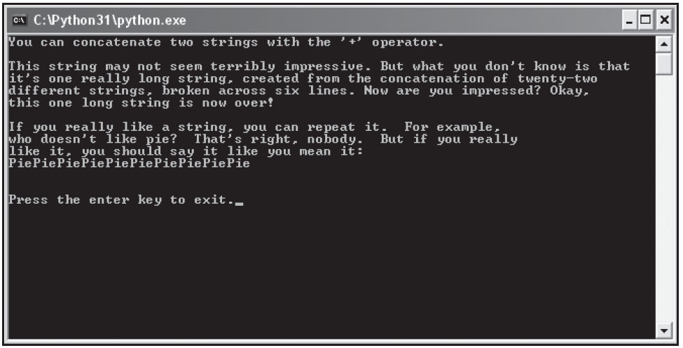
Concatenating and Repeating Strings
Introducing the Silly Strings Program
The Silly Strings program prints several strings to the screen. The results are shown in Figure

Slide 34
Concatenating and Repeating Strings
Introducing the Silly Strings Program
# Silly Strings
# Demonstrates string concatenation and repetition
print("You can concatenate two " + "strings with the '+' operator.")
print("\nThis string " + "may not " + "seem terr" + "ibly impressive. " \ + "But what " + "you don't know" + " is that\n" + "it's one real" \ + "l" + "y" + " long string, created from the concatenation " \ + "of " + "twenty-two\n" + "different strings, broken across " \ + "six lines." + " Now are you" + " impressed? " + "Okay,\n" \ + "this " + "one " + "long" + " string is now over!")
print("\n If you really like a string, you can repeat it. For example,")

Slide 35
Concatenating and Repeating Strings
Introducing the Silly Strings Program
print("who doesn't like pie? That's right, nobody. But if you really")
print("like it, you should say it like you mean it:")
print("Pie" * 10)
input("\n\n Press the enter key to exit.")

Slide 36
Concatenating and Repeating Strings
Concatenating Strings
Concatenating strings means joining them together to create a whole new string. A simple example is in the first print statement:
print("You can concatenate two " + "strings with the '+' operator.")
The + operator joins the two strings, "You can concatenate two " and "strings with the ‘+’ operator.", together to form a new, larger string
It’s like adding the strings together using the same symbol you’ve always used for adding numbers

Slide 37
Concatenating and Repeating Strings
Using the Line Continuation Character
Generally, you write one statement per line. But you don’t have to. Python allows to stretch a single statement across multiple lines
All you have to do is use the line-continuation character, \ (which is just a backslash), as I did in the preceding code. Put it anywhere you’d normally use a space (but not inside a string) to continue your statement on the next line. The computer will act as if it sees one long line of code.
print("\n This string " + "may not " + "seem terr" + "ibly impressive. " \
+ "But what " + "you don't know" + " is that\n" + "it's one real" \
+ "l" + "y" + " long string, created from the concatenation " \
+ "of " + "twenty-two\n" + "different strings, broken across " \
+ "six lines." + " Now are you" + " impressed? " + "Okay,\n" \
+ "this " + "one " + "long" + " string is now over!")

Slide 38
Concatenating and Repeating Strings
Repeating Strings
The next new idea presented in the program is illustrated in the following line:
print("Pie" * 10)
This line creates a new string, "PiePiePiePiePiePiePiePiePiePie", and prints it out. That’s the string "Pie" repeated 10 times, by the way.

Slide 39
Working with Numbers
Computers let you represent information in other ways, too
One of the most basic but most important ways is as numbers. Numbers are used in almost every program
Whether you’re writing a space shooter game or home finance package, you need to represent numbers some way. You’ve got high scores or checking account balances to work with, after all.
Fortunately, Python has several different types of numbers to fit all of your game or application programming needs.

Slide 40
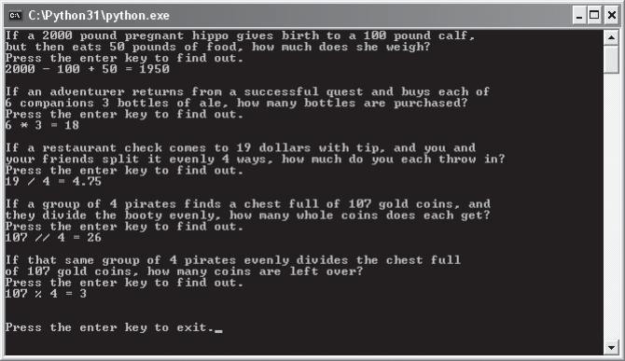
Working with Numbers (Contd.)
Introducing the Word Problems Program
The Word Problems program is just an amusing (hopefully) way to explore working with numbers.

Slide 41
Working with Numbers (Contd.)
Introducing the Word Problems Program
# Word Problems
# Demonstrates numbers and math
print("If a 2000 pound pregnant hippo gives birth to a 100 pound calf,")
print("but then eats 50 pounds of food, how much does she weigh?")
input("Press the enter key to find out.")
print("2000 - 100 + 50 =", 2000 - 100 + 50)
print("\n If an adventurer returns from a successful quest and buys each of")
print("6 companions 3 bottles of ale, how many bottles are purchased?")
input("Press the enter key to find out.")
print("6 * 3 =", 6 * 3)

Slide 42
Working with Numbers (Contd.)
Introducing the Word Problems Program
print("\n If a restaurant check comes to 19 dollars with tip, and you and")
print("your friends split it evenly 4 ways, how much do you each throw
in?")
input("Press the enter key to find out.")
print("19 / 4 =", 19 / 4)
print("\n If a group of 4 pirates finds a chest full of 107 gold coins,
and")
print("they divide the booty evenly, how many whole coins does each get?")
input("Press the enter key to find out.")
print("107 // 4 =", 107 // 4)

Slide 43
Working with Numbers (Contd.)
Introducing the Word Problems Program
print("\nIf that same group of 4 pirates evenly divides the chest full")
print("of 107 gold coins, how many coins are left over?")
input("Press the enter key to find out.")
print("107 % 4 =", 107 % 4)
input("\n\nPress the enter key to exit.")

Slide 44
Working with Numbers (Contd.)
Understanding Numeric Types
Python allows programmers to use several different types of numbers
The two types used in this program, and probably the most common, are integers and floating-point numbers (or floats)
Integers are whole numbers—numbers with no fractional part. Or, another way to think about them is that they can be written without a decimal point
Floats are the numbers with fractional part/ decimal part
The numbers 1, 27, -100, and 0 are all examples of integers. Floats are numbers with a decimal point, like 2.376, -99.1, and 1.0.

Slide 45
Understanding Variables
Through variables, you can store and manipulate information, a fundamental aspect of programming. Python lets you create variables to organize and access this information.

Slide 46
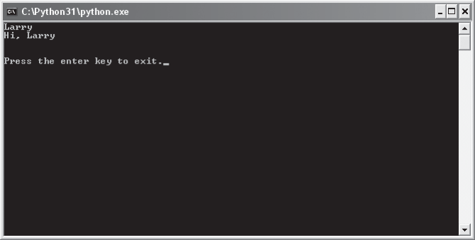
Understanding Variables (Contd.)
Introducing the Greeter Program
# Greeter
# Demonstrates the use of a variable
name = "Larry“
print(name)
print("Hi,", name)
input("\n\nPress the enter key to exit.")

Slide 47
Understanding Variables (Contd.)
Creating Variables
A variable provides a way to label and access information
Instead of having to know exactly where in the computer’s memory some information is stored, you use a variable to get at it
It’s kind of like calling your friend on his cell phone. You don’t have to know where in the city your friend is to reach him. You just press a button and you get him.
But, before you use a variable, you have to create it, as in the following line:
name = "Larry”
This line is called an assignment statement. It creates a variable called name and assigns it a value so that it references the string "Larry".
In general, assignment statements assign a value to a variable. If the variable doesn’t already exist, as was the case with name, it’s created, then assigned a value.

Slide 48
Understanding Variables (Contd.)
Using Variables
Once a variable has been created, it refers to some value
The convenience of a variable is that it can be used just like the value to which it refers. print(name)
So the line prints the string "Larry" just like the statement print("Larry") does. print("Hi,", name)
The above line prints the string "Hi," followed by a space, followed by "Larry". In this case, I can use name instead of "Larry" with the same results.

Slide 49
Understanding Variables (Contd.)
Naming Variables
For this program, I chose to call my variable name, but I could just as easily have used person, guy, or alpha7345690876, and the program would have run exactly the same
There are only a few rules that you have to follow to create legal variable names. Create an illegal one and Python will let you know about it with an error
The following are the two most important rules:
1. A variable name can contain only numbers, letters, and underscores
2. A variable name can’t start with a number

Slide 50
Understanding Variables (Contd.)
Naming Variables
The following are some guidelines that more experienced programmers follow for creating good variable names
Choose Descriptive Names: Variable names should be clear enough so that another programmer could look at the name and have a good idea what it represents.
Be Consistent: There are different schools of thought about how to write multiword variable names. Is it high_score or highScore? I use the underscore style. But it’s not important which method you use, as long as you’re consistent.
Follow the Traditions of the Language: Some naming conventions are just traditions. For example, in most languages (Python included) variable names start with a lowercase letter. Another tradition is to avoid using an underscore as the first character of your variable names. Names that begin with an underscore have special meaning in Python.
Keep the length in check: This may seem to go against the first guideline: Choose descriptive names. Isn’t personal_checking_account_balance a great variable name? Maybe not. Long variable names can lead to problems. They can make statements hard to read. Plus, the longer the variable name, the greater the chance of a typo. As a guideline, try to keep your variable names under 15 characters.

Slide 51
Getting User Input
Instead of working with a predefined value, the computer lets the user enter his or her name and then uses it to say hi
# Personal Greeter
# Demonstrates getting user input
name = input("Hi. What's your name ? \n")
print(name)
print("Hi,", name)
input("\n\n Press the enter key to exit.")

Slide 52
Getting User Input (Contd.)
Using the input() Function
name = input("Hi. What's your name? ")
Variable ‘name’ is created and a value is assigned to it, just like before. But this time, the right side of the assignment statement is a call to the function input().
The input() function gets some text from the user. It takes a string argument that it uses to prompt the user for this text.
In this case, the argument passed to input() is the string "Hi. What's your name? ". input() waits for the user to enter something. Once the user presses the Enter key, input() returns whatever the user typed as a string.
To help visualize how this works, imagine that in the assignment statement, the call to input() is replaced with the string the user typed. Now of course, the code in the program doesn’t change, but imagining the return value of a function in place of the call to that function helps drive home how you can use return values.

Slide 53
Using String Methods
Python has a rich set of tools for working with strings. One type of these tools is string methods
String methods allow you to create new strings from old ones. You can do everything from the simple, such as create a string that’s just an all-capital-letters version of the original, to the complex, such as create a new string that’s the result of a series of intricate letter substitutions

Slide 54
Using String Methods (Contd.)
“I think there is a world market for maybe five computers.” This was made by then IBM chairman, Thomas Watson, in 1943
# Quotation Manipulation
# Demonstrates string methods
# quote from IBM Chairman, Thomas Watson,
in 1943
quote = "I think there is a world market for maybe five computers."
print("Original quote:")
print(quote)
print("\nIn uppercase:")
print(quote.upper())
print("\nIn lowercase:")
print(quote.lower())
print("\nAs a title:")
print(quote.title())
print("\nWith a minor replacement:")
print(quote.replace("five", "millions of"))
print("\nOriginal quote is still:")
print(quote)
input("\n\nPress the enter key to exit.")

Slide 55
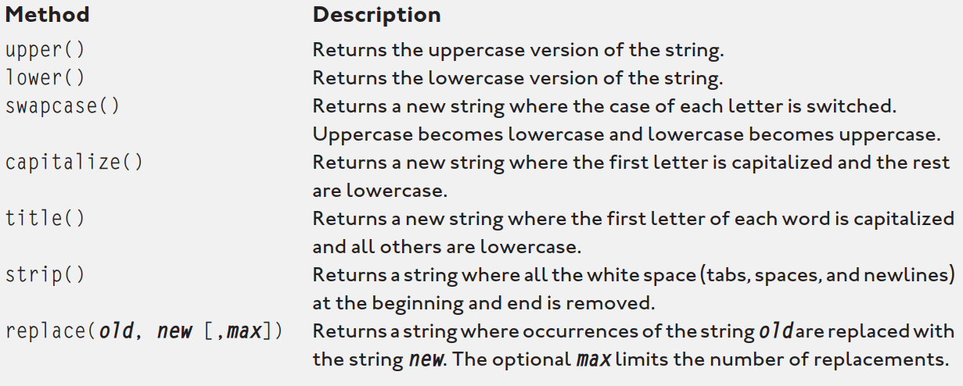
Using String Methods (Contd.)

Slide 56
Using The Right Types
You’ve used three different types so far: strings, integers, and floating-point numbers.
It’s important to know not only which data types are available to you, but how to work with them.
If you don’t, you might end up with programs that produce unintended results

Slide 57
Using The Right Types (Contd.)
Introducing the Trust Fund Buddy-Bad Program
The program is supposed to calculate a grand total for monthly expenditures based on user input
This grand total is meant to help those living beyond any reasonable means to stay within budget so they don’t ever have to think about getting a real job
Trust Fund Buddy—Bad doesn’t work as the programmer intended
The program produces unintended results but doesn’t crash, it has a logical error
Based on what you already know, you might be able to figure out what’s happening by looking at the code

Slide 58
Using The Right Types (Contd.)
Introducing the Trust Fund Buddy-Bad Program
car = input("Lamborghini Tune-Ups: ")
rent = input("Manhattan Apartment: ")
jet = input("Private Jet Rental: ")
gifts = input("Gifts: ")
food = input("Dining Out: ")
staff = input("Staff (butlers, chef, driver, assistant): ")
guru = input("Personal Guru and Coach: ")
games = input("Computer Games: ")
total = car + rent + jet + gifts + food + staff + guru + games
print("\n Grand Total:", total)
input("\n\n Press the enter key to exit.")
# Trust Fund Buddy - Bad
# Demonstrates a logical error
print("""
Trust Fund Buddy
Totals your monthly spending so that your trust fund doesn't run out (and you're forced to get a real job).
Please enter the requested, monthly costs. Since you're rich, ignore
pennies and use only dollar amounts.
""“ )

Slide 59
Using The Right Types (Contd.)
Tracking Down Logical Errors
Logical errors can be the toughest bugs to fix. Since the program doesn’t crash, you don’t get the benefit of an error message to offer a clue. You have to observe the behavior of the program and investigate the code
In this case, the huge number is clearly not the sum of all the numbers the user entered. But, by looking at the numbers, you can see that the grand total printed is a concatenation of all the numbers
How did that happen? Well, if you remember, the input() function returns a string. So each “number” the user enters is treated like a string. Which means that each variable in the program has a string value associated with it.
So, the line is not adding numbers. It’s concatenating strings!
total = car + rent + jet + gifts + food + staff + guru + games

Slide 60
Using The Right Types (Contd.)
Converting Values
The solution to the Trust Fund Buddy—Bad program is to convert the string values returned by input() to numeric ones. Since the program works with whole dollar amounts, it makes sense to convert each string to an integer before working with it
# Trust Fund Buddy - Good
# Demonstrates type conversion
print(
"""
Trust Fund Buddy
Totals your monthly spending so that your trust fund doesn't run out
(and you're forced to get a real job).
Please enter the requested, monthly costs. Since you're rich, ignore
pennies and use only dollar amounts.
""“ )

Slide 61
Using The Right Types (Contd.)
Converting Values
car = input("Lamborghini Tune-Ups: ")
car = int(car)
rent = int(input("Manhattan Apartment: "))
jet = int(input("Private Jet Rental: "))
gifts = int(input("Gifts: "))
food = int(input("Dining Out: "))
staff = int(input("Staff (butlers, chef, driver, assistant): "))
guru = int(input("Personal Guru and Coach: ") )
games = int(input("Computer Games: "))
total = car + rent + jet + gifts + food + staff + guru + games
print("\nGrand Total:", total)
input("\n\nPress the enter key to exit.")

Slide 62
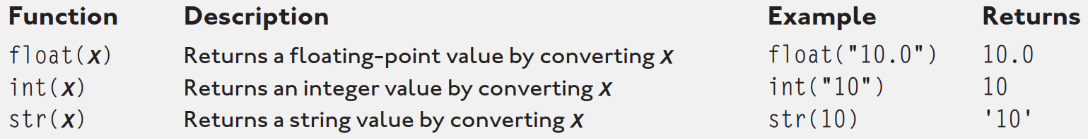
Using The Right Types (Contd.)
Converting Values
Notice that the assignments are done in just one line. That’s because the two function calls, input() and int(), are nested
Nesting function calls means putting one inside the other. This is perfectly fine as long as the return values of the inner function can be used as argument values by the outer function. Here, the return value of input() is a string, and a string is a perfectly acceptable type for int() to convert.
Converting from one type to another type is called Type Conversion

Slide 63
Using Augmented Assignment Operators
Let’s say you want to know the yearly amount the user spends on food. To calculate and assign the yearly amount, you could use the line
food = food * 52
This line multiplies the value of food by 52 and then assigns the result back to food. You could accomplish the same thing with the following line:
food *= 52
*= is an augmented assignment operator. It also multiplies the value of food by 52 and then assigns the result back to food, but it’s shorter than the first version
Since assigning a new value to a variable based on its original value is something that happens a lot in programming, these operators provide a nice shortcut to a common task.

Slide 64
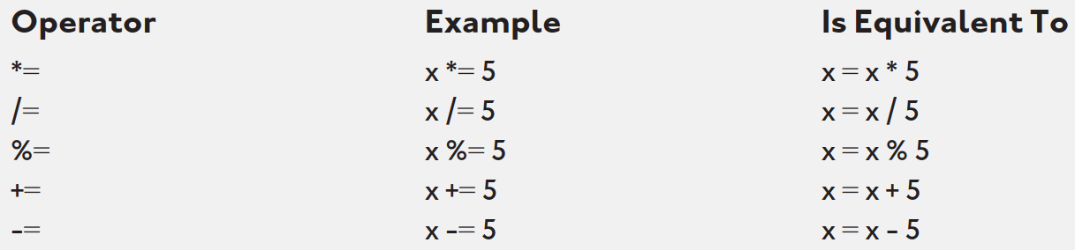
Using Augmented Assignment Operators
Useful Augment Assignment Operators

Slide 65


