Slide 1
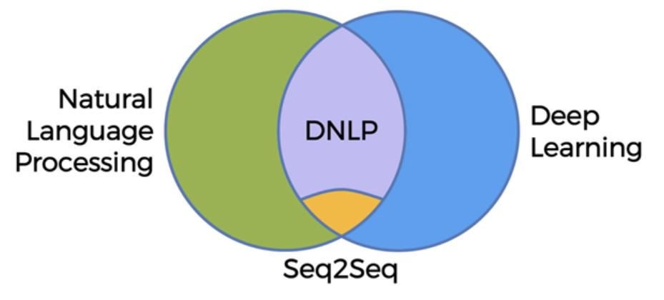
Natural Language Processing combined with Deep Learning
Classical NLP Examples:
If / Else Rules (old Chatbot implementation method) : Someone asks a question, we give them a response. All answers are predetermined.
Bag-of-words model (Classification) : For example, you have a list of comments, some are positive and some are negative. All of these words are put into a bag. The model calculates how often the word great (for example) comes up with a 1 and pool with a 0 (1 being positive, 0 being negative)
Deep NLP Examples:
Modern Chatbot implementation using Sequence to Sequence architecture (Seq2Seq).
Convolutional Neural Network for text recognition.
Recurrent Neural Network for document summarization.

Slide 2
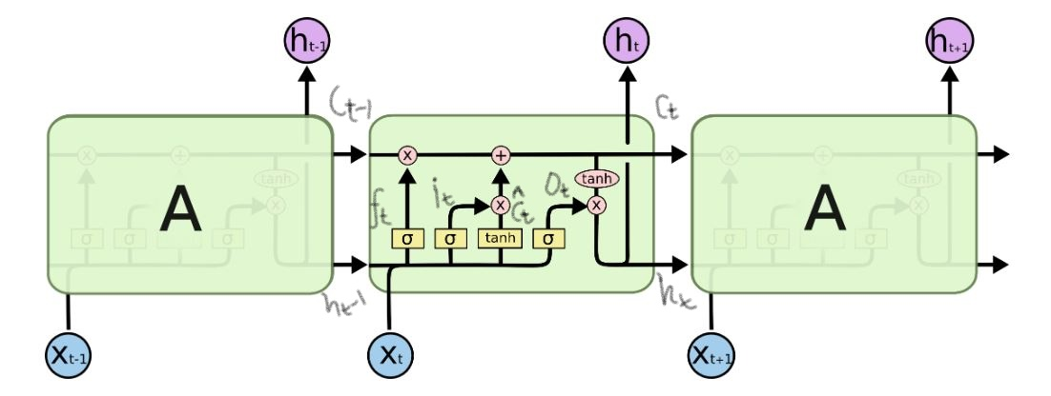
LSTM used in Seq2Seq for Chatbot implementation:
Long Short Term Memory networks – usually just called “LSTMs” – are a special kind of RNN, capable of learning long-term dependencies.
It consists of 3 gates:
Forget Gate: The first step in our LSTM is to decide what information we’re going to throw away from the cell / context state. This decision is made by a sigmoid layer called the “forget gate layer.”
Input Gate: The next step is to decide what new information we’re going to update in the cell state. First, a sigmoid layer called the “input gate” decides which values we’ll update. Next, a tanh layer creates a vector of new candidate values C-cap(t) that could be added to the state. Both of them multiplied and update the old cell state, Ct−1, into the new cell state Ct.
Output Gate: Output will be based on our cell state, but will be a filtered (tanh) version. Later, we run a sigmoid layer which decides what parts of the cell state we’re going to output. Then, we multiply them, so that we only output the parts we decided to.

Slide 3
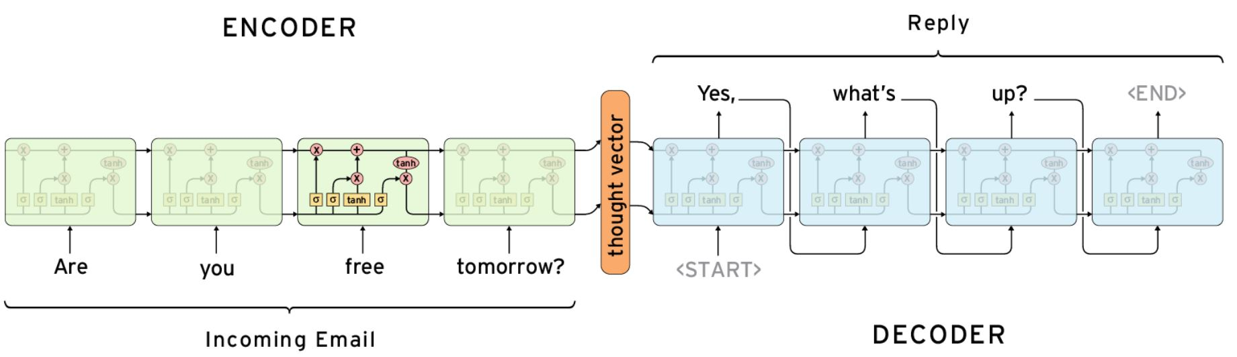
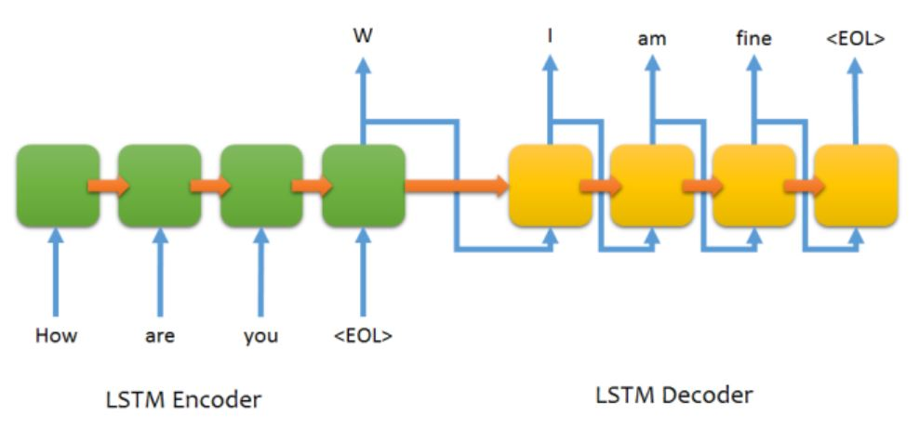
Chatbot Implementation using Seq2Seq:
Seq2Seq consists of 2 Recurrent Neural Networks (Basically LSTM), one is called the Encoder and other is called the Decoder.

Slide 4
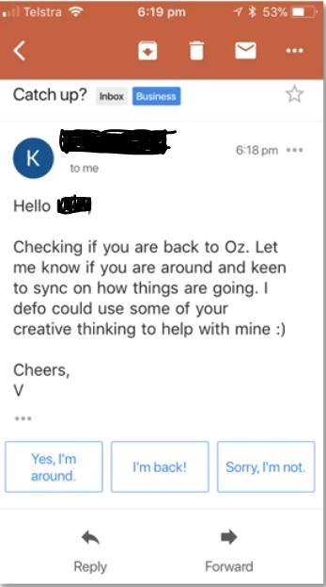
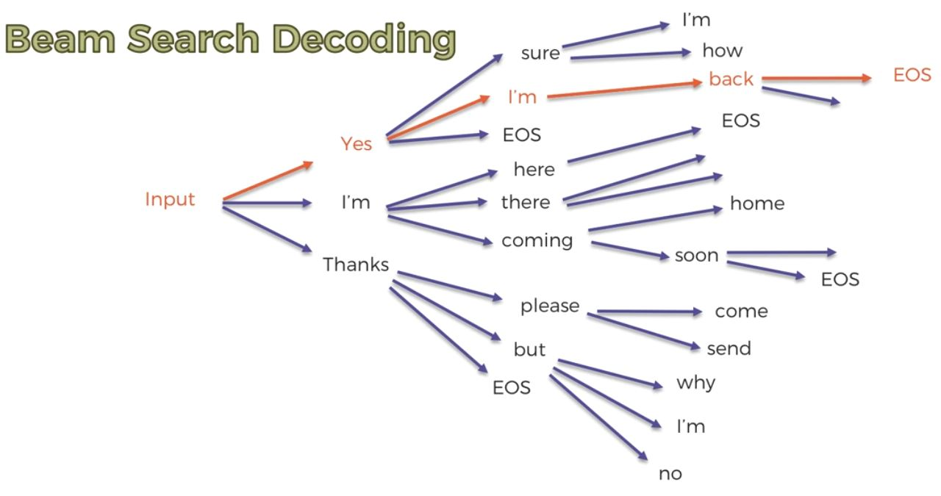
Beam Search Decoding:
Greedy Decoding : The highest probability word is only looked at and is chosen to be the reply.
Beam Search Decoding : Defines top n ( = 3, in above case ) reply sentences to look at.
In order to pick the winner, we choose the highest probability of the joint beam. Making it the best fit for our reply.

Slide 5
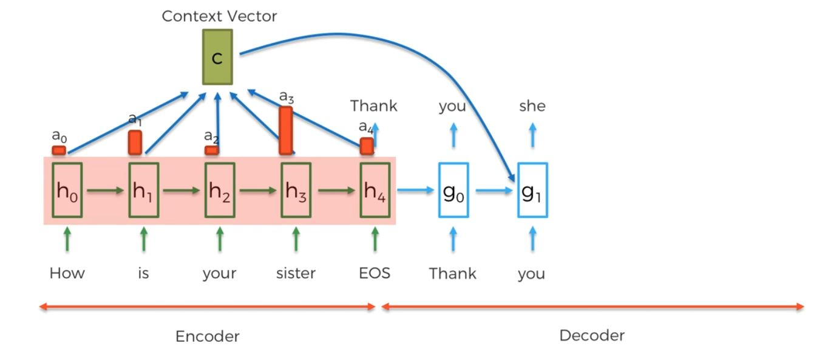
Attention Mechanism:
Attention Mechanisms are when the decoder is able to access any of the information from the encoder, instead of just relying on the EOS token. The decoder is trained to assign unique weights to each word of the encoder, the higher the weight the more relevance it has to the next word in the sentence.
The weights within the encoder are then calculated together to make a weighted sum called the context vector. This is then fed into the new layer of the decoder to help provide a new word as the output.
Chatbot implementation code present at https://github.com/ShreekantSaurabh/ChatBot-using-Deep-NLP

