Slide 1
Binary Heap implementation

Slide 2
Trees
Code is all written out for you in the Jupyter Notebook!
Read through Wikipedia article first, before viewing this lecture!

Slide 3
Trees
In order to make our heap work efficiently, we will take advantage of the logarithmic nature of the binary tree to represent our heap.
In order to guarantee logarithmic performance, we must keep our tree balanced.

Slide 4
Trees
A balanced binary tree has roughly the same number of nodes in the left and right subtrees of the root.
In our heap implementation we keep the tree balanced by creating a complete binary tree.
A complete binary tree is a tree in which each level has all of its nodes.

Slide 5
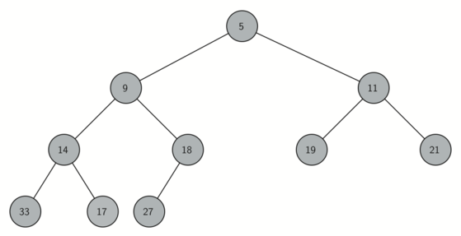
Trees
Example Binary Tree

Slide 6
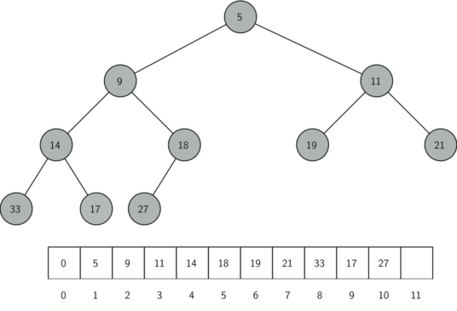
List Representation of Trees

Slide 7
Binary Heaps
Reminder, as we continue on, use the Jupyter Notebook to reference the complete code

Slide 8
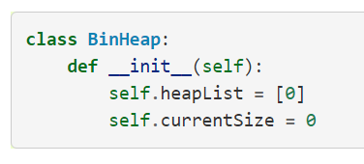
Binary Heaps
Start off with our list representation code

Slide 9
Binary Heaps
The next method we will implement is insert. The easiest, and most efficient, way to add an item to a list is to simply append the item to the end of the list.
The good news about appending is that it guarantees that we will maintain the complete tree property.
The bad news about appending is that we will very likely violate the heap structure property.

Slide 10
Binary Heaps
However, it is possible to write a method that will allow us to regain the heap structure property by comparing the newly added item with its parent.
If the newly added item is less than its parent, then we can swap the item with its parent.
Let’s see the series of swaps needed to percolate the newly added item up to its proper position in the tree!

Slide 11
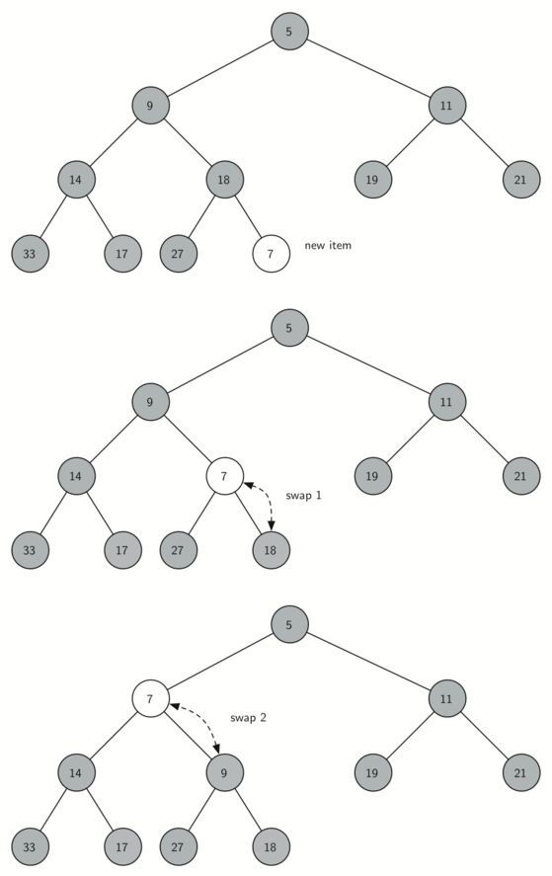
Binary Heaps

Slide 12
Binary Heaps

Slide 13
Binary Heaps

Slide 14
Binary Heaps
Notice that when we percolate an item up, we are restoring the heap property between the newly added item and the parent.
We are also preserving the heap property for any siblings.
Of course, if the newly added item is very small, we may still need to swap it up another level.
In fact, we may need to keep swapping until we get to the top of the tree.

Slide 15
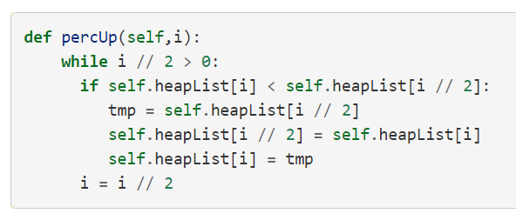
Binary Heaps
Methods for insertion

Slide 16
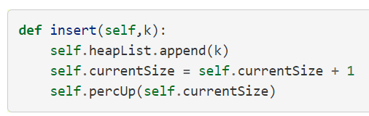
Binary Heaps
Methods for insertion

Slide 17
Binary Heaps
With the insert method properly defined, we can now look at the delMin method.
Since the heap property requires that the root of the tree be the smallest item in the tree, finding the minimum item is easy.
The hard part of delMin is restoring full compliance with the heap structure and heap order properties after the root has been removed.

Slide 18
Binary Heaps
We can restore our heap in two steps.
First, we will restore the root item by taking the last item in the list and moving it to the root position.
Moving the last item maintains our heap structure property.
However, we have probably destroyed the heap order property of our binary heap.
Second, we will restore the heap order property by pushing the new root node down the tree to its proper position.

Slide 19
Binary Heaps
Series of swaps needed to move the new root node to its proper position in the heap.

Slide 20
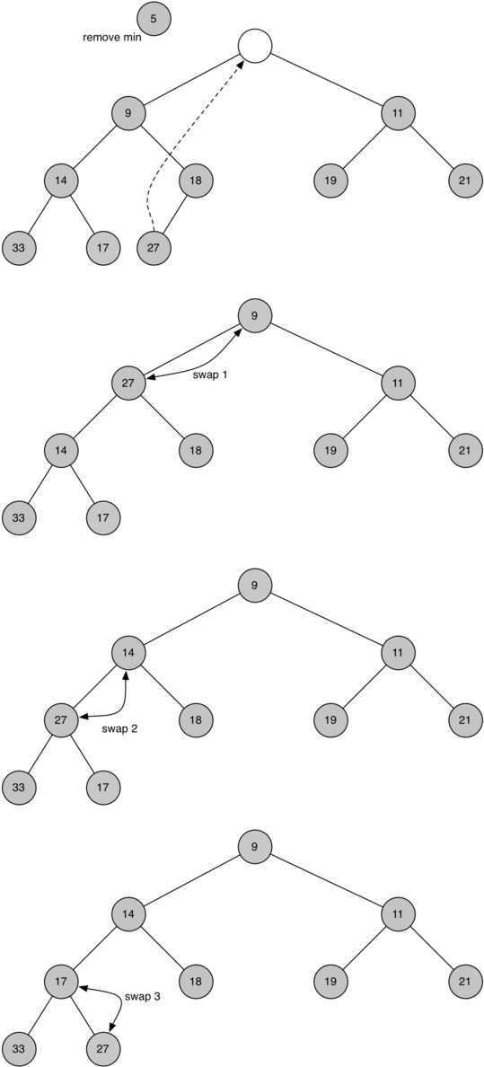
Binary Heaps

Slide 21
Binary Heaps

Slide 22
Binary Heaps

Slide 23
Binary Heaps

Slide 24
Binary Heaps
In order to maintain the heap order property, all we need to do is swap the root with its smallest child less than the root.
After the initial swap, we may repeat the swapping process with a node and its children until the node is swapped into a position on the tree where it is already less than both children.

Slide 25
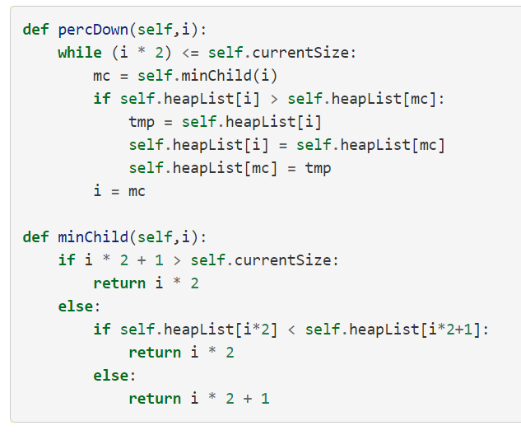
Binary Heaps
Code for percolating a node down the tree is found in the percDown and minChild

Slide 26
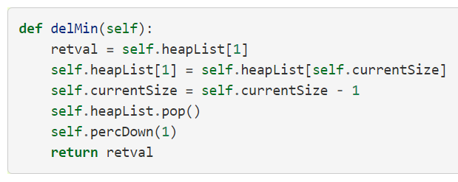
Binary Heaps
Code for delMin

Slide 27
Binary Heaps
To finish our discussion of binary heaps, we will look at a method to build an entire heap from a list of keys.
The first method you might think of may be like the following.
Given a list of keys, you could easily build a heap by inserting each key one at a time.
Since you are starting with a list of one item, the list is sorted and you could use binary search to find the right position to insert the next key at a cost of approximately O(log⁡n) operations.

Slide 28
Binary Heaps
However, remember that inserting an item in the middle of the list may require O(n) operations to shift the rest of the list over to make room for the new key.
Therefore, to insert n keys into the heap would require a total of O(nlog⁡n) operations.
However, if we start with an entire list then we can build the whole heap in O(n) operations.

Slide 29
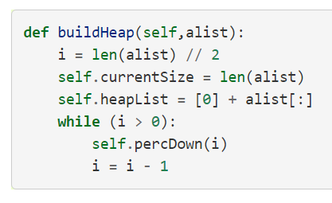
Binary Heaps
Code to build the heap

Slide 30
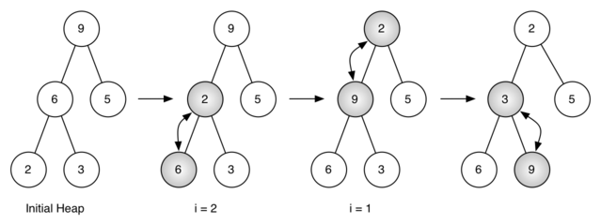
Binary Heaps
Heap from list of [9,6,5,2,3]

Slide 31
Binary Heaps
Make sure to review Jupyter Notebook and the Wikipedia article!
This lecture will lead into the next topic – Binary Search Trees.

