Slide 1
Nodes and References
Implementation

Slide 2
Trees
In this case we will define a class that has attributes for the root value, as well as the left and right subtrees.
Since this representation more closely follows the object-oriented programming paradigm, we will continue to use this representation for the remainder of this section.

Slide 3
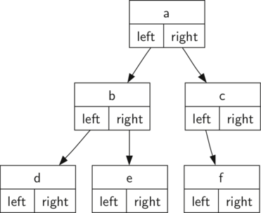
Trees

Slide 4
Trees
Let’s get started with the implementation!

