Slide 1
Tree Representation
Implementation

Slide 2
Trees
In this lecture we will implement a Tree as a List of Lists

Slide 3
Trees
In a list of lists tree, we will store the value of the root node as the first element of the list.
The second element of the list will itself be a list that represents the left subtree.
The third element of the list will be another list that represents the right subtree.

Slide 4
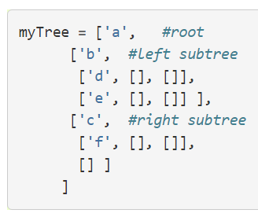
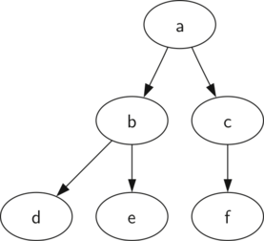
Trees

Slide 5
Trees
Let’s implement it!

