Slide 1
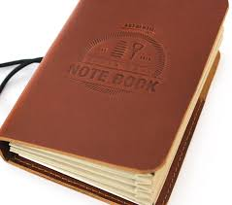
Note Book Application

Slide 2
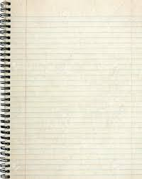
Note (or Page)
Notebook contain pages, so for this application we will create two classes
1st NoteBook
2nd Note (page class)
NoteBook ( class)
Note (page class)

Slide 3
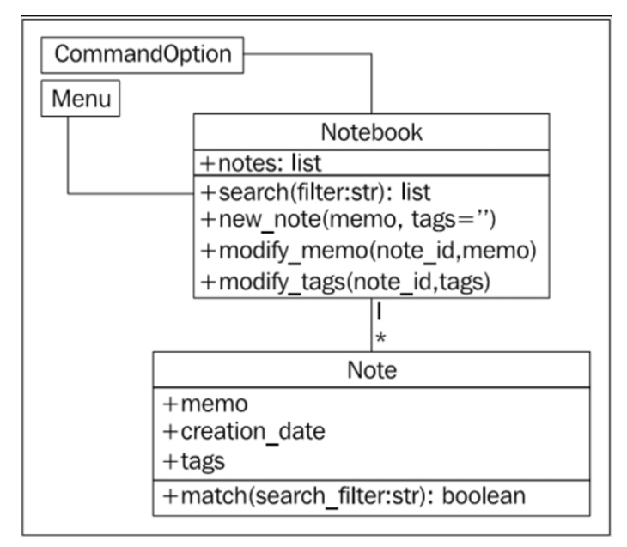
NoteBook App

Slide 4
Once my class prototype for :
1:: NoteBook
2:: Note
is ready , I will be creating an object of type NoteBook and Page
Simply by writing –
Nb = NoteBook()
Pg = Note ()

Slide 5
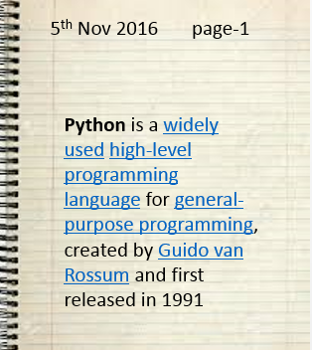
Note Class(Page)
+Memo +Creation_date +tags
+match (search_filter:str) : Boolean
Attribute
Function
Creation_date
5th Nov 2016 page-1
tags
Python is a widely used high-level programming language for general-purpose programming, created by Guido van Rossum and first released in 1991
Memo

Slide 6

Function Calling Sequence
class point:
pass
P1 = point()
P1.x = 100
P2.x = 200
Class ABC:
__init__(self, arg1, arg2, arg3):
sefl.arg1 = arg1
self.arg2 = arg2
self.arg3 = arg3
Obj = ABC(20,30,40) ➔ __init__(self, arg1, arg2, arg3)
‘’’ABC() is a constructor of this class ABC which intern will be calling a special function __init_() , and since in python we can add attribute once object is created.
So code => sefl.arg1 will create a attribute arg1. similarly other attribute too.

Slide 7
import datetime
# Store the next available id for all new notes
last_id = 0
class Note:
'''Represent a note in the notebook. Match against a
string in searches and store tags for each note.'''
def __init__(self, memo, tags=''):
'''initialize a note with memo and optional
space-separated tags. Automatically set the note's
creation date and a unique id.'''
self.memo = memo
self.tags = tags
self.creation_date = datetime.date.today()
global last_id
last_id += 1
self.id = last_id
def match(self, filter):
'''Determine if this note matches the filter
text. Return True if it matches, False otherwise.
Search is case sensitive and matches both text and
tags.'''
return filter in self.memo or filter in self.tags
>>> n1 = Note("hello first")
>>> n2 = Note("hello again")
>>> n1.id
1
>>> n2.id
2
>>> n1.match('hello')
True
>>> n2.match('second')
False

Slide 8
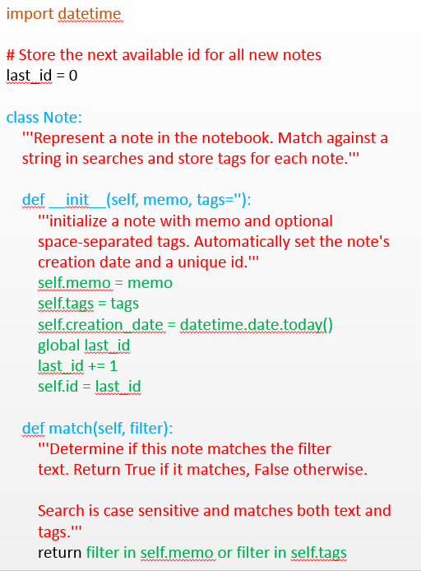
Code Execution Sequence::
n1 = Note ( "hello this is my first python class “, ”page-1”)
n1.match (“ python”)

Slide 9
RAM
n1 = Note ("hello this is my first python class “, ”page-1”)
Kernal/os
Note()
__init__(self, memo , tags='')
User Area
NoteApp

Slide 10
n1 = Note ("hello this is my first python class “, ”page-1”)
Note()
__init__(self, memo, tags='')
NoteApp

Slide 11
n1 = Note ("hello this is my first python class “, ”page-1”)
Note
Note()
__init__(self, memo, tags='')
n1
NoteApp

Slide 12
n1 = Note ("hello this is my first python class “, ”page-1”)
Note
Note()
__init__(self, memo , tags='')
n1
self.memo = memo
self.tags = tags
self.creation_date = datetime.date.today()
global last_id
last_id += 1
self.id = last_id
0x555673
NoteApp
self
0x555673
memo
hello this is my first
python class
tags
Page-1

Slide 13
Code Execution Sequence::
n1 = Note ( "hello this is my first python class “, ”page-1”)
n1.match (“ python”)

Slide 14
Code Execution Sequence::
n1 = Note ( "hello this is my first python class “, ”page-1”)
n1.match (“ python”)
hello this is my first python class
page-1
memo
tags
Last_id = 0

Slide 15
Code Execution Sequence::
n1 = Note ( "hello this is my first python class “, ”page-1”)
n1.match (“ python”)
hello this is my first python class
page-1
memo
tags
hello this is my first python class
Last_id = 0

Slide 16
Code Execution Sequence::
n1 = Note ( "hello this is my first python class “, ”page-1”)
n1.match (“ python”)
hello this is my first python class
page-1
memo
tags
page-1
hello this is my first python class
Last_id = 0

Slide 17
Code Execution Sequence::
n1 = Note ( "hello this is my first python class “, ”page-1”)
n1.match (“ python”)
hello this is my first python class
page-1
memo
tags
2/7/16
page-1
hello this is my first python class
Last_id = 0

Slide 18
Code Execution Sequence::
n1 = Note ( "hello this is my first python class “, ”page-1”)
n1.match (“ python”)
hello this is my first python class
page-1
memo
tags
2/7/16
page-1
hello this is my first python class
1
Last_id = 1

Slide 19
n1 = Note ("hello this is my first python class “, ”page-1”)
2/7/16
page-1
Note()
__init__(self, memo, tags='')
n1
hello this is my first
python class
self.memo = memo
self.tags = tags
self.creation_date = datetime.date.today()
global last_id
last_id += 1
self.id = last_id
1
0x555673
NoteApp
self
0x555673
memo
hello this is my first
python class
tags
Page-1

Slide 20
n1 = Note ("hello this is my first python class “, ”page-1”)
n1.match(“python”)
2/7/16
page-1
def match(self, filter):
'''Determine if this note matches the filter
text. Return True if it matches, False otherwise.
Search is case sensitive and matches both text and tags.'''
return filter in self.memo or filter in self.tags
tags
creation_date
memo
hello this is my first
python class
id
1
0x555673
NoteApp
n1

Slide 21
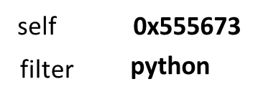
n1 = Note ("hello this is my first python class “, ”page-1”)
n1.match(“python”)
2/7/16
page-1
def match(self, filter):
'''Determine if this note matches the filter
text. Return True if it matches, False otherwise.
Search is case sensitive and matches both text and tags.'''
return filter in self.memo or filter in self.tags
tags
creation_date
memo
hello this is my first
python class
id
1
0x555673
NoteApp
n1

Slide 22
n1 = Note ("hello this is my first python class “, ”page-1”)
n1.match(“python”)
2/7/16
page-1
def match(self, filter):
'''Determine if this note matches the filter
text. Return True if it matches, False otherwise.
Search is case sensitive and matches both text and tags.'''
return filter in self.memo or filter in self.tags
tags
creation_date
memo
hello this is my first
python class
id
1
0x555673
NoteApp
n1

Slide 23

Quick Test
Q1::
print id(memo) ➔ in __init__
And
Print id(n1.memo) ➔ compare the result
Q2::
Attr = vars(n1)

Slide 24
NoteBook
NoteBook
+Notes = []
+new_note (self, memo, tags=''): +modify_memo (self, note_id, memo): +modify_tags (self, note_id, tags): +Search (self, filter):

Slide 25
Now we have to Implement NoteBook class, so that we can create a notebook object. Using below syntax ::
nb = NoteBook()
About NoteBook object ::
1: Pages can be added as and when needed in this notebook, Initially notebook will be empty without any page or note (like a initial word document).
2: Content/memo of the note or pages attached with notebook can be modified.
3: tag of the note or pages attached with notebook can be modified.
4: We should be able to search a given string in all pages of notebook.

Slide 26
from test_note import Note ➔ As soon as we import that file will execute
class Notebook:
'''Represent a collection of notes that can be tagged,
modified, and searched.'''
def __init__(self):
'''Initialize a notebook with an empty list.'''
self.notes = []
def new_note(self, memo, tags=''):
'''Create a new note and add it to the list.'''
self.notes.append(Note(memo, tags))
nb = Notebook()
nb.new_note("This is first page of the book", "page-1")
nb.new_note("This is second page of the book", "page-2")
print (nb.notes)

Slide 27
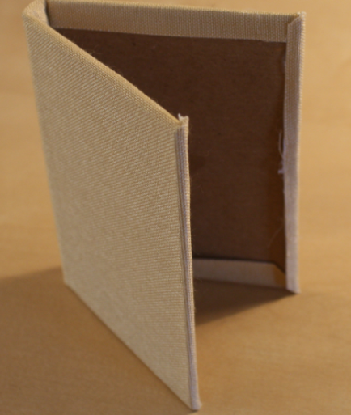
from test_note import Note ➔ As soon as we import that file will execute
class Notebook:
'''Represent a collection of notes that can be tagged,
modified, and searched.'''
def __init__(self):
'''Initialize a notebook with an empty list.'''
self.notes = []
def new_note(self, memo, tags=''):
'''Create a new note and add it to the list.'''
self.notes.append(Note(memo, tags))
nb = Notebook()
nb.new_note("This is first page of the book", "page-1")
nb.new_note("This is second page of the book", "page-2")
print (nb.notes)

Slide 28
from test_note import Note ➔ As soon as we import that file will execute
class Notebook:
'''Represent a collection of notes that can be tagged,
modified, and searched.'''
def __init__(self):
'''Initialize a notebook with an empty list.'''
self.notes = []
def new_note(self, memo, tags=''):
'''Create a new note and add it to the list.'''
self.notes.append(Note(memo, tags))
nb = Notebook()
nb.new_note("This is first page of the book", "page-1")
nb.new_note("This is second page of the book", "page-2")
print (nb.notes)

Slide 29
from test_note import Note ➔ As soon as we import that file will execute
class Notebook:
'''Represent a collection of notes that can be tagged,
modified, and searched.'''
def __init__(self):
'''Initialize a notebook with an empty list.'''
self.notes = []
def new_note(self, memo, tags=''):
'''Create a new note and add it to the list.'''
self.notes.append(Note(memo, tags))
nb = Notebook()
nb.new_note("This is first page of the book", "page-1")
nb.new_note("This is second page of the book", "page-2")
print (nb.notes)

Slide 30
Function Call stack
nb.new_note("This is first page of the book", "page-1")
new_note(self, memo, tags=''):
self.notes.append(Note(memo, tags))
Note(memo, tags)
__init__(self, memo, tags=''):

