Slide 1
Object Oriented Programming using Python

Slide 2
What we are going to cover
Basic inheritance
Inheriting from built-ins
Multiple inheritance
Polymorphism and duck typing

Slide 3
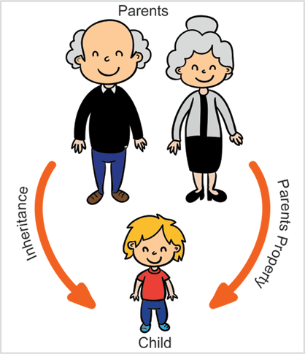
Inheritance
Inheritance allows us to create "is a" relationships between two or more classes, abstracting common details into super classes and storing specific ones in the subclass.
Class A
Class B

Slide 4
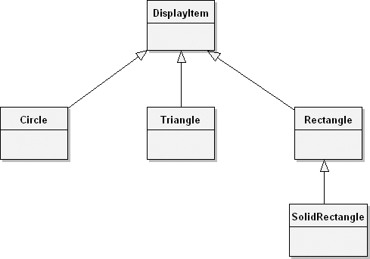
"is a" relationships
Ex1: Convert below diagram into python code !!!

Slide 5
Basic Inheritance
Every class we create uses inheritance. All Python classes are subclasses of the special class named object.
If we don't explicitly inherit from a different class, our classes will automatically inherit from object. However, we can openly state that our class derives from object using the following syntax:
class MySubClass(object):
pass

Slide 6
class Myclass(object):
pass
obj = Myclass()
obj.x = 45
obj.y = "Pratap"
print "Value of obj.y"
print obj.y
Every class inherits a class called object
We can data member dynamically in Python, like x and y in this shown program.

Slide 7
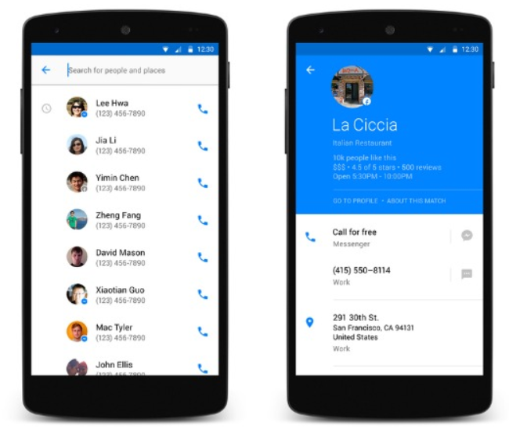
Contact Manager

Slide 8
contact manager that tracks the name and e-mail address of several people.
We should design contact manager class in such a way that contacts can be added dynamically.

Slide 9
Contact Manager Application Version 1
Let's start with a simple contact manager that tracks the name and e-mail address of several people. The contact class is responsible for maintaining a list of all contacts in a class variable, and for initializing the name and address, in this simple class.
class My_Contact:
all_contacts = []
def __init__(self,name,email):
self.name = name
self.email = email
My_Contact.all_contacts.append(self)
Q: What if I don’t want to use class name every time Ex: all_contacts.append(self) ?

Slide 10
Contact Manager Continued...
obj1 = My_Contact("Abhi","Abhi@gmail.com")
obj2 = My_Contact("Aditya","Aditya@yahoomail.com")
obj3 = My_Contact("Krishna","krishna@hotmail.com")
obj4 = My_Contact("Chinmay","Chinmay@hotmail.com")
obj5 = My_Contact("Kiran","Kiran@hotmail.com")

Slide 11
Contact Manager Continued...
for i in My_Contact.all_contacts:
print i.name
print i.email
print My_Contact.all_contacts
Example introduces us to class variables. The all_contacts list, because it is part of the class definition, is actually shared by all instances of this class. This means that there is only one Contact.all_contacts list, and if we call self.all_contacts on any one object, it will refer to that single list.
Q: What if we want to use for i in all_contacts: instead using class name ?

Slide 12
Extending built-ins contd.
class ContactList(list):
def search(self, name):
'''Return all contacts that contain the search value
in their name.'''
matching_contacts = []
for contact in self:
if name in contact.name:
matching_contacts.append(contact)
return matching_contacts
Q. can we change this self (for contact in self:) with any other variable and result should be same ????
Q. id (self ) == id ( ?? )
Q. is there any function in python which list attributes of an object ???

Slide 13
Extending built-ins: Q1
what about writing as below : ???
for contact in Contact.all_contacts:
OR
for contact in c1.all_contacts:
OR
for contact in c2.all_contacts:

Slide 14
The list data type is a class that we can extend, the list itself extends the object class

Slide 15
Extending built-ins: Q3
attrs = vars(c1)

Slide 16
Overriding and super
what if we want to add a phone number for our close friends in contact manager ?
class Friend(Contact):
def __init__(self, name, email, phone):
self.name = name
self.email = email
self.phone = phone

Slide 17
Overriding and super
1:: Our Contact and Friend classes have duplicate code to set up the name and email properties; this can make code maintenance complicated as we have to update the code in two or more places.
2:: More alarmingly, our Friend class is neglecting to add itself to the all_contacts list we have created on the Contact class.

Slide 18
Overriding and super
class Friend(Contact):
def __init__(self, name, email, phone): super().__init__(name, email) self.phone = phone

Slide 19
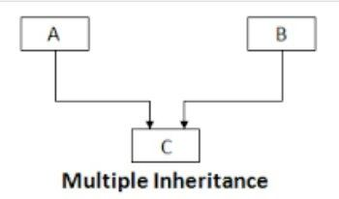
Multiple Inheritance

Slide 20
Multiple inheritance::
A subclass that inherits from more than one parent class is able to access functionality from both of them.
Mixin Class::
The simplest and most useful form of multiple inheritance is called a mixin. A mixin is generally a superclass that is not meant to exist on its own, but is meant to be inherited by some other class to provide extra functionality

Slide 21
For example, let's say we wanted to add functionality to our Contact class that allows sending an e-mail to self.email. Sending e-mail is a common task that we might want to use on many other classes.
Q2: Implement a mixin class !!!

Slide 22
class MailSender:
def send_mail(self, message):
print("Sending mail to " + self.email)
# Add e-mail logic here
This class allow us to define a new class that describes both a Contact and a MailSender, using multiple inheritance:
class EmailableContact(Contact, MailSender):
pass
The Contact class initializer is still adding the new contact to the all_contacts list, and the mixin is able to send mail to self.email

Slide 23
Other options we had, rather than using a mixin here (To provide email capability):
We could have used single inheritance and added the send_mail function to the subclass. The disadvantage here is that the e-mail functionality then has to be duplicated for any other classes that need e-mail.
We can create a standalone Python function for sending an e-mail, and just call that function with the correct e-mail address supplied as a parameter when the e-mail needs to be sent.
We could have explored a few ways of using composition instead of inheritance. For example, EmailableContact could have a MailSender object instead of inheriting from it.
We could monkey-patch the Contact class to have a send_mail method after the class has been created. This is done by defining a function that accepts the self argument, and setting it as an attribute on an existing class.

Slide 24
Multiple Inheritance -> Gets very messy when we have to call methods on the superclass
For example Lets add Address to our friend class
An address is a collection of strings representing the street, city, country, and other related details of the contact. We could pass each of these strings as a parameter into the Friend class's __init__ method. We could also store these strings in a tuple or dictionary and pass them into __init__ as a single argument. This is probably the best course of action if there are no methods that need to be added to the address
Another option would be to create a new Address class to hold those strings together, and then pass an instance of this class into the __init__ method of our Friend class. The advantage of this solution is that we can add behavior (say, a method to give directions or to print a map) to the data instead of just storing it statically.
inheritance is also a viable solution

Slide 25
class AddressHolder:
def __init__(self, street, city, state, code):
self.street = street
self.city = city
self.state = state
self.code = code
Why class name is AddressHolder why not Address ???
Since we will be implementing it using inheritance
It is not correct to say a "Friend" is an "Address" , but since a friend can have an "Address" , we can say that a "Friend" is an "AddressHolder"

Slide 26
class Friend(Contact, AddressHolder):
def __init__( self, name, email, phone,street, city, state, code):
Contact.__init__(self, name, email)
AddressHolder.__init__(self, street, city, state, code)
self.phone = phone
Problems ::
it is possible for a superclass to go uninitialized if we neglect to explicitly call the initializer
possibility of a superclass being called multiple times because of the organization of the class hierarchy.
The __init__ method from the Friend class first calls __init__ on Contact, which implicitly initializes the object superclass (remember, all classes derive from object). Friend then calls __init__ on AddressHolder, which implicitly initializes the object superclass again. This means the parent class has been set up twice. With the object class, that's relatively harmless, but in some situations, it could spell disaster. Imagine trying to connect to a database twice for every request!
Contact
AddressHolder
Friend

Slide 27
Polymorphism
different behaviors happen depending on which subclass is being used,
without having to explicitly know what the subclass actually is.

Slide 28
Example of a Audio player
Playing a audio is as simple as :
audio_file.play()
the process of decompressing and extracting an audio file is very different for different types of files. The .wav files are stored uncompressed, while .mp3, .wma, and .ogg files all have totally different compression algorithms,
We can use inheritance with polymorphism to simplify the design. Each type of file can be represented by a different subclass of AudioFile, for example, WavFile, MP3File. Each of these would have a play() method, but that method would be implemented differently for each file to ensure the correct extraction procedure is followed. The media player object would never need to know which subclass of AudioFile it is referring to; it just calls play() and polymorphically lets the object take care of the actual details of playing

Slide 29
Example of a Audio player
Main program:
>>> ogg = OggFile("myfile.ogg")
>>> ogg.play()
playing myfile.ogg as ogg
>>> mp3 = MP3File("myfile.mp3")
>>> mp3.play()
playing myfile.mp3 as mp3
The media player can use the exact same code to play a file, no matter what type it is; it doesn't care what subclass of AudioFile it is looking at.

Slide 30
Duck typing
Duck typing in Python allows us to use anyobject that provides the required behavior without forcing it to be a sub,
The following example does not extend AudioFile, but it can be interacted with in Python using the exact same interface:
class FlacFile:
def __init__(self, filename):
if not filename.endswith(".flac"):
raise Exception("Invalid file format")
self.filename = filename
def play(self):
print("playing {} as flac".format(self.filename))
Our media player can play this object just as easily as one that extends AudioFile.

Slide 31
Abstract class
A class that may not be instantiated.
>>> from collections import Container
>>> Container.__abstractmethods__
frozenset(['__contains__'])
help(Container.__contains__)

Slide 32
Abstract class
class OddContainer:
def __contains__(self, x):
if not isinstance(x, int) or not x % 2:
return False
return True
>>> from collections import Container
>>> odd_container = OddContainer()
>>> isinstance(odd_container, Container)
True
>>> issubclass(OddContainer, Container)
True

Slide 33
Creating an abstract base class
import abc
class MediaLoader(metaclass=abc.ABCMeta):
@abc.abstractmethod
def play(self):
pass
@abc.abstractproperty
def ext(self):
pass
@classmethod
def __subclasshook__(cls, C):
if cls is MediaLoader:
attrs = set(dir(C))
if set(cls.__abstractmethods__) <= attrs:
return True
return NotImplemented

Slide 34
Testing Abstract class concept:
>>> class Wav(MediaLoader):
... pass
...
>>> x = Wav()
Traceback (most recent call last):
File "<stdin>", line 1, in <module>
TypeError: Can't instantiate abstract class Wav with abstract methods ext, play
>>> class Ogg(MediaLoader):
... ext = '.ogg'
... def play(self):
... pass
...
>>> o = Ogg()

Slide 35
__subclasshook__ method.
It is basically saying that any class that supplies concrete implementations of all the abstract attributes of this ABC should be considered a subclass of MediaLoader,
even if it doesn't actually inherit from the MediaLoader class.

Slide 36

Real estate application

Slide 37




Real estate application
Purchase

Slide 38
Designing a simple real estate application that allows an agent to manage properties available for purchase or rent. There will be two types of properties: apartments and houses.
1: The agent needs to be able to enter a few relevant details about new properties.
2: List all currently available properties.
3: Mark a property as sold or rented.
Houses and apartments may need separate classes. Rentals and purchases also seem to require separate representation.

Slide 39
House and Apartment are both types of properties, so Property can be a superclass of those two classes
what attributes might be associated with a Property class? Regardless of whether it is an apartment or a house, most people will want to know …
the square footage,
number of bedrooms,
and number of bathrooms.

Slide 40
If the property is a house, it will want to advertise the number of stories,
whether it has a garage (attached, detached, or none), and
whether the yard is fenced.
An apartment will want to indicate if it has a balcony,
and if the laundry is ensuite, coin, or off-site.
Rental properties will need to store the rent per month, whether the property is furnished, and whether utilities are included, and if not, what they are estimated to be
Properties for purchase will need to store the purchase price and estimated annual property taxes.
An Agent object that holds a list of all properties, displays those properties, and allows us to create new ones.

Slide 41


