Slide 1

ITAP 3012 Developing web application
Group Presentation

Slide 2

Group Members
Kapil Pandey
Keshav Neupane
Sujita Koju
Anita Suwal
Bishal Parajuli

Slide 3
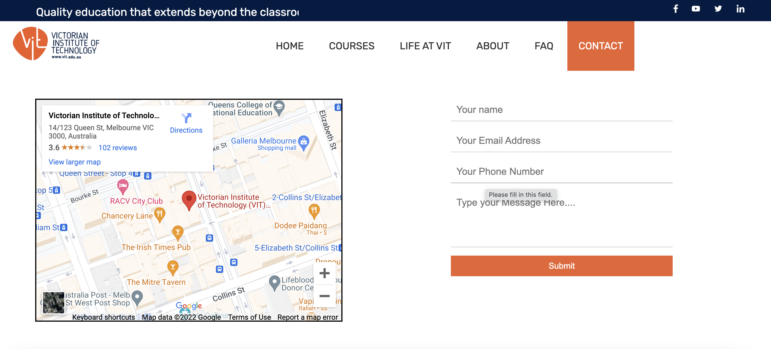
Introduction to the Project 1
Contents:
Embedded location address
Contact us Form(Irresponsive)
Responsive Nav Bar with respective Page Links.
Home page With the Introduction Video.

Slide 4
Introduction to the Project 2
This project is about developing the sample website where student, teachers and admin can perform their task.
This project is developed by using HTML, CSS & JAVA script and PHP codes.
Databases are added to store the data using PHP MyAdmin.

Slide 5
More about project
The function added on the Moodle
Registration (User and Admin)
Login
Management (Student and Teacher)

Slide 6


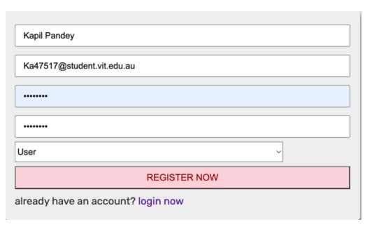


Registration Page
This is the main registration page of the website . With this page one can create their account as an admin or user
As an Admin or a lecturer can allocate the courses to the specific student and the user or student can login from their account and can access the courses.

Slide 7
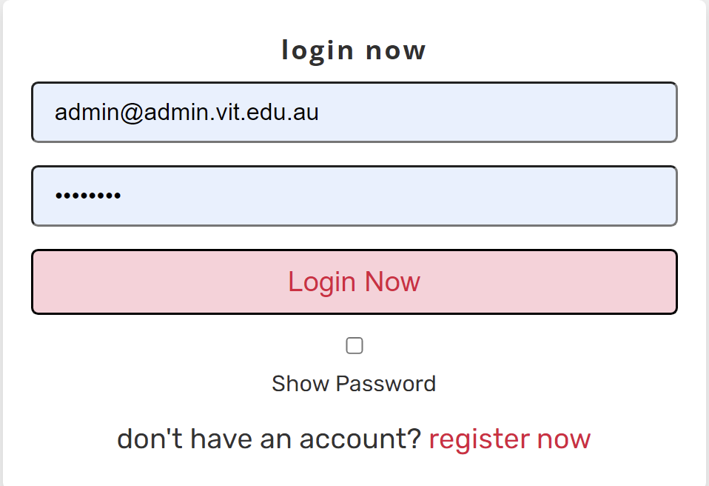
Login Page
This is the main Login form of the website . With this page individual can access their account portal as an admin or user.
If they don’t have any account registered on the database, they need to register their ID.
Validation check is applied on Email with the error message.

Slide 8
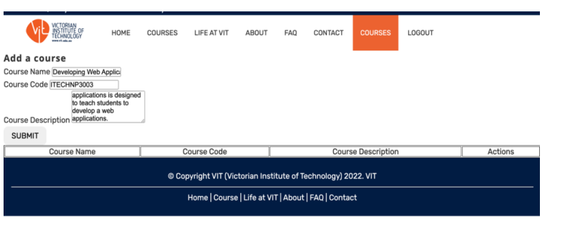
Management System
Adding courses
Admin can add the course and upload the file and assigned the specific students in a created course. Any changes made to the student’s course can be accessed by the students in their LMS.

Slide 9
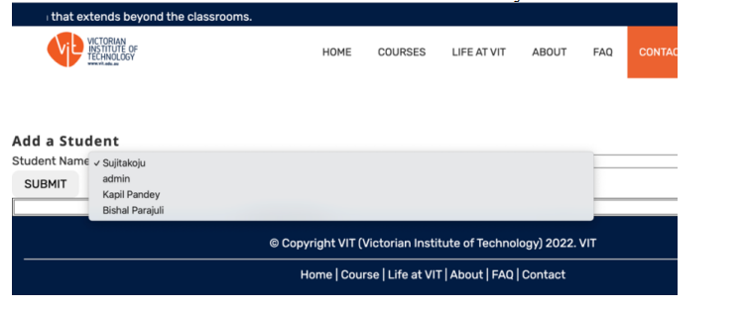
Cont.…
Admin can successfully create the course. Admin can also add students to the course created. System will look for the students registered in database and admin need to select which Unit can be excess by the selected students.

Slide 10
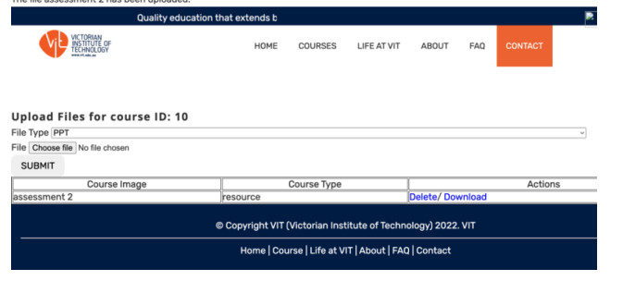
Admins Action (Lecturer)
Admin can upload the document
Admin can check the attendance
Admin can check if the student has accessed the class or not
Admin can also upload the puzzles, quizzes and the reference books .

Slide 11
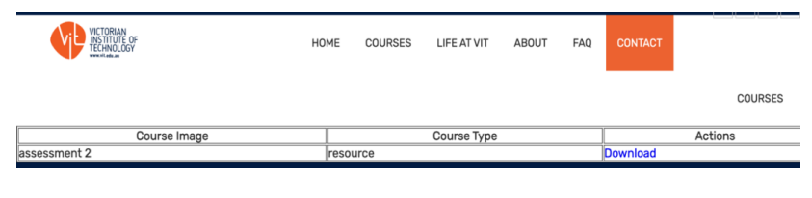
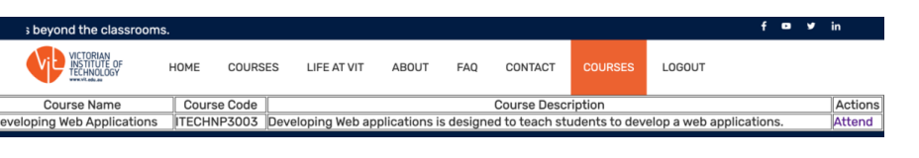
Student Action
Student can access the course allocated by the teacher
Student can download the files uploaded by the lecturer
Student can mark the attendance online and can submit the assignment
Student can attempt the quiz as well

Slide 12
Last Words
This project helps us to understand about the HTML, CSS and PHP along with the use of the JAVA script and SQL database.
Creating a small project with greater outcomes and usability.
Facilitates the completion of one or more tasks.

Slide 13
Last Words
Thank You !!!

