Slide 1


MS BUSINESS ANALYTICS CAPSTONE PROJECT

Slide 2






Outline
FRAMEWORK
BUSINESS UNDERSTANDING & THE PROBLEM
DATA UNDERSTANDING & PREPARATION
EXPLORATORY DATA ANALYSIS
MODELING & EVALUATION
CONCLUSION & FUTURE WORK

Slide 3
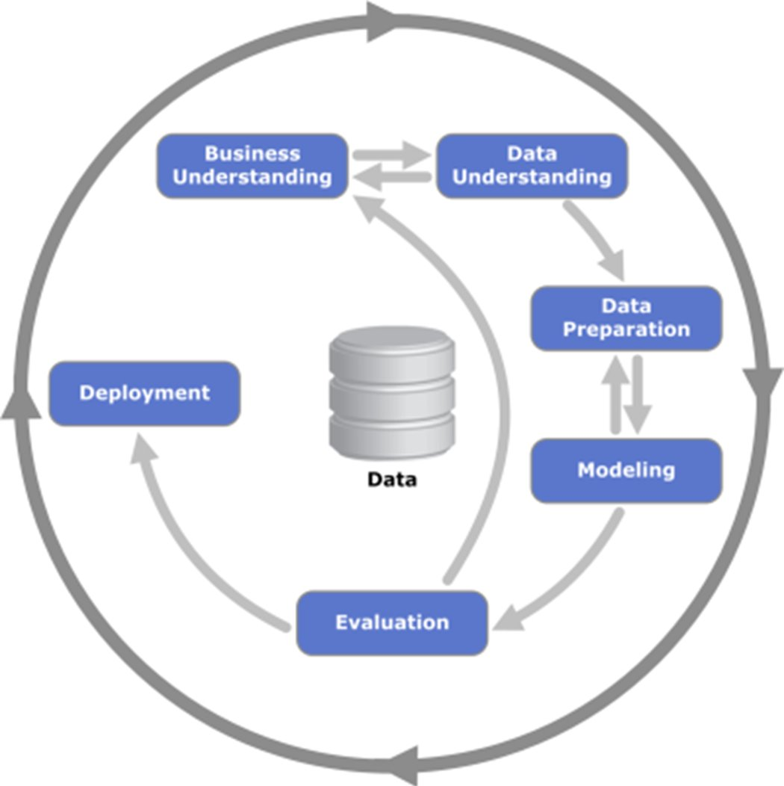
CRISP-DM Framework
Iterative and adaptive approach.
Continuously improves results & adaptable across all the industries for Data Mining, Data Analytics and Data Science.

Slide 4
Business Understanding
The Business
Business Model &Concept: Focuses on fast-casual dining experience mostly franchises.
Presence: Currently 469 stores in 37 states/territories & 369 Cities. Envisions the possibility of over 3,000 units in future.
Revenue & Valuation: $534M per year with 9,751 employees. Average per Employee $114K
Freddys Mobile App: Customizable orders and convenient pickup times. Carryout and delivery options, no subscription. Loyalty rewards : $1 = 10 points
The Problem
To grow Freddy's In-app orders and net sales as compared to other delivery partners.

Slide 5
DATA UNDERSTANDING
6 CSV files from Freddy’s, containing a vast amount of data totaling approximately 500 GB
Developed a data dictionary, understanding the relationship between the tables
Dataset Name | Description | Records | Size | Fields
Item_Sold | Information about items sold |  |  | 38
 | items_sold22-23 | 383M | 97.1GB
 | items_sold20-21 | 703M | 179 GB
 | items_sold19 | 525M | 131 GB
CheckSummary | Summary of each check of every transaction | 239M | 72 GB | 38
Giveback | Information about promotions and their period | 49,310 | 3.8MB | 7
StoreInfo | Specific details about each store | 716 | 385KB | 63

Slide 6
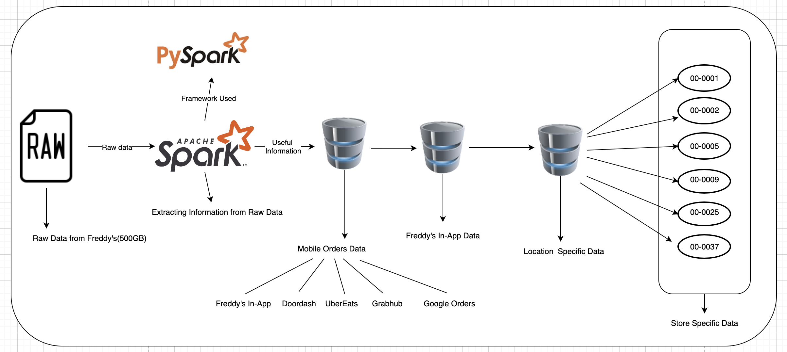
DATA PREPARATION

Slide 7
Exploratory Data Analysis
Initial exploratory analysis on entire data using PySpark.
Exploratory analysis on mobile orders using Tableau.
Exploratory analysis on Freddy's in-app orders at Wichita Location using Tableau.

Slide 8

Initial EDA On Entire Data Using PySpark

Slide 9
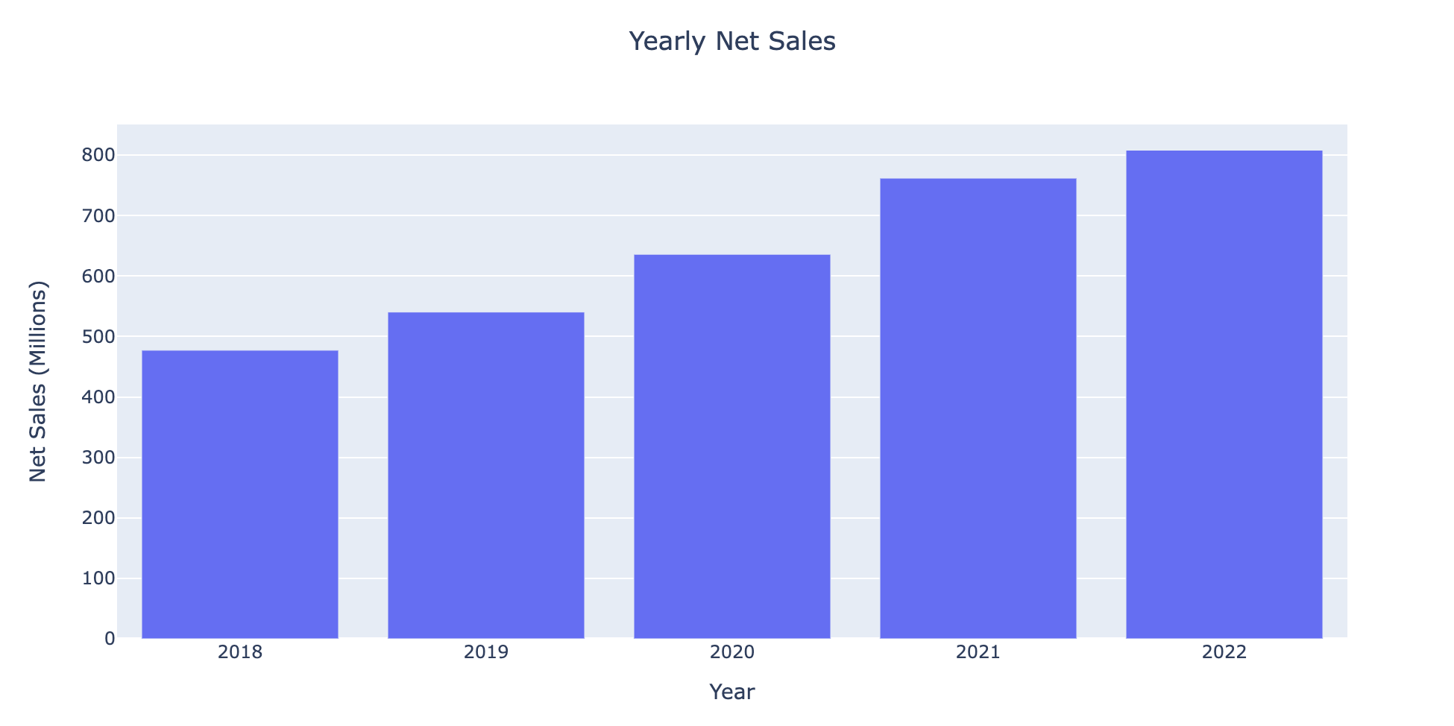

Slide 10
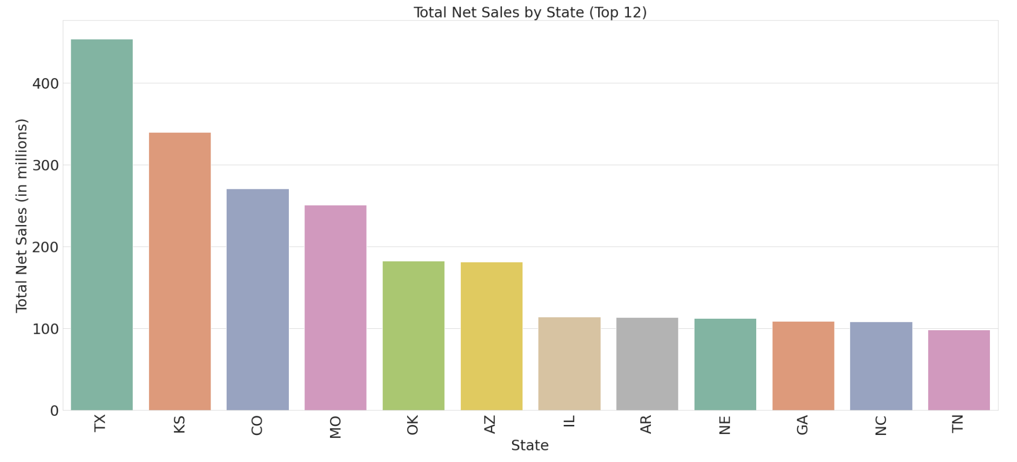
Net sales figures for the states that have above-average total net sales and their store count.

Slide 11
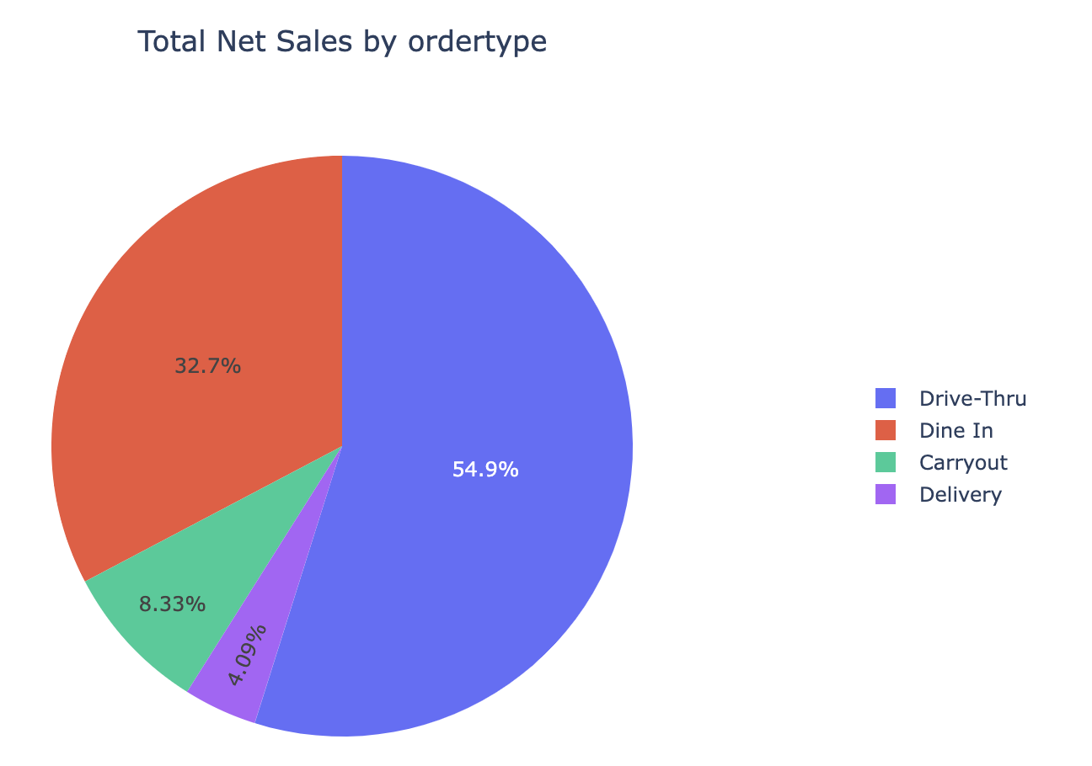
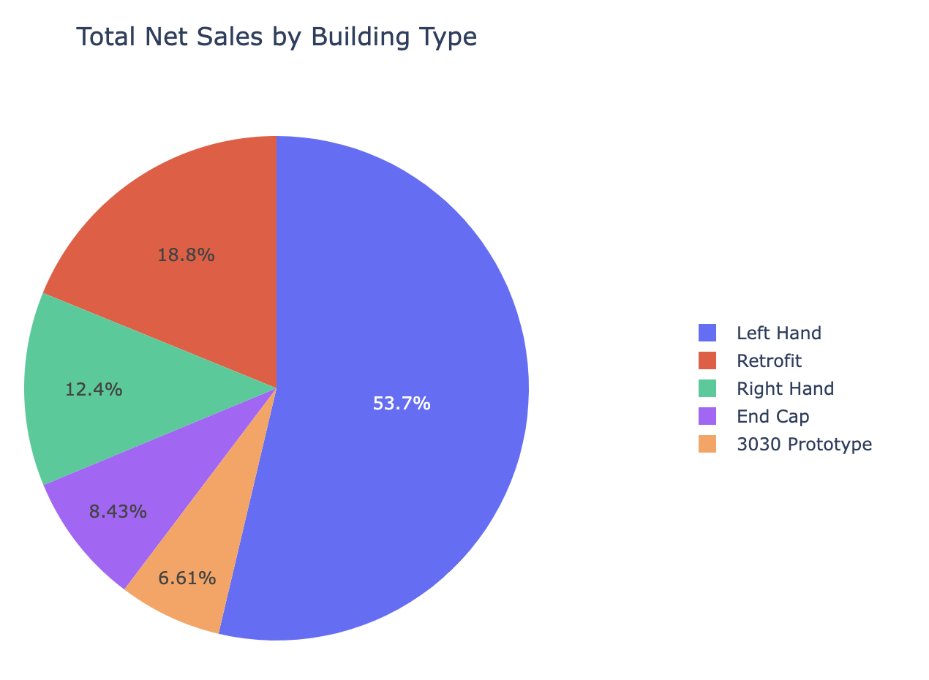

Slide 12
Exploratory Analysis on Mobile Orders

Slide 13
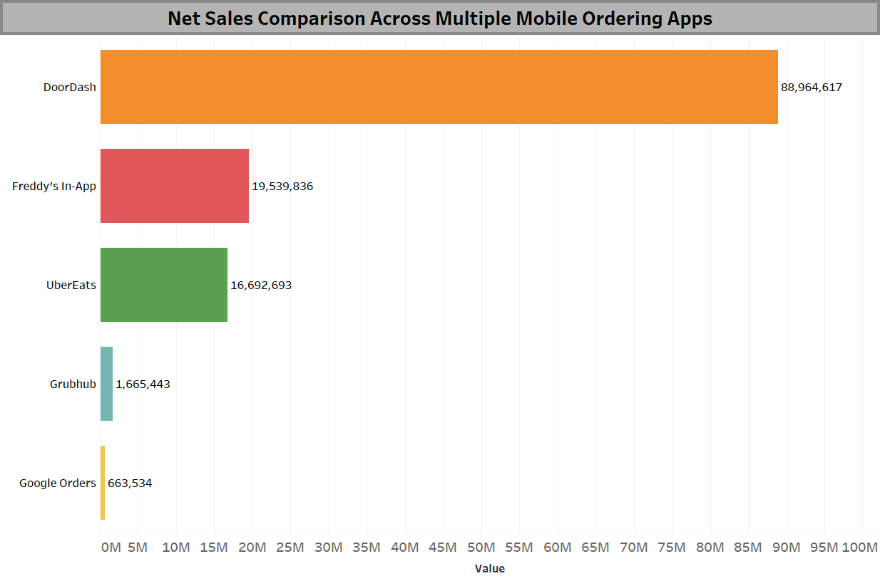

Slide 14
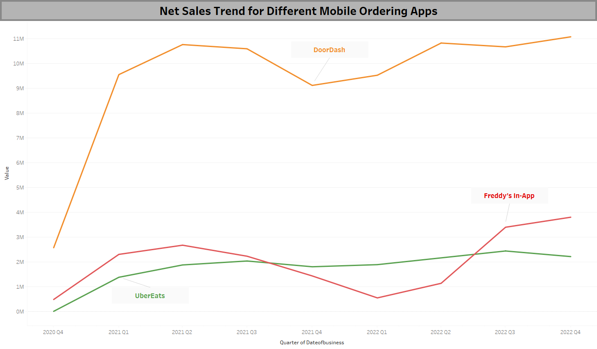

Slide 15
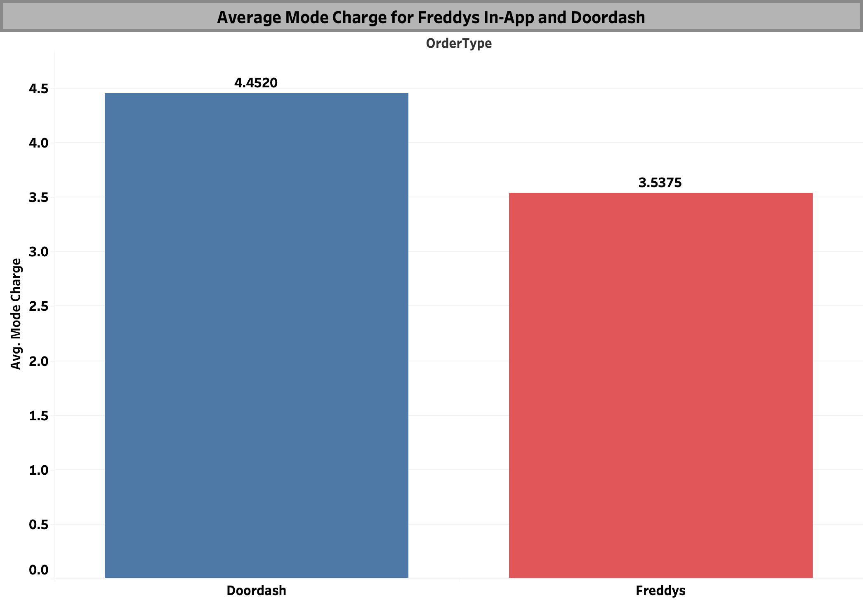

Slide 16
Exploratory Analysis on Freddy’s In-App Netsales in Wichita

Slide 17
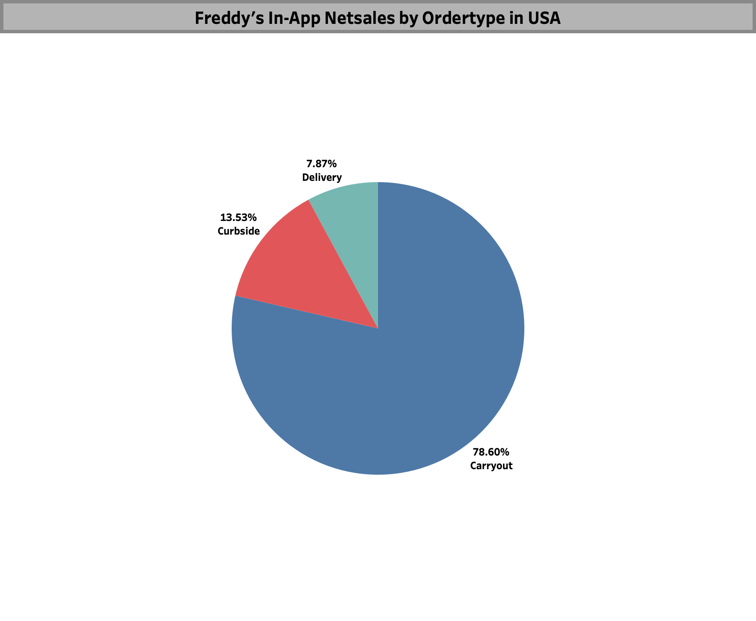

Slide 18
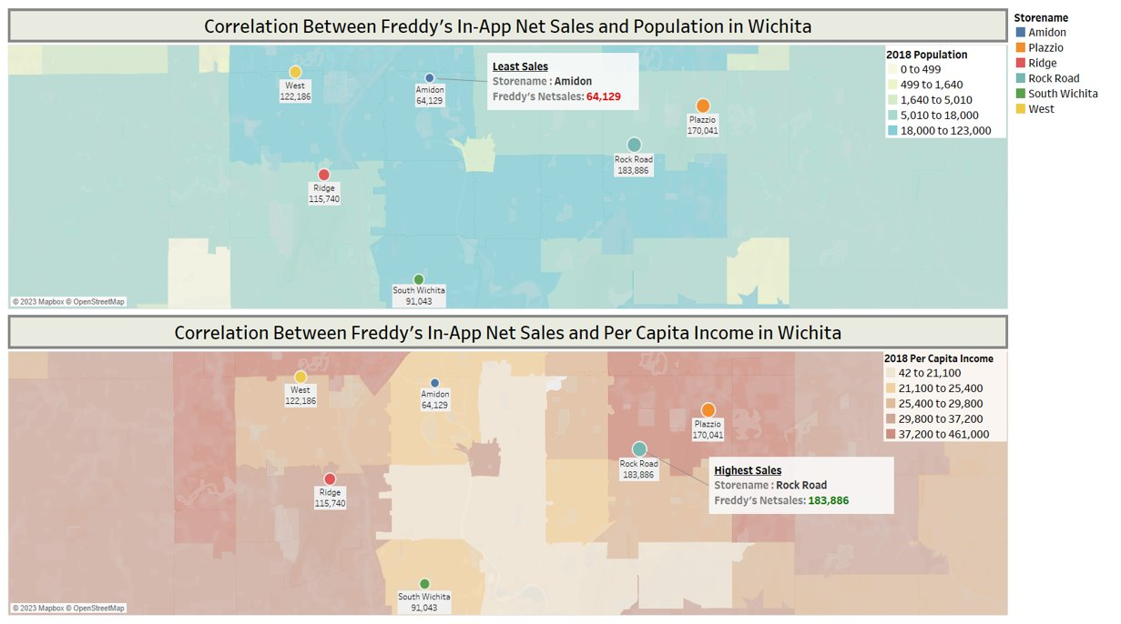

Slide 21
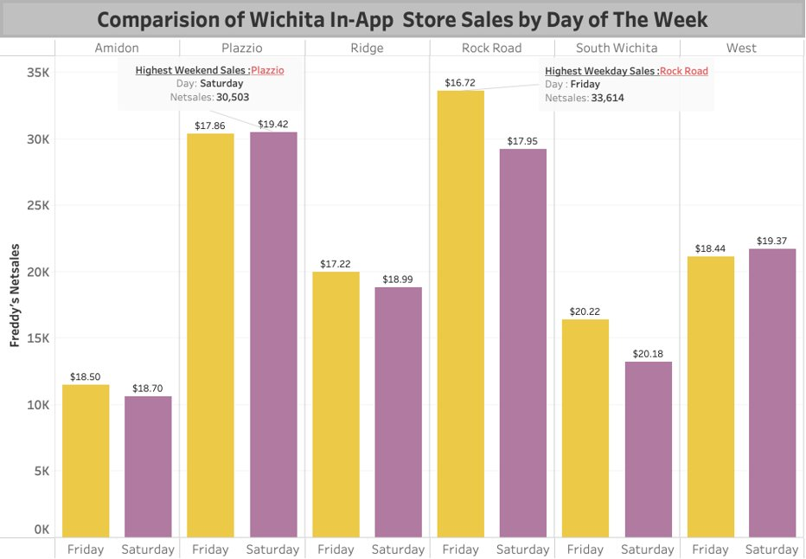

Slide 22
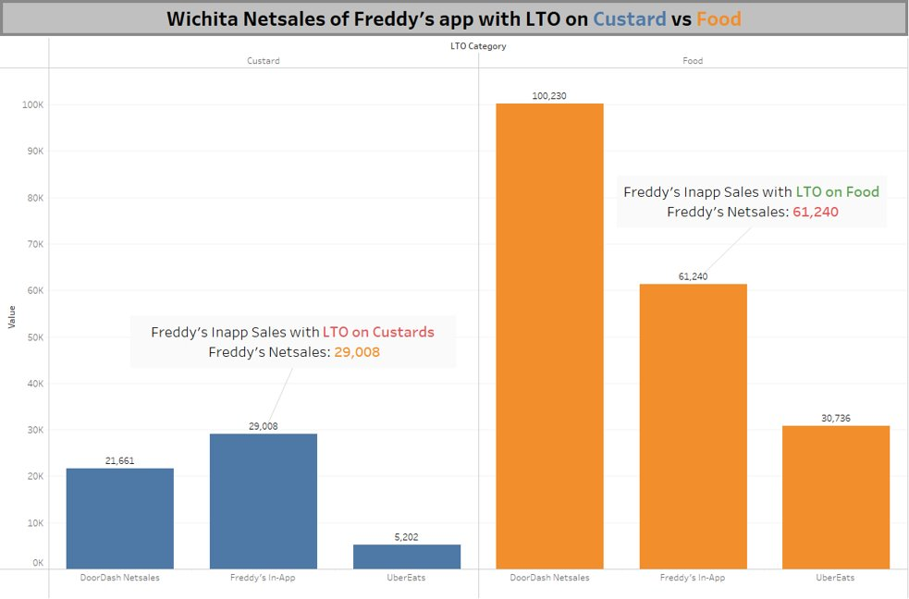

Slide 23
MODELING & EVALUATION
Regression analysis was conducted at different levels i.e., on Freddy's In-App data, location specific data
and at store level.
The focus was on the Freddy's In-App data which includes entire USA data.
RMSE (Root Mean Square Error) and R-Square values were calculated as a result of the analysis.
Results
RMSE : 0.56
R-Square: 0.85

Slide 24
Conclusion and Future Work
Conclusion
Identifying the top-performing stores and their characteristics.
Identifying the peak and off-peak hours and optimize staffing and marketing during those hours.
Predicting future sales based on historical data to optimize inventory, plan marketing and promotional campaigns, and identify potential opportunities for growth.
Future Work
Customer segmentation
A/B testing
Sentiment analysis on app reviews
Clustering analysis

Slide 25


