Slide 1
HEALTHWELLNESS
By Shreelata M Kandkoor
M.Sc (CS)-II
Seat no.

Slide 2
Contents
Objective
Introduction
Scenario
Related Work
Health IT Outcome
Methodology
Conclusion
References

Slide 3
Objective
In the present Indian scenario, healthcare information is independently maintained by hospitals , institutions and not readily accessible in a centralized, informed manner. This greatly limits the health providers’ efforts to improve quality and efﬁciency. Through this paper, we address this issue on bringing various information from many sources into one place in real-time which can be truly life saving. Also, low ratio of doctor to patient and the low per captain come in India hikes the medical expenses thereby increasing the patient’s inaccessibility to receive proper health care in their reach especially for people in the rural areas. A means by which the bridge between the patients and doctors can be gapped and how patients can be treated data lower expense is the prime concern.

Slide 4
INTRODUCTION
In India, millions are deprived from accessing overburdened hospitals and inadequate medical facilities.
According to IndiaSpend, India is short of nearly 500,000 doctors and the claimed doctor-patient population ratio is about 1:1,674 is in India.
This is below par with the World Health Organization (WHO) norm of 1:1,000 population. Also, there is an 83% shortage of specialist medical professionals in community health centres.
The situation is more worse in the rural scenario where there would currently be at best 2.7 lakh doctors to serve close to 870 million people, that is one doctor for about 3,200 people. Rural India still needs 6 lakh more doctors to meet the WHO norm.

Slide 5
In addition to the fact that there is a signiﬁcant shortage of doctors, doctors are also challenged by the lack of access and insight into the medical history of their patients which can impact the quality of care they can provide to a patient.
Health institutions maintain independent medical databases and thus electronic health records are poorly interconnected. There is need of analytics which will provide instant and accurate insight into patient’s medical history — including past clinical conditions, diagnoses, treatments, utilization, and outcomes.
But unfortunately there is a scarcity of medical datasets upon which analytics can be carried out, and this has been addressed by the real-time data collection feature of our application.
So there is a major need to shift from volume based to value based healthcare system. Taking these facts into consideration, we have proposed to automate healthcare solutions and reduce unnecessary medical costs.
A Digitised HealthCare Model for India is proposed which has the potential to revolutionize how populations interact with national health services and also strengthen health systems. It will play an important role in preventive, promotive and curative health.
The major advantage of such a system is to detect and predict diseases accurately, easily and faster with the help of machine learning.

Slide 6
This is because of the fact that a set of particular symptoms will not always lead to a particular disease and can be causing another set of diseases. So we may be able to tap the appropriate set of diseases linked to the symptoms easily after analysis.
This model also meets the key challenges posed to us in health sector that are shortage of human resources in the sector, accessibility of healthcare infrastructure, affordability of healthcare services especially for the rural population. Some major beneﬁts from the model includes:
Cutting down recurring medical costs .
Well- maintained medical history .
Secured medical records accessible any-time anywhere.
Centralised system with patients having personalised dashboard for self monitoring as well as for surveillance by the doctors.
Socio-demographic factors and locations of patients taped and analysed .

Slide 7
SCENARIO
People living in rural areas face major crisis due to shortage of proper healthcare institutions as well as medical professionals.
The public healthcare centres and community health care centres are poorly run with less professional human resources and limited medical facilities. Also, there is a scarcity of specialized centres. Local medical centre may have medications to provide ﬁrst aid, but may not have the expertise.
People in rural areas have to travel long distances to access proper health care which can be the difference between life and death in the case of emergency. Moreover there is lack of ambulance in the remote areas, even in urban areas to pinpoint the exact location of the patient is difﬁcult, hence we need some kind of interface between the patient and the hospital in order to the save the crucial time.
Patient should be given proper ﬁrst aid during the time until some sort of expert help arrives, not everyone is aware of right kind of ﬁrst aid in every situation.

Slide 8
Also, doctors often have limited insight into all of the patient’s disease and comorbidity status. This missing knowledge can signiﬁcantly have a negative impact on the accuracy of medication and also lead duplication of medical tests and thus incurs more cost. Knowing about patient’s medical history will help doctor to more precisely identify the cause of the patient’s condition and eventually lower number of inapt practices during treatment.

Slide 9
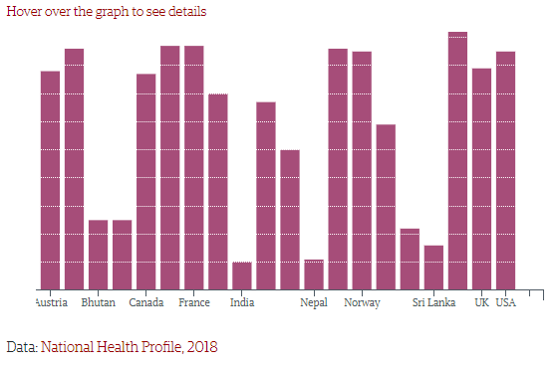
RELATED WORK
India's Health Crisis
According to the latest National Health Profile (NHP) 2018, India is among the countries with the least public health spending. The Indian government plans to live up to its promise of 'health assurance to all Indians' with a health spending of just Rs 3 per person per day that counts for 1.02 per cent of the GDP.

Slide 10
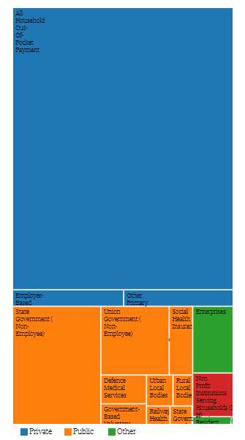
High Out-of-pocket expenditure
There is a need to enhance public health spending to a minimum of 5 per cent of the GDP. According to the National Health Accounts (NHA) estimate for 2014-15, the Government Health Expenditure (GHE) per person per year is only Rs 1,108 that comes to Rs 3 per day. This is in contrast to the Out-of-Pocket Expenditure (OPE) of Rs 2,394, which comes out to be 63 per cent of the total health expenditure.
Data Source: National Health Profile, 2018

Slide 11
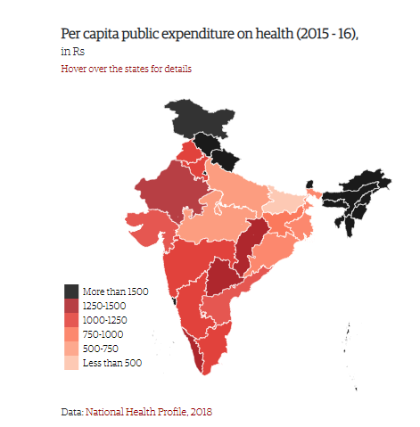
Bihar spent just Rs 491 per capita on health
Mizoram's per capita health expenditure is Rs 5,862, almost five times the Indian average, with the state spending 4.2 percent of its GDP on health in 2015. Arunachal Pradesh (Rs 5,177) and Sikkim (Rs 5,126) followed at the top. At the other end of the spectrum, Bihar spent Rs 491 per capita on health -less than half the Indian average- spending 1.33 per cent of its GDP on health. Just above Bihar were Madhya Pradesh (Rs 716) and Uttar Pradesh (Rs 733). While Delhi spends Rs 1,992 per capita on health.

Slide 12
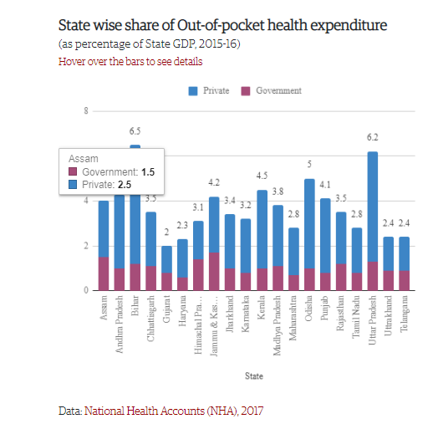
State wise share of Out-of-pocket health expenditure (as percentage of State GDP, 2015-16).
The Union health ministry reveals that medicines are the biggest financial burden on Indian households. Of more than three lakh crore rupees that households spent on health in 2014-15, around 43 per cent of the total out-of-pocket spending (OOP) went in buying medicines. In private hospitals, households spent around 28 per cent of the OOP spending. Much of this problem of debt can be solved if medicines are made available to people at affordable prices. The National Health Policy 2017 also highlighted the need for providing free medicines in public health facilities by stepping up funding and improving drug procurement and supply chain mechanisms.

Slide 13
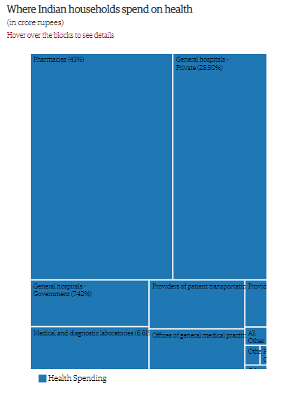
Cost of inaction
One of the central problems has been the low levels of public spending on health, and as a, result the poor access to affordable and good quality healthcare for the majority of India’s population.
The National Crime Records Bureau says that 0.38 million people committed suicide in India between 2001 and 2015 due to the lack of treatment facilities. This is 21 per cent of the total suicides in that time. According to National Sample Survey Office (NSSO), outstanding loans for health reasons doubled between 2002 and 2012. In India, low health spending is pushing people towards the private sector for their healthcare needs since India stands sixth in the out-of-pocket (OOP) health spending among the low-middle income group of 50 nations.

Slide 14
HEALTH IT OUTCOMEs
Health IT Outcomes is the premier information resource for today’s most pressing Health IT topics. Our mission is to provide healthcare providers with expert guidance on technology system selection, integration, project management, and change management.
Health IT Outcomes covers all technology solutions that impact the productivity, efficiency, patient care, and cash flow of a healthcare facility — from the latest electronic health record software (EHR), healthcare information exchange (HIE), healthcare information management Software (HIM), healthcare document management, healthcare business intelligence software, healthcare revenue cycle management software, point of care (POC) EMR (electronic medical record) and HIM (health information management) software to point-of-care solutions and medical imaging systems. The site features a comprehensive buyer's guide, daily health IT news updates on the latest technologies, contributed articles from leading healthcare industry analysts and vendors, and original success stories that highlight how leading healthcare facilities are implementing technology solutions with maximum return.

Slide 15
1. Why Enterprise Analytics Should Be More Like a Book, Less Like a Spotify Playlist
People like stories. We like to tell them. We like to read them. Enterprise analytics is the story of a healthcare organization. Just like the chapters in a book, enterprise analytics takes “readers” from the beginning to the end, from chapter to chapter without interruption.
2. Finding The Balance Between Patient Outreach and Patient Care with Technology
Patient engagement is crucial to all healthcare organizations. It might seem at first glance that the larger an organization is, the more hands there would be to connect with patients. Unfortunately, the opposite is often true.
4 Ways Identity and Access Management (IAM) Solutions Can Benefit Healthcare Organizations
Healthcare is one of the most highly regulated industries in existence because of the sensitivity of information and data that is collected. Thus, high levels of privacy and security are expected and demanded to maintain order throughout the sector.

Slide 16
Is Employee Training the Only Solution Against Phishing in Healthcare?
Healthcare organizations are being bombarded with phishing attacks. Of the 168 hacking incidents against healthcare organizations in the first half of 2019, more than half (52 percent) were phishing attacks, according to the Protenus 2019 Mid-Year Breach Barometer Report.

Slide 17
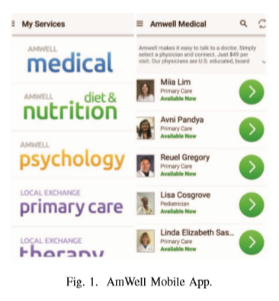
There are various applications used today which try to provide remote healthcare to the patients. Few of the most popular applications are :
AmWell
American Well is ranked as the most popular consumer telehealth app in the world by app analytics services company App Annie.
It connects the patients remotely with the doctors. The patients can log in with the application or website with their query and can check for the doctor’s proﬁle and schedule a meeting (via video, audio or text).
A web based queue will be generated and expected waiting time will be provided. After the meeting, the doctor comes up with remedies and all the necessary steps to be considered.

Slide 18
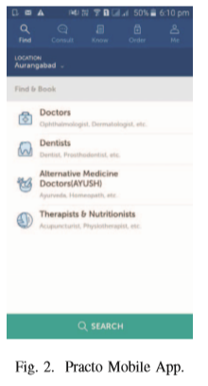
B. Practo
A complete health app to book doctor appointments at clinics and hospitals, order medicines, set medicine reminders,
consult doctors online, manage digital health records and read health tips.

Slide 19
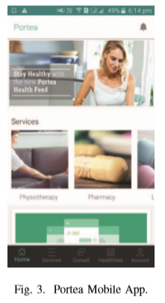
C. Portea
Helps patients connect with specialised doctors for consultation and treatment. It also helps delivering medicines online and get medical opinions with hospital-quality nursing care at home.

Slide 20
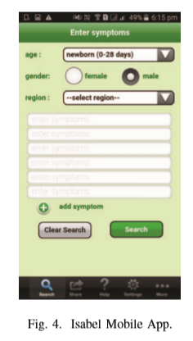
D. Isabel (Ann Arbor, Mich.)
Isabel is a clinical decision support tool and gives healthcare professionals access to an online system that helps them arrive at an accurate diagnosis more quickly.
The diagnostic tool is to understand multiple symptoms. It has a database of over 6000 diseases and conditions. The results provided also consider age and gender. It helps to research and understand the symptoms so as to have a better discussion with the doctor about the possible diagnoses.

Slide 21
METHODOLOGY
Our motive is to create an automated data-driven model that integrates the process of healthcare data collection, delivery and its data analysis.
We believe that this model will enable healthcare organizations and institutions to fully understand and leverage the capabilities of health big data analytics and achieve the ultimate goal by improving the quality of care while lowering costs and enhancing clinician and patient satisfaction.
When an individual’s medical history is documented, it helps to assure that health care providers provide the most effective treatment and support for the individual’s illnesses and health conditions so that they maintain the best possible health.
A person’s medical history is made up of many different pieces of information that tell the complete account about that individual’s current and past health.
The Model aims to provide a centralised platform where patient’s database is maintained and thus it will serve as a source to learn about their medical history.

Slide 22
It will help ensure maintaining all medical records at a place accessible any time anywhere. It will also help in studying the Socio-demographic factors associated with healthcare.
When the user signs up, unique identiﬁcation number is generated against which records are maintained. The patient through a mobile device inputs information regarding his/her general details – name, age, gender and major symptomatic query. They can upload voice and pictures also. Using these communication means, vital data concerning the health of the person is sent to the cloud for processing. If the input from the user is in the form of voice, then we will ﬁrst convert speech into text using google speech to text API. If the data is already in the form of text, then we will send it directly to the server along with the coordinates of the patient obtained by GPS of his/her mobile phone.
A successful and sustainable analytics strategy requires building foundational elements of the model ﬁrst in order to support the upper levels of the model in later years. Thus initially, there is a need for physicians / medical examiners on the server side to routinely analyse the input of the patient. This analysis contains extracting keywords from the text input received from the patient and storing those keywords into a database along with the original text. The next step of this analysis requires medical examiner to allot this patient to the relevant ward. Moreover this information will also be updated in the above mentioned database. This whole procedure will be automated once we collect enough data from users and achieve desired accuracy.

Slide 23
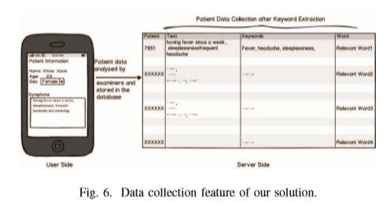

Slide 24
BIGDATA PROPOSED SOLUTION
The volume of worldwide healthcare data in 2012 was 500 petabytes. That is estimated to grow in 2020 to 25,000
petabytes - a ﬁftyfold increase from 2012 to 2020. Thus, Big Data in healthcare domain has great potential to help derive meaningful insights after analysis. Big Data in Healthcare can drive clinical decision support, disease surveillance, epidemic control and population health management.
The key function of our application being data collection, data collected can be dealt wih big data technologies. In our proposed system, the patient’s input and discharge sheets form the big data. Apache Hadoop provides a technology to process these larger volumes of data and also keep the data on the original data clusters. Per terabyte of storage in Hadoop is, on average, 10 times cheaper than a traditional relational data warehouse system. The Hadoop Distributed File System (HDFS) stores data across multiple data nodes in a simple hierarchical form of directories of ﬁles. Conventionally, data is stored in 64MB chunks (ﬁles) in the data nodes with a high degree of compression. Hadoop uses MapReduce on the data being processed.

Slide 25
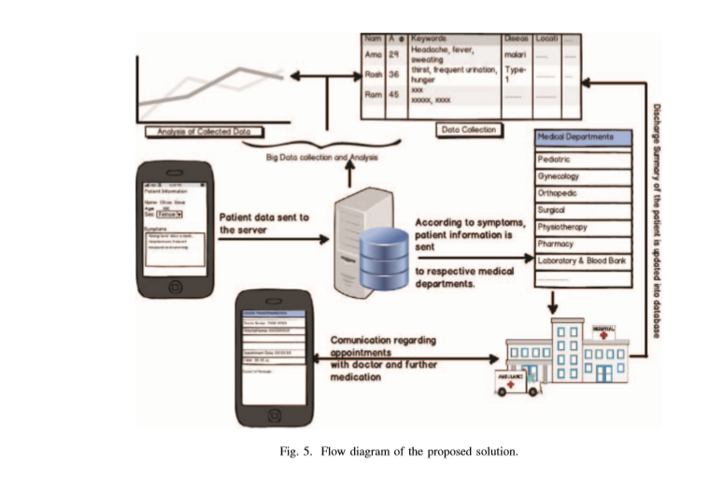

Slide 26
CONCLUSION
India takes the second place in the world in its population. Increasing population in India over-burdens the health care structure in the country. We see that there is huge incoming data in the health domain. Thus, the proposed model is the solution for efﬁcient data collection, healthcare delivery integrated with analytics. Thus, this system can automate the health care services for patients as well as doctors.

Slide 27
REFERENCES
Healthcare crisis, www.hindustantimes.com/india-news/healthcarecrisis-short-of-5-lakh-doctors-india-has-just-1-for-1-674-people/storySZepTyjJ78WgOVIo93tBVK.html
[2] Why more doctors are not the answer to India’s health crisis, timesoﬁndia.indiatimes.com/india/Why-more-doctors-are-not-theanswer-to-Indias-health-crisis/articleshow/54383884.cms
[3] Health IT Outcomes, “The Power of Real Time Analytics at the Point of Care,” December 2015
[4] 50 healthcare apps for clinicians and consumers to know, http://www.beckershospitalreview.com/healthcare-informationtechnology/50-healthcare-apps-for-clinicians-and-consumers-toknow.html
[5] 10 Indian Healthcare Startups You Should Know About, http://gadgets.ndtv.com/apps/features/roundup-10-indian-healthcarestartups-you-should-know-about-792075
[6] Soltau, H., Liao, H. and Sak, H., 2016. Neural Speech Recognizer: Acoustic-to-Word LSTM Model for Large Vocabulary Speech Recognition. arXiv preprint arXiv:1610.09975.
[7] Yang, H., Spasic, I., Keane, J.A. and Nenadic, G., 2009. A text mining approach to the prediction of disease status from clinical discharge summaries. Journal of the American Medical Informatics Association, 16(4), pp.596-600.

Slide 28
THANK YOU.

