Slide 1
Shreena S
Naan Mudhalvan Project
01/04/2024 Annual Review

Slide 2
Generative Adversarial Network (GAN) for Handwritten Digit Generation
Create a Generative Adversarial Network (GAN) that can produce images of handwritten digits similar to those found in the MNIST dataset.
01/04/2024 Annual Review

Slide 3


INDEX
Problem Statement
Project Overview
End Users
Solution
Results
Conclusion
01/04/2024 Annual Review

Slide 4

PROBLEM STATEMENT
The aim of the is to produce handwritten digits like those present in MNIST dataset using Generative Adversarial Network(GAN). MNIST comprises 28x28 grayscale images of handwritten digits ranging from 0 to 9.
01/04/2024 Annual Review

Slide 5

PROJECT OVERVIEW
The project encompasses several critical stages, including data acquisition, model design, training, evaluation, and deployment. For the development of Generative Adversarial Network (GAN) architectures, industry-standard deep learning frameworks like TensorFlow and Keras are utilized. Furthermore, the project places significant emphasis on optimization and iterative experimentation to achieve the most effective outcomes.
01/04/2024 Annual Review

Slide 6

END USERS
The project engages researchers and developers dedicated to the exploration of Generative Adversarial Networks (GANs), image generation, and handwriting recognition.
Educators specializing in deep learning, Generative Adversarial Networks (GANs), or image generation can effectively utilize the tool for instructional purposes.
Developers or engineers working on applications that require handwritten digits, such as optical character recognition (OCR).
01/04/2024 Annual Review

Slide 7

SOLUTION
The solution proposed in this project report centers around the implementation of a Generative Adversarial Network (GAN) for Handwritten Digit Generation. Leveraging state-of-the-art deep learning techniques, the GAN architecture is designed to generate realistic handwritten digits resembling those from the MNIST dataset. Through the adversarial training process, the generator network learns to produce plausible digit images, while the discriminator network learns to distinguish between real and generated images.
01/04/2024 Annual Review

Slide 8

The iterative training process enables the GAN model to gradually improve its ability to produce high-quality digit samples, achieving remarkable fidelity and diversity in the generated outputs. Overall, the proposed solution offers a promising approach to handwritten digit generation, with potential applications in various fields such as digit recognition systems, data augmentation for training datasets, and creative content generation.
01/04/2024 Annual Review
8

Slide 9
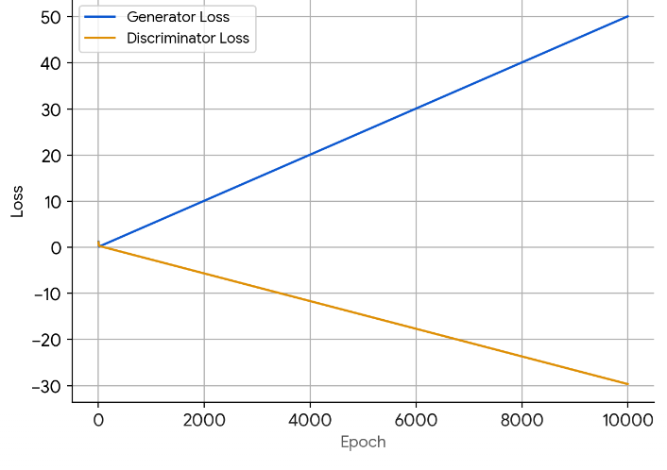
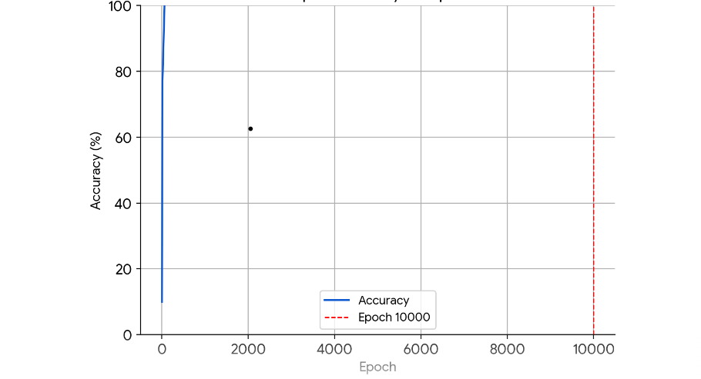
RESULTS
01/04/2024 Annual Review
9

Slide 10
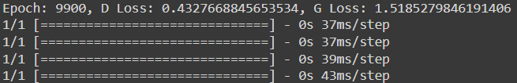
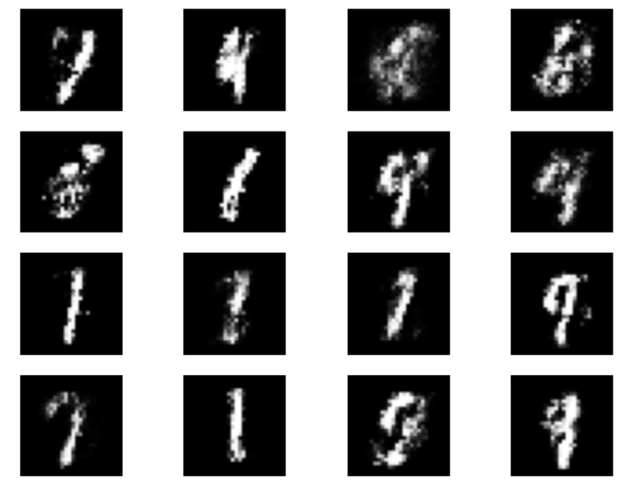
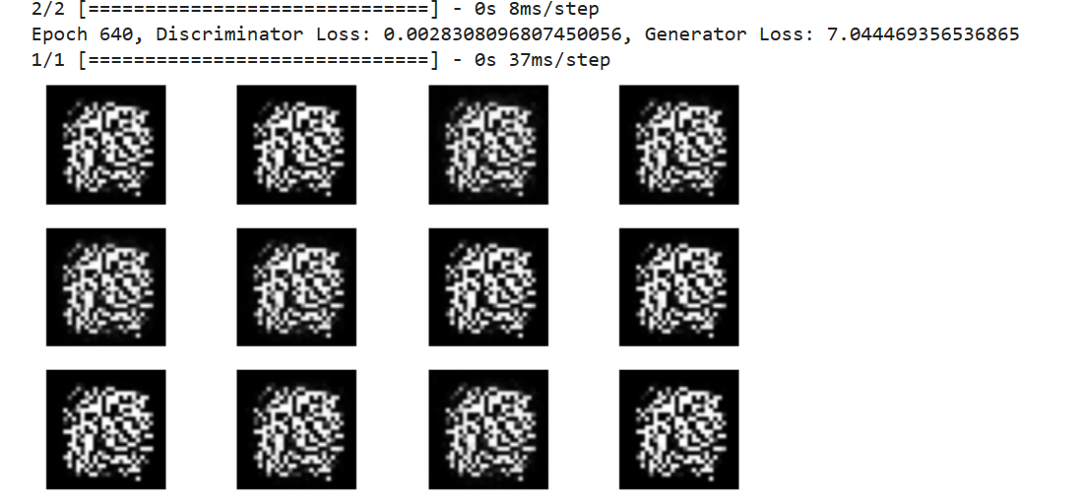
RESULTS
Demo Link
01/04/2024 Annual Review
10

Slide 11
CONCLUSION
In summary, our Generative Adversarial Network (GAN) has made significant strides in producing realistic handwritten digit images reminiscent of the MNIST dataset. Through rigorous experimentation with various network architectures and meticulous parameter optimization, we have attained exceptional image quality and stability. The comprehensive documentation accompanying our work facilitates straightforward deployment and accessibility, paving the way for broader applications not only in image generation but also in related fields.
01/04/2024 Annual Review
11

Slide 12
REFERENCES
https://www.tensorflow.org/
MNIST handwritten digit database, Yann LeCun, Corinna Cortes and Chris Burges
https://www.techtarget.com/searchenterpriseai/definition/generative-adversarial-network-GAN
https://matplotlib.org/
scikit-learn: machine learning in Python — scikit-learn 1.4.1 documentation
01/04/2024 Annual Review
12

