Slide 1
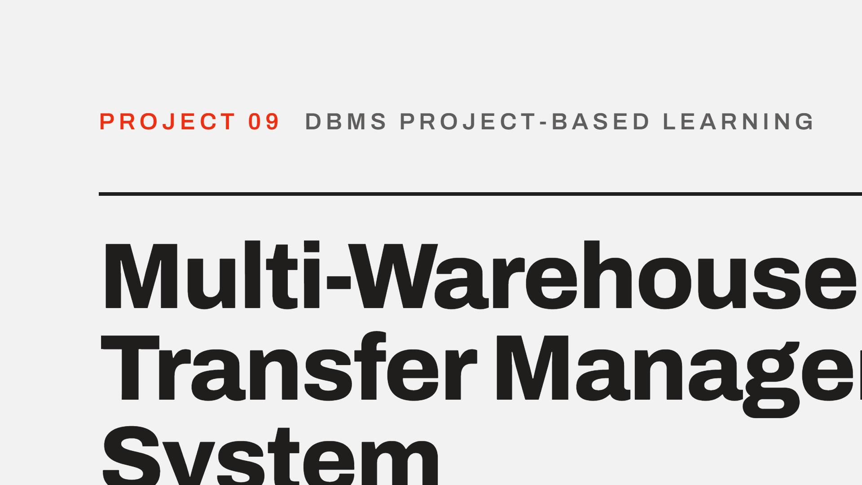

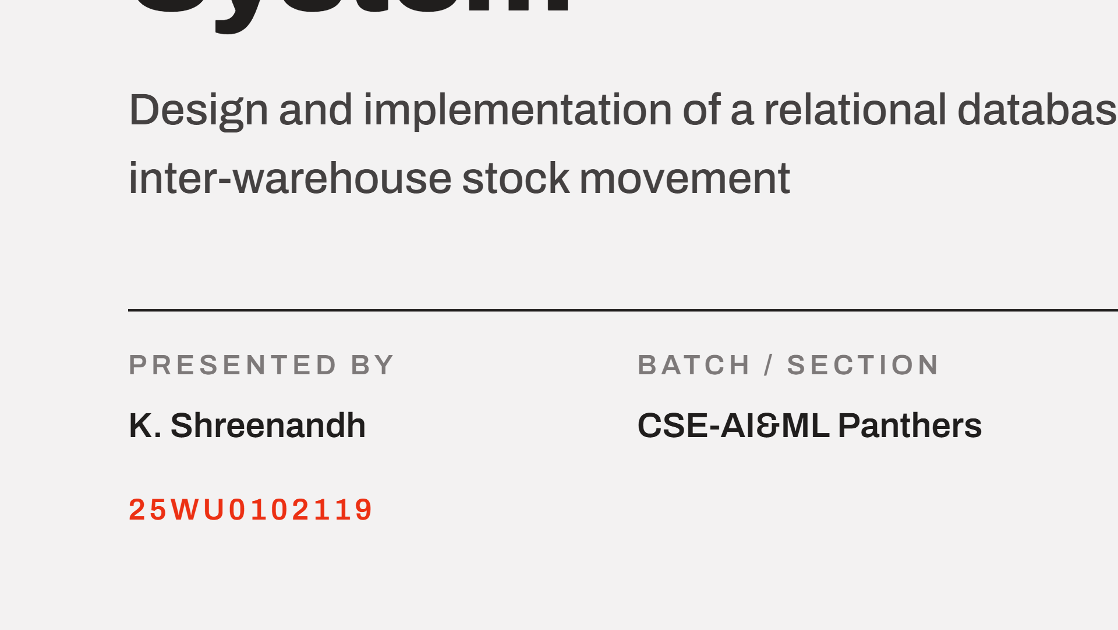

Notes:
Good morning. Project 09, Review 1. I will cover the problem and scope, the users and functional requirements, the conceptual ER design, and the initial relational schema.

Slide 2
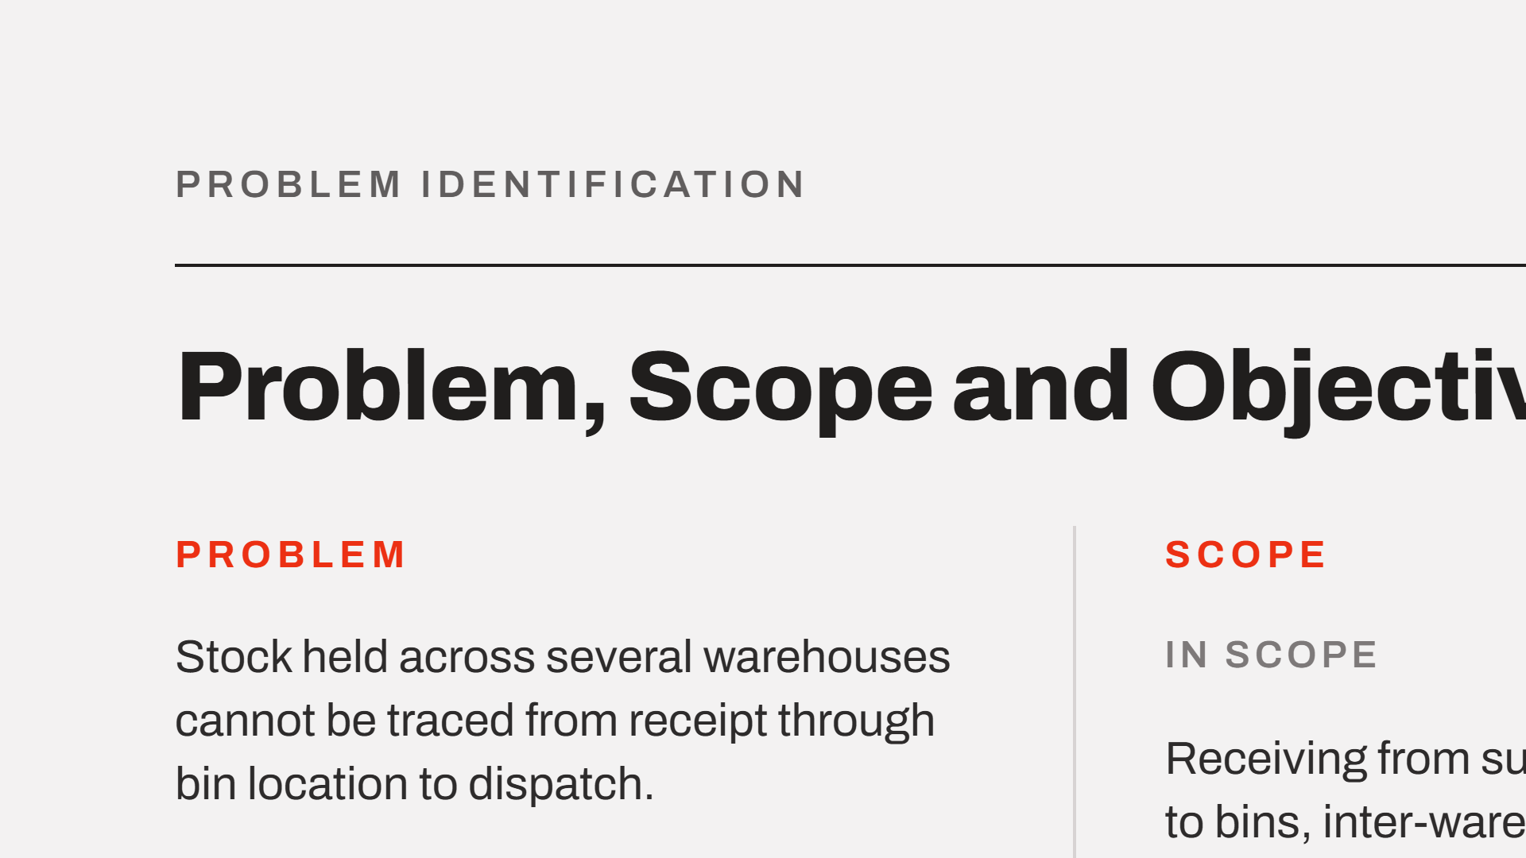
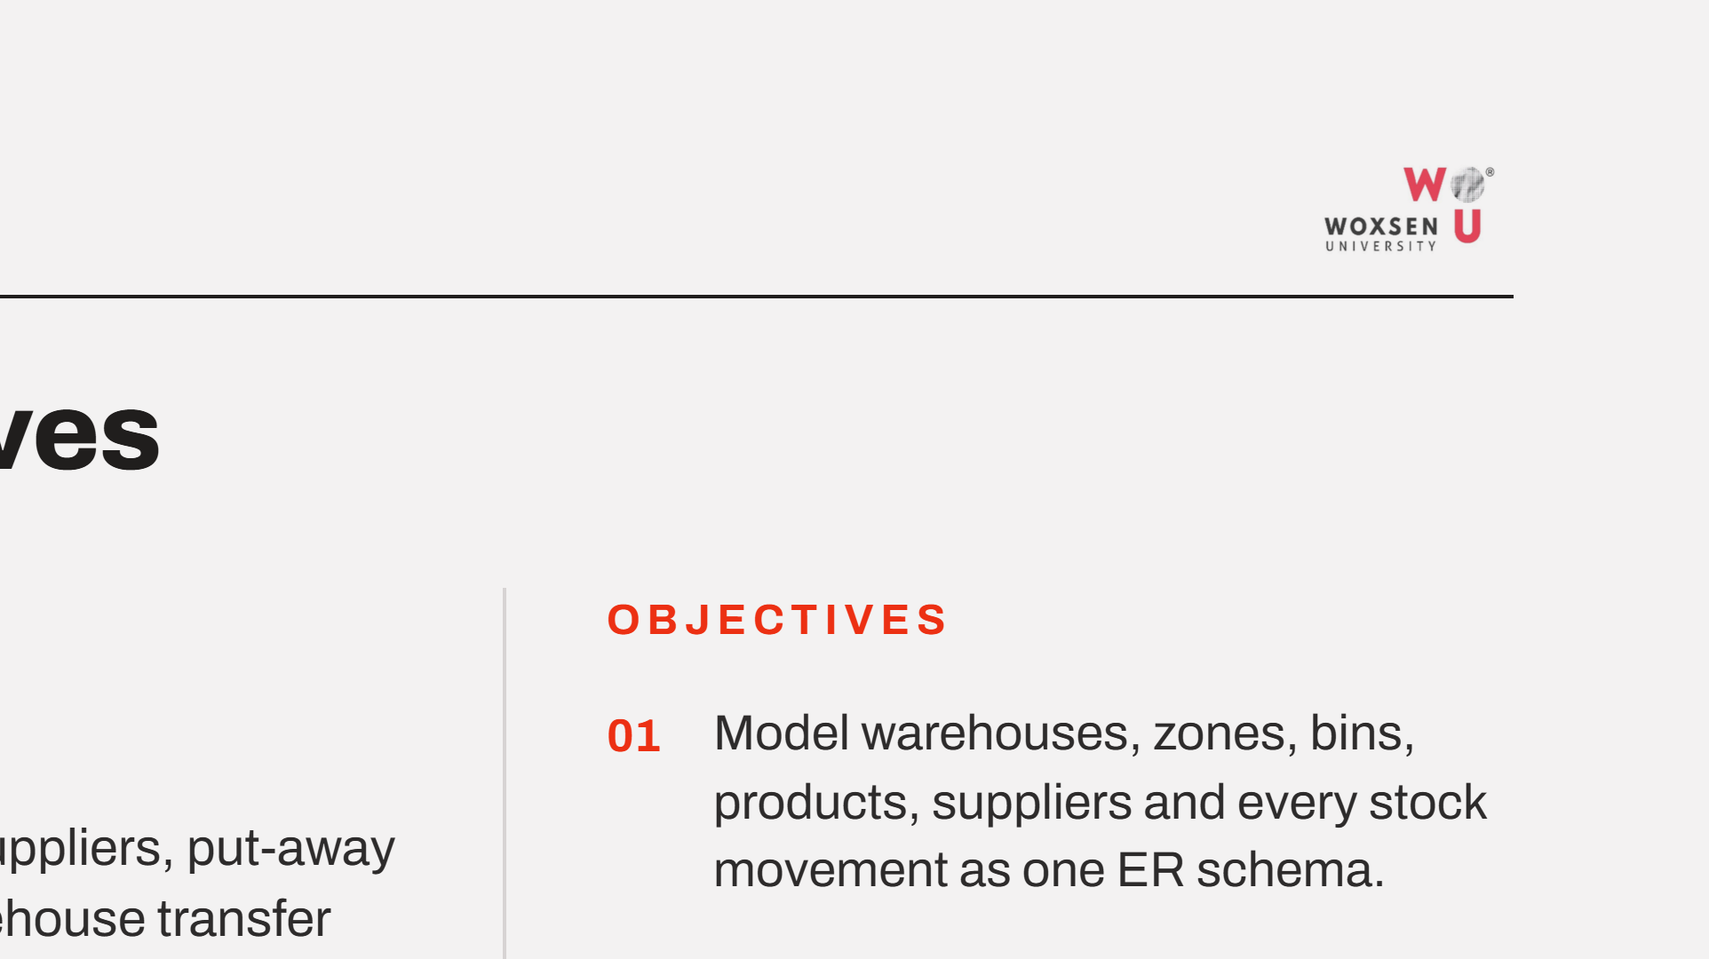
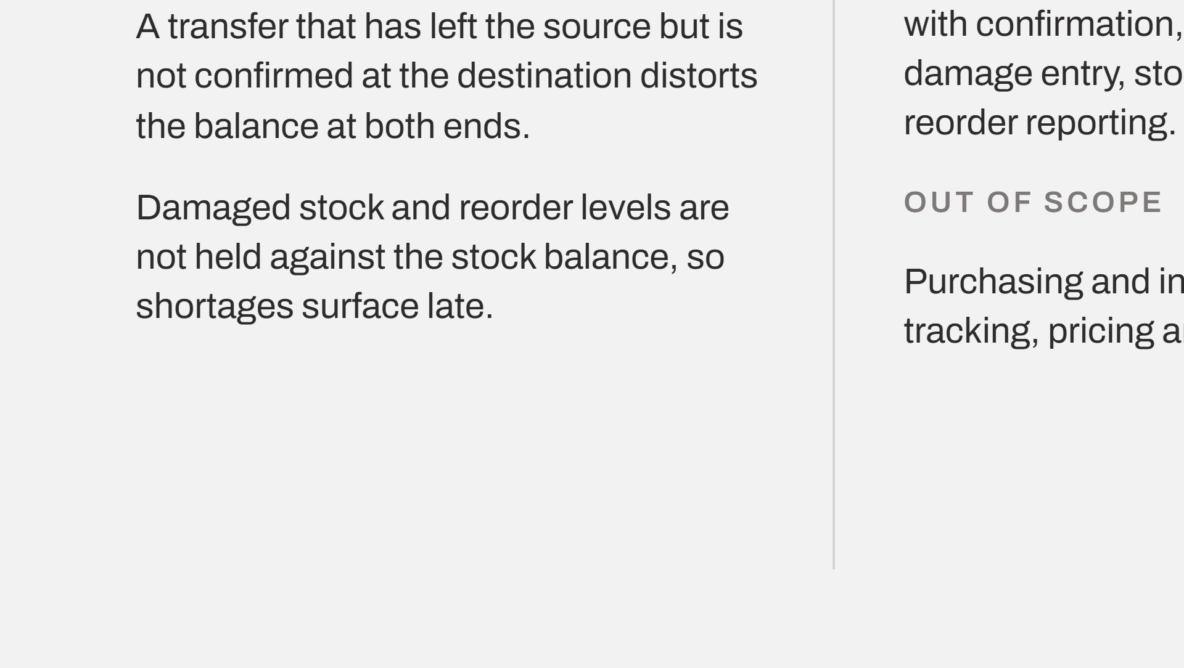
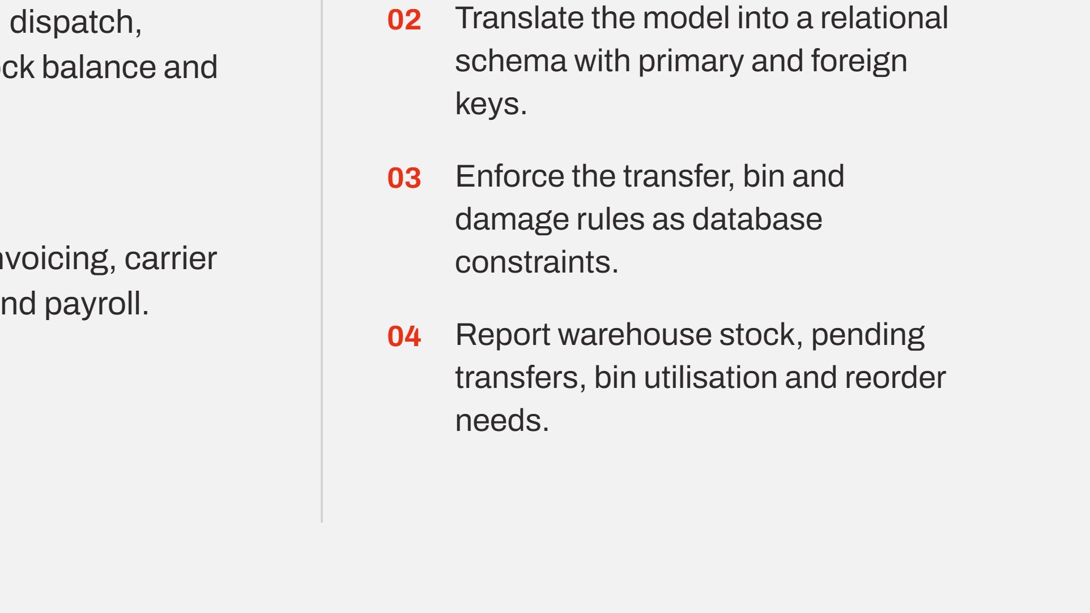
Notes:
The core defect is the unconfirmed transfer: stock has left the source but is not yet acknowledged at the destination, so it is counted twice or lost. Scope is deliberately limited to physical movement; purchasing and invoicing are out.

Slide 3
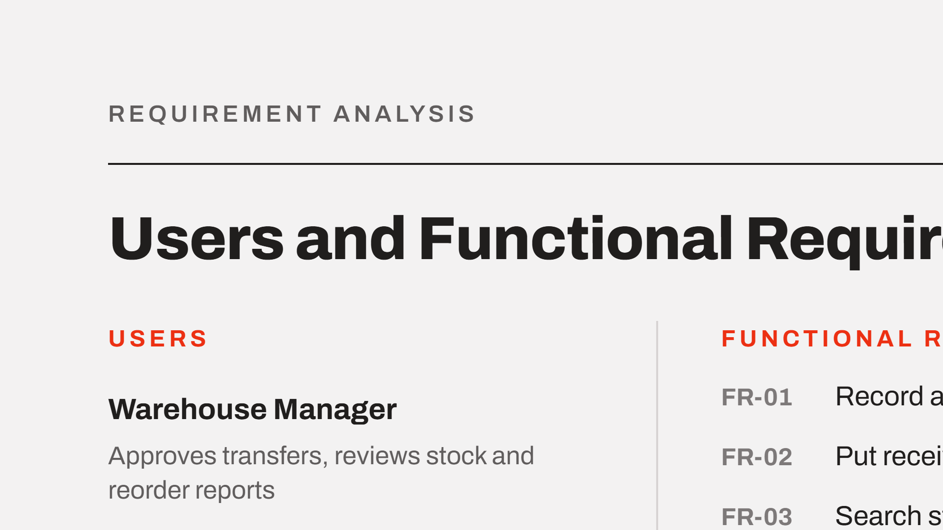
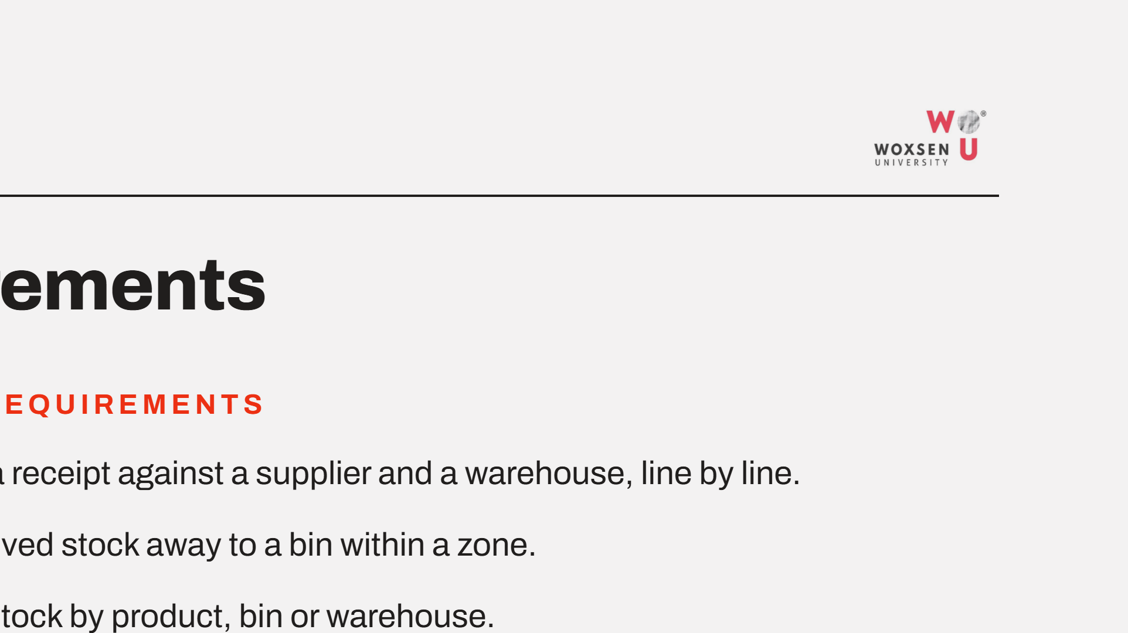
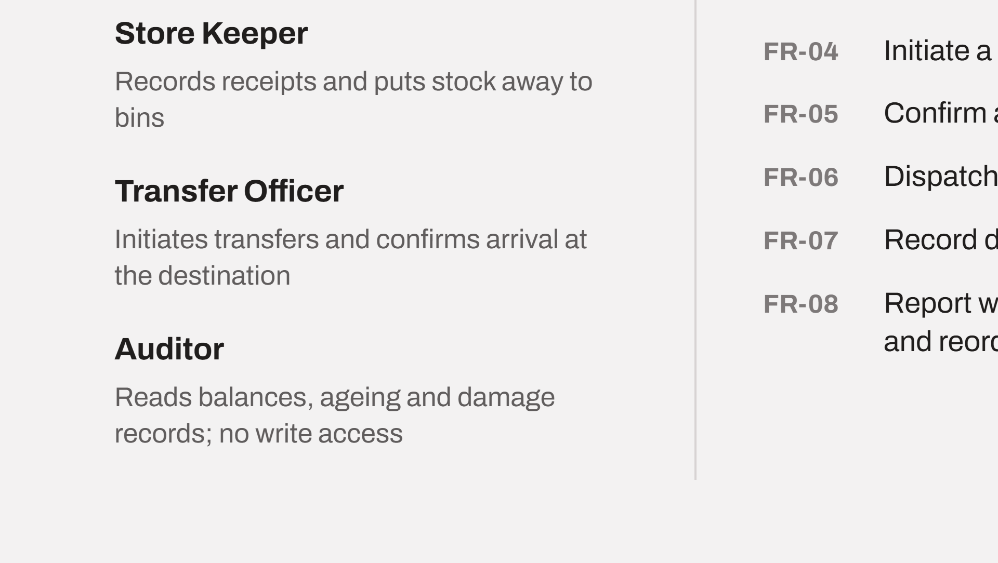
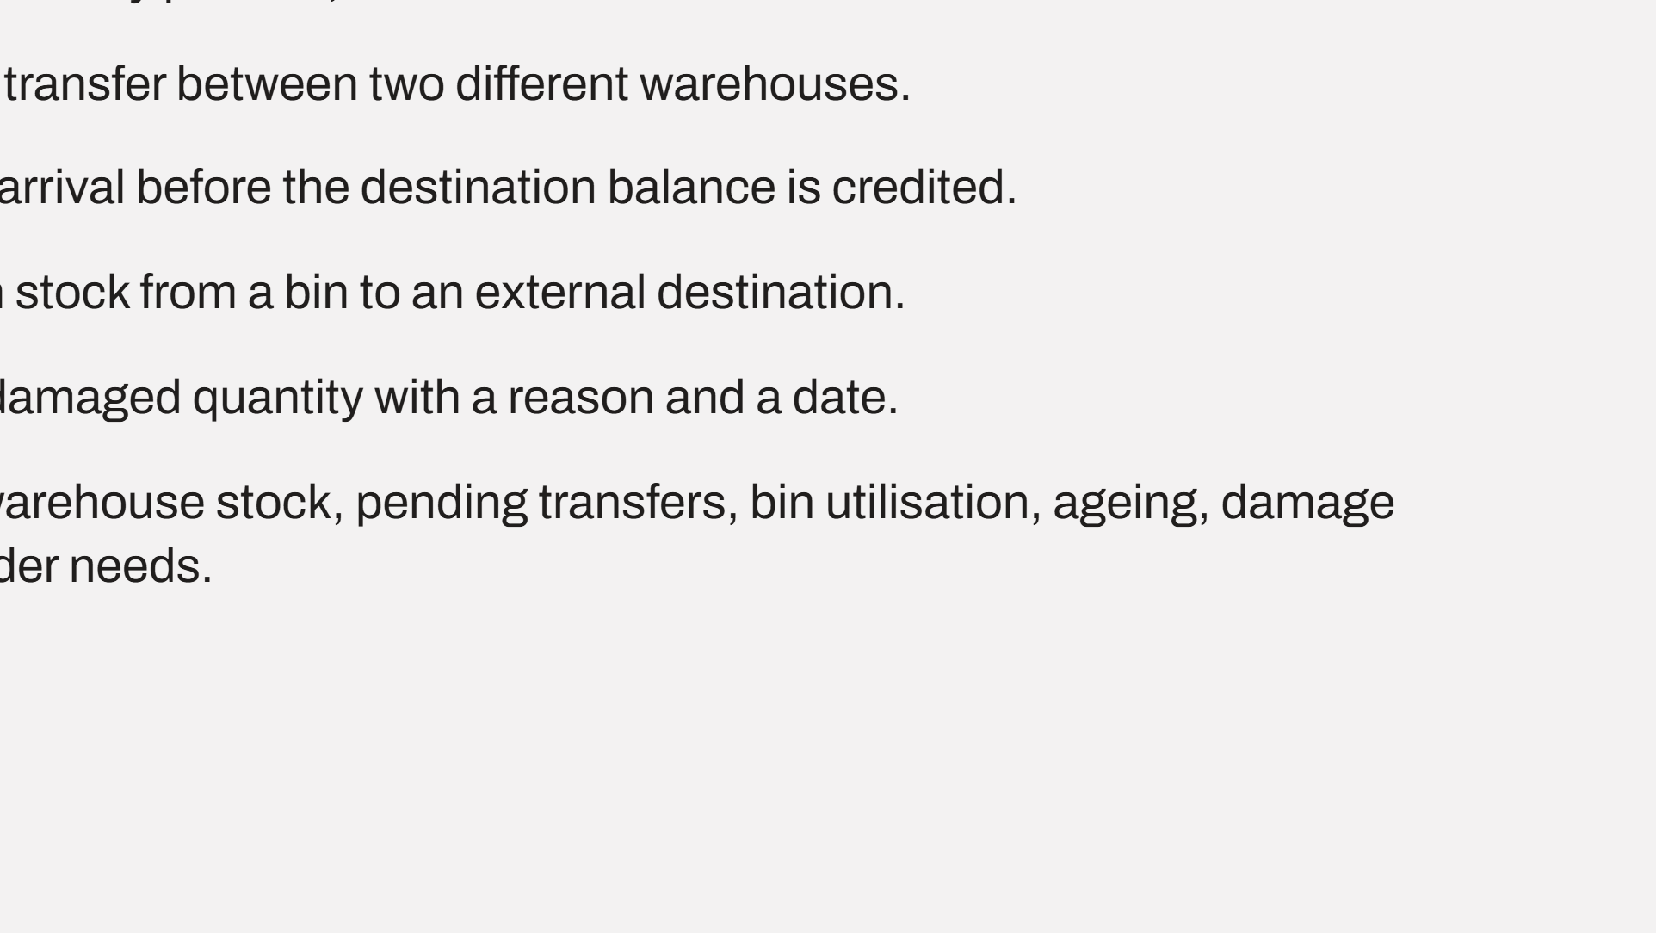
Notes:
Four roles. The Transfer Officer and the Auditor matter most for integrity: one raises and confirms movement, the other only reads. Eight functional requirements follow the physical flow of stock.

Slide 4

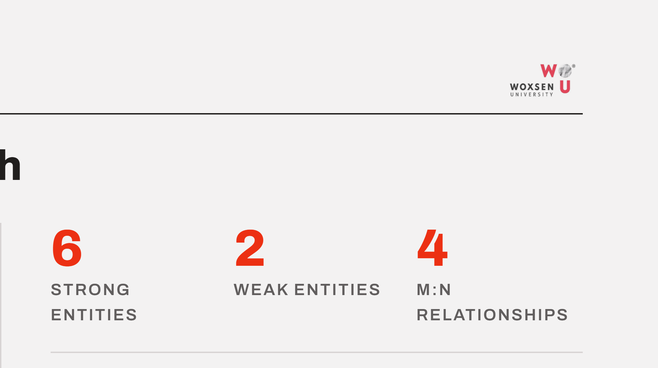
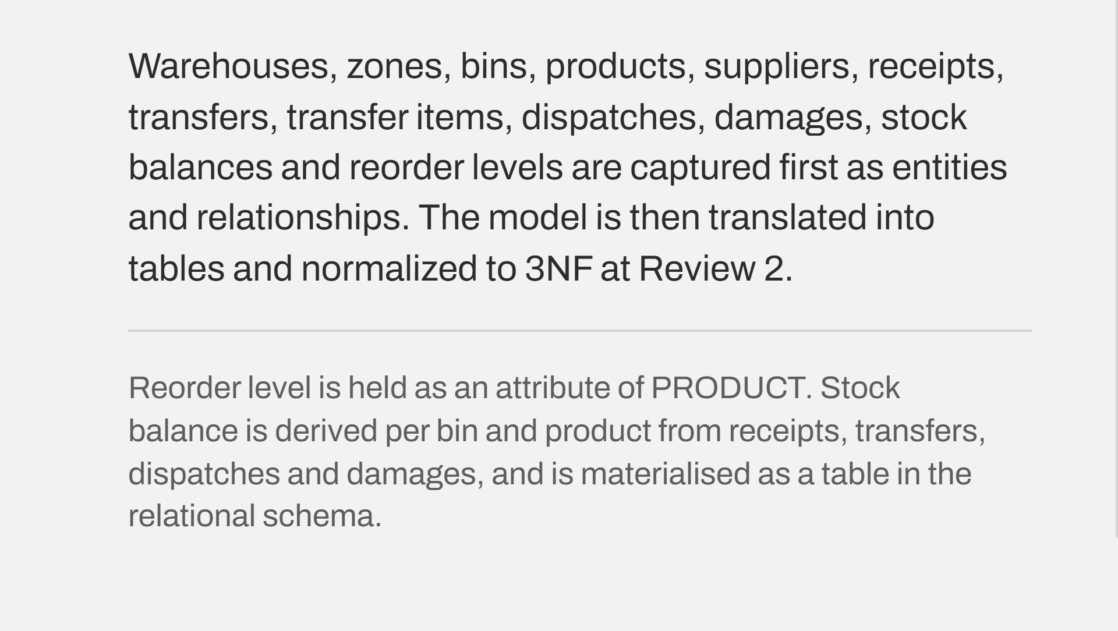
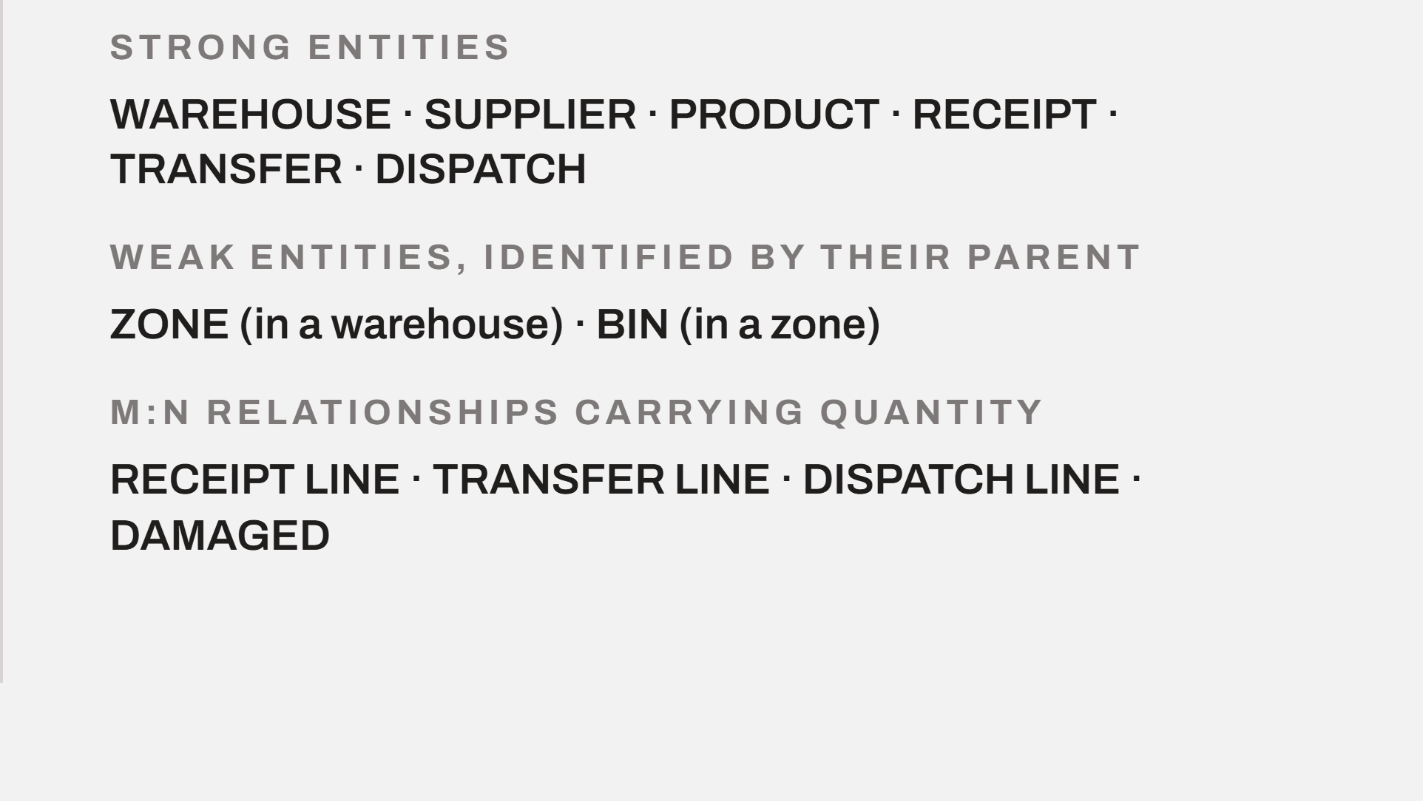
Notes:
The model is drawn in Chen's notation before any normalization. Zone and bin are weak entities identified through their parent. Reorder level sits on product; stock balance is derived per bin and product and is materialised as a table in the relational schema.

Slide 5
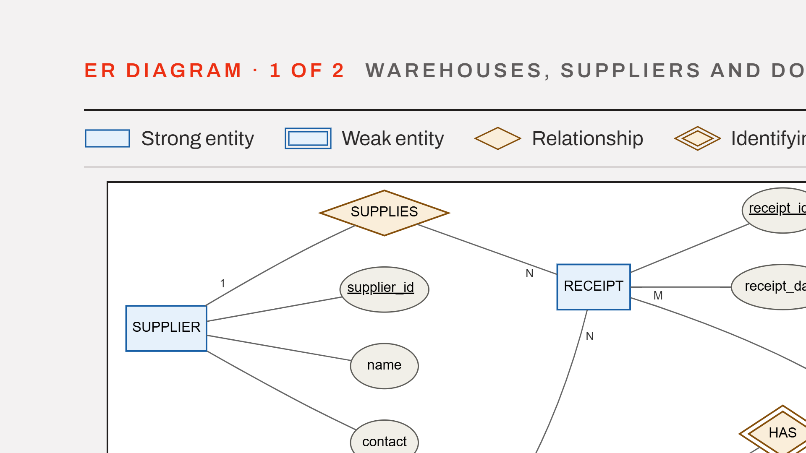
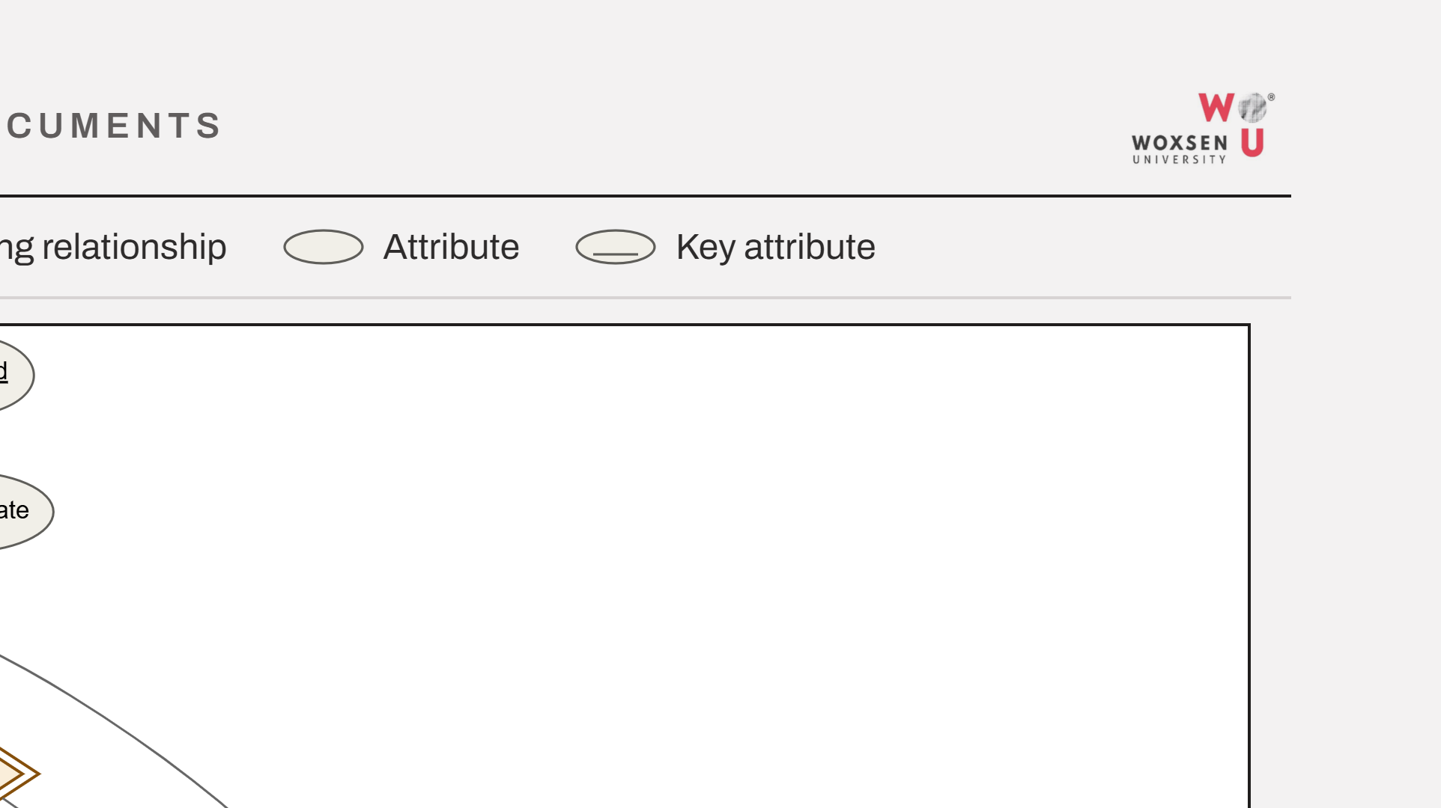
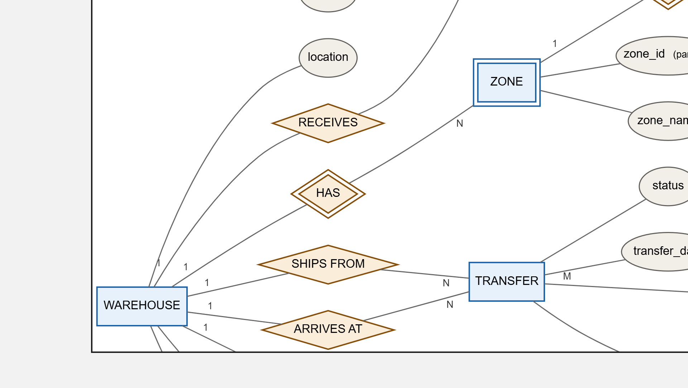
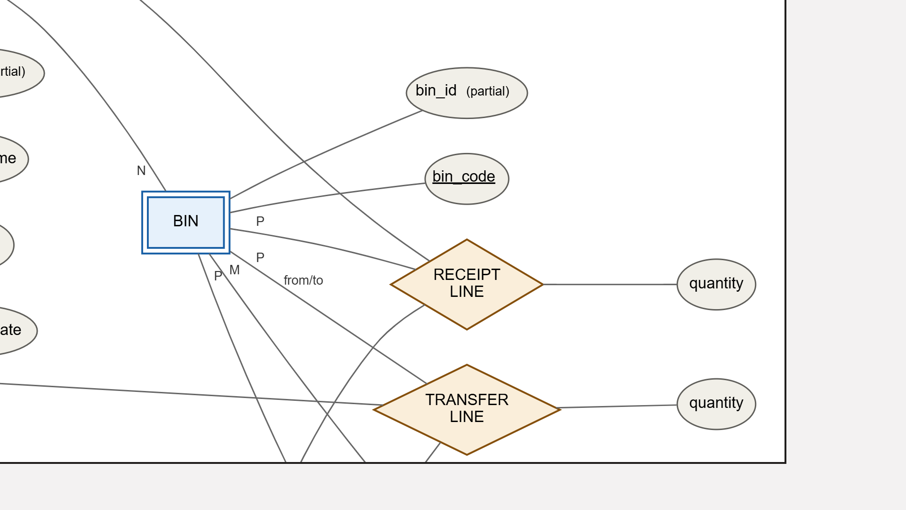
Notes:
The upper half of the model at one and a half times scale. Supplier and receipt at the top, the warehouse with its zones and bins on the left, and the transfer with its source and destination roles across the middle band.

Slide 6
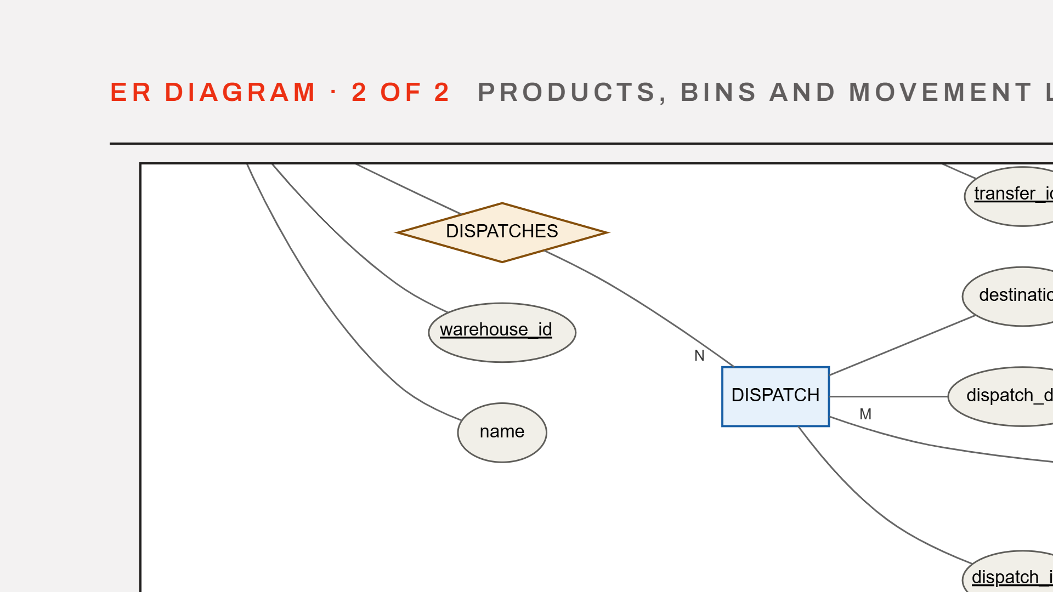
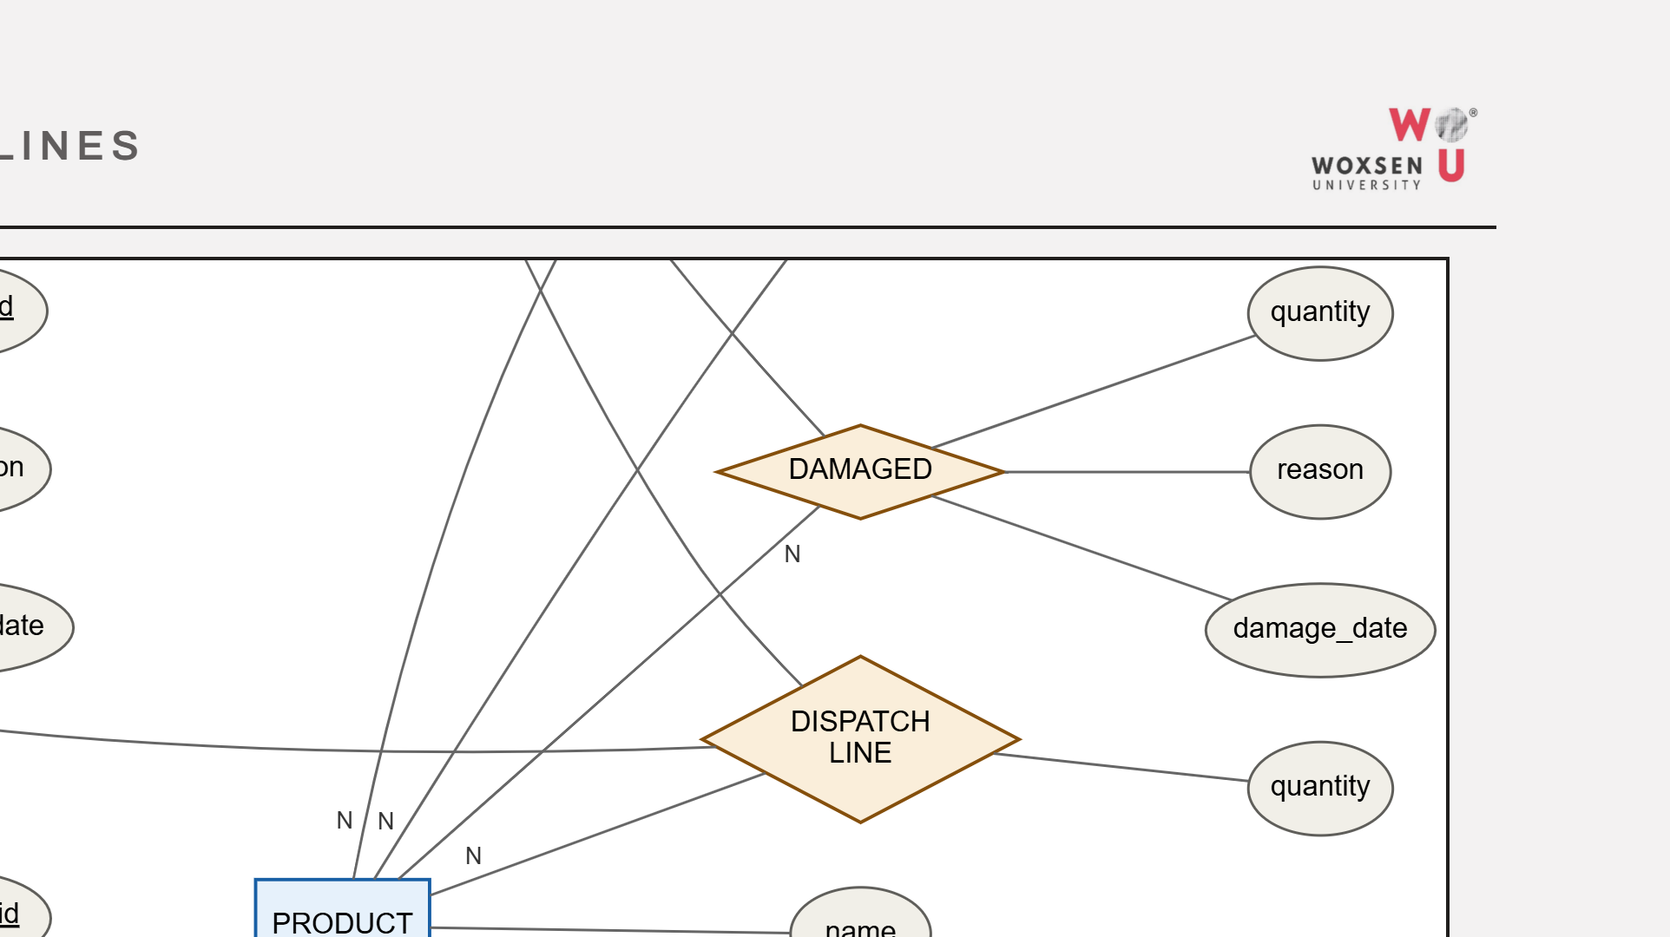
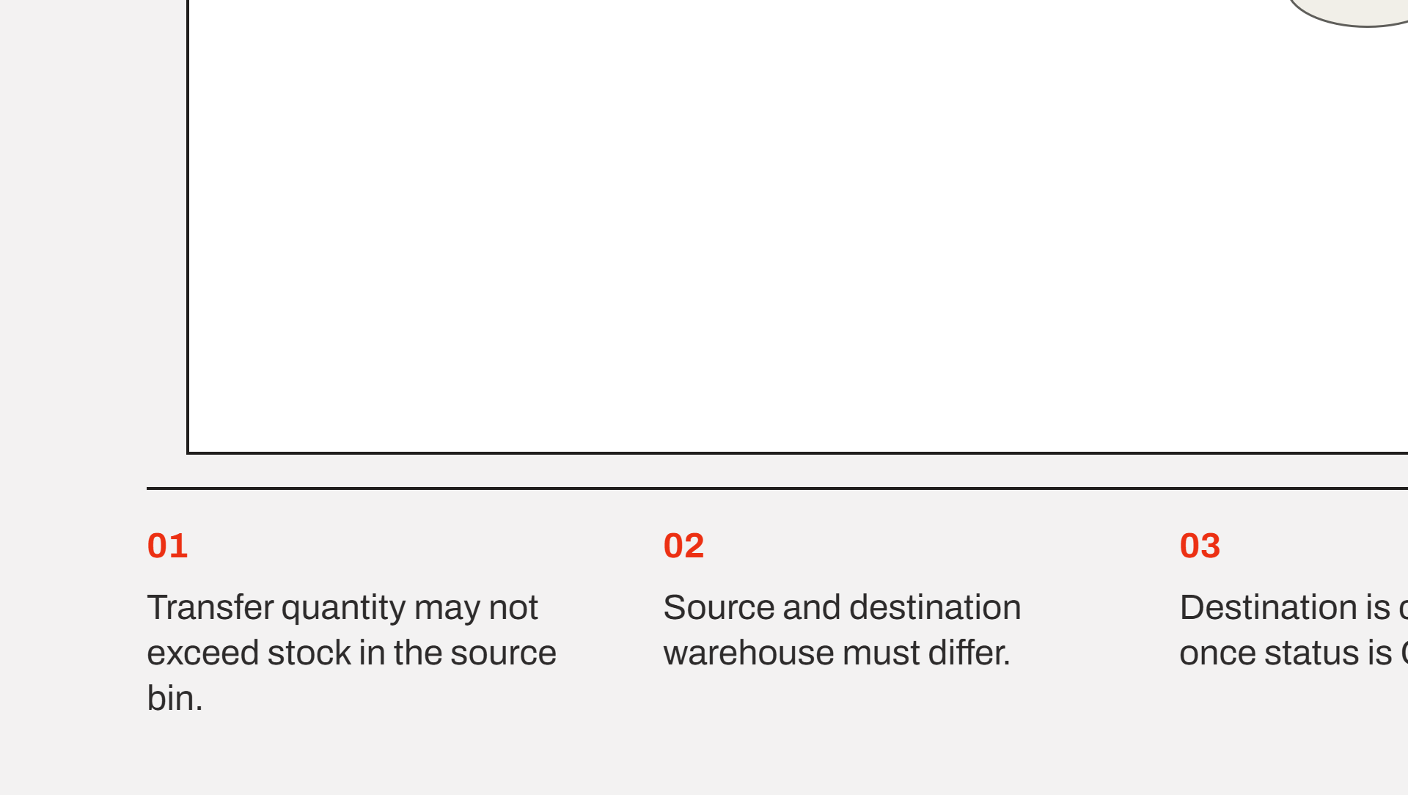
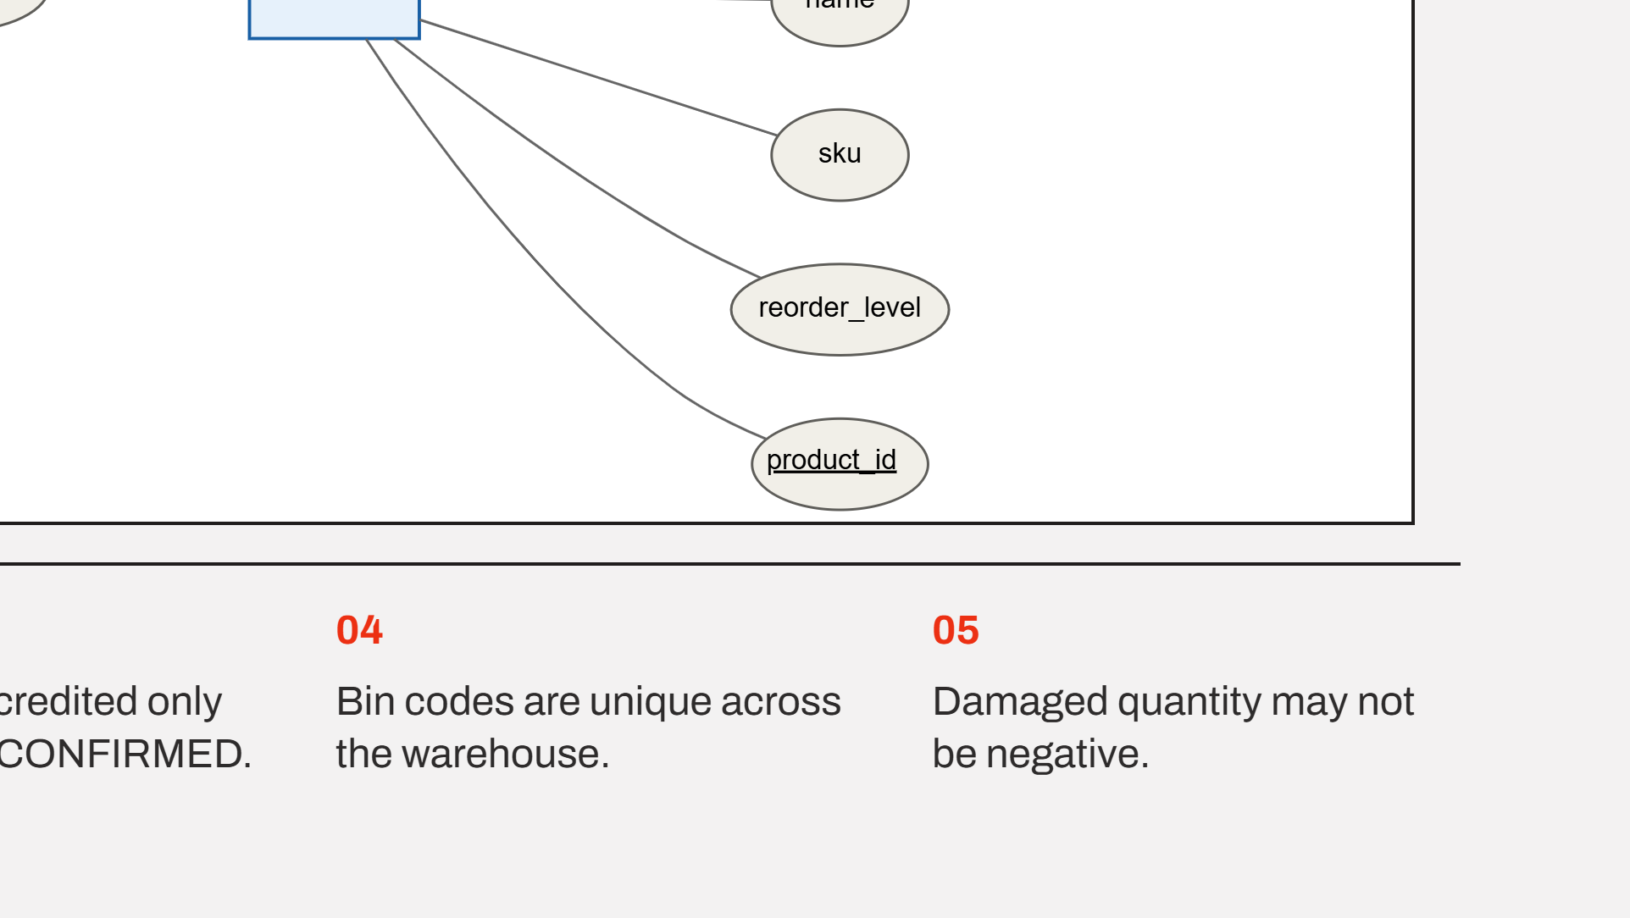
Notes:
The lower half, continuing from the warehouse band. Dispatch on the left, product on the right, and the four quantity-carrying relationships down the middle. The five business rules below are what the constraints will enforce at Review 2.

Slide 7
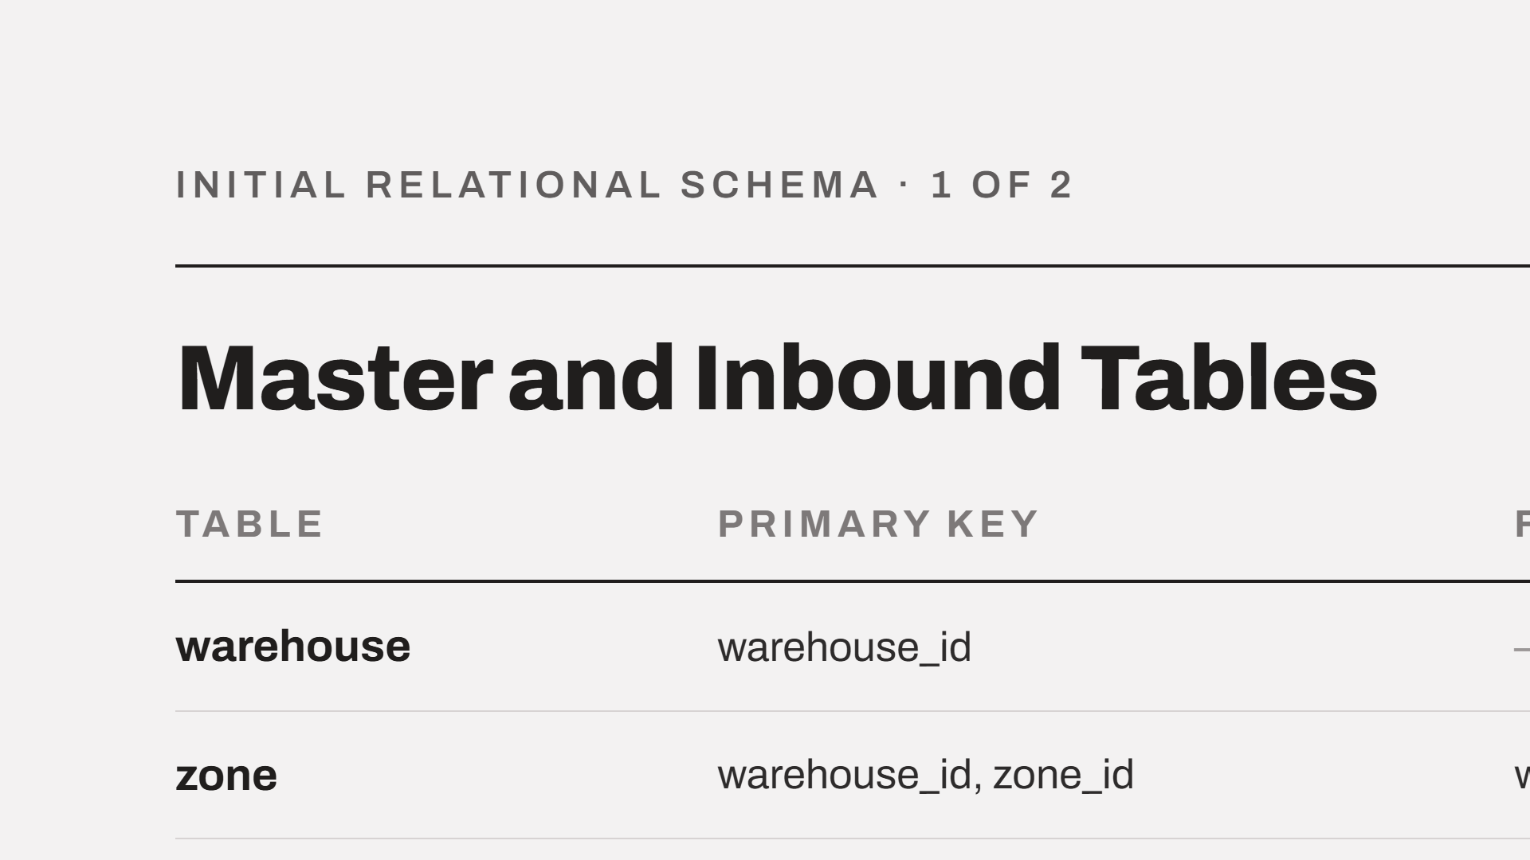
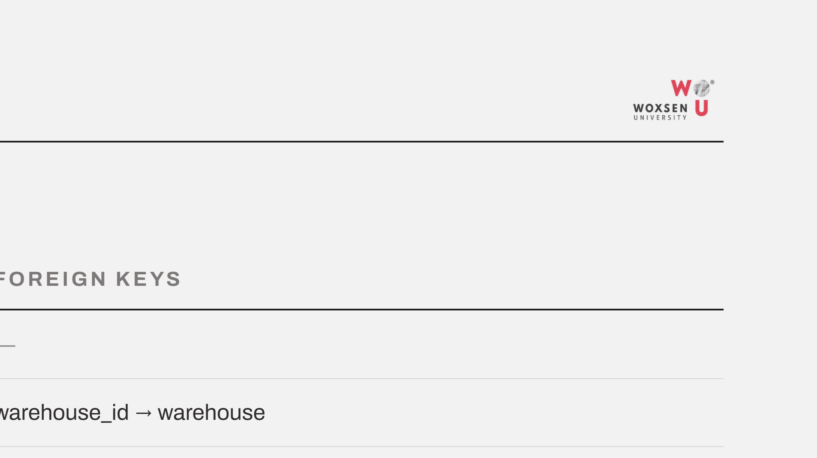
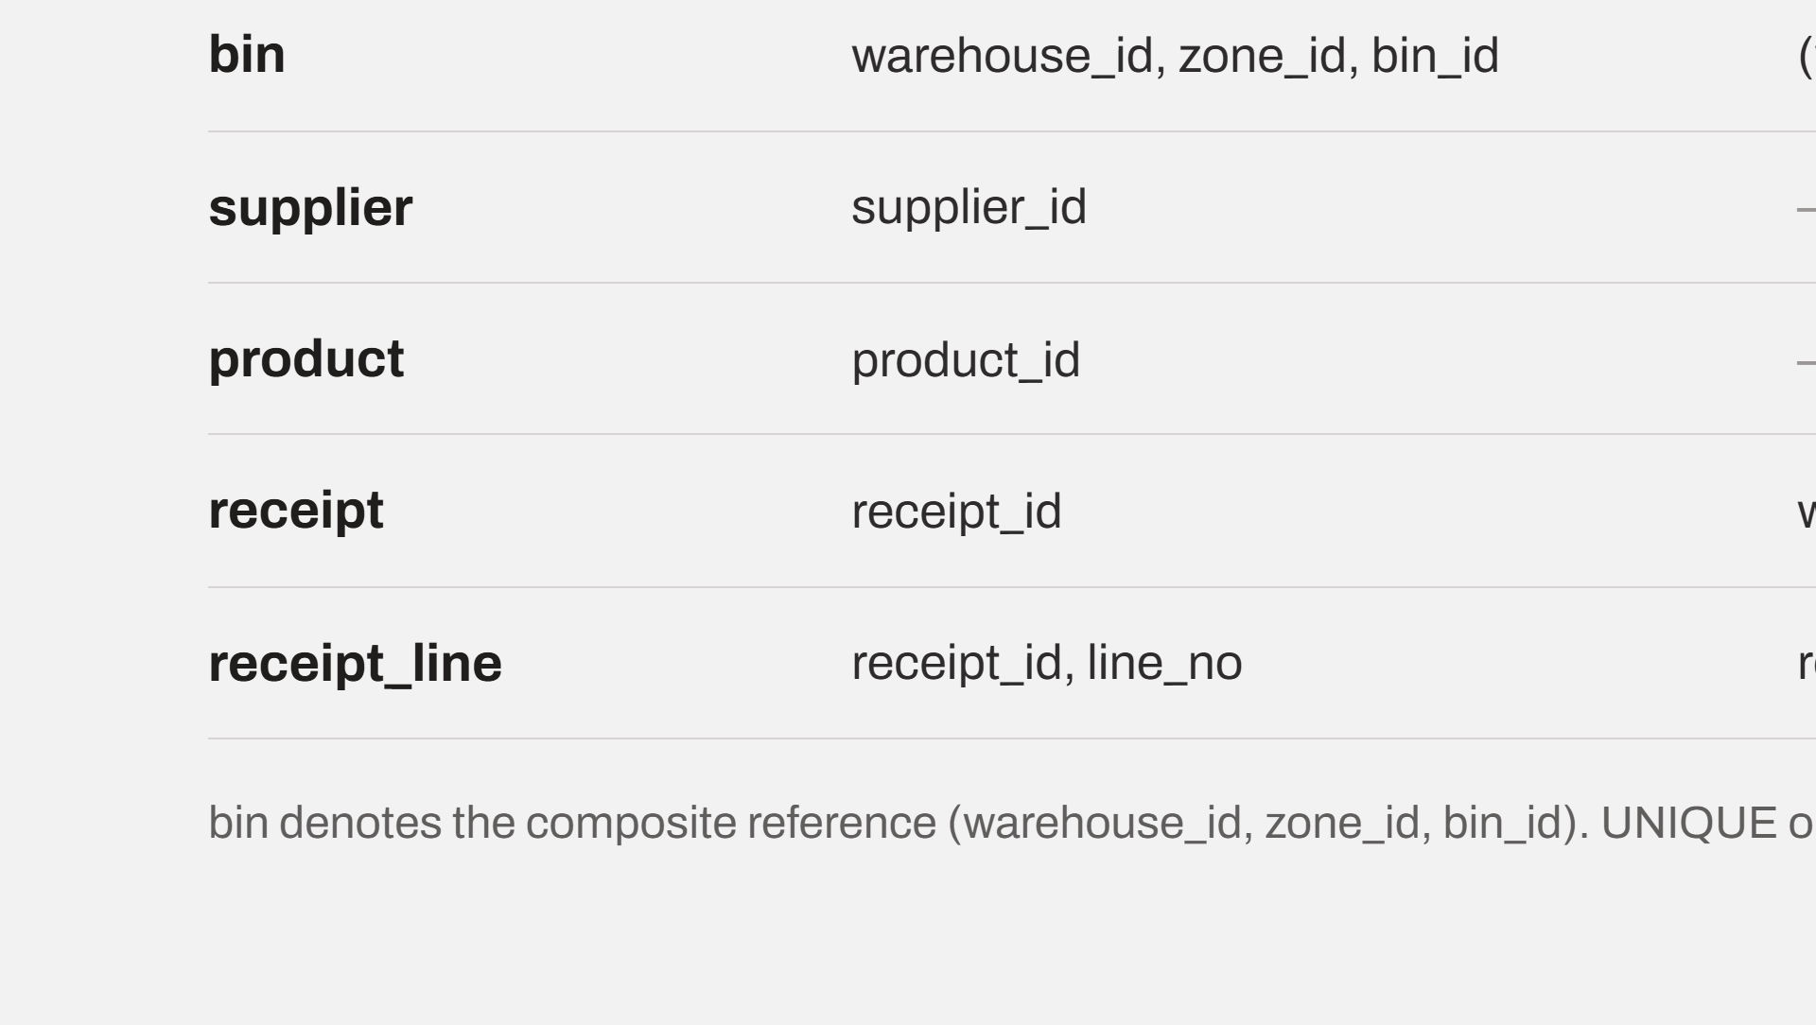
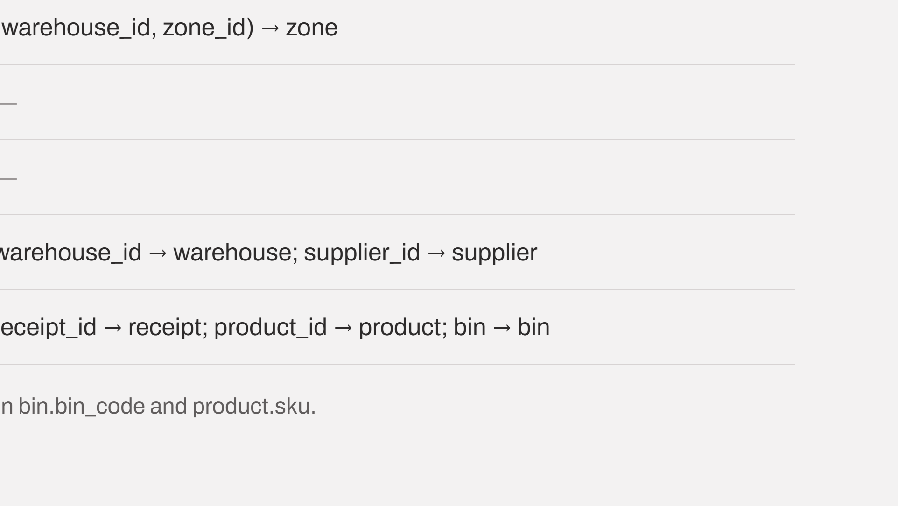
Notes:
Seven tables covering the master data and the inbound flow. Zone and bin inherit their parent keys, which is how the weak entities become composite primary keys.

Slide 8
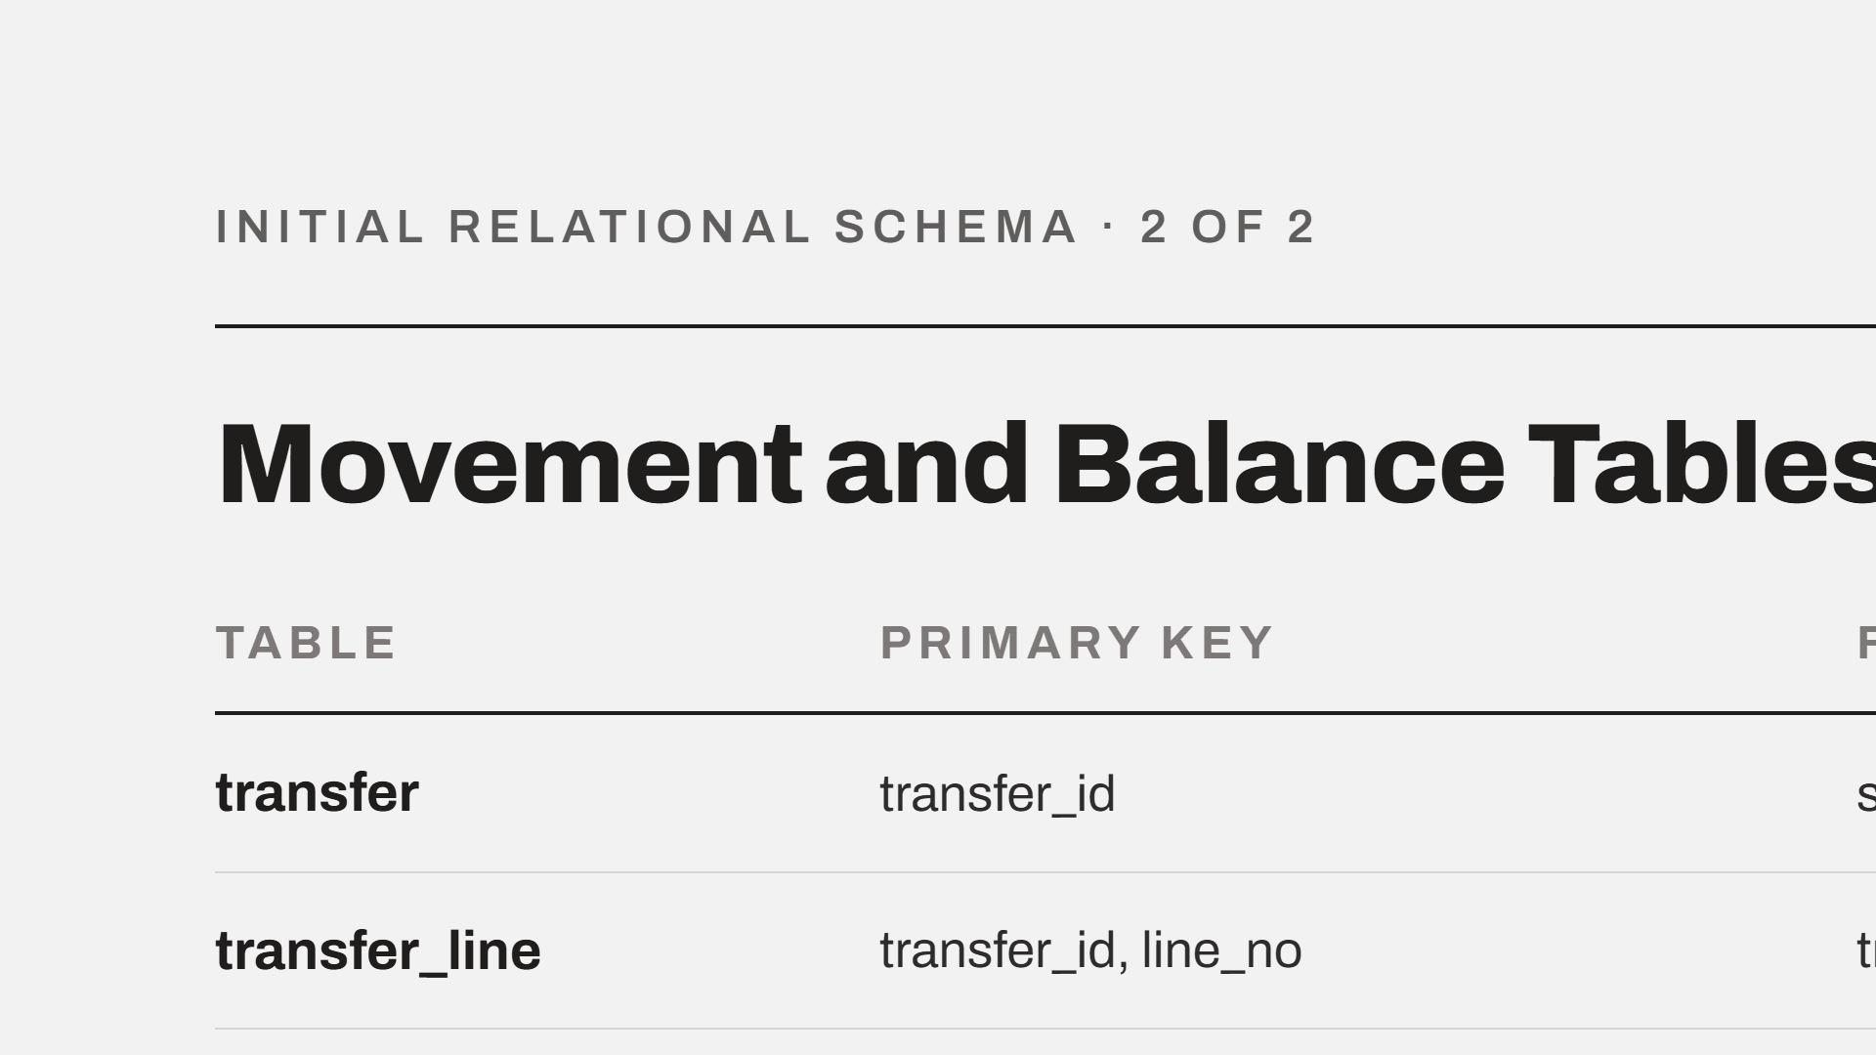
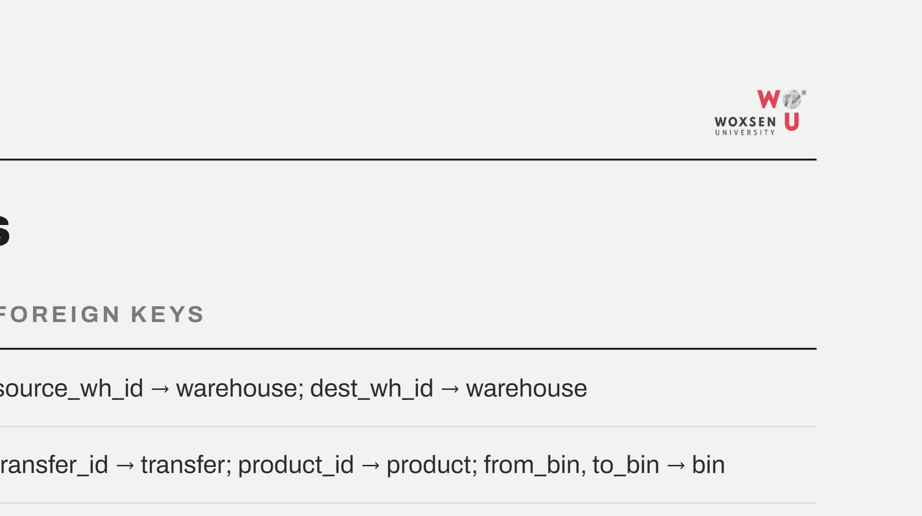
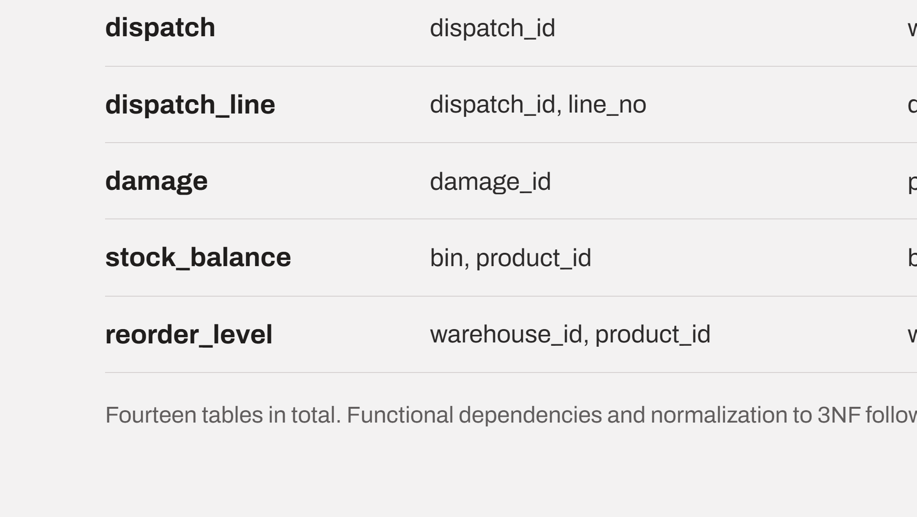
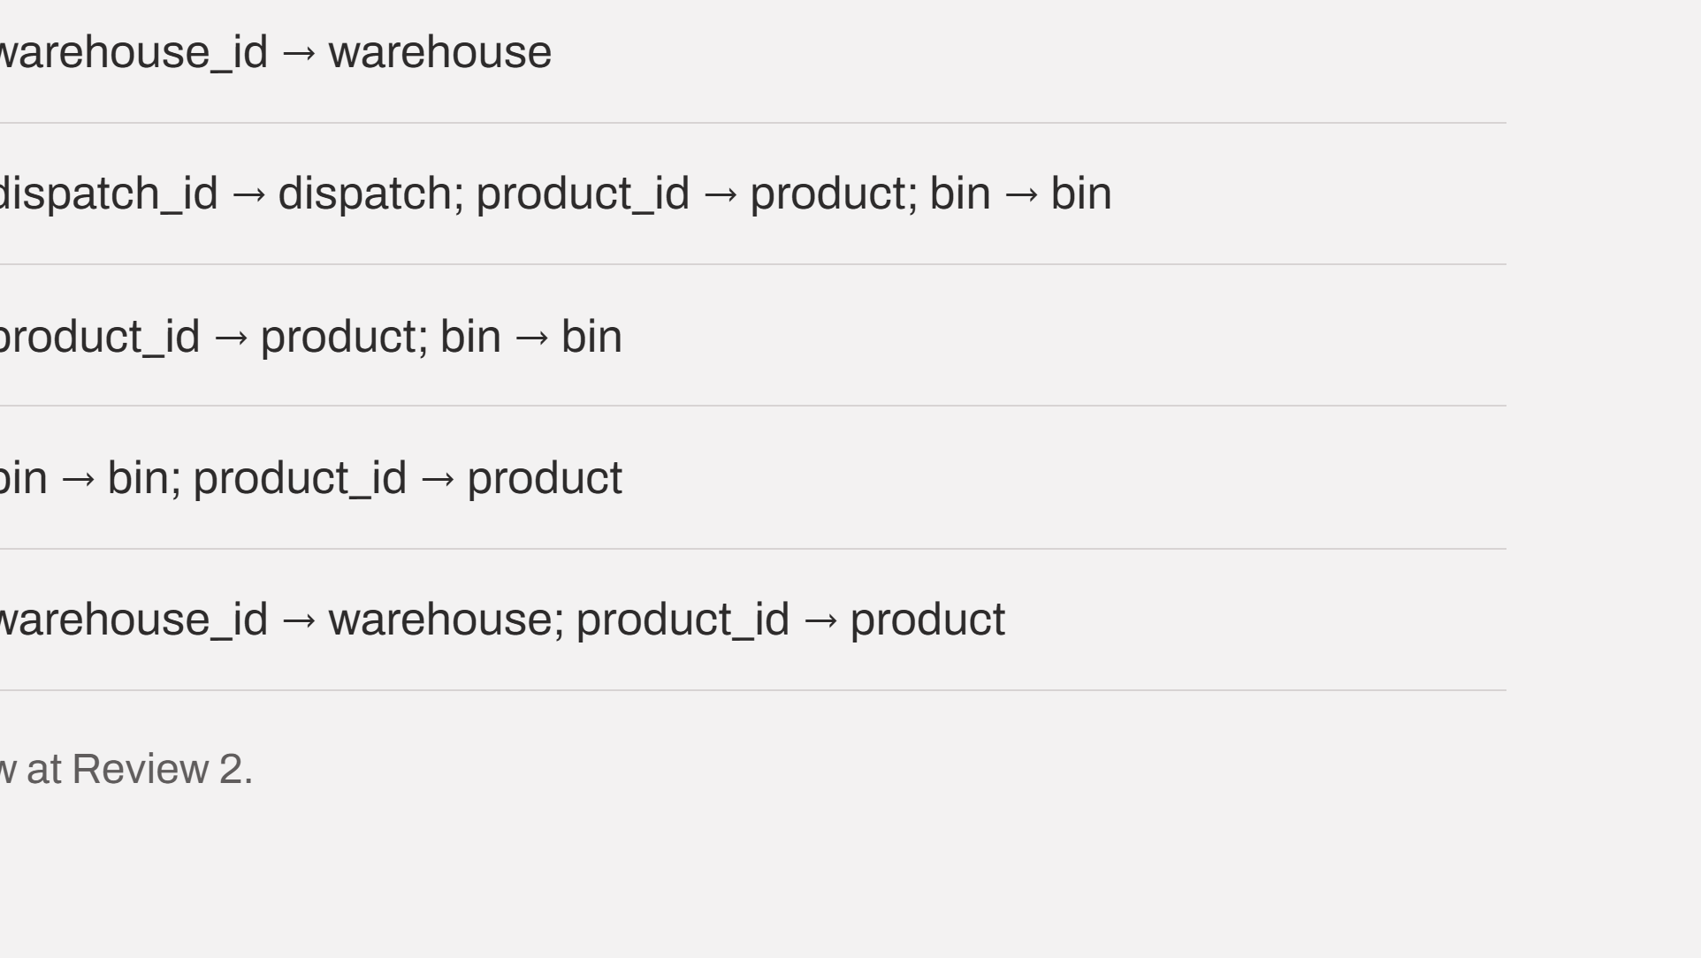
Notes:
The movement tables. Transfer carries two foreign keys into warehouse, which is how the distinct source and destination roles are represented. Stock balance is keyed by bin and product; reorder level by warehouse and product.

Slide 9




Notes:
Thank you. I am happy to take questions on the model or the schema.

