Slide 1
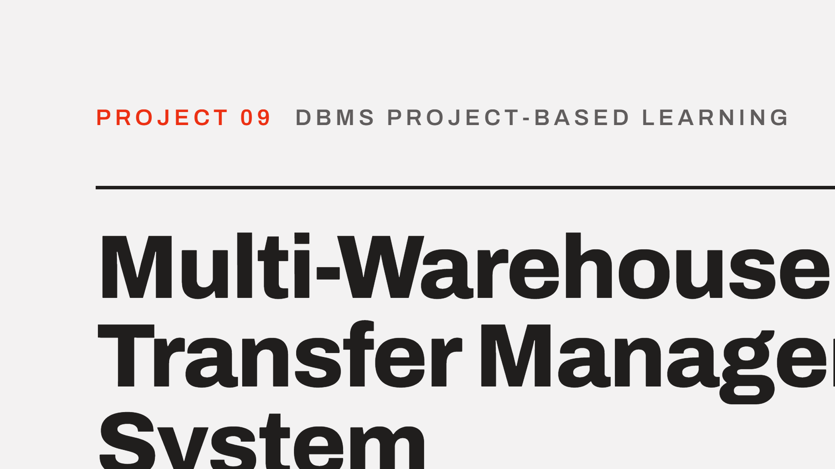

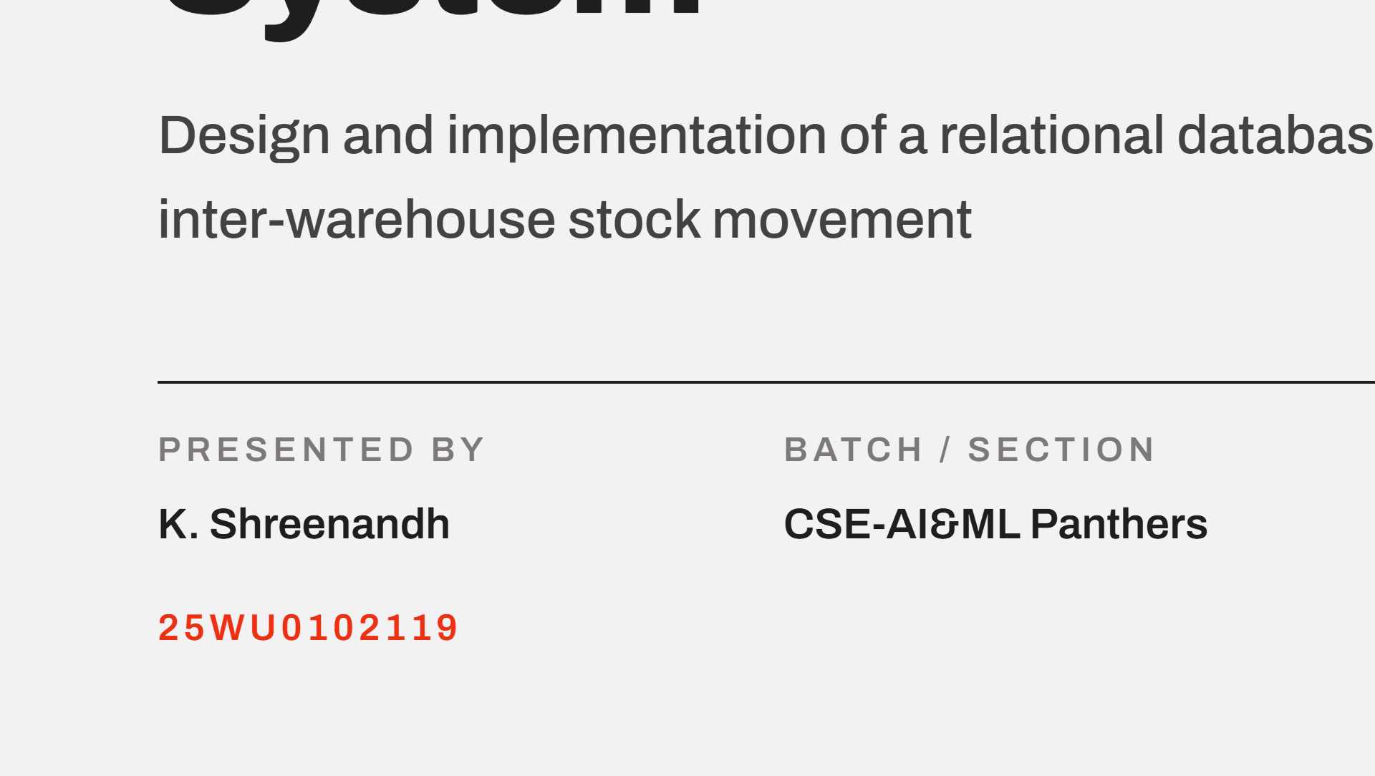

Notes:
Good morning. Project 09, Review 2. I will cover the design foundations in brief, the ER model, the final implemented relational schema, how the business rules are enforced, and the triggers and stock view.

Slide 2
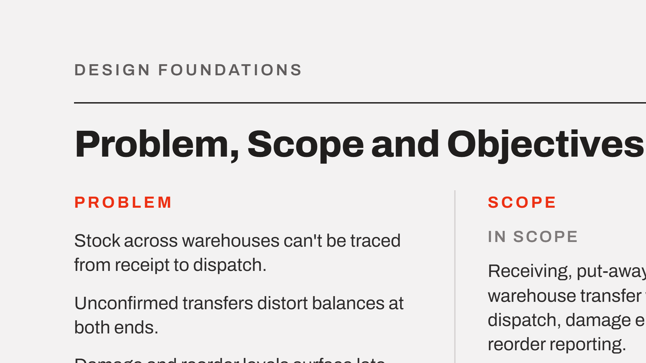
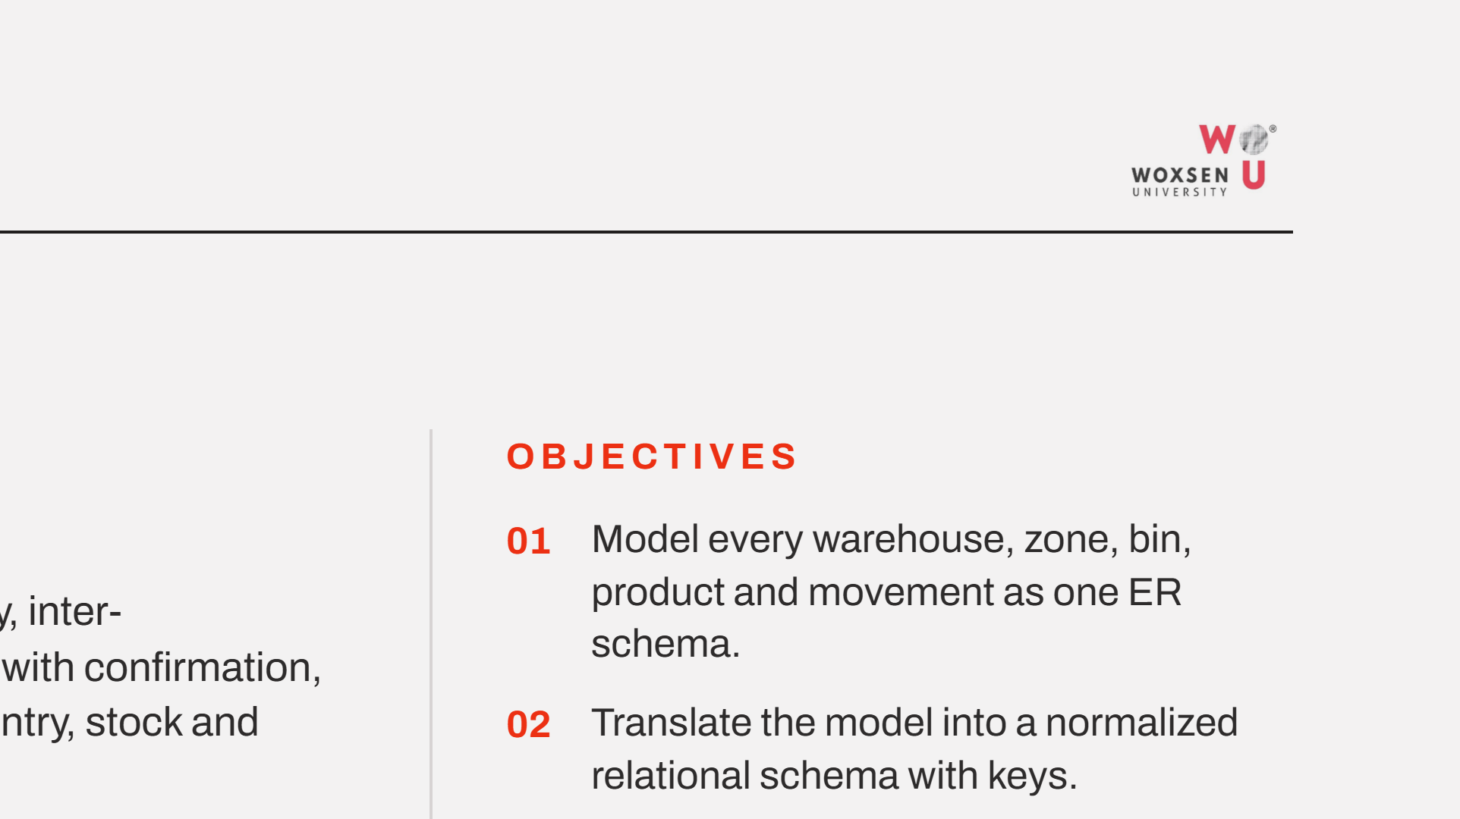
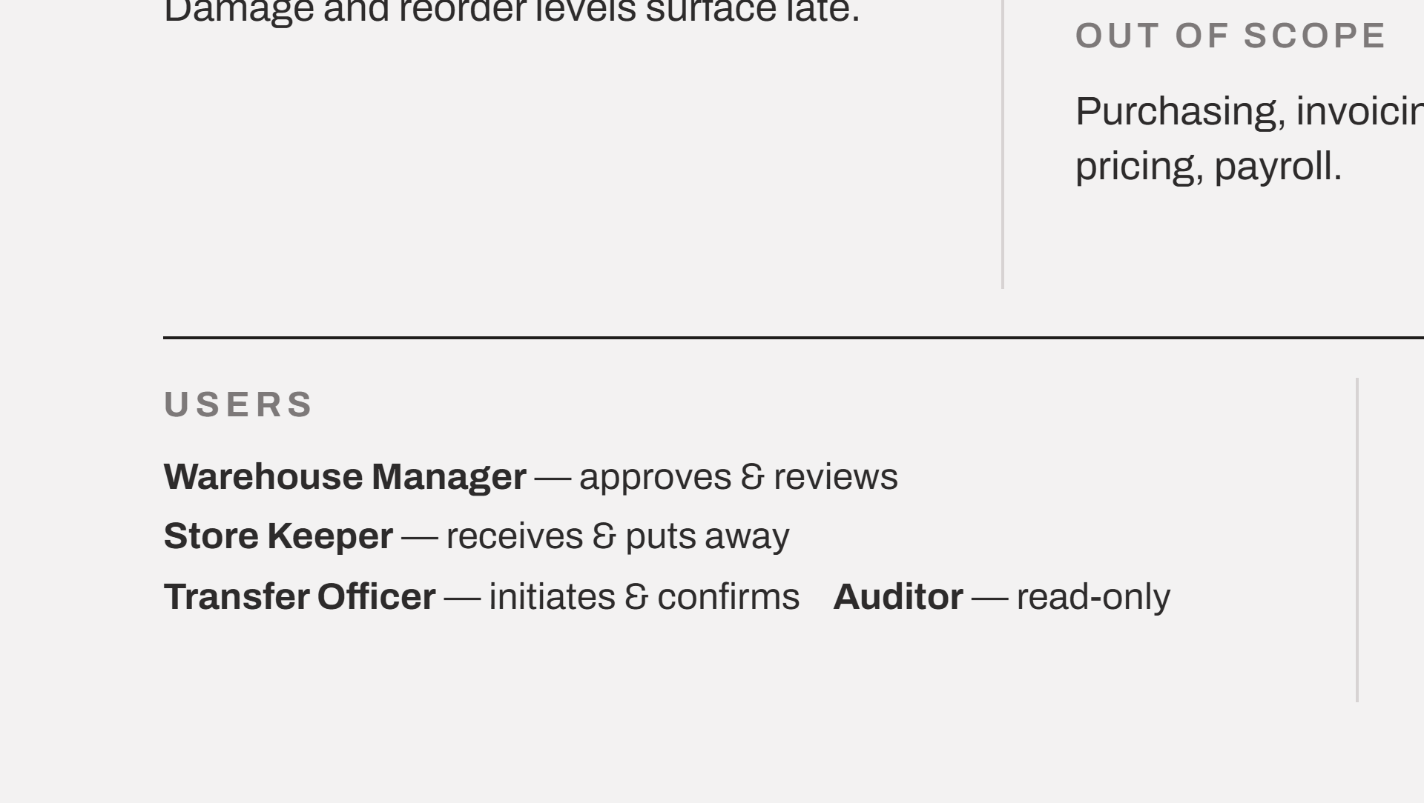
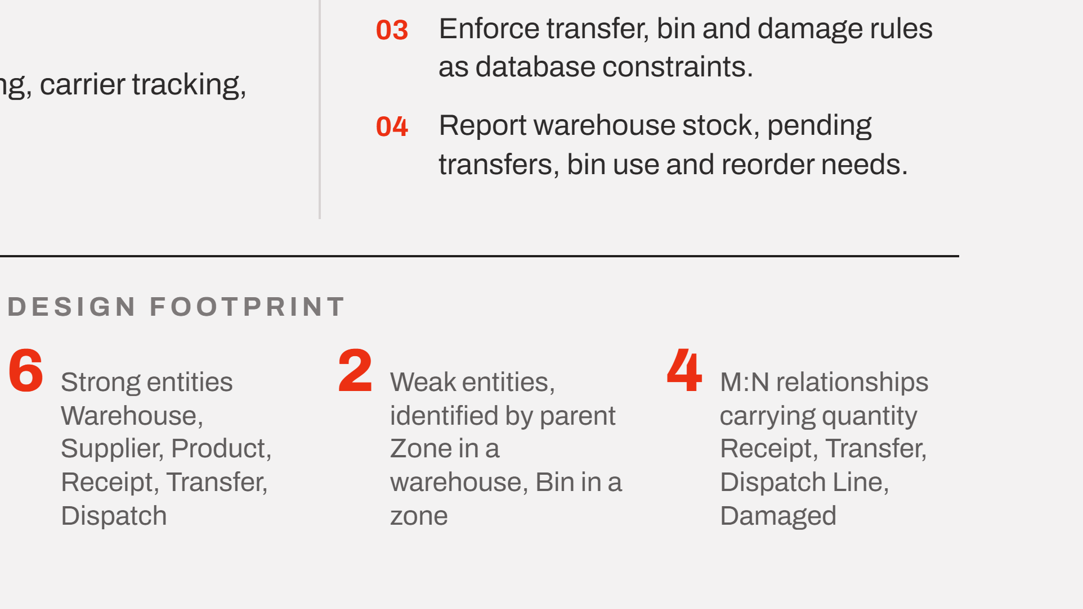
Notes:
A quick recap of the foundations carried forward from Review 1. The core defect is the unconfirmed transfer: stock has left the source but is not acknowledged at the destination, so it is counted twice or lost. Scope stays on physical movement. Four roles, four objectives, and the entity counts the ER model is built on.

Slide 3
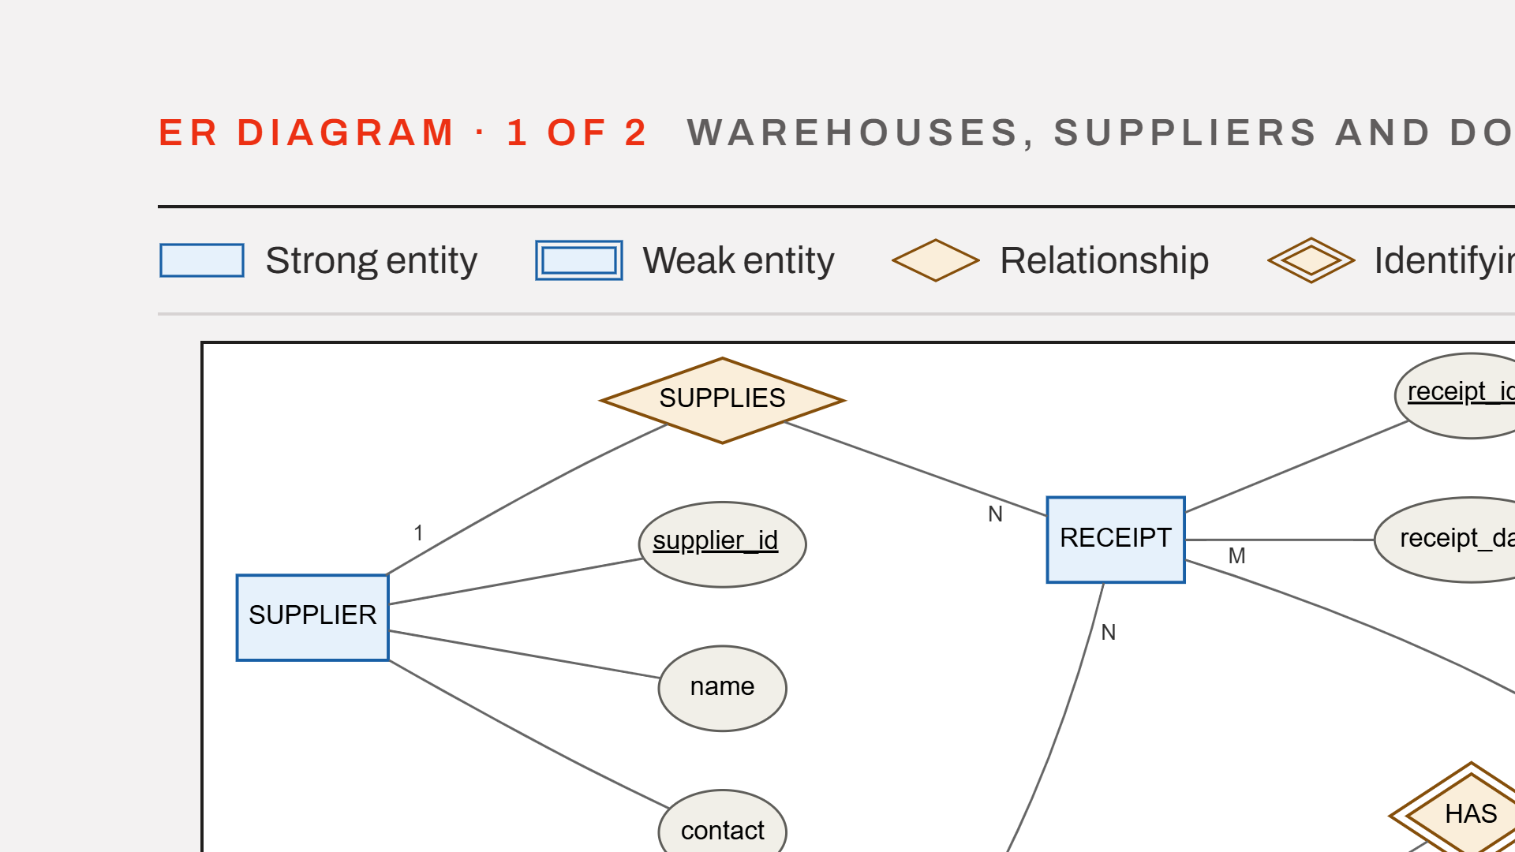
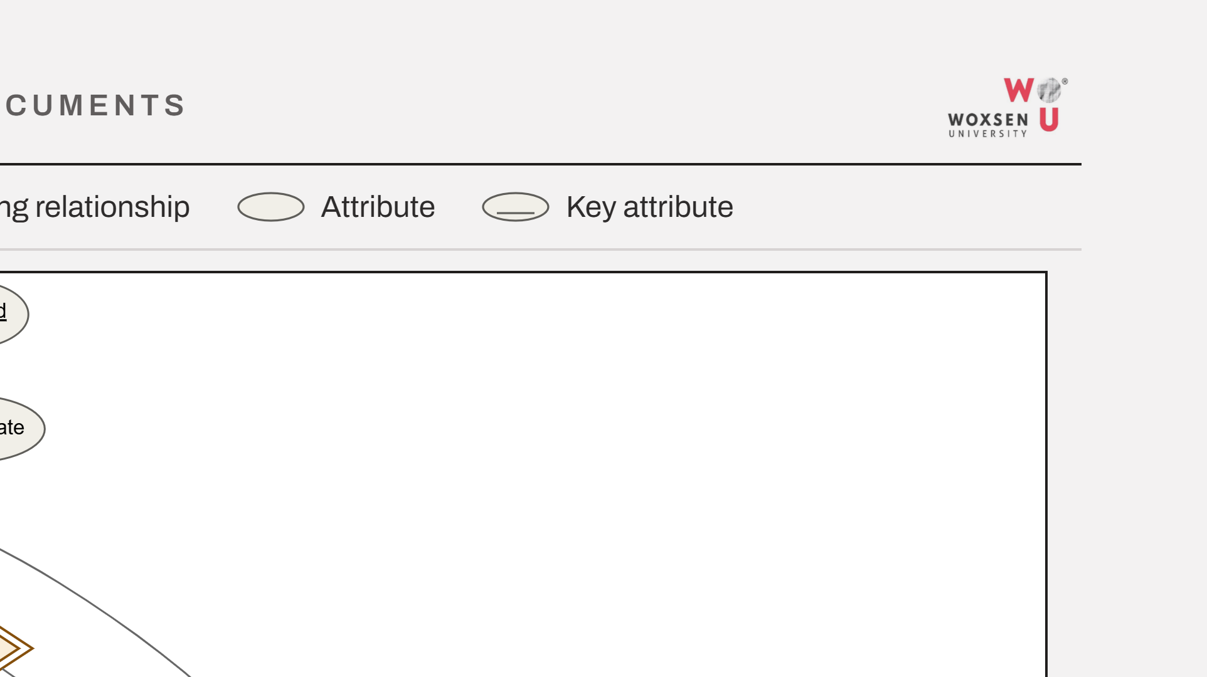
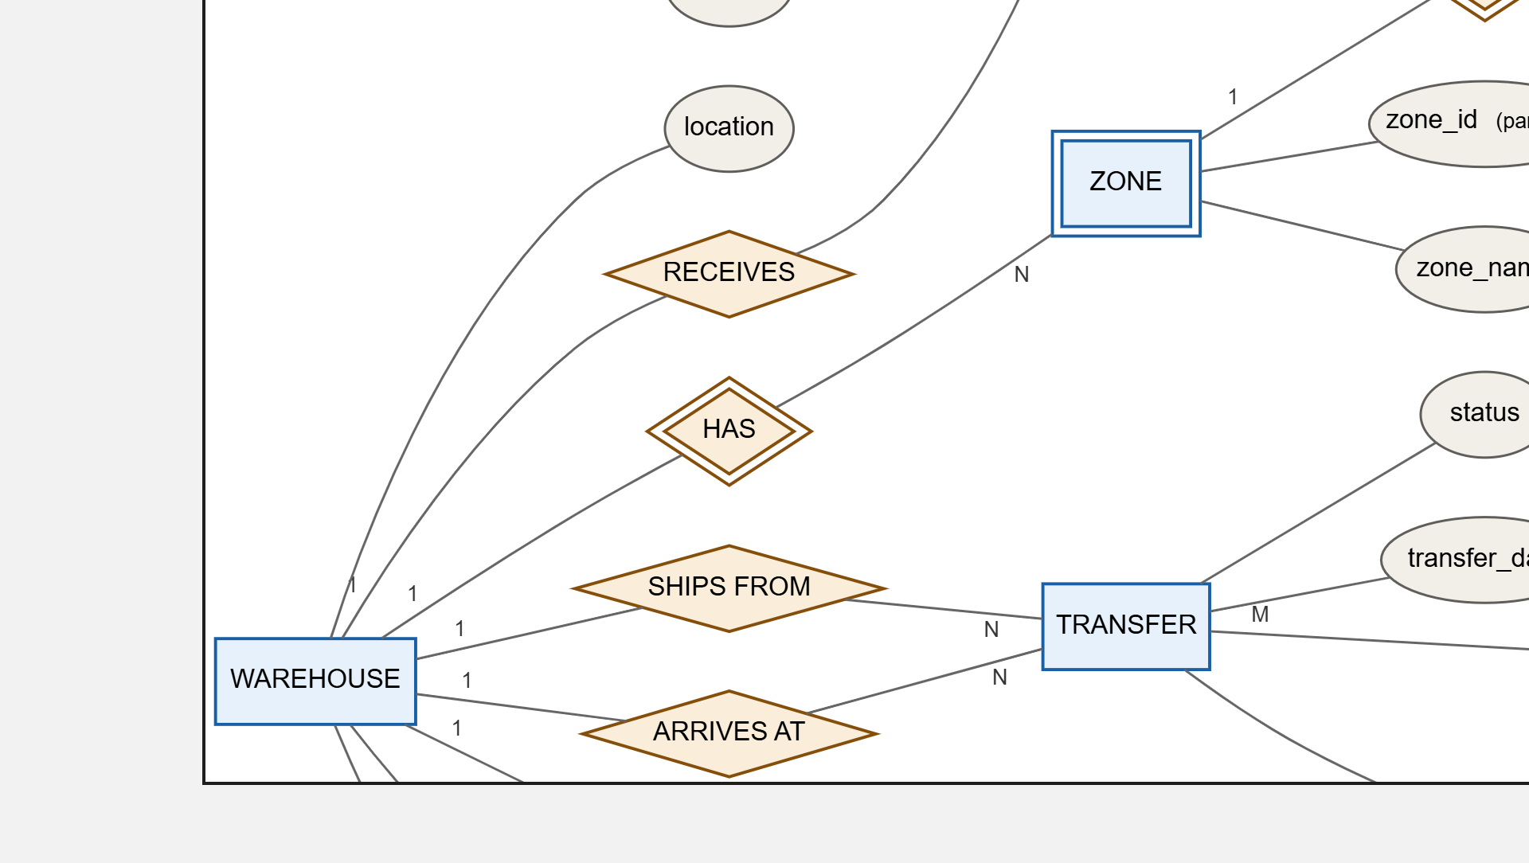
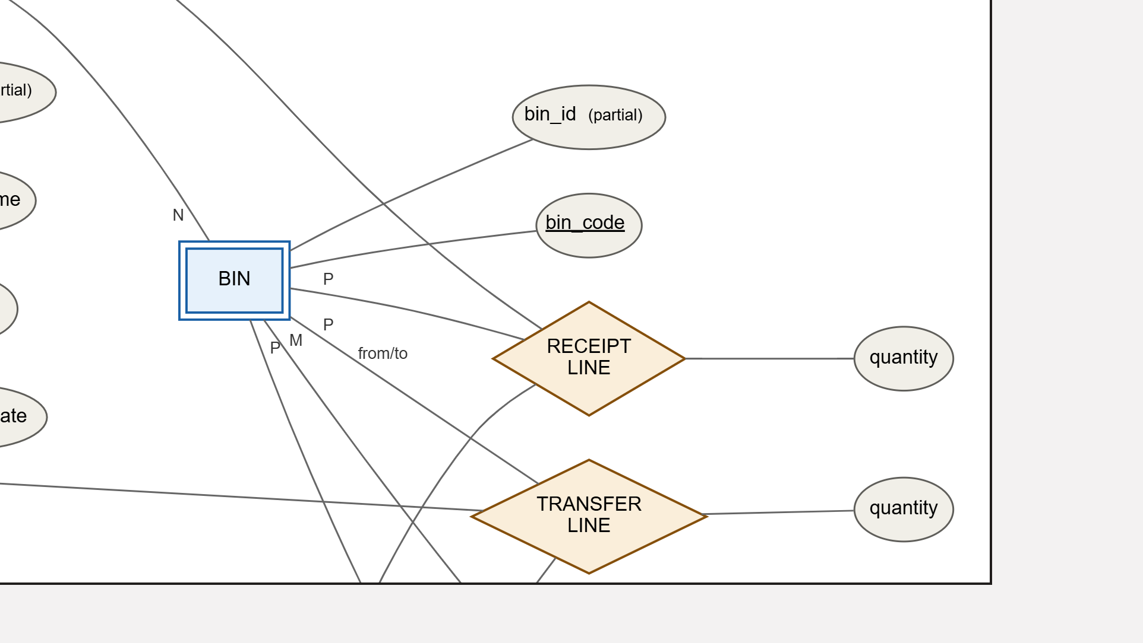
Notes:
The upper half of the model at one and a half times scale. Supplier and receipt at the top, the warehouse with its zones and bins on the left, and the transfer with its source and destination roles across the middle band.

Slide 4
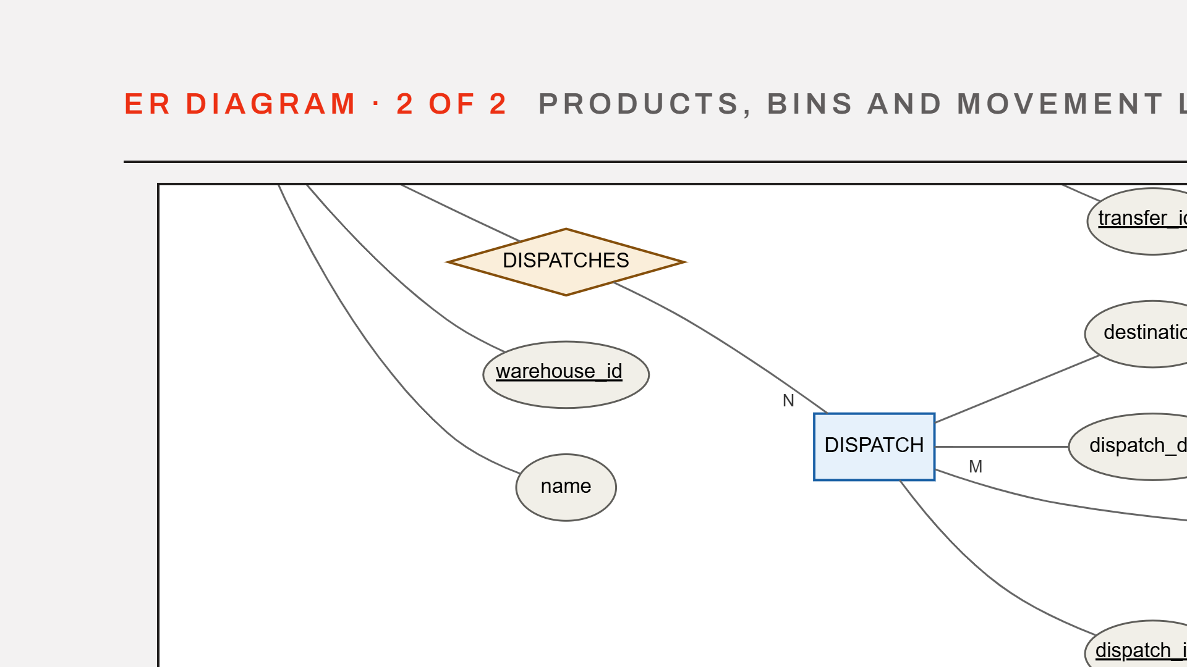
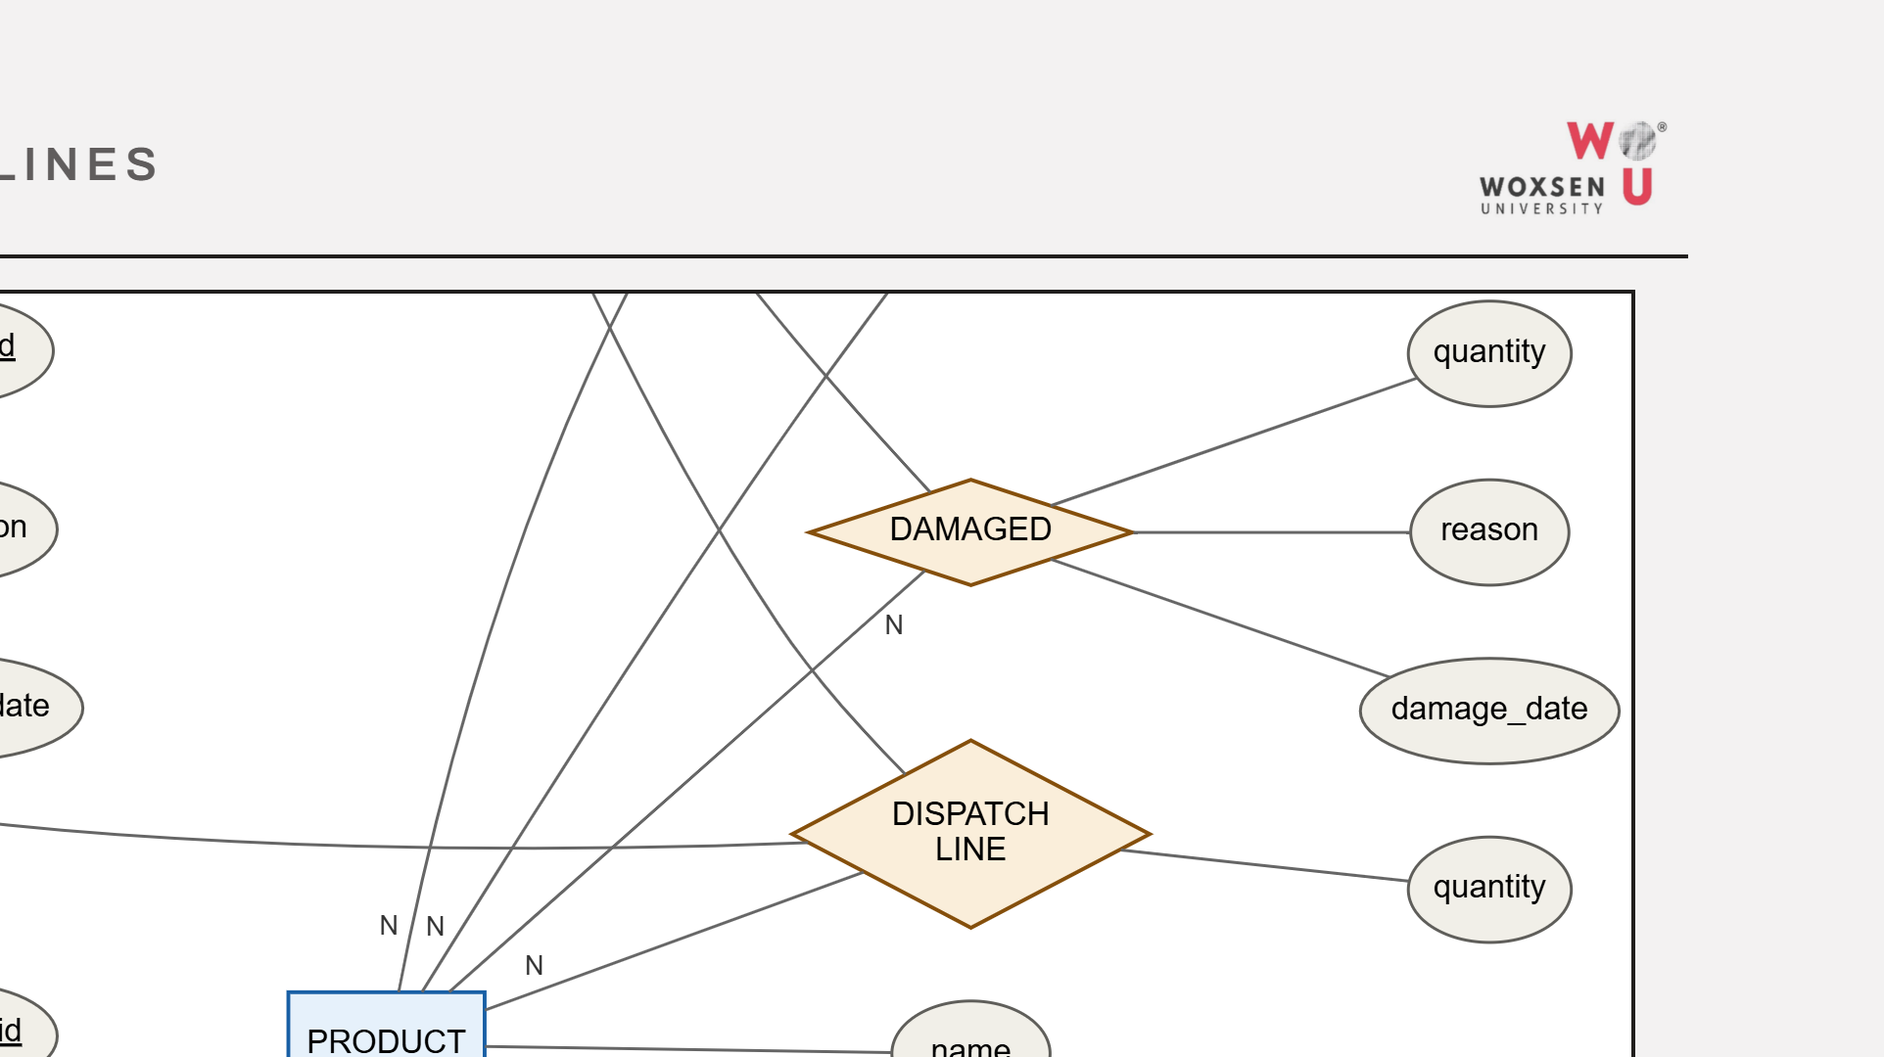
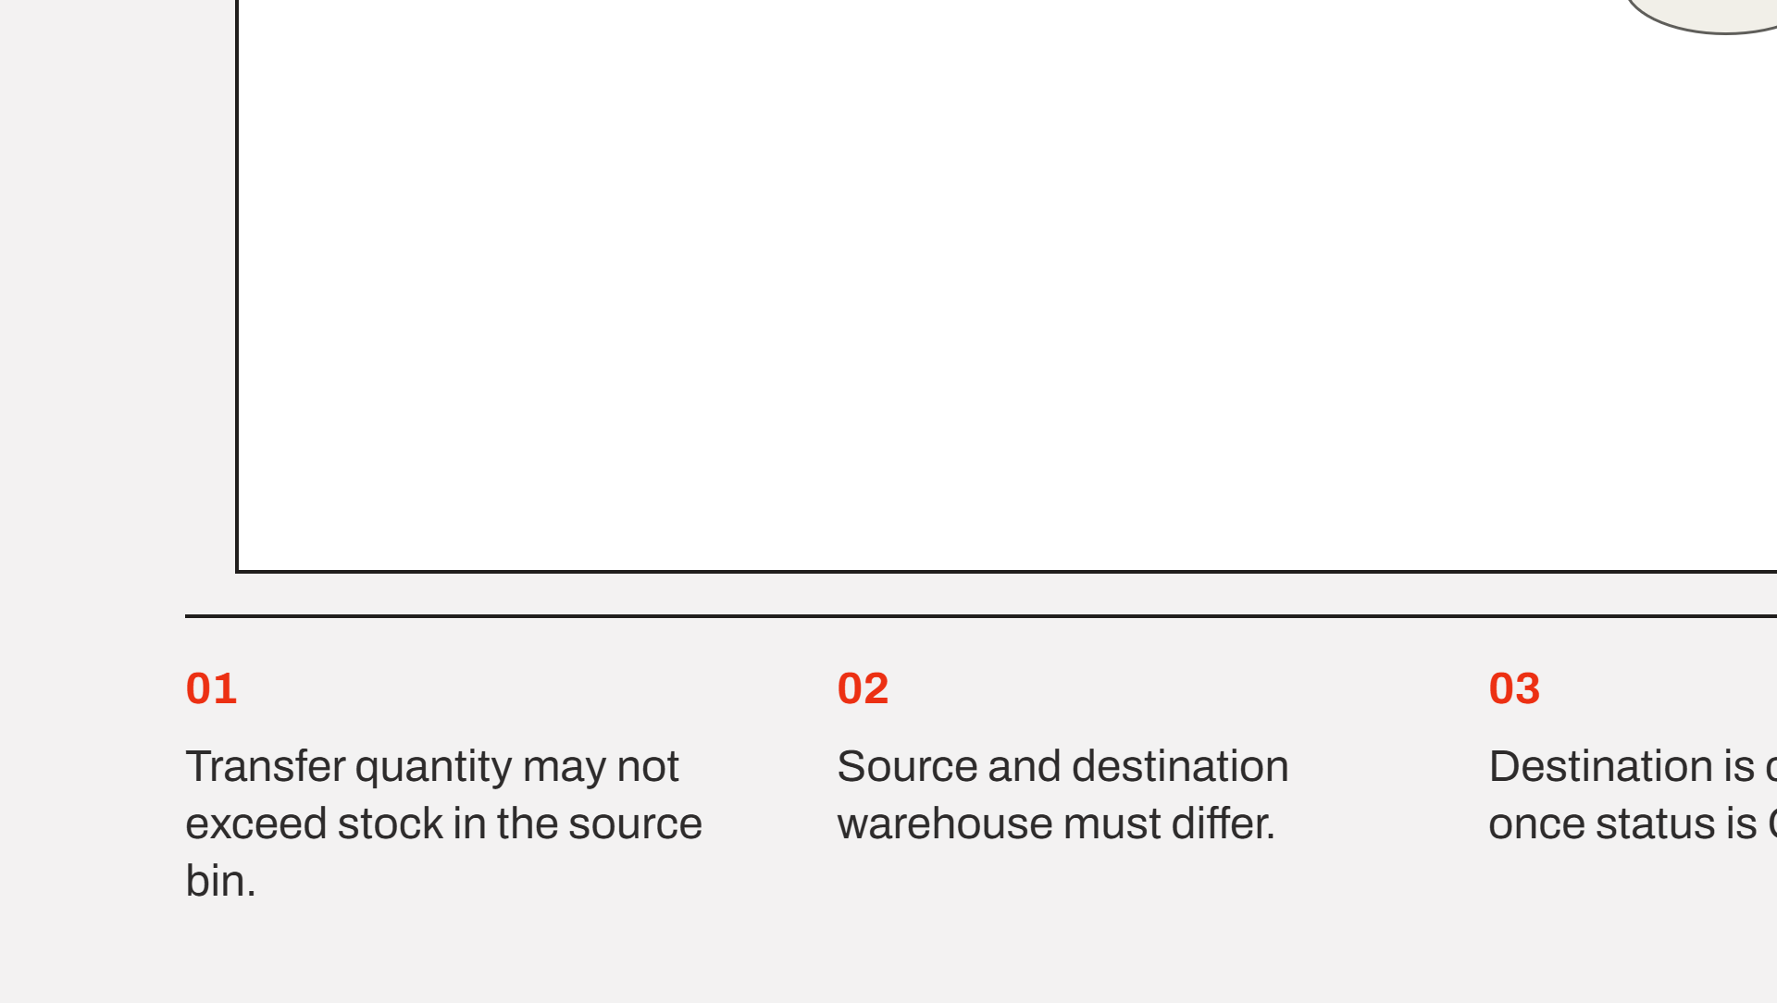
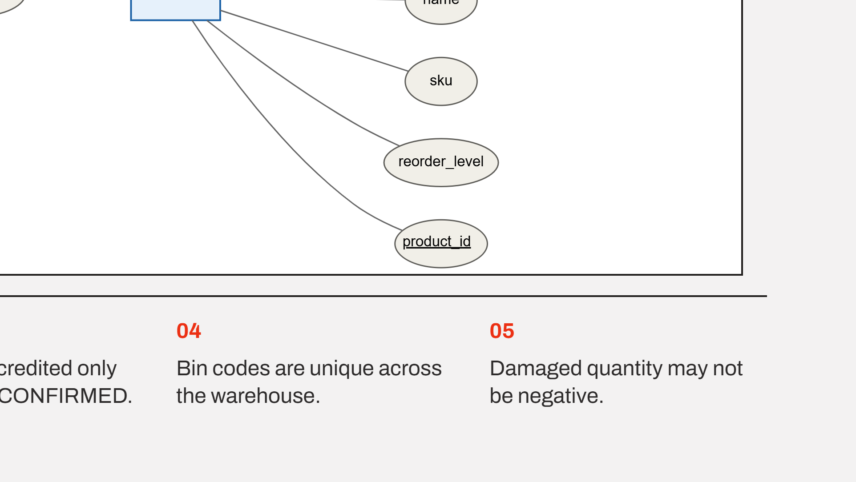
Notes:
The lower half, continuing from the warehouse band. Dispatch on the left, product on the right, and the four quantity-carrying relationships down the middle. The five business rules below are the ones the constraints and triggers now enforce.

Slide 5
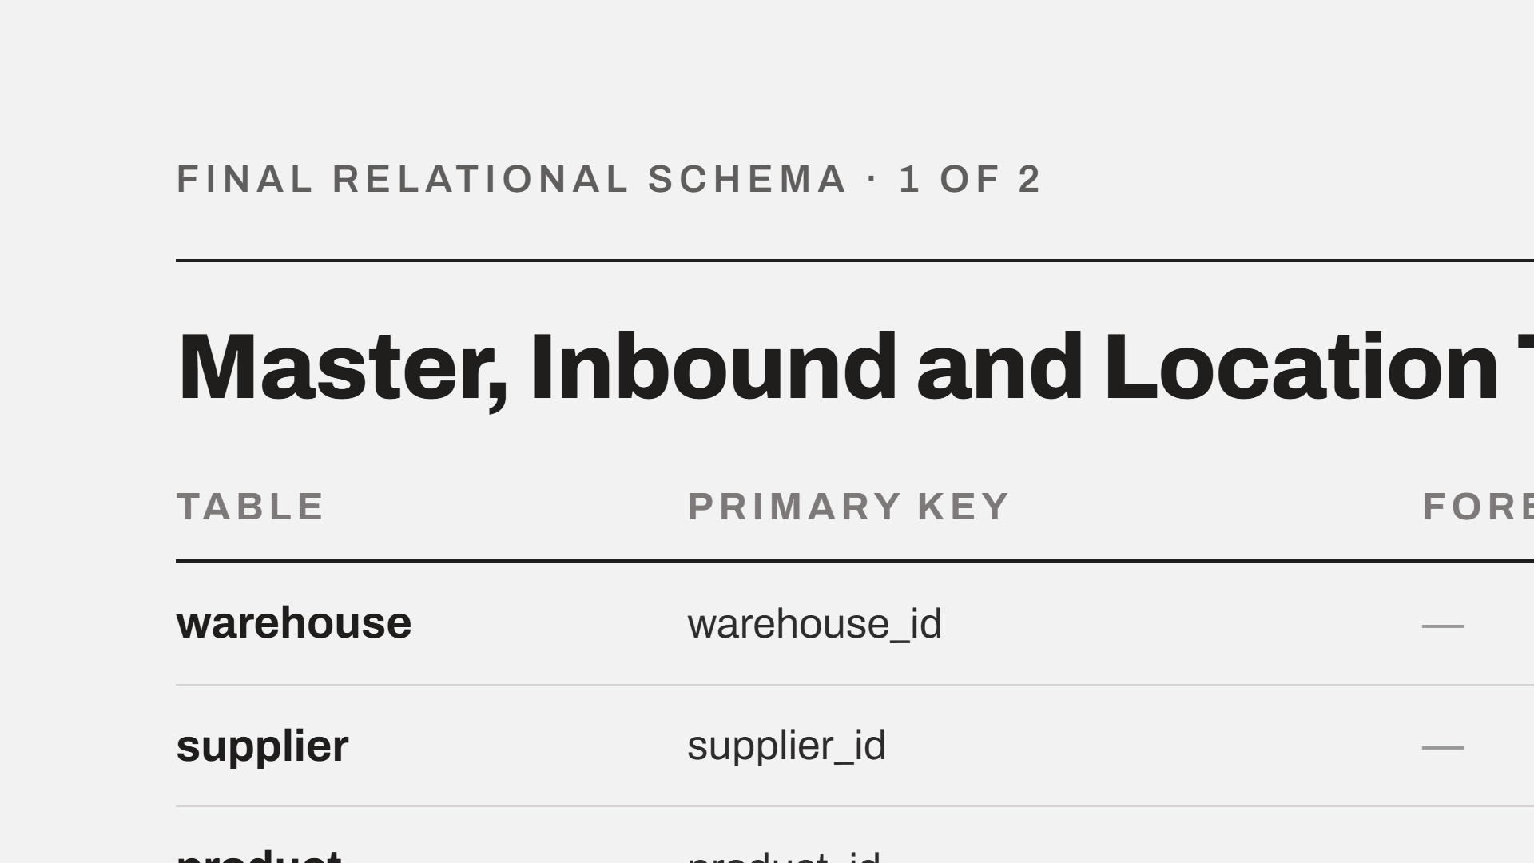
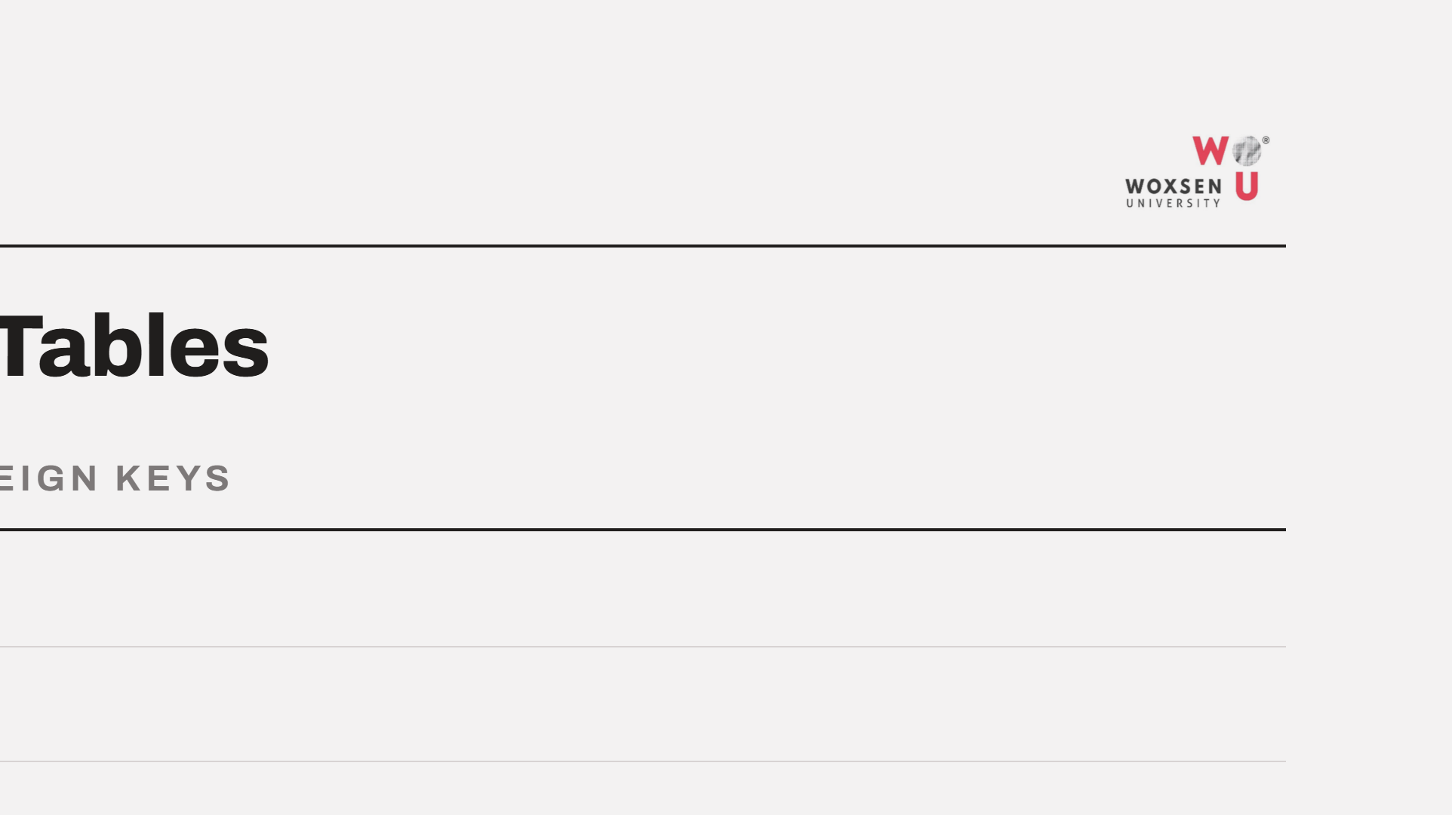
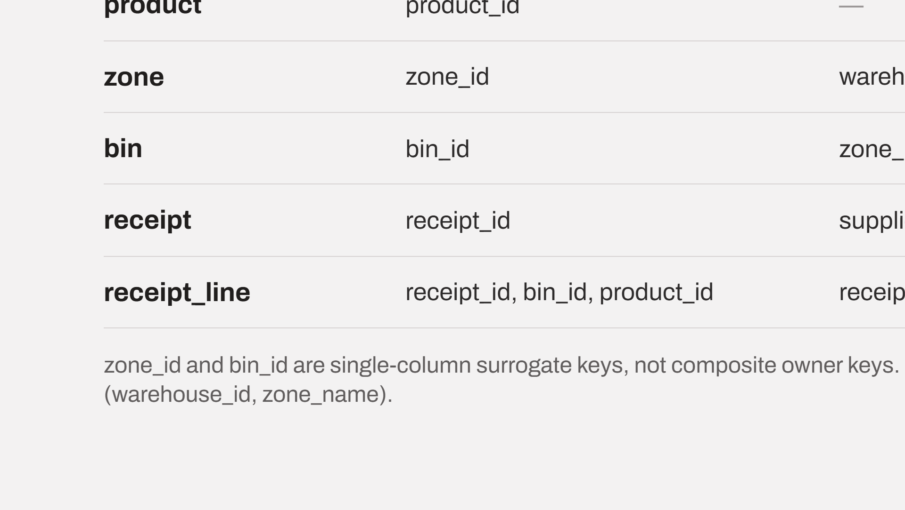
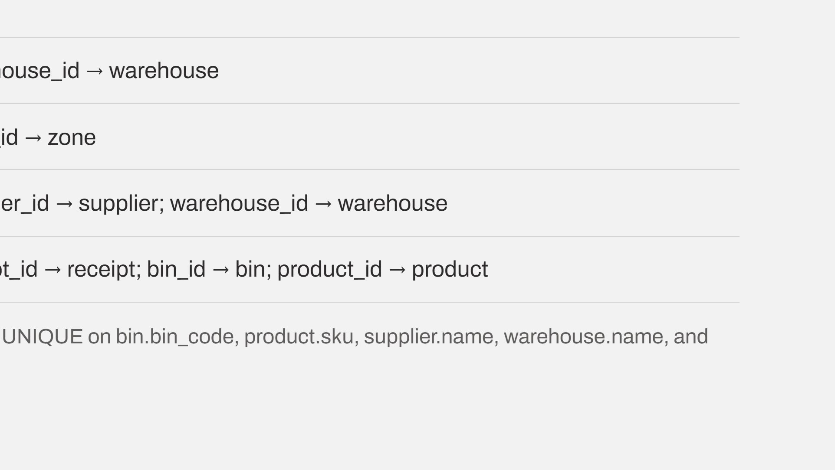
Notes:
Seven tables covering master data, location and the inbound flow. The change from Review 1 is that zone and bin now carry single-column surrogate keys instead of composite owner keys, which keeps every foreign key to one column.

Slide 6
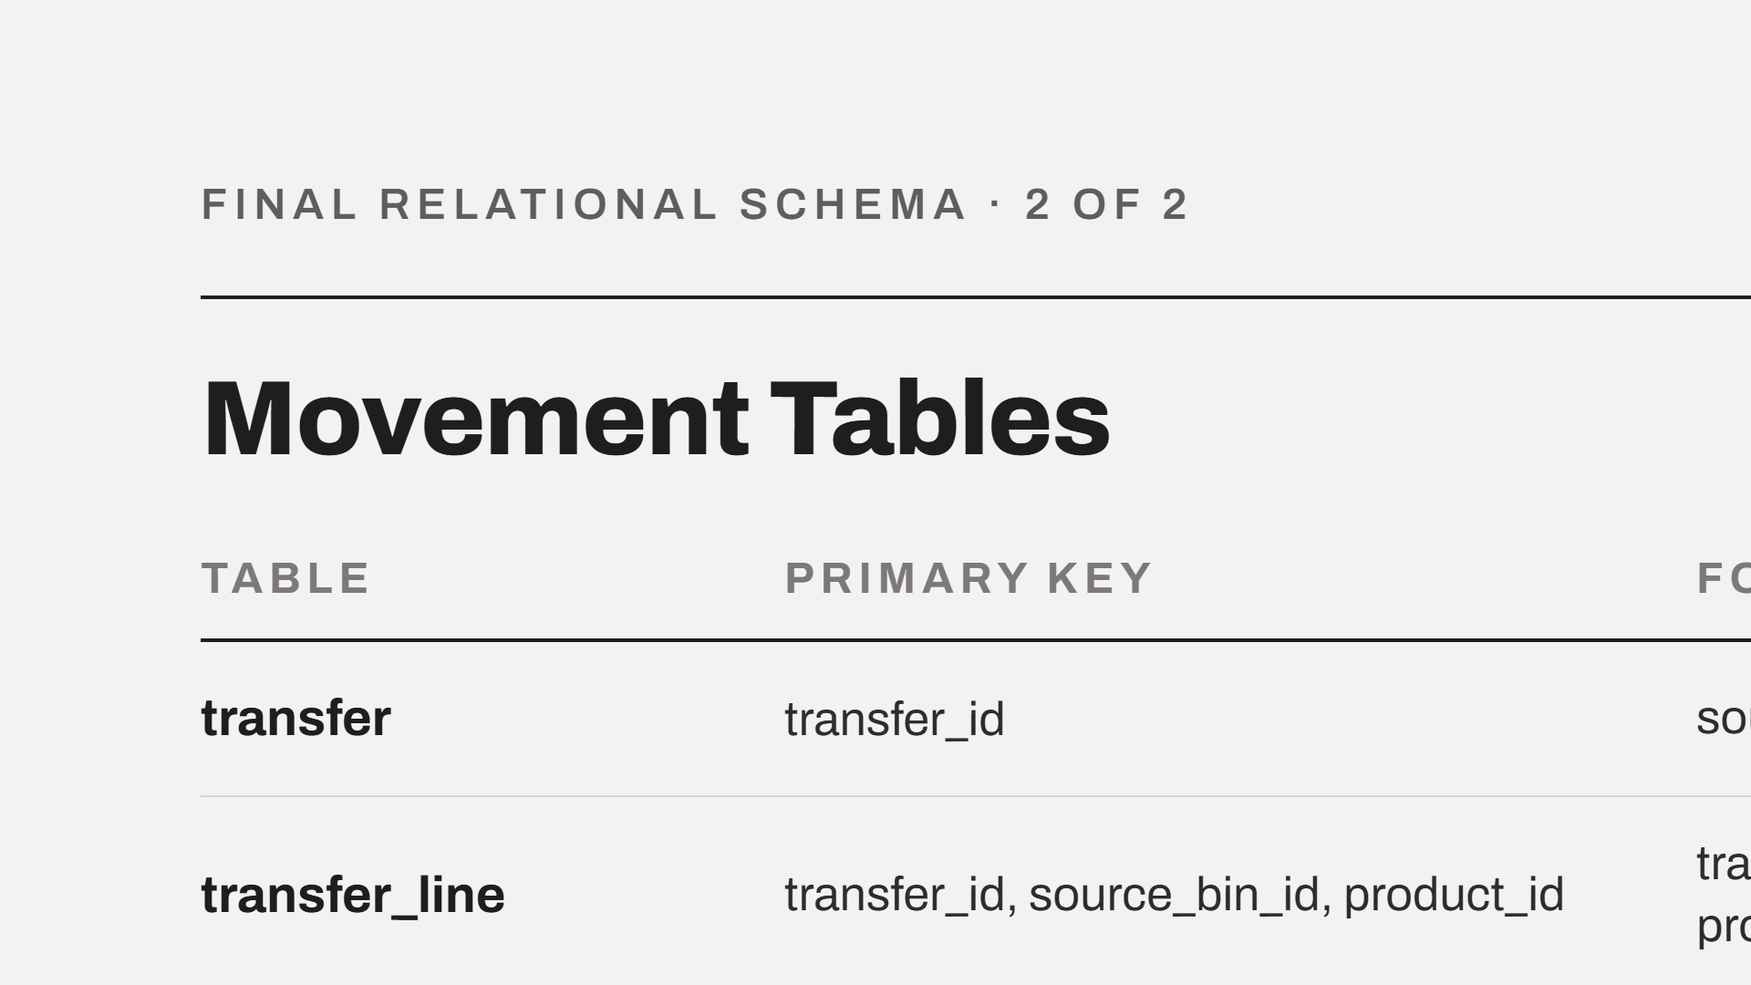
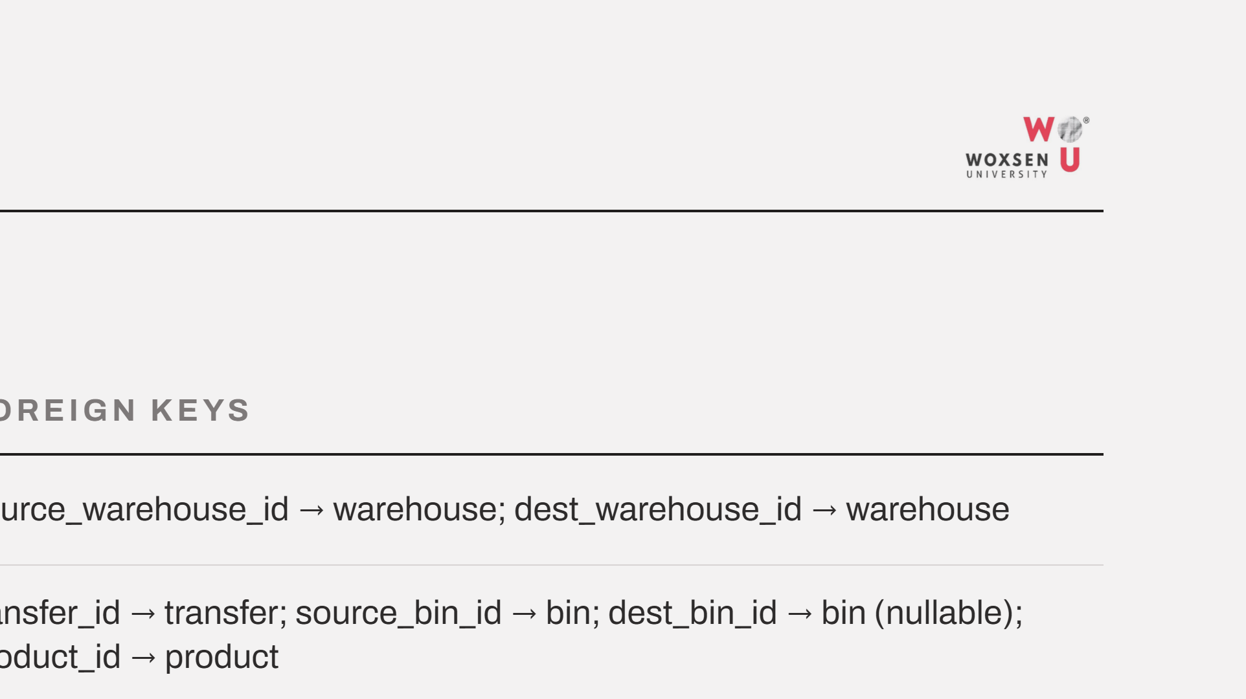
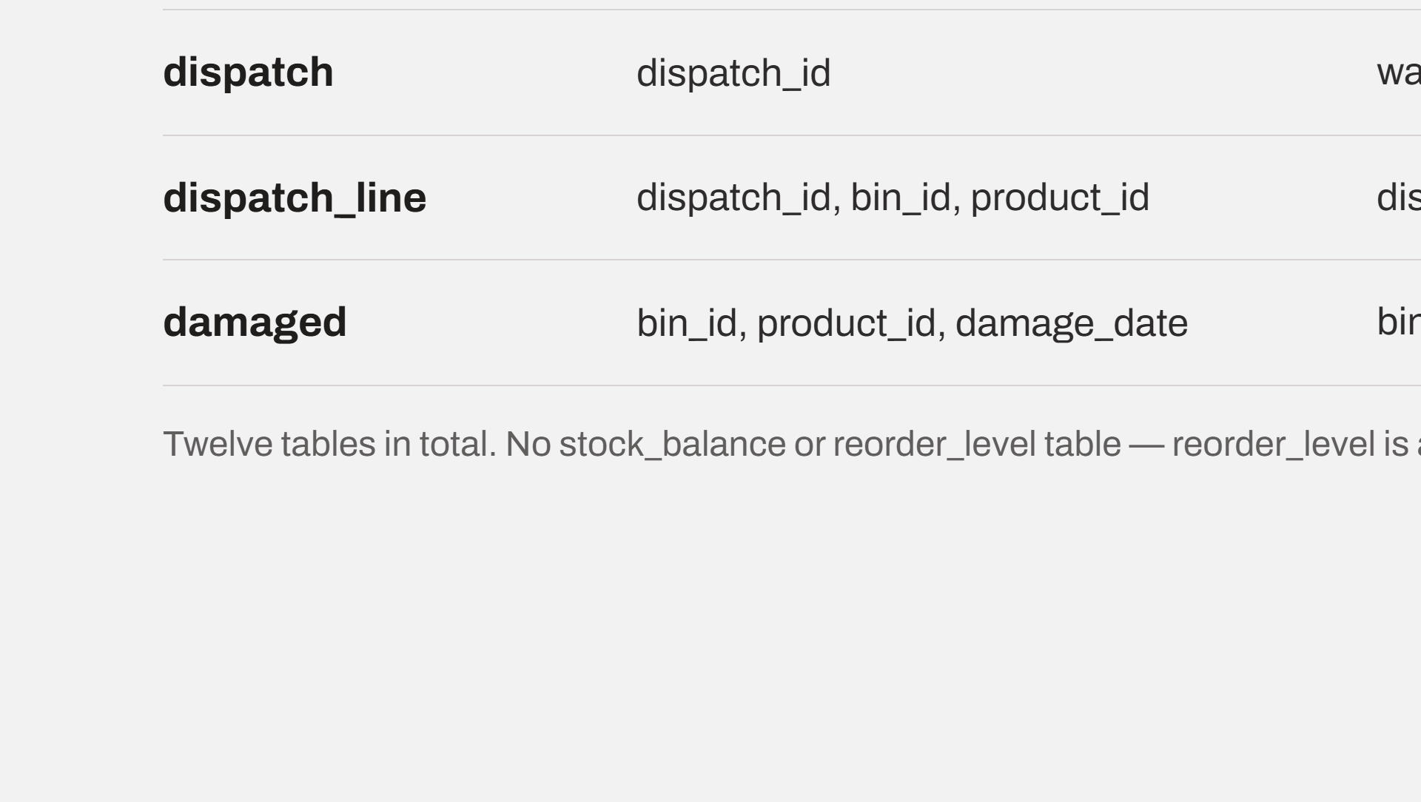
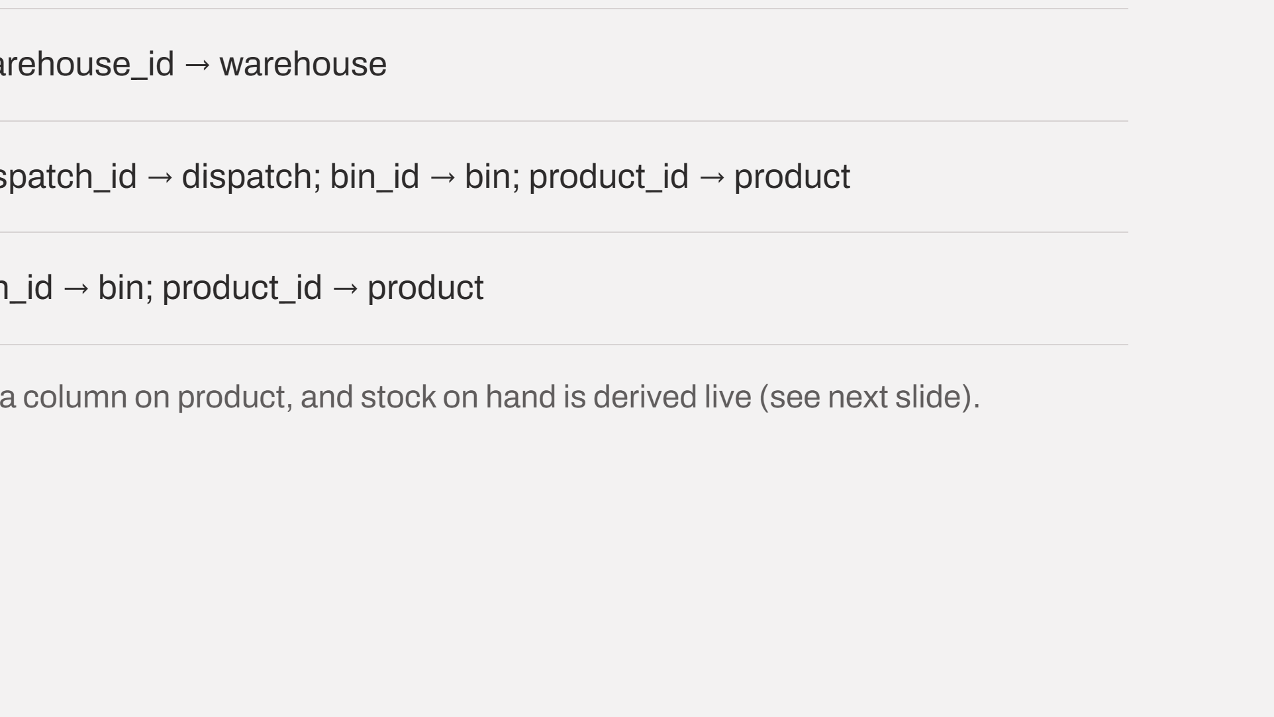
Notes:
The five movement tables. Transfer carries two foreign keys into warehouse, which is how the source and destination roles are represented. dest_bin_id is nullable until the transfer is confirmed. There is no stored stock table.

Slide 7
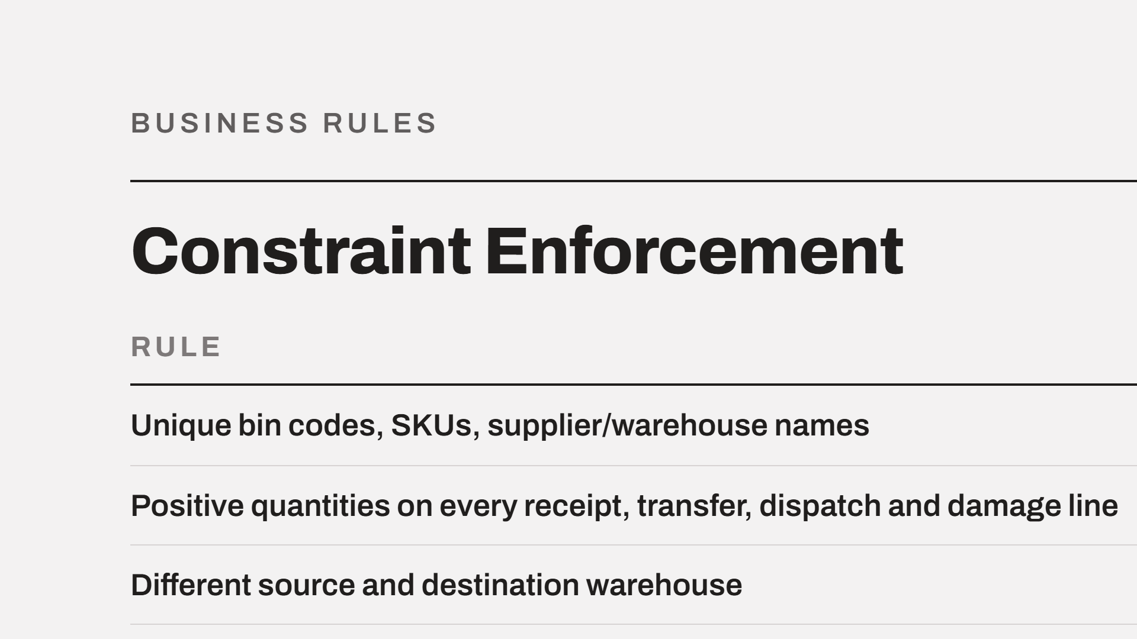
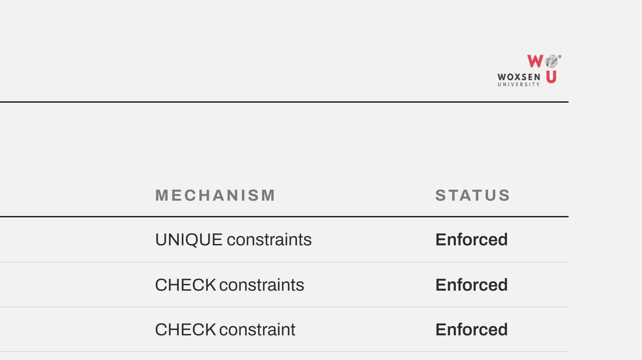
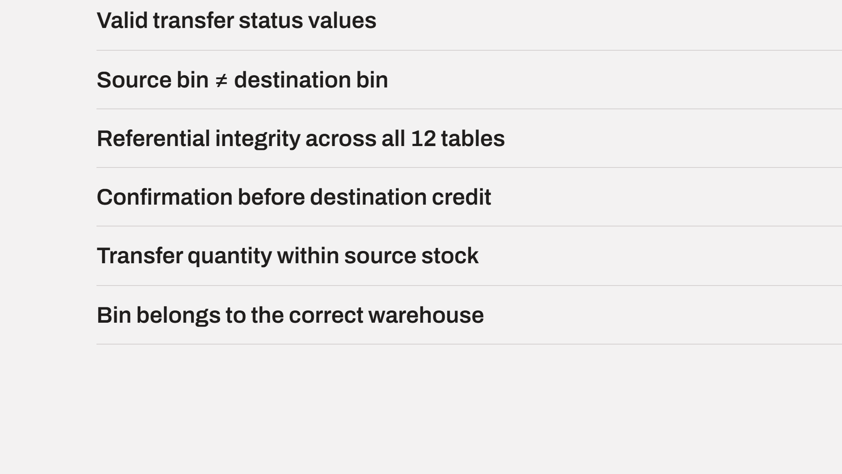
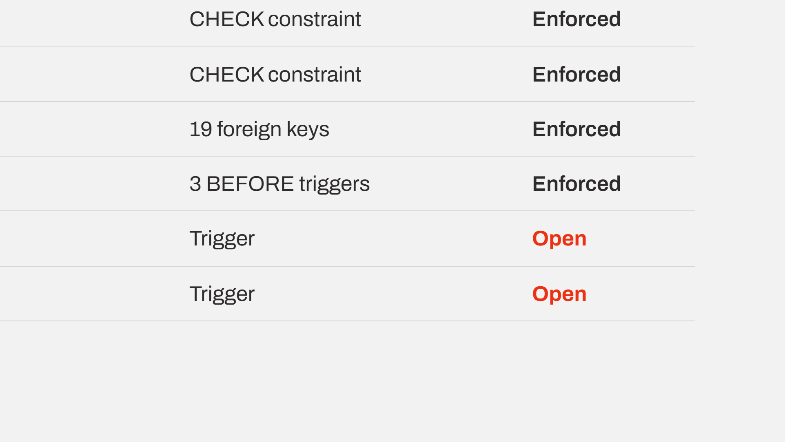
Notes:
Seven of the nine rules are enforced in the database today: unique constraints, check constraints, nineteen foreign keys and three triggers. The two open items both need a trigger, because a check constraint cannot read another table's rows. Both are scheduled before Review 3.

Slide 8
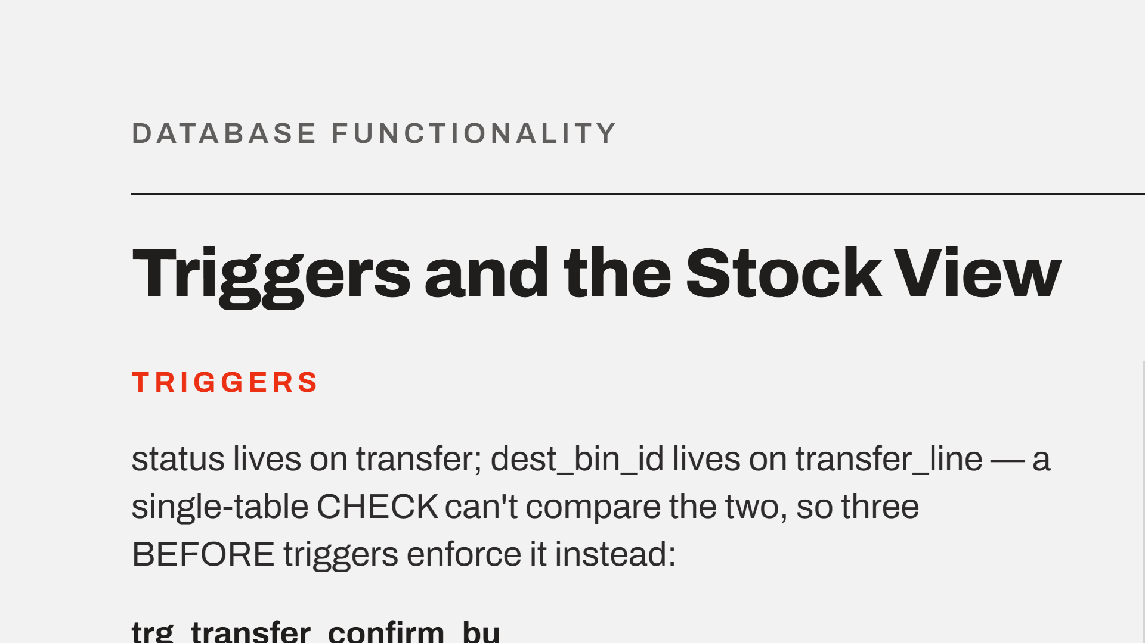
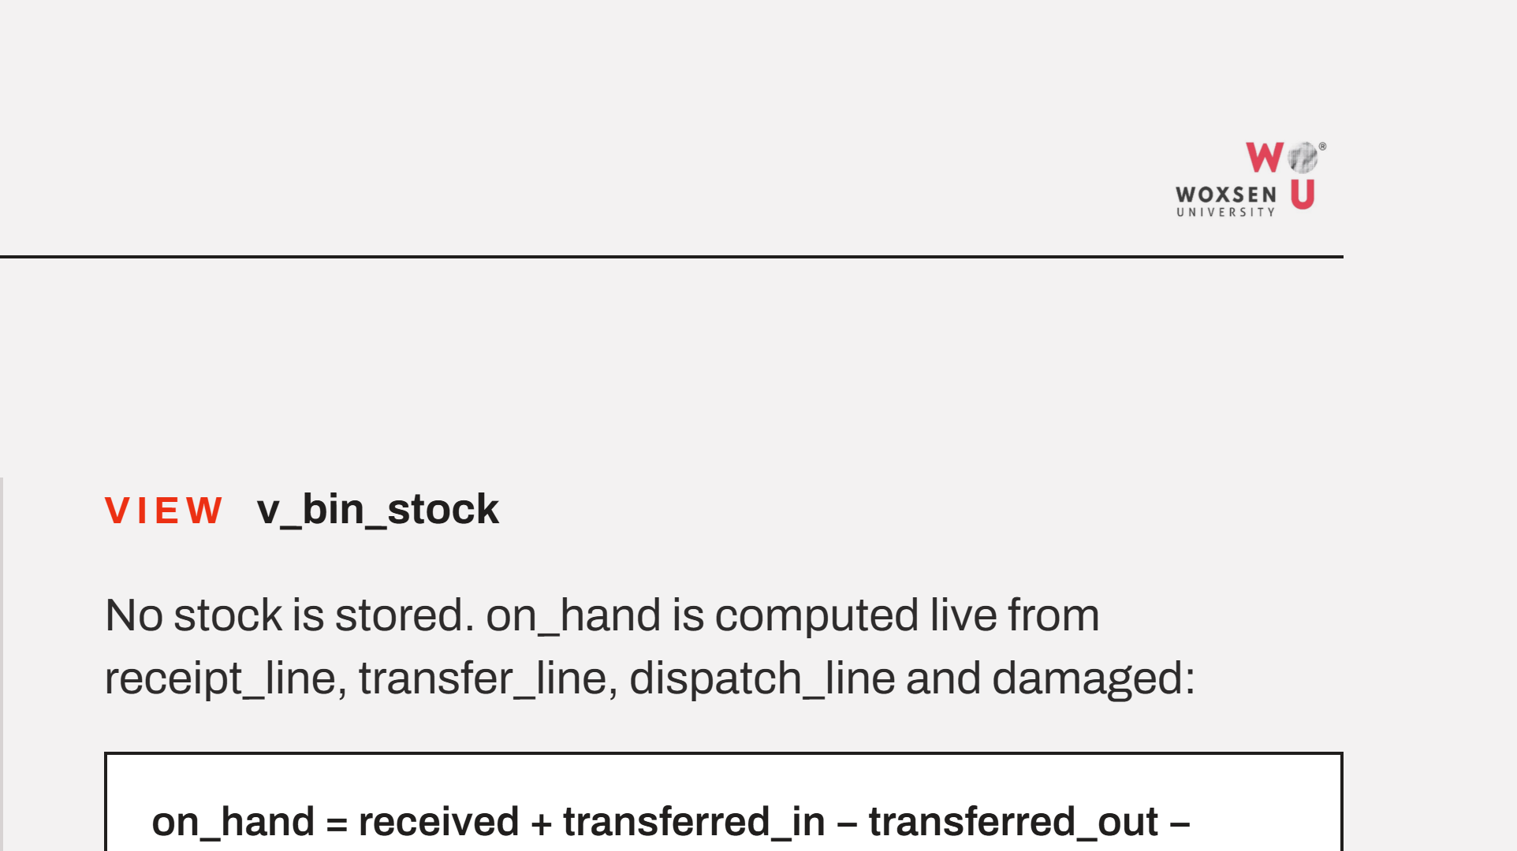
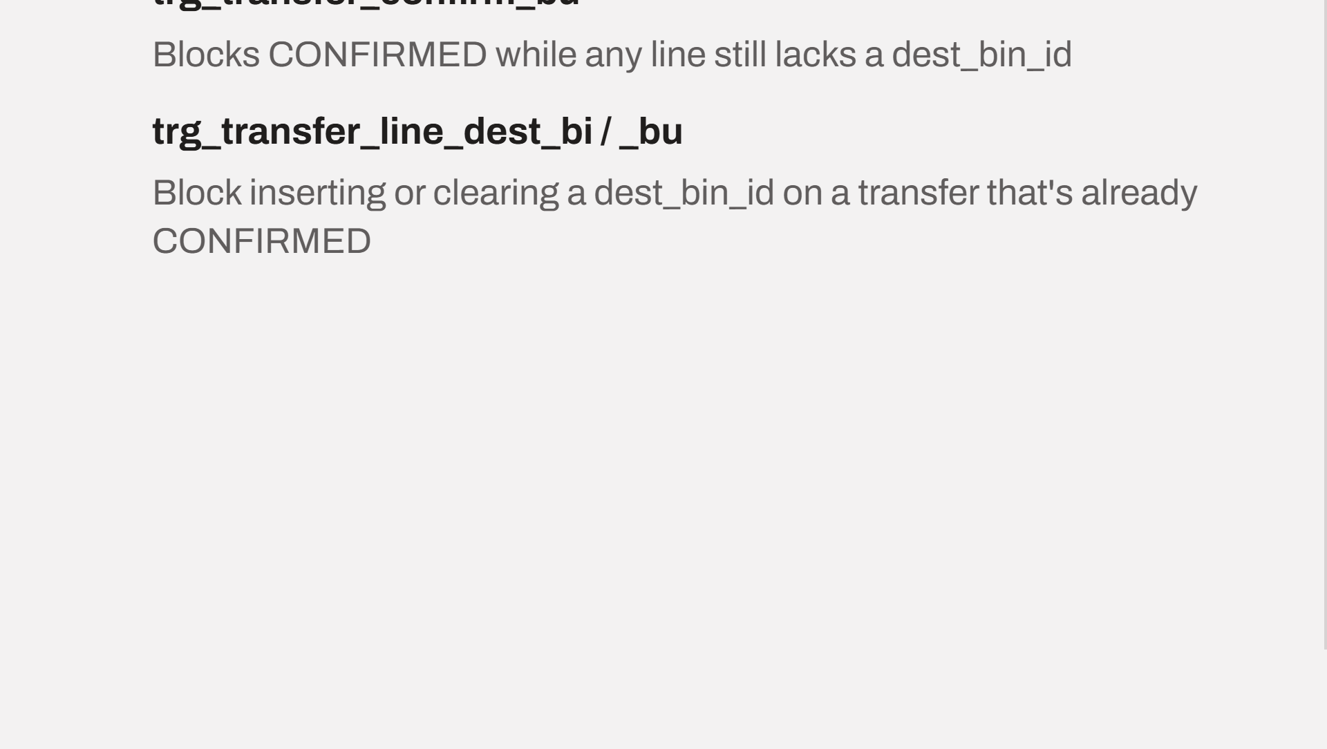
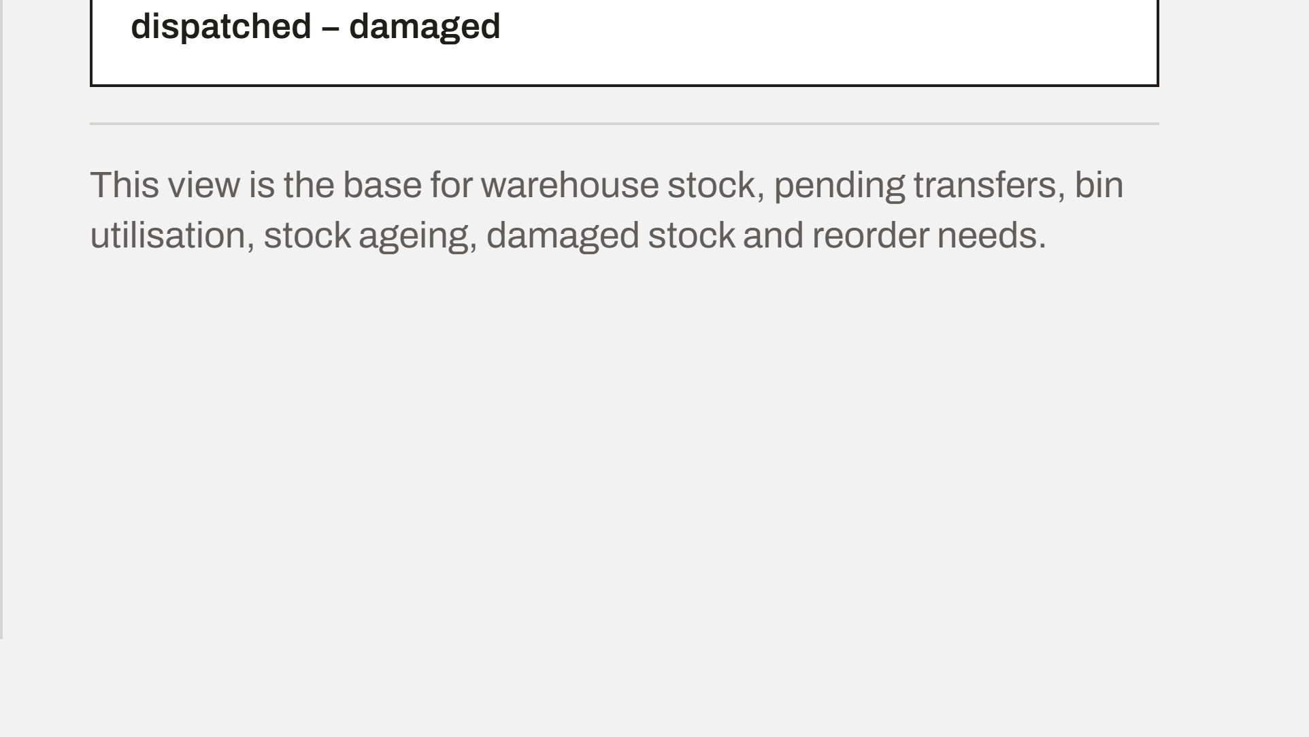
Notes:
Status lives on transfer and dest_bin_id lives on transfer_line, so a single-table check cannot compare the two. Three before-triggers do it instead. On the right, no stock is stored at all: the view computes on-hand live from the four movement tables, and every Review 2 report reads from it.

Slide 9




Notes:
Thank you. I am happy to take questions on the schema, the constraints or the stock view.

