Slide 1
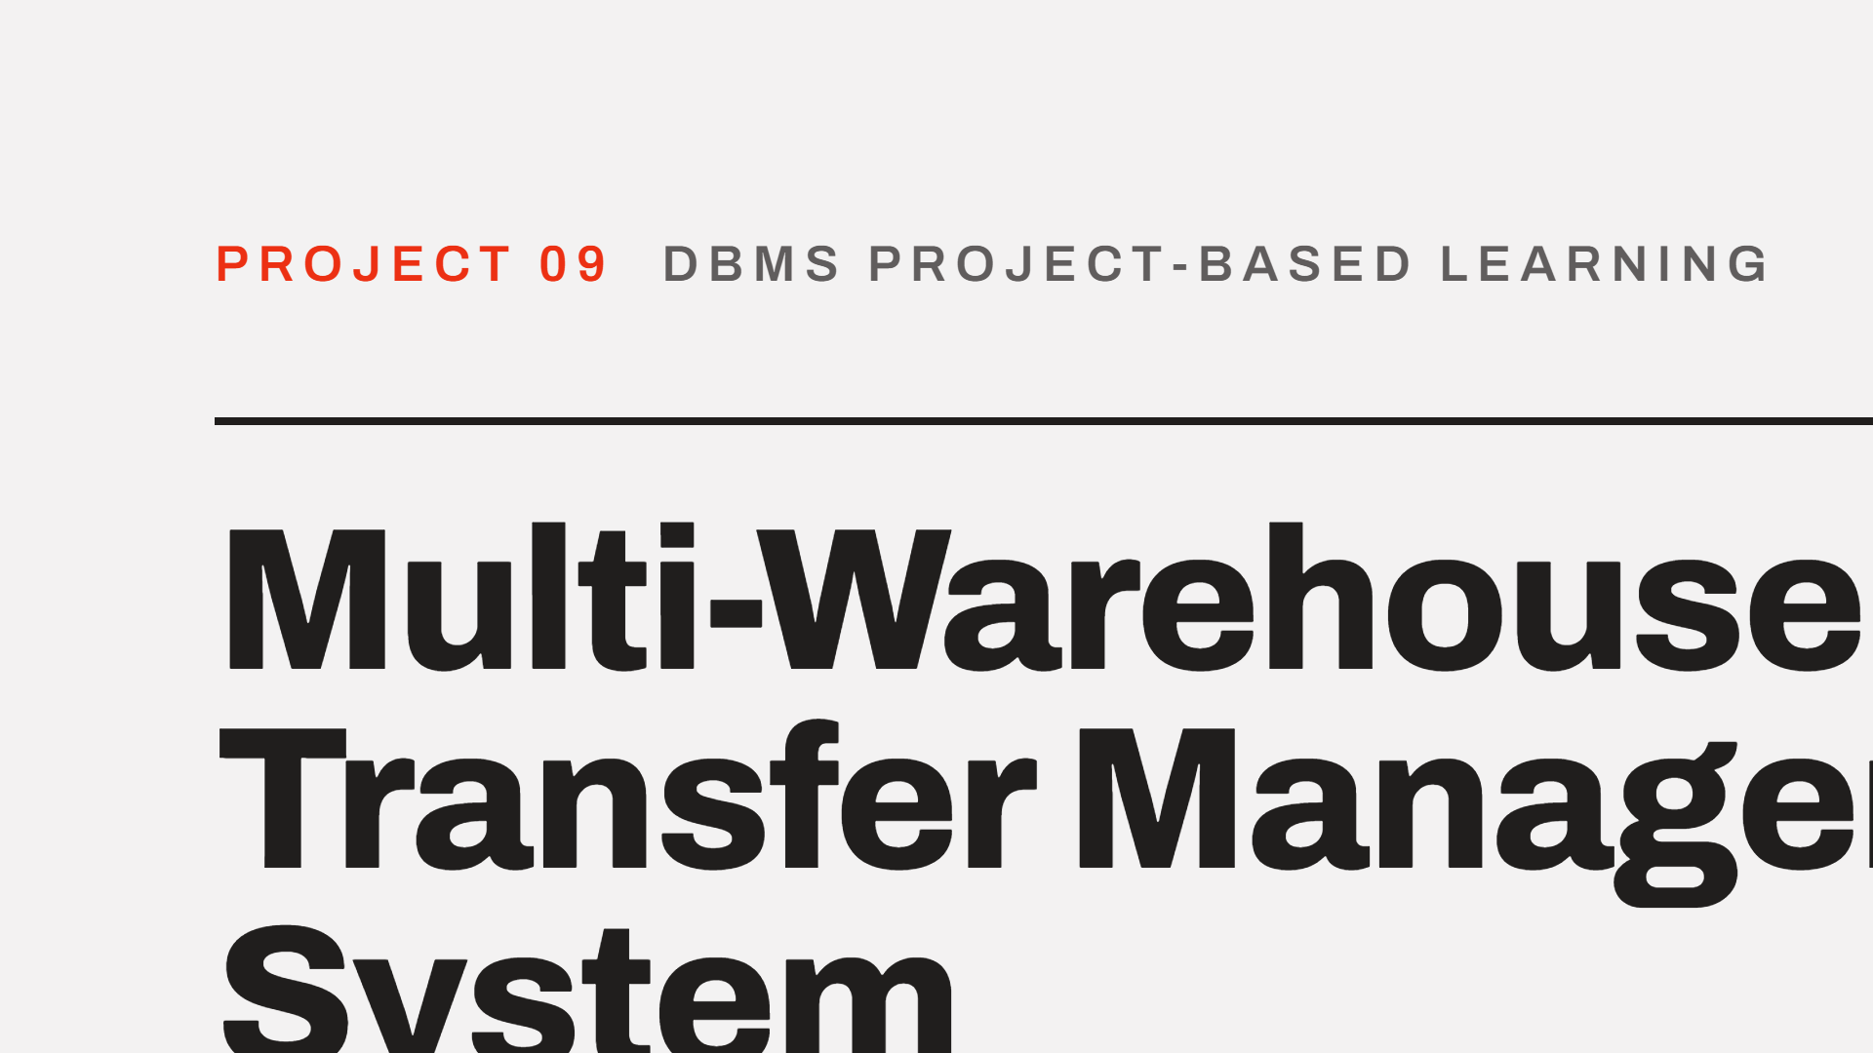

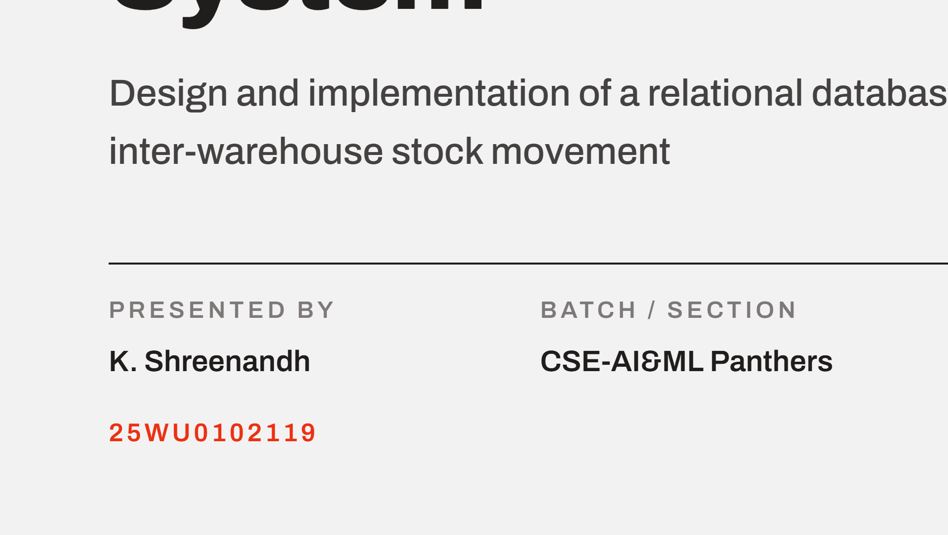

Notes:
Good morning. Project 09, Review 2. I will cover the design foundations in brief, the ER model, the final implemented relational schema, how the business rules are enforced, and the triggers and stock view.

Slide 2
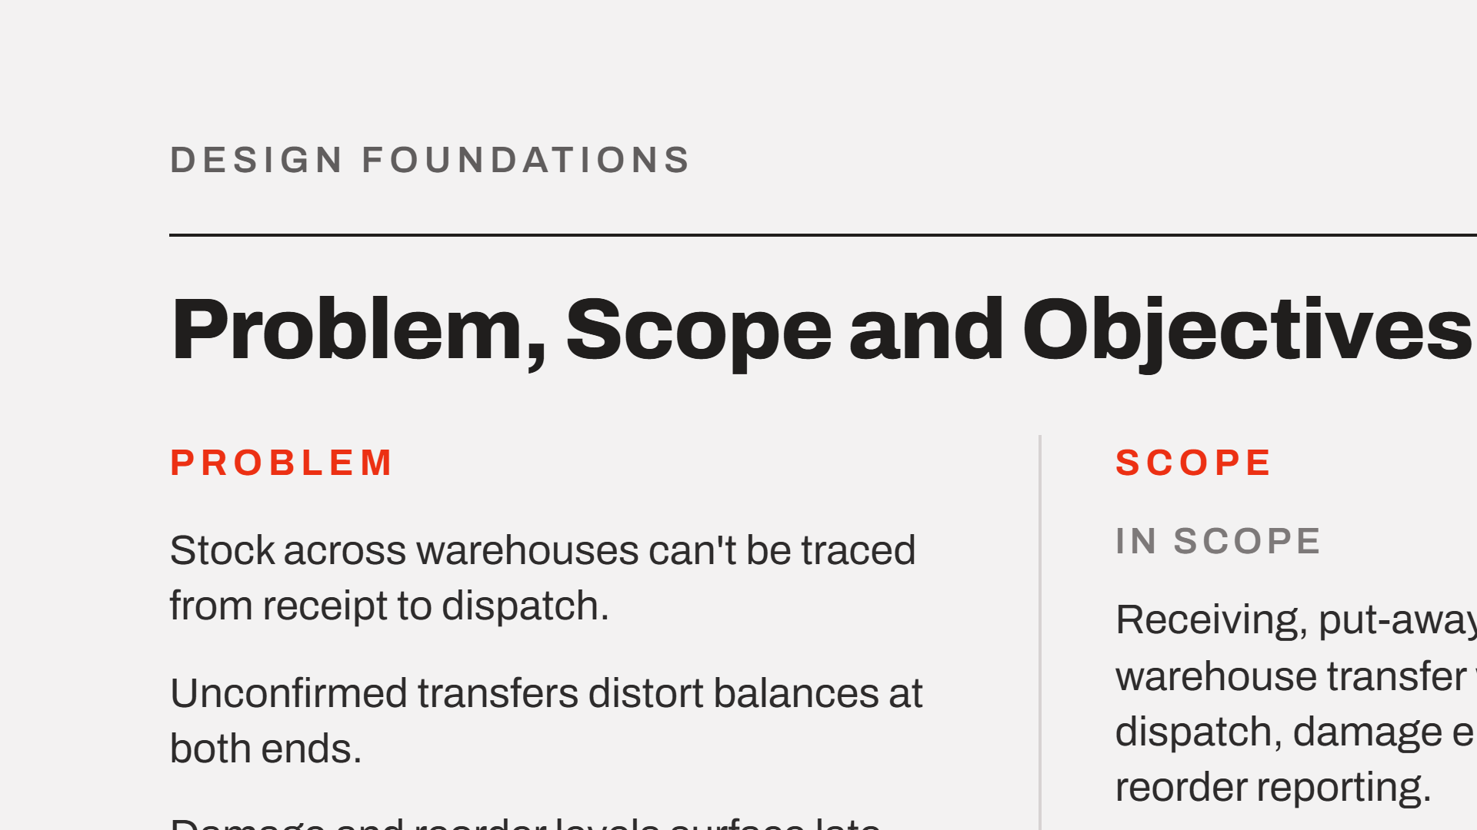
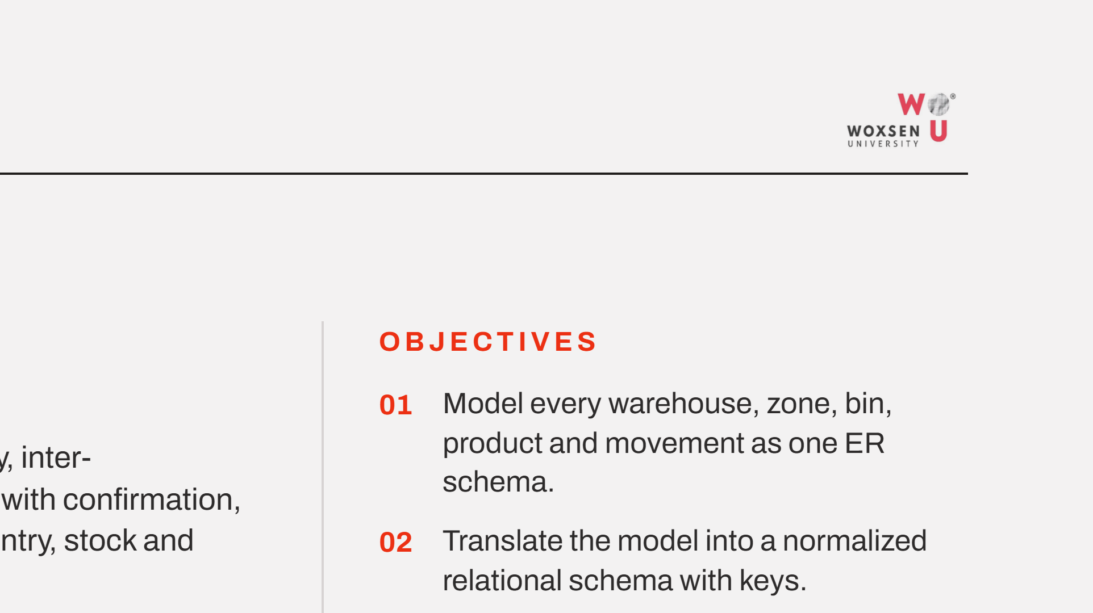
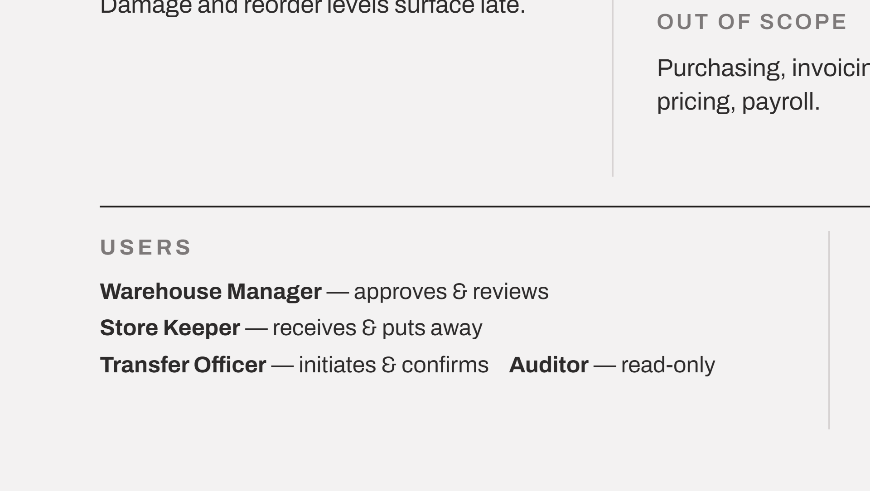
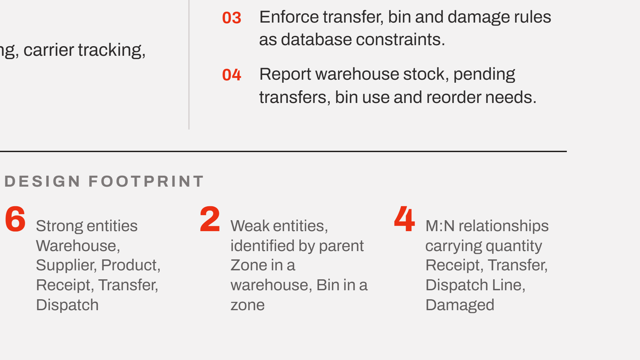
Notes:
A quick recap of the foundations carried forward from Review 1. The core defect is the unconfirmed transfer: stock has left the source but is not acknowledged at the destination, so it is counted twice or lost. Scope stays on physical movement. Four roles, four objectives, and the entity counts the ER model is built on.

Slide 3
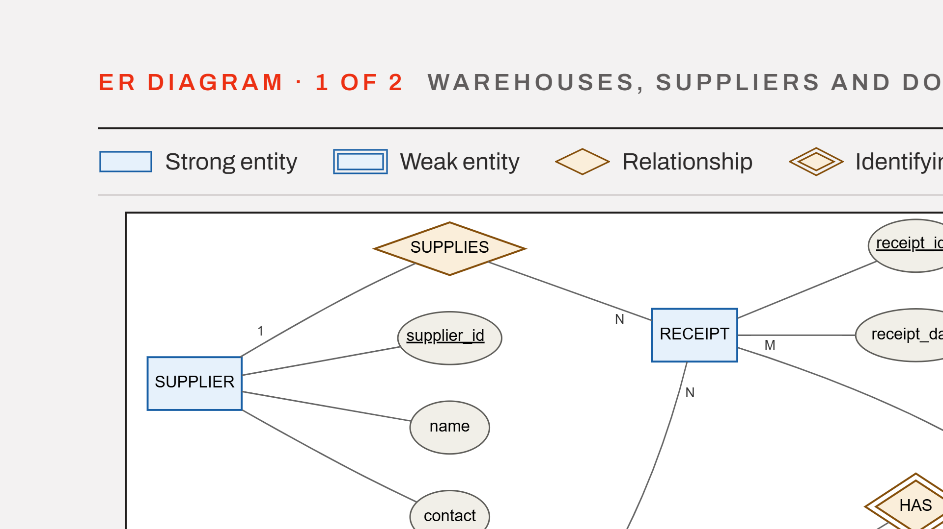
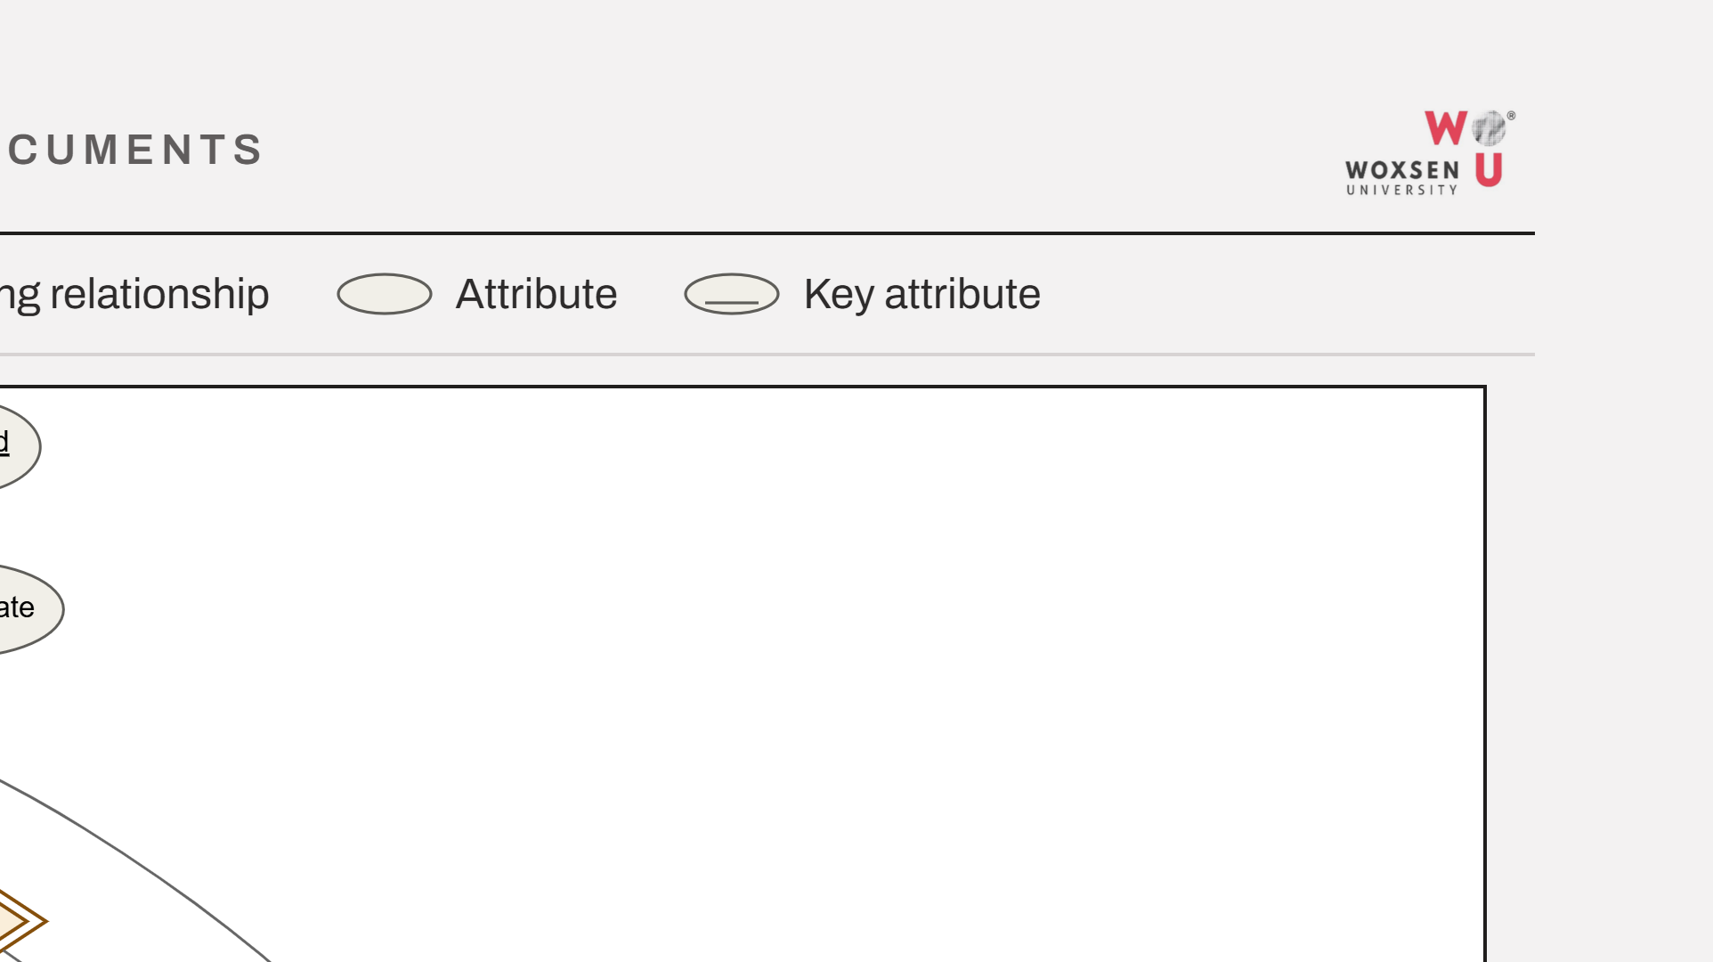
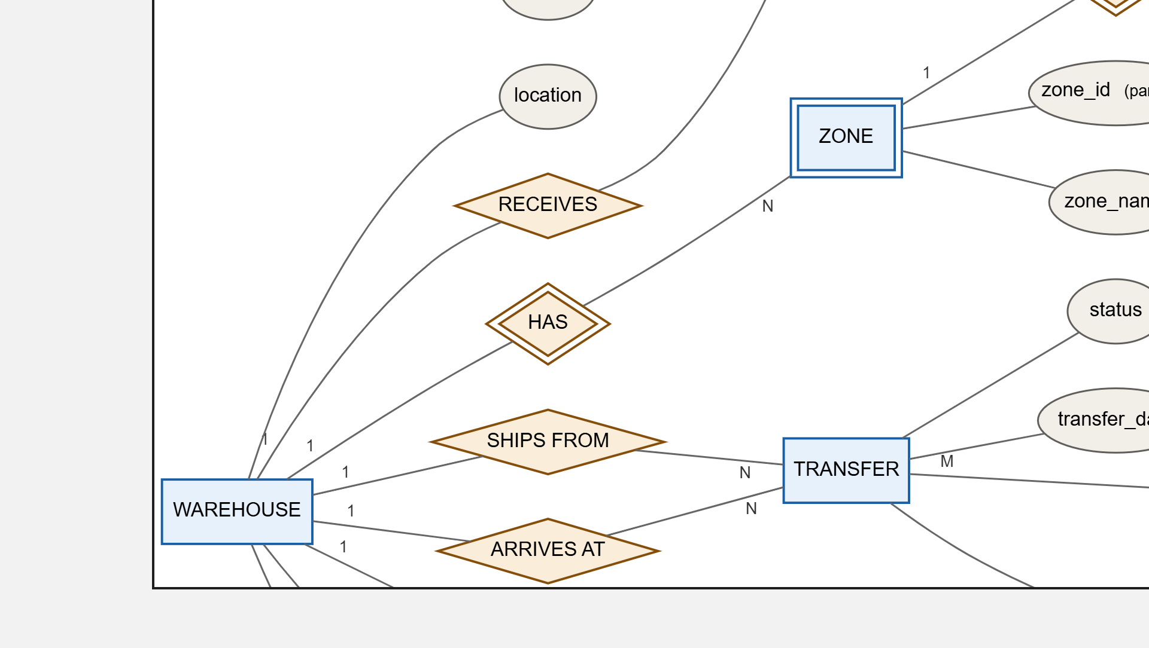
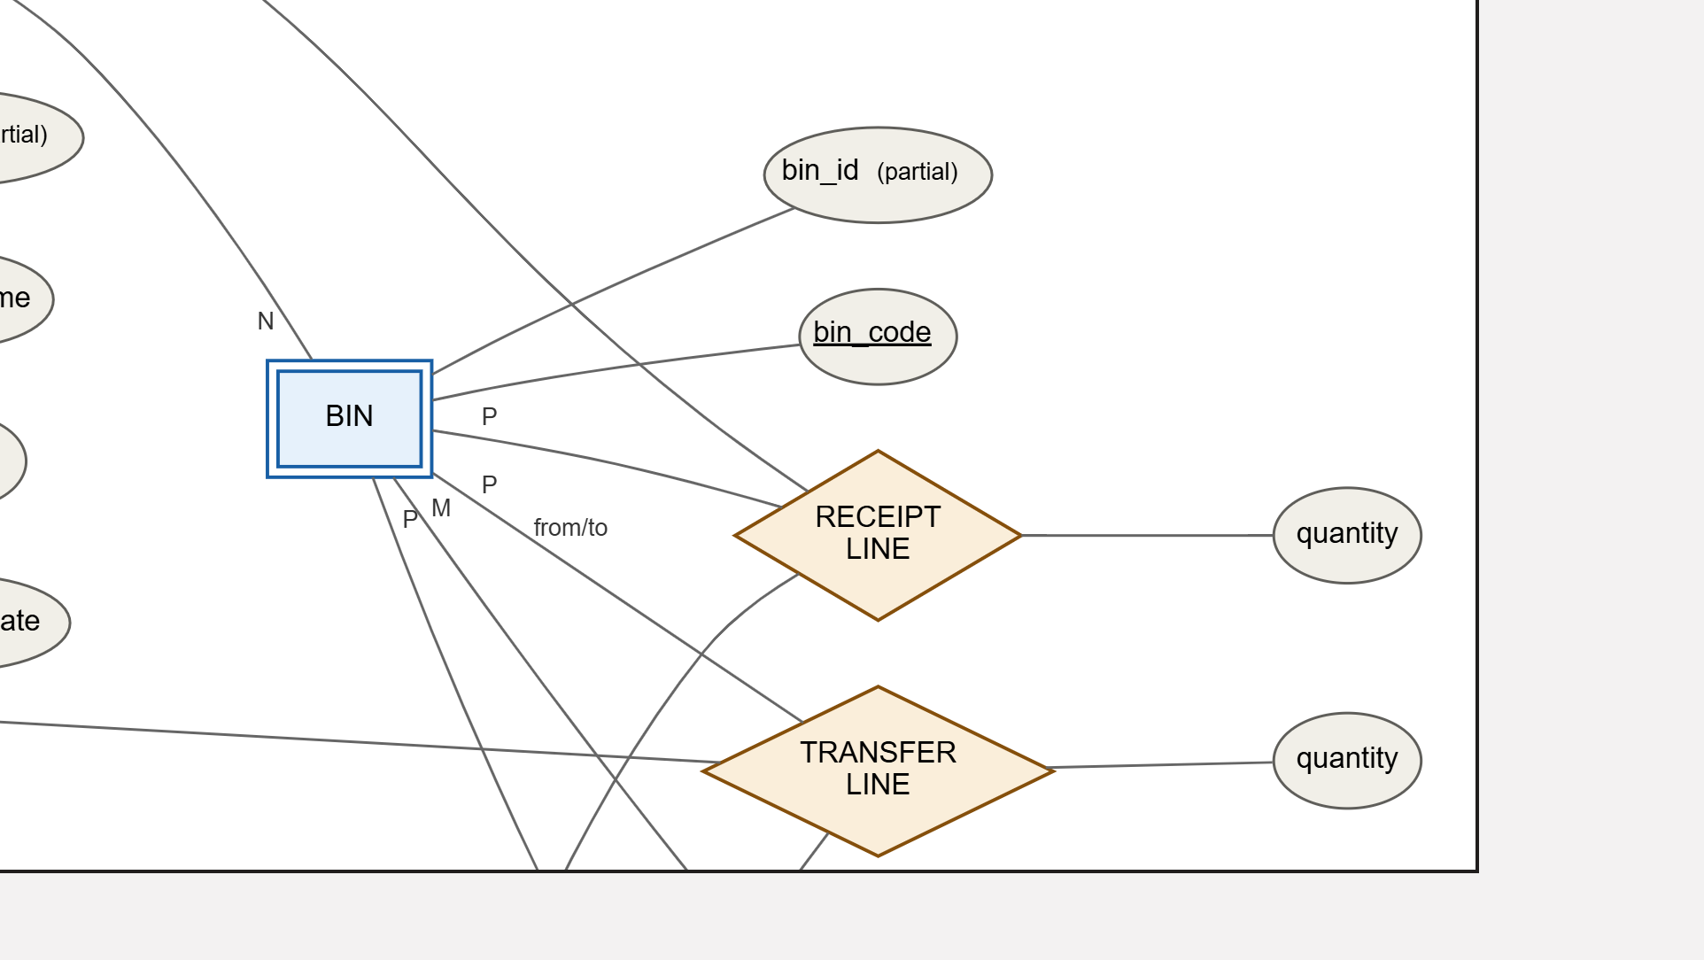
Notes:
The upper half of the model at one and a half times scale. Supplier and receipt at the top, the warehouse with its zones and bins on the left, and the transfer with its source and destination roles across the middle band.

Slide 4
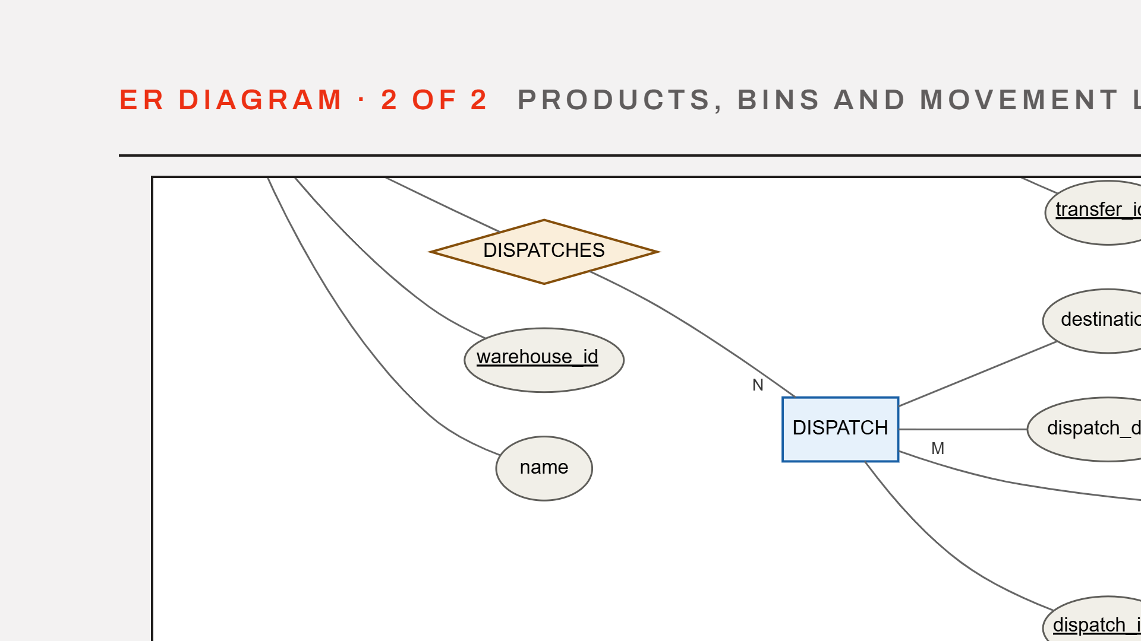
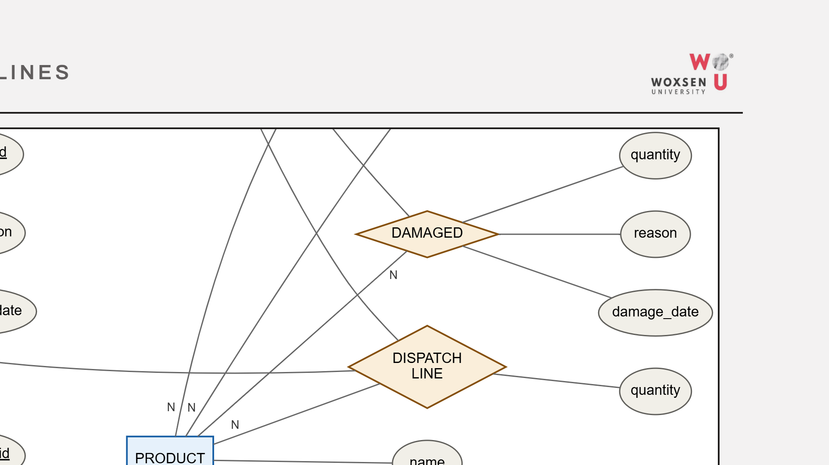
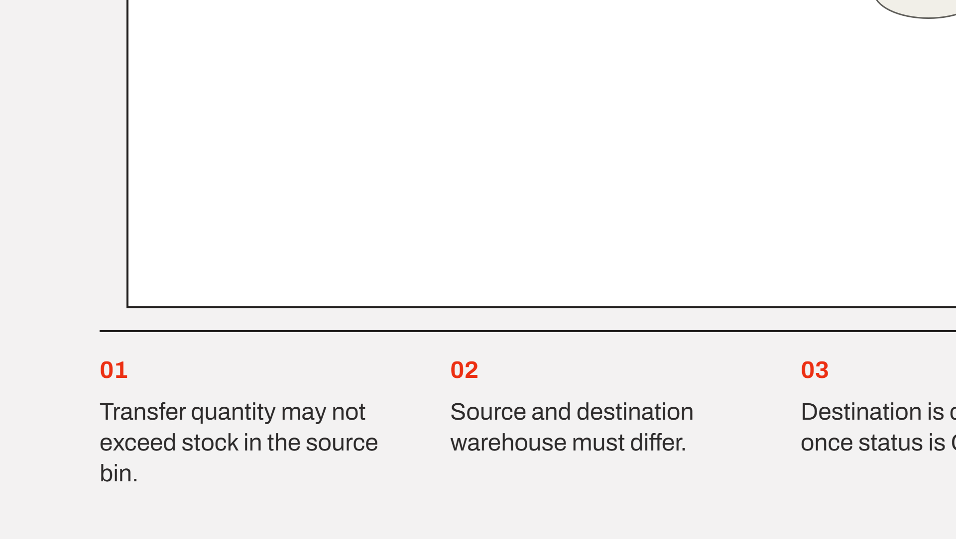
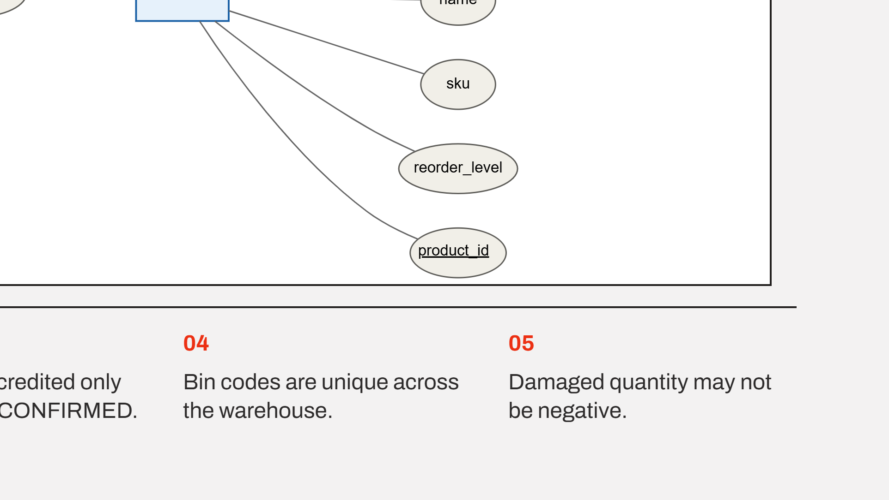
Notes:
The lower half, continuing from the warehouse band. Dispatch on the left, product on the right, and the four quantity-carrying relationships down the middle. The five business rules below are the ones the constraints and triggers now enforce.

Slide 5
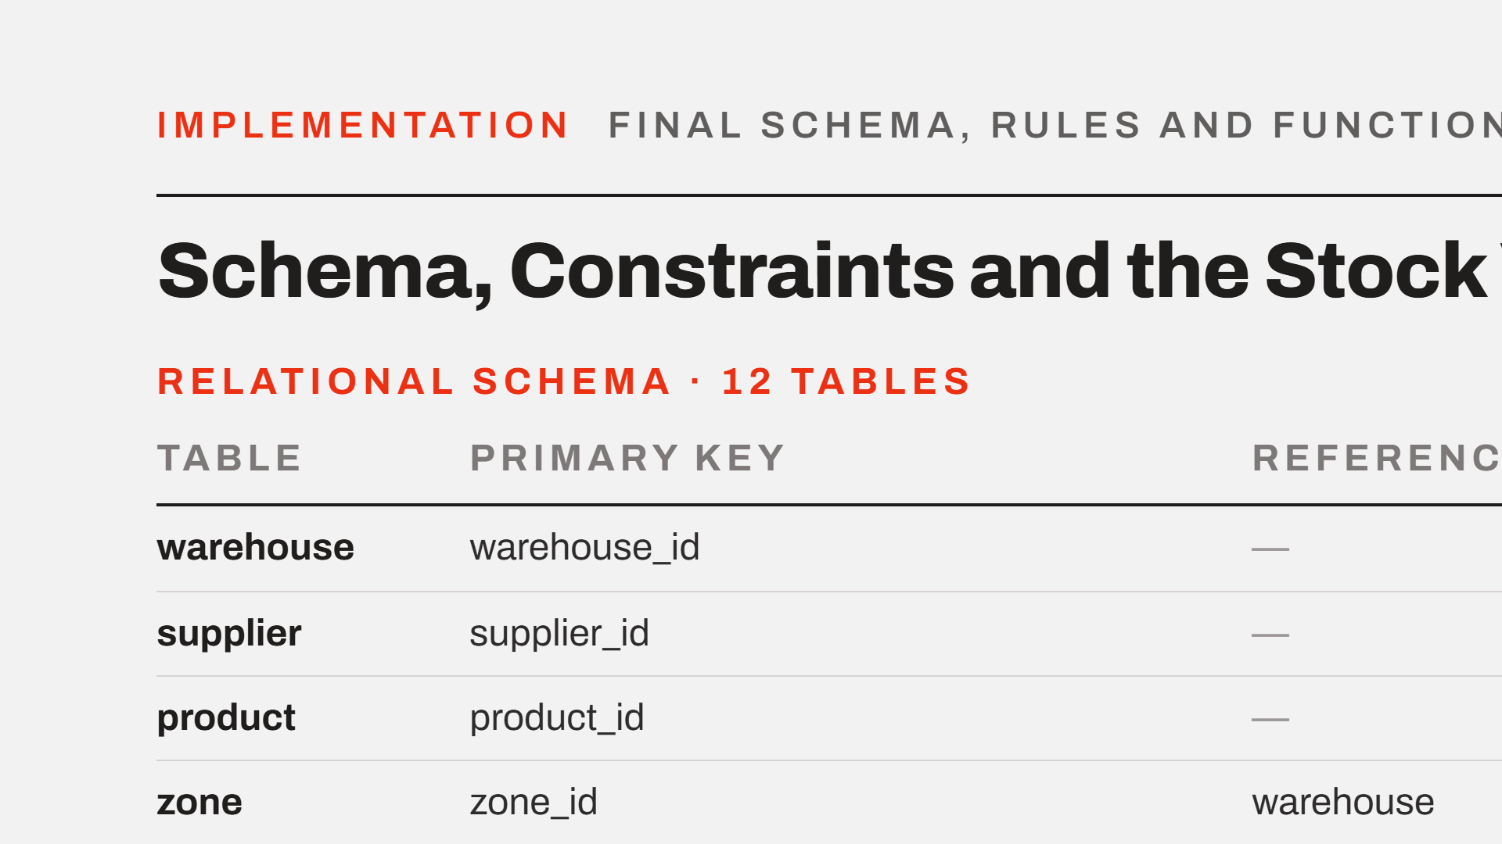
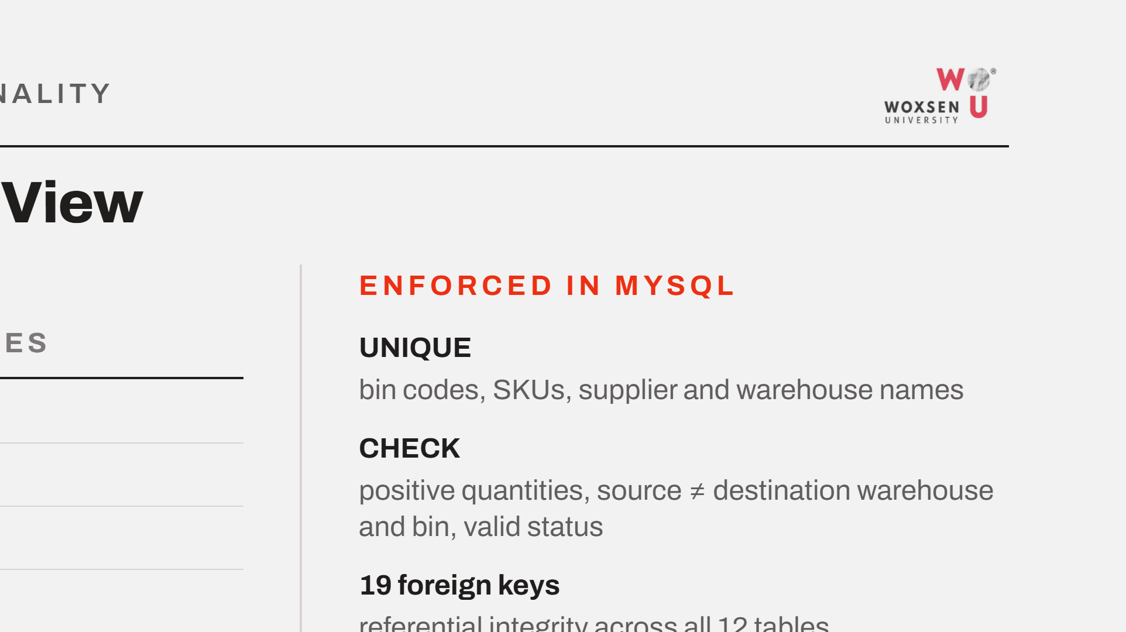
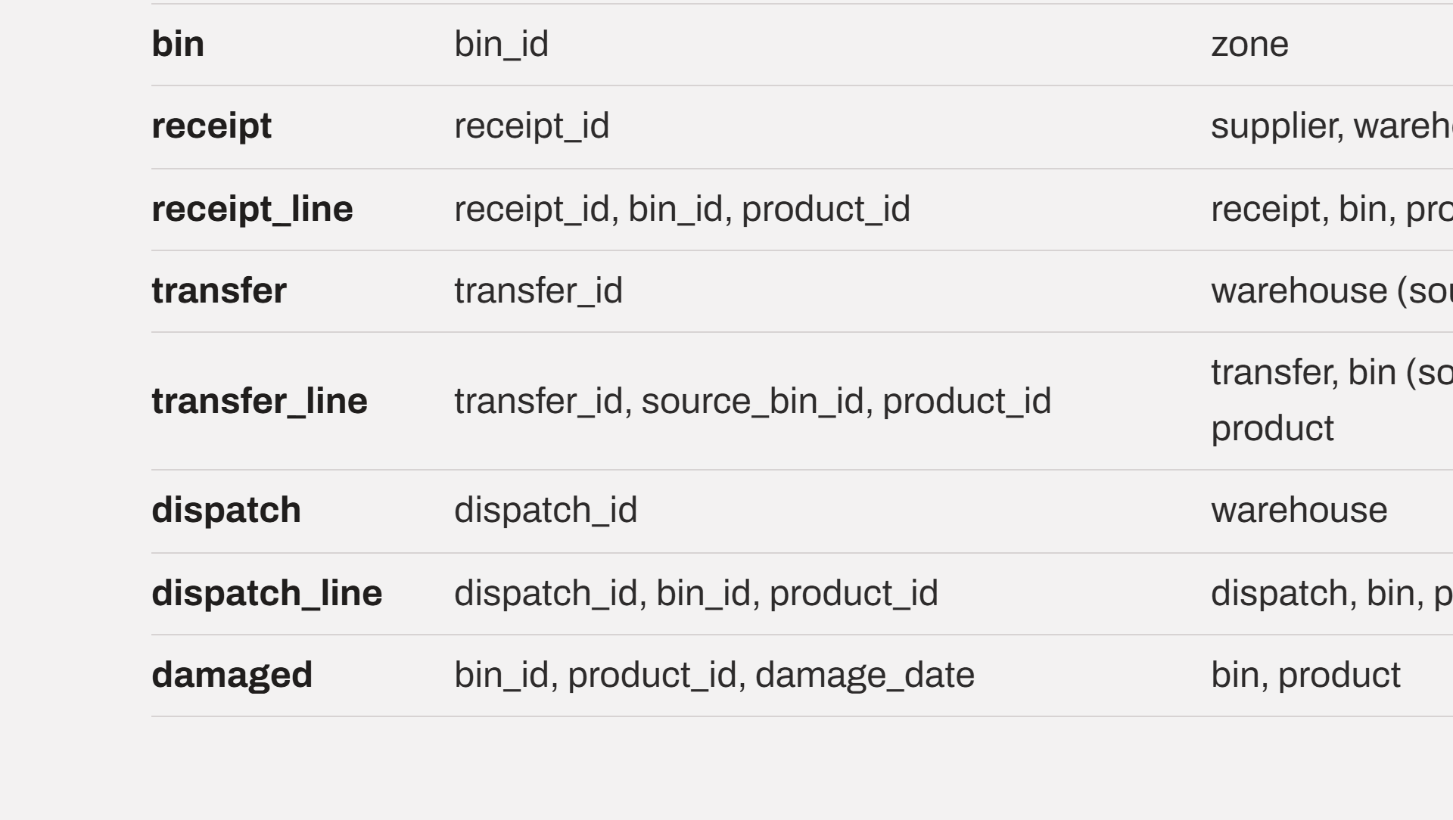
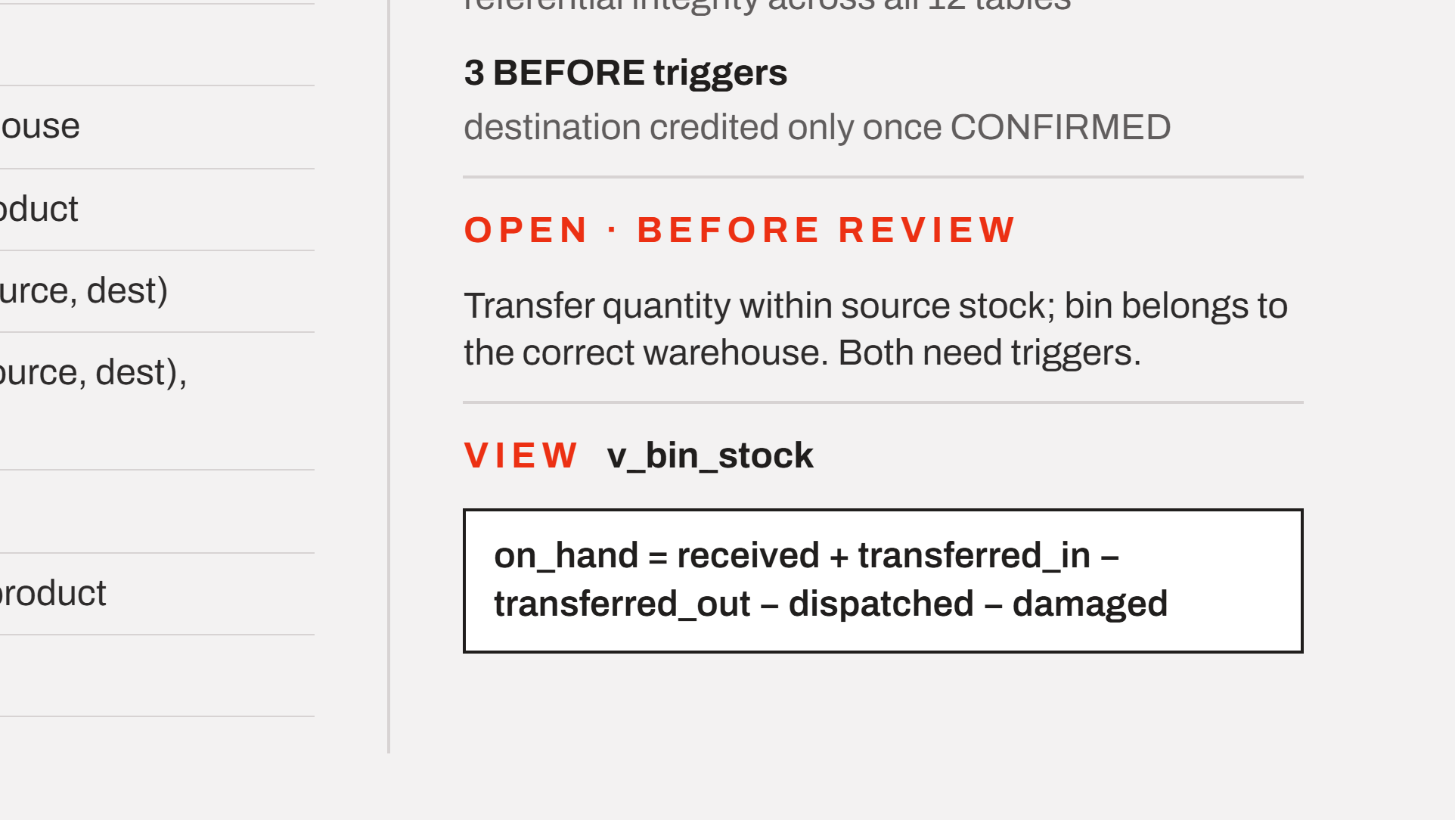
Notes:
The implemented schema in one view: twelve tables with single-column surrogate keys on zone and bin. On the right, how the rules are enforced: unique and check constraints, nineteen foreign keys and three triggers. Two rules are still open and need triggers. Stock is never stored; the view computes it live.

Slide 6
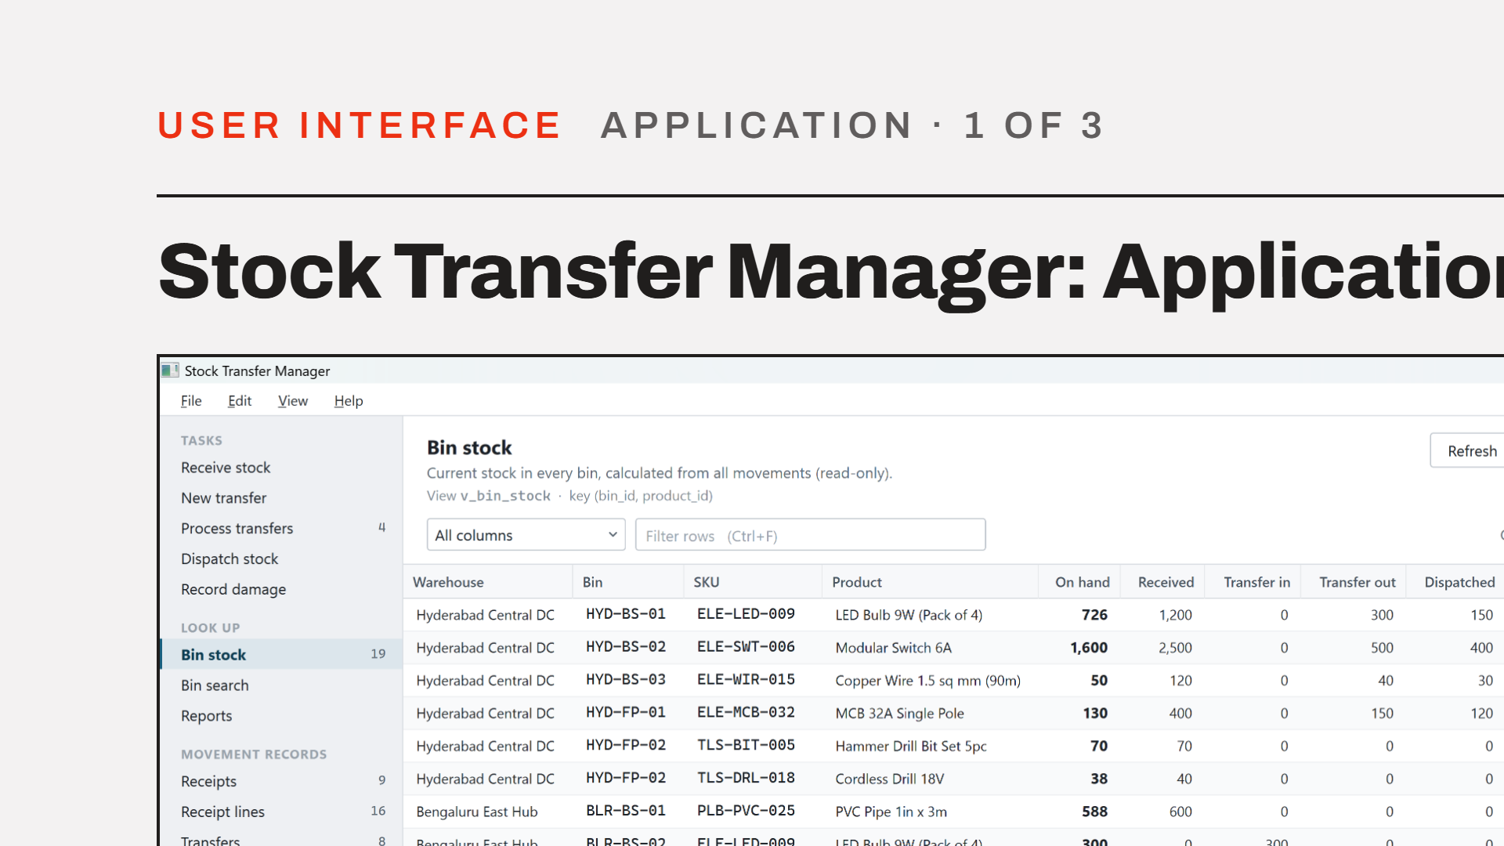
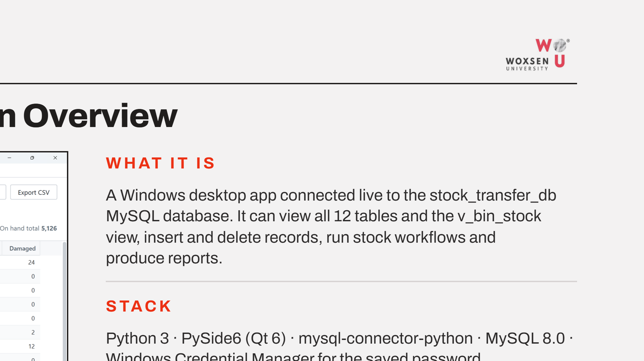
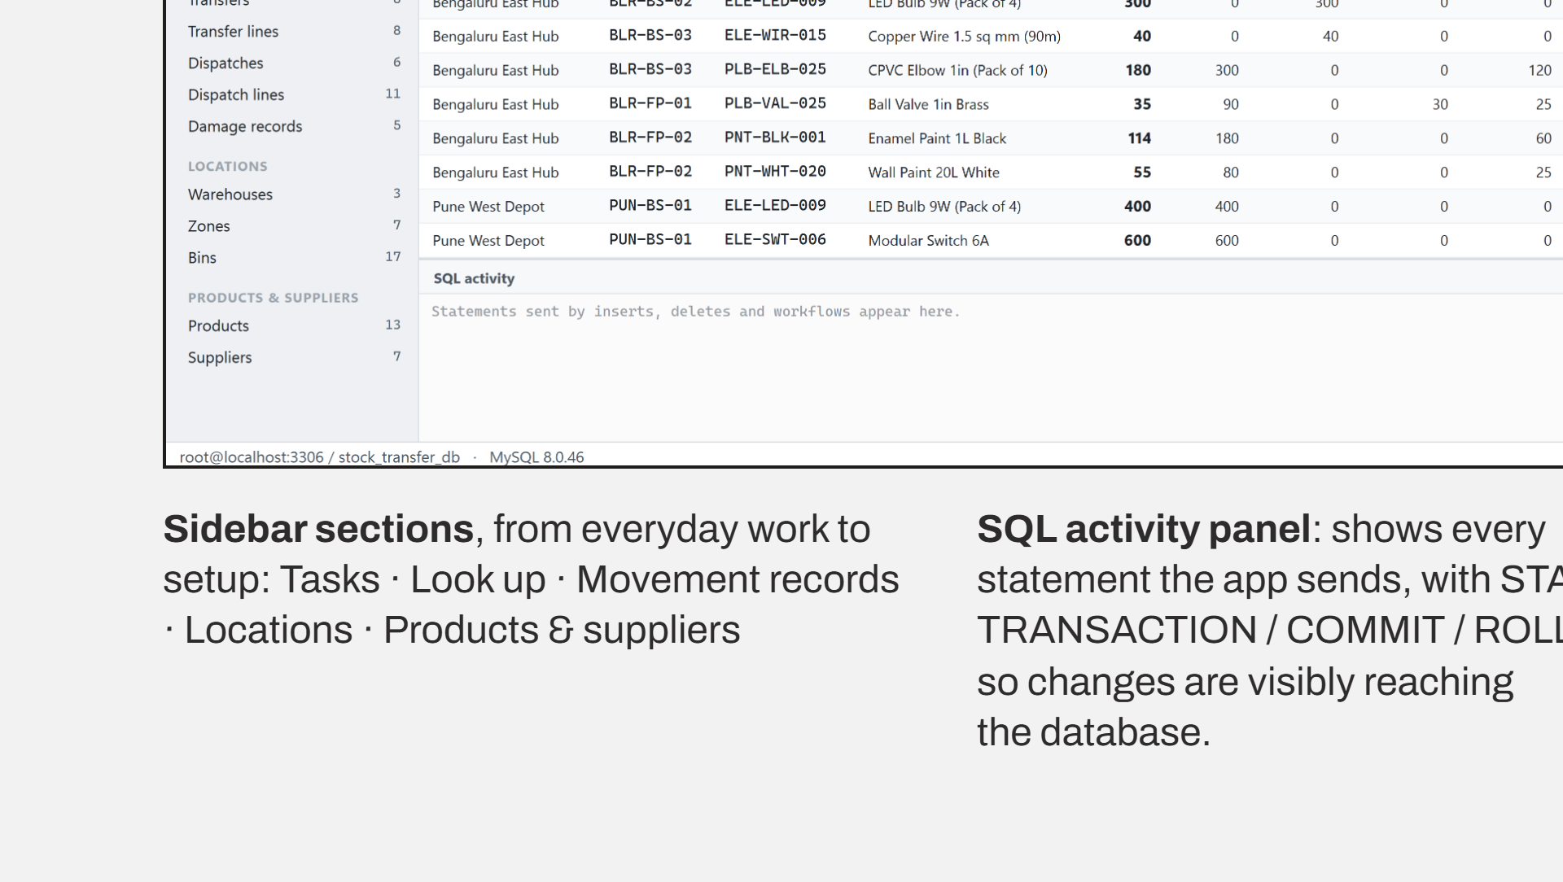
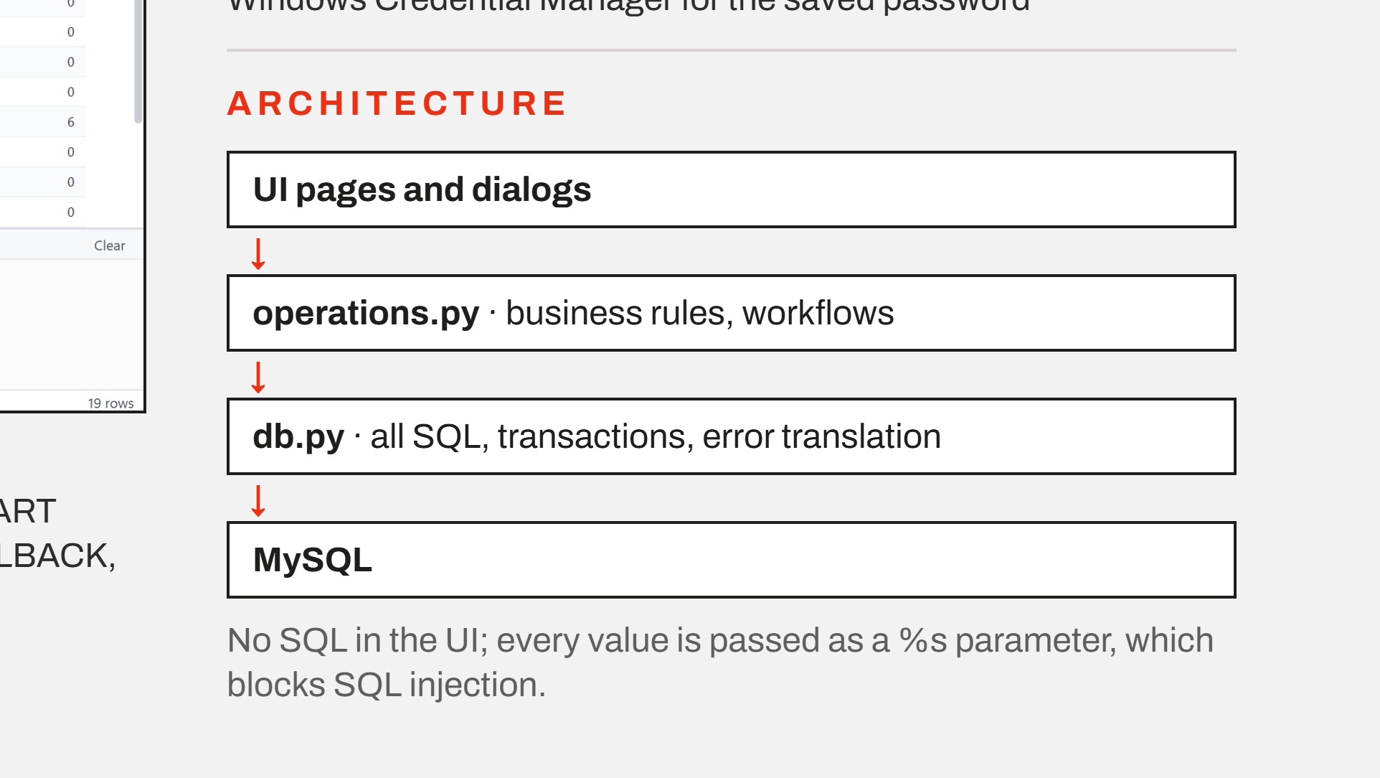
Notes:
The Stock Transfer Manager is a Windows desktop app connected live to stock_transfer_db. It is layered so the UI never contains SQL: pages call operations.py for business rules, which calls db.py for every query. The SQL activity panel at the bottom shows each statement as it is sent.

Slide 7
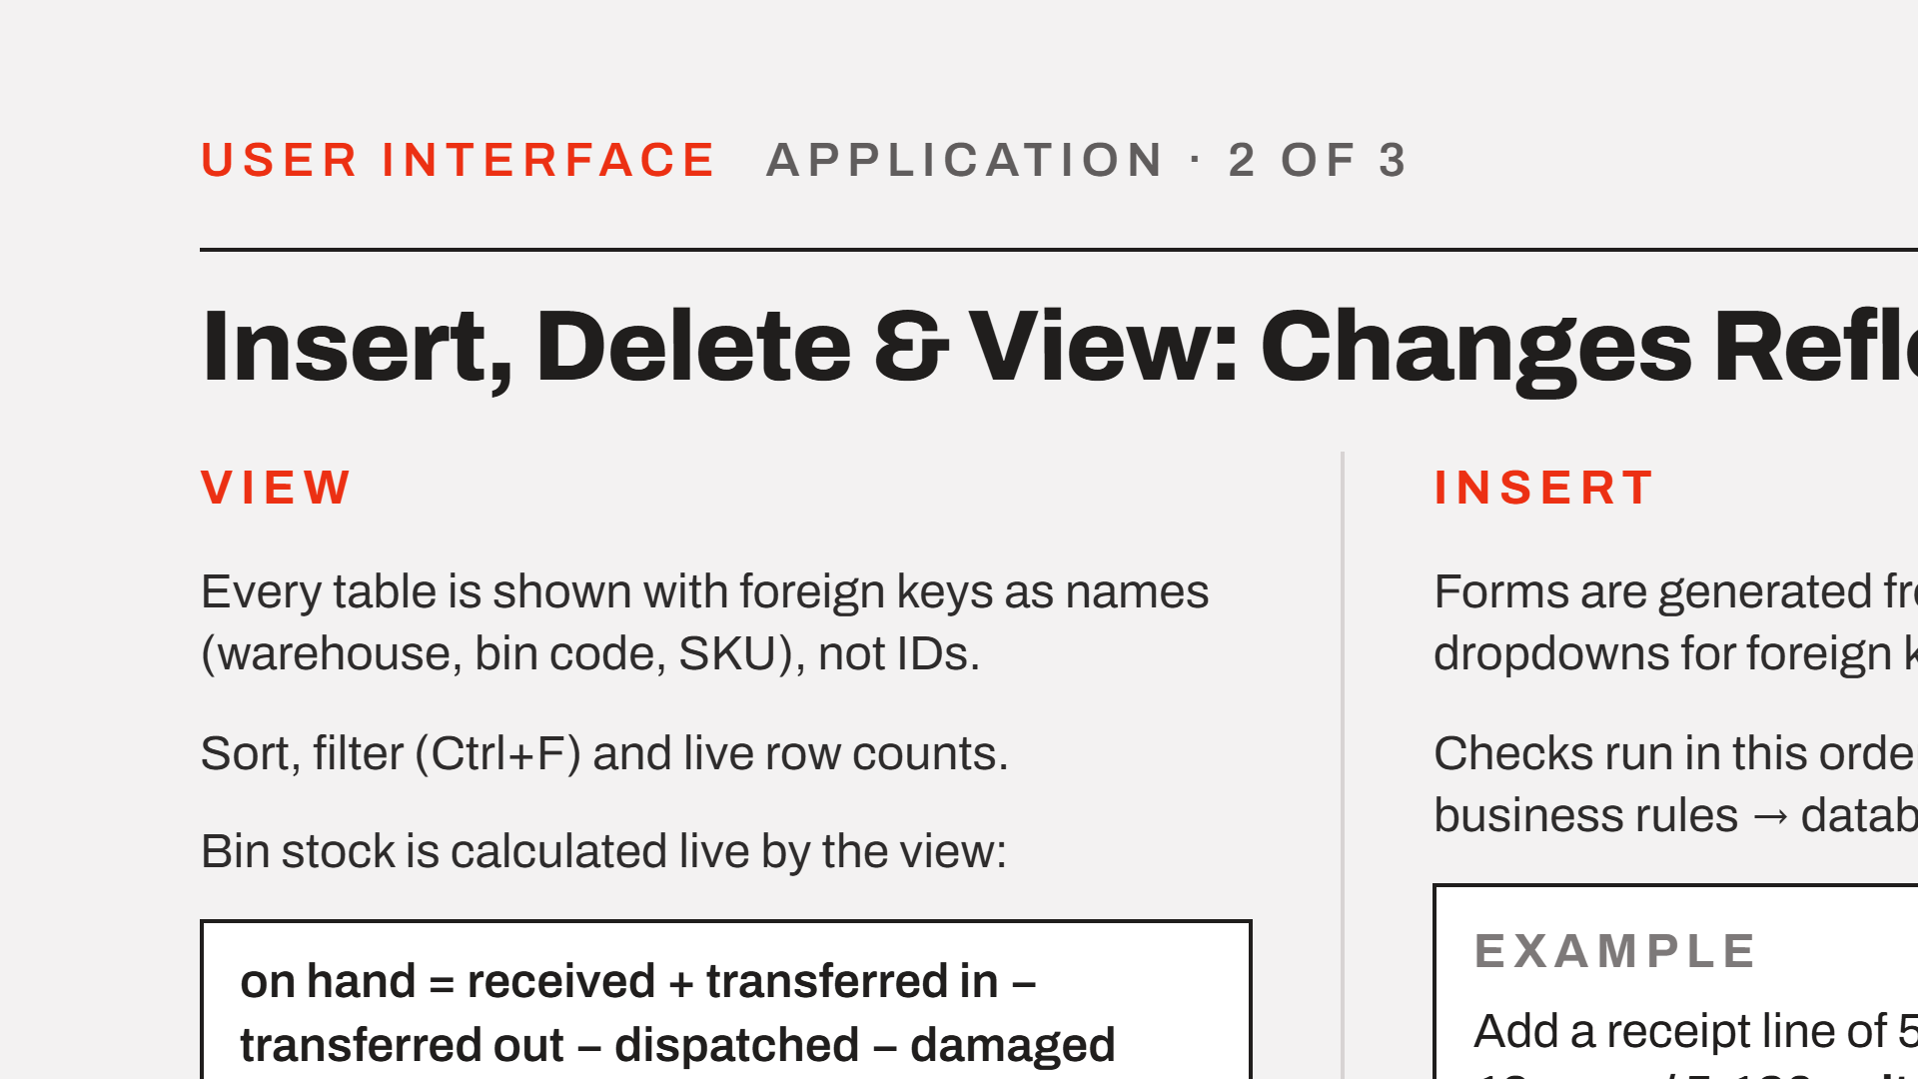
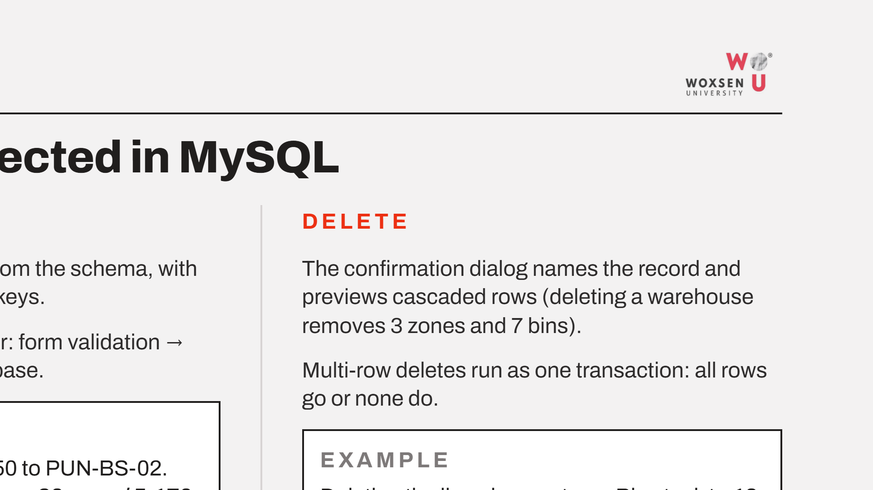
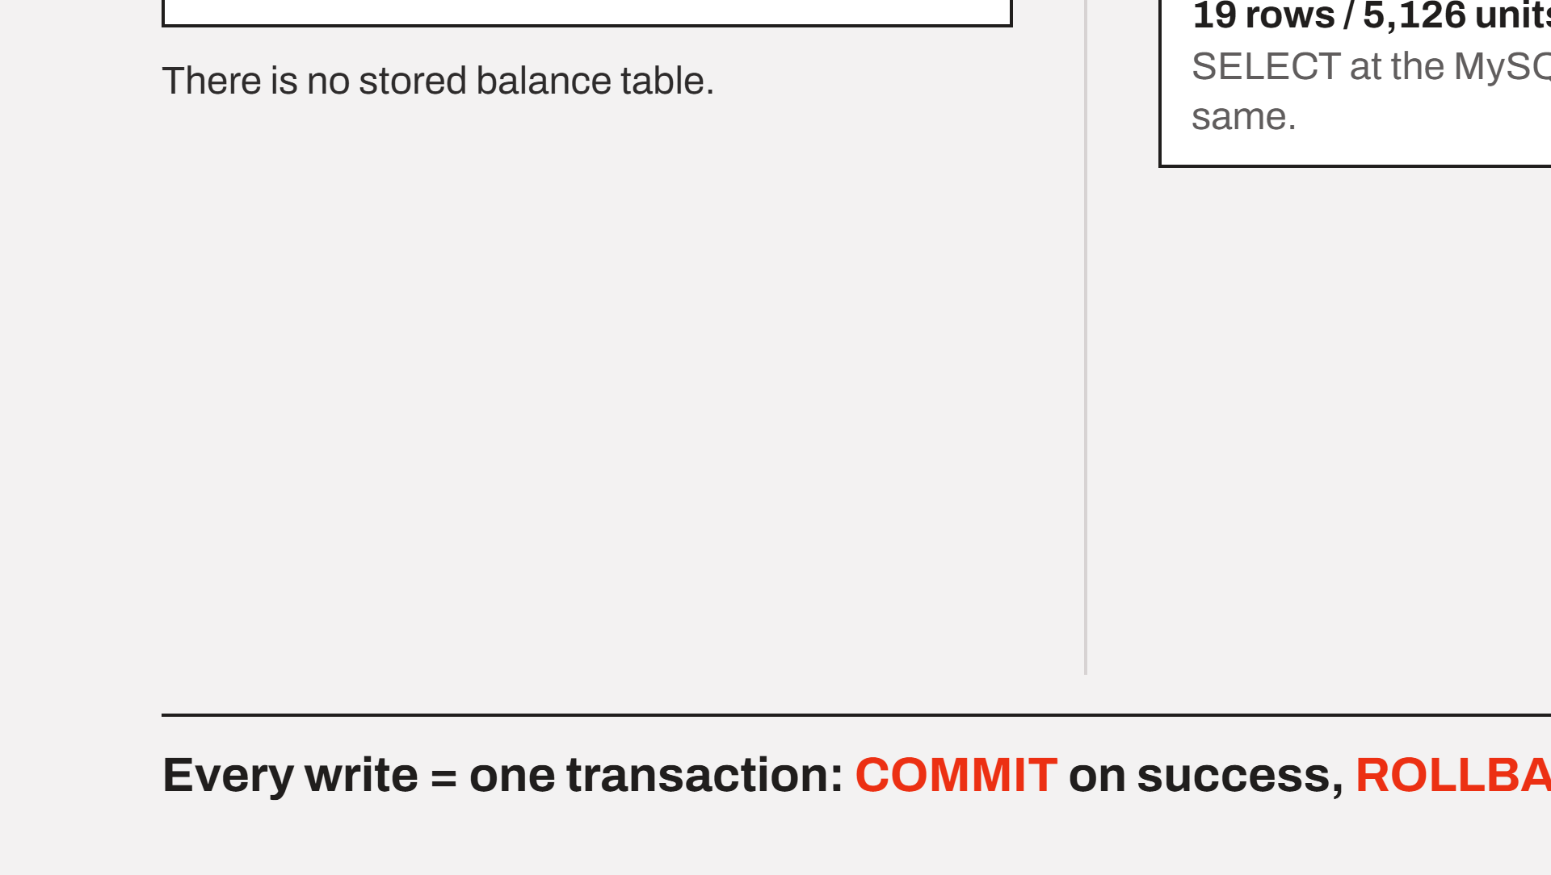
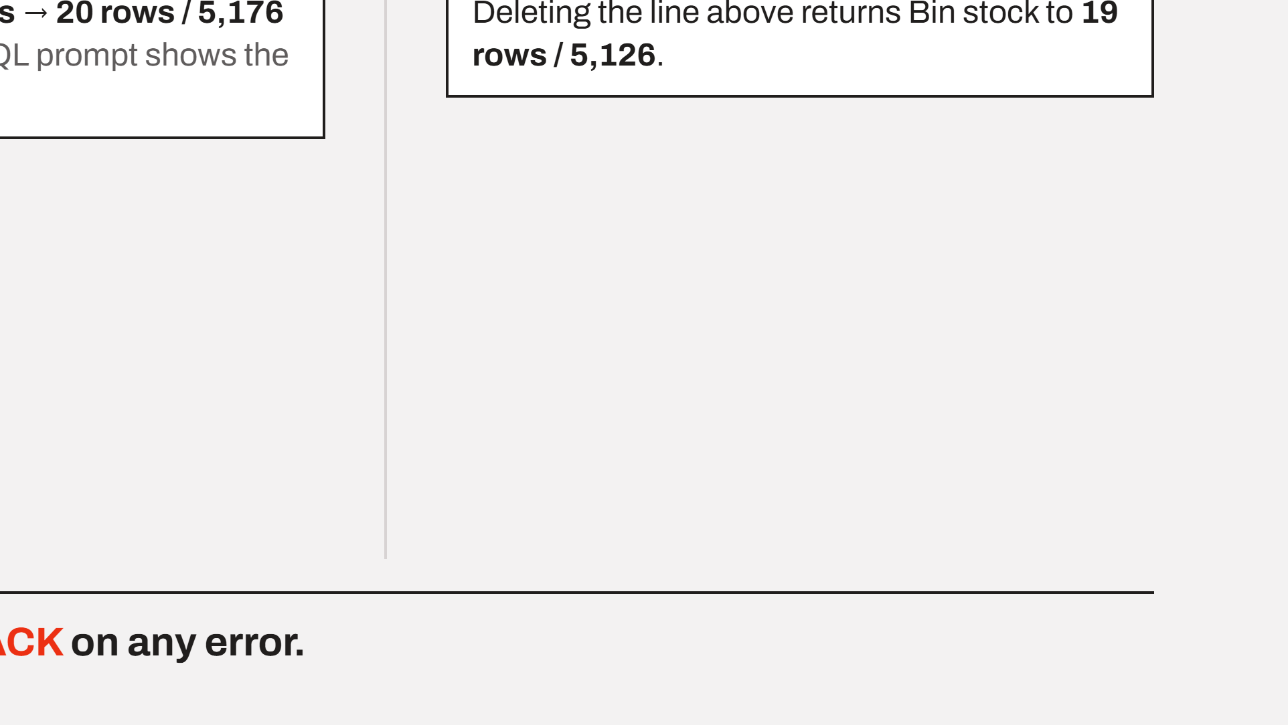
Notes:
Every table is browsable with names instead of IDs. Inserts go through three layers of checks. The example: adding a receipt line of 50 units moves bin stock from 19 rows and 5,126 units to 20 rows and 5,176, and a SELECT at the MySQL prompt confirms it. Deleting the same line restores the original totals.

Slide 8
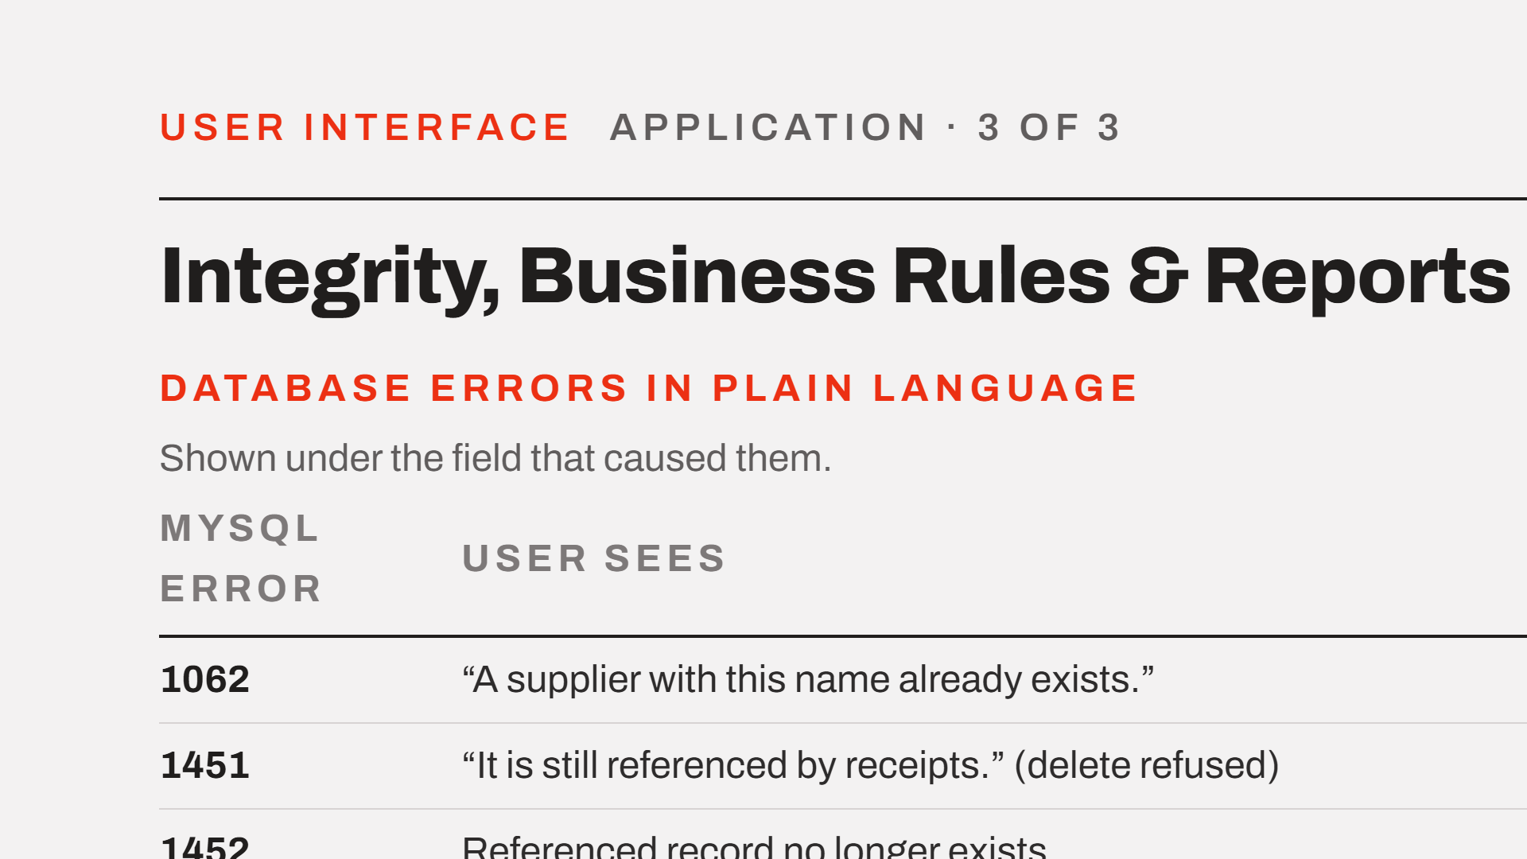
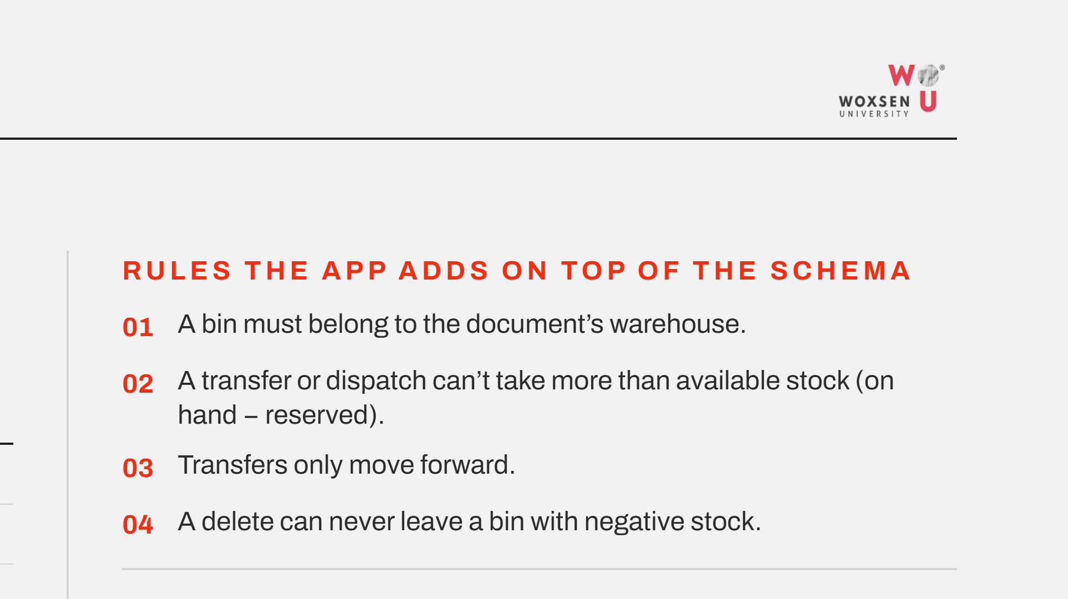
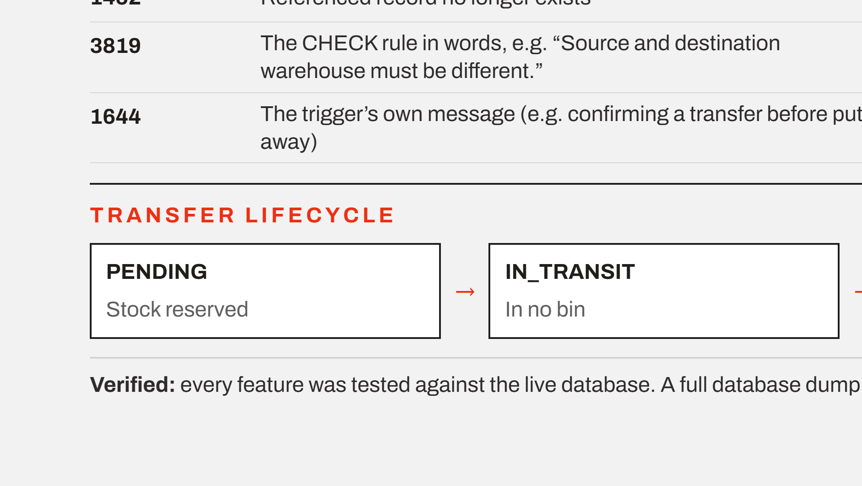
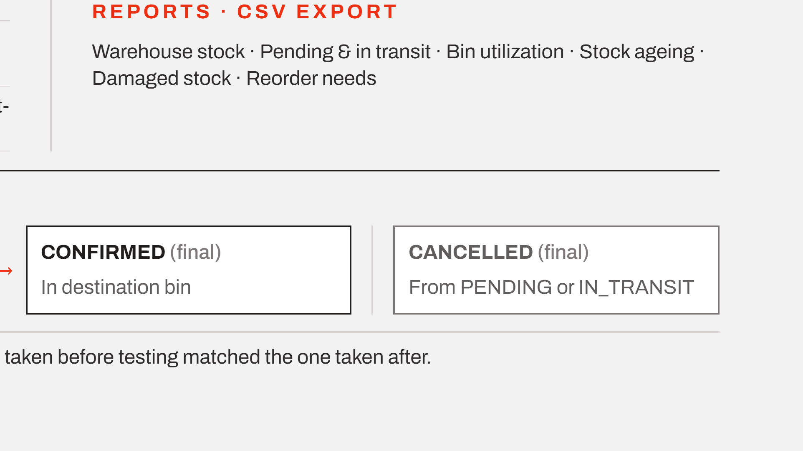
Notes:
MySQL error codes are translated into plain messages shown under the field that caused them. The app adds four rules the schema can't express on its own. Transfers move forward only, and stock is reserved, in transit or in the destination bin depending on state. Every feature was tested on the live database; dumps before and after testing matched. If time is short, skip the reports line; the demo shows them.

Slide 9




Notes:
Thank you. I am happy to take questions on the schema, the constraints or the stock view.

