Slide 1

Notes:
Introduce the team and the one-line idea: we choose which work runs, how it is computed and in what order, under a thermal budget, using only DAA syllabus techniques. The bar is real output: 0/1 Knapsack admits J2 and J3, filling the budget of 50 exactly, for benefit 220.

Slide 2
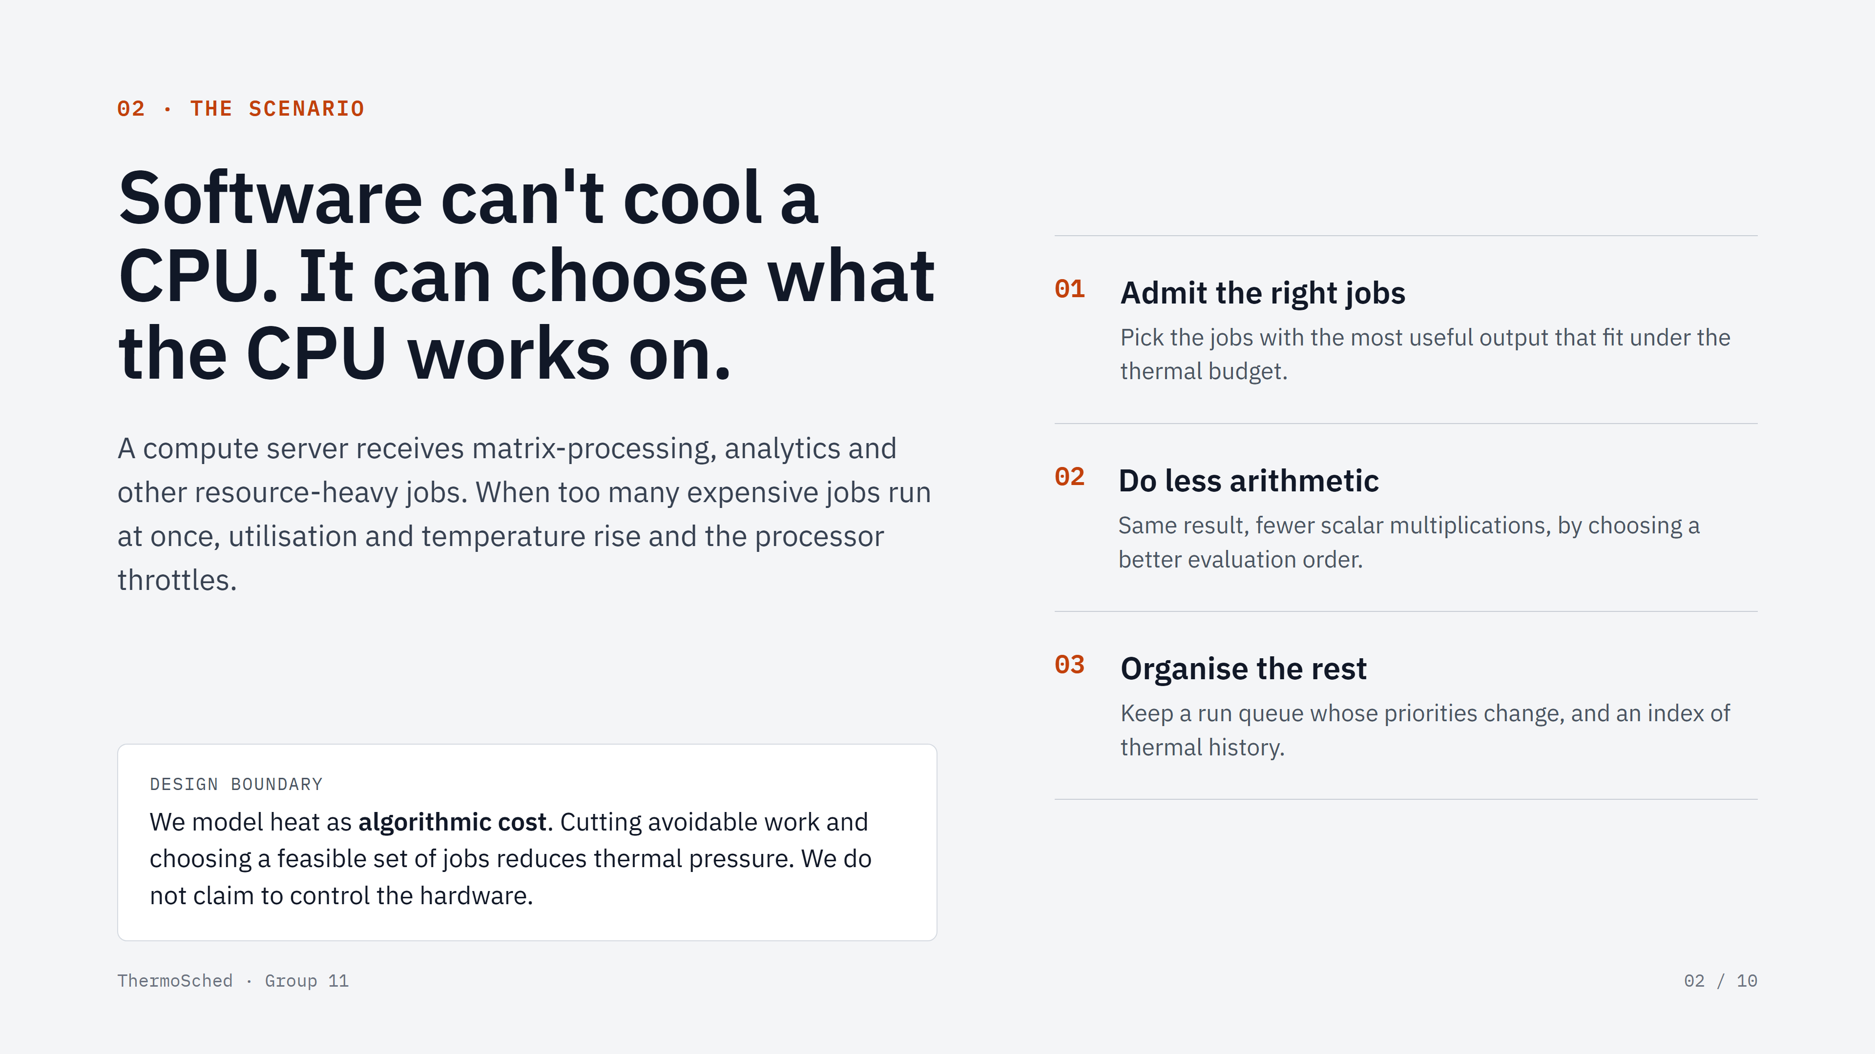
Notes:
Explain the problem: heavy jobs together cause heat and throttling. Software cannot cool the CPU, so state the design boundary clearly. Then name the three things software can do: admit the right jobs, do less arithmetic, organise the rest. Each maps to a module.

Slide 3
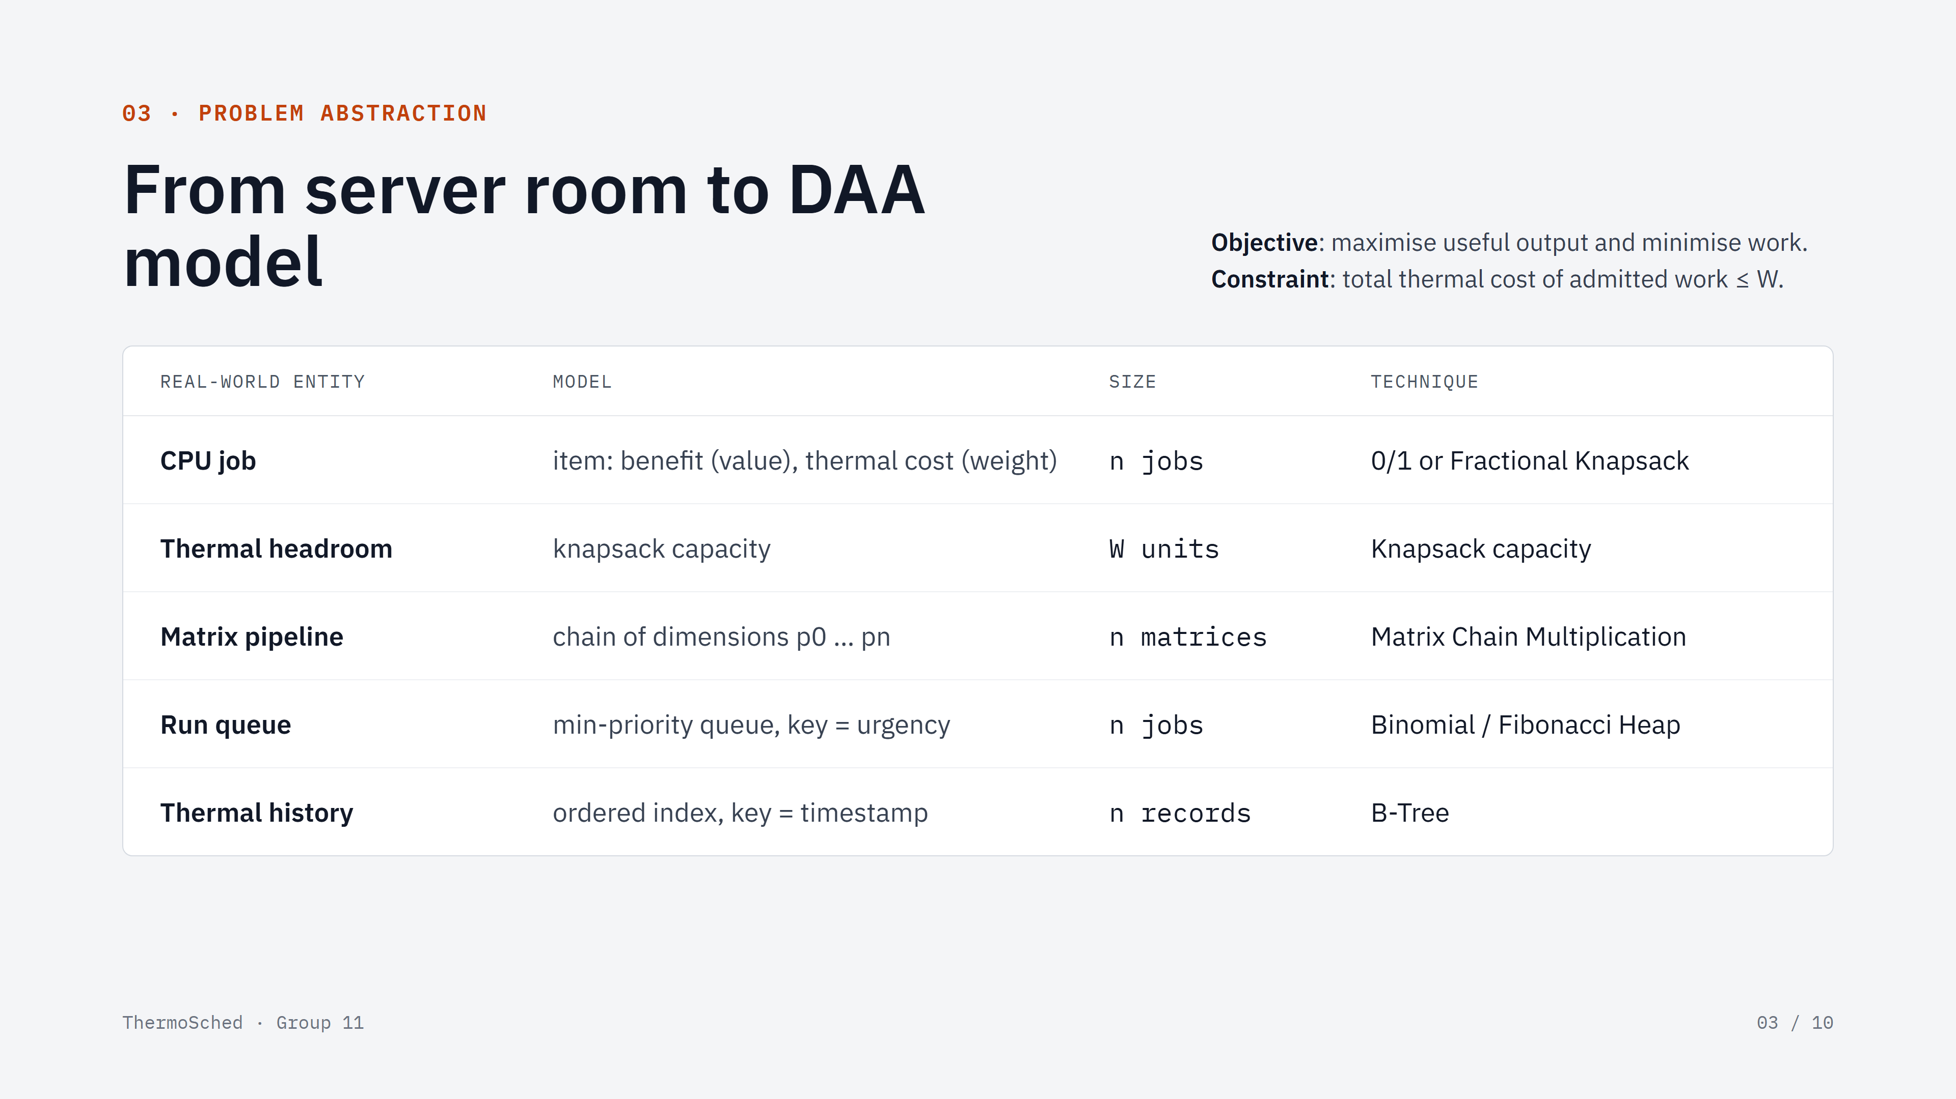
Notes:
Walk the table row by row: entity, model, size parameter, technique. Stress that we started from the scenario, not from the algorithm. State the objective (maximise useful output, minimise work) and the constraint (total thermal cost ≤ W).

Slide 4
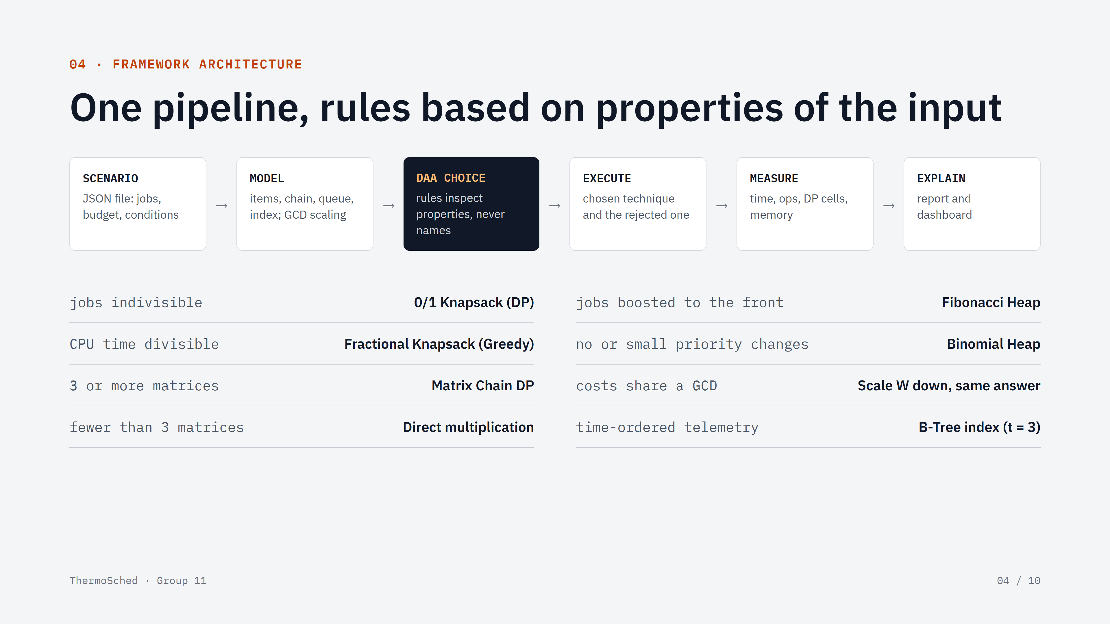
Notes:
Show the six stages. The dark box is the heart: rules inspect properties of the input, never algorithm names. Read two or three rules aloud. Mention GCD scaling in the MODEL stage and that telemetry always uses a B-Tree because of the data's shape.

Slide 5
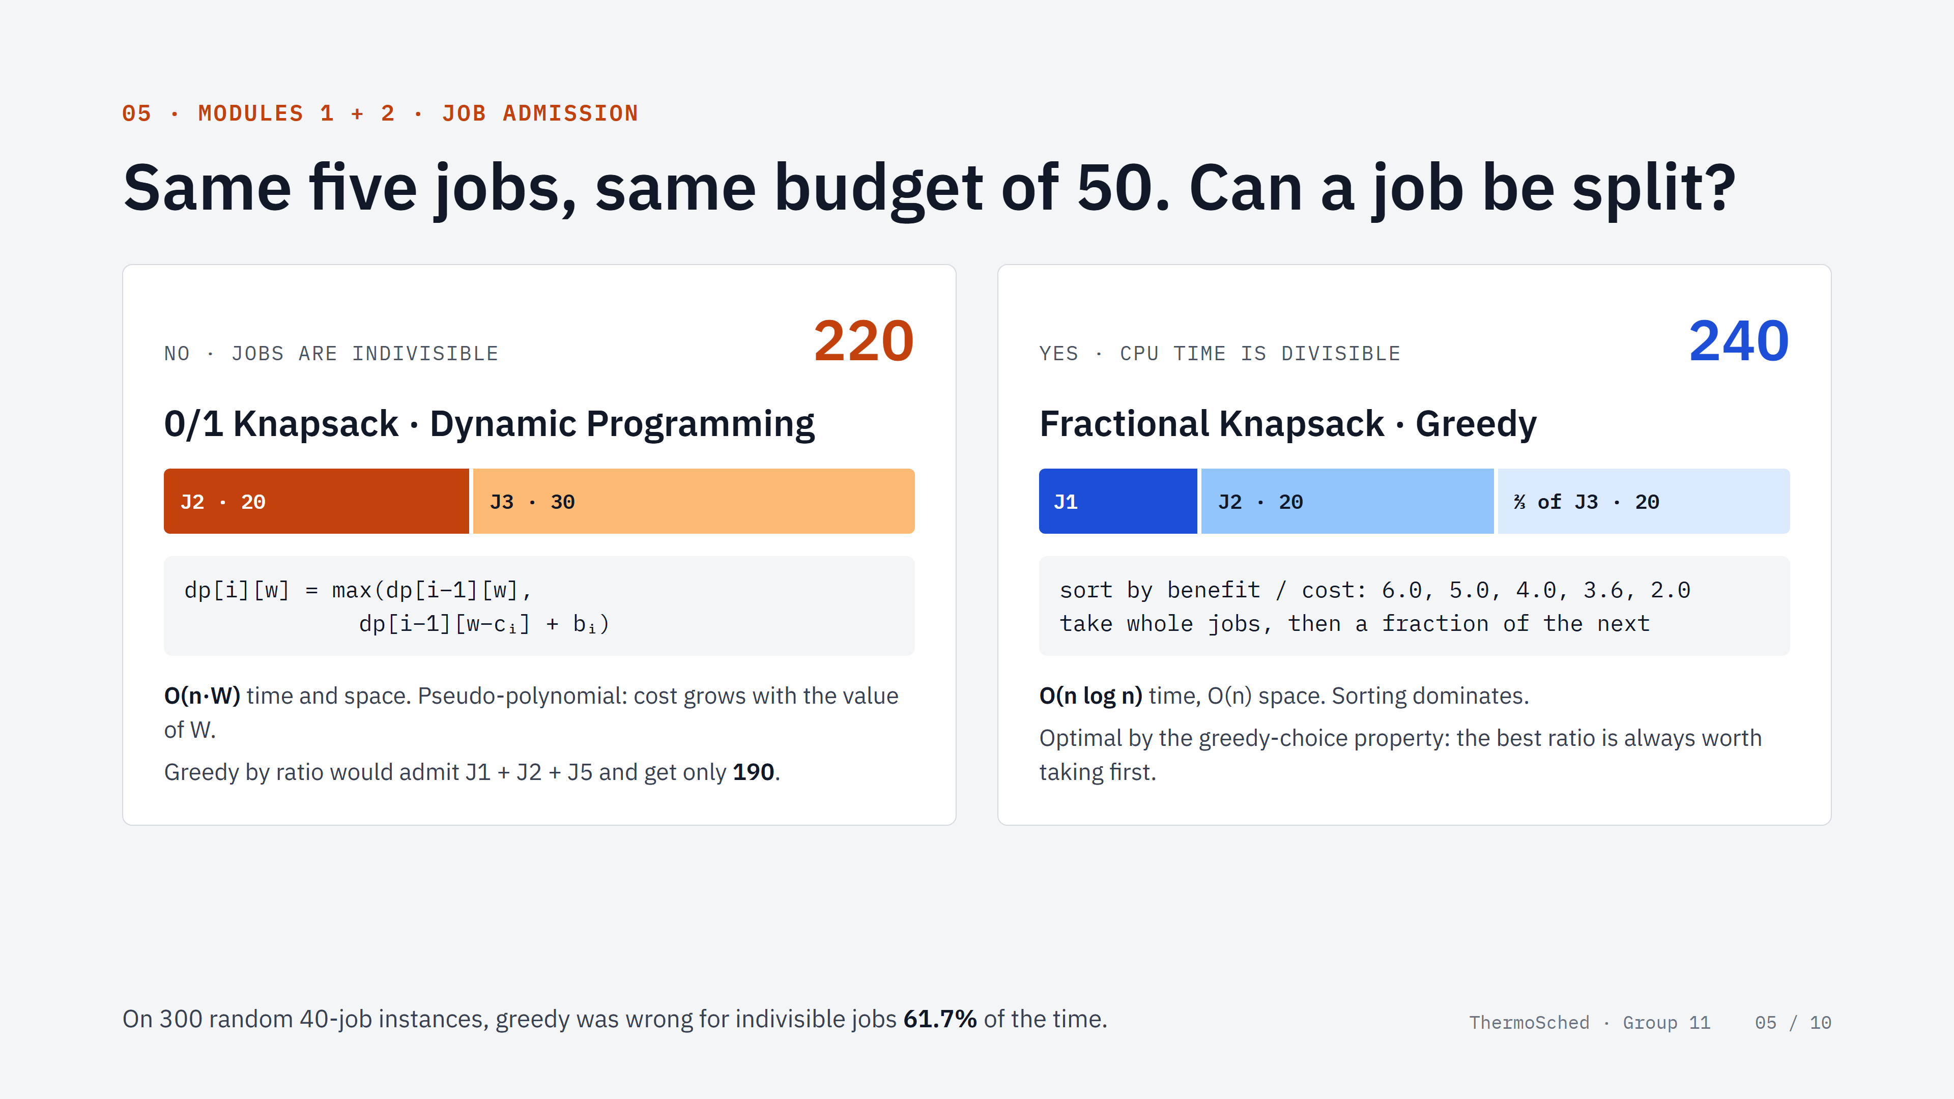
Notes:
Same five jobs, same budget, one question: can a job be split? If not, 0/1 DP gets 220, and greedy would get only 190. If yes, the greedy is provably optimal and gets 240. Show the recurrence and complexities. Greedy was wrong in 61.7% of random 40-job instances.

Slide 6
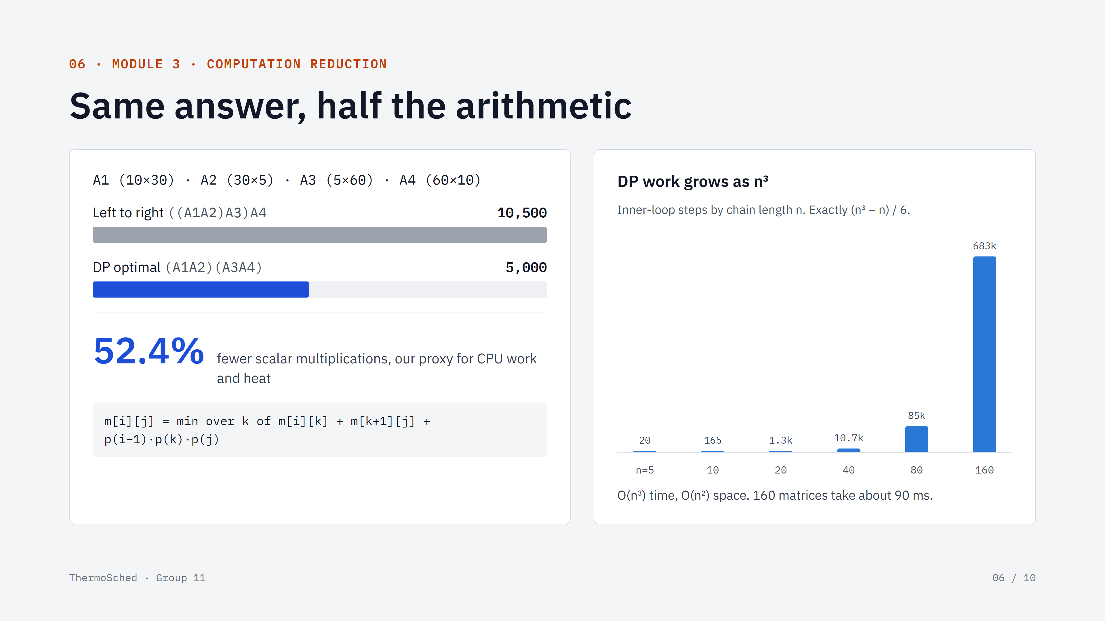
Notes:
Same answer, half the arithmetic. ((A1A2)(A3A4)) needs 5,000 multiplications vs 10,500 left to right: 52.4% less work, our proxy for heat. DP work grows exactly as (n³ − n)/6; 160 matrices take about 90 ms.

Slide 7
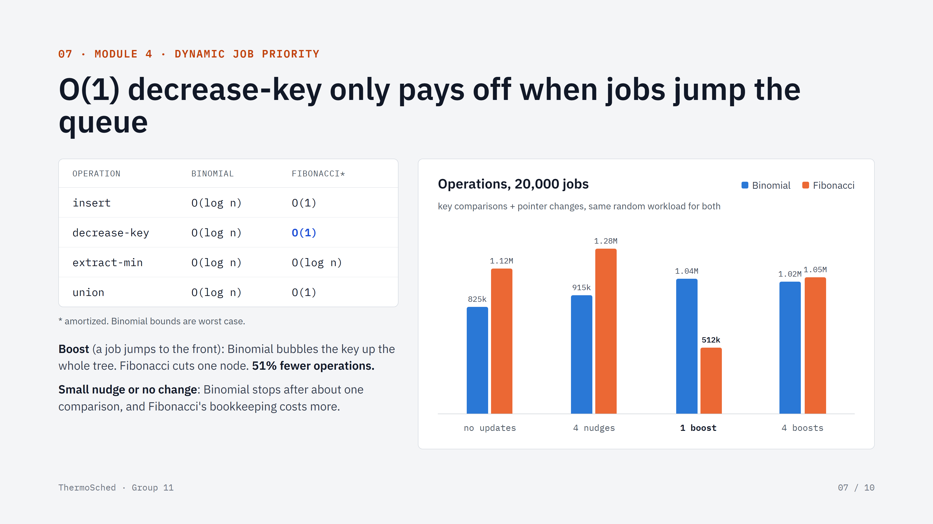
Notes:
Compare the bounds: Fibonacci has O(1) amortized decrease-key. Then show the measurement: it wins only when jobs are boosted to the front (512k vs 1.04M operations). With no or small updates, Binomial does less work, so our rule checks the kind of update.

Slide 8
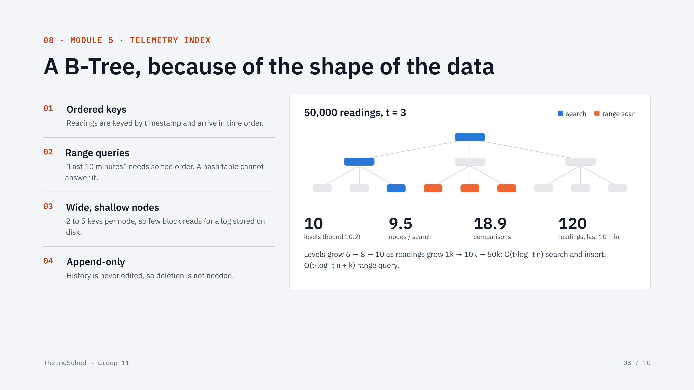
Notes:
Explain why the data's shape decides the structure: ordered timestamp keys, 'last 10 minutes' range queries (a hash table cannot do these), wide shallow nodes for a log on disk, and no deletion. Blue is the search path, orange the range scan. At 50,000 readings: 10 levels, 9.5 nodes and 18.9 comparisons per search, 120 readings in the window.

Slide 9
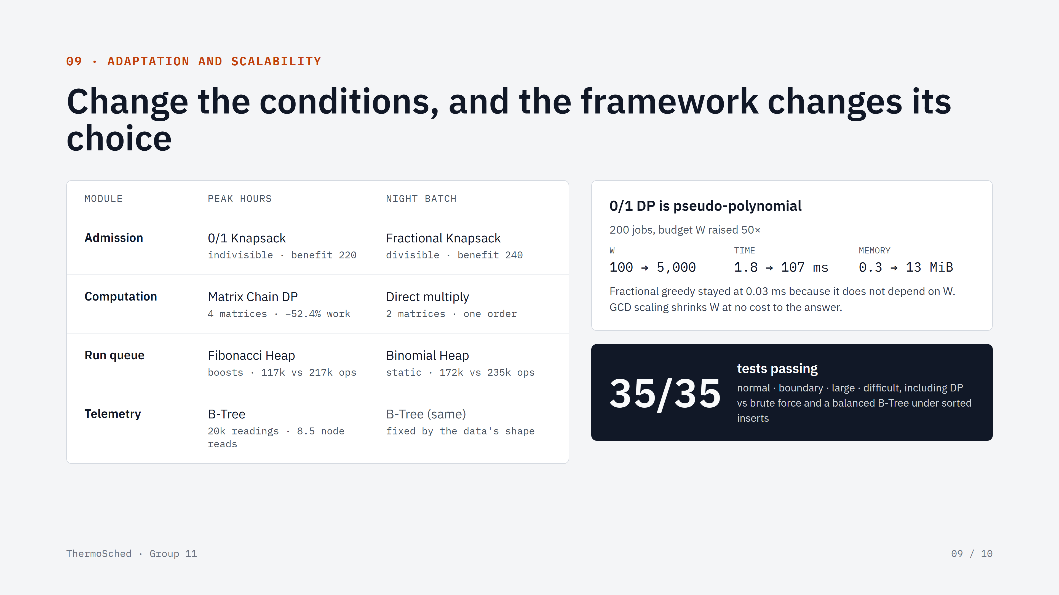
Notes:
From peak hours to night batch, admission, computation and the run queue all switch technique; the B-Tree stays because the data's shape has not changed. 0/1 DP is pseudo-polynomial: raising W 50× raised time from 1.8 to about 107 ms and memory to 13 MiB, while the greedy stayed at about 0.03 ms. 35/35 tests pass.

Slide 10
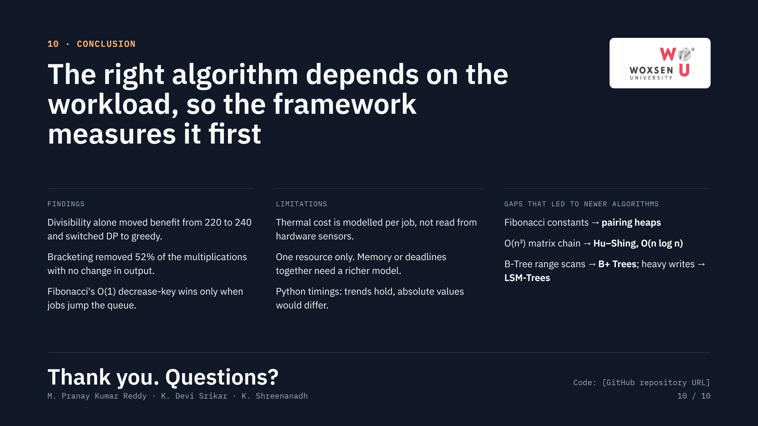
Notes:
Three findings, three limitations, and the gaps that motivated newer algorithms (pairing heaps, Hu–Shing, B+ Trees, LSM-Trees). End with 'Thank you' and invite questions. Have the dashboard open in case they ask for a demo.

