Slide 1
Web designing project
Topic : Sweet Shop
Name : Shreenath Srivastava
Roll no. : 202501101400049

Slide 2
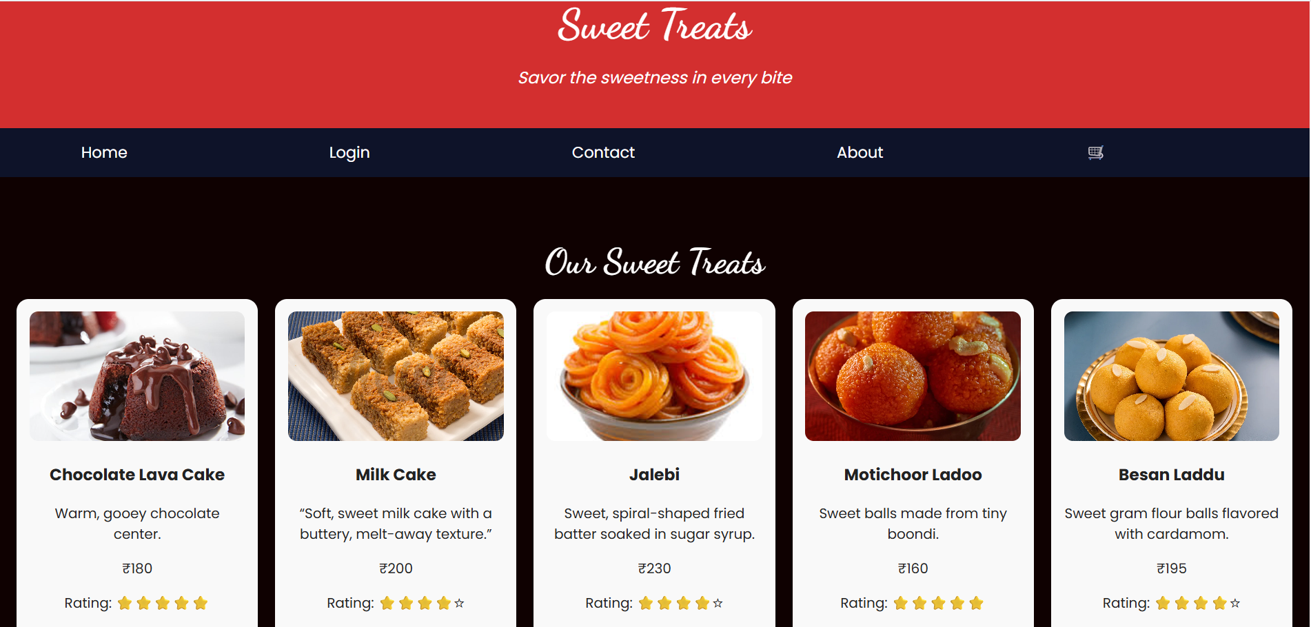
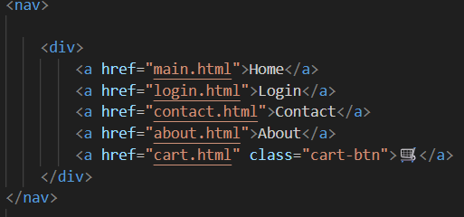
Sweet Treats Home page
Navigation Bar Snippet

Slide 3
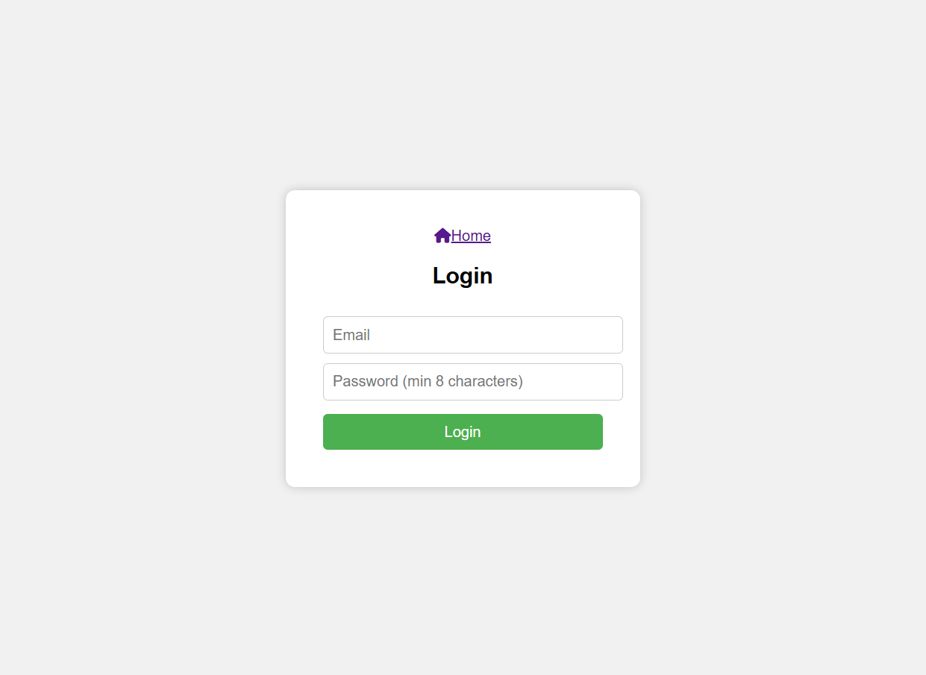
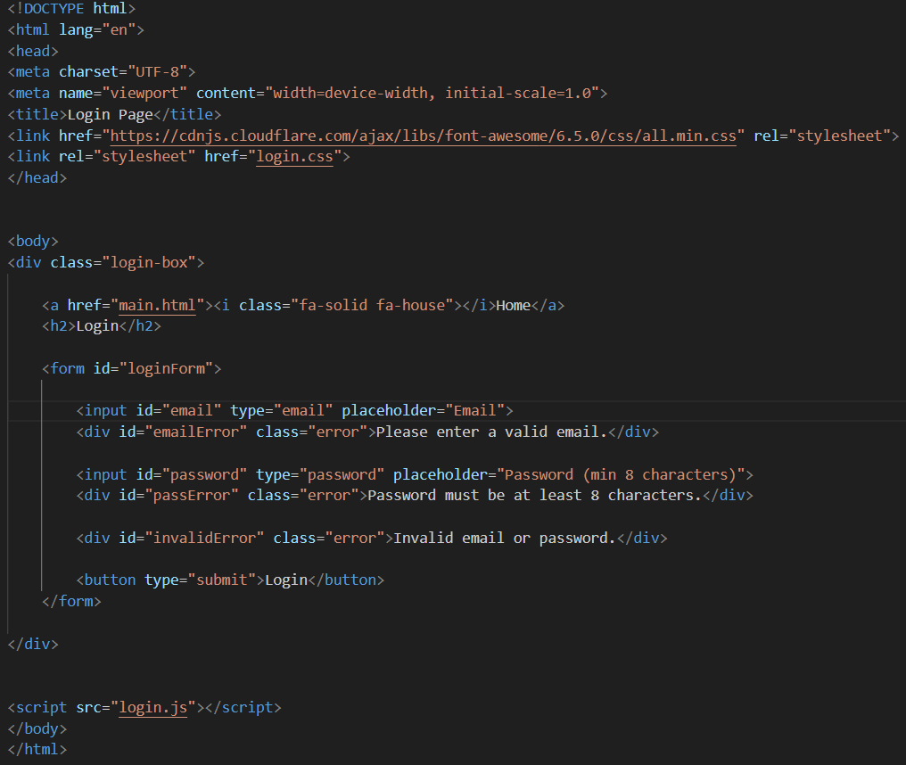
Login Screen
Login Screen Snippet

Slide 4
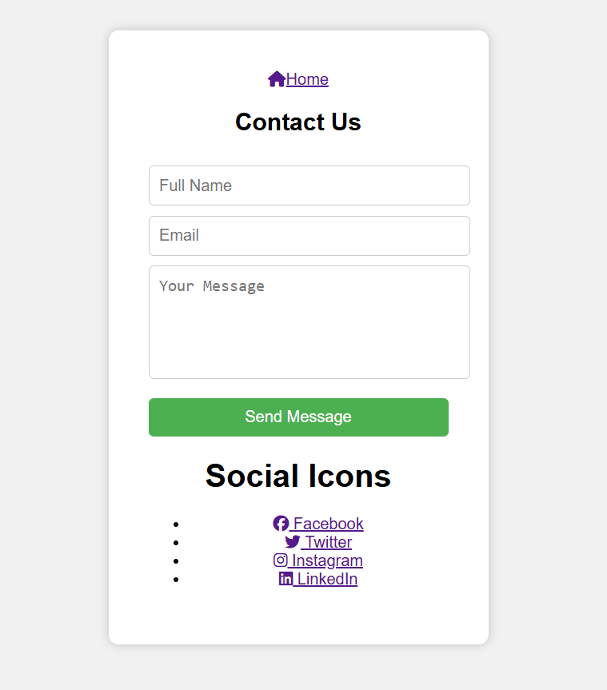
Contact Us Anytime
We Are Welcome To Help You

Slide 5
Thank you

