Slide 1
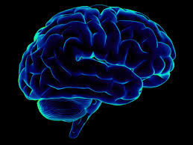

Narendra Damodardas Modi
Text, sentiment & trend analysis
Submitted by:
Vishal (11810095)
Shreenath(11810117)

Slide 2
1) Executive Summary (Abstract)
Motivation: To understand people’s sentiment on Narendra Modi from social media and understand his initiatives in deep and give recommendations accordingly on whether or not involvement would be beneficial or detrimental to a campaign. Promoting positivity and reacting to negativity. As near and real time as possible
Method: We have used Text & Sentiment analysis using NLP, so the data that we extracted are over 2 years, this included 3rd party sources and extracting from Twitter, YouTube, Google trends, NewsAPI & other sites, having text contents and further deep dive related information. We performed EDA and understood key trends & patterns further more topic modelling & sentiment analysis was implemented with leverage of secondary search.
Models: We have implemented LDA statistical model, which classifies words to topics based on probability and also the document wise probability by each topic. Sentiment Analytics using NRC emotion lexicon.
Message: How best to communicate with the citizens and increase over all engagements. This can then be customized to increase the outreach to specific demographics/ target groups.
Means: Tableau,Tweepy,Selenium,GOT3,twitteR,Textblob, R shiny, Matplotlib, selenium, NewsAPI, ggplot2, Topicmodels, wordcloud, dplyr, stringr, Rsentiment, syuzhet, lubridate.

Slide 3
2) Business Problem
Business Understanding
Understanding people’s, Influential leader’s & Key opinion leaders sentiments and impact through initiatives therby giving a deep dive insight on the how its has effected the citizens and economy. This will help to understand Narendra Modi’s of how far his promises have been delivered to the masses and his position on the 2019 lok sabha elections. it helps to identify what groups of citizens to reach out to and best medians of communications and engage and mobilize the voters.
Analytics Approach
Identifying sources, extracting data from the sources, cleaning and modelling the data, applying feature engineering and analytical modelling for arriving at desired outputs for study and recommendations.
We covered data collection, EDA, Text analytics, Statistical analysis (Modeling) & Data visualization techniques.
It is definitely useful for Data analytics, so far we have utilized all the learning methods on this data and this would help in future working scope in building machine learning models for predictions, which would in order help in political campaigns, it helps to identify what groups of citizens to reach out to and best medians of communications and increase the overall engagement.

Slide 4

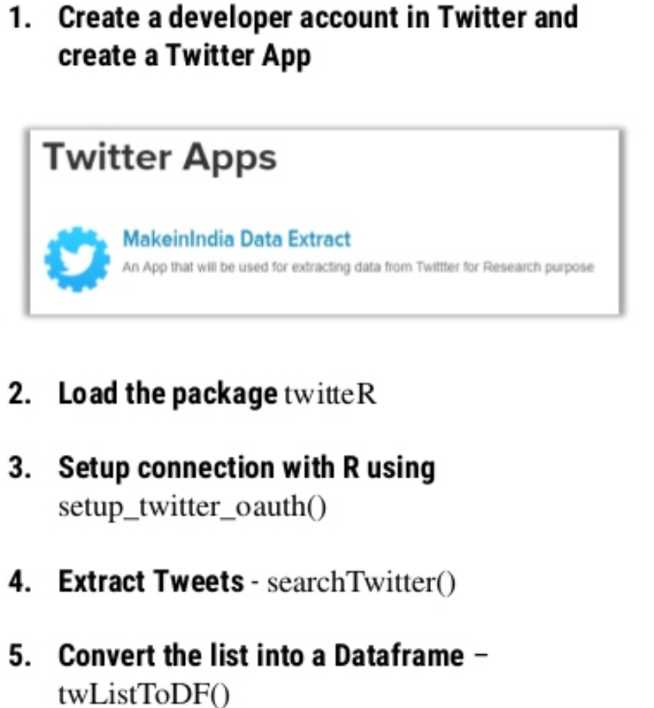




3) Data Requirements & Collections
Data Requirements
Twitter data for current and historical, YouTube, News & journals, other data sources and RBI transactional data.
Data Collections
Pre-requisites
Twitter API : Creating twitter account, creating an app, generating auth keys
NewsAPI: Generatig NEWSAPI key (newsapi.org)
YouTube: Installing selenium drivers and chrome drive.
Access to Kaggle dataset, by creating a Kaggle account.
Data sources:
Twitter, YouTube, News & journals, Kaggle & RBI (DBIE site)
Challenges:
Twitter gives you current week data and max pull of data limit per day is 3200. Also, the length of the tweets with only 140 characters.
NewsAPI allows you only to extract 1000 documents, with limited length of the content.

Slide 5
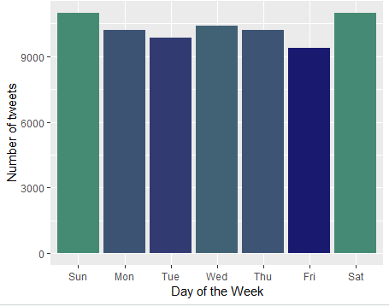
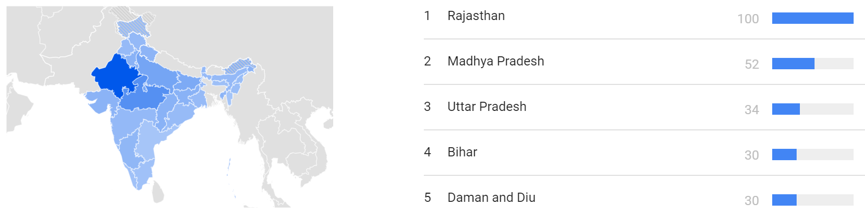
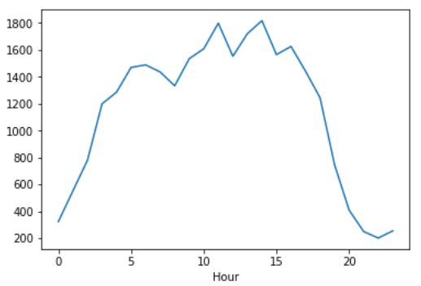
4) Data Understanding
Data Understanding:
Data Summary: Extracting the data from Twitter, youtube & NewsAPI had a lot of unclean, unstructured data, it had Twitter handles, Re-tweets, punctuations, digits, HTML tags, white spaces, English stop words and unrecognized characters.
Visual Explorations: We explored options of Tableau, R plots (ggplots) & Python plots (Matplotlib)
First Cut Analysis & Initial Patterns:
Analysis:
The count of tweets we could extract are given in the Year & Month graphs
These are basically the dispersions of the data we have extracted.
Below is the patterns we could read on a Day to hour and minute basis.
So we notice that there are spikes of tweets on #Narendra Modi during the beginning
Mid of the month and end of the month and mostly on mid hour of the day (lunch times) and 30th minute of the hour.
Possibly due to most of the working professions having a break during lunch time knowing the current affairs and also 30th minute of the hour could possibly be a bot generated tweet.
Analysis:With recently concluded elections in the states of Madhya Pradesh, Rajasthan, Chhattisgarh, Telangana & Mizoram. It is expected that these states would have shown some interest to understand Narendra Modi’s reactions and comments on the elections, but however it seems like only Rajasthan & Madhya Pradesh was looking for it. Seems like Uttar Pradesh & Bihar had some keen interest on the ‘Mahagathbandhan’ event during the time of August 12th 2018. Apart from that on the 2nd week of April’18 seemed to have a spike in search for ‘Narendra Modi’ at the time there was voilence breakout during a ‘Bharat Bandh’ protest in parts of UP & Bihar by the Dalit community. Also, Narendra Modi had announced that NDA government had built 8.5 lakhs toilets as part of the Swacch Bharat mission.

Slide 6
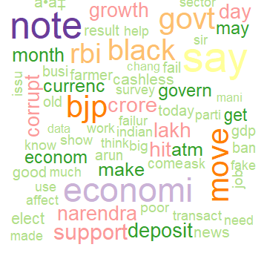
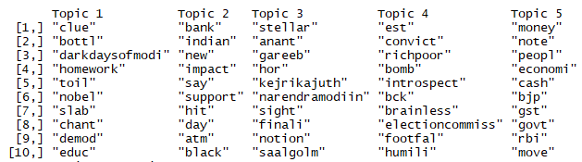
5) Data Preparation
Noise: There were many unwanted contents in the data like, Twitter handles, Re-tweets, punctuations, digits, HTML tags, white spaces, English stop words and unrecognized characters. We had used gsub function to clean the noise from dplyr package. We have used DTM method to create bag of words
Curse of Dimensionality: We had lot of columns in Twitter, YouTube and Newsapi, but we considered only text and date columns.
Data Standardization: To standardize the data we cleaned the data and used stemming later converting the data content to lower case to standardize.
Deriving latent variables: Created LDA - Latent Dirichlet Allocation modeling LDA helps explaining the unobserved groups using generative statistical model. This is mainly to classify the text to a particular topic by using probability functions. By using the LDA, we went a lower in granularity to access the total sentiment score for the words used, classifying them under topics.
For e.g. The topics on K=5

Slide 7
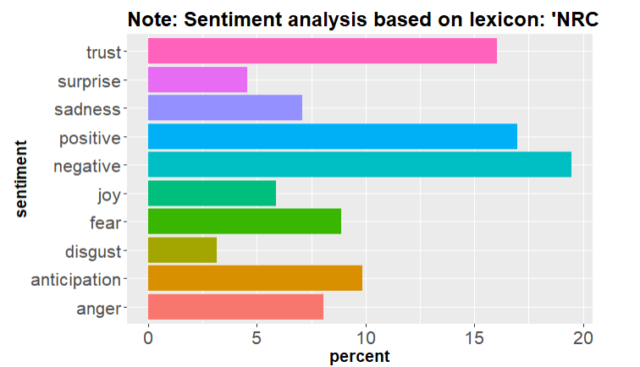
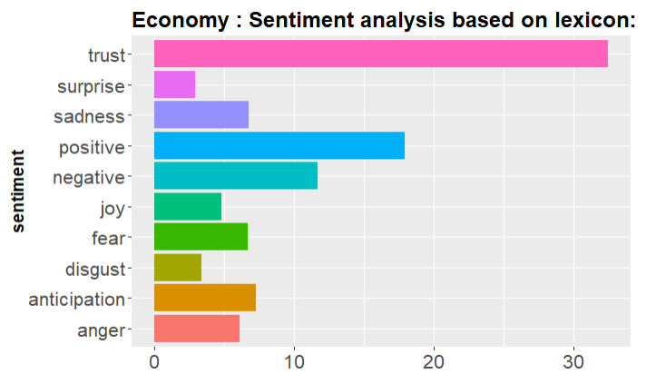
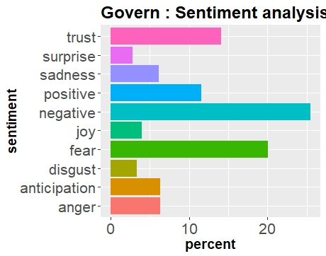
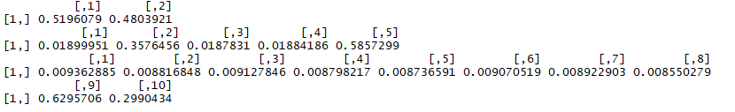
6) Modeling, Evaluation and Feedback
Choice of Models: We have used LDA : Statistical topic Modeling, for document level sentiment analysis, so that the sentiment polarity is based on the relevant parts of the document. As a statistical model, LDA provides probability of each word to be belonging to a topic and again probability of each topic belonging to each document.
NRC : Sentiment Lexicon, is used for division of words based on 10 proto typical emotions namely, trust, surprise, sadness, joy, fear, disgust, anticipation, anger, positive & negative.
Optimization Techniques: When we were depicting a word by creating a DTM & frequency matrix, we observed the frequency of words were getting repeated on the terms we had searched for. For e.g. Modi, India, Demonetize etc. So we placed them under stop words, also we had used stemming algorithm to reduce the word to its base form.
Evaluation: On applying LDA topic modeling , we have classified different topics using the bag of words approach, used 2, 5 & 10 as number of topics and created 3 different LDA models based on these K-values whatever classifications were made by LDA, post LDA we took 4 most common topics and did further analysis using NRC sentiment lexicon. This is done explain granularity vs generalization.
Feedback: By optimization, we built a better corpus which eventually makes it more suitable for the modeling and sentiment analysis
Document wise probability of each of topic
K = 2
K = 5
K = 10
Notes:
Why did we use 2,3,5 selecting more number of topics may result in more granular segregation, but at the same time difference among different topics may get blured, but on the other hand selecting very small number of topics may lead to loosing possible topic. To minimize the error we have used 3 different K or number of topics.
LDA model then creates a prob on each topic, on each doc & dist the words under each topic
Model picked more topics in 5 or 10, to compare granularity vs generalization

Slide 8
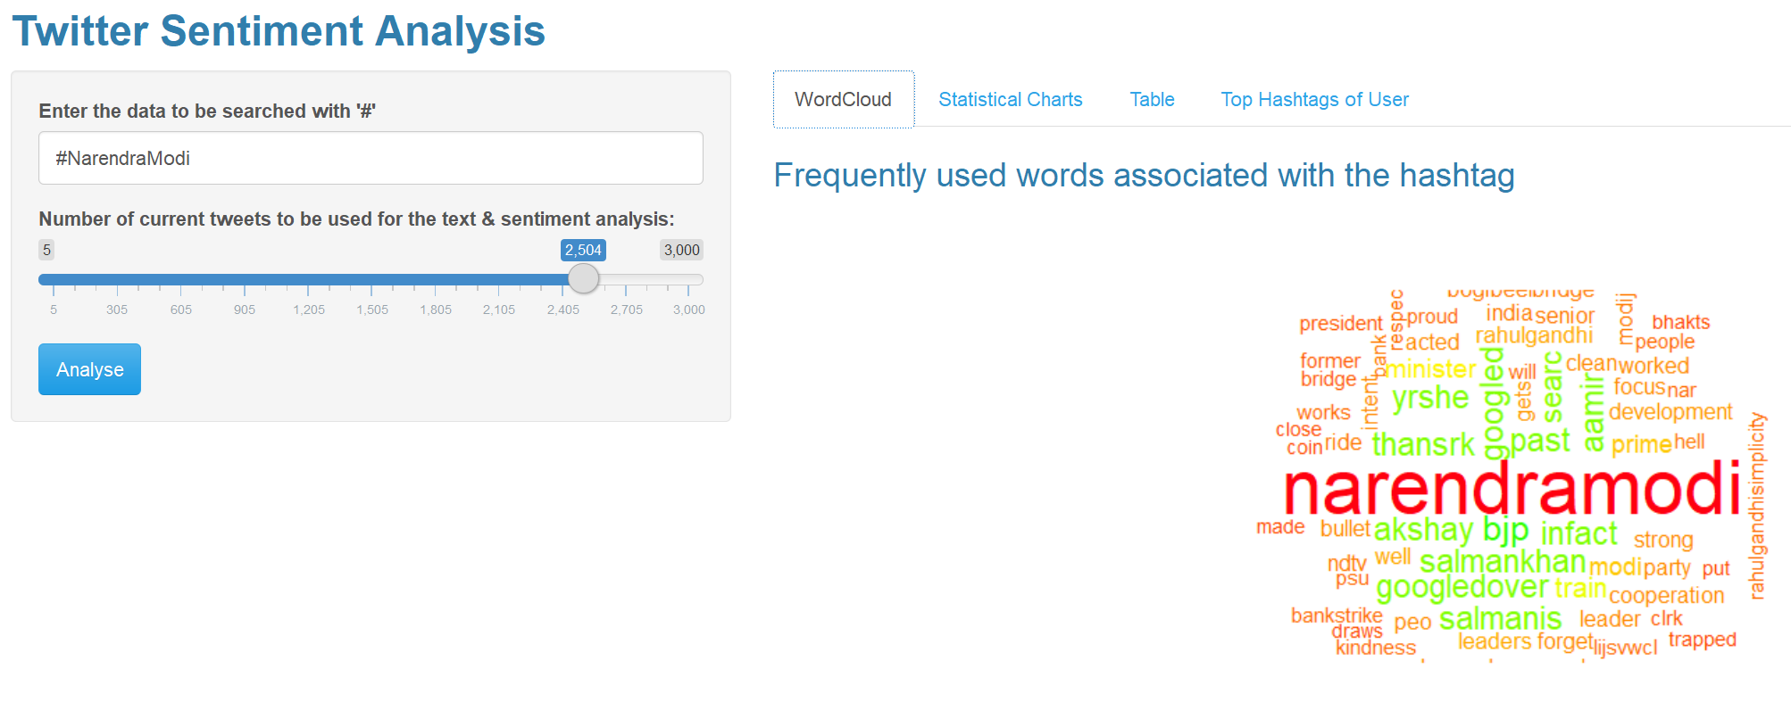
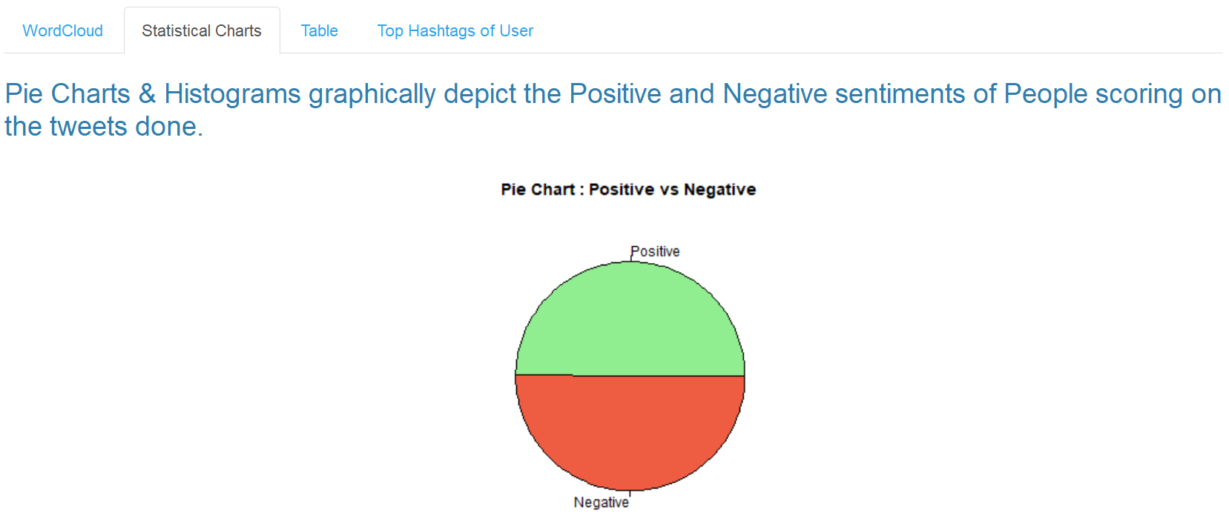
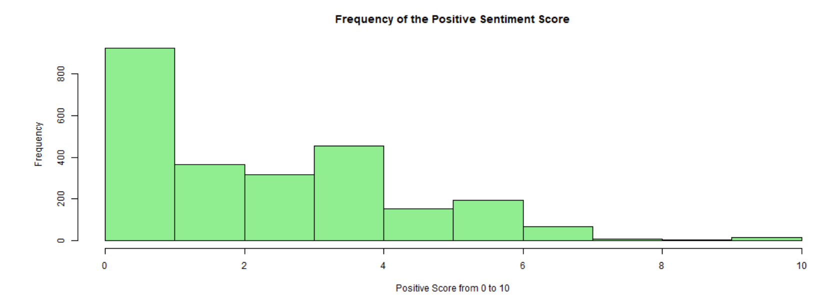
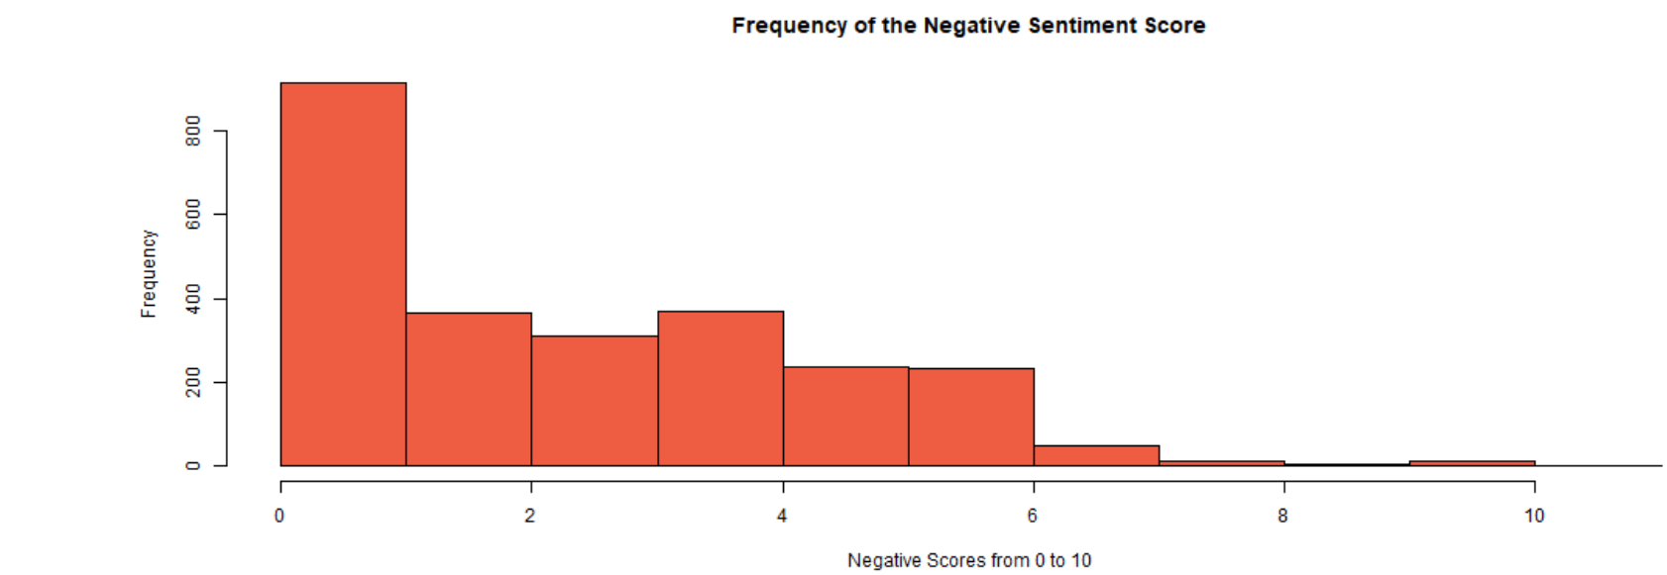
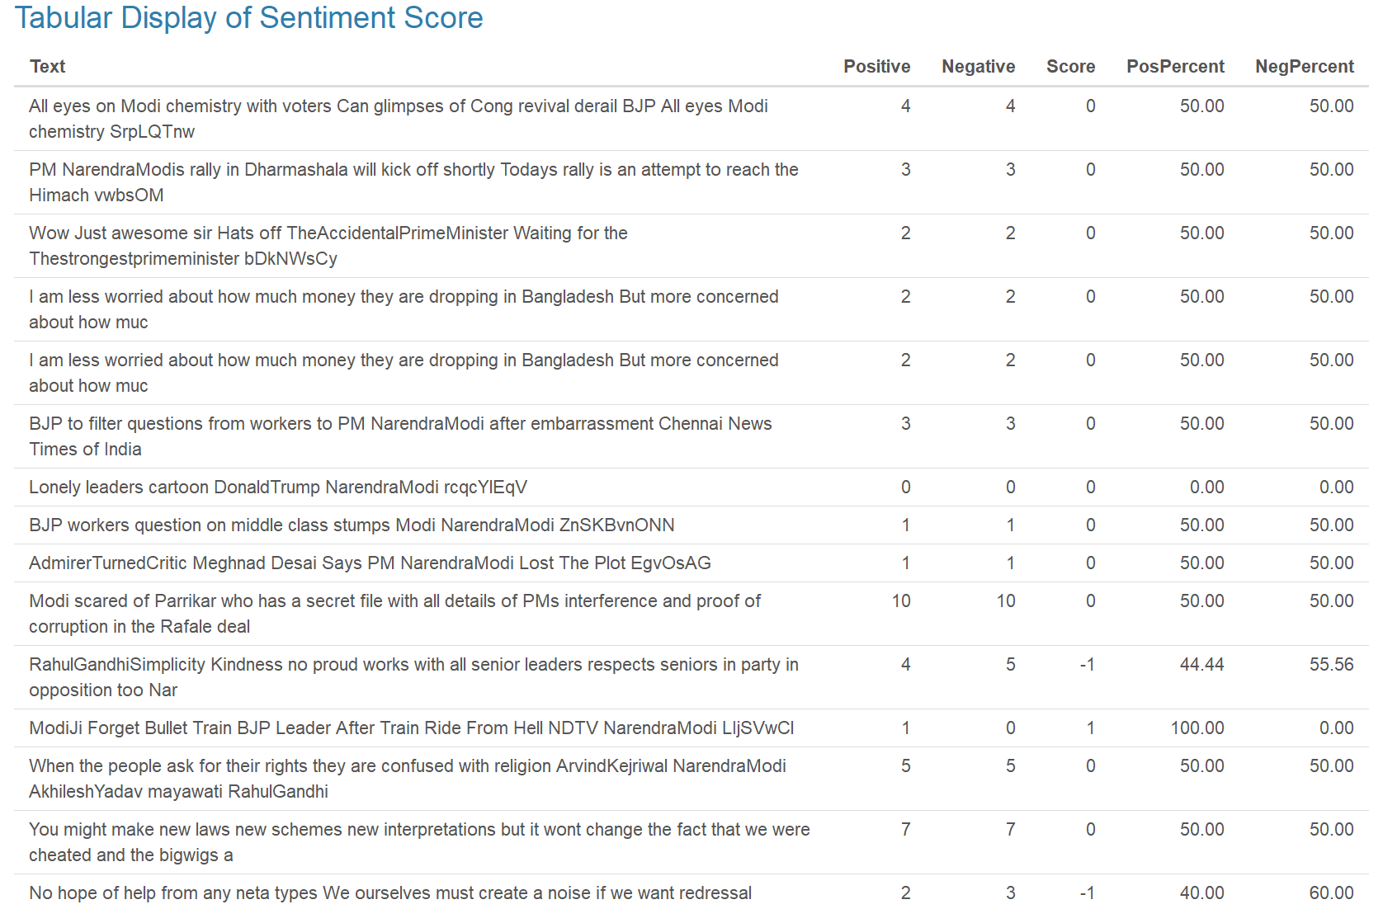
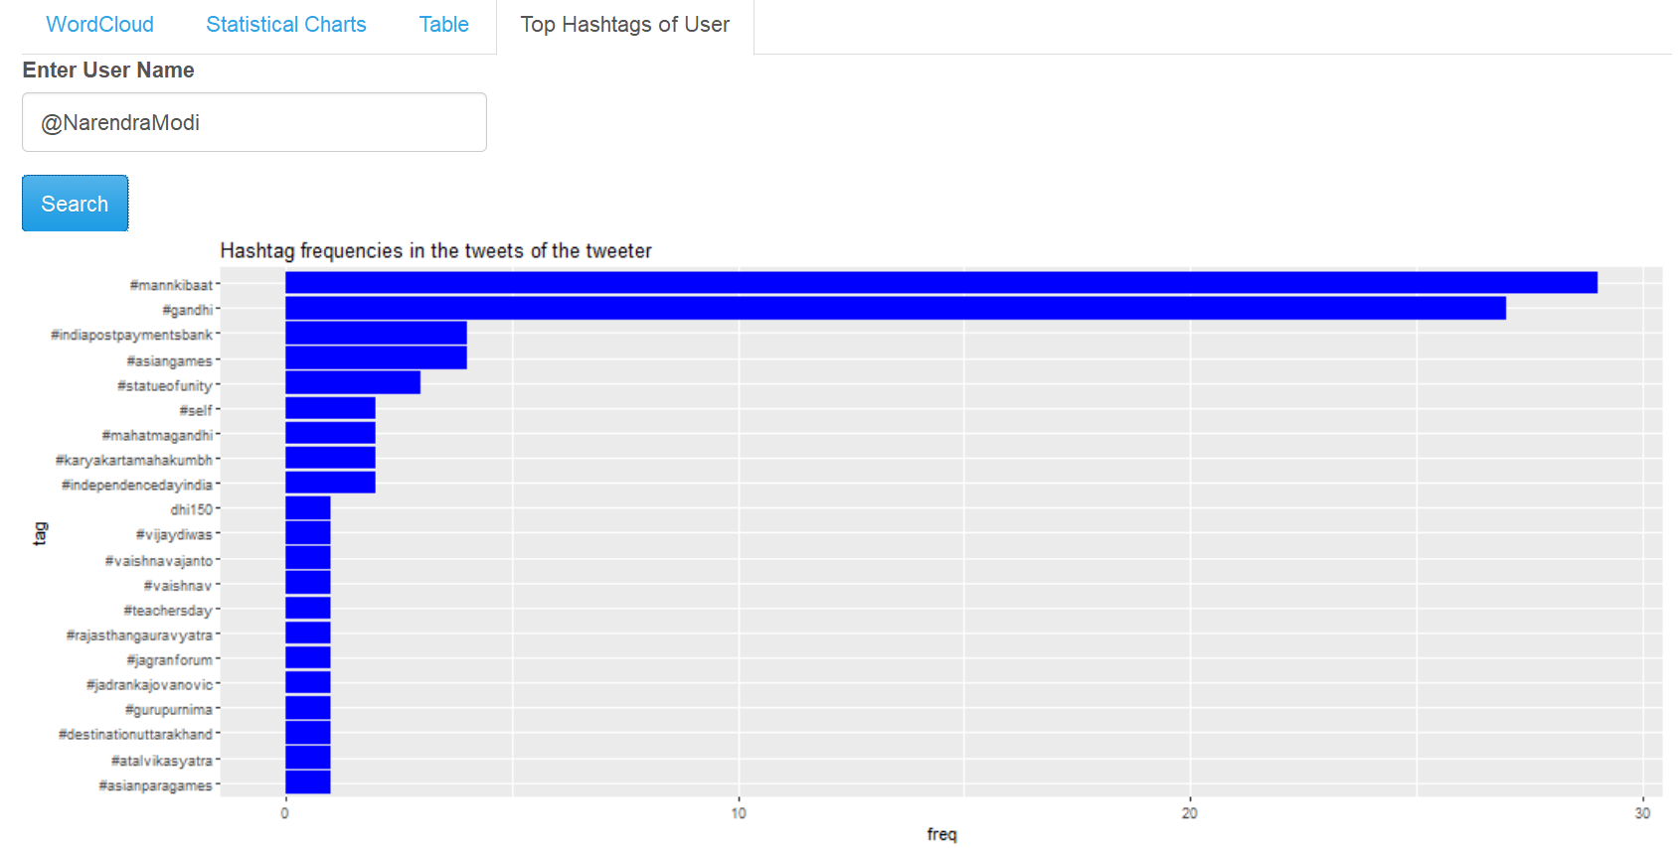
6) Modeling, Evaluation and Feedback
Model Comparison – Visual, Descriptive & Tabular (R Shiny)
Notes:
This Shinny app gives us a real time sentiment of what is happening in twitter, which would help us devise a proactive strategy to address the sentiments on the go.

Slide 9
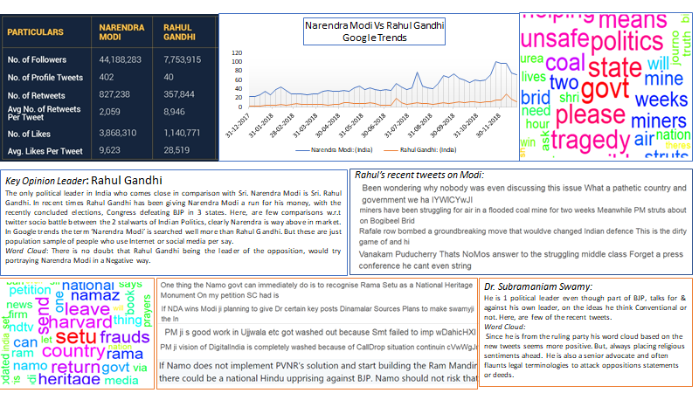
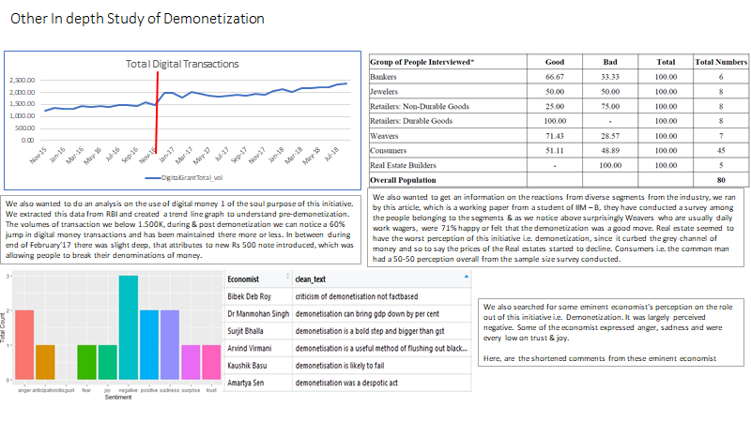
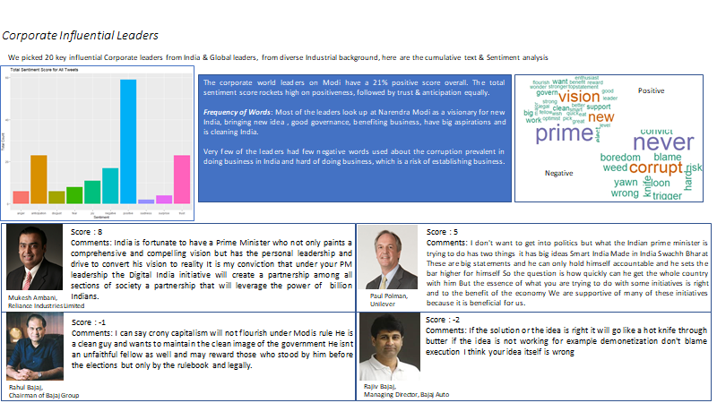
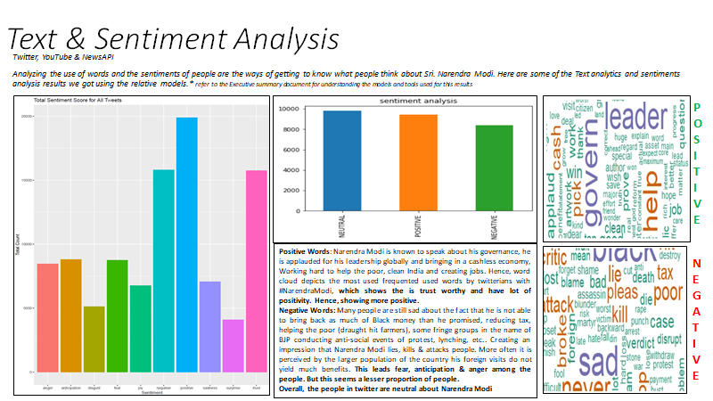
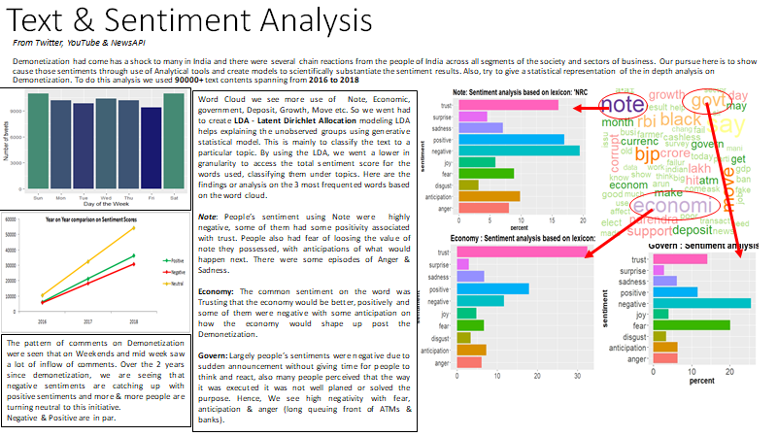
Recommendation: Organizing campaigns based on the target groups and customize the out reach based on the insights and convert these segments to voters and positive social media users.
Deployment: Understanding the reaction patterns based on time series analysis, and devising burst of communication and activities in social media platforms to address the target audience accordingly. Informed strategies and improved performance.
Notes:
Recommendation: For e.g we have analyzed Top corporate leaders/ celebrities, post / social media activity followers, to determine whether or not their involvement will be beneficial to campaign

Slide 10
8) Assumptions, Limitations & Further Works
Assumption:
The calculated scores of Sentiment from NRC, Text blob assumed to be correct, Sentiment analysis model is very subjective & hence should be taken as an educative quest. The 3rd party sites data we have used is genuine.
Limitations:
Our findings are only based on a sample of the population of people having access to Internet and using social media. The extracts from Twitter, YouTube, NewsAPI are not the complete contents of the actual version of truth from the users. Twitter can retrieve a maximum of only 7 days old. Contains 140 characters, lot of noisy data, lot of abbreviations and irregular expressions.
Future scope of work:
Deducting sarcasm, sentiment analysis on Hinglish and regional languages, profiling the segments of the society, Classifying model using machine learning models, supervised like (Naïve bayse, Logistic regression, Random Forest) & Unsupervised (Clustering of most frequent topics, creating a COG graph, K – means clustering). Looking in to analyzing images for emotions.
Drawbacks:
Cannot get 100% efficiency in analyzing sentiment analysis. Not deducting unknown errors. Since certain words can be subjective, it depends the person inference from that words or based on the contest. For e.g. Swachh Bharat has words like toilet, which is considered Negatve, but in this context is positive.

