Slide 1

RASP AI RECRUITER
IBM HACK CHALLENGE 2020

Slide 2
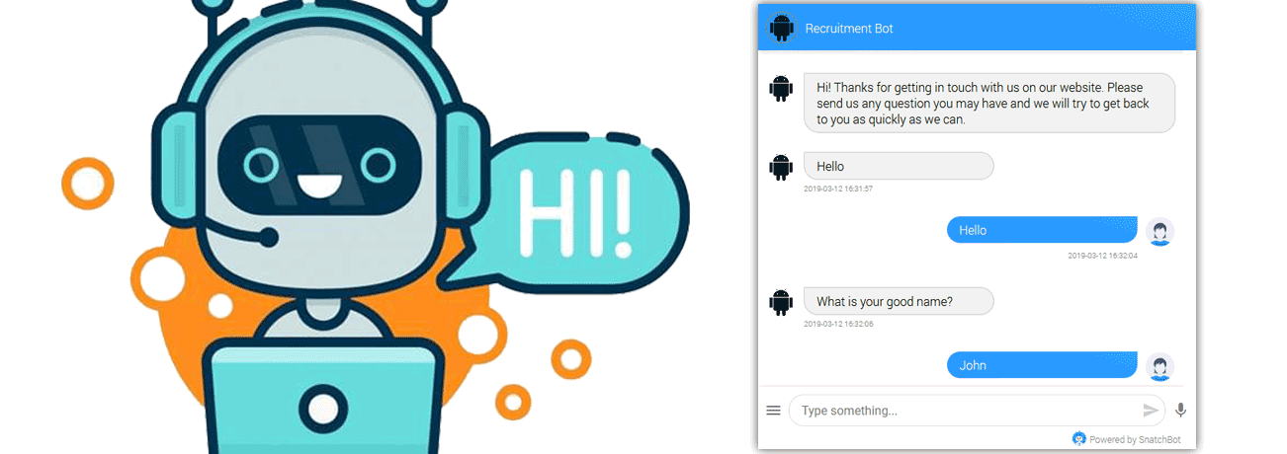
AI Recruiter – Shortlist a Suitable candidate for specific Job Role
PROJECT BY TEAM :
Abhirami M
Pavithra S
Rooban S
Shreenidhi N

Slide 3
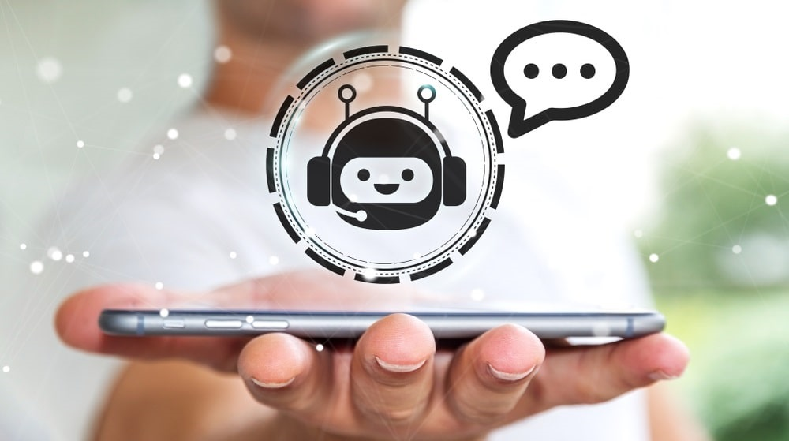
In today’s world, AI plays a major role and helps for the betterment.
We have created an AI recruiter that shortlists a suitable candidate for a specific Job Role. The Software Bot enables Artificial Intelligence, acquires the candidate application, shortlists for interview and identifies his skills & personality traits through conversation and various ability testing processes.

Slide 4
Existing Problem
As companies expand and continue to grow, new job posts are created and thus the number of applications also grows parallely. But companies interviewing and testing each and every candidate is impractical and inefficient in modern times. The manpower needed for interviewing candidates for big MNCs is inefficient in terms of time and energy. Therefore the need for an intermediate process that can automatically select the right people from the vast pool of candidates is of utmost importance. The automatic process must efficiently shortlist candidates by testing the relevant skills and also make sure to identify the required abilities.

Slide 5

Proposed Solution
Our recruitment chatbot can:
collect information from candidates such as their resume and contact information.
collect information about the company, job title, location and all other requirements.
Conduct tests that evaluate a candidate’s logical thinking as well as domain related knowledge.
ask screening questions about candidates’ experience, knowledge, and skills based on the requirements.
schedule an interview with a human recruiter.

Slide 6

Software Design
The IBM Cloud Platform is very useful for designing this project.
We used the Watson Assistant which provides services for creating a custom chatbot. With this we have implemented a bot using hard coded words and synonyms. The job application input and some knockout questions round are done with our specialized bot. The shortlisting process initially requires the candidates to submit their resume through Node red forms. Node Red is used for all the front end user interfaces that is very clear and user friendly. Cloudant is the database where all the data gets stored.

Slide 7




Slide 8
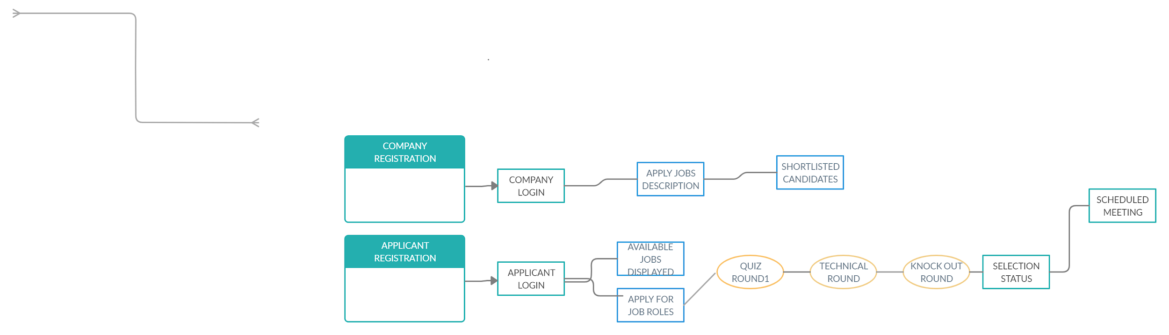
Flow Chart of our work

Slide 9
Result
We have proposed a system to identify candidates based on their resumes, logical thinking capabilities, domain related knowledge and also test candidates in pressure environments. We have approached the problem using the IBM Watson Assistant, which provides services for creating a custom chatbot. With this we have implemented a bot using hard coded words and synonyms. The shortlisting process initially requires the candidates to submit their resume through Node red forms. All of this information can be collected in real life and simultaneously from hundreds to thousands of candidates. This information, after processing and shortlisting, can then be fed into the database and directly to a human recruiter to follow up. Thus, the prototype works well for the sample jobs and applications.

Slide 10

Conclusion
A recruitment chatbot is software that uses AI technology to understand a person’s messages and know how to respond. The main benefits of using a chatbot include automating top-of-funnel recruiting tasks such as candidate pre-qualification and interview scheduling to speed up time to hire and improve candidate experience. The major challenges of using a chatbot in recruiting include the lack of standardization in texting, how “human” a chatbot should be, and not knowing how candidates will react.

Slide 11
Applications
Chatbot is an important application of AI in Recruitment. Further, there can be:
AI powered Video Interviews in Recruitment
Automated Talent Sourcing through AI in Recruitment
Talent rediscovery can be accomplished through AI in recruitment
Sentiment Analysis through AI in Recruitment

Slide 12

Future Scope
Industry experts believe the future of AI for recruiting is Augmented Intelligence. Augmented intelligence is the belief that you cannot fully replace human capabilities through technology. Instead, augmented intelligence suggests we should look to create technology to enhance human aptitude and efficiency. The ability to use augmented AI to automate repetitive, administrative tasks will be extremely valuable.

Slide 13
References
https://ideal.com/recruitment-chatbot/
https://marutitech.com/14-powerful-chatbot-platforms/
https://chatbotsmagazine.com/how-to-develop-a-chatbot-from-scratch-62bed1adab8c

Slide 14
Thank You
Team RASP AI Recruiter

