Slide 1
Winter Air Quality Analysis

Slide 2
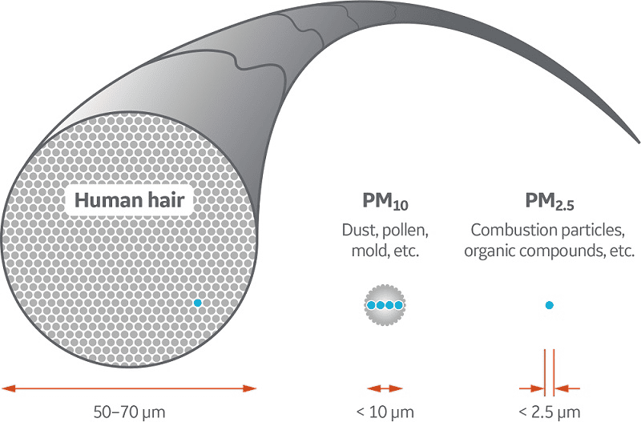
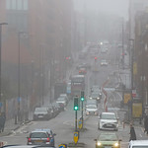
Understanding PM2.5 and PM10: Why These Pollutants Matter
What is PM?
Particulate matter is a type of air pollutant that is composed of tiny bits of solid or liquid particles
PM2.5: Fine particles less than 2.5 micrometres can enter the lungs and bloodstream
sources: Toxic organic compounds, Heavy metals, Cars, Fires, Metal processing
PM10: Slightly larger particles, which are less than 10 micrometres, that usually deposit in the narrow passages of the lungs
sources: Smoke, Dirt and dust from factories, farming, and roads, Mould spores, pollen
Why is it harmful?
increases the risk of health problems like heart disease, asthma, and low birth weight

Slide 3
Data Used
Air quality data from UK Air Quality Network (Nov 1 – Jan 17)
Weather data (temp, wind speed, humidity)
Source: Meteostat API( https://meteostat.net/en/)
Holidays data:
Source: UK Gov-Bank Holidays(https://www.gov.uk/bank-holidays)
Air quality data from previous years(2022-2024)
Source: UK Air Quality Network(https://www.ukairquality.net/)

Slide 4
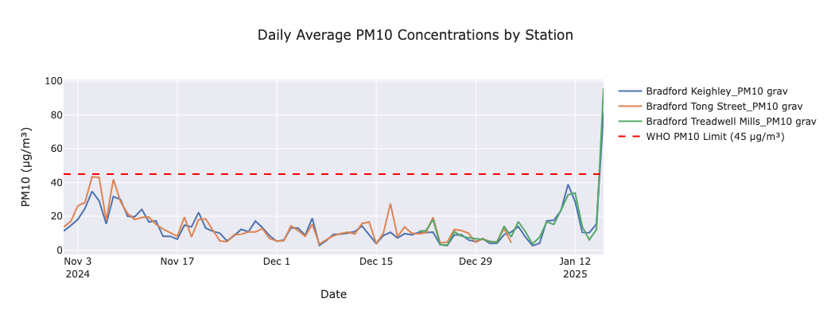
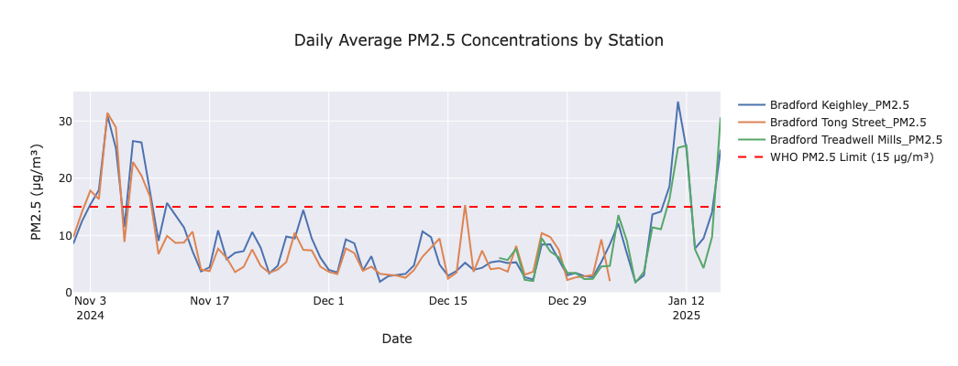
What we learnt from the data
Daily average plots of PM2.5 and PM10 with the WHO threshold.
Winter air quality in Bradford showed clear periods of concern, with PM2.5 breaching guidelines on multiple days.
PM10 was generally better controlled, but still showed isolated exceedances, particularly during early November and mid-January.

Slide 5
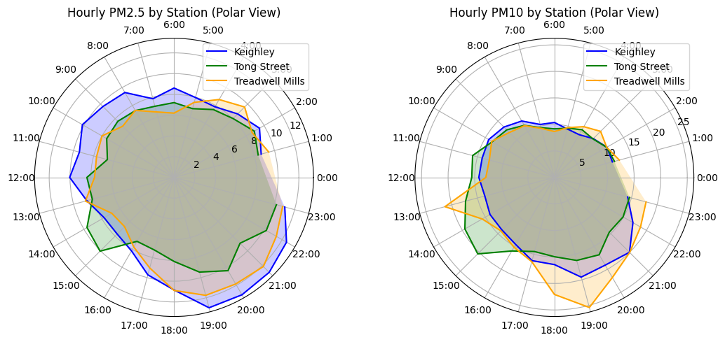
What Influenced Pollution Levels?
Time of Day:
PM2.5 and PM10 levels were highest in the late evening and early morning.
All three stations show similar diurnal trends.
Cause: These peaks likely reflect traffic, domestic heating, and low atmospheric mixing.

Slide 6
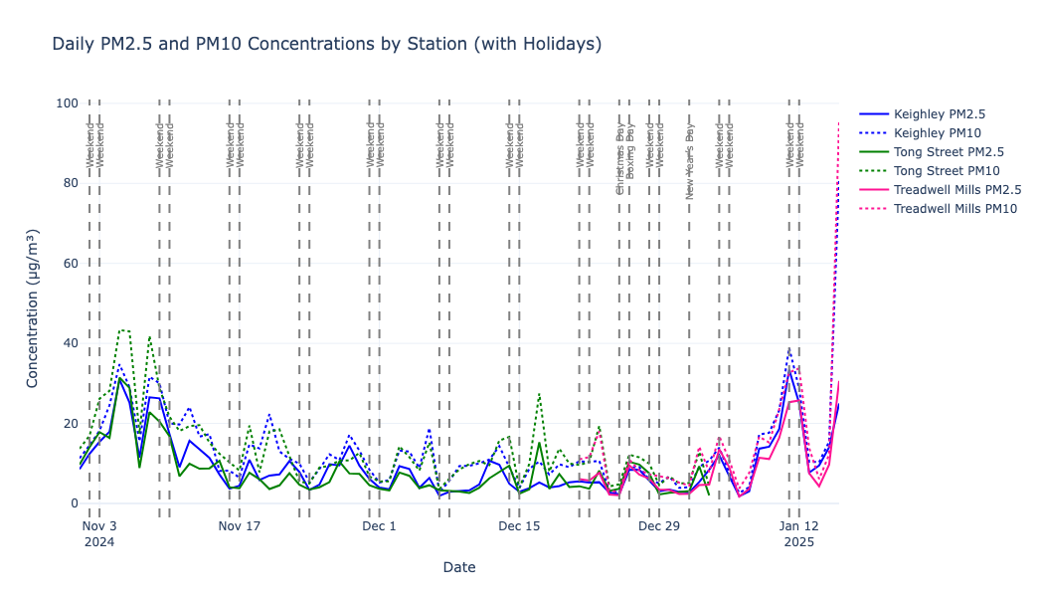
What Influenced Pollution Levels?
Weekends and Holidays
Frequent pollution dips on weekends, possibly due to reduced traffic and industrial activity.
Spikes around holidays, especially New Year’s Day and Bonfire Night, suggest influence from fireworks, home heating, or gatherings.
Some PM10 spikes on Sundays may reflect wood burning or recreational activities.

Slide 7
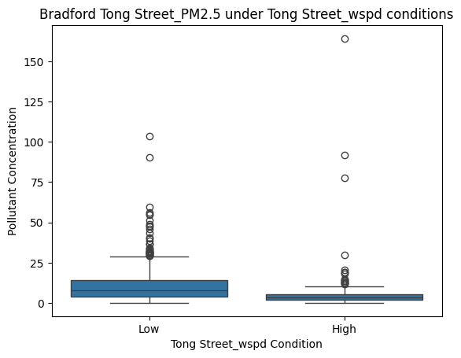
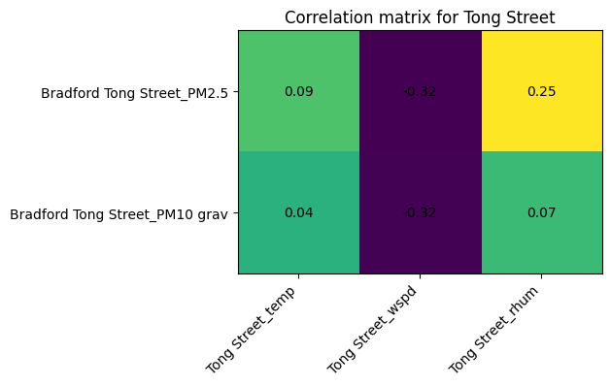
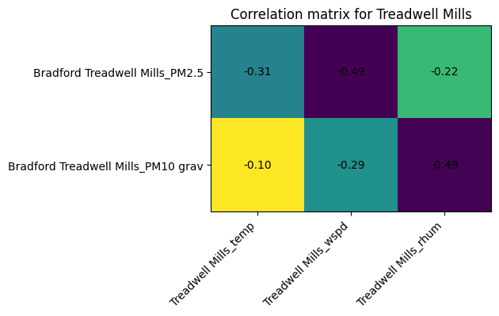
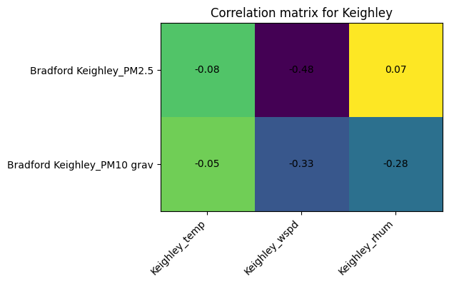
What Influenced Pollution Levels?
Weather influence:
Wind speed had the strongest inverse correlation with PM2.5 and PM10 across all sites.
High humidity showed a moderate positive correlation at Tong Street.
Boxplot confirms PM2.5 is higher under low wind conditions, and stagnant air traps pollutants.

Slide 8
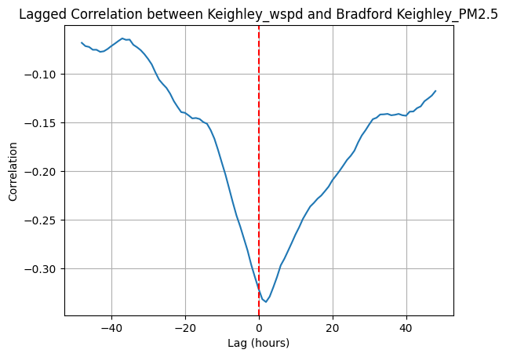
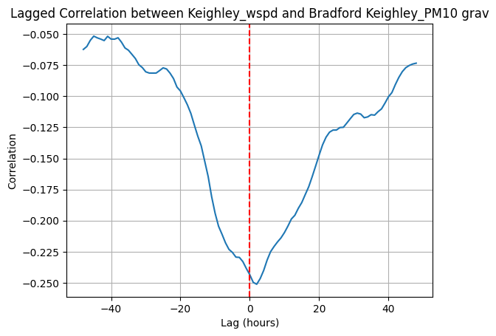
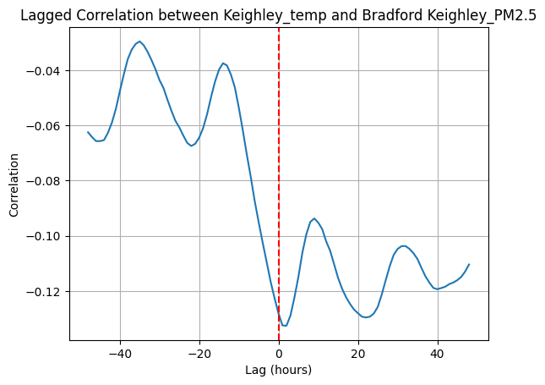
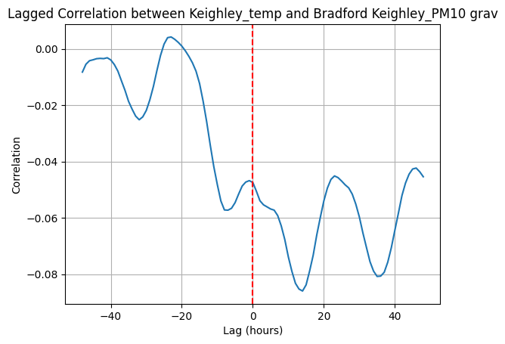
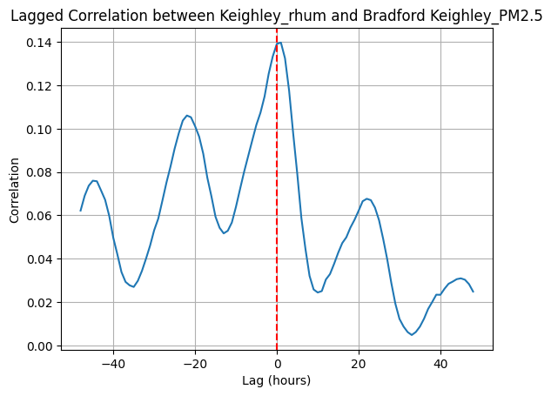
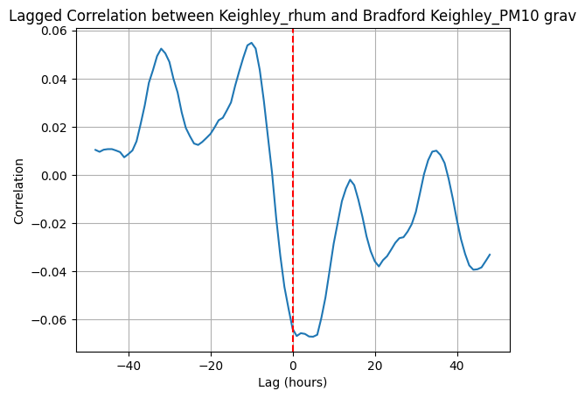
Lagged Correlation: Weather’s Lasting Impact
Wind speed had the strongest and most immediate effect, especially on PM2.5, with correlation peaking at 0 to 12 hours.
Temperature showed a delayed, moderate effect, possibly influencing heating behaviours or atmospheric mixing.
Humidity had mixed effects, positive for PM2.5, slightly negative for PM10.

Slide 9
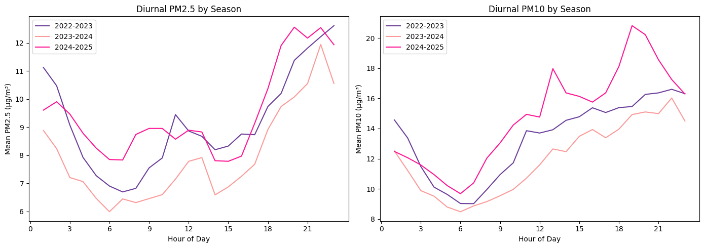
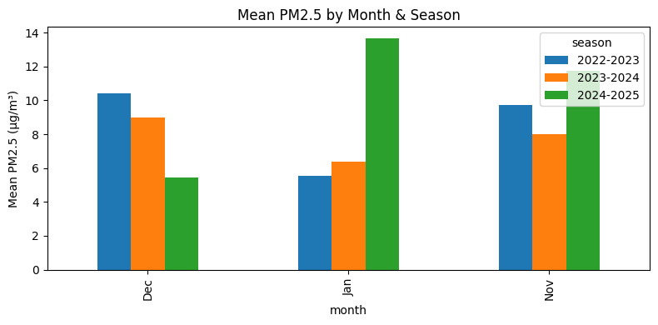
Historical Comparisons: Last 3 winters
Morning dip is consistent across years. But the evening peak is most pronounced in 2024–2025.
Overall, 2024–2025 has the highest late-day PM2.5 and PM10, contrary to the earlier version. possibly from heating or stagnant evening conditions

Slide 10
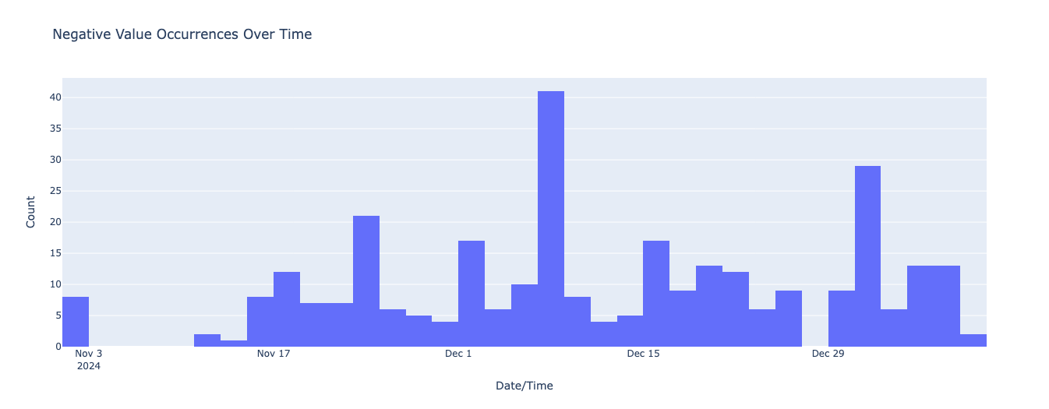
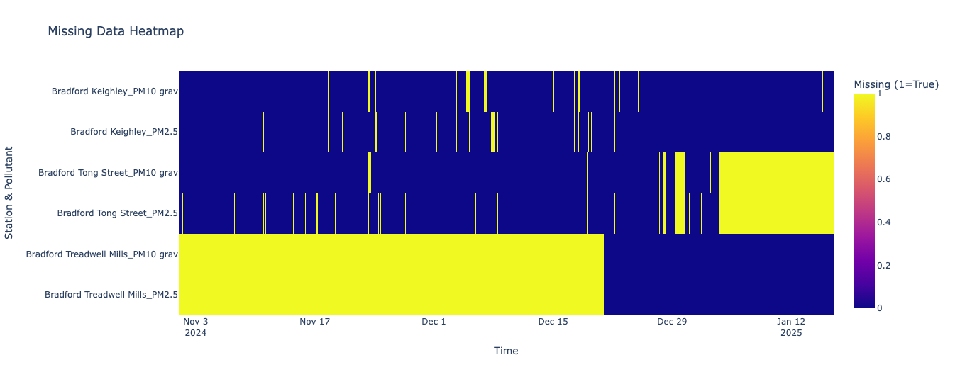
Challenges in Measurement (Sensor Story)
1. Negative values :
Negative readings of PM2.5 or PM10 often indicate sensor calibration drift or measurement artefacts, especially when true concentrations are very low.
Notable peak around early December, possibly indicating sensor drift or calibration error.
2. Missing values:
Missing data may align with sensor downtime or extreme weather conditions that disrupt measurement
Sporadic gaps are also seen, but less severe
Cause:
Persistent anomalies suggest systematic issues, potential hardware degradation or power/network issues.

Slide 11
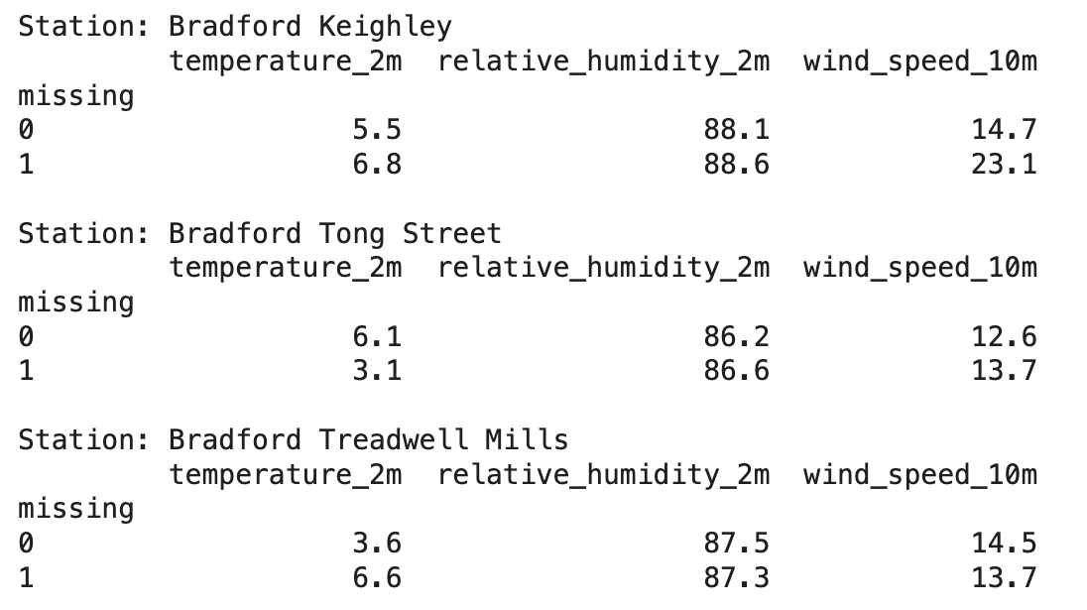
Environmental Influences
High‐wind vulnerability at Keighley → maybe inlet turbulence or power wobbles in storms.
Cold-temperature issues at Tong Street → perhaps condensation or icing in the optics.
Heat-related drift at Treadwell Mills → Check shelter ventilation or solar loading
This allows us to schedule calibration, maintenance, or QA downtime more efficiently without missing key pollution events.
Avoids servicing during critical periods (e.g., cold, calm days when spikes are likely)

Slide 12
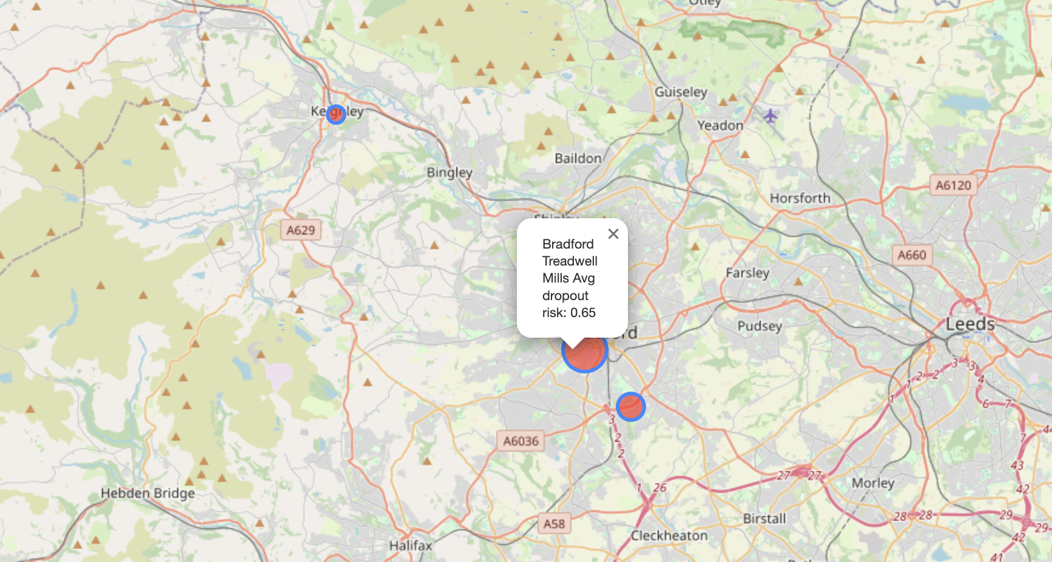
Sensor Dropout Risk
To analyse the probability of sensor data dropout as a function of environmental variables, logistic regression (specifically using a Generalised Linear Model) is used.
The given map shows which stations are more susceptible to dropouts(missing values) due to weather conditions
Bradford Treadwell Mills showed the highest average dropout risk: 0.65.
Spatial visualisation shows risk concentrated in the southern cluster.

Slide 13
Predictive Modelling
Site | Pollutant | MAE (µg/m³) | RMSE | R² (Fit Quality)
Keighley | PM2.5 | 2.873 | 4.089 | 0.643
 | PM10 | 3.446 | 6.411 | 0.621
Treadwell Mills | PM2.5 | 1.546 | 2.610 | 0.694
 | PM10 | 2.324 | 6.144 | 0.651
Tong Street | PM2.5 | 2.729 | 4.300 | 0.488
 | PM10 | 3.467 | 5.324 | 0.602
Used XGBoost, a powerful machine learning algorithm for regression
Important feature used: weather, time and pollution lags
The model showed good predictive performance across stations
Higher R² (up to 0.69) indicates that weather data helped explain pollution levels effectively.

Slide 14
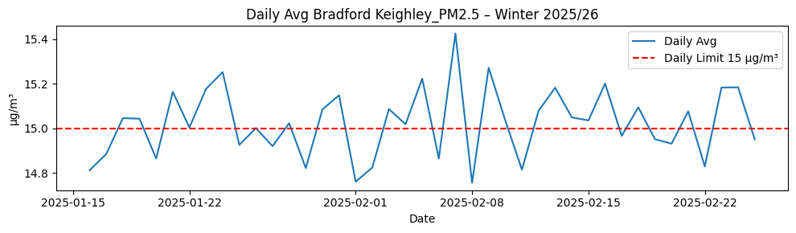
Example Prediction: Keighley PM2.5 Forecast
This is an example forecast using the trained model for Bradford Keighley PM2.5.
Simulates daily average PM2.5 between 16 Jan and 25 Feb 2026.
Multiple days are predicted to exceed the legal daily limit of 15 µg/m³.
Demonstrates how the model can support early warning and planning for air pollution risks.

Slide 15
Future work
Feature Enhancement
Integrate additional meteorological variables (e.g., wind direction, boundary‐layer height) and real‐time traffic flow data.
Incorporate land‐use and GIS layers (industrial zones, major roads) to capture spatial heterogeneity.
Modeling Improvements
Experiment with neural time‐series models (LSTM, Temporal Convolutional Networks).
Perform hyperparameter optimisation and k-fold cross-validation to improve generalisation.
Operationalization
Build an automated pipeline for data ingestion, model retraining, and dashboard visualisation.
Set up alerting for forecast exceedances beyond health thresholds.

Slide 16
THANK YOU

