Slide 1
NAME :SHREENITHI.S
DEPARTMENT:COMPUTER SCIENCE ENGINEERING
COLLEGE :PARK COLLEGE OF ENGINEERING AND TECHNOLOGY
MAIL ID : shreenithisureshkumar@gmail.com

Slide 2
Language translation model

Slide 3
Agenda
Problem statement
Project overview
End users
Proposition
Wow factors
Modelling approach
Result
conclusion

Slide 4
Problem statement
A language translation model is a system designed to convert text or speech from one language into another.
Its primary function is to accurately and fluently translate content while preserving meaning, tone, and context.
The goal is to create a model that can produce high-quality translations across a wide range of languages and domains, providing users with seamless communication and understanding across linguistic barriers.

Slide 5
Project overview
The main aim of the project is to translate one language into another language
By using python, we seek to accurately change one language into another specified language
The system will utilize deep learning techniques to lean The mappings between source and target languages enabling accurate and fluent translations across various language pairs

Slide 6
End users
The end users of a language translation model are
Typically individuals or organizations who utilize the model to translate text or speech from one language to another for various purposes, such as communication, information retrieval, or content localization.
These users can include individuals seeking translation services, businesses expanding into global markets, researchers analyzing multilingual data, and more.

Slide 7
Proposition
The value proposition of a language translation model lies in its ability to accurately and efficiently translate text or speech from one language to another, facilitating communication and understanding across linguistic barriers.
These models can save time, reduce costs, and improve accessibility for individuals, businesses, and organizations operating in multilingual environments.
Additionally, they can enhance user experience by providing seamless and natural translations across various platforms and applications.

Slide 8
Wow Factors
Language translation models, like the one you’re using now, offer several wow factors: 1.Accuracy 2.Speed 3.Adaptability 4.Multilingualism 5.Continuous Improvement 6. Integration 7. Customization. These factors collectively contribute to the wow factor of language translation models, revolutionizing the way we communicate across languages.

Slide 9
Modelling approach
Language translation models, especially those based on neural networks, typically use a sequence-to-sequence (seq2seq) modelling approach. Here’s a brief overview: 1. Encoder-Decoder Architecture: The model consists of two main components: an encoder and a decoder. The encoder processes the input sequence (source language) and converts it into a fixed-length vector representation called the context vector. The decoder then generates the output sequence (target language) based on this context vector. 2. Recurrent Neural Networks (RNNs) or Transformers: Traditionally, recurrent neural networks (RNNs), especially variants like Long Short-Term Memory (LSTM) or Gated Recurrent Unit (GRU), were used for both the encoder and decoder. However, transformer-based architectures, such as the one introduced in the “Attention is All You Need” paper, have become more popular due to their superior performance and parallelization capabilities. 3. Attention Mechanism: Attention mechanisms help the model focus on relevant parts of the input sequence during the decoding process. This allows the model to effectively handle long-range dependencies and improve translation accuracy.

Slide 10
4.Training Objective: The model is trained using a parallel corpus of source-target language pairs. The training objective is typically maximum likelihood estimation (MLE) or its variants, such as cross-entropy loss, which measures the discrepancy between the model’s predicted probability distribution over the target vocabulary and the true distribution.
5.Beam Search or Greedy Decoding: During inference, the model generates translations by either greedily selecting the most likely word at each step or using beam search to explore multiple candidate translations and select the one with the highest overall probability
6.Fine-tuning and Transfer Learning: Large pre-trained language models, such as BERT or GPT, can be fine-tuned for specific translation tasks to leverage their language understanding capabilities. This approach often leads to improved performance, especially when training data is limited
Overall, the choice of modelling approach depends on factors such as the size of the dataset, computational resources available, and desired translation quality. Transformer-based architectures have become the de facto standard due to their effectiveness and scalability.

Slide 11
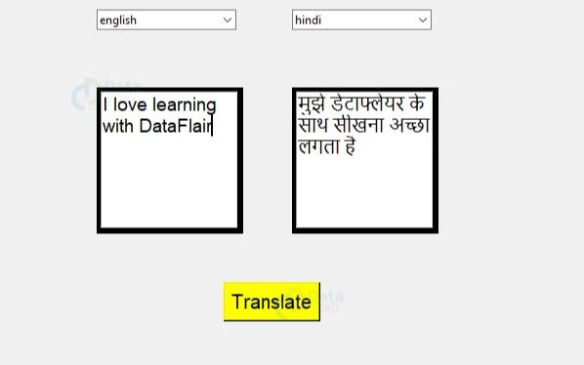
Result

Slide 12
Conclusion
The language translation model demonstrates remarkable capabilities in bridging linguistic barriers, facilitating global communication, and fostering cultural exchange.
Its accuracy, efficiency, and adaptability signify significant advancements in artificial intelligence.
It promises a future where language is no longer a barrier to understanding and connection among diverse communities worldwide.

