Slide 1
AirSeva
Agentic Air Quality Health Advisory System for Indian Communities
Shreenivas S B
Dayananda Sagar University, Bangalore | MCA – Data Science
1M1B AI for Sustainability · IBM SkillsBuild + AICTE
Live App: https://airseva-4uzac5mbekkwmzvdt4rsux.streamlit.app
1M1B AI for Sustainability · IBM SkillsBuild + AICTE · Shreenivas S B · Dayananda Sagar University, Bangalore

Slide 2
SDG Alignment
SDG 3 — Good Health & Well-Being
AirSeva delivers real-time, personalised air quality health advisories to help Indian communities — especially vulnerable groups — protect their health during high pollution periods.
SDG 11 — Sustainable Cities & Communities
By covering 26 Indian cities including Tier-2 and Tier-3 locations, AirSeva promotes equitable access to environmental health information, supporting more sustainable and resilient urban communities.
1M1B AI for Sustainability · IBM SkillsBuild + AICTE · Shreenivas S B · Dayananda Sagar University, Bangalore

Slide 3
Problem Statement
How might we use AI to provide accessible, real-time, and location-specific air quality health advisories so that communities across India — especially vulnerable groups — can take timely precautions and become more resilient to air pollution?
The Gap
300M+ Indians exposed to hazardous AQI levels annually.
Existing tools show raw AQI numbers with no health guidance.
The Vulnerable
Children, elderly, asthma patients, and outdoor workers face disproportionate health risk from air pollution.
The Need
A system that translates raw pollutant data into clear, personalised, actionable health advice — in real time.
1M1B AI for Sustainability · IBM SkillsBuild + AICTE · Shreenivas S B · Dayananda Sagar University, Bangalore

Slide 4
AI Solution – 4-Agent Pipeline
Agent 1
Data Fetcher
WAQI API + Open-Meteo
Live AQI + 7-day PM2.5 history
Agent 2
ML Predictor
Random Forest
Risk: Low / Moderate / High
Agent 3
Advisor
IBM Granite 4
WatsonX Frankfurt
Agent 4
Reporter
WHO 2021 checks
PDF report
Output
Streamlit Dashboard
AQI gauge + Charts
Downloadable PDF
Stack: Python · Streamlit · scikit-learn · IBM Granite 4 (WatsonX) · WAQI API · WHO 2021 Guidelines
1M1B AI for Sustainability · IBM SkillsBuild + AICTE · Shreenivas S B · Dayananda Sagar University, Bangalore

Slide 5
Target Users
General Public
Citizens seeking real-time AQI information and daily outdoor activity guidance.
Vulnerable Groups
Children, elderly, pregnant women, asthma/COPD patients needing cautious, tailored advisories.
ASHA Workers & Health Volunteers
Frontline workers using AirSeva to counsel vulnerable households and run awareness campaigns.
Urban Local Bodies & Policy Makers
Municipal teams referencing city-level AQI trends to inform public health advisories and policy.
1M1B AI for Sustainability · IBM SkillsBuild + AICTE · Shreenivas S B · Dayananda Sagar University, Bangalore

Slide 6
Responsible AI Considerations
Fairness
WHO 2021 standards applied equally across all 26 cities — metro, Tier-2, and Tier-3. No metro-centric bias.
Transparency
All agent outputs (pollutant data, ML prediction, advisory) are shown explicitly. No black-box responses.
Ethics
Medical disclaimer displayed prominently. Advice framed as precautionary guidance, not medical prescription.
Privacy
No personal data collected or stored. All data is public city-level AQI from open APIs. No user tracking.
1M1B AI for Sustainability · IBM SkillsBuild + AICTE · Shreenivas S B · Dayananda Sagar University, Bangalore

Slide 7
Expected Impact
Scale
26 Indian cities covered
Metro + Tier-2 + Tier-3
Equitable health access
Individual
Personalised vulnerability scoring
Actionable daily guidance
Empowers health decisions
Community
Supports ASHA worker outreach
Informs municipal policy
Builds pollution resilience
Aligned with India’s national health and sustainability goals under SDG 3 and SDG 11
1M1B AI for Sustainability · IBM SkillsBuild + AICTE · Shreenivas S B · Dayananda Sagar University, Bangalore

Slide 8
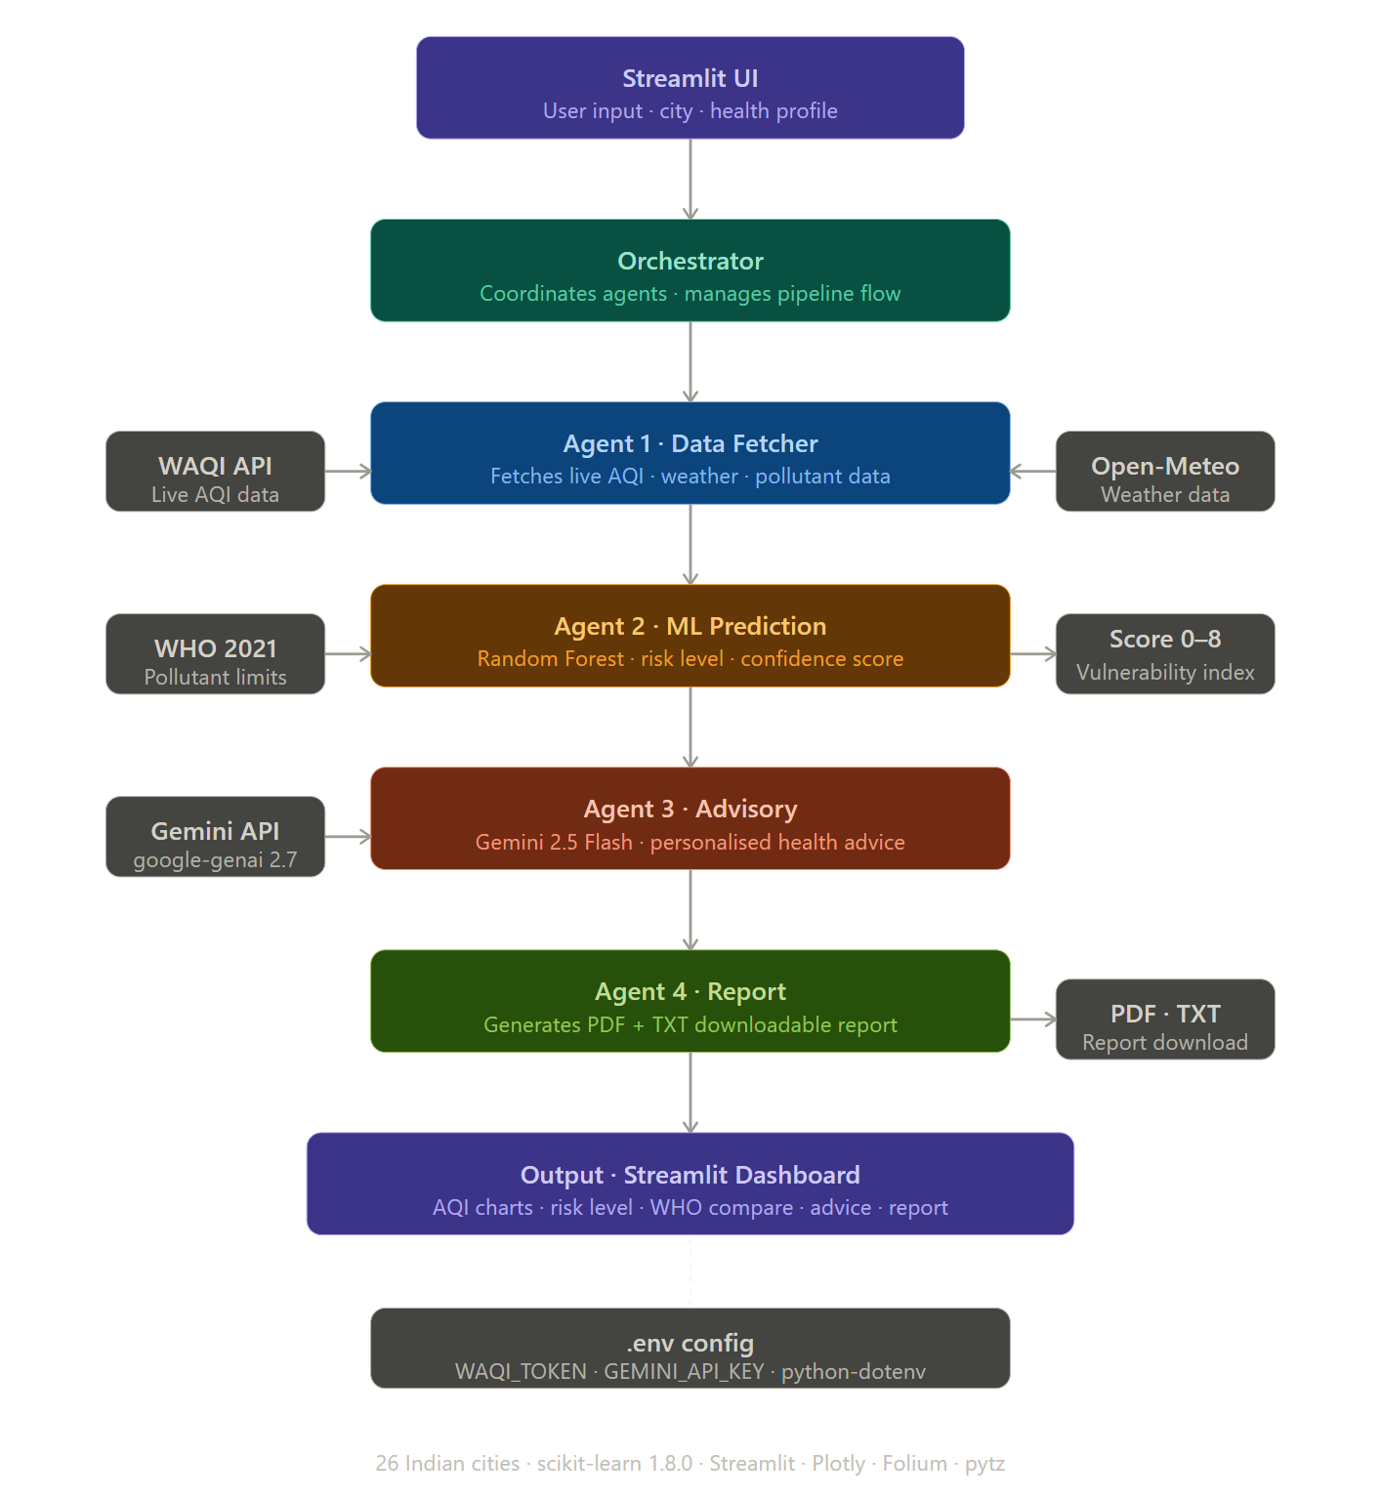
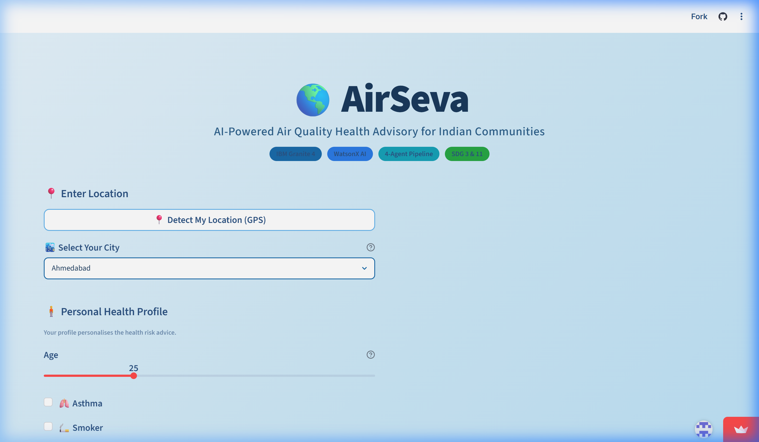
Prototype & Demo
System Architecture — 4-Agent Pipeline
Live App — AirSeva Dashboard
Live App: https://airseva-4uzac5mbekkwmzvdt4rsux.streamlit.app | GitHub: https://github.com/ShreenivasSB/AirSeva
1M1B AI for Sustainability · IBM SkillsBuild + AICTE · Shreenivas S B · Dayananda Sagar University, Bangalore

Slide 9
Impact Statement
AirSeva empowers individuals and communities to make informed, health-conscious decisions based on real-time air quality data across 26 Indian cities. By translating raw pollutant data into clear, actionable advisories, it bridges the gap between complex environmental monitoring and everyday public health behaviour.
Who Benefits
Citizens · Vulnerable groups · ASHA workers · Urban local bodies
What Changes
Reduced gap between AQI data and public action · Proactive health behaviour · Supports India’s SDG 3 + SDG 11 goals
Built with IBM Granite 4 · WatsonX AI · Random Forest ML · WAQI API · WHO 2021 Standards
1M1B AI for Sustainability · IBM SkillsBuild + AICTE · Shreenivas S B · Dayananda Sagar University, Bangalore

