Slide 1



Vishwakarma Application ID

Slide 2






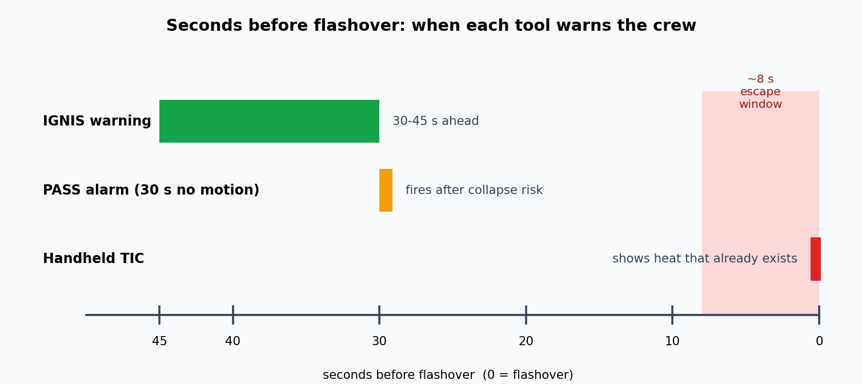

Problem Context
~8 s
30 s
₹4.5 Lakh+
30–45 s
FLASHOVER ESCAPE WINDOW
PASS ALARM LAG (NO MOTION)
THERMAL IMAGER COST
IGNIS ADVANCE WARNING
Target User & Problem Statement
▪
Target User: Municipal and industrial fire brigade crews entering smoke-filled structures, with an Incident Commander at the perimeter.
▪
Operational Bottleneck: Crews advance blind in zero visibility; flashover can occur within ~8 s of a room reaching critical heat, leaving no time to retreat.
▪
Current-State Flow: Crew enters → handheld thermal imager (TIC) scan shows heat that already exists → conditions change fast → flashover or collapse strikes with no predictive cue.
▪
Public Search Disclosure: Handheld TICs cost ₹4.5 lakh+ and only show current heat; PASS devices alarm after 30 s of no motion. Neither predicts flashover or collapse.
Figure: Warning lead time of current tools versus IGNIS (conceptual).
Submission Note: Team ID: [to be added] | Track: Physical AI & Frontline Response | Core Innovation: Throwable thermal + acoustic flashover and collapse predictor.

Slide 3
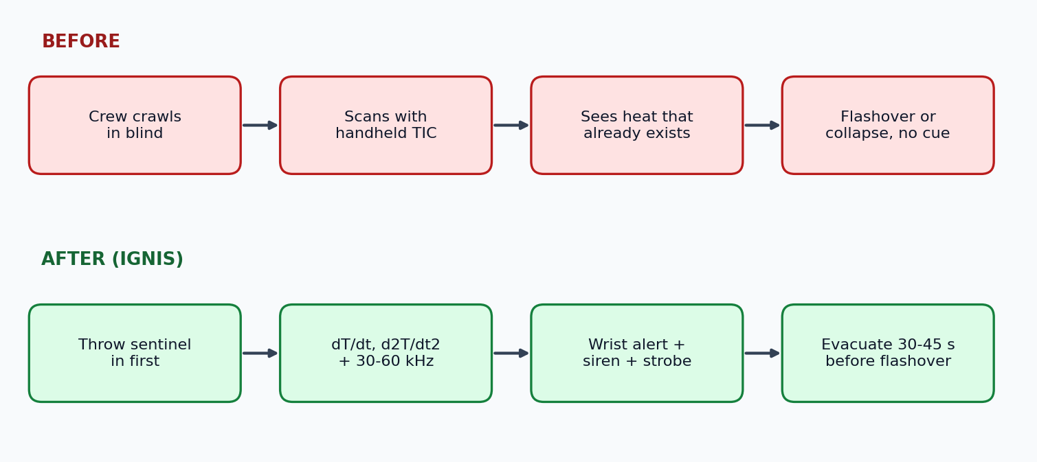
User Journey
30–45 s
4 Walls
0.45 kg
<₹6,500
ADVANCE WARNING (AFTER)
ALERT PENETRATION
THROWABLE POD MASS
TARGET COST AT SCALE
Before-State vs After-State Flow
▪
Before State: Crew crawls in blind; handheld TIC shows existing heat only, with no prediction or collapse warning.
▪
After State: The commander throws the 0.45 kg sentinel in first; it tracks heat acceleration (d²T/dt²) and 30–60 kHz structural cracking, then alerts the wrist unit.
▪
Alert & Response: Wrist display, vibration, 105 dB siren and a 520 nm strobe trigger evacuation 30–45 s before flashover; the strobe also marks the exit path.
▪
Quantified Efficiency: A 30–45 s warning versus a ~8 s escape window, at under ₹6,500 per unit at scale versus ₹4.5 lakh+ for a TIC.
Figure: Before-state versus after-state crew flow with IGNIS (conceptual).
Submission Note: Team ID: [to be added] | Track: Physical AI & Frontline Response | Core Innovation: Throwable thermal + acoustic flashover and collapse predictor.

Slide 4


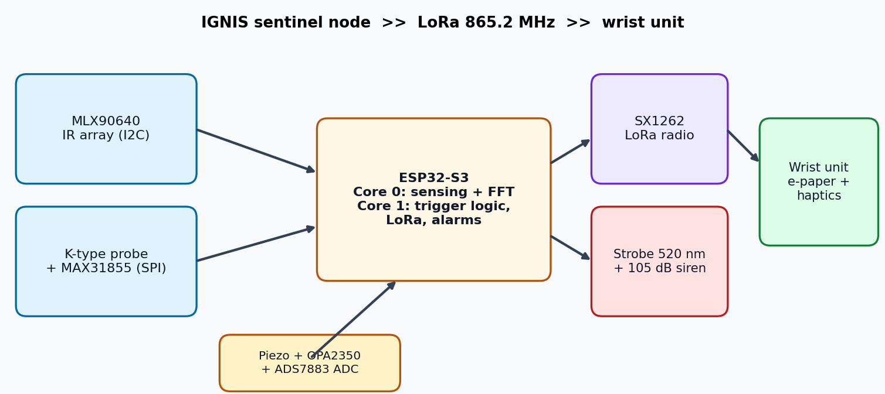
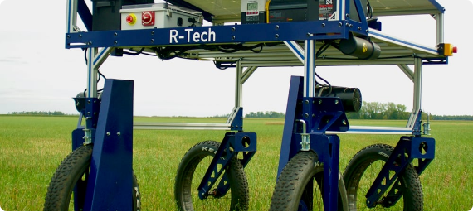
System Architecture & Specs
Engineering Target Specifications & Subsystems
Parameter | Target Spec | Selected Hardware / Protocol
Alert Lead Time | 30–45 s before flashover | MLX90640 IR array + K-type thermocouple
Structural Sensing | 30–60 kHz energy ratio >0.42 | PZT disc, OPA2350, ADS7883, 1024-pt FFT
Radio Link | 159 dB budget, through 4 walls | SX1262 LoRa, 865.2 MHz, AES-128-CTR
Runtime | 8.8 h monitor, 45+ min alarm | LiFePO4 18650, 3.3 V buck-boost, 12 V alarm rail
Core Controller | Dual-core DSP / RF split | ESP32-S3 (Core 0 sensing, Core 1 logic + LoRa)
Mass | 0.45 kg throwable | PA12-CF shell, aerogel + PCM thermal shield
Figure: IGNIS node and wrist-unit system block diagram.
Architecture Rationale: Core 0 runs sensing and DSP; Core 1 runs logic and radio, so LoRa retries never drop acoustic samples. Sub-GHz LoRa needs no cloud or SIM.

Slide 5
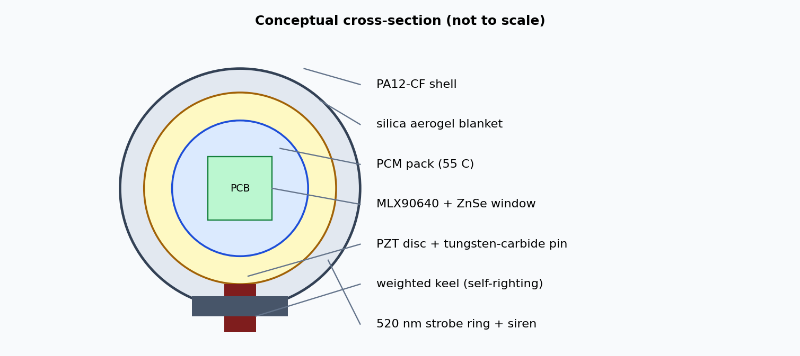
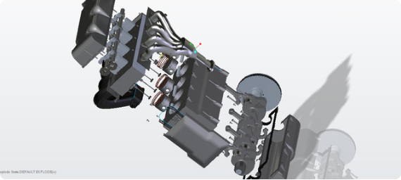
CAD Design & Mechanical Specs
Mechanical Validation & Thermal Protection
▪
Shell: Sintered PA12-CF (HDT 185°C) throwable shell with a silica aerogel blanket and ceramic nylon standoffs.
▪
Thermal Protection: A 55°C phase-change (PCM) pack keeps the MCU below 65°C; a ZnSe optical window with a peel-off layer resists soot.
▪
Drop Test Plan: 10 drops from 2.0 m onto concrete (MIL-STD-810H, Method 516.8) to check the PZT, lens alignment and solder joints.
▪
Self-Righting Keel: A weighted base with a spring-loaded tungsten-carbide acoustic pin and a baffled IR cone keeps sensors aimed after landing.
▪
FEA Results: Stress and deflection plots are to be added; no simulation results are in the project files yet.
Figure: Conceptual cross-section of the IGNIS pod (not a CAD render).
Design Intent: A weighted keel self-rights the pod after landing; a tungsten-carbide pin couples acoustic waves. FEA and drop-test plots are to be added.

Slide 6
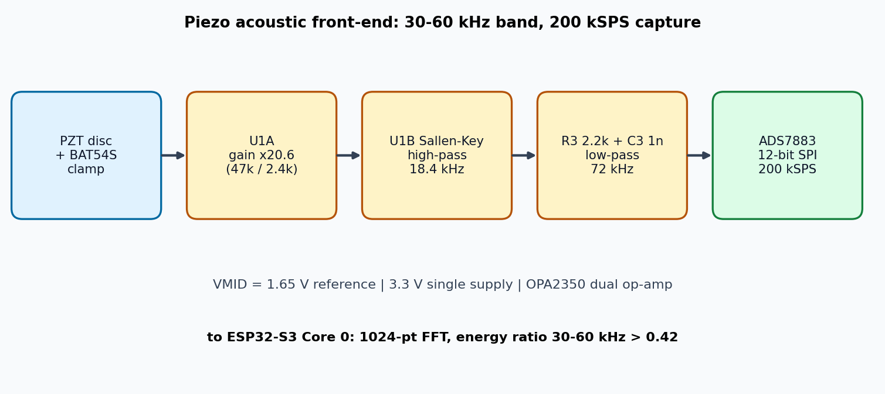
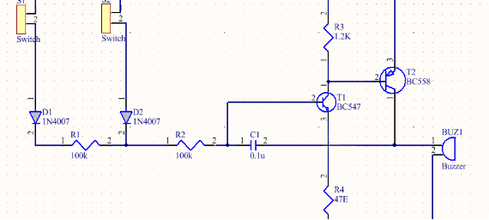
Electronics Schematics & BOM
Itemized Prototype Bill of Materials (BOM)
Component | Part / Specification | Qty | Lead Time | Cost (INR)
MCU Boards | ESP32-S3-DevKitC-1 N16R8 | 2 | TBC | ₹1,800
IR Thermal Array | MLX90640 BAB, 110° FOV | 1 | TBC | ₹6,200
LoRa Radios | SX1262 E22-900M22S + antenna | 2 | TBC | ₹2,000
Acoustic Chain | PZT disc, OPA2350, ADS7883 | 1 set | TBC | ₹1,000
Power & Alarm | LiFePO4, boost, siren, LEDs | 1 set | TBC | ₹1,890
Probe, Display, Shell | MAX31855, e-paper, passives, shell | 1 set | TBC | ₹5,280
Total Electronics & Mechanical BOM | ₹18,170
Figure: Piezo front-end signal chain into the 200 kSPS ADC.
Procurement Status: Parts come from Robu.in, Mouser/DigiKey and Ritchie Street (Chennai); lead times and the carrier PCB quote are to be confirmed.

Slide 7
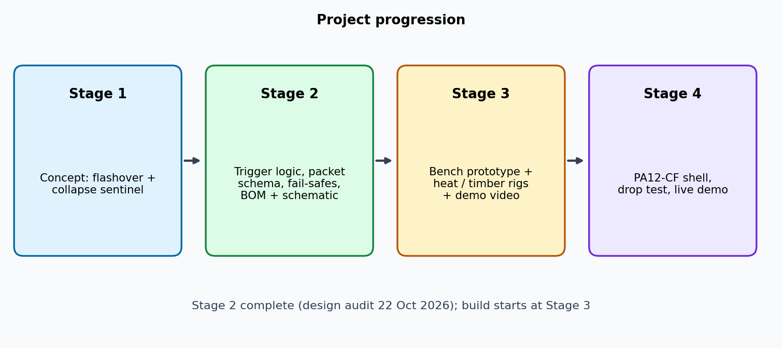

Maker Journey
Design Progress Through Stage 2
▪
Design Milestone: Dual-domain trigger defined: dT/dt > 12 °C/s, d²T/dt² > 0 and ambient > 180 °C, backed by a 30–60 kHz energy ratio above 0.42.
▪
Firmware Architecture: Two-core split, 1024-pt FFT pipeline and a CRC16 telemetry packet defined.
▪
Stage 2 Audit: Fail-safes, RF duty cycle (2.06% standby) and test plan reviewed on 22 Oct 2026; BOM and carrier-PCB plan prepared.
▪
Verified Drive Repository: [Drive / GitHub link to native design files to be added by the team.]
Figure: Stage 1 to Stage 4 project progression (conceptual).
Institutional Sign-Off: [Faculty guide name, department and institution to be added by the team.]

Slide 8



Safety & Hazard Mitigation
Design FMEA (Failure Mode and Effects Analysis)
Failure Mode | Potential Hazard | Embedded Fail-Safe / Mitigation Response
Soot-Blinded IR Sensor | False "safe" reading during a fire | Firmware promotes the K-type thermocouple and sets the sensor-fault flag
Low Battery (<3.0 V) | Alarm cutoff in the field | Extra LEDs off, LoRa at +14 dBm; siren and strobe held for 30+ min
Electronics Overheat (>75°C) | Compute failure, lost exit guide | Latching circuit keeps the 360° strobe flashing until battery exhaustion
Standards & Compliance
Alarm & Power Safety
▪
WPC GSR 853(E): 865–868 MHz short-range band; standby duty cycle 2.06% against a 2.5% limit, burst mode only on alarm.
▪
Power Integrity: A 1,000 µF low-ESR bank absorbs strobe surges; a 500 ms hardware watchdog forces recovery.
▪
Ingress & Impact: IP67 seams with fluorosilicone O-rings and an ePTFE vent; 2.0 m MIL-STD-810H drop test.
▪
Acoustic Alarm: A 105 dB siren at 3.5 kHz is designed to penetrate NFPA 1971 hoods and SCBA noise.

Slide 9
Roadmap
Stage-Gate Milestones
Stage | Milestone | Exit Criterion
Stage 3: Prototype | Procure parts, build the bench rig | Node reads IR, thermocouple and acoustic data; LoRa link reaches the wrist unit
Stage 3: Validation | Heat-chamber and timber-stress rigs | Trigger fires at 180–220°C; FFT ratio crosses 0.42 before fracture
Stage 4: Demo | PA12-CF pod shell with keel | Drop test passed; 3-minute video and 2-minute live demo
Fabrication Phase (Stage 3)
Integration & Demo (Stage 4)
▪
Procure & Build: Order the parts (about ₹18,000 student BOM) and assemble the sensor, ADC and LoRa bench rig.
▪
Enclosure: Print the PA12-CF / PETG shell with weighted keel; add the aerogel shield and PCM pack.
▪
Bench Validation: Radiant heat chamber, timber-stress rig and thermocouple fault-injection tests.
▪
Demo: 2.0 m drop test, range test through walls and a 2-minute live demonstration.

Slide 10



Technical Challenges & Risks
Bottleneck: Soot Blinding
Bottleneck: Thermal Limits
Bottleneck: Signal & Power
Observed Risk: Soot can coat the IR window, and the MLX90640 saturates above 300°C, giving a false reading during a real fire.
Observed Risk: The MCU and cells degrade above 85°C ambient, so the electronics need a shield to survive a real fire.
RF Multipath: Steel rebar creates LoRa nulls in large buildings.
False Alarms: Flame noise and hot drafts can mimic the 30–60 kHz band or a thermal spike.
Impact: A blinded sensor could report a safe temperature while the room approaches flashover.
Impact: Compute failure would end the warning and the exit-path strobe.
Brownout: 450 mA strobe peaks can reset the MCU.
Risk Priority: Soot on the IR lens and heat on the electronics are the highest risks; both have a sensor fallback and a thermal shield planned.

Slide 11
Potential Solutions & Risk Mitigation
Solution: Sensor Fallback
Solution: Thermal Shield
Solution: Link & Power
Primary Fix: The K-type thermocouple takes over when IR saturates above 300°C; CRC16 drops bad packets and bit 2 flags the fault.
Primary Fix: A silica aerogel blanket plus a 55°C PCM pack keep the MCU below 65°C.
RF: Channel hopping across 865.2, 865.8 and 866.4 MHz.
False Alarms: A trigger needs d²T/dt² > 0 plus a 30–60 kHz band-pass hit, fused with the thermal reading.
Backup: A sacrificial peel-off layer on the ZnSe window keeps the lens clear during short exposures.
Backup: A latching circuit keeps the 360° strobe flashing above 75°C even if compute fails.
Brownout: A 1,000 µF bank and 500 ms watchdog.
Verification Plan: Each fix is checked on the bench: thermocouple fault injection, heat-chamber runs and the 10-drop test.

Slide 12


References & Sources
(Mention the References and Sources used in your PPT)
[1] IGNIS: Pinnacle Research & Reconnaissance Dossier (PROJECT_OVERVIEW.md), 22 Oct 2026
[2] IGNIS Defense & Compliance Audit (SEVEN_SHADOWS_AUDIT.md), 22 Oct 2026
[3] Indian WPC GSR 853(E): de-licensed 865–868 MHz Short Range Device band
[4] NFPA / NIOSH firefighter line-of-duty-death reports; NFPA 1971; MIL-STD-810H Method 516.8
[5] Datasheets: Melexis MLX90640, Semtech SX1262, Maxim MAX31855

