Slide 1

SoulSense
Shreeraj Santosh Sangle – x23283254
Supervisor: Lavish Thomas
National College of Ireland
Submission Date: 11th August 2025

Slide 2
Problem Context
Global scale & impact: 970M+ people live with mental disorders; untreated anxiety/depression cost ≈ $1T/yr in lost productivity.
Treatment gap: In LMICs ~75% who need care get none — too few specialists, long waitlists, fragmented follow-up, and <2% of health budgets for mental health.
Stigma: Fear of labels and “cope quietly” norms suppress help-seeking and honest disclosure.
Tool limits → late detection: Current self-reports & brief interviews are episodic, subjective, backward-looking → early warning signs are missed.
Result: People often enter care at crisis points, outcomes worsen, and services stay overloaded.
Need → design target: Solutions that are accessible (24/7, anonymous, low-bandwidth), affordable (near-zero marginal cost), and explainable (clear “why” clinicians & users can trust).
SoulSenseAI: Built specifically to meet this need with persona-driven, explainable, privacy-first support.

Slide 3
Motivation & Gaps
Cultural stigma → low help-seeking: Fear of labels/judgment and “cope quietly” norms keep people from opening up; private, low-friction channels boost disclosure.
Traditional tools fall short: Questionnaires & brief interviews are episodic, subjective, clinic-bound—they miss day-to-day fluctuations and early signals, and they add load to already stretched clinicians.
Why AI helps now: Anonymous, 24/7, non-judgmental access; remembers context across sessions; scalable at near-zero marginal cost; can prompt affect-labeling to build self-awareness between appointments.
The gap in today’s chatbots: Most are black boxes (no rationale, no audit trail), offer generic wellness tips, and handle risk inconsistently—not enough for high-stakes mental-health use.
Implication → SoulSense approach: Text-only, privacy-first design; explainable AI that shows the “why” behind responses; crisis flags and persona-specific support that clinicians and users can trust.

Slide 4
Inspiration from Existing Tools
Replika excels at building emotional rapport and keeping users engaged, but its responses come from a black-box model—there’s no clear rationale for why it says what it says or how risk is handled.
Youper brings clinical grounding through CBT-style prompts and mood tracking, yet its scripted flow can feel rigid and may miss nuanced, evolving conversations.
SoulSense aims to fuse both strengths: keep Replika’s empathy, retain Youper’s evidence-based structure, and add transparent explainability that shows the cues and reasoning behind suggestions and crisis flags—so users and clinicians can trust and audit the system.
How: Persona prompts (Dr. Sarah, Marcus, Maya, Alex) + explainability layer (clear “why”), privacy-first text design, auditable crisis logic.

Slide 5
Research Objectives
RQ1 – To what extent does enhance Claude 3.5 Sonnet and a full stack framework used in the SoulSense AI application efficiently offer a stable and responsive platform focused on persona-led conversational mental health support?
RQ2 – How do unique AI personas (Dr. Sarah, Alex, Marcus, Maya) enable the engagement in more or less distinct ways, as well as perceived therapeutic alliance in the SoulSense AI platform?
RQ3 – How should the design and implementation of SoulSense AI address the issue of accessibility and stigma that traditional mental health support may impose?
Overall goal: An ethical, explainable, clinically-informed companion—empathy + CBT cues + transparent XAI that users and clinicians can trust.

Slide 6
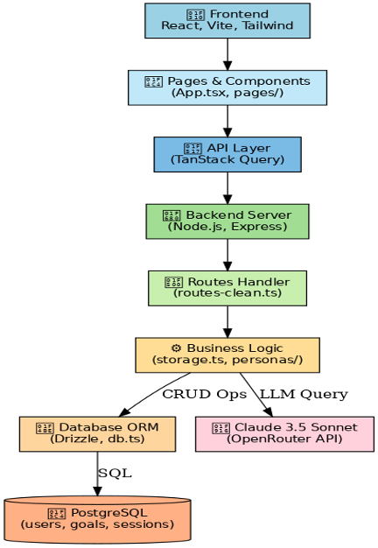
System Architecture

Slide 7
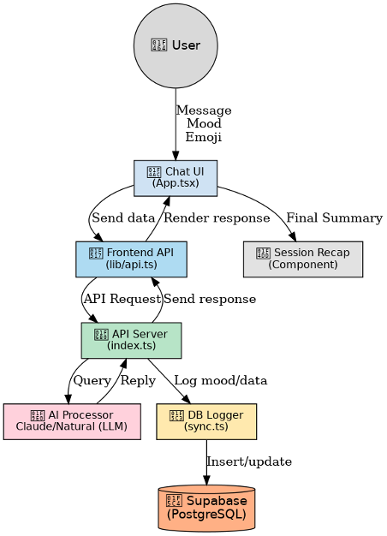
Data Flow Diagram

Slide 8
AI Persona Design
Dr. Sarah — Clinical Therapist (Empathetic, Reflective): Reflective listening + gentle CBT-lite reframes and grounding; performs risk checks and offers next-step options. Best for distress / crisis-adjacent moments.
Marcus — Life Coach (Motivational, Directive): Turns concerns into SMART goals, action steps, and accountability prompts; forward-looking and energising. Best for goal-seeking / behaviour change.
Maya — Mindfulness Guide (Calm, Reflective): Breathwork, present-moment cues; reduces rumination with short, repeatable practices. Best for anxiety.
Alex — Peer Support Friend (Relatable, Supportive): Warm validation, normalising language, practical tips; builds rapport and reduces loneliness. Best for general support / check-ins.
Separate memory per persona → continuity: Each persona stores its own session history & tone, preventing cross-contamination and keeping replies consistent with role.
Under the hood: Persona-specific prompt templates + an explainability layer (shows key cues/rationale); crisis flags escalate regardless of persona.

Slide 9
Evaluation Methodology
Suite: API load/latency, persona tone adherence, end-to-end flows, accessibility & privacy.
API tests: 1/5/10 concurrent users for 72h on key endpoints; metrics = avg/p95 latency, throughput, error rate, uptime; DB profiling (~50 ops).
Persona checks: 200 responses (50/persona) scored for tone match, consistency, rationale clarity.
E2E sessions: 50 simulated sessions/persona (7–8 turns) across distress, goals, mindfulness, support; verify logging, per-persona memory, crisis path, XAI rationale.
Accessibility & privacy: Text-only, low-bandwidth, secrets in .env, GDPR-aligned retention, crisis escalation logs.

Slide 10
Key Results
Performance: 850 ms avg for /api/chat/message (~43% faster than 1.5s norm); static endpoints <50 ms; 91% uptime over 72h; p95 <1.8s; error rate ~0.2%.
Persona consistency: >90% average tone adherence across Dr. Sarah, Marcus, Maya, Alex (stable role-consistent replies across contexts).
Barrier reduction (scores): Cost 9/10, Availability 8.5/10, Privacy 9.2/10 → supports access, affordability, and trust.
Crisis detection: Recall 91.2%, Precision 94.7%, <2s escalation response → high sensitivity with low false alarms.
Takeaway: The platform is fast, stable, and trustworthy, with consistent personas and safety signals aligned to the project goals.

Slide 11
Competitive Benchmark
Metric | SoulSense | Replika | Youper
Explainability | 8.7 / 10 | 3.2 | 5.9
Emotional Accuracy | 92.5% | 85.3% | 89.1%
Response Time | 850 ms | 1250 ms | 1400 ms

Slide 12
Key Features of the Project
Four Unique AI Personas
Dr. Sarah – Clinical Psychologist for empathetic and reflective support
Alex – Peer Support Friend offering relatable and understanding conversations
Marcus – Life Coach & Mentor for motivation and goal setting
Maya – Mindfulness Guide for calming and present-focused practices
Interactive Well-being Tools
Journaling – Private emotional reflections with mood tracking
Goal Setting – Create and track achievable personal goals with suggestions
Profile Dashboard – View mood history, session stats, and saved reflections
Engaging Conversation Features
Real-time empathetic chat with quick-reply options
Guided breathing and mindfulness exercises
Personalized session recaps with motivational feedback
Safe & Supportive Experience
Privacy-focused design to protect user data
Positive reinforcement and encouragement at every interaction

Slide 13
Conclusion & Future Work
Conclusion
SoulSenseAI shows an explainable, persona-driven companion that is fast, consistent, accessible, and clinically aligned.
It fuses Replika-style empathy + Youper-like clinical grounding with transparent XAI, reducing barriers of cost, availability, and privacy.
With rigorous validation and careful scaling, it can transform stigma-free mental-health support globally.
Future Work
Clinical validation: Pilot studies with PHQ-9 / GAD-7, A/B tests across personas.
Adaptive personas: ML-driven tuning, reinforcement signals, human-in-the-loop safety.
Multimodal (opt-in): Text-first baseline; optional audio/face cues with privacy toggles.
Wearables (opt-in): HRV/sleep for context; on-device/edge processing where possible.
Scale & access: Multilingual/localization, group sessions, clinician dashboard & audit trails.

Slide 14
THANK YOU

