Slide 1








TEAM up
A Collaborative Platform for Students and Teams
By Innov MasterZ

Slide 2





1
INTRODUCTION
TeamUp is a web platform built to help students and small teams collaborate easily.
Instead of using multiple apps for chat, task tracking, and updates, TeamUp brings everything into one single platform.

Slide 3


2
PROBLEM STATEMENT
Difficulty managing teammates
Poor communication
Tasks not tracked properly
Missing deadlines
Confusion due to multiple apps

Slide 4


3
our solution
Centralized project management
Task tracking board
Real-time chat
Notifications system
Everything connected in one place
Updation of Upcoming Events

Slide 5


4
key features
User Authentication (JWT secured login/signup)
Project Creation & Team Management
Task Management Board (To Do, In Progress, Completed)
Real-Time Chat (Socket.IO)
Notification System
Updation of Upcoming Events

Slide 6
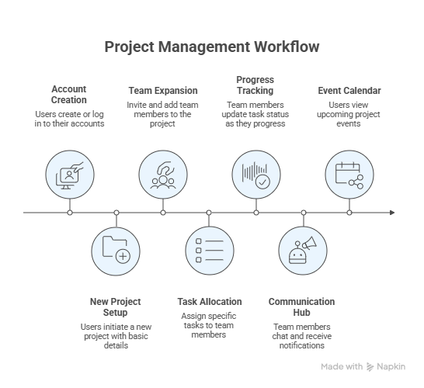
5
WORK FLOW DIAGRAM

Slide 7
7
Technologies Used
Node JS
Express JS
MongoDB
FRONTEND
backEND
React
Tailwind CSS
Socket.IO Client

Slide 8

8
CONCLUSION
TeamUp simplifies collaboration for students by combining project management, task tracking, communication, and notifications in one platform.

Slide 9
THANK YOU
By Innov MasterZ

Slide 11

6
Stay Calm During Uncertainty
Staying calm during uncertainty helps teams feel secure. Adaptive leaders maintain composure, providing clear direction while addressing challenges, ensuring teams remain focused and confident during transitions.

