Slide 1
Nifty Closing Price Prediction Presented by: SHREERANG MHATRE (52) SARVESH GURAV (44)
Guided by: Prof. MANISHA WANI

Slide 2
Table of contents
01
02
03
05
05
06
Introduction
Dashboard
System specification
System Design / Algorithm
07
08
Observations
Applications
Conclusion
Advantages and disadvantages

Slide 3
Introduction
In our project, we deployed a formidable lineup of six forecasting models — GRU, LSTM, Bidirectional GRU, Bidirectional LSTM, XGBoost, and Random Forest — to accurately predict Nifty closing prices over a 7-day period. Leveraging the strengths of recurrent neural networks, ensemble learning, and bidirectional processing, our models demonstrated precision and adaptability in navigating the complexities of the stock market. From the simplicity of GRU to the robustness of XGBoost, each model contributed uniquely to our predictive arsenal, showcasing the effectiveness of diverse machine learning approaches in anticipating Nifty's future movements.

Slide 4
System Specification
For speeding data-driven business outcomes, Rubiscape is a flexible and unified data scienceplatform that is easy to use, quick to load, and powerful. We can convert data into AI apps withthe aid of Rubiscape.
a) Rubiscape is a low-code platform with end-to-end capabilities to address the entireanalytics process.
b) 5X Faster TCO- Data ingestion, modelling, enrichment, visualisation, and collaborationare all made possible with Rubiscape.
c) Hybrid Deployment- Rubiscape supports a hybrid deployment strategy and offersflexible paths to the cloud, so you can start on-premises or in the cloud.
With Rubiscape we can utilise our data assets to their full potential. It is a single platform thatenables us to empower everyone involved to make a difference, regardless of the organisationof our team or the level of development of the data science activities. It’s a platform built forprofessionals from various sectors like- Automotive, Financial Services, Media, Banking,Healthcare, etc to meet their industrial needs. With Rubiscape, we can efficiently manage andtransform vast datasets while also implementing scalable security and governance measuresthat can expand in sync with an organization.

Slide 5
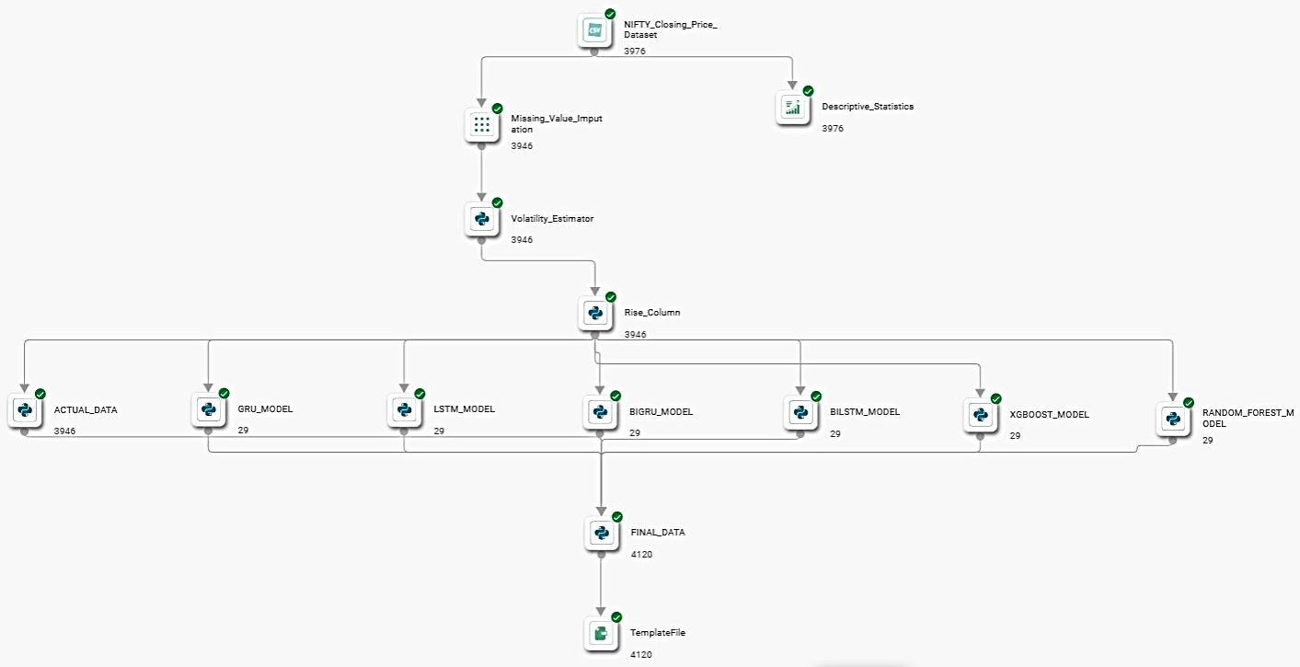
System Design

Slide 6
System Algorithm
We utilized six powerful forecasting models for predicting Nifty closing prices over a 7-day period:
Gated Recurrent Unit (GRU) : The basic idea behind GRU is to use gating mechanisms to selectively update the hidden state of the network at each time step.
Long-and-Short-Term Memory (LSTM) : LSTMs, with their memory cells addressing the limitation of traditional RNNs, excel in learning long-term dependencies, making them ideal for language translation etc.
Bidirectional GRU : It is a bidirectional recurrent neural network with only the input and forget gates
Bidirectional LSTM : Bidirectional LSTM or BiLSTM is a term used for a sequence model which contains two LSTM layers, one for processing input in the forward direction and the other for processing in the backward direction.
XGBoost : XGBoost is an optimized distributed gradient boosting library designed for efficient and scalable training of machine learning models.
Random Forest : Random Forest Regression is a versatile machine-learning technique for predicting numerical values.

Slide 7
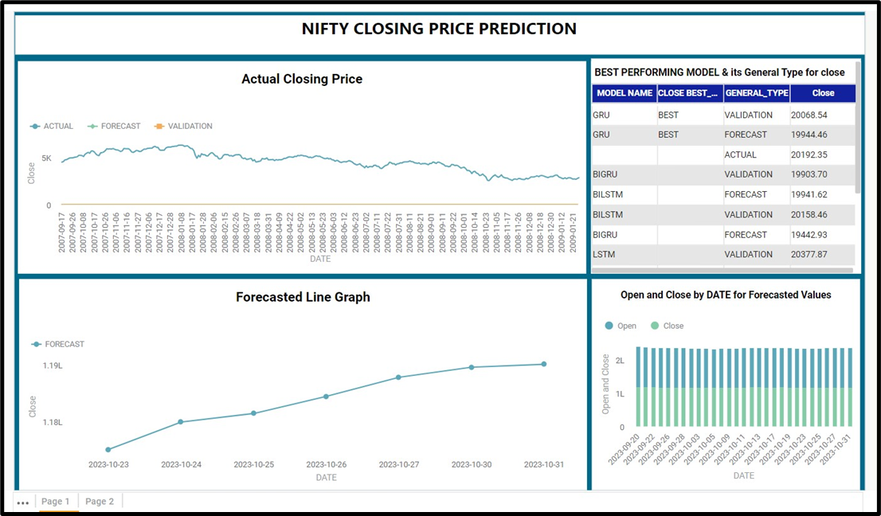
Dashboard

Slide 8
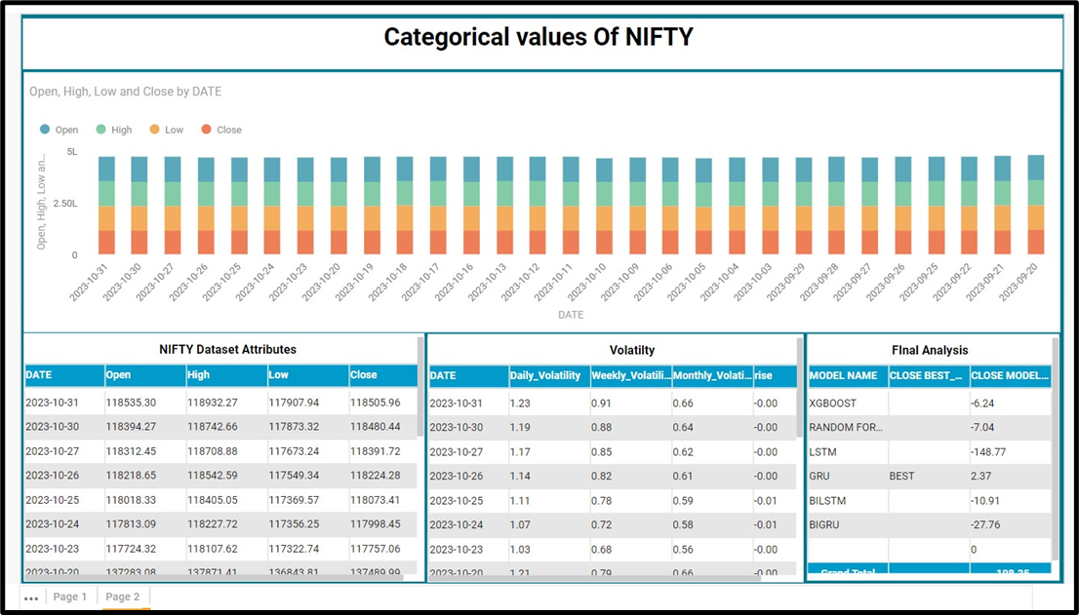
Dashboard

Slide 9
Observation
In our analysis, employing multiple forecasting models enhanced our understanding of their performance, with the final algorithm comparing and categorizing actual and forecasted data based on MAPE. Notably, the Gated Recurrent Unit (GRU) model outshone others, proving superior in training, testing, and providing the most accurate forecasts. The CSGenerator function output played a pivotal role in comprehending DataFrame column types. The GRU model's success suggests its potential for optimization in future datasets, empowering investors and stock brokers to make informed decisions by predicting stock prices with precision. This underscores the transformative power of advanced forecasting in navigating the dynamic stock market landscape.

Slide 10
Advantages Disadvantages
Speed and Precision: Our models provide fast, accurate, and precise predictions, enhancing decision-making processes.
Versatility Across Datasets: Capable of adapting to different datasets, ensuring applicability in diverse financial scenarios.
Global Market Optimization: Tailored for different stock markets, offering flexibility and optimization for global financial landscapes.
Security with Parallel Forecasting: Enhanced security through parallel forecasting, minimizing risks and ensuring robust protection.
Integrated Model Framework: Combining various models in a unified framework enhances overall forecasting capabilities.
Risk of Misuse: Acknowledge the potential for misuse, such as spreading false rumors or misinformation based on predictions.
Quantum Computing Uncertainty: Future compatibility with quantum computing is still under research, introducing uncertainty about future capabilities.
Complexities with Large Datasets: Managing large datasets may introduce complexities, impacting model efficiency and processing times.
Logistical Challenges with Parallel Models: Using parallel models may require careful consideration of logistical challenges when handling multiple stock datasets simultaneously.

Slide 11
Applications
forecasting models, proven to deliver accurate and precise predictions, offer diverse applications:
Comprehensive Prediction: Extend models to predict various market attributes like OPEN, CLOSE, HIGH, LOW, providing a holistic view of market dynaamics.
Versatile Forecasting: Apply models to different datasets, adapting them for forecasting in various financial scenarios and market conditions.
Fraud Prevention: Utilize predictions to cross-check and prevent stock market scams by identifying anomalies against actual market values.
Market Portfolio Enhancement: Facilitate in-depth research on companies and organizations, aiding in the creation of robust and diversified market portfolios.
Educational Research: Serve as a dynamic and practical case study for educational research, offering insights into the application of advanced forecasting models.

Slide 12
Conclusion
Our presentation highlighted the implementation and evaluation of six robust deep learning-based regression models for predicting NIFTY 50 closing values. We introduced LSTM, GRU, BiLSTM, BiGRU, XGBoost, and Random Forest, meticulously building, optimizing, and testing each model on daily index values. While all models demonstrated high accuracy, the univariate Gated Recurrent Unit (GRU) stood out as the most precise, utilizing previous data for enhanced forecasting. This underscores the efficacy of deep learning methodologies, especially the GRU model, in providing accurate predictions for NIFTY 50 closing values. Our findings open avenues for further exploration and emphasize the potential of advanced techniques in financial forecasting.

Slide 13
Refrences
https://www.bing.com/search?q=Nifty+closing+price+prediction+projects&form=ANNTH1&refig=1f65403871f74e3a855b2d07d6215acb&pc=ASTS
Nifty 50 Index Trade Ideas — NSE:NIFTY — TradingView — India
(PDF) Closing Price Prediction of Nifty Stock Using LSTM with Dense Network (researchgate.net)
https://www.tandfonline.com/doi/full/10.1080/08839514.2022.2111134
https://ieeexplore.ieee.org/document/9754148
https://ieeexplore.ieee.org/abstract/document/9317207
https://www.researchgate.net/publication/357908545_Nifty_Price_Prediction_from_Nifty_SGX_using_Machine_Learning_Neural_Networks_and_Sentiment_Analysis
https://www.mdpi.com/1911-8074/16/10/423
https://dl.acm.org/doi/10.1145/3590837.3590919
https://journalofbigdata.springeropen.com/articles/10.1186/s40537-020-00333-6

Slide 14
Thankyou

