Slide 1
Title
AI Research Agent
Shreesh | B.Tech CSE
Speaker note: Introduce yourself and the project name. Mention this is built using n8n workflow automation as part of Assignment 13.5.

Slide 2
Introduction
Automates web research using AI
Built entirely on n8n (workflow automation)
Combines search + AI reasoning + report generation
Speaker note: Briefly explain what the project does in one sentence before diving into details.

Slide 3
Problem Statement
Manual research is slow and repetitive
Requires visiting many sites and compiling notes
No consistent report format
Speaker note: Describe the pain point this project solves, based on your own research experience.

Slide 4
Objectives
Accept a topic via chat
Search the web in real time
Synthesize sources using AI
Generate a structured HTML report
Handle errors gracefully
Speaker note: Walk through each objective quickly; these map directly to assignment requirements.

Slide 5
Proposed Solution
Single n8n workflow: Chat → Search → AI Agent → HTML
Tavily for live web search
Groq LLM for analysis
Automatic HTML formatting
Speaker note: Summarize the end-to-end solution in one breath before the architecture slide.

Slide 6
Technology Stack
n8n (automation engine)
Tavily Search API
Groq (LLM inference)
JavaScript (Code nodes)
HTML/CSS output
Speaker note: Mention why each tool was chosen — e.g., Groq for fast inference, Tavily for AI-optimized search results.

Slide 7
System Architecture
Chat Trigger → Extract Topic → Validation
Tavily Search → Process Results
Research Agent (Groq) → HTML Generation
Three error-handling branches
Speaker note: Use this slide to show the full node diagram from ARCHITECTURE.md.

Slide 8
Workflow
11 nodes, 3 functional groups
Validate topic → Search the web → Generate report
Modular, easy to extend
Speaker note: Explain the grouping used in the actual JSON (`nodeGroups`), and why modularity matters.

Slide 9
Tavily Search API
Advanced search depth
Up to 8 results per query
Includes a quick-answer summary
Returns title, URL, and content excerpt per result
Speaker note: Explain why Tavily specifically (AI-optimized search) rather than a general search engine.

Slide 10
AI Research Agent + Groq
LangChain Agent node performs the reasoning
Groq model: openai/gpt-oss-120b, temperature 0.3
System prompt enforces synthesis, not copying
Fixed report structure (7 sections)
Speaker note: This is the core AI slide — explain the system prompt design briefly.

Slide 11
HTML Report Generation
Custom JavaScript Markdown-to-HTML converter
Embedded CSS, no external dependencies
Fully self-contained, browser-ready file
Speaker note: Mention that no external libraries are used — the parser is hand-written for this exact report format.

Slide 12
Error Handling
Missing Topic Error
Search Error (Tavily failure)
AI Error (Groq/Agent failure)
Each returns a clear, user-friendly message
Speaker note: Emphasize that failures are handled explicitly, not left to crash the workflow.

Slide 13
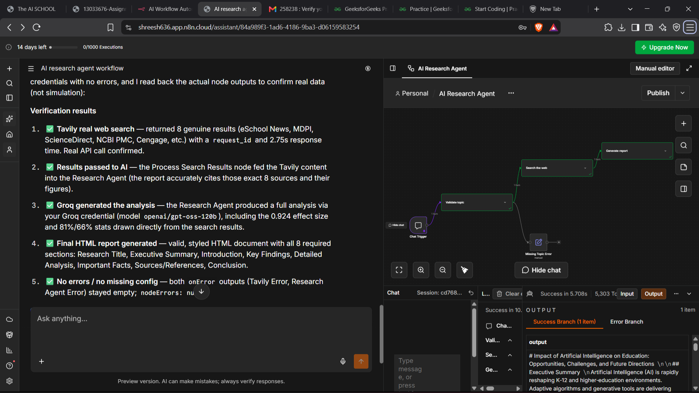
Testing & Results
Tested live with real Tavily and Groq credentials
Confirmed real API responses (request ID, response time)
Full HTML report generated with all required sections
Speaker note: Reference the execution screenshot as evidence of a successful live test run.

Slide 14
Advantages & Future Scope
Advantage: fully automated, consistent, fast
Future Scope: PDF export, database storage, citation management, scheduled runs
Speaker note: Be clear that the Future Scope items are not implemented yet — they are proposed improvements.

Slide 15
Conclusion / Thank You
Successfully automated end-to-end research
Meets all core assignment requirements
Thank you — questions welcome
Speaker note: Close by restating the core value: turning one chat message into a complete, structured research report.

