Slide 1
Internship project portfolio
SHREESHA
Data Analyst Intern
Unified Mentor Pvt Ltd
LinkedIn: www.linkedin.com/in/shreesha-poojary85

Slide 2
Tools & Technologies
- Power BI Desktop
- Microsoft Excel
- DAX (Data Analysis Expressions)
- CSV Dataset
-Python (pandas , matplotlib , seaborn) for cleaning data
- GitHub (for code and dashboard sharing)

Slide 3
3. Customer Satisfaction Prediction
GOALS:-
Analyze customer support data to identify key factors affecting customer satisfaction.
Clean and preprocess the dataset to ensure accuracy and reliability for analysis.
Create interactive Power BI dashboards to visualize customer satisfaction trends and support performance.
Develop machine learning models to predict customer satisfaction based on ticket and customer attributes.
Provide actionable insights to improve customer support processes and enhance customer experience.
Demonstrate end-to-end data analysis and predictive modeling skills for data-driven decision making.

Slide 4
dataset overview
Dataset Overview
• Total Records: 8,469 support tickets • Target Column: Customer Satisfaction Rating (scale of 1 to 5) • Problem Type: Binary Classification (Satisfied vs Unsatisfied) • Total Features: 17 columns (before cleaning)
Key Columns: • Customer Age, Gender, Product Purchased • Ticket Type, Ticket Priority, Ticket Channel • First Response Time, Time to Resolution, Resolution • Customer Satisfaction Rating
Preprocessing Performed: • Converted date columns to datetime format • Engineered features: Response Delay Minutes, Resolution Time Hours, Day of Week • Cleaned and standardized categorical columns • Removed rows with negative resolution time • Dropped unnecessary ID columns

Slide 5
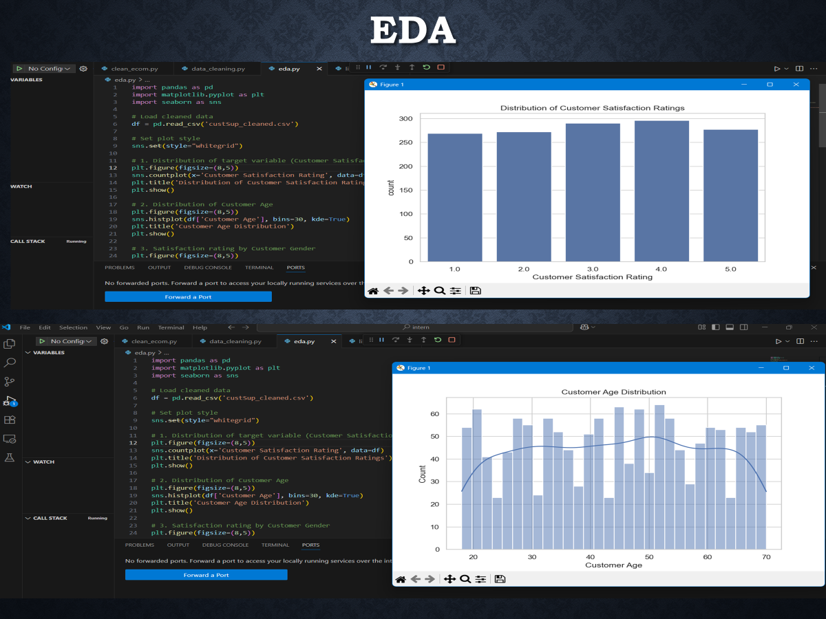

Slide 6
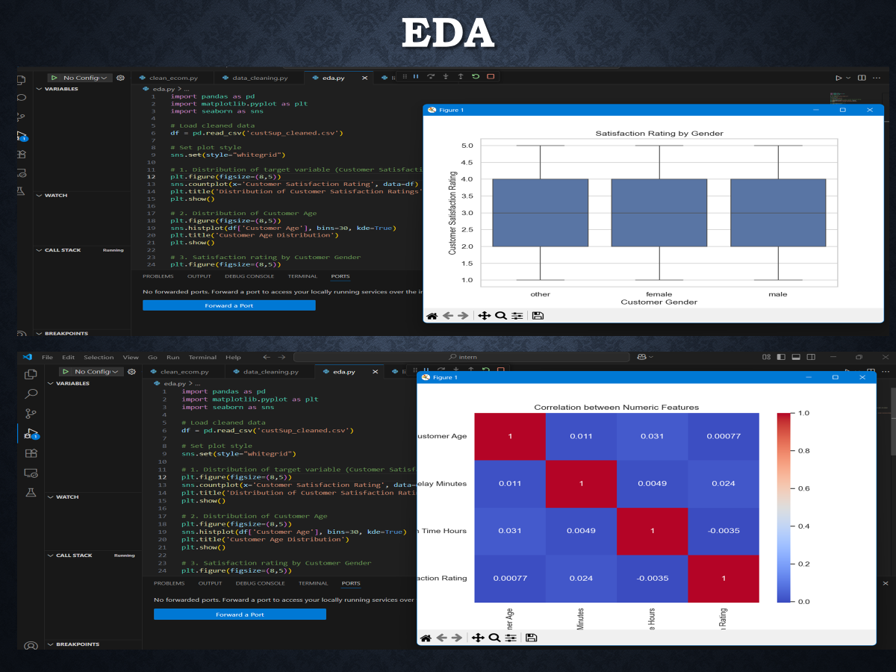

Slide 7
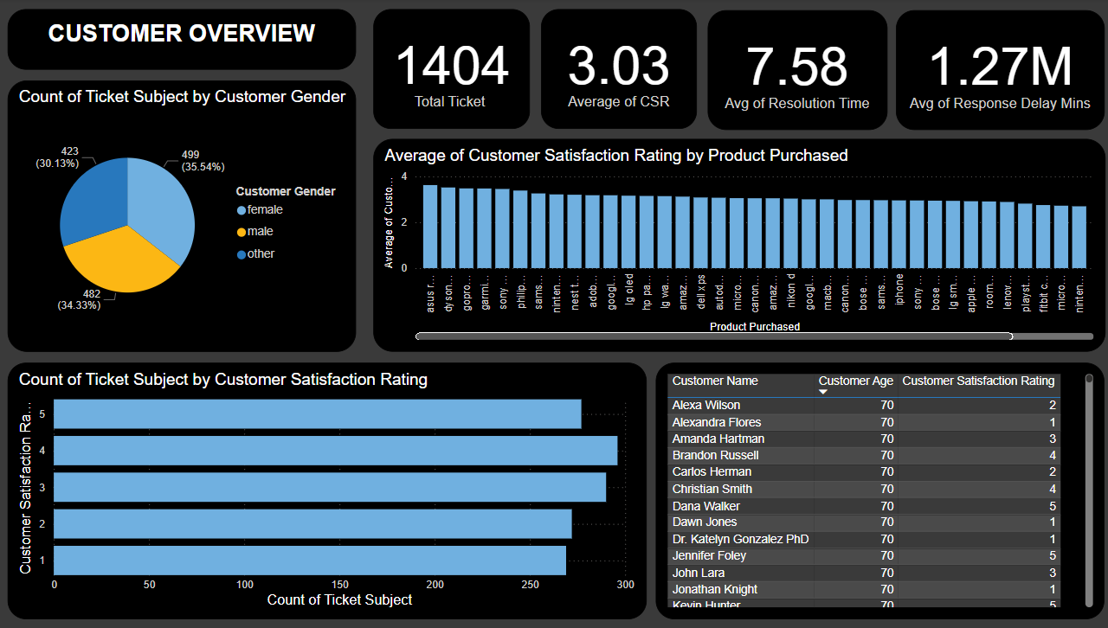
Dashboard: customer overview

Slide 8
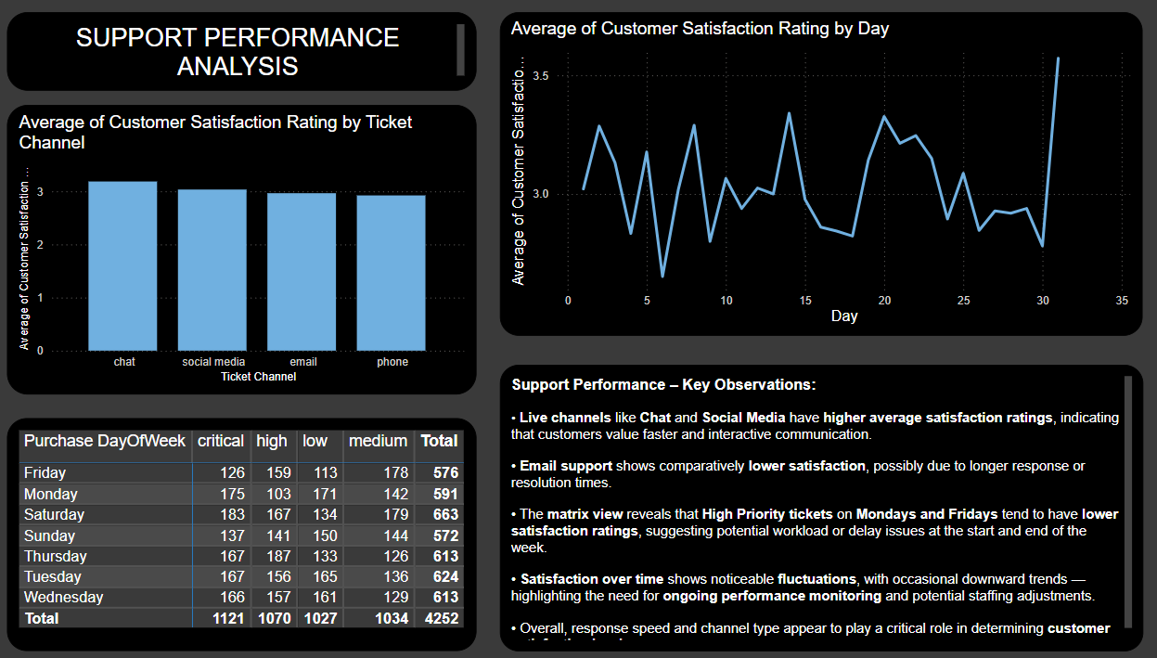
Dashboard : support performance

Slide 9
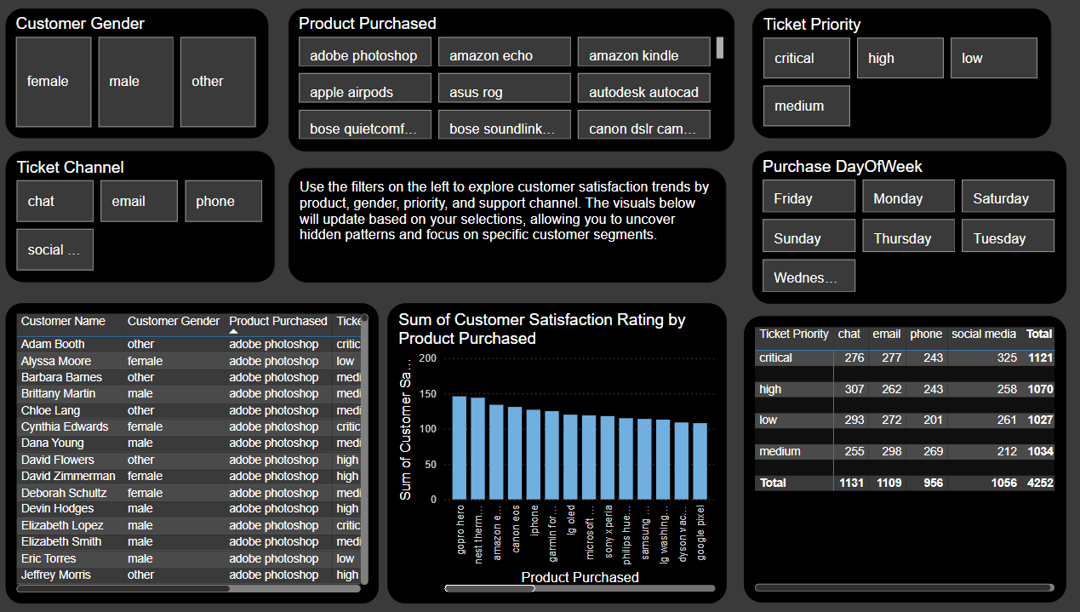
Dashboard : interactive filter & drilldown

Slide 10
Dax measures used
DAX Measures Used
• Total Tickets Total Tickets = COUNTROWS('custSup_cleaned’)
• Average Satisfaction Avg Satisfaction = AVERAGE('custSup_cleaned'[Customer Satisfaction Rating])
• Average Resolution Time (Hours) Avg Resolution Time = AVERAGE('custSup_cleaned'[Resolution Time Hours])
• Average Response Delay (Minutes) Avg Response Delay = AVERAGE('custSup_cleaned'[Response Delay Minutes])

Slide 11
Key insights from dashboard
• Live support channels like Chat and Social Media lead to higher customer satisfaction, while Email support shows lower ratings.
• Average ticket resolution time is around 7.58 hours, indicating efficient issue handling for most tickets.
• First response delays impact satisfaction — tickets with faster initial responses generally have higher ratings.
• High-priority tickets on Mondays and Fridays tend to receive lower satisfaction scores, likely due to workload or delay patterns.
• Customer satisfaction trends vary over time, showing some inconsistency — indicating opportunities for service process improvements.
• Interactive filters reveal performance gaps across product types, genders, and days of the week, enabling targeted actions.

