Slide 1
Internship project portfolio
SHREESHA
Data Analyst Intern
Unified Mentor Pvt Ltd
LinkedIn: www.linkedin.com/in/shreesha-poojary85

Slide 2
Tools & Technologies
- Power BI Desktop
- Microsoft Excel
- DAX (Data Analysis Expressions)
- CSV Dataset
-Python (pandas , matplotlib , seaborn) for cleaning data
- GitHub (for code and dashboard sharing)

Slide 3
1) E-commerce Furniture Dataset 2024
Goals of the Project
To analyze sales performance of e-commerce furniture products using Power BI
To uncover patterns based on pricing, discount, and shipping tags
To identify top-selling products and underperforming segments
To evaluate how discounts and free shipping affect sales volume
To present key business insights through interactive visuals and KPIs

Slide 4
Dataset overview
The dataset contains product-level sales data from an e-commerce furniture platform
It includes key metrics such as:
product title
Original price
Price
Sold
Tag test
derived fields like discount % price bins and sold bins for analysis
The dataset helps analyze the impact of pricing, discounts, and shipping on sales volume

Slide 5
Python for data cleaning
import pandas as pd
# Load CSV
df = pd.read_csv("ecom.csv")
# Clean price columns: remove '$' and convert to float
df['price'] = df['price'].replace('[\$,]', '', regex=True).astype(float)
df['originalPrice'] = df['originalPrice'].replace('[\$,]', '', regex=True)
# Handle missing originalPrice: fill with price if originalPrice is missing
df['originalPrice'] = df['originalPrice'].fillna(df['price'])
# Convert to float
df['originalPrice'] = df['originalPrice'].astype(float)
# Fill missing tagText with 'No Tag'
df['tagText'] = df['tagText'].fillna("No Tag")
# Save cleaned file
df.to_csv("cleaned_ecom.csv", index=False)
print("✅ Cleaning complete. Cleaned file saved as 'cleaned_ecom.csv'")
print(df.head())

Slide 6
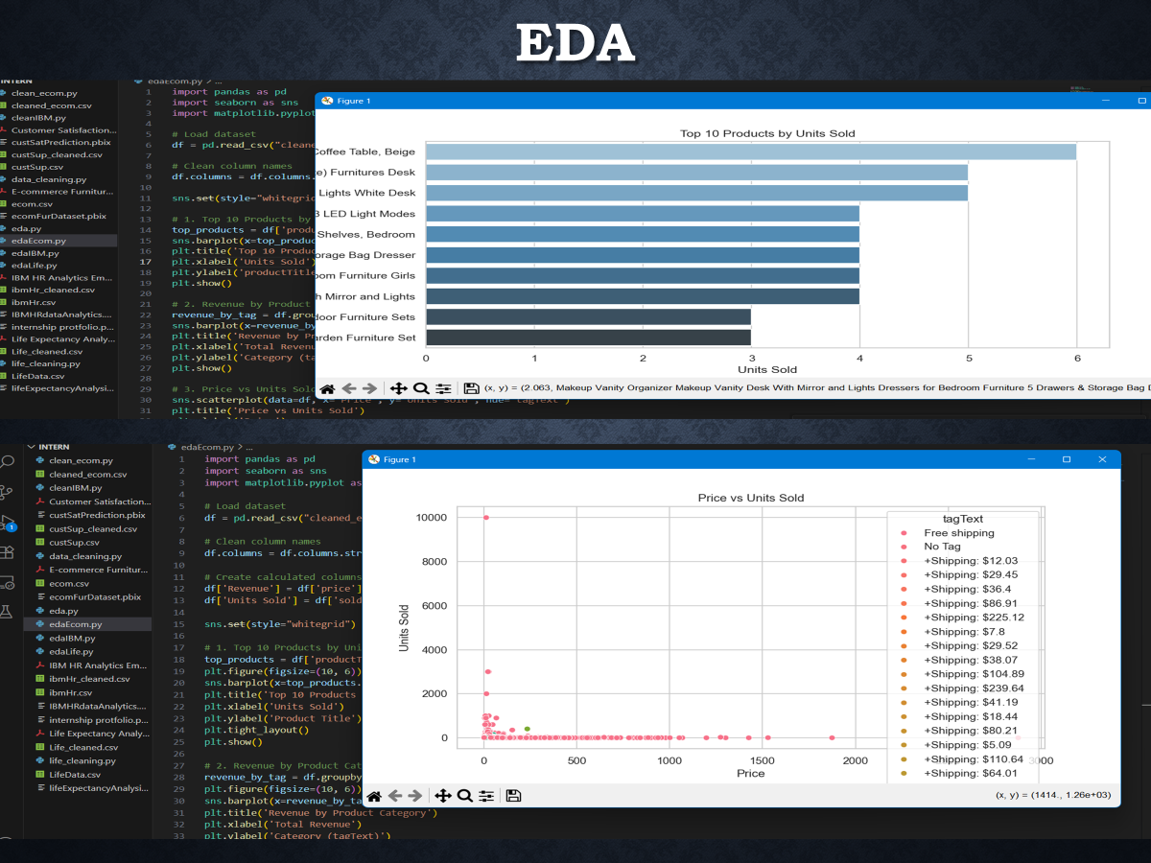

Slide 7
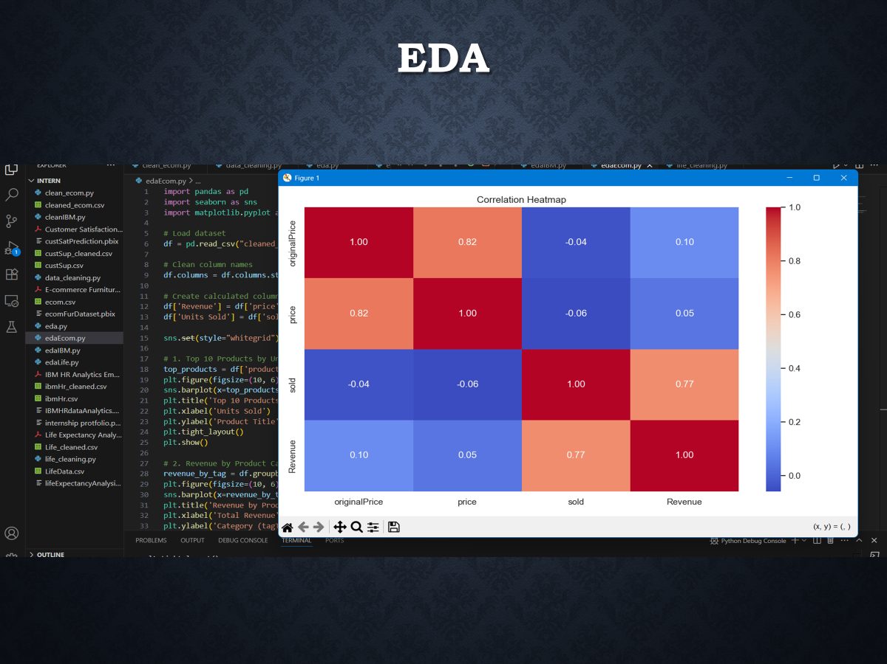

Slide 8
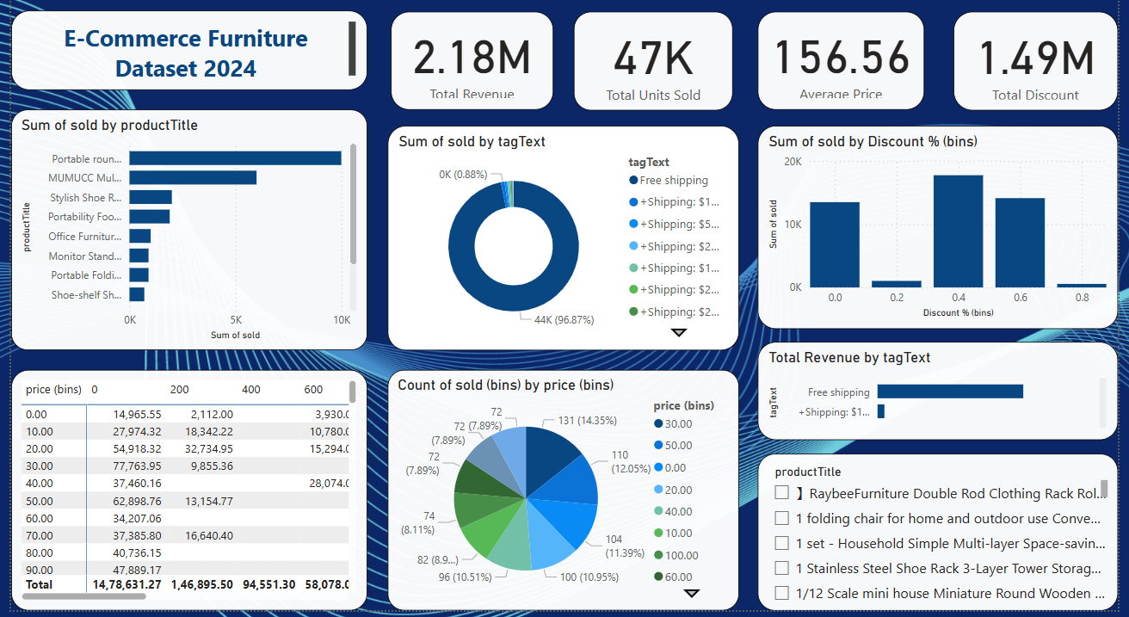
Dashboard overview:-

Slide 9
Important DAX Measures Used
DAX Measures Used:
• Total Revenue – SUMX(price × sold)
• Total Units Sold – SUM(sold)
• Average Price – AVERAGE(price)
• Total Discount – SUMX((originalPrice - price) × sold)
Calculated Columns:
• Discount % – (originalPrice - price) ÷ originalPrice
• Price Bins – Grouped into $10 intervals
• Sold Bins – Grouped into 200-unit intervals

Slide 10
Key insights from the dashboard
Products with free shipping tags showed significantly higher sales volume
A small group of top products contributes to the majority of total units sold
Most products are priced under $200, and higher-priced items tend to sell less
Items with a 40–60% discount range showed strong sales performance
The average selling price across all products was around $X (update with your actual value)
Price vs Sold heatmap reveals that affordable, medium-discounted products sold the most
Products grouped in lower price and higher sold bins generated more revenue overall

