Slide 1
Internship project portfolio
SHREESHA
Data Analyst Intern
Unified Mentor Pvt Ltd
LinkedIn: www.linkedin.com/in/shreesha-poojary85

Slide 2
Tools & Technologies
- Power BI Desktop
- Microsoft Excel
- DAX (Data Analysis Expressions)
- CSV Dataset
- GitHub (for code and dashboard sharing)

Slide 3
1) IBM HR Data Analytics Employee Attrition & Performance
GOALS:-
To analyze employee attrition and performance trends using Power BI.
Enable HR to make data-driven decisions to reduce turnover and identify top performers.
This dashboard gives HR visibility into employee behavior
Supports data-driven HR decisions on retention, rewards, and engagement.

Slide 4
Dataset Overview
IBM HR Analytics Dataset (CSV)
Key Fields:
- Attrition, Department, Age, Gender
- Job Role, Education, Monthly Income
- Performance Rating, OverTime, Job Satisfaction

Slide 5
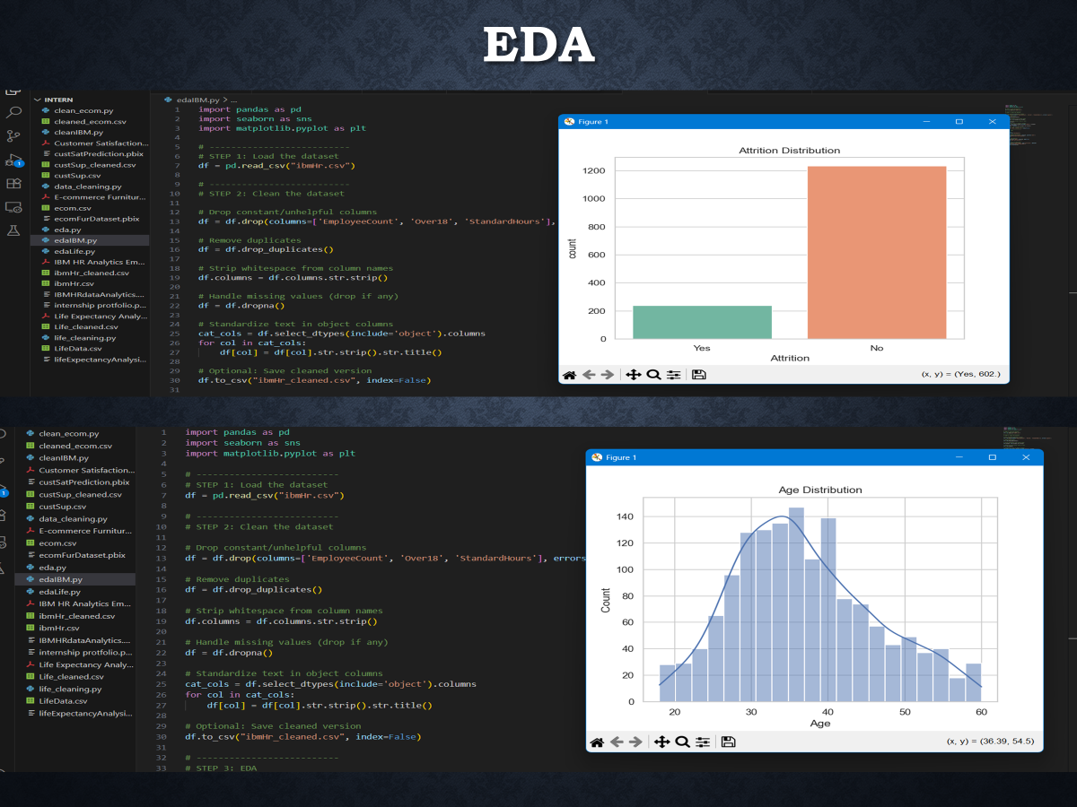

Slide 6
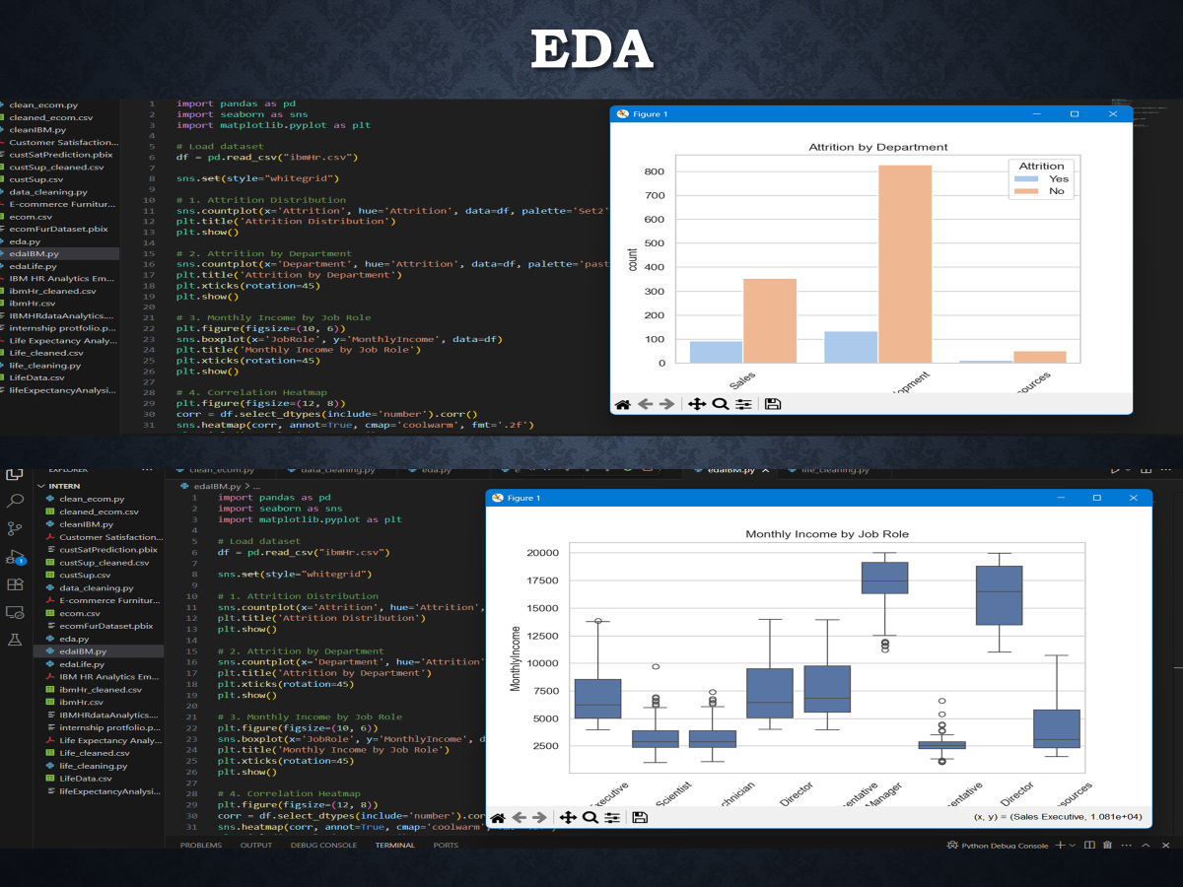

Slide 7
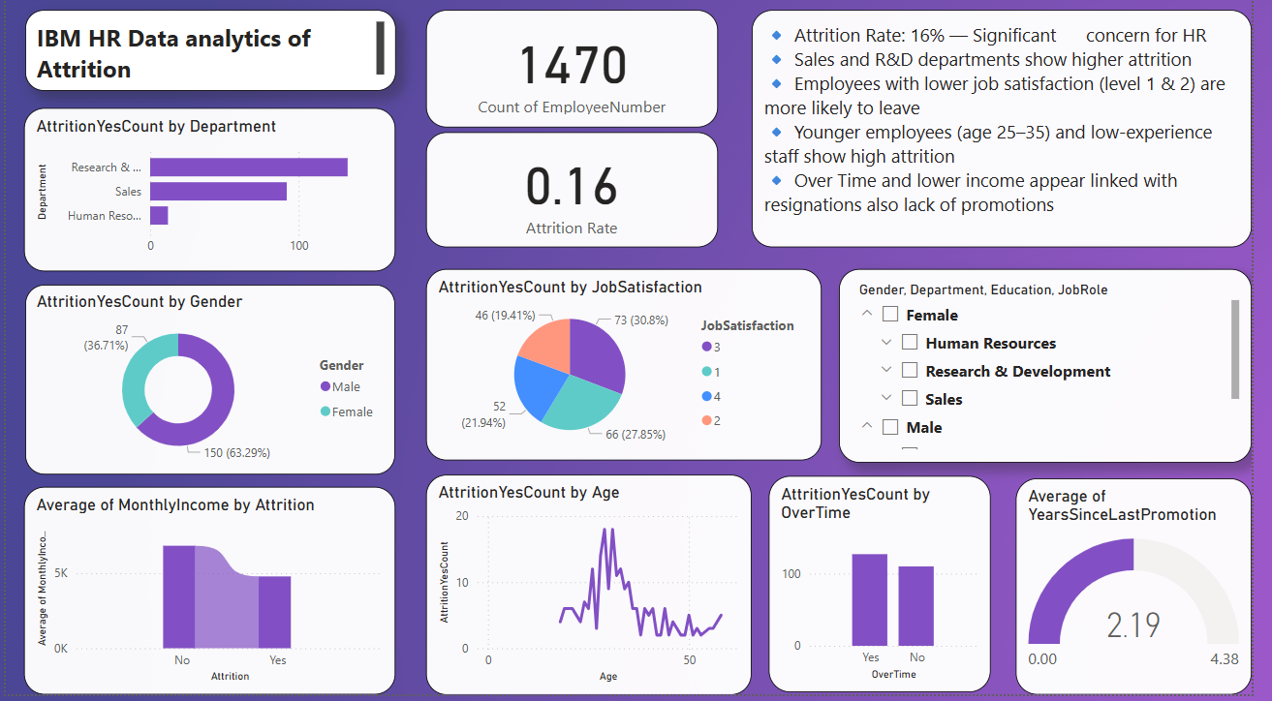
Dashboard Page 1: Attrition Overview
- Attrition Rate (Card) - Attrition by Department (Bar Chart) - Attrition by Gender (Donut Chart)
- Satisfaction vs Attrition (Column) - Over Time Gauge

Slide 8
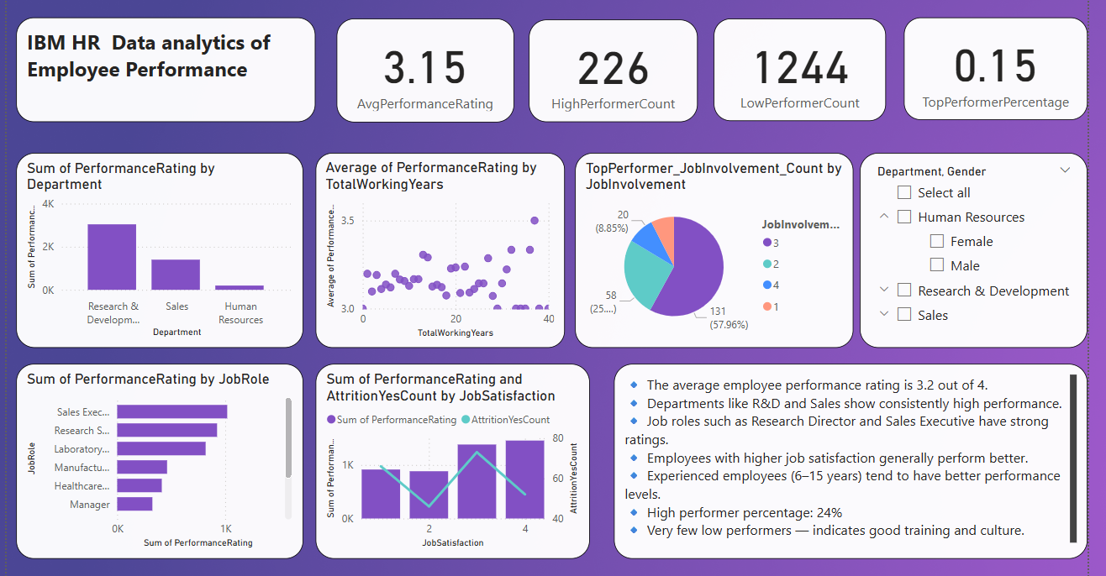
Dashboard Page 2: Performance Overview
- KPI Cards: Avg Rating, Top % - Performance by Role/Dept - Satisfaction vs Performance - Job Involvement (Pie)
Over Time Impact

Slide 9
Important DAX Measures Used
AttritionYesCount = CALCULATE( COUNTROWS(IbmHr), IbmHr[Attrition] = "Yes")
- Attrition Rate = COUNT(Attrition='Yes') / COUNT(All)
- AvgPerformanceRating = AVERAGE(PerformanceRating)
- HighPerformer = COUNT(PerformanceRating=4)
- Overtime Rate = DIVIDE(CALCULATE(COUNTROWS(IbmHr), IbmHr[OverTime] = "Yes"),COUNTROWS(IbmHr))
AgeGroup = SWITCH(TRUE(),IbmHr[Age] <= 25, "18-25",IbmHr[Age] <= 35, "26-35",IbmHr[Age] <= 45, "36-45","46+")

Slide 10
Key Insights from Dashboard
- High attrition in Sales & R&D
- Low satisfaction + high OverTime = higher exits
- Performance improves with experience
- Job involvement links strongly with top ratings
- Most employees are average to high performers

