Slide 1
Internship project portfolio
SHREESHA
Data Analyst Intern
Unified Mentor Pvt Ltd
LinkedIn: www.linkedin.com/in/shreesha-poojary85

Slide 2
Tools & Technologies
- Power BI Desktop
- Microsoft Excel
- DAX (Data Analysis Expressions)
- CSV Dataset
-Python (pandas , matplotlib , seaborn) for cleaning data
- GitHub (for code and dashboard sharing)

Slide 3
4)Life expectancy analysis
🎯 Project Goals
• Analyze global health and economic indicators to understand their impact on life expectancy
• Clean and prepare raw data for accurate visualization and analysis
• Create an interactive Power BI dashboard to explore trends and patterns
• Identify key factors such as GDP, education, alcohol, HIV/AIDS, and infant mortality
• Compare life expectancy patterns across developed and developing countries
• Deliver insights to support data-driven public health and policy decisions

Slide 4
🗂️ Dataset Overview
Total Records: 2,928 rows × 22 columns
Data Source: Raw CSV file with global health statistics (2000–2015)
Target Variable: Life expectancy (in years)
Key Features:
- Economic: GDP, Income composition of resources
- Health: HIV/AIDS, Alcohol, infant deaths, Measles, Hepatitis B
- Social: Schooling, Status (Developed/Developing)
• Data Issues: Missing values, formatting inconsistencies, outliers
• Cleaned using Python (pandas) before Power BI visualization

Slide 5
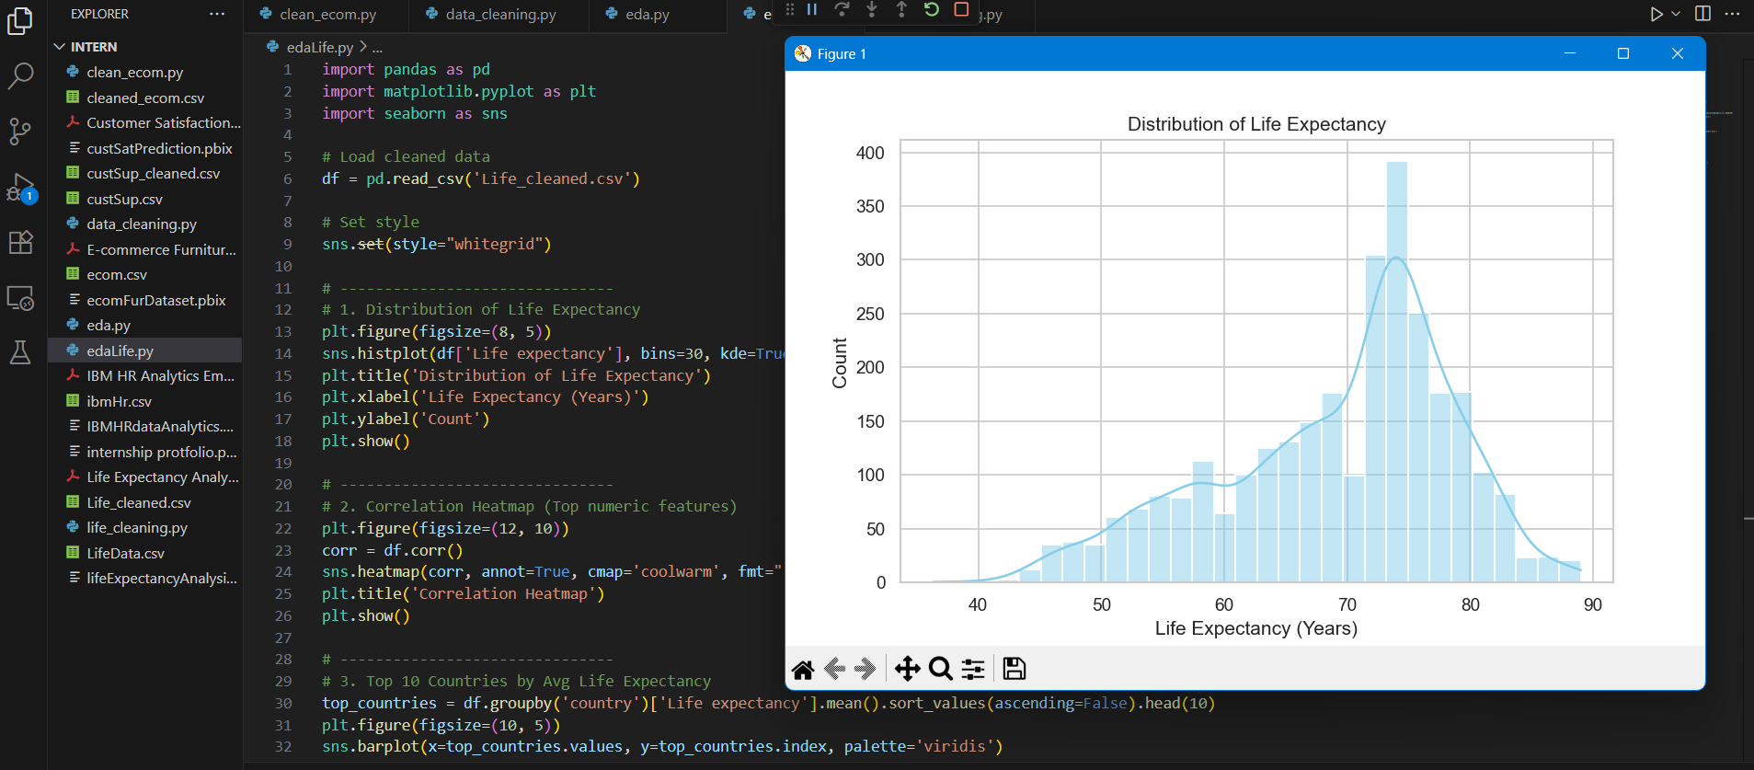
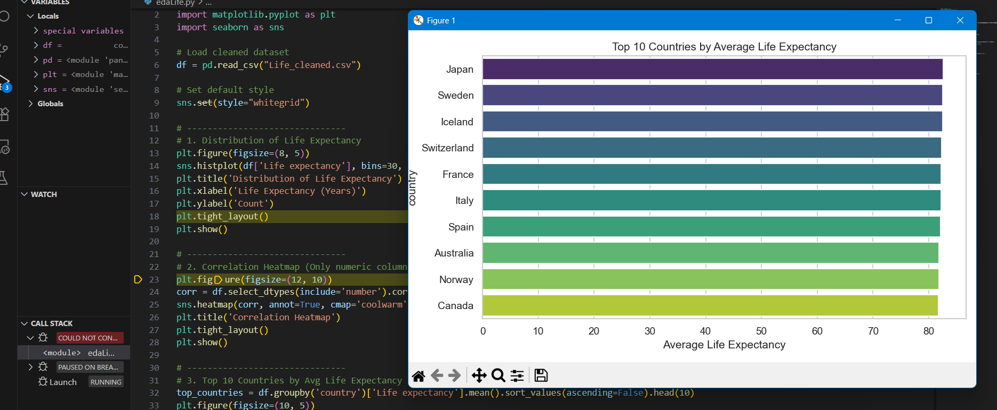
eda

Slide 6
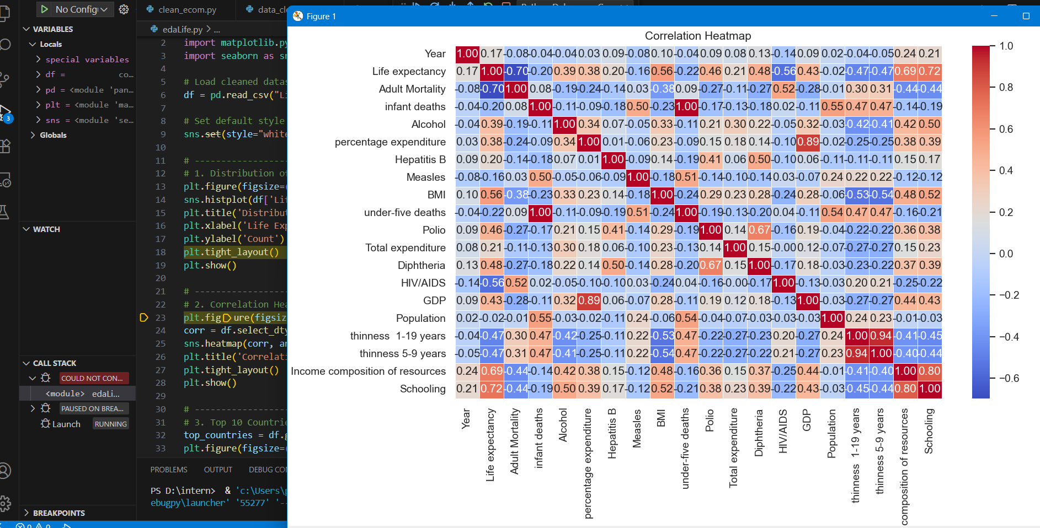
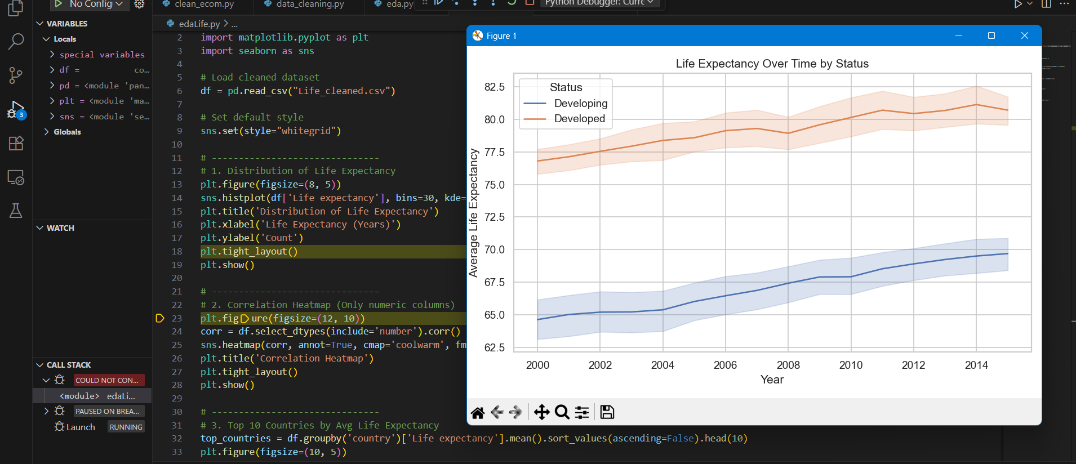
eda

Slide 7
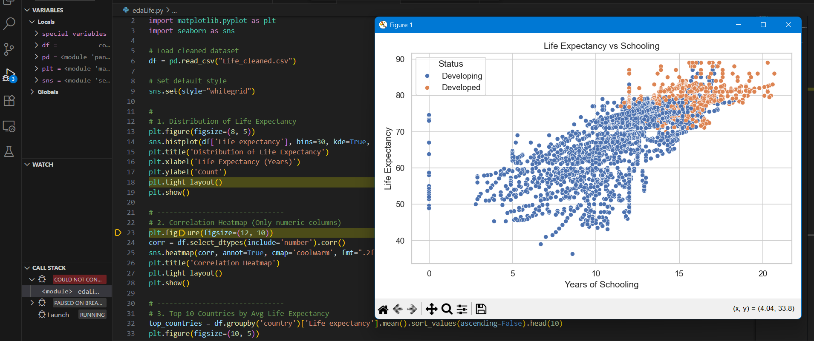
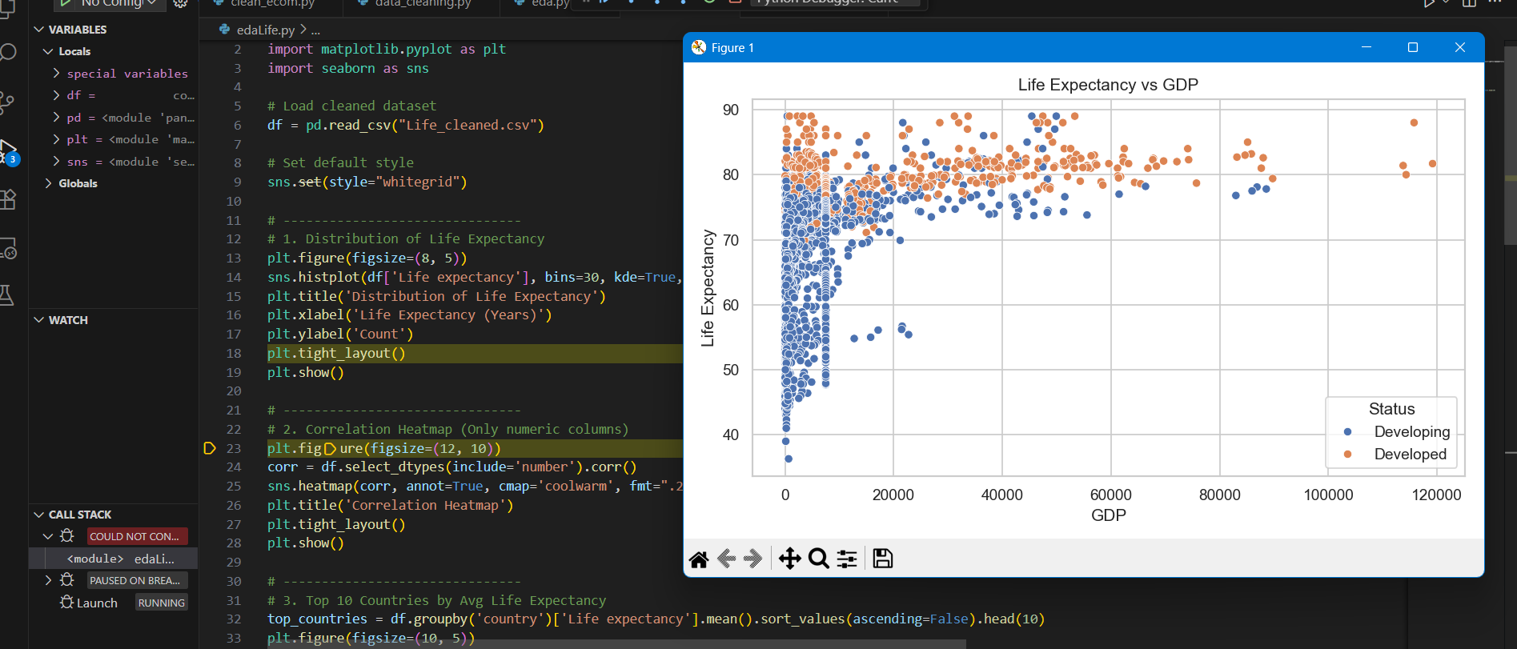
eda

Slide 8
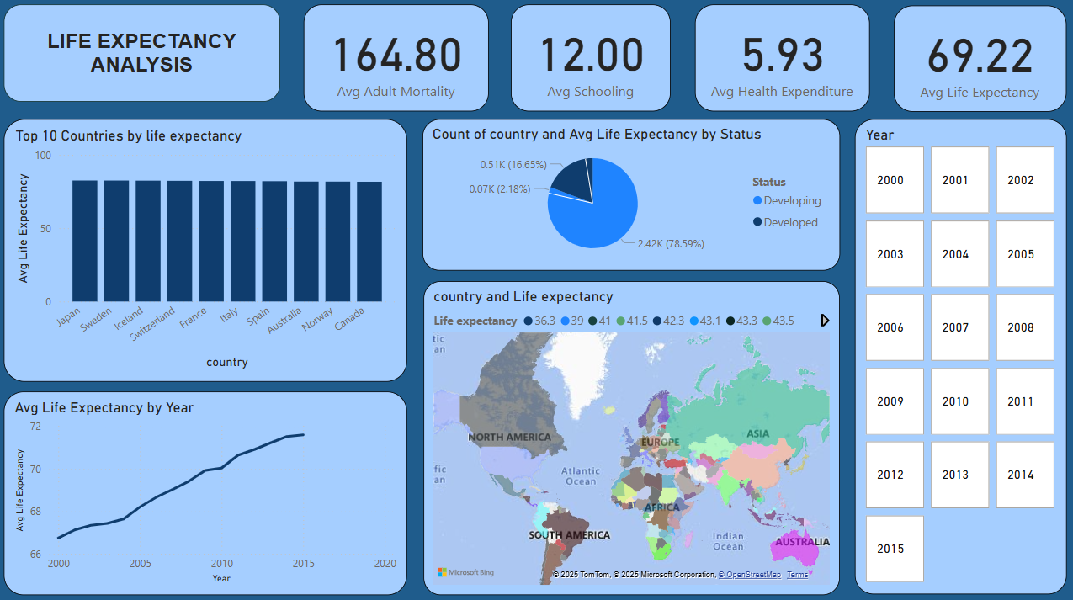
Dashboard 1: life expectancy analysis

Slide 9
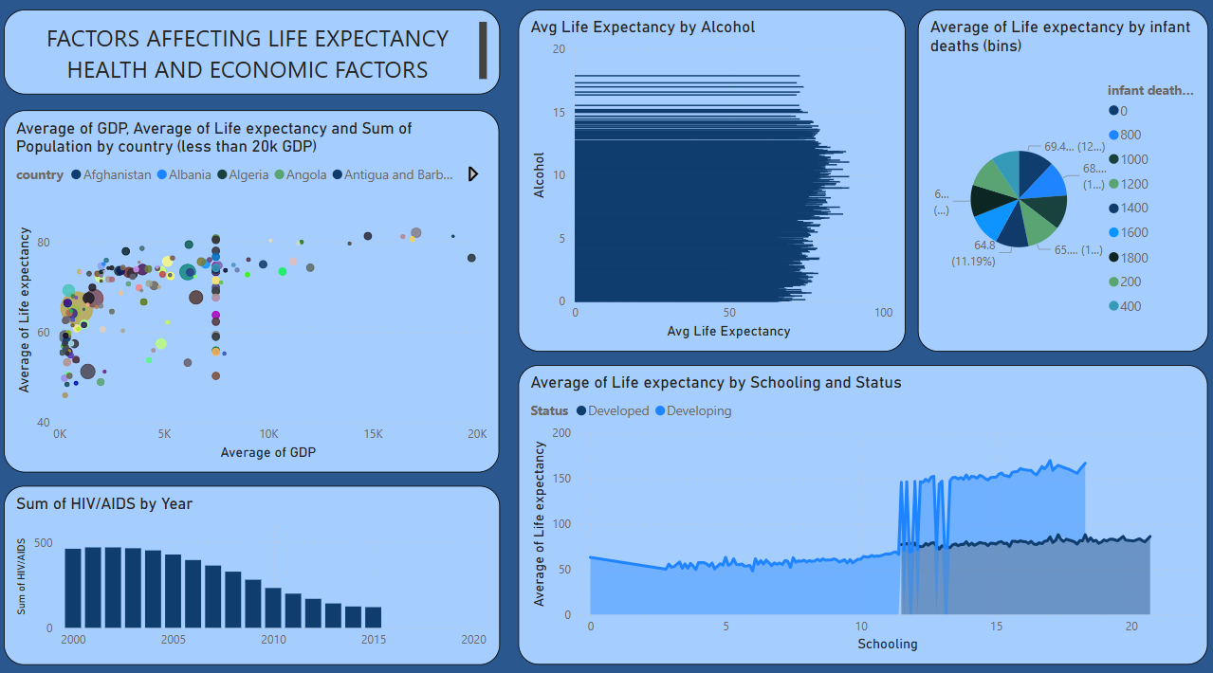
Dashboard 2: health and economic factors

Slide 10
📐 DAX Measures Used
Avg Life Expectancy = AVERAGE('Life_cleaned'[Life expectancy])
Avg GDP = AVERAGE('Life_cleaned'[GDP])
Avg Alcohol = AVERAGE('Life_cleaned'[Alcohol])
Avg HIV = AVERAGE('Life_cleaned'[HIV/AIDS])
Avg Schooling = AVERAGE('Life_cleaned'[Schooling])
Avg Infant Deaths = AVERAGE('Life_cleaned'[infant deaths])

Slide 11
📈 Key Insights
• Countries with higher GDP generally show higher life expectancy.
• HIV/AIDS rate has a strong negative impact on life expectancy, especially in developing nations.
• Infant mortality and alcohol consumption are also key health indicators affecting life span.
• Better schooling and income composition are strongly linked to longer life expectancy.
• Developing countries consistently show lower average life expectancy than developed ones.
• Over time, global life expectancy trends show gradual improvement across most regions.

