Slide 1
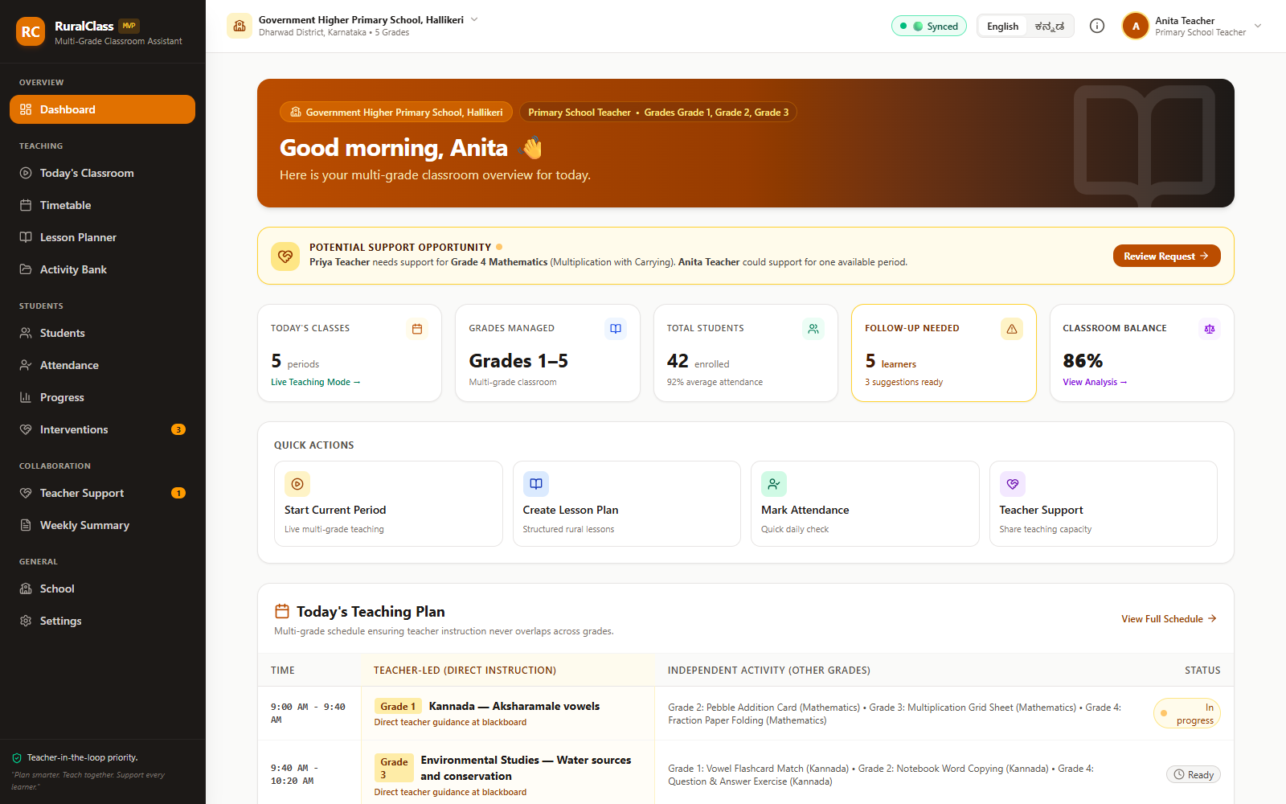
RC
RuralClass
01 / 06 · IMPACT
MULTI-GRADE CLASSROOM ASSISTANT
One teacher.
Five grades.
One classroom.
RuralClass turns that constraint into a plan the teacher can run — timetable, lesson delivery and learner support in one workspace.
52.1%
1.04 lakh
5
13 connected views
13 / 13 tests
English / ಕನ್ನಡ
of government primary
schools have fewer than
60 students
single-teacher schools
across India
grades coordinated in
a single timetable
A working prototype — not a slideware promise.
From period-by-period improvisation to a plan the teacher can run.
Sources: ASER 2024 National Findings; UDISE+ 2024-25, Ministry of Education.
github.com/ShreeshaN2006/RuralClass · Hackathon 2026
01 / 06
Notes:
IMPACT — 30 seconds.
Open with the room, not the technology: one adult, up to five grades, six periods, and no margin for a bad plan. Multi-grade teaching is the operating model in India's smallest schools, not an edge case. ASER 2024 finds 52.1% of government primary schools have fewer than 60 students; UDISE+ 2024-25 counts about 1.04 lakh single-teacher schools.
The benefit RuralClass is designed for: the teacher stops improvising each period and starts from a plan that already accounts for every grade. We are not claiming measured time savings yet — the pilot metrics on page 6 are how we will prove them. Keep this page to half a minute and move to the mechanism.

Slide 2
RC
RuralClass
02 / 06 · INNOVATION
MULTI-GRADE CLASSROOM ASSISTANT
The missing layer is coordination, not content.
Most tools optimise what to teach. RuralClass optimises where the teacher's attention goes.
01
Constraint-first scheduling
PERIOD 3 · 10:40 – 11:20
1 teacher · 5 grades
A hard invariant, not a best-effort heuristic: one grade gets direct instruction each period; every other grade gets a concrete independent, group or peer task.
Grade 1
Independent · Fraction folding
02
Explainable, not opaque
Grade 2
Group · Word and picture match
Every intervention states the triggering rule and the recent evidence. Deterministic logic, no model. The teacher accepts, edits or dismisses.
Grade 3
Teacher-led · Multiplication tables
03
Bilingual parity
Grade 4
Peer · Map reading
Timetable rationale, lesson phases and intervention options are generated in English and Kannada — not just the navigation labels.
Grade 5
Independent · Sentence building
The unit of design is the room, not the lesson.
Exactly one teacher-led cell. Every period. Enforced by test.
github.com/ShreeshaN2006/RuralClass · Hackathon 2026
02 / 06
Notes:
INNOVATION — 40 seconds.
The originality is not a feature list; it is the unit of design. Existing planning tools optimise a lesson for one class. RuralClass schedules the whole room: a hard invariant means exactly one grade is teacher-led in every period, and the other grades always have a concrete task, so no child waits for the teacher.
Second, every recommendation is explainable: the rule and the evidence are shown, and the teacher keeps the decision. Third, Kannada parity is in generated content, not just labels.
Point at the period card: amber is teacher-led, four stations are independent, group or peer work. This invariant is tested, not aspirational.

Slide 3
RC
RuralClass
03 / 06 · EXECUTION
MULTI-GRADE CLASSROOM ASSISTANT
A working system, not a mockup.
Thirteen connected views, four pure TypeScript engines, and a test suite that checks the invariant teachers depend on.
ruralclass — zsh
01
One workspace, end to end
$ npm run check
Sign-in → timetable → lesson plan → classroom → assessment → intervention → parent summary. Thirteen views share one state model.
tsc --noEmit
✓ TypeScript clean
> tsx --test src/services/*.test.ts
02
Decision logic is pure and testable
✓ 13 tests passing
Timetable, intervention, lesson planning and scoring run outside React as deterministic TypeScript functions.
$ npm run build
✓ production build clean
dist/ static HTML, CSS and JS
03
Build quality is checked, not claimed
Strict TypeScript, 13 engine and auth tests, a passing production build, reproducible check scripts and a Render blueprint.
$ ls dist/assets
index-*.js index-*.css
✓ 0 servers required
13
connected views
4
pure decision engines
13/13
tests passing
0
servers or secrets
github.com/ShreeshaN2006/RuralClass · Hackathon 2026
03 / 06
Notes:
EXECUTION — 30 seconds.
This is a working application, not a prototype shell. Thirteen views cover the teacher's day end to end, sharing one state model. The decisions that matter — timetabling, interventions, lesson phases and scoring — are pure TypeScript functions, so they can be tested without a browser.
The terminal is the proof: strict TypeScript, 13 passing tests, a successful production build. The repo includes the test suite and a Render blueprint. There is no backend, no API key and no secret to configure.
If asked what is not built: persistence is session-only and demo auth is not security — those are stated on page 6.

Slide 4

RC
RuralClass
04 / 06 · UI / UX
MULTI-GRADE CLASSROOM ASSISTANT
One calm workspace for a crowded room.
Plan the week, run the period, support the learner — without re-entering the same data.
01 Plan
→
02 Teach
→
03 Support
Same grammar everywhere
Sidebar, cards, status language and actions repeat across all 13 views, so a teacher learns the interface once.
Kannada is first-class
The full dashboard, generated rationale, lessons and interventions switch language; the choice persists.
Teacher keeps the pen
Rationale is shown before a timetable is accepted; interventions are proposals the teacher accepts or dismisses.
Accessibility today: labelled dialogs, announced toasts, status with text and colour. Known gap: a complete keyboard and screen-reader pass — on the roadmap, not hidden.
The same dashboard in Kannada: language changes the content, not just the labels.
github.com/ShreeshaN2006/RuralClass · Hackathon 2026
04 / 06
Notes:
UI / UX — 30 seconds.
The journey is the job: Plan, Teach, Support. The same visual grammar repeats across thirteen views, so there is one interface to learn. Kannada is not a translated menu — the dashboard, generated timetable rationale, lesson phases and interventions all switch, and the choice persists.
The teacher stays in control: a timetable shows its rationale before acceptance, and an intervention is a proposal, not an automatic action. The interaction model assumes a shared classroom tablet and low bandwidth, not a personal laptop.
Be candid about accessibility: dialogs are labelled and toasts announced, status uses text plus colour, but a full keyboard and screen-reader pass is still on the roadmap. Judges reward knowing the gap.

Slide 5
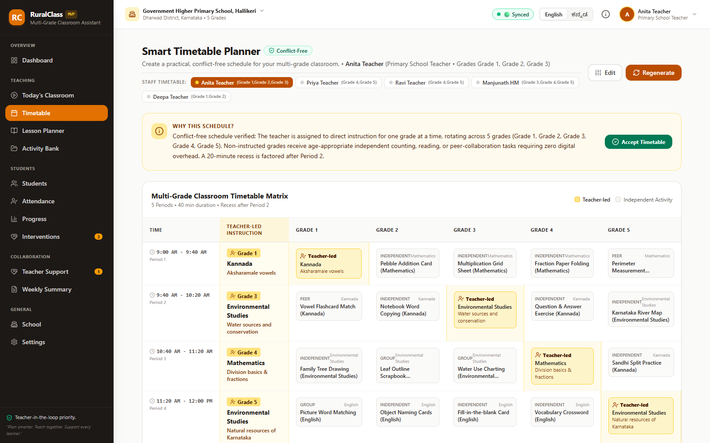
RC
RuralClass
05 / 06 · DEMO
MULTI-GRADE CLASSROOM ASSISTANT
Five minutes. Four moves. Real state.
A judge can reproduce this on any laptop — no account, API key or network service.
01
Sign in as a teacher
teacher_anita / demo123 — 11 profiles across three Karnataka schools, one click each.
02
Generate the day
Grades 1–5, six periods. Inspect any period: one teacher-led cell, four independent stations. Accept it.
03
Run Period 1
Start the class, see every grade's station, mark it complete with an observation. The dashboard updates.
04
Close the learner loop
Record two sub-50% checks. The intervention appears with its rule and evidence. Accept it, then switch to Kannada.
Every period is verified in the UI before the teacher accepts it.
$ npm install && npm run dev
→ localhost:3000
Demo data is fictional. Demo auth is a walkthrough, not security.
github.com/ShreeshaN2006/RuralClass · Hackathon 2026
05 / 06
Notes:
DEMO — 90 seconds, live if possible.
Use the seeded account: teacher_anita / demo123. Show the one-click login, then generate Grades 1–5 across six periods. Scroll the matrix and point out that every period has exactly one amber teacher-led cell and four concrete stations. Accept the timetable so the state change is visible.
Open Today's Classroom, start Period 1, show the five stations, mark complete with a short observation. Then record two assessments below 50% for a learner, open Interventions, and read the rule and evidence aloud. Accept the suggestion and toggle Kannada to show the same flow in the classroom language.
If the live demo fails, use the screenshots on this page and the terminal proof on page 3. Never debug in front of judges. The command is npm install && npm run dev; the app opens on localhost:3000.

Slide 6
RC
RuralClass
06 / 06 · FEASIBILITY
MULTI-GRADE CLASSROOM ASSISTANT
Deployable today. Adoptable where it counts.
Static hosting, existing devices, near-zero running cost — with the constraints stated plainly.
01
02
03
Ship
Run
Harden
npm run build produces a static dist/. The repo includes a Render blueprint; any static host works. No server, database, API key or secret.
A modern browser on a shared tablet or laptop. English or Kannada. No install and no runtime API calls; free-tier hosting covers a pilot.
Before real learners: school-managed accounts, IndexedDB persistence and sync, a full accessibility pass, and a data-protection review.
render.yaml included
no install, no API key
pilot gate
Assumption: grades 1–5, one teacher, one shared device, intermittent connectivity. Demo auth is not security; session state does not persist across reload.
THE ASK
PILOT TARGETS, NOT CLAIMS
Three pilot schools. One mentor. Eight weeks.
Planning time
Direct-instruction minutes
Intervention follow-through
Teacher retention
Validate the workflow with teachers, then harden it for real learners.
Give every multi-grade teacher a plan they can run.
github.com/ShreeshaN2006/RuralClass · Hackathon 2026
06 / 06
Notes:
FEASIBILITY — 30 seconds, then close.
RuralClass is a static React build: npm run build produces a dist/ folder that runs on Render, GitHub Pages or any school web server. There is no database, API key, secret or server to operate, so the running cost for a pilot is effectively hosting only. The included Render blueprint configures the build and SPA fallback.
State the constraints before judges ask: demo authentication is not security, domain state resets on reload, and a full accessibility pass is pending. Hardening means school-managed accounts, IndexedDB plus sync, and a data-protection review.
Close on the ask: three pilot schools, one mentor, eight weeks. The pilot measures planning time, direct-instruction minutes, intervention follow-through and teacher retention. These are targets to validate, not results we are claiming today.

