Slide 1



PROBLEM SOLVING THROUGH PROGRAMMING (CSE103)

Slide 2
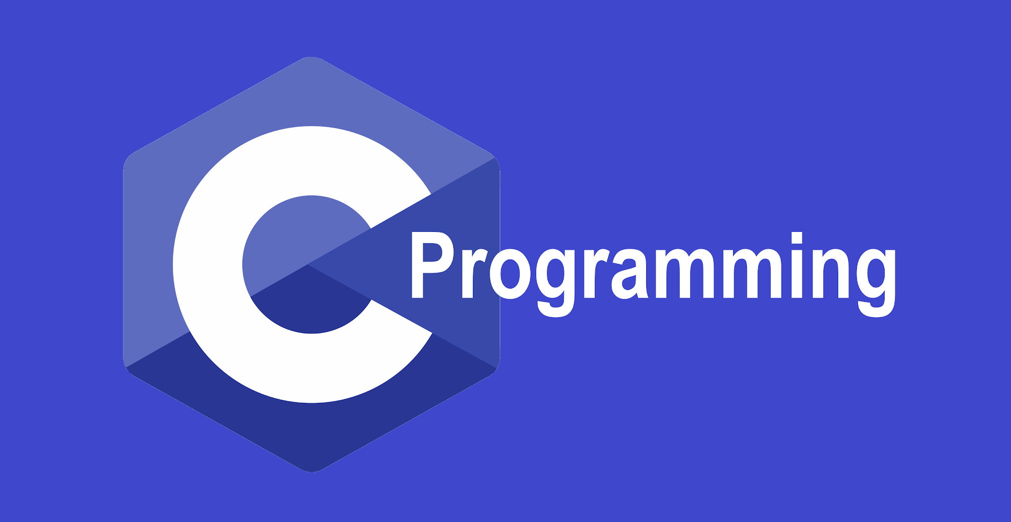
Unit 2

Slide 3
Syllabus:
Decision making and Branching: Decision making with if statement, Simple if Statement, the if...else statement, Nesting of if...else statements, The else...if ladder, The switch statement.
Decision making and Looping: The for statement, the while statement, the do...while statement, Jump statements (goto, break, continue).

Slide 4
Decision making an Branching
INTRODUCTION:
Generally C program execute it’s statements sequentially. But in order to solve problems we may have some situations where we have to change the order of executing the statements based on whether some conditions have met or not.
So controlling the execution of statements based on certain condition or decision is called decision making and branching.

Slide 5
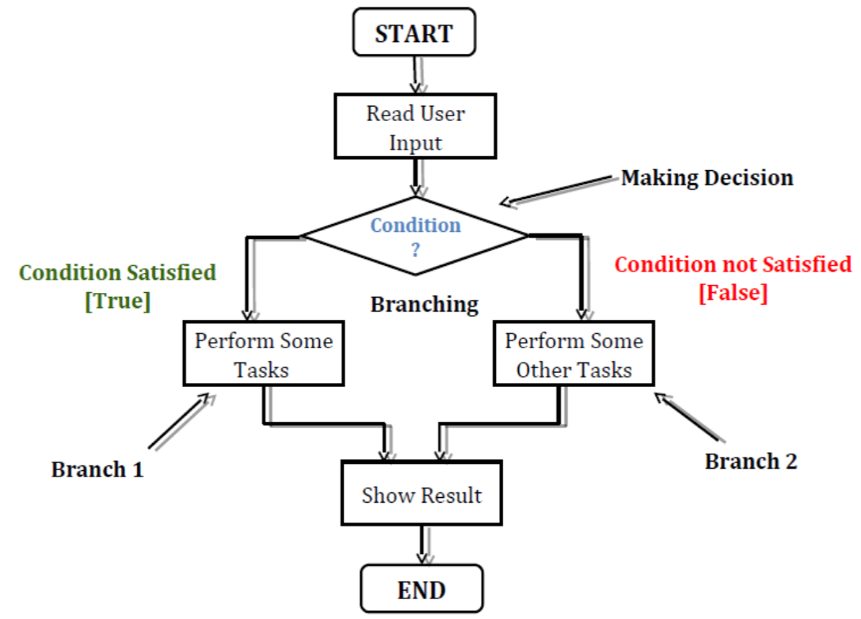

Slide 6
Types of Control Statements are:
(1) Conditional Branching Control Statements
(a) if statement
(b) if-else statement
(c) nested if-else statement
(d) else if ladder
(e) switch statement
(2) Unconditional Branching Control Statement
(a) goto statement

Slide 7
Simple if:
It is called one way branching statement.
It involves a test expression (a relational or conditional expression).
if (condition)
{
statement; // body of if
}
statement –x;

Slide 8
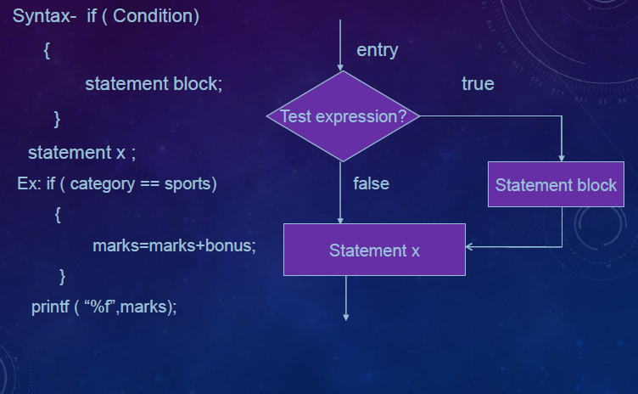
Simple if Statement

Slide 9
int number=15
if(number%2==0)
{
printf(“This is even number\n");
}
printf(“The number is %d\n“,number);

Slide 10
Else if statement
The if statement provides one way branching, i.e., it executes the statement/s associated with if, only when the test expression is true, but does nothing if it is false.
The if-else statement is an extension of the if statement. The if-else statement is a two way
branching, i.e., it executes one set of statement/s if the test expression is true or it executes another set of statement/s if the test expression is false.

Slide 11
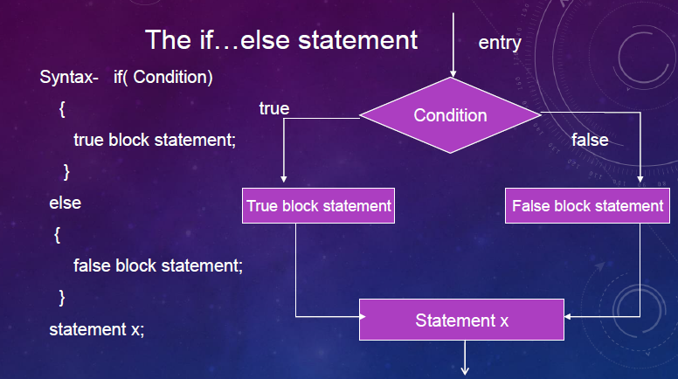

Slide 12
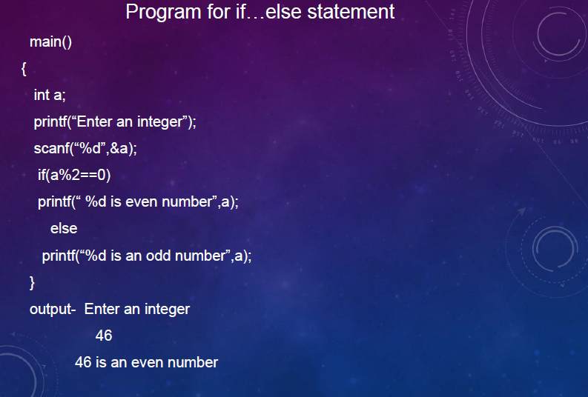

Slide 13
NESTED IF STATEMENTS
When a series of decisions are involved, we may have to use more than one if-else statement. Enclosing one if within another is called nested if statement.
Syntax:
if (condition1)
{
if (condition2)
{
statement1;
}
else
{
Statement 2
}
}

Slide 14
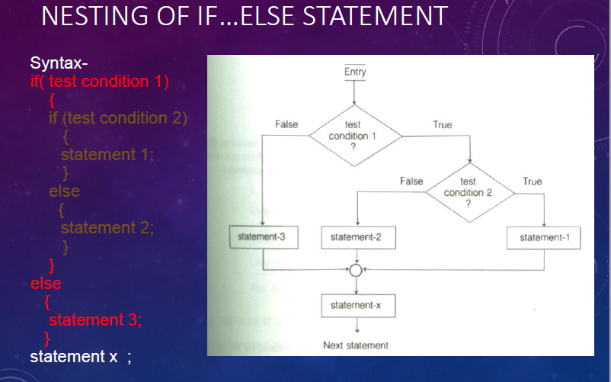

Slide 15
Largest of three numbers a,b,c:
if(a>b){
if(a>c){
printf("\n%d is greatest number ",a);
}else{
printf("\n%d is greatest number ",c);
}
}else if(b>a){
if(b>c){
printf("\n%d is greatest number ",b);
}else{
printf("\n%d is greatest number ",c);
}

Slide 16
THE ELSE-IF LADDER
When multipath decisions are involved, we can have a chain of ifs in which the statements associated with each else is an if.

Slide 17
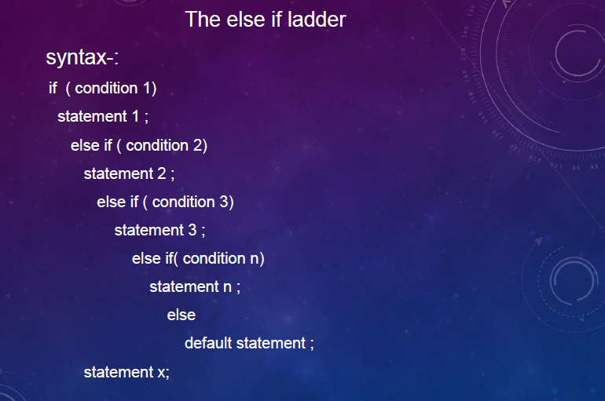

Slide 18
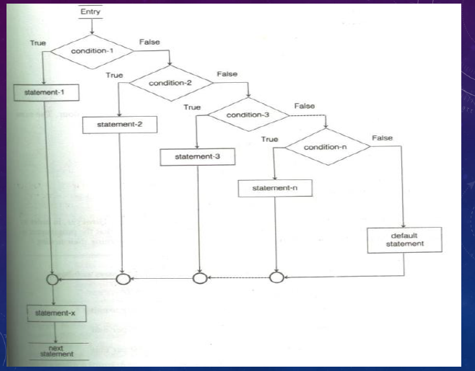

Slide 19
SWITCH STATEMENT
The nested if allows selecting one of the many alternatives but it is time consuming because it tests all the conditions and based on the result a particular branch is taken for execution.
To overcome this disadvantage, the switch statement is used. The switch statement provides a multiple way branching.

Slide 20
Syntax:
switch (expression)
{
case value1: block1;
break;
case value2: block2;
break;
case value3: block3;
break;
…….
case value n:block n;
break;
default: default block;
break;
}

Slide 21
The use of break is very important here. The block of statements corresponding to each case ends with a break statement. What if the break statement is not used?
The switch-case works like this: As the program enters the switch construct, it starts comparing the value of switching expression with the cases, and executes the block of its first match. The break causes the control to go out of the switch scope. If break is not found, the subsequent block also gets executed, leading to incorrect result.

Slide 22
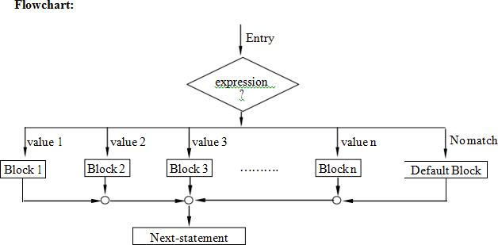

Slide 23
int main() {
int day;
printf("Enter day number (1 to 7): ");
scanf("%d", &day);
switch(day) {
case 1: printf("Sunday\n"); break;
case 2: printf("Monday\n"); break;
case 3: printf("Tuesday\n"); break;
case 4: printf("Wednesday\n"); break;
case 5: printf("Thursday\n"); break;
case 6: printf("Friday\n"); break;
case 7: printf("Saturday\n"); break;
default: printf("Invalid day number\n");
}
return 0;
}

Slide 24
Write a C program to implement a simple calculator.

Slide 25
int main ()
{
int a = 10, b = 5;
int op = 1;
float result;
printf("1: addition\n 2: subtraction\n 3: multiplication\n 4: division\n ");
printf("\na: %d b: %d : op: %d\n", a, b, op);
switch (op){
case 1: result = a + b; break;
case 2: result = a - b; break;
case 3: result = a * b; break;
case 4: result = a / b; break;
default: printf("Invalid operation\n");
}
printf("Result: %6.2f", result); return 0; }

Slide 26
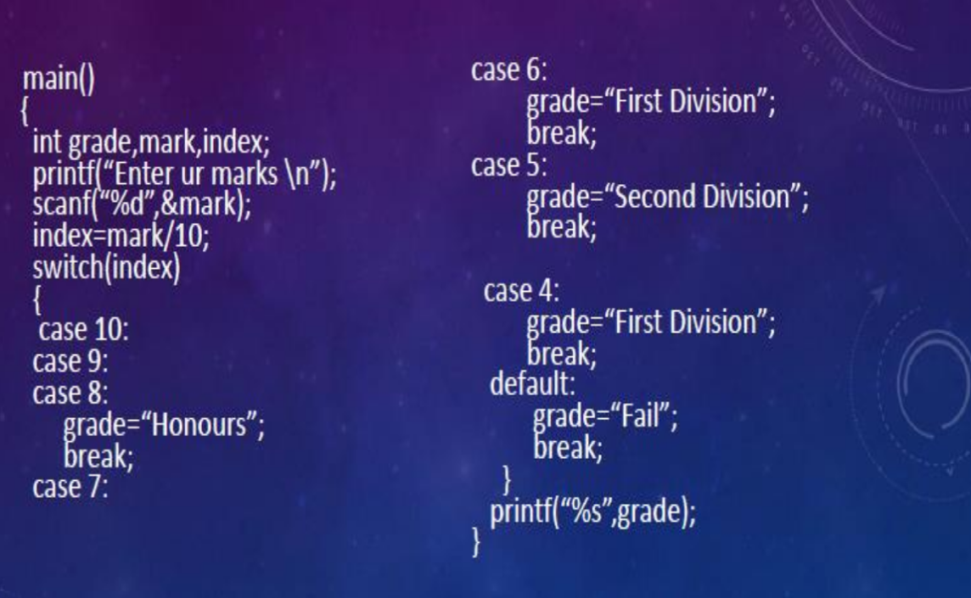
Example 2

Slide 27
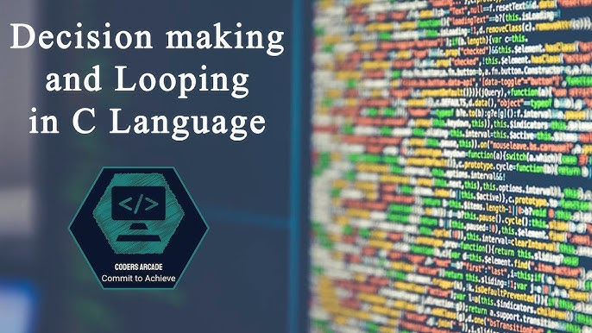

Slide 28
Contents:
while statement
do...while statement
for statement
Jumps in Loops.
break and continue statements.
goto statement
return statement

Slide 29
Looping
Loops in programming are used to repeat a block of code until the specified condition is met.
A loop statement allows programmers to execute a statement or group of statements multiple times without repetition of code.

Slide 30
There are mainly two types of loops in C Programming:
Entry Controlled loops: In Entry controlled loops the test condition is checked before entering the main body of the loop. Ex: For Loop and While Loop are Entry-controlled loops.
Exit Controlled loops: In Exit controlled loops the test condition is evaluated at the end of the loop body. The loop body will execute at least once, irrespective of whether the condition is true or false. Ex: do-while Loop is Exit Controlled loop.

Slide 31
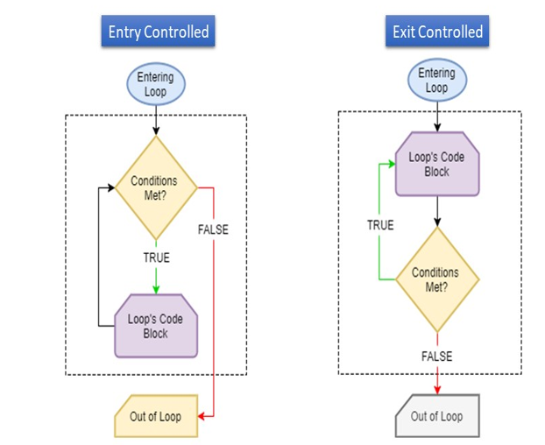

Slide 32
while loop
It executes a set of statements repeatedly as long as the specified condition is true.
Entry-controlled loop.
Syntax of while statement:
while (test_condition)
{
statements;
}
statement x;
statement y;
while is a keyword.
test_condition is a logical or relational expression that results in either TRUE or FALSE.

Slide 33
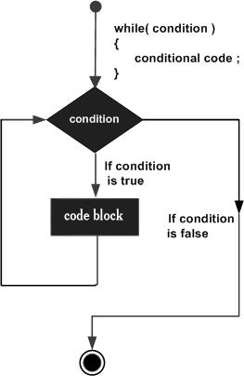
while (test_condition)
{
statement1; // compound statement
statement2;
statement3;
}
Statement x;
Statement y;

Slide 34
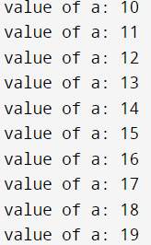
Example
#include<stdio.h>
int main ()
{
int a = 10;
while( a < 20 )
{
printf("value of a: %d\n", a);
a++;
}
return 0;
}

Slide 35
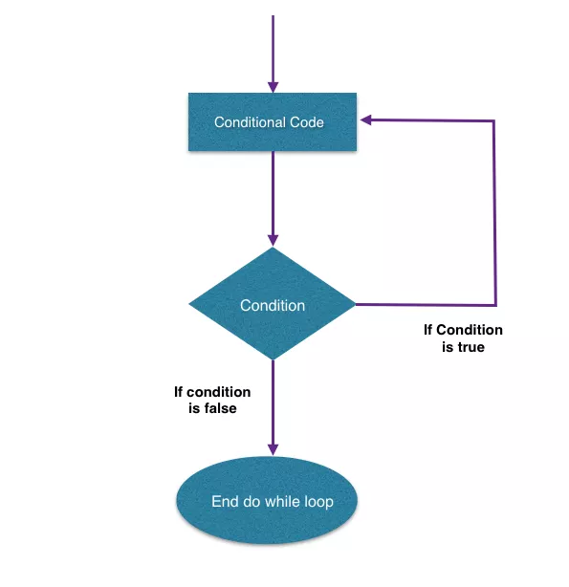
do..while statement
Syntax of do..while statement:
do
{
statement1;
statement2;
} while (test_condition);
Statement x;
Statement y;
do and while are keywords.
test_condition is a logical or relational expression that results in either TRUE or FALSE.

Slide 36
On reaching the do statement, the program proceeds to evaluate the body of the loop first. At the end of the loop, the test_condition in the while statement is evaluated.
If the condition is true, the program continues to evaluate the body of the loop once again. This process continues as long as the condition is true.
When the condition becomes false, the loop will be terminated and the control goes to the statement that appears immediately after the while statement.
Since the test_condition is evaluated at the bottom of the loop, the do...while construct provides an exit controlled loop and therefore the body of the loop is always executed at least once.

Slide 37
Example
OUTPUT
#include<stdio.h>
int main ()
{
int a = 10;
do
{
printf("value of a: %d\n", a);
a++;
} while( a < 20 ) ;
return 0;
}

Slide 38
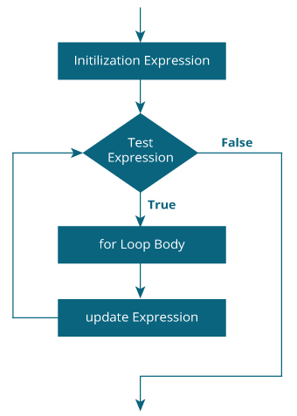
for statement
for is an entry – controlled loop statement.
This statement is used when the programmer knows how many times a set of statements are executed.
Syntax of for statement:
for (initialization; test_condition; update_expression)
{
statement1;
statement2;
}
Statement x;
Statement y;

Slide 39
Initialisation of the control variable is done first. Using assignment statements such as i = 1 and count = 0. The variables i and count are known as loop – control variables.
The value of the control variable is tested using the test_condition. If the condition is true, the body of the loop is executed; otherwise the loop is terminated and the execution continues with the statement the immediately follows the loop.
When the body of the loop is executed, the control is transferred back to the for statement after evaluating the last statement in the loop. Now, the control variable is incremented using an assignment statement such as i = i+1 and the new value of the control variable is again tested to see whether it satisfies the loop condition.
If the condition is satisfied, the body of the loop is again executed. This process continues till the value of the control variable fails to satisfy the test_condition.

Slide 40
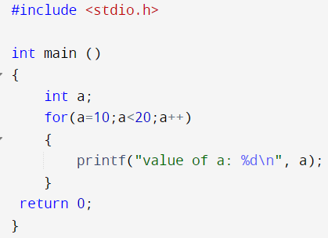

Slide 41
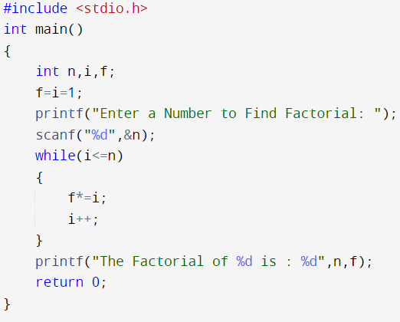
//Factorial of a given number using while loop

Slide 42
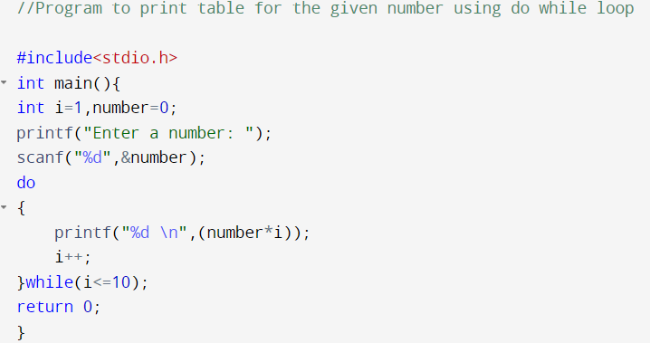
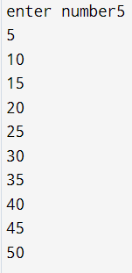

Slide 43
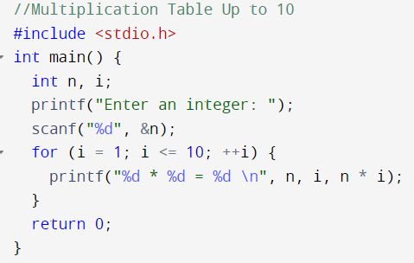

Slide 44
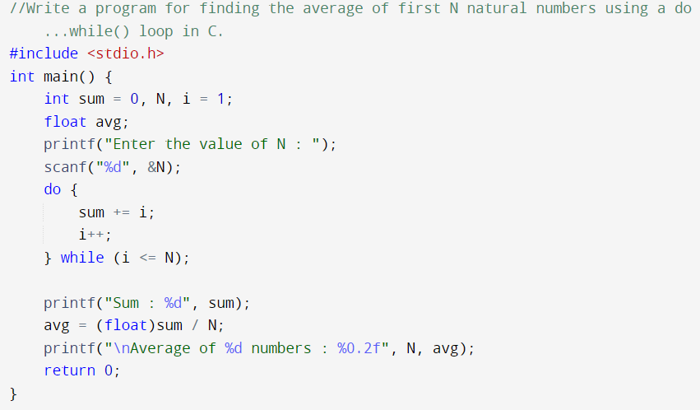

Slide 45
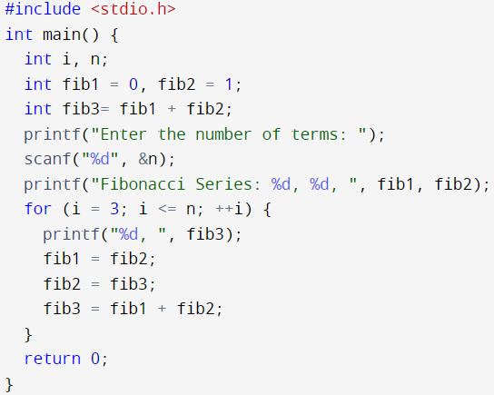

What is the Fibonacci series in C? The Fibonacci sequence is a sequence where the next term is the sum of the previous two terms. The first two terms of the Fibonacci sequence are 0 followed by 1 The Fibonacci sequence: 0, 1, 1, 2, 3, 5, 8, 13, 21

Slide 46
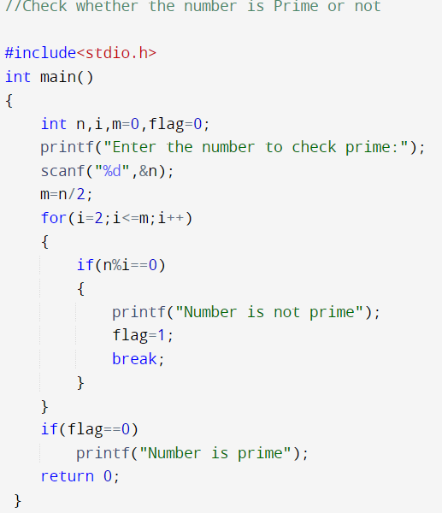

Slide 47
Unconditional Statements/Jumps in Loops
Unconditional statements are the statements which transfer control or flow of execution unconditionally to another block of statements. These are also called as jump statements.
When executing the body of loop, sometimes it becomes desirable to skip a part of the loop or to leave the loop as soon as a certain condition occurs.
Example, in the case of searching for a particular name in a list containing, say, 100 names, program loop must be terminated as soon as the desired name is found.

Slide 48
There are mainly four unconditional statements namely:
Break statement
Continue statement
Goto statement
Return statement

Slide 49
Break statement
The break is a keyword in C which is used to bring the program control out of the loop.
The break statement is used inside loops or switch statement.
The break statement breaks the loop one by one, i.e., in the case of nested loops, it breaks the inner loop first and then proceeds to outer loops.
The break statement in C can be used in the following two scenarios:
With switch case
With loop

Slide 50
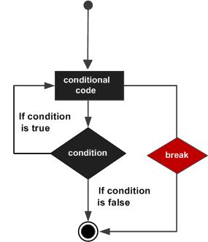
When the break statement is encountered inside the loop, the loop is immediately exit and program continues with the statement immediately following the loop.
When the loops are nested, the break would only exit from the loop containing it. That is break will exit only a single loop.

Slide 51
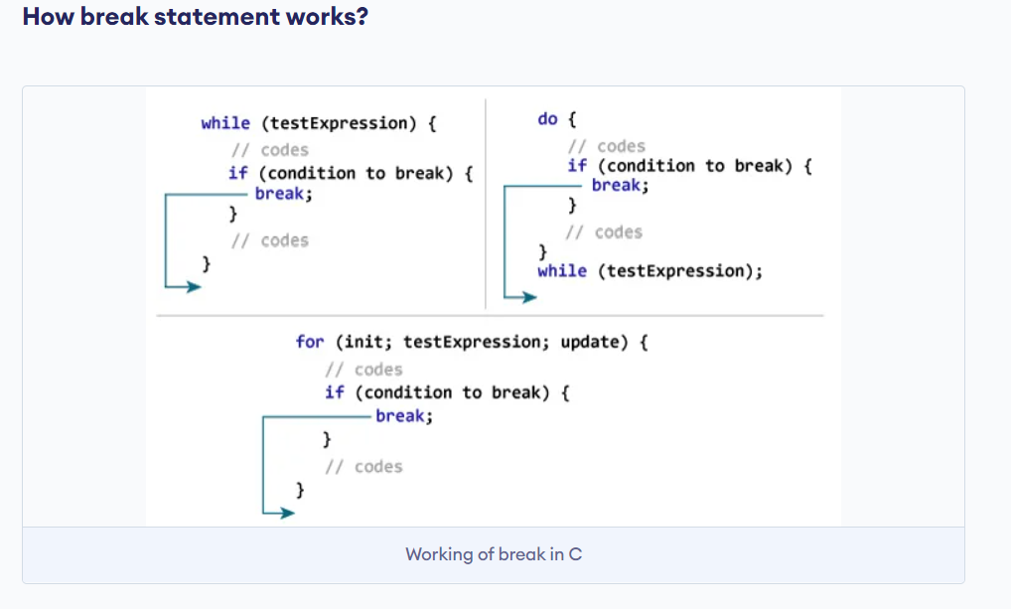

Slide 52
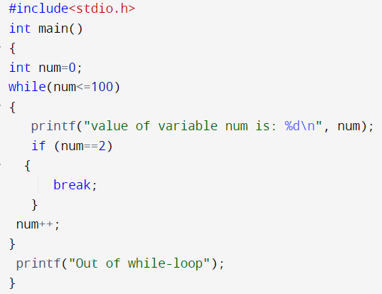
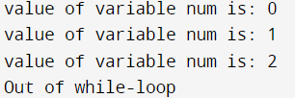
Examples:

Slide 53
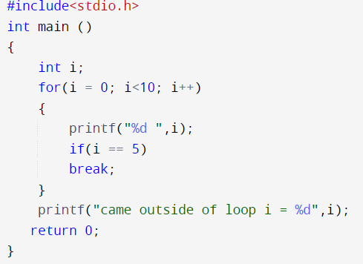

Slide 54
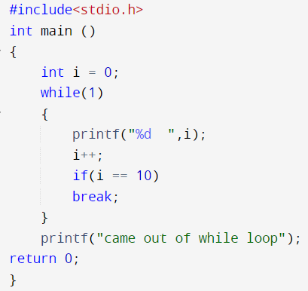
while(1) acts as an infinite loop that runs continually until a break statement is explicitly issued.
The while(0) loop means that the condition available to us will always be false.

Slide 55
Continue Statement
Continue statement is placed inside a loop to skip the current iteration and proceed to next.
The continue statement in C programming works somewhat like the break statement.
Instead of forcing termination, it forces the next iteration of the loop to take place, skipping any code in between.
For the for loop, continue statement causes the conditional test and increment portions of the loop to execute.
For the while and do...while loops, continue statement causes the program control to pass to the conditional tests.

Slide 56
Skipping a part of a loop:
To skip certain statements in the loop and to continue with the next iteration of the loop continue statement is used.
while (test_condition1)
{
statement1;
if (test_condition2)
continue; // back to while when test_condition 2 is true
statement2;
statement3;
}

Slide 57
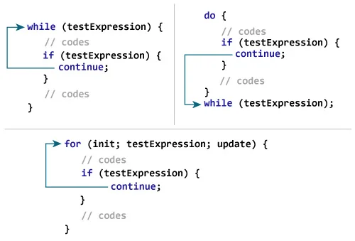

Slide 58
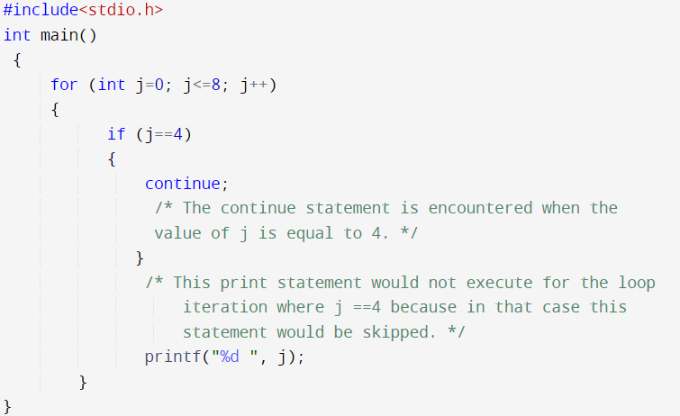

Example

Slide 59
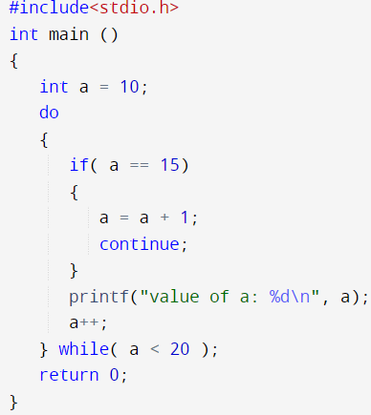
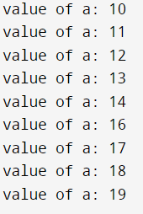

Slide 60
goto statement
The goto statement is an unconditional statement in C which allows the flow of execution of statements to be altered without the use of any conditional expression.
The goto statement transfers the control from one point to another in a C program. This is also known as Jumping of control or Unconditional Jumping.
The syntax of goto statement is as follows:
goto label;
………
label :
where, goto is a keyword, and
label is a symbolic constant or an identifier which need not be pre-declared.

Slide 61
Two types of jumping (branching) is possible by using goto statement:
Forward jump: Here the statements immediately following the goto statement will be skipped and control is transferred to the statement beginning with the symbolic constant label.
Backward jump: Here the symbolic constant label is placed before the goto statement and the statements between the label and goto statements are repeated resulting in looping.

Slide 62
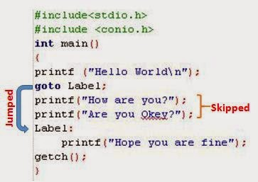
Output: ??

Slide 63
/* Goto Statement in C Programming example */
#include <stdio.h>
#include<stdlib.h>
int main()
{
int marks;
printf(" \n Please Enter your Subject Marks \n ");
scanf("%d", &marks);
if(marks >= 35)
{
goto Pass;
}
else
goto Fail;
Pass: printf(" \n Congratulation! You made it\n"); exit(0);
Fail: printf(" \n Better Luck Next Time\n");
return 0;
}

Slide 64
return statement
Return statement terminates the execution of a function and returns control to the calling function.
It can also return a value to the calling function.
Syntax:
return expression;
Here the value of expression is returned.

Slide 65
End of Unit 2
Thank You

