Slide 1

SQL Project
Exploratory Data Analysis of EdTech Company
By
Shreetama Dasgupta

Slide 2

What is an Edtech?
Edtech, or education technology, is the practice of introducing information and communication technology tools into the classroom to create more engaging, inclusive and individualized learning experiences.
EdTech is short for “education technology.” It uses computers, computer programs, and educational systems to provide learning and training to students and employees.

Slide 3
Business Objective
The Edtech company is focused on accelerating its growth by increasing the number of enrolled users.
The objective is to analyze various aspects of customer acquisition to see the status of new users’ growth in the company. The insights discovered will help the business team in designing a better marketing strategy for the company.

Slide 4
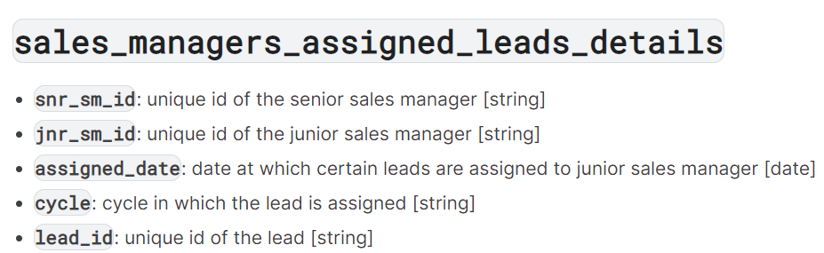
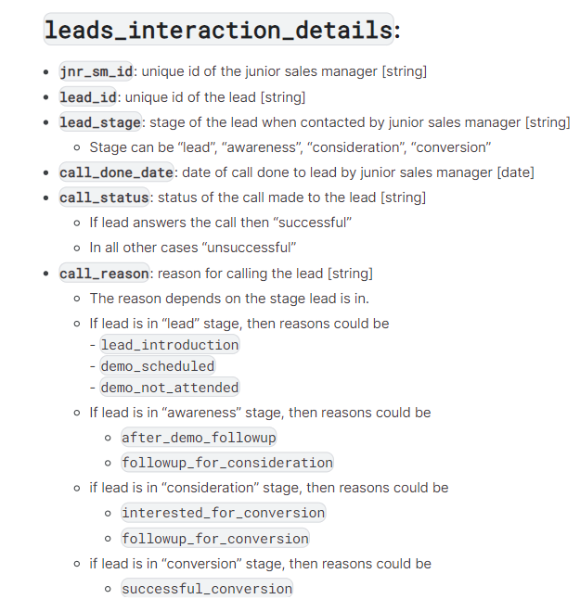
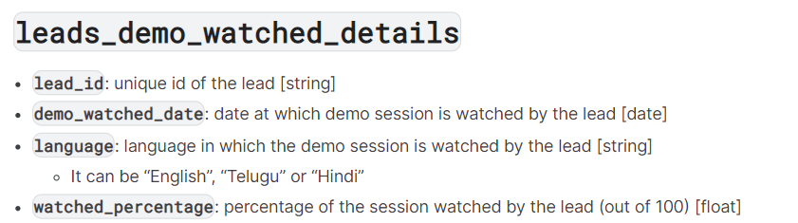
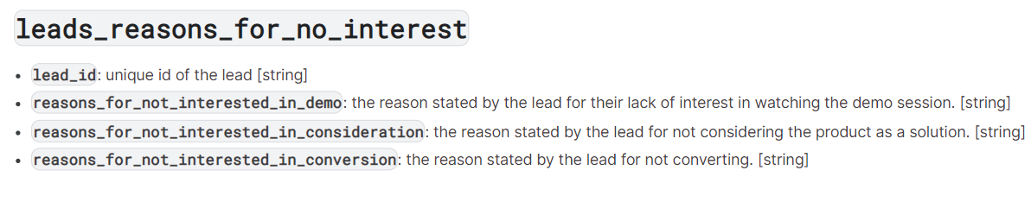
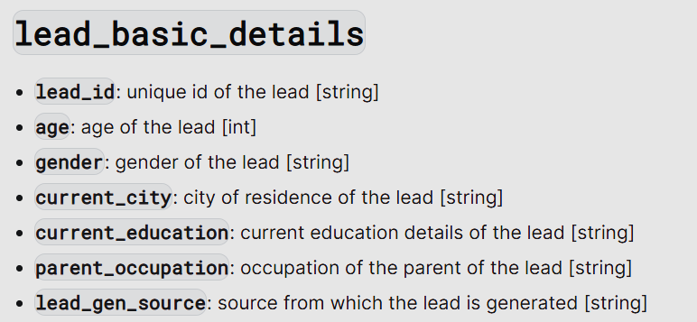
Understanding the dataset

Slide 5
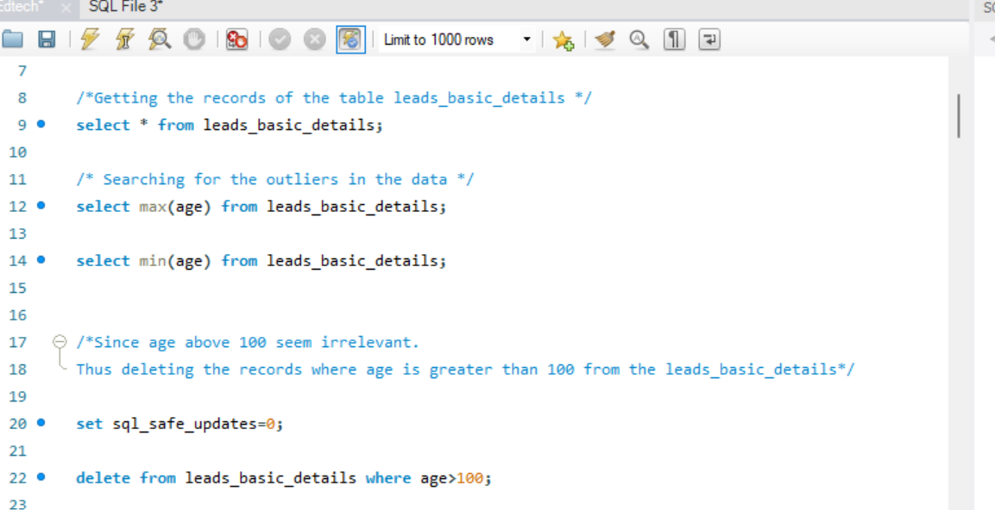
Data Cleaning.
Removing the outliers from the table leads_basic_details

Slide 6
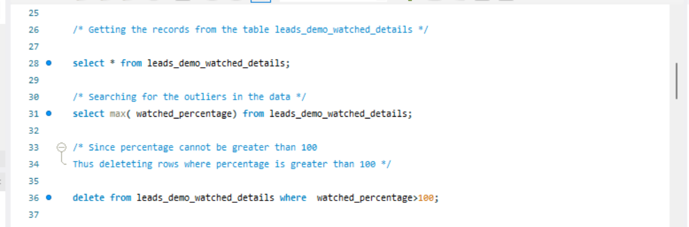
Data Cleaning.
Removing the outliers from the table leads_demo_watched_details

Slide 7
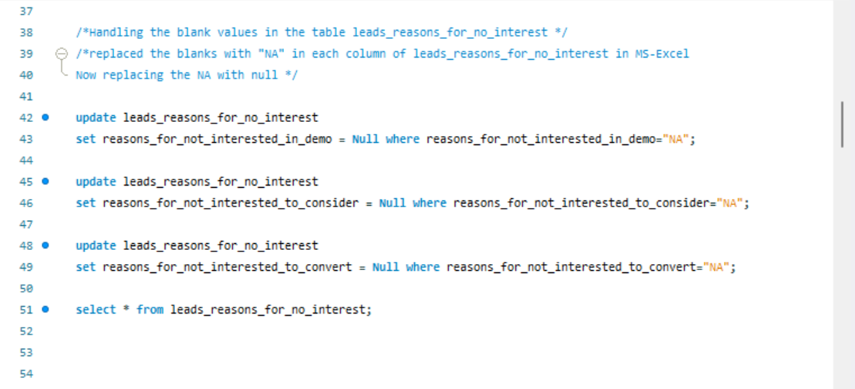
Data Cleaning
Handling the blank values in the table leads_reasons_for_no_interest

Slide 8
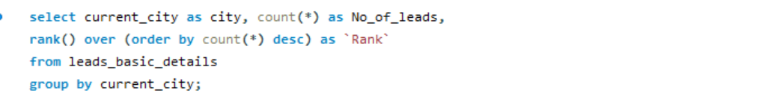
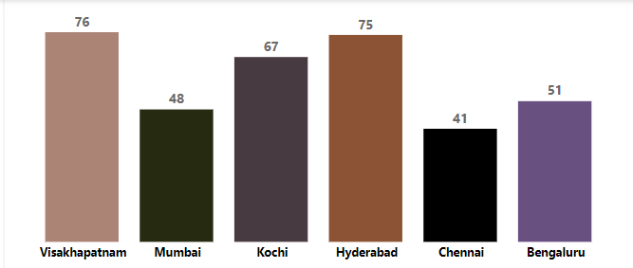
Rank of the cities with respect to the number of leads
Observation
Visakhapatnam and Hyderabad have the maximum number of leads.
Mumbai and Chennai have comparatively lesser number of candidates. New strategies should be developed to attract more leads in these cities.

Slide 9
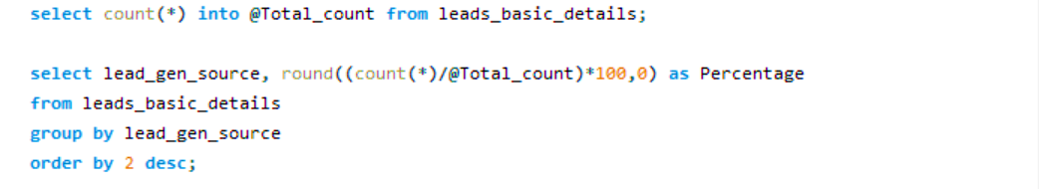
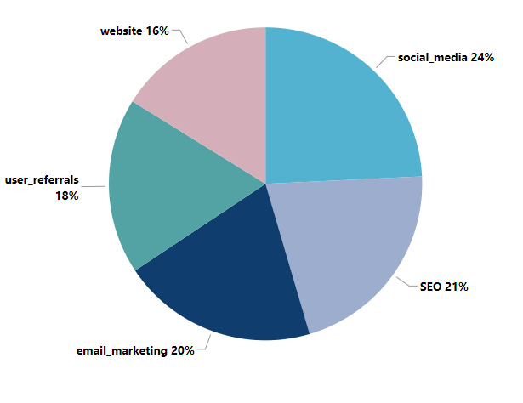
Major sources of generation of leads
Observation
Some of the major sources for generating leads can be Social Media, SEO and Email Marketing.
About 24% of the leads came to know about the company through social media.
The next important sources were SEO and email marketing each contributing 21% and 20 % respectively.

Slide 10
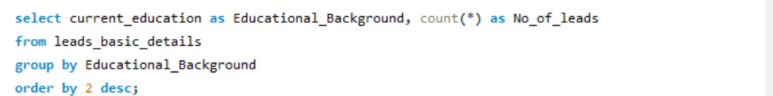
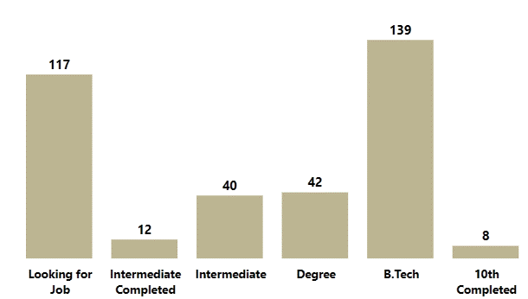
Educational background of the leads
Observation
Maximum number of leads have B.Tech educational background or are looking for job.

Slide 11
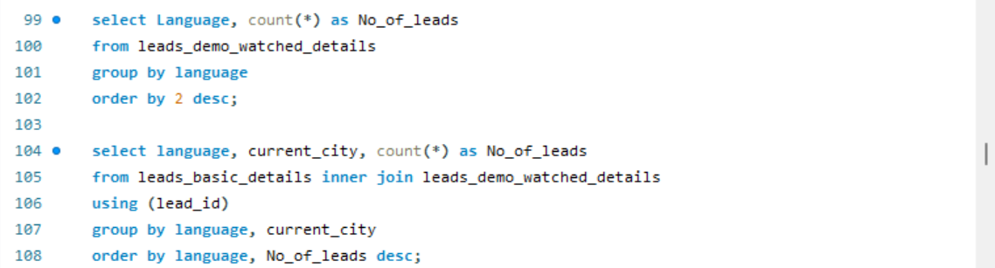
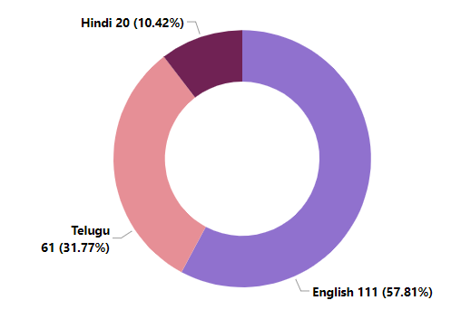
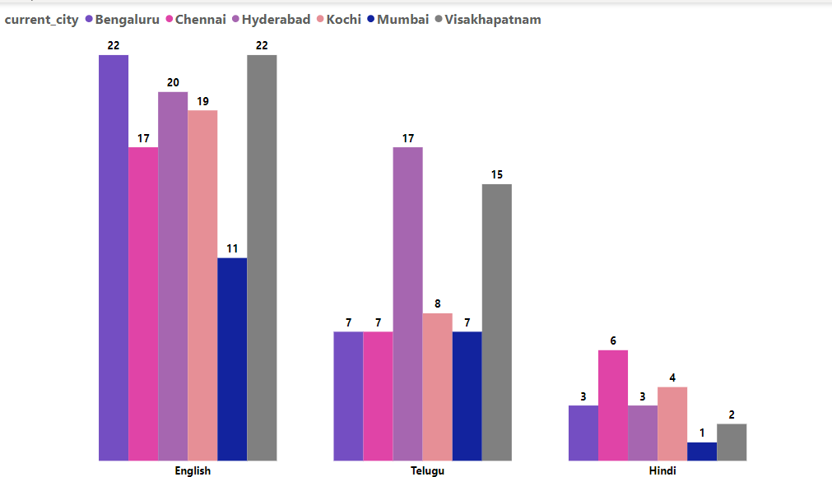
Most preferred language for demo
Observation
English is the most preferred language followed by Telugu which is mostly spoken in Hyderabad and Visakhapatnam.

Slide 12
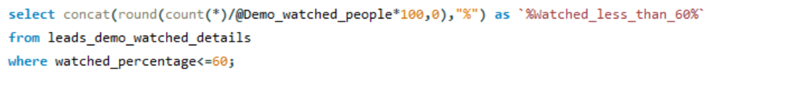
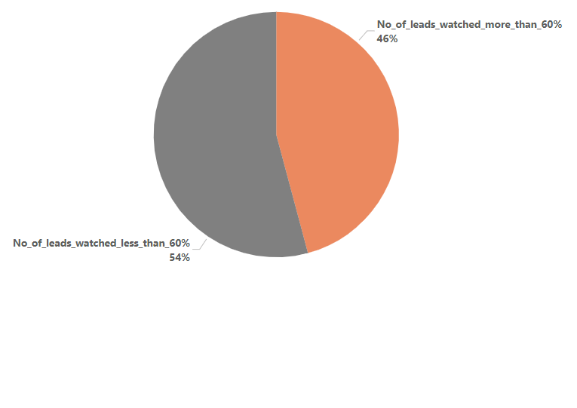
Percentage of the demo video watched by people
Observation
More than 50% of the leads are watching less than 60% of the video
The watched percentage can be increased if the demo is brief and concise as well as of shorter duration.

Slide 13
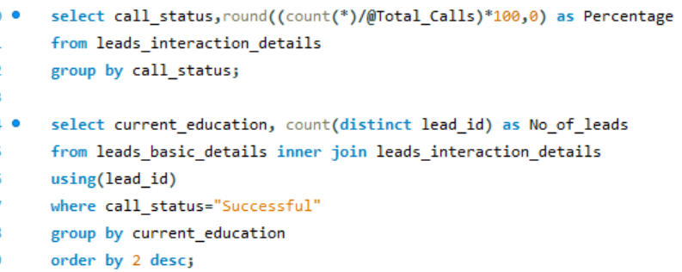
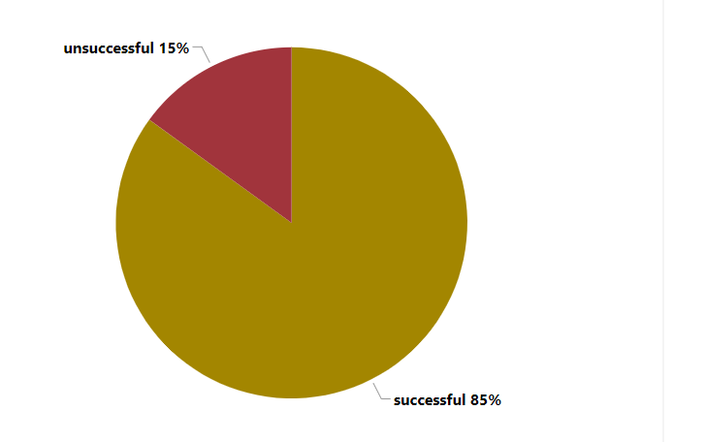
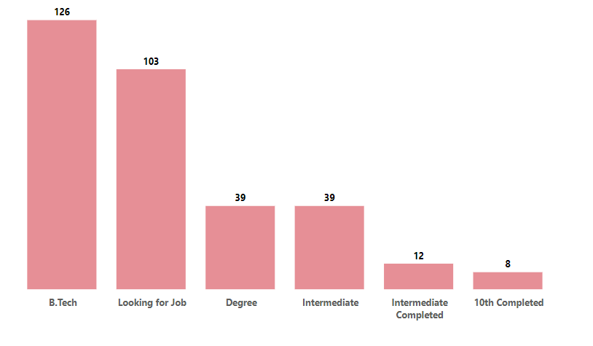
Percentage of successful calls
Observation
Most of the leads with successful call status are having B.Tech educational background or are on the verge of job hunting

Slide 14
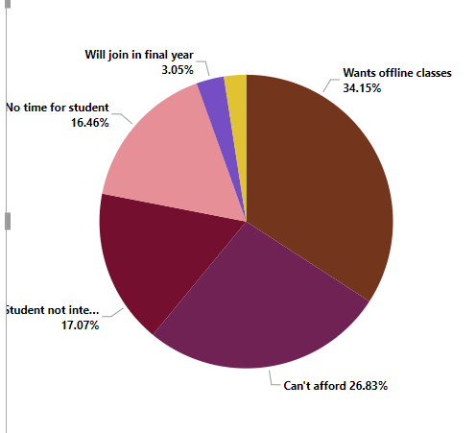
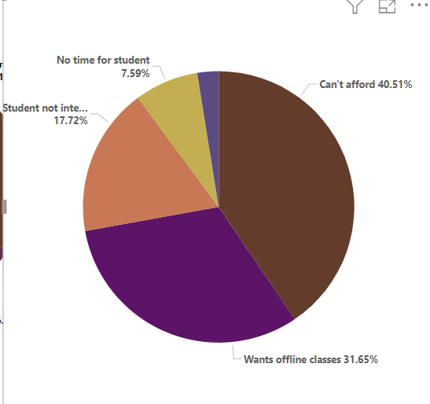
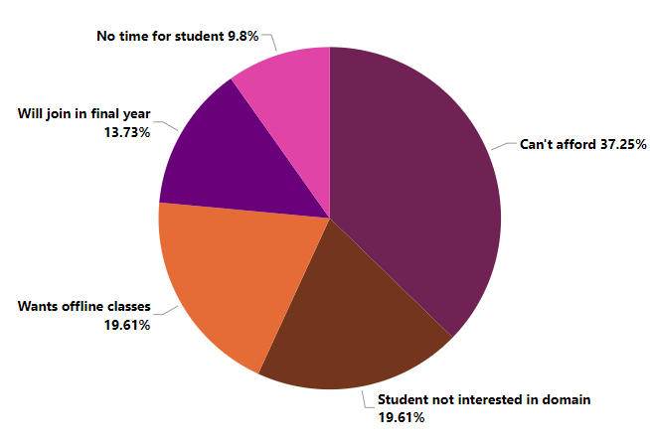
Reasons leads are not interested in demo
Reasons leads are not interested to consider
Reasons leads are not interested to convert
Observation
Most of the leads are dropping at different stages due to affordability. Since most of the leads are students or are in the job hunting stage, higher price of the course can be an issue.

Slide 15
Thanking You.

