Slide 1

VestEdu
Sakshi Mehta, Shree Vandana Kachroo,
Shrikant Adhikarla, Scott Kirschner
Goergen Institute for Data Science
University of Rochester
Fall 2019

Slide 2

Outline
Vision and Goals
Description of dataset
Exploratory Analysis
Methods
Results and Conclusions
Key insights
Challenges
Future Work

Slide 3


Vision
Create a system where birthplace does not determine our destiny.
Our journey is from a small village in India to the Silicon Valley, USA; living through the experience, we are committed to change the world for better.
Goals
Identifying the contribution of educational parameters:
University Ranking
Major
Level of education (Degree)
in the creditworthiness of a loan borrower.
2. Finding the interest rate from LC for such loan borrowers.

Slide 4
Approach - 1

Slide 5
Dataset
U.S. Department of Education's College Scorecard Data expanded to add new data elements including
1) earnings of students one-year after graduation by field of study
2) cumulative loan debt of borrowers by field of study
Top 300 Universities
Clubbed into 6 Tiers
~250 Majors categorized into 4 Majors:
Science, Tech & Engineering
Business
Fine Arts & Humanities
Health & Medicine
3 Degree Levels:
Bachelor’s
Master’s
Doctorate
Monthly_Repy =
PMT(rate/12, periods, -amount)
rate = 5%
periods = 120 months (10 years)
amount = mean debt value
Loan_Status:
Fully Paid => Monthly_DTI
<= 0.3
“PrivacySuppressed” entries removed and so 216639 rows come down to 7614 rows, 12 columns

Slide 6
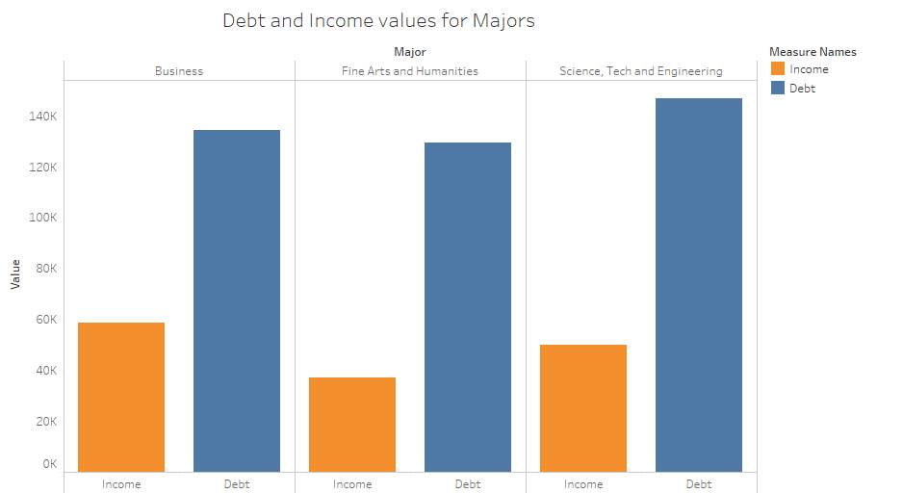
EDA
Distribution of Income and Debt values for various Majors

Slide 7

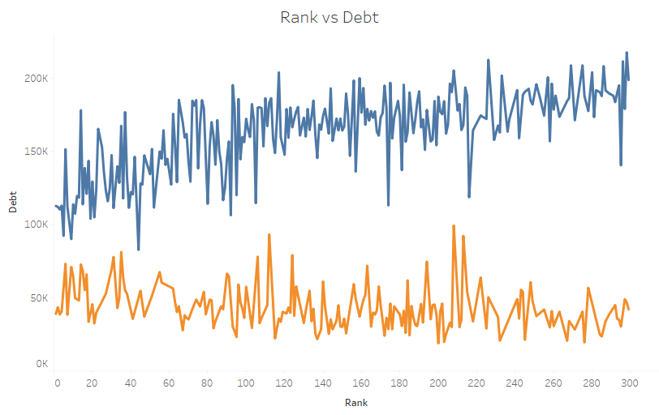
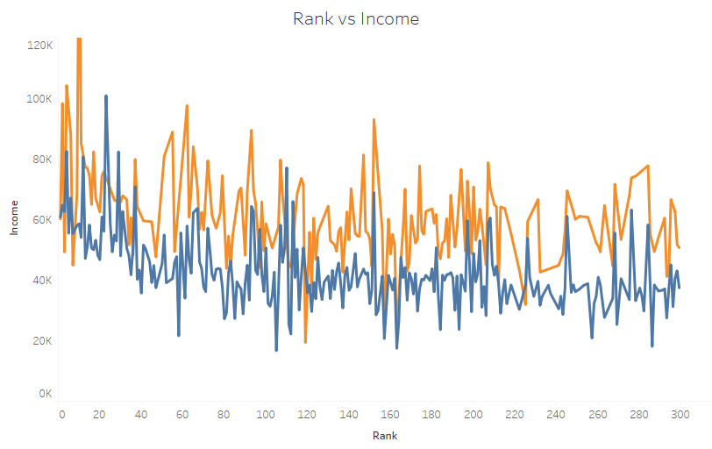
EDA
Trend of Debt and Income for different degree levels which explains the proportions of loan status.

Slide 8
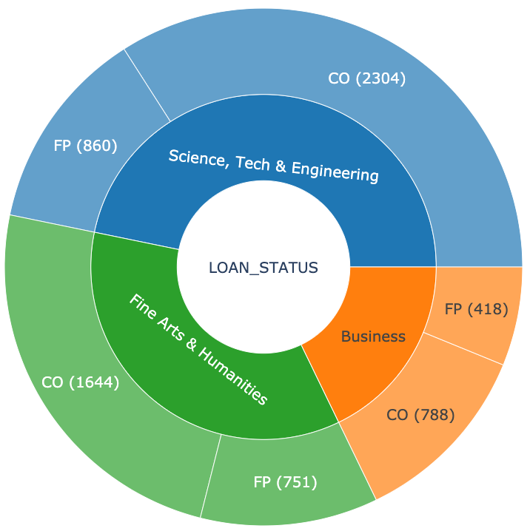
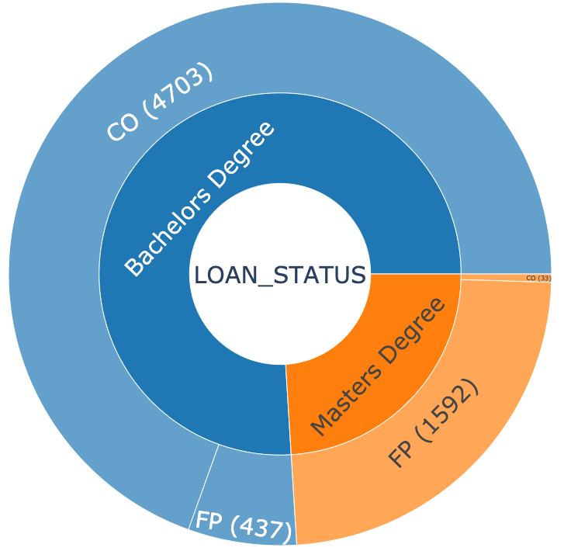
EDA
Number of Fully Paid (FP) and Charged Off (CO) entries at the majors and degree level.
91%
72%
46.7%
75.9%
28%
Majors
Degree
2%
35%
24.1%
35.4%
17.9%
68%
65%
98%
9%
32%

Slide 9
XG-Boost
Extreme Gradient Boosting is an ensemble learning technique. It uses a technique called boosting to optimize the performance of weak learners.
Grid search over the following parameters:
Max Depth [2 - 10]
Number of Estimators [60 - 200]
Learning Rate [0.05 - 0.1]
The model was trained on University Rank, Major and Degree to predict the Loan Status
Metrics | Train (80% data) | Test (20% data)
AUC Score | 92.14% | 92.17%
Accuracy | 94.04% | 93.95%
Feature importance:

Slide 10
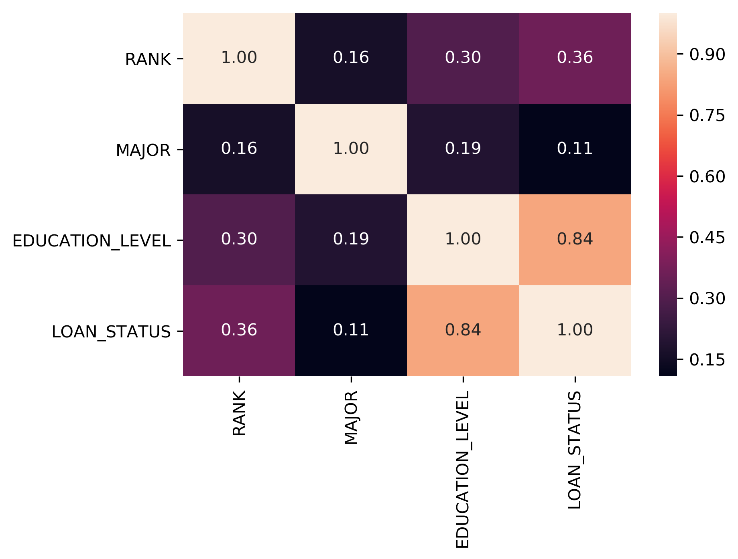
Cramer’s V
Cramer’s V is a measure of correlation between two nominal (categorical) variables with values ranging from 0 to 1.
0 represents no correlation and 1 represents complete correlation. It is an extension of Pearson’s Chi Squared correlation when the contingency table is larger than 2x2.
This graphic shows Cramer’s V correlation values for how university rank, major, education level, and loan status.

Slide 11
Approach - 2

Slide 12
Dataset
provides Undergrad CDR-2yrs and 3yrs for each university
Forbes Rankings (Scraped from Forbes website)
Fuzzy match the university names in base data to get the ranks
NSLDS (National Student Loan Database System)
Yearly Undergrad and Grad CDR data (at public/private/for-profit university aggregation)
Base Data (DOE – College Scorecard)
NSLDS Data for UG major wise
Used CDR UG:G proportions to scale the values in base data
We get the UG Arts:Business:STEM CDR ratios from this data
We used approximate number of students in each major from the base data along with the ratios in 4 to get the UG major wise CDRs
Once we have UG major wise CDRs, we use the same method as (3) to get the Graduate major wise CDRs
CDR = Cohort Default Rate

Slide 13
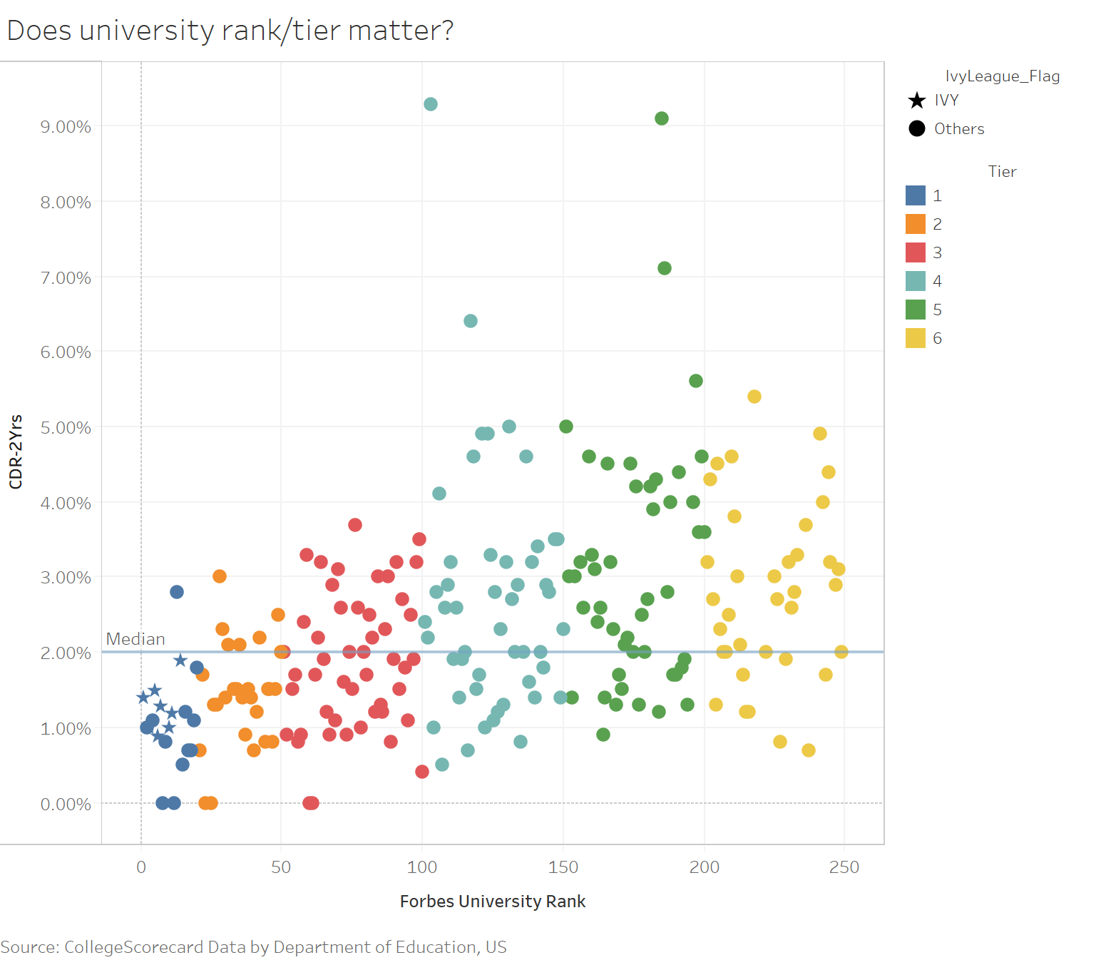
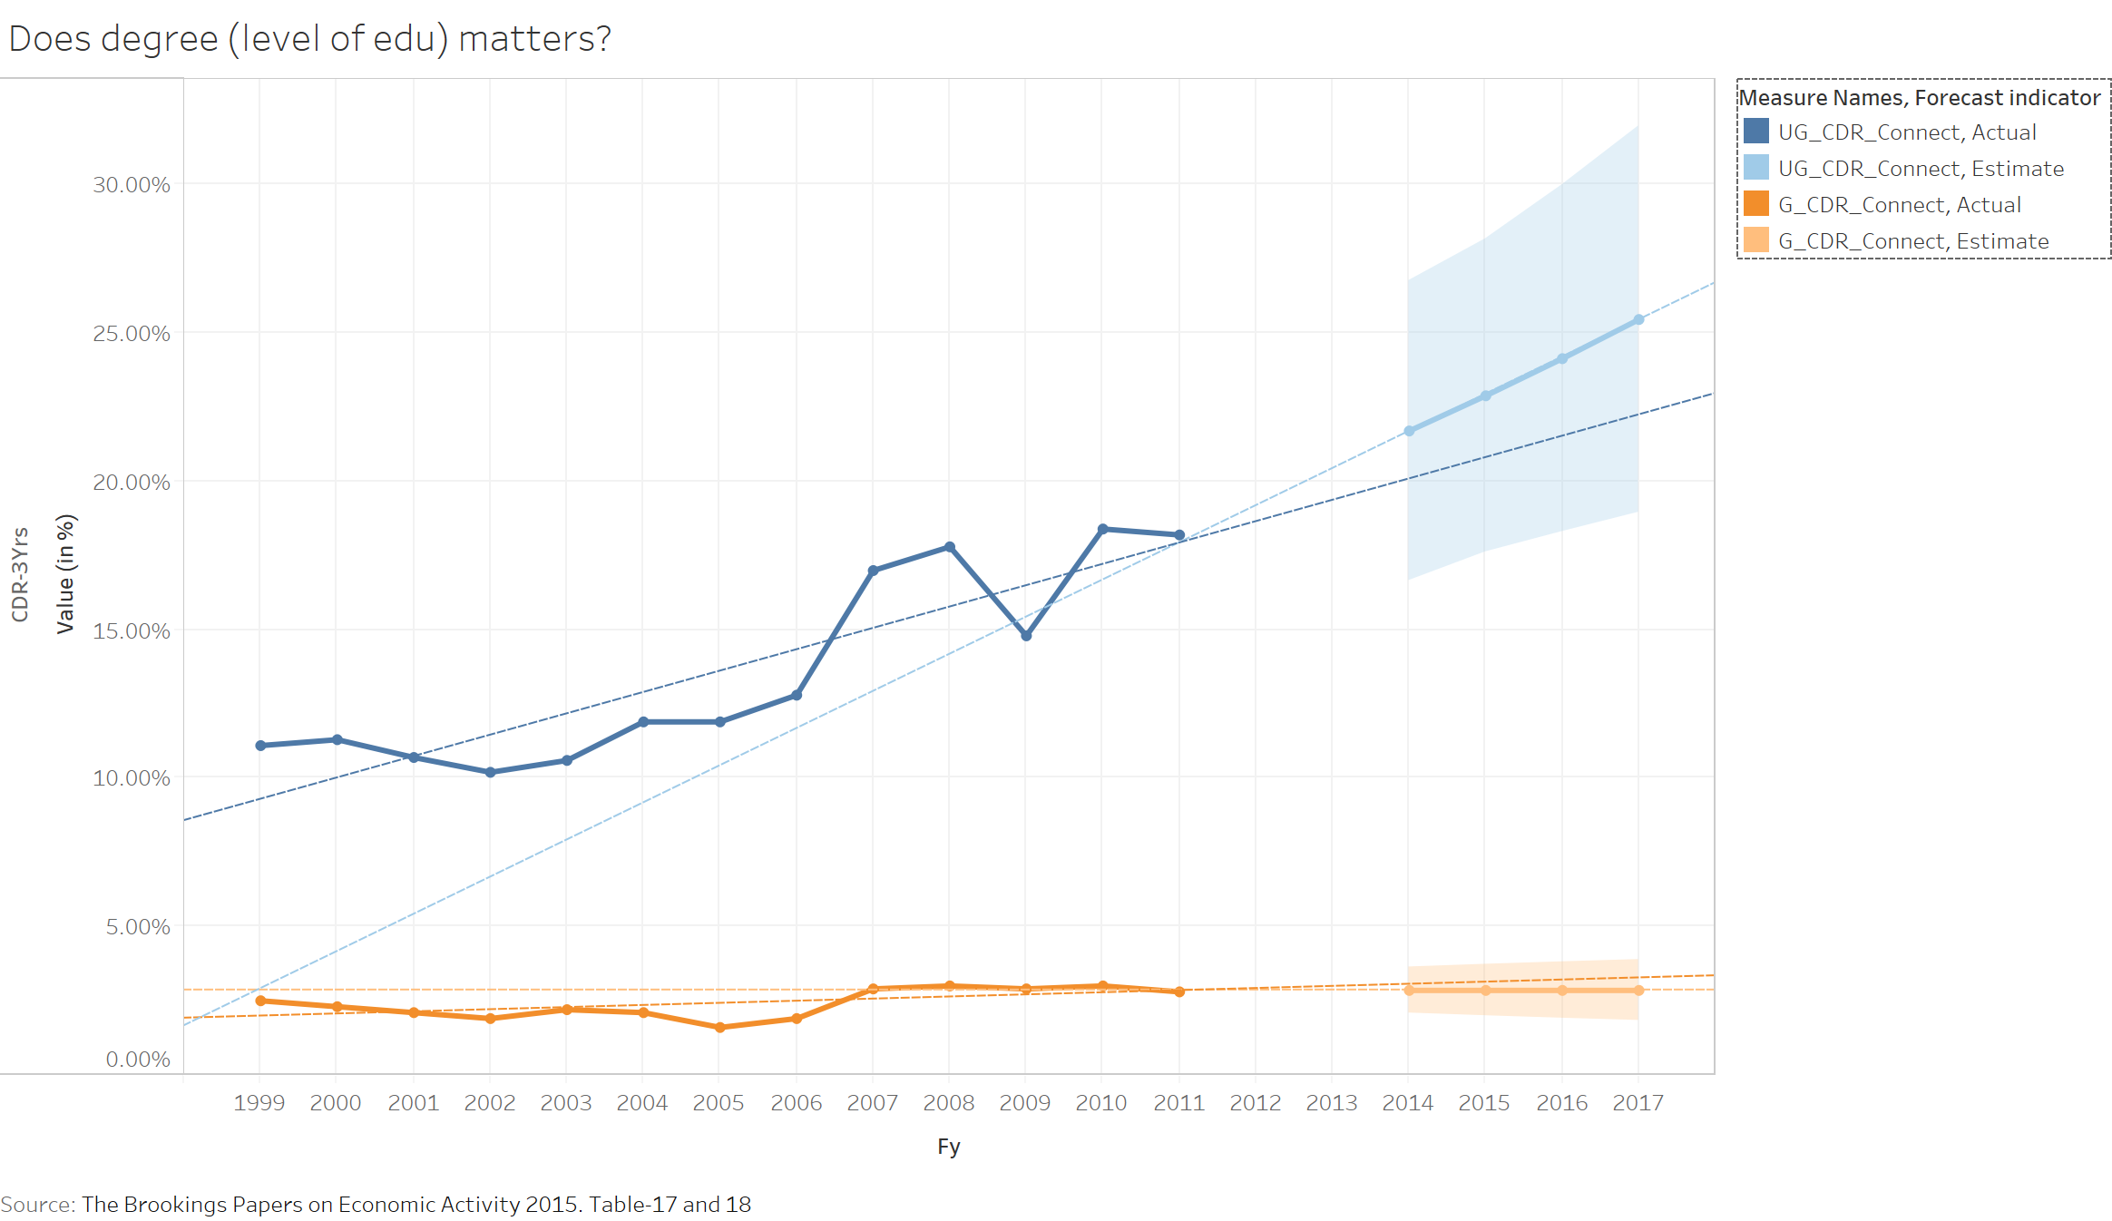
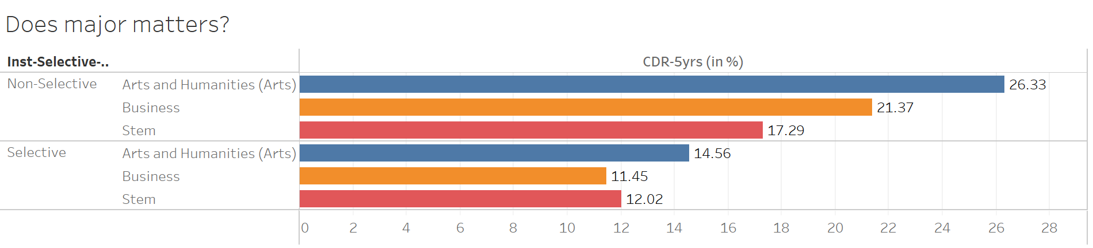
EDA
Graphs indicating how CDR values change by tiers, majors, degree

Slide 14
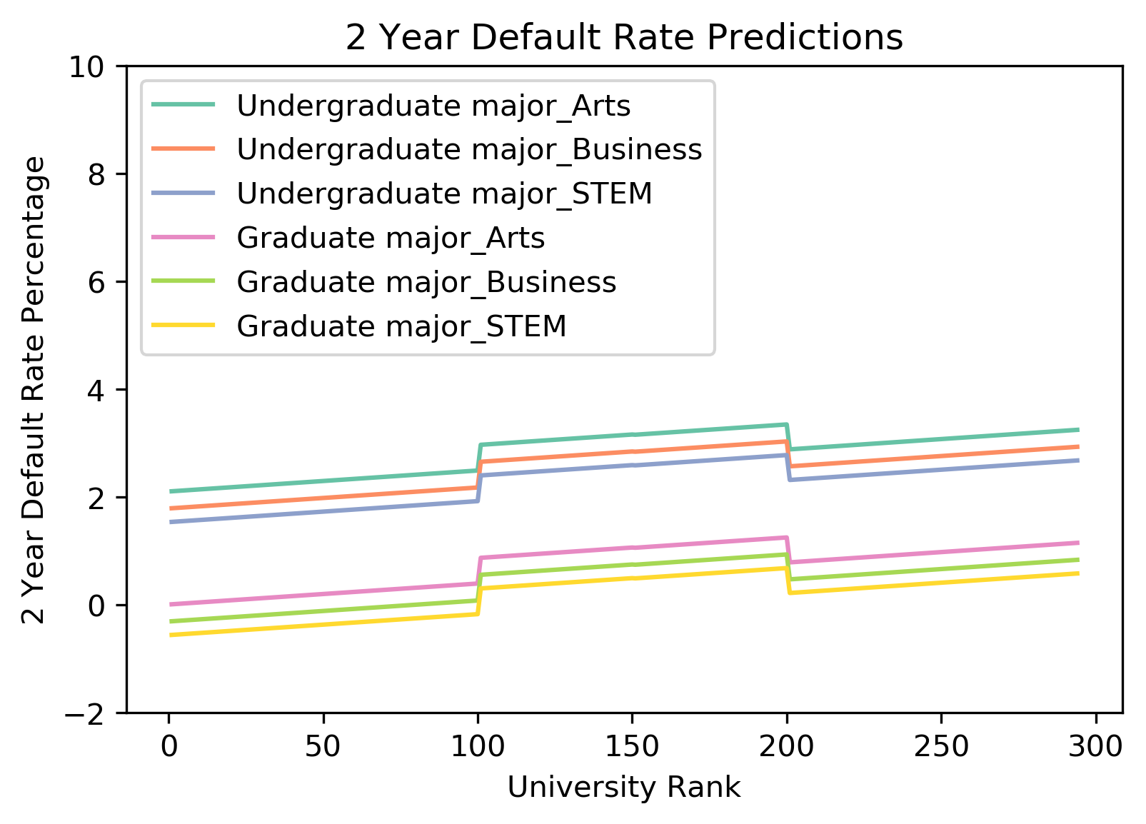

Spline
Spline Regression is a non-parametric regression technique that splits the dataset into individual bins or intervals, each with its own regression fit. Essentially, each subset of data has a linear regression model fit to it separately. The interfaces between the bins are called knots and can be seen by the sharp changes in the fit.
We chose to look at a spline model as we hypothesized that different groups of universities by rank would have CDR rates that behaved differently.
The regression identified knots at rank 100 and rank 200 as can be seen by the steep uptick and downtick at those locations

Slide 15
Random Forest
CDR2/3 ~ Rank + Major + Degree
Random forest regressor with 2 features at a time for splitting the trees
Performance was better than simple linear regression and also splines with the following in-sample and out-of-sample
Feature importance based on Gini coeffs (mean decrease in impurity over all the fully grown trees generated)

Slide 16
Random Forest
Degree:Rank:Major = 6:3:1

Slide 17
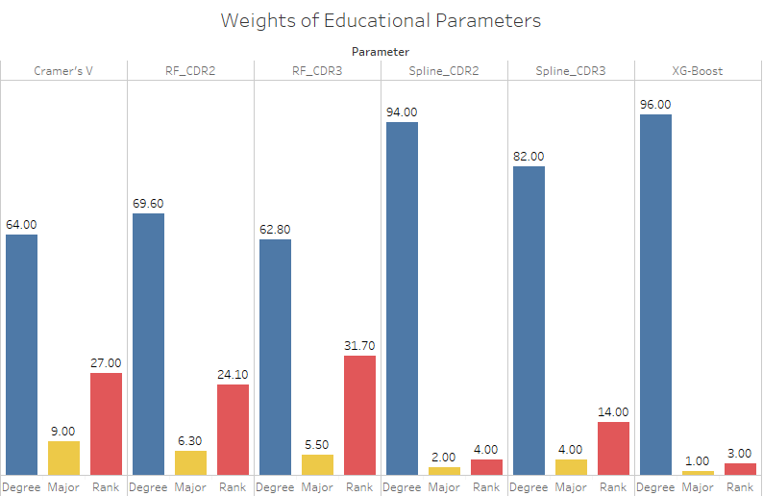
Conclusion

Slide 18
Goal – 2
Finding Interest Rate from
Lending Club

Slide 19
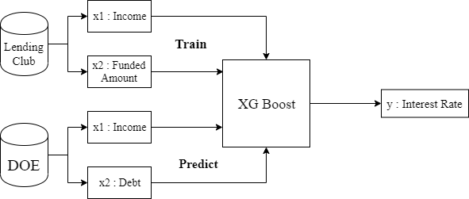
XG-Boost
Extreme Gradient Boosting is an ensemble learning technique. It uses a technique called boosting to optimize the performance of weak learners.
Grid search over the following parameters:
Max Depth [2 - 10]
Number of Estimators [60 - 200]
Learning Rate [0.05 - 0.1]

Slide 20
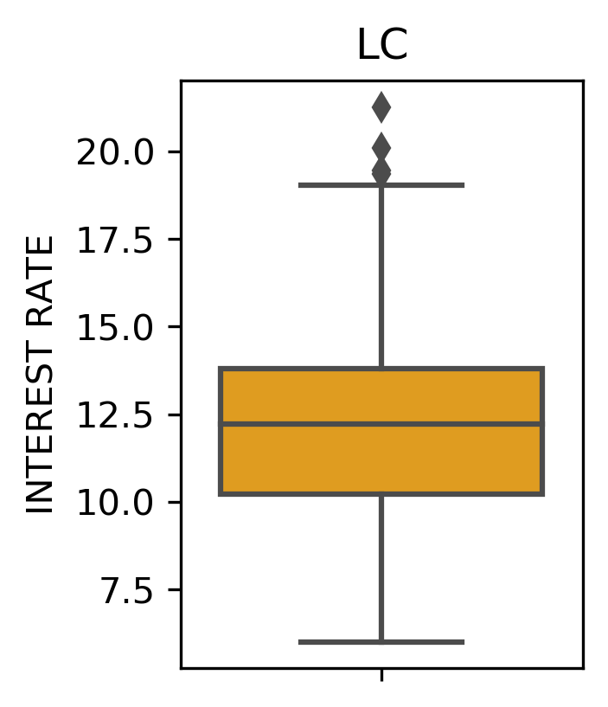
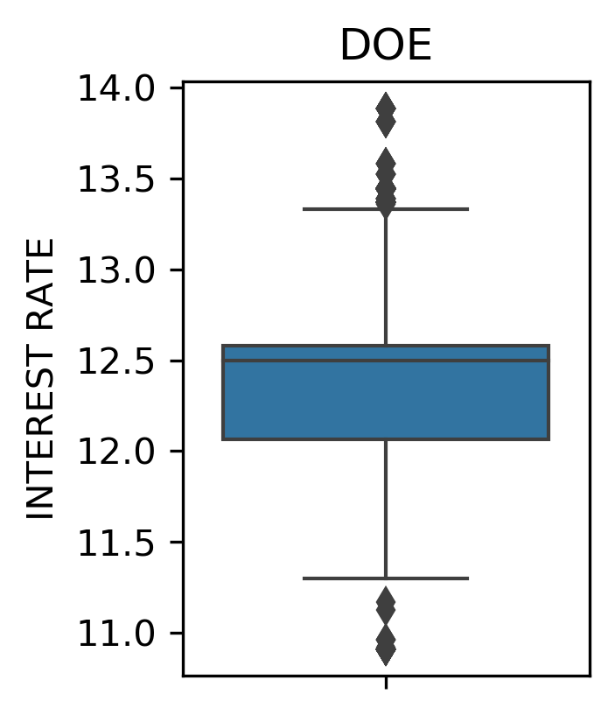
Results
The predicted interest rate follows a very similar distribution to train data despite of a different distribution of Income and Debt values.
Mean value of MSE over 10 runs using the best estimator: 6.43

Slide 21
Key Insights
Random Forest using CDR3 explains more variance and provides best results with lowest residuals and highest R² value.
University Ranking : Major : Degree
32 : 5 : 63
2. Distribution up to 1 SD for predicted interest rate falls in the same range as LC.
Feature Importance
Income | 0.45
Debt | 0.55

Slide 22
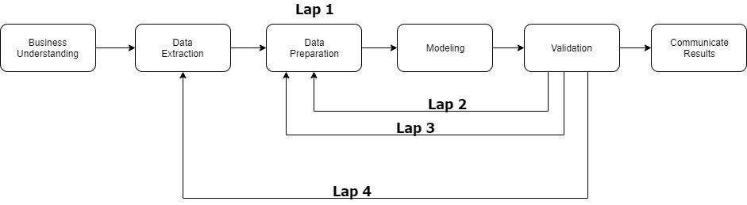
Challenges
Multiple times going back/forth to populate a dataset that would support the goal

Slide 23
Future Work
Build a RESTful API which reads a JSON file with educational parameters and based on the weights provide a risk score.
Improve the performance of existing models.
Subset the DOE and CDR data by degree to recalculate the feature importance.

Slide 24
Thank you!
Prakash Goswami
Sponsor, CEO
VestEdu
Pedro J. Fernandez
Mentor, Capstone
University of Rochester
Ajay Anand
Professor, Capstone
University of Rochester

