Slide 1
Documenting Sources for Personal Project

Slide 2
Style guide:
A style guide is a published manual that gives guidance on citation and references. Style guides also give advice on spelling, abbreviations, punctuation, and so on.
While there are multiple style guides, INDUS suggests using the MLA format.

Slide 3
MLA FORMAT:
Typed on white 8.5“ x 11“ paper
Double-spaced
12 pt. Times New Roman (or similar) font
Only one space after punctuation
All margins set to 1 inch on all sides
Indent the first line of paragraphs one half-inch

Slide 4
MLA Format
Have a header with page numbers located in the upper right-hand corner
Use italics for titles
Place endnotes on a separate page before the list of works cited

Slide 5
Difference between Citation, Reference and Bibliography
A citation is a method of making a reference in the body of an essay, either as an in-text citation or footnote/endnote.
Each entry in a bibliography are called a reference
An alphabetical list of all the references (sources) utilised in the process of completing the work is called a bibliography
.

Slide 6
What to cite?
Any ideas that aren’t yours (that you may have summarised, paraphrased, or quoted). These include:
Facts, figures, ideas, words, theories, or exact language that another person used in other publications
Books, book chapters, articles, web pages, theses, etc.
Basic/Common knowledge in a field does not need to be cited.

Slide 7
In-text citation
An in-text citation is a brief reference in your text that indicates the source you consulted. In the MLA format a citation, which utilises the author’s name and page number, in the body would look as follows:
Wordsworth stated that Romantic poetry was marked by a "spontaneous overflow of powerful feelings" (263).
Romantic poetry is characterized by the "spontaneous overflow of powerful feelings" (Wordsworth 263).
Wordsworth extensively explored the role of emotion in the creative process (263).

Slide 8
Other cases
Shortened Title in Quotes for unknown author.
“Poetry is the spontaneous overflow of powerful feelings” (“Lyrical Ballads 263)
Works with two authors
“Hamlet is terrible” (Rosencrantz and Guildenstern 22)
Works with multiple authors
“Hamlet is terrible” (Ophelia et al. 28)
Multiple works by the same author : shortened titles are used as part of the citation.
Indirect citations (qtd in Lyrical Ballad 23)
Multiple citations: (Wordsworth 26,27) Enter the citation at the end of the paragraph in case the same author is cited multiple times in the paragraph.

Slide 9
Block quotes
Used for five lines or more of text:
Nelly Dean treats Heathcliff poorly and dehumanizes him throughout her narration:
They entirely refused to have it in bed with them, or even in their room, and I had no more sense, so, I put it on the landing of the stairs, hoping it would be gone on the morrow. By chance, or else attracted by hearing his voice, it crept to Mr. Earnshaw's door, and there he found it on quitting his chamber. Inquiries were made as to how it got there; I was obliged to confess, and in recompense for my cowardice and inhumanity was sent out of the house. (Bronte 78)
*Please use the tab to indent the lines

Slide 10
Footnotes/End notes
MLA generally discourages the overuse of footnotes/endnotes. They are used for two purposes:
Content notes: to provide readers comment, explanation or information that cannot be included without interrupting the flow of the text.
Bibliographic notes: To cite several sources or make evaluative comments on your sources.
They are indicated in-text using superscript numbers AFTER the punctuation.
Please see the below link for further information:
https://style.mla.org/using-notes-in-mla-style/
NOTE: MLA 8 does not specify how to format footnotes.

Slide 11
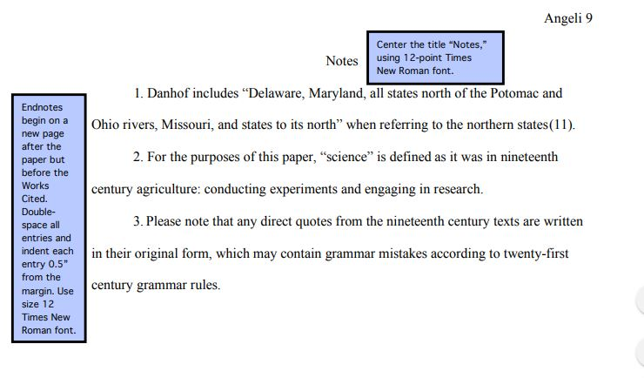
Endnotes format
From the OWL Purdue site. Please note that the endnotes format is different from the Works Cited page.

Slide 12

Works Cited
A reference is a way of indicating to the reader, in an orderly form, where information has been obtained. A reference provides all the information needed to find the source material.
Fields required for reference
Author.
Title of the chapter or section.
Title of the book,
Other contributors,
Volume number of the book (if applicable),
Publisher,
Publication date,
Location.

Slide 13
Format for any works cited citation
Author. Title of source. Title of container (self contained if book), Other contributors (translators or editors), Version (edition), Number (vol. and/or no.), Publisher, Publication Date, Location (pages, paragraphs URL or DOI). 2nd container’s title, Other contributors, Version, Number, Publisher, Publication date, Location, Date of Access (if applicable)
From OWL Purdue

Slide 14
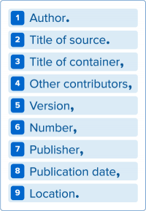
MLA 8: the information needed across the board

Slide 15
Examples: Book with a single author
Format:
Last Name, First Name. Title of Book. City of Publication, Publisher, Publication Date
Corresponding Reference entry:
Gleick, James. Chaos: Making a New Science. Penguin, 1987.

Slide 16
Book with two authors
Gillespie, Paula, and Neal Lerner. The Allyn and Bacon Guide to Peer Tutoring. Allyn and Bacon, 2000.

Slide 17
Book with three or more authors
Include the author that is listed first on the source. Omit the other authors’ names and include the term et al., which translates to “and others” in Latin.
Wysocki, Anne Frances, et al. Writing New Media: Theory and Applications for Expanding the Teaching of Composition. Utah State UP, 2004.

Slide 18
Other entries for books
Please check: https://owl.purdue.edu/owl/research_and_citation/mla_style/mla_formatting_and_style_guide/mla_works_cited_page_books.html

Slide 19
Entries for Periodicals
Works cited entries for periodical sources include three main elements—the author of the article, the title of the article, and information about the magazine, newspaper, or journal.
Article in a magazine
Author(s). "Title of Article." Title of Periodical, Day Month Year, pages.
Article in a Newspaper:
Brubaker, Bill. "New Health Center Targets County's Uninsured Patients." Washington Post, 24 May 2007, p. LZ01.
Article in a journal:
Bagchi, Alaknanda. "Conflicting Nationalisms: The Voice of the Subaltern in Mahasweta Devi's Bashai Tudu." Tulsa Studies in Women's Literature, vol. 15, no. 1, 1996, pp. 41-50.
Please check: https://owl.purdue.edu/owl/research_and_citation/mla_style/mla_formatting_and_style_guide/mla_works_cited_periodicals.html

Slide 20
Entries for Electronic sources
https://owl.purdue.edu/owl/research_and_citation/mla_style/mla_formatting_and_style_guide/mla_works_cited_electronic_sources.html

Slide 21
MLA HELP
https://owl.purdue.edu/owl/research_and_citation/mla_style/mla_formatting_and_style_guide/mla_formatting_and_style_guide.html
www.easybib.com
Microsoft Word Citations (Use the reference feature in Microsoft Word)

Slide 22
Evaluating sources
Articles published in scholarly journals
Materials at websites that focus on scholarly resources (such as Google scholar)
Look for peer-reviewed work, which is timely (date of creation/update), reliable (use of sources, facts vs opinions, working links), based on authority (credentials of the writer, reputable publisher), and not biased (use of ads, opinions etc.)
Ask personal project advisor for help.

Slide 23
Thank you

