Slide 1

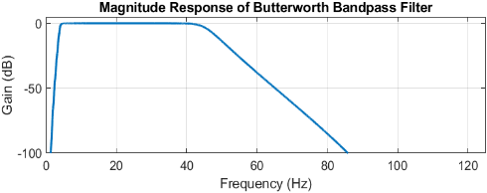
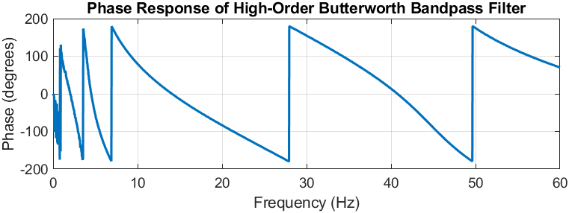
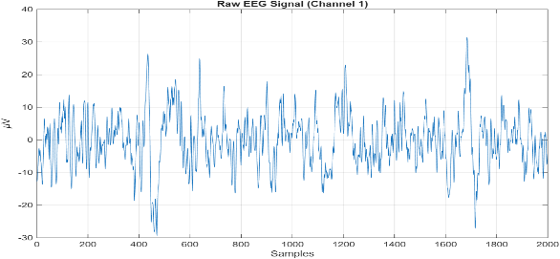
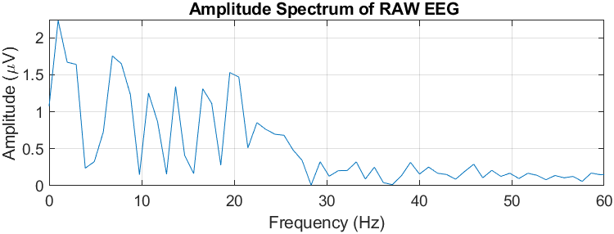
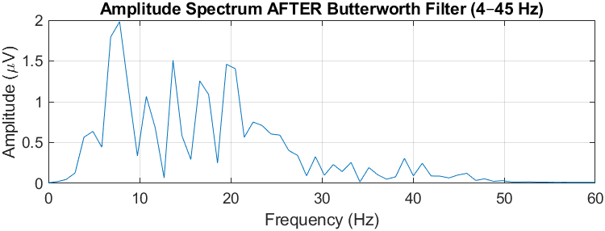
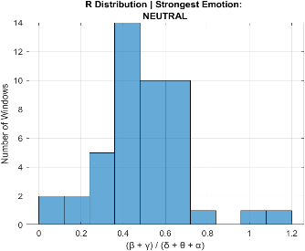
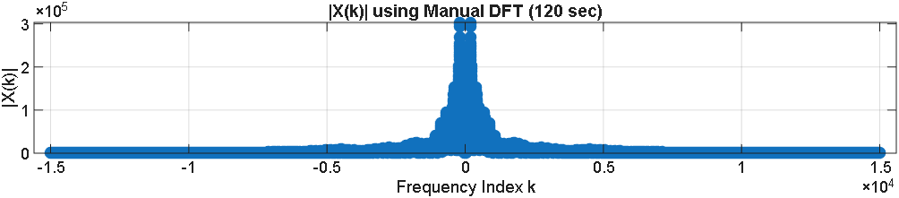


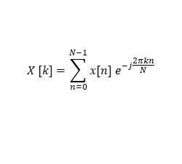

DSP using PBL Approach 2025-2026
EEG BASED EMOTION CLASSIFICATION USING DSP TECHNIQUES
Theme: Bio-Medical Signal Processing
Team D13:Shreevatsa, Vinuta N., Sangeetha S.S., Shrusti M.D.
Department of ECE
Need Statement
Block Diagram
Frequency Response of Filter
EEG signals are non-stationary and highly noisy, requiring effective preprocessing for reliable analysis, while accurate emotion recognition depends on extracting meaningful features from specific EEG frequency bands. Most existing approaches rely on machine learning techniques, which often provide limited interpretability of the underlying signal characteristics. This work addresses the challenge of classifying emotional states using pure digital signal processing methods such as bandpass filtering, Fast Fourier Transform (FFT), and power spectral density analysis.
EEG Signal Acquisition
Preprocessing
(Filtering + Artifact Removal)
Feature Extraction
Emotion
Classification/Analysis
Energy computation
(Band power ratios)
Fig.4: Magnitude response of the IIR Butterworth Bandpass filter
Fig.5: Phase response of the IIR Butterworth Bandpass filter
Fig1: Block diagram of EEG based Emotion detection
Literature Survey
Signal Characteristics
Results
EEG-Based Emotion Recognition:
Uses alpha and beta band EEG features with statistical classification to demonstrate a strong link between brain activity and emotions.
Hybrid EEG Emotion Recognition Method:
Combines signal decomposition and intelligent algorithms to improve emotion classification accuracy at the cost of high computational complexity.
Survey on EEG-Based Emotion Detection:
Reviews existing EEG emotion recognition techniques and datasets, highlighting challenges in real-time implementation and interpretability.
Comprehensive EEG Emotion Recognition Study:
Analyses EEG emotion recognition using signal preprocessing and frequency-domain feature extraction techniques, highlighting their effectiveness and limitations in handling non-stationary EEG signals.
Signal Parameters
Time domain signal
Frequency domain output
Signal length | 30870
Amplitude range | ~5 to 100 µV
Sampling frequency | 256 Hz
Frequency range | 0.5 Hz to 45 Hz
Fig.2: Raw EEG signal containing noise
Fig.6 and 7: Comparison of raw EEG signal and Butterworth bandpass filtered EEG signal (4–45 Hz)
Frequency Spectrum
Frequency domain output
Challenges and Considerations
Condition | Frequency Domain Rule
Happy | (β+γ) / (δ+θ+α) > 0.54
Sad | (β+γ) / (δ+θ+α) < 0.45
Neutral | 0.45≤(β+γ /(δ+θ+α)≤0.54
EEG is affected by eye blinks, muscle activity, and power-line interference, requiring careful preprocessing.
Identifying discriminative DSP features (band power, spectral energy, entropy) without ML is challenging.
Algorithms must be computationally efficient for real-time or embedded implementation.
$$X [k]=\sum_{n=0}^{N−1}{x[n] e^{−j\frac{2πkn}{N}}}$$
Fig.3: Frequency spectrum of the Raw EEG signal containing noise
Fig.8: Emotion Classification Distribution
Band-pass filtered EEG signal contains emotion-related frequency components.
EEG bands analysed: Delta, Theta, Alpha, Beta, Gamma.
Emotion-related feature (Arousal Index) calculated.
Final emotional state detected: HAPPY / NEUTRAL / SAD.
Problem Definition
Filter Design
Inferences and Future Scope
Classification of human emotional states from non-stationary and noise-corrupted EEG signals using only digital signal processing techniques.
Concept Mapping: To isolate EEG frequency bands relevant for emotion classification.
Identified Filter: IIR Butterworth Bandpass Filter.
Design Parameters:
EEG signals were effectively processed using time- and frequency-domain DSP techniques.
Extraction of EEG band energies enabled reliable analysis of emotional states.
The proposed DSP-based approach provides an interpretable and low-complexity solution for EEG emotion analysis.
Window-based processing captures temporal variations in emotional states effectively.
The methodology can be extended to real-time emotion monitoring systems using wearable EEG devices.
Passband edge frequencies (Hz) | Stopband edge frequencies (Hz) | Passband gain (dB) | Stopband gain (dB) | Filter order N
4-45 | < 3 Hz and > 50 Hz | 0 | <= -20 db | 10
Objectives
Noise and artifacts: EEG is affected by eye blinks, muscle activity, and power-line interference, requiring careful preprocessing. Design digital filtering techniques to reduce noise from raw EEG signals
Develop algorithms for extracting relevant features from the enhanced EEG signals for arrhythmia identification.
Butterworth Magnitude Response:
$${|H(jω)|}^{2} = \frac{1}{{(1 + (ω/ω_{c}))}^{2N}}$$
Bandpass Frequency Transformation:
s$→ \frac{(s^{2} −{Ω_{0}}^{2})}{(B_{s}) }$
Digital Butterworth Transfer Function:
$$H(z) = H_{a}(s) ,s →\frac{2}{T}\frac{1−z^{−1}}{1+z^{−1}}$$

