Slide 1

cv
AUTOMATED NOTARIZATION OF DOCUMENTS USING BLOCKCHAIN
Team members
Ashwath S
Dushyanth V
G M Lohith
Shreevatsa U Upadhyaya
Under the guidance of
Dr. Deepak G,
Associate Professor,
Dept of Computer Science and Engineering
Department of Computer Science & Engineering, DSCE

Slide 2
TABLE OF CONTENTS
Abstract 03
Problem Statement 04
Introduction 05
System Architecture 06
Workflow 08
Smart Contracts 09
Adding and editing document exporters
Deleting a document exporter
Uploading a document
Verification of documents
Deleting a document
Tech Frameworks Used 15
Team Contributions 16
Co-guide Interactions 17
Conclusion and Future Work 18
Project Management Tool 20
Department of Computer Science & Engineering, DSCE

Slide 3
cv
ABSTRACT
In the modern world, the certification process for academic texts is laborious and time-consuming. Additionally, there is a chance that students could lose their diplomas. In order to validate academic materials, a cutting-edge and original method is needed.
Our project is an export and notarization management system for academic certificates. It automates certificate creation and reduces the cost and labor-intensive manual effort necessary for their verification. The idea behind our system's capacity to upload a diploma from a university.
Department of Computer Science & Engineering, DSCE

Slide 4
cv
PROBLEM STATEMENT
To eliminate the need for a third party in the verification of the legitimacy of academic credentials granted by academic institutions. This will simplify, accelerate, and make verification safer and less expensive. The project will focus on using blockchain technology to notarize documents and determine the authenticity of certificates issued via the Ethereum network, as well as how to increase the legitimacy of certificate issuers within the network.
Department of Computer Science & Engineering, DSCE

Slide 5
cv
INTRODUCTION
The majority of educational institutions in the country still issue certificates in physical form, which makes it difficult to verify their validity, share them with other organizations for use, and store them, which results in a lot of labor-intensive work and high costs. Technology can be used to develop methods for figuring out whether academic certifications are real or fake. A reliable and secure solution to use blockchain technology to create a certificate notarization system. Without relying on third parties, you can notarize using the blockchain. Because it cannot be altered or deleted, the information stored inside the blocks is unforgivable. Traditional cloud-based storage systems are less dependable, secure, and cost-effective than blockchain, which uses distributed ledger technology (DLT).
Department of Computer Science & Engineering, DSCE

Slide 6
cv
SYSTEM ARCHITECTURE
The system architecture and workflow methodology consists of the university that issued the document, the graduating student, the organization or location intended by the student for their own goals, and the university that stores the documentation of graduating students in its own archiving system (Blockchain). A student submits their PDF or QR code file to the organization when applying for a job or finishing up postgraduate studies at a university, and the university that issued the document will check its legitimacy or reject it.
Department of Computer Science & Engineering, DSCE

Slide 7

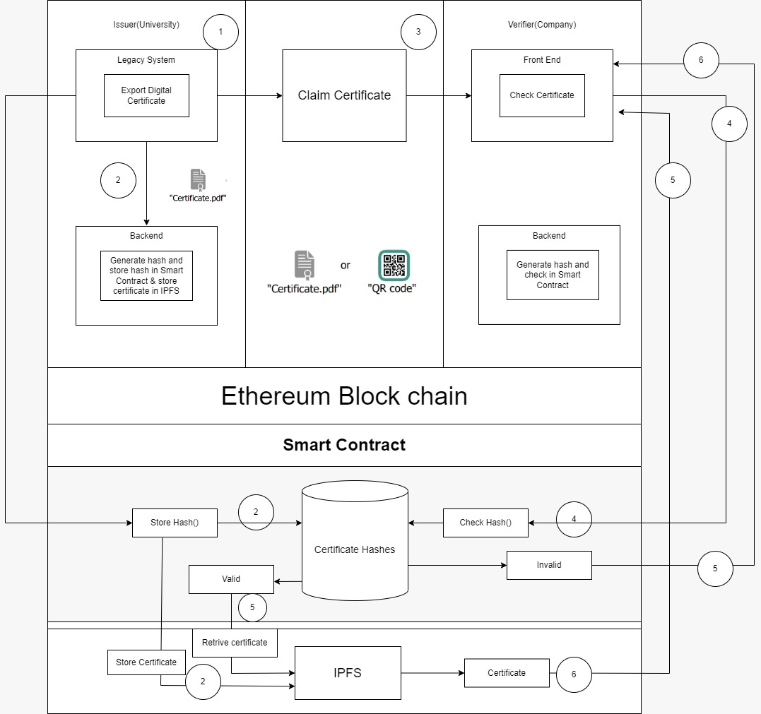
SYSTEM ARCHITECTURE
Department of Computer Science & Engineering, DSCE

Slide 8
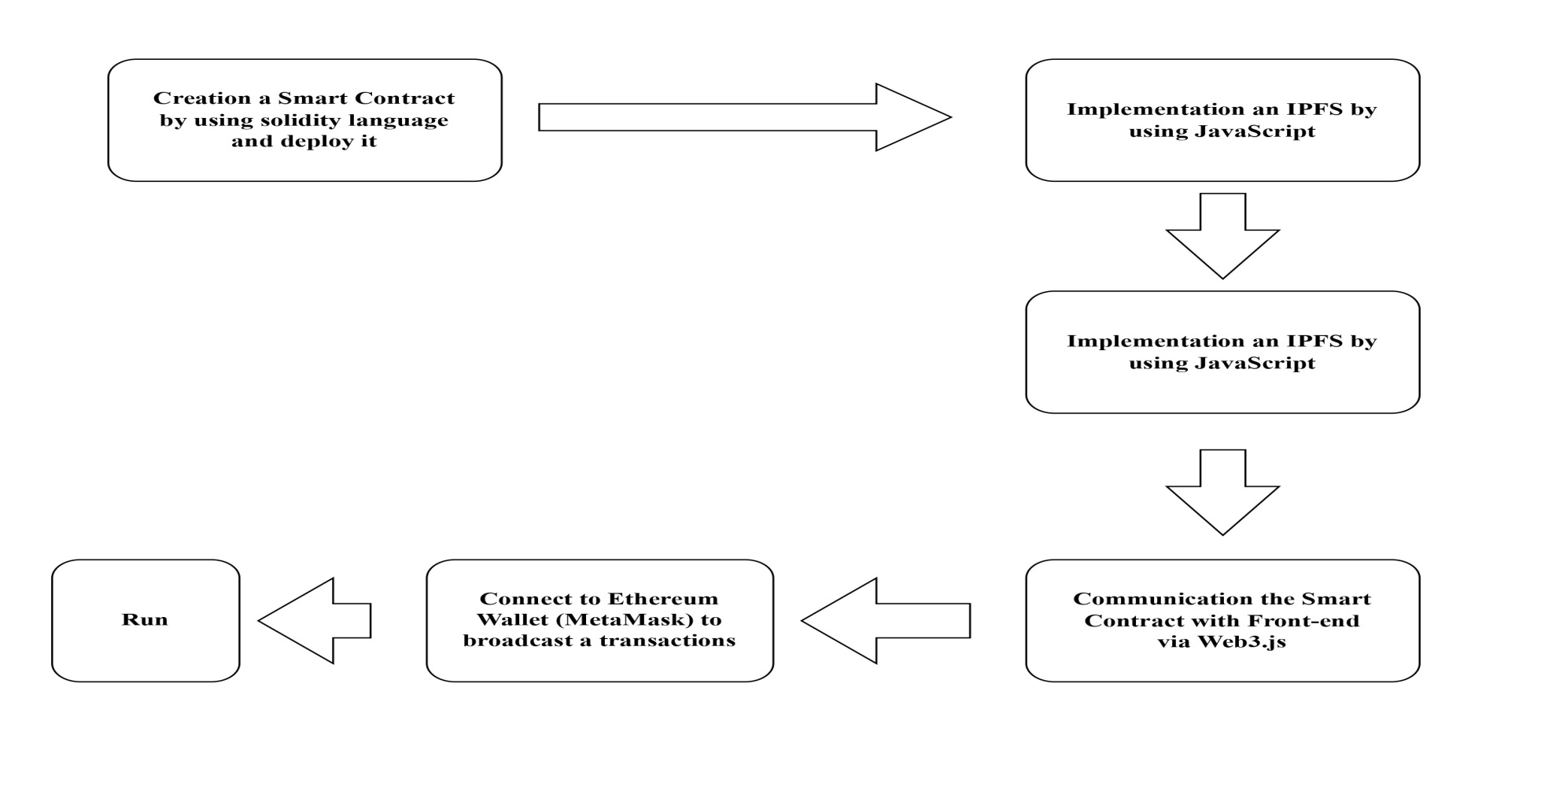
cv
WORKFLOW OF THE IMPLEMENTATION
Department of Computer Science & Engineering, DSCE

Slide 9
cv
SMART CONTRACT
The functionalities of the smart contract are :
Adding and editing document exporters
Deleting a document exporter
Uploading a document
Verification of documents
Deleting a document
Department of Computer Science & Engineering, DSCE

Slide 10
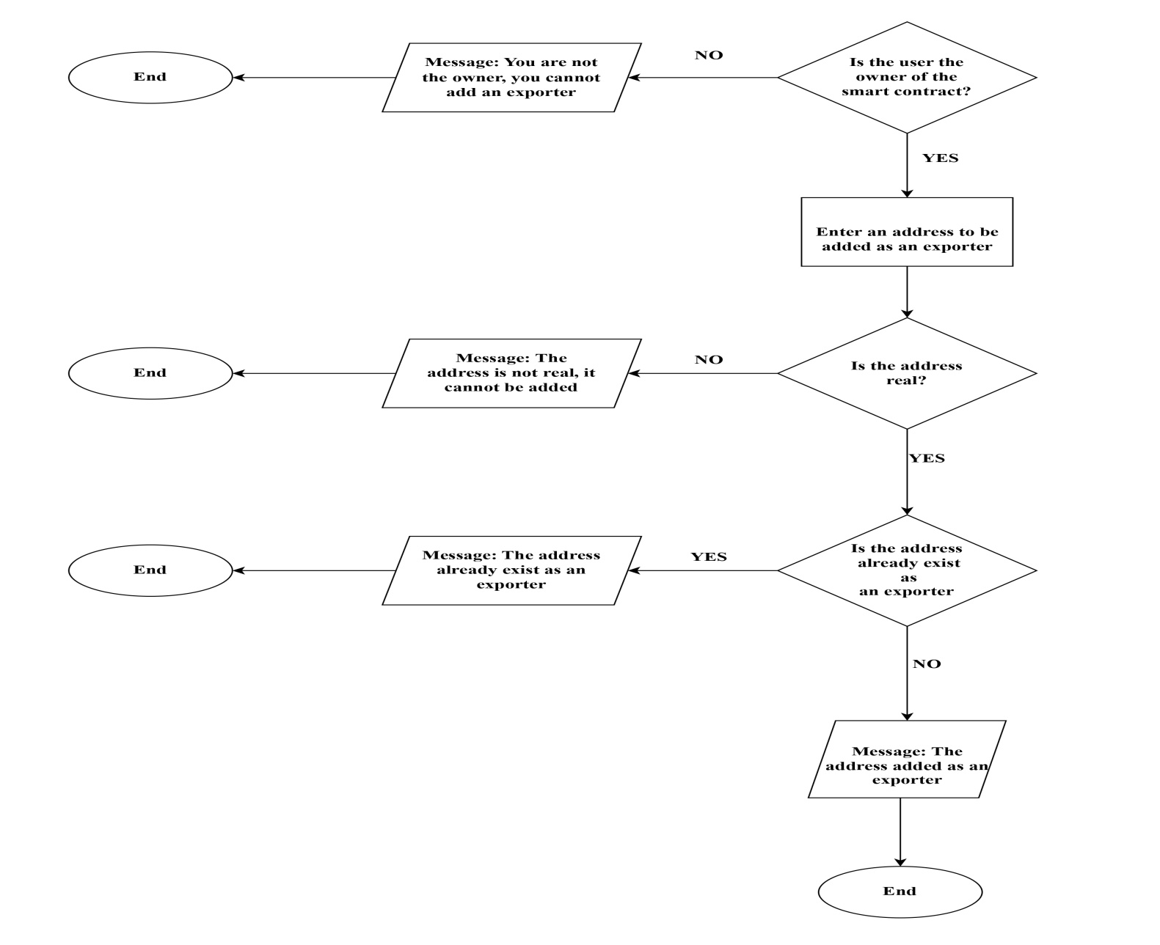
cv
Flowchart of function of addition a documents exporters
Department of Computer Science & Engineering, DSCE

Slide 11
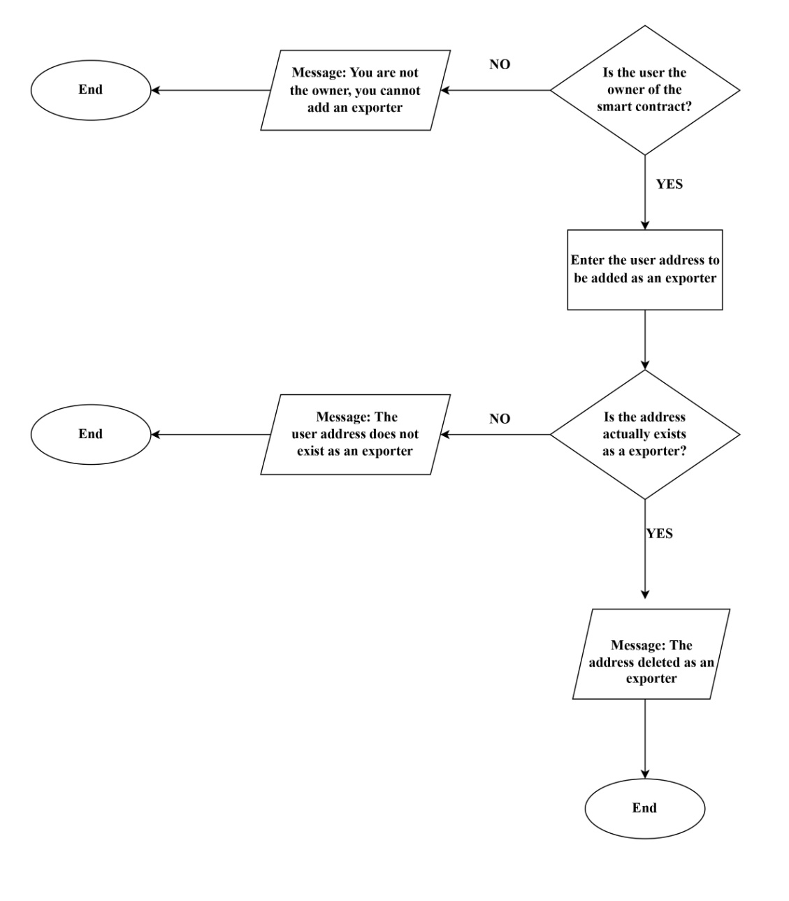
cv
Flowchart of function of deleting a document exporter
Department of Computer Science & Engineering, DSCE

Slide 12
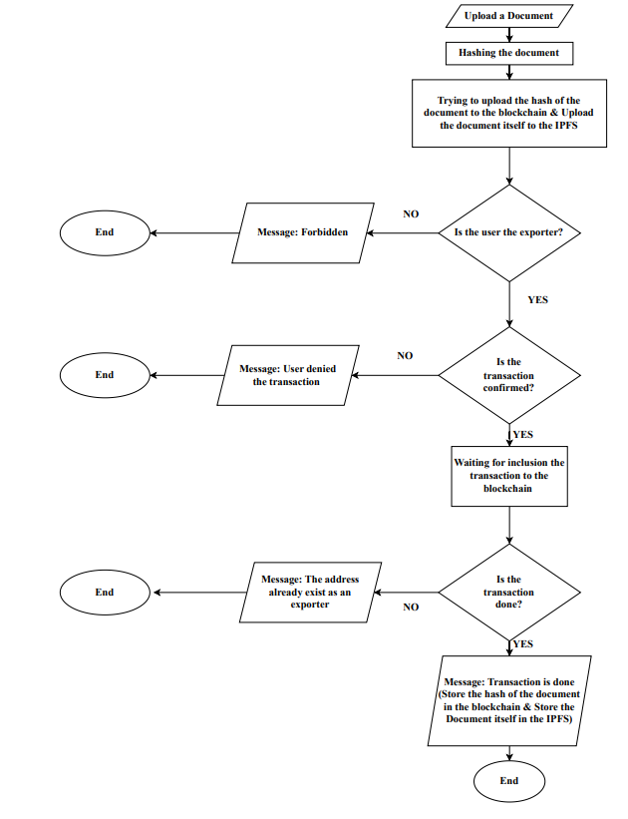
cv
Flowchart of function of exporting documents
Department of Computer Science & Engineering, DSCE

Slide 13
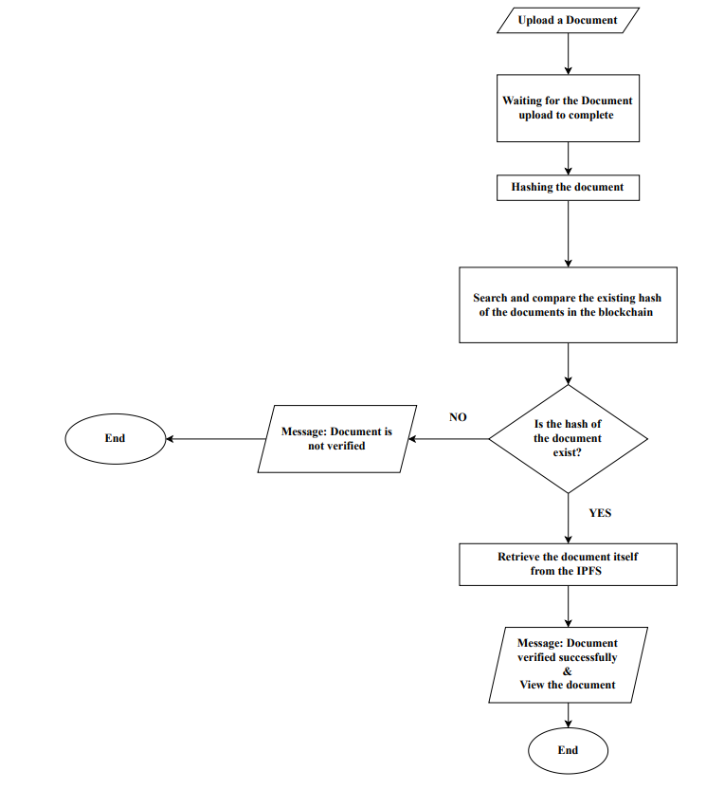
cv
Flowchart of function of verifying the documents
Department of Computer Science & Engineering, DSCE

Slide 14
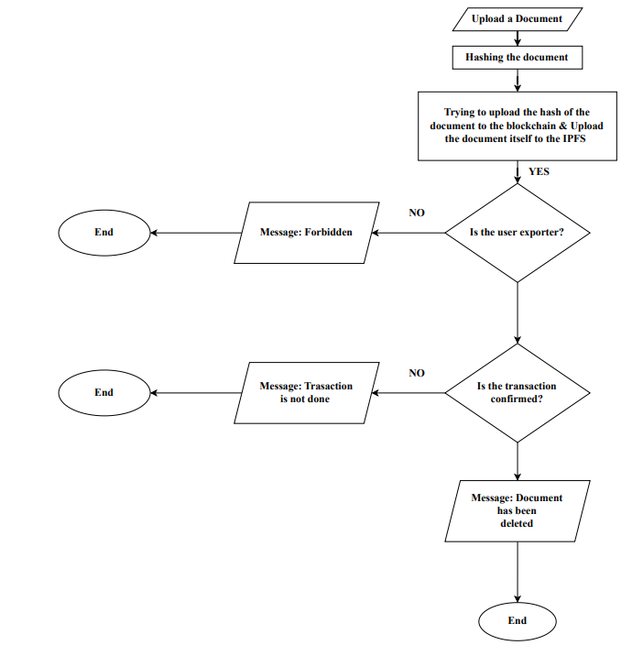
cv
Flowchart of function of deleting the documents
Department of Computer Science & Engineering, DSCE

Slide 15
TECH FRAMEWORKS USED
BLOCKCHAIN NETWORK Ethereum
LOCAL BLOCKCHAIN Ganache
FRONTEND HTML, CSS, Bootstrap, Javascript
IPFS SERVICE PROVIDER Infura
CRYPTOCURRENCY WALLET MetaMask
JAVASCRIPT FOR BLOCKCHAIN Web3.js
Department of Computer Science & Engineering, DSCE

Slide 16
TEAM CONTRIBUTIONS
Member | Contribution
Ashwath S 1DS19CS032 | Development of Upload page and Admin page along with its backend
Dushyanth V 1DS19CS046 | Development of the Verify page along with its backend
G M Lohith 1DS19CS050 | Development of the Delete page along with its backend
Shreevatsa U Upadhyaya 1DS19CS152 | Design and development of Verification smart contract
Department of Computer Science & Engineering, DSCE

Slide 17
CO-GUIDE INTERACTIONS
Date | Particulars
14th January 2023 | We discussed the problem statement selected We put forth our understanding of the base paper
30th January 2023 | We presented our literature survey work Some implementation ideas were discussed Suggestions given: Use boilerplate code to get started, and build from there
Department of Computer Science & Engineering, DSCE

Slide 18
cv
CONCLUSION
Solution proposed automates the creation of Certificates, notarizing the documents and decreases the amount of manual work required for their verification. Additionally, there is a comparatively low chance of certificate loss for participants. We are reducing the amount of data that has been altered by employing an additional hashing algorithm. Since no two distinct inputs have produced the same output, the SHA3 hash algorithm has so far been demonstrated to be secure. In the same way, it is impossible to derive actual information from a hash if the generated hash cannot be used to retrieve the same document. The only method for retrieving the same document is IPFS.
Department of Computer Science & Engineering, DSCE

Slide 19
cv
FUTURE WORK
Explore integration possibilities with existing systems and platforms, such as government databases, educational institutions, or financial institutions. This integration can streamline the verification process and enhance the interoperability of the blockchain-based solution.
Address scalability challenges by employing techniques like sharding or layer-two solutions. Enhance the performance of the blockchain network to handle a larger volume of document verification transactions efficiently.
Department of Computer Science & Engineering, DSCE

Slide 20
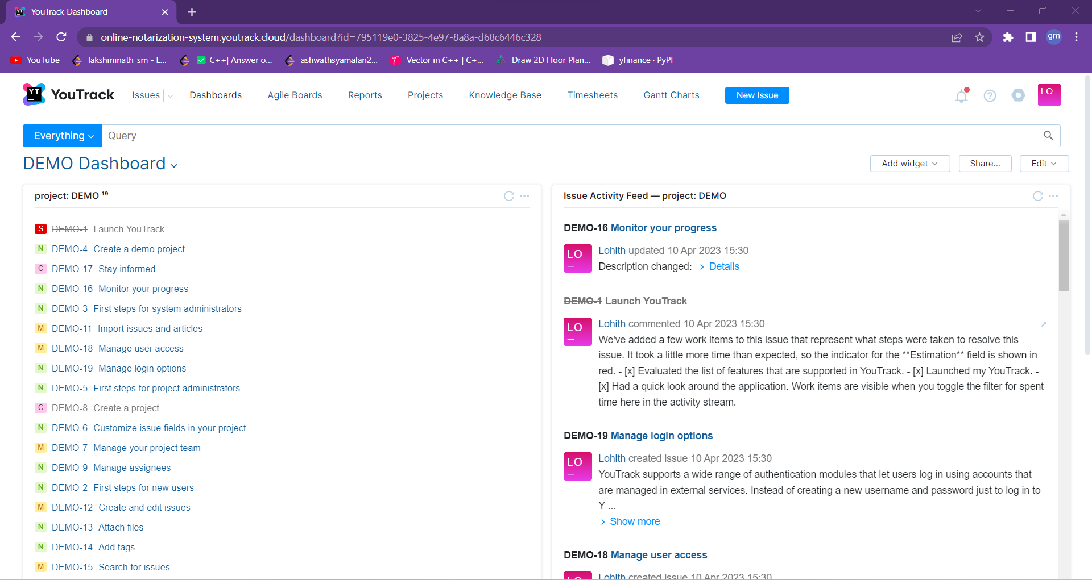
PROJECT MANAGEMENT TOOL YouTrack

Slide 21
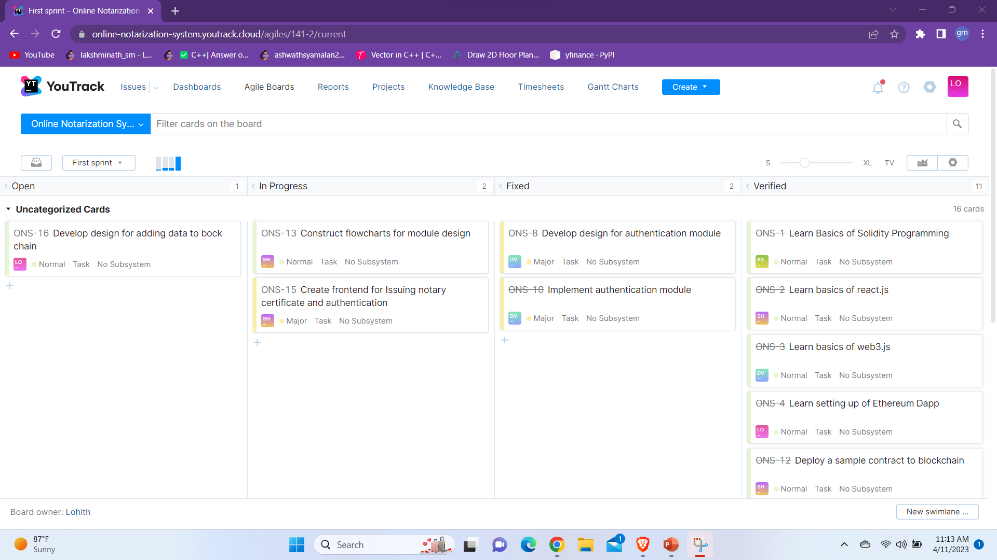
PROJECT MANAGEMENT TOOL YouTrack

