Slide 1
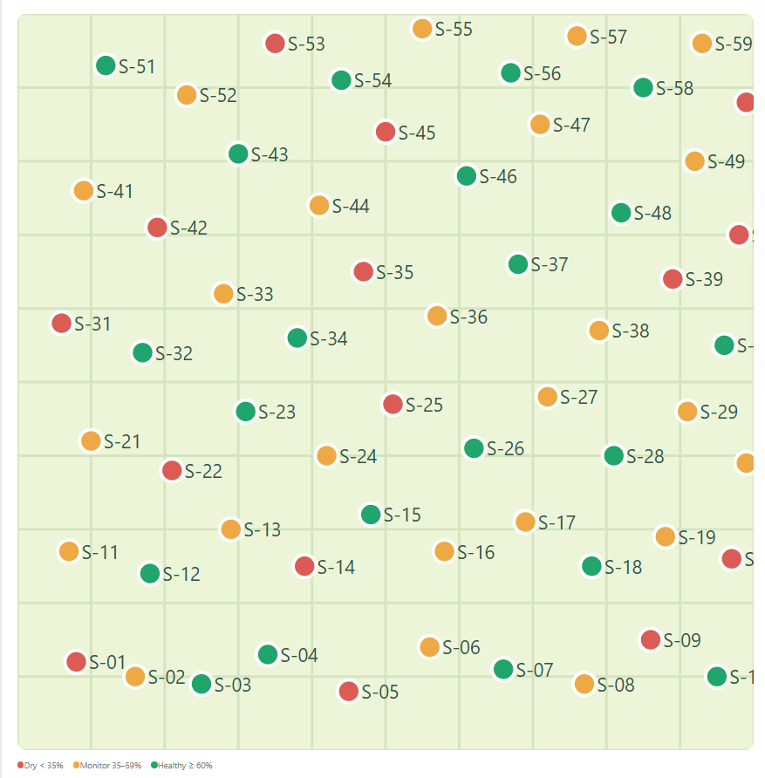
DATA STRUCTURES & ALGORITHMS • CAPSTONE PROJECT
Precision Agriculture Spatial Analytics and Smart Irrigation System
using Orthogonal Range Search, KD-Tree, and Fractional Cascading
STUDENT NAMES
REGISTER NUMBES
Shreeya Khanal
Ishika Rana
R Pooja Sri
Nitya
CH.SC.U4AIE25073
CH.SC.U4AIE25021
CH.SC.U4AIE25059
CH.SC.U4AIE25010
COURSE
COURSE CODE
Data Structures and Algorithms
22AIE203
DEPARTMENT
INSTITUTION
Department of Computer Science & Engineering
Amrita School of Computing
FACULTY / GUIDE
ACADEMIC YEAR
G Bharathi Mohan
2026 – 2027
01 / 16

Slide 2
INTRODUCTION
Introduction & Domain
Precision agriculture requires location-based analysis of field conditions.
1
Agricultural fields exhibit spatial variation in moisture, pH, temperature, humidity and nutrients.
2
Sensor networks generate multidimensional data associated with X–Y field coordinates.
3
Traditional linear scanning becomes inefficient as the number of sensors increases.
4
Efficient spatial data structures can enable fast queries and localized irrigation decisions.
Farm
Sensors
Spatial Data
Decisions
02 / 16

Slide 3
BASELINE
Existing System
Traditional Sensor Analysis — how field-sensor queries are conventionally handled
Sensor Dataset
HOW IT WORKS TODAY
Sensor readings are commonly stored as sequential records.
Queries can require scanning multiple or all sensor records.
Spatial conditions are evaluated individually for each sensor.
Irrigation decisions are then generated from the retrieved readings.
Sequential Scan
Check every sensor
Key complexity: Linear search → O(n)
Identify required sensors
This becomes the baseline we compare against throughout this project.
Generate decision
This is a reasonable, widely-used approach — it is simple, correct, and easy to implement. The goal of this project is not to fault it, but to show where a spatially-indexed alternative meaningfully improves performance as sensor networks scale.
03 / 16

Slide 4
BASELINE
Existing System — Limitations
1
Search inefficiency
2
Poor scalability
Every sensor may need to be examined → O(n).
Search cost increases directly with the number of sensors.
3
Repeated spatial processing
4
Limited real-time responsiveness
Different queries repeatedly examine the same coordinate data.
Large datasets can delay location, range and nearest-sensor queries.
10 sensors → manageable
1,000 sensors → more scanning
100,000 sensors → expensive scanning
Need → Spatial Indexing
04 / 16

Slide 5
DIRECTION
Problem Statement & Objectives
PROBLEM STATEMENT
Agricultural sensor datasets contain spatially distributed measurements that must be searched and analyzed efficiently. Sequentially scanning all sensors for point, range, nearest-neighbor and moisture-based queries results in unnecessary computation as dataset size increases. The project therefore develops a spatial analytics system using KD-Trees, Orthogonal Range Trees and Fractional Cascading to improve sensor retrieval and support localized irrigation and soil-management decisions.
OBJECTIVES
1
Store and manage multidimensional agricultural sensor data.
2
Implement KD-Tree for spatial nearest-neighbor retrieval.
3
Implement Orthogonal Range Tree for rectangular spatial queries.
4
Implement Fractional Cascading for efficient searches across related sorted catalogs.
5
Evaluate the time and space complexity of the proposed DSA-based approach.
05 / 16

Slide 6
DESIGN
Selected Data Structures & Algorithms
DSA | Role
KD-Tree | Nearest sensor retrieval
Orthogonal Range Tree | 2D rectangular range queries
Fractional Cascading | Related sorted moisture searches
ArrayList | Sensor storage and result collections
Balanced binary trees | Hierarchical spatial indexing
MAJOR OPERATIONS
1
2
3
4
5
Point location
Nearest-neighbor search
Orthogonal range search
Moisture threshold search
Sensor insertion / removal
06 / 16

Slide 7
JUSTIFICATION
Why These DSAs?
Requirement | Conventional | Selected DSA
Nearest sensor | Linear scan | KD-Tree
Rectangle query | Scan all sensors | Range Tree
Multiple sorted searches | Independent searches | Fractional Cascading
Growing dataset | Poor scalability | Spatial indexing
THE CENTRAL MESSAGE
Each data structure is selected for a different computational requirement.
We are not using three algorithms for the sake of it — each targets a distinct query pattern that agricultural sensor analysis actually needs.
07 / 16

Slide 8
METHODOLOGY
Proposed Methodology — System Architecture
FARM SENSOR DATA
CSV DATASET
CSV LOADER
SENSOR OBJECTS
KD-Tree
Range Tree
Fractional
Cascading
Nearest
Sensor
Spatial
Range
Moisture
Search
AGRICULTURAL ANALYSIS
Irrigation Zones • Soil Analysis • Fertilizer Suggestion
WEB INTERFACE
08 / 16

Slide 9
CORE ALGORITHMS
Algorithm & Pseudocode
KD-TREE — NEAREST NEIGHBOR
RANGE TREE
FRACTIONAL CASCADING
NearestSearch(node, target):
if node is null:
return
calculate distance to target
update nearest sensor
select nearer subtree
search nearer subtree
if splitting plane may
contain closer point:
search opposite subtree
RangeSearch(node, rectangle):
if subtree outside X-range:
return
if subtree completely
inside X-range:
binary-search Y catalog
report sensors in Y-range
return
check pivot
search left subtree
search right subtree
Search(target):
binary-search main catalog
follow bridge to next
catalog
locally correct position
follow bridge to final
catalog
return matching positions
09 / 16

Slide 10
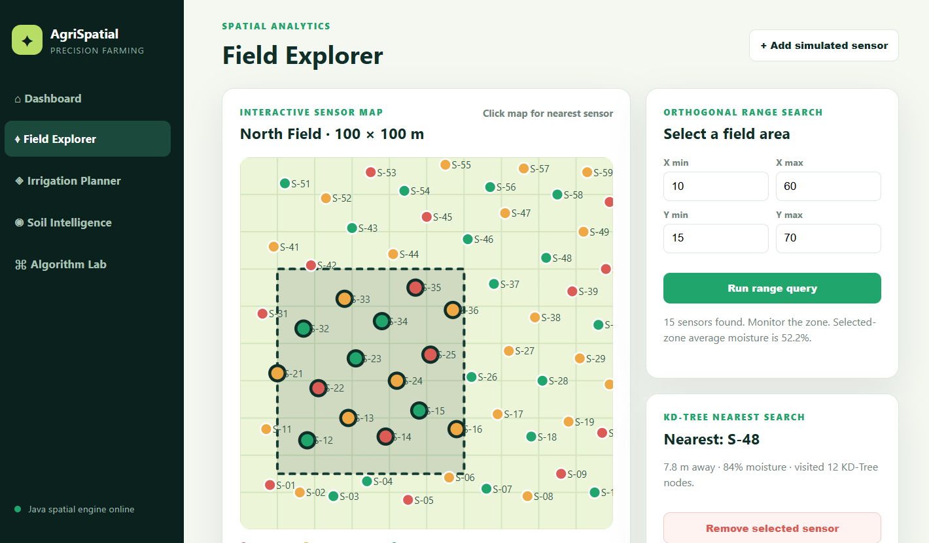
BUILD
Implementation
TECHNOLOGY
MAIN CLASSES
UI MODULES
Java
Java Collections Framework
HttpServer for backend / API
HTML / CSS / JavaScript frontend
CSV-based sensor dataset
Sensor
Dashboard
Overview of the live sensor network
SensorManager
KDTree
Field Explorer
Map-based nearest & range queries
RangeIndex
FractionalCascade
IrrigationService
Soil Intelligence
pH / nutrient analysis & fertilizer suggestions
FertilizerService
Java classes drive an actual working application — not just an isolated DSA demo — proving the indexes are integrated end-to-end.
CSVLoader
Irrigation Planner
Zone-wise irrigation recommendations
Main
Algorithm Lab
Interactive view into KD-Tree / Range Tree / Fractional Cascading
10 / 16

Slide 11
ANALYSIS
Complexity Analysis
Operation | Best | Average | Worst | Space
KD-Tree construction | O(n log n) | O(n log² n) | O(n log² n) | O(n)
KD-Tree nearest search | O(log n) | O(log n) | O(n) | O(n)
Range Tree construction | O(n log n) | O(n log² n) | O(n log² n) | O(n log n)
Orthogonal range query | O(log n) | O(log² n + k) | O(n) | —
Fractional Cascade construction | O(n log n) | O(n log n) | O(n log n) | O(n)
Fractional Cascade query | O(log n) | O(log n + d) | O(log n + d) | —
Sensor insertion / removal | O(n log n) | O(n log² n) | O(n log² n) | O(n log n)
n = number of sensors · k = points reported by a range query · d = cascaded catalogs (main, north, south)
WHY NOT THE TEXTBOOK NUMBERS?
WHY FRACTIONAL CASCADING STAYS CLEAN
Our KDTree and RangeIndex classes re-sort the remaining point list at every recursive call (rather than partitioning by median in place), and RangeIndex additionally rebuilds a full sorted Y-catalog at every node. This adds a log n factor over the idealized O(n log n) build, giving an honest O(n log² n) construction cost — verified directly from the source.
FractionalCascade sorts each of its three catalogs exactly once and assigns bridge pointers in a single linear pass, so its construction is the textbook O(n log n) — no repeated re-sorting penalty. Its query then collapses three catalog binary searches into one search plus O(1)-amortised bridge corrections.
11 / 16

Slide 12
VALIDATION
Experimental Setup & Test Cases
DATASET
60 sensors across a 100 × 100 field • fields: ID, X, Y, soil moisture, pH, temperature, humidity, nutrient level, crop health, water availability
# | Test | Input | Expected / Measured
1 | Point location | (50, 50) | Nearest sensor = S-25, distance = 3.162
2 | Range query | X: 20–60, Y: 20–70 | 12 matching sensors, exact match vs. brute-force scan
3 | Nearest sensor (nodes visited) | Random targets, n=200 trials | Avg. 8.89 of 60 nodes visited (≈85% pruned)
4 | Moisture search | Target moisture = 50% | Main[42]=S-55(51) → North[23]=S-55(51) → South[15]=S-24(52)
5 | Dynamic update | Add sensor(55,55) → query → remove → query | New sensor found post-add; reverts to S-36 post-remove
12 / 16

Slide 13
RESULTS
Experimental Results
79×
346×
100%
faster nearest-sensor lookup at n = 10,000
faster threshold search at n = 10,000
of test cases matched the brute-force baseline
Measured on the actual project source (KDTree, RangeIndex, FractionalCascade), cross-checked against a brute-force linear scan for correctness on every query. Range-query results (13.0× at n=10,000) and full figures are tabulated in the report.
13 / 16

Slide 14
DISCUSSION
Results Analysis — So What?
Spatial indexing reduces unnecessary examination
KD-Tree pruning avoids irrelevant branches
At n=10,000, nearest-sensor lookup drops from 1,161 µs (linear) to 14.6 µs indexed — a 79× reduction in work per query.
Across 200 randomized queries on the real 60-sensor dataset, findNearest() visited an average of only 8.89 of 60 nodes — about 85% of the tree is pruned away per search.
Range Tree secondary catalogs cut Y-scanning
Fractional Cascading avoids independent searches
Binary search over each node's pre-sorted Y-catalog avoids re-scanning every candidate's Y-coordinate on each query, at the cost of extra build-time and storage.
A single binary search on the main catalog plus bridge corrections replaces three separate binary searches — reflected in its 346× speed-up at n=10,000.
Dynamic updates are supported via rebuild
Performance scales as dataset size grows
rebuildIndexes() reconstructs all three structures after add/remove; Test 5 confirms new sensors are retrievable immediately and removed sensors disappear from every index.
The gap between indexed and linear query time widens continuously from n=60 to n=10,000, matching the O(log n)-type vs. O(n) trends predicted on Slide 11.
14 / 16

Slide 15
WRAP-UP
Conclusion & Future Scope
CONCLUSION
1
Developed a spatial agricultural analytics system.
2
Integrated KD-Tree, Orthogonal Range Tree and Fractional Cascading.
3
Supported nearest, range and moisture-based searches.
4
Added irrigation-zone and soil / fertilizer analysis.
5
Demonstrated how DSA-based indexing can support scalable agricultural analytics.
FUTURE SCOPE
Dynamic tree updates without full index reconstruction.
Larger real-time sensor datasets.
1
2
GIS / map integration and live sensor feeds.
More advanced irrigation prediction using historical data / ML.
3
4
15 / 16
15 / 16

Slide 16
SOURCES
References
1
Bentley, J. L. (1975). Multidimensional binary search trees used for associative searching. Communications of the ACM, 18(9), 509–517.
2
Chazelle, B., & Guibas, L. J. (1986). Fractional cascading: I. A data structuring technique. Algorithmica, 1(1), 133–162.
3
de Berg, M., Cheong, O., van Kreveld, M., & Overmars, M. (2008). Computational Geometry: Algorithms and Applications (3rd ed.), Ch. 5 — Range Searching Trees. Springer.
4
Cormen, T. H., Leiserson, C. E., Rivest, R. L., & Stein, C. (2022). Introduction to Algorithms (4th ed.). MIT Press.
5
Samet, H. (2006). Foundations of Multidimensional and Metric Data Structures. Morgan Kaufmann.
6
Oracle Corporation. Java SE Platform documentation — java.util, com.sun.net.httpserver. docs.oracle.com/en/java/javase/
7
Project dataset: data/farm_sensors.csv — 60-record synthetic precision-agriculture sensor dataset (this project).
16 / 16

