Slide 1

Meta Ensemble model for few shot classification problems in Medical domain.
Team O7
Team Members
Name USN
Shreeya Goggi 01FE19BCS045
Sahana Bhasme 01FE19BCS072
Sneha Kashetti 01FE19BCS112
Sakshi B Badiger 01FE19BCS170
Guide : Dr. Shantala Giraddi.

Slide 2
PROBLEM STATEMENT
Meta Ensemble model for few shot classification problems in Medical domain-
To apply Meta Ensemble model on few shot images for detection of Oral and Breast cancer and comparing results of various k shot images.

Slide 3
OBJECTIVES
To implement ensemble model for oral cancer and breast cancer.
To compare results of N way K shot images of oral cancer and breast cancer.
To compare performance of deep learning model and meta ensemble learning model.

Slide 4
LITERATURE SURVEY. Paper 1
Name of the paper:Convolutional Neural Network Design for Breast Cancer Medical Image Classification.
Author :Yongbin Yu; Ekong Favour; Pinaki Mazumder
Year of Publication : 2020.
Implications : Aims at employing image classification and medical image segmentation based on deep learning to detect medical issues on time. In this paper, a 15-layer CNN model is designed to classify and recognize medical images; especially, breast cancer cells, by using relevant CNN classification techniques.
Results : The accuracy obtained is about 98.50.

Slide 5
Paper 2
Name of the paper : Melanoma Skin Cancer Detection using CNN AlexNet
Architecture.
Author :Shikha Rai A, Joswin Mark Monteiro, Namitha, Valentina Laira Veigas.
Year of Publication : 2020.
Implications :The authors paper proposes a convolutional neural network (CNN) model using AlexNet architecture that classifies the skin lesion images into melanoma and non-melanoma skin cancers..
Results : The accuracy achieved was about 70.

Slide 6
Paper 3
Name of the paper : A review of medical image data augmentation techniques for deep learning applications
Author : Phillip Chlap, Hang Min, Nym Vandenberg, Jason Dowling, Lois Holloway, Annette Haworth
Year of Publication : 2021.
Implications : To address limited dataset problem, Data augmentation uses images in the training set and applies modifications to these cases to generate further representative samples which simulate changes in acquisition and anatomical variation of patients.
Results : Data augmentation techniques can help to generalise the model.

Slide 7
Paper 4
Name of the paper : Automatic Diagnosis of Early-Stage Oral Cancer and Precancerous Lesions from ALA-PDD Images Using GAN and CNN
Author : Taro Fujimoto, Eiji Fukuzawa, Seiko Tatehara, Kazuhito Satomura, Jun Ohya
Year of Publication : 2022.
Implications : This paper proposes a method for automatically classifying oral cancer severity stages into three classes: Normal, Low-Risk, High-Risk. Here they augment a small image dataset by training GAN (Generative adversarial networks) with Differentiable Augmentation, and then train CNN (Convolutional Neural Network) for the classification by the augmented dataset.
Results : The accuracy achieved was about 89.2.

Slide 8
Paper 5
Name of the paper : Meta-DermDiagnosis: Few-Shot Skin Disease Identification using
Meta-Learning
Author : Kushagra Mahajan, Monika Sharma, Lovekesh Vig
Year of Publication : 2020.
Implications : The proposed network Meta-Derm Diagnosis which utilizes meta-learning for identification of rare diseases with much less annotated data.It consists of a meta-learner which involves training the neural network for few-shot image classification tasks based on an initial set of class labels.Proposed method uses Reptile(i.e., gradient-based method) and Prototypical networks (i.e., distance metric based learner) to identify skin lesions from medical image.
Results : The accuracy achieved was about 82.1.

Slide 9
Paper 6
Name of the paper : Meta-ensemble learning with a multi -headed models for few -shot problems
Author : Seokhyeon Ha, Youngseok Yoon,Jungwoo Lee
Year of Publication : 2022.
Implications : To address generalization in meta-learning the proposed meta-ensemble learning approach combines a multi-input multi-output (MIMO) configuration,which creates multiple subnetworks in single model.It combines several different tasks into an input structures multiple times and single model learns multiple tasks simultaneously which improves generalizations and reduces over-fitting.
Results : The accuracy achieved was about 68.92

Slide 10
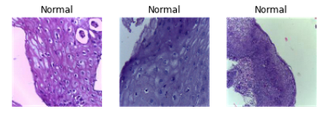
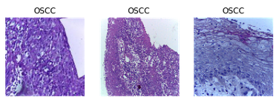
Dataset
1. OSCC image dataset
Contains two classes :Normal, OSCC
Total images : 5192
Normal : 2494
OSCC: 2698

Slide 11
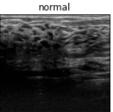
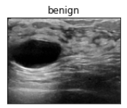
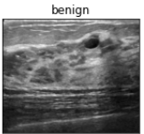
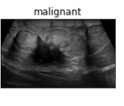
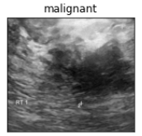
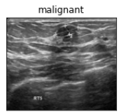
Dataset
2. Breast ultrasound images dataset
Contains two classes Normal, Benign, Malignant
Total images :1578
Normal : 266
Benign: 891
Malignant: 421

Slide 12
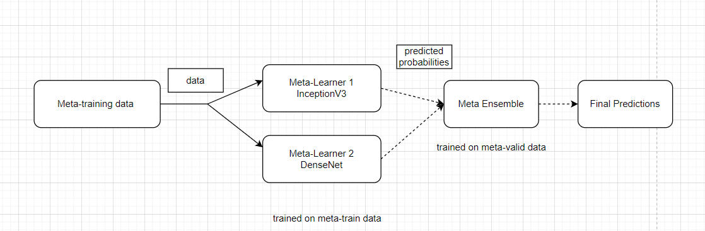
Methodology

Slide 13
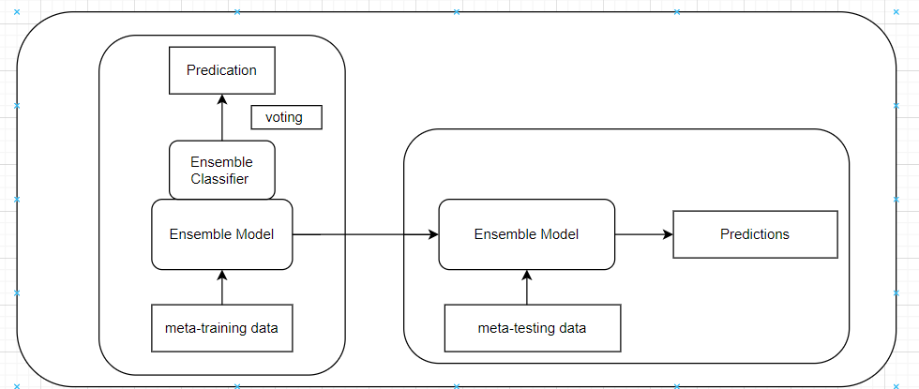
Methodology

Slide 14
Methodology
Ensemble learning is a meta learning approach that seeks better predictive performance by combining the predictions from multiple models
In the proposed methodology the voting ensemble model is trained using two meta learners i.e InceptionV3 and DenseNet201 .
A voting ensemble is an ensemble machine learning model that combines the predictions from multiple other models (InceptionV3 and DenseNet201).
In voting ensemble model the predictions for each label are summed and the label with the majority vote is predicted.
The proposed model improves the generalization in few shot datasets.

Slide 15
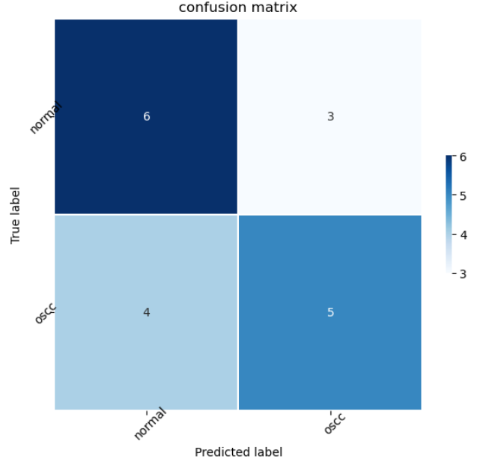
Implementation
Test
Oral cancer : 10 shot images

Slide 16
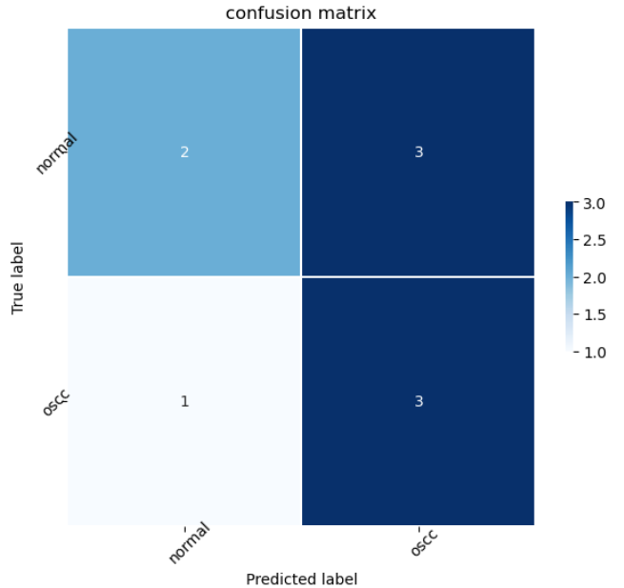
Implementation
Test
Oral cancer : 5 shot images

Slide 17
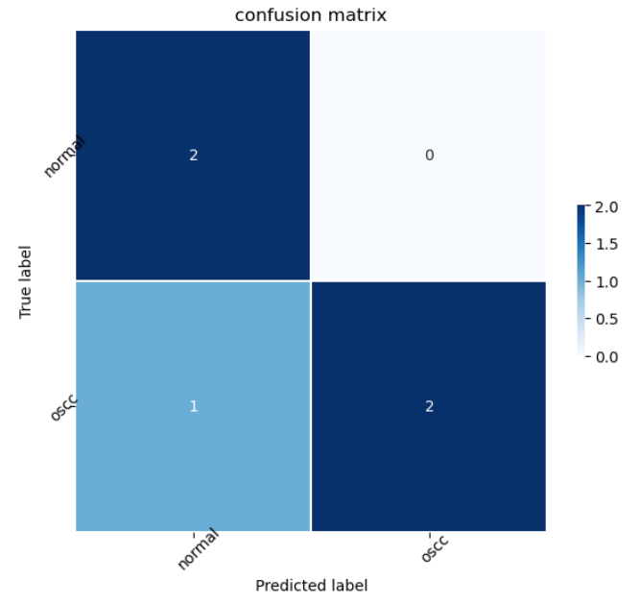
Implementation
Test
Oral cancer : 3 shot images

Slide 18
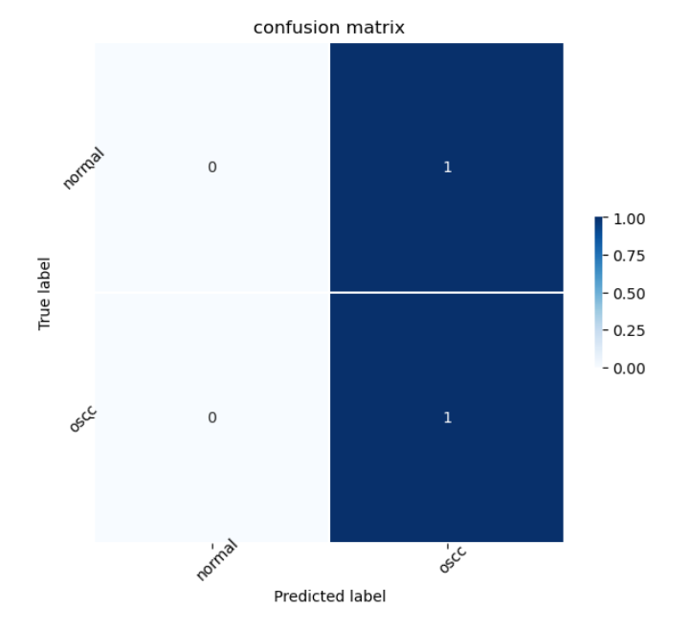
Implementation
Test
Oral cancer : 1 shot image

Slide 19
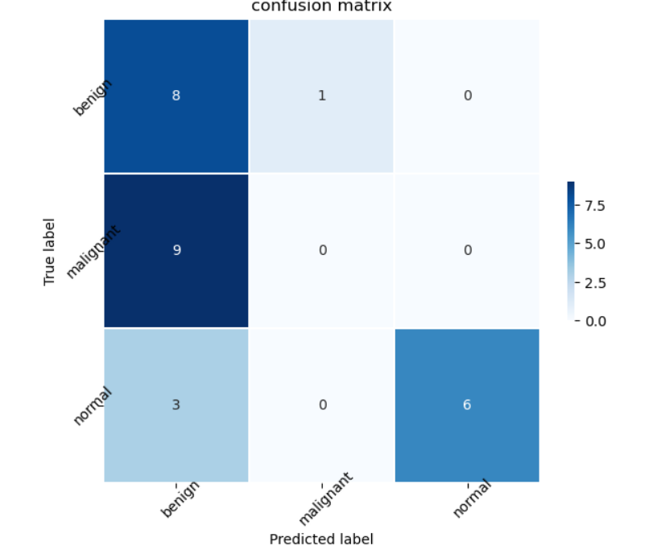
Implementation
Test
Breast cancer : 10 shot images

Slide 20
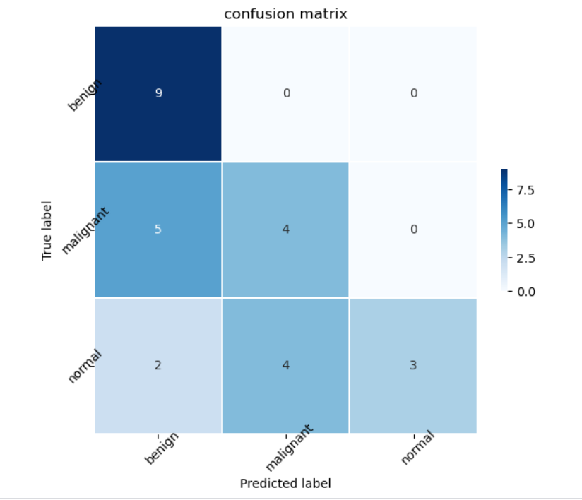
Implementation
Breast cancer : 5 shot images

Slide 21
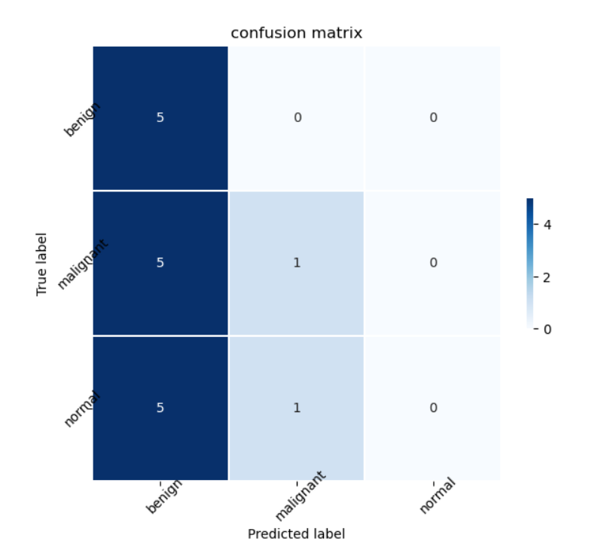
Implementation
Breast cancer : 3 shot images

Slide 22
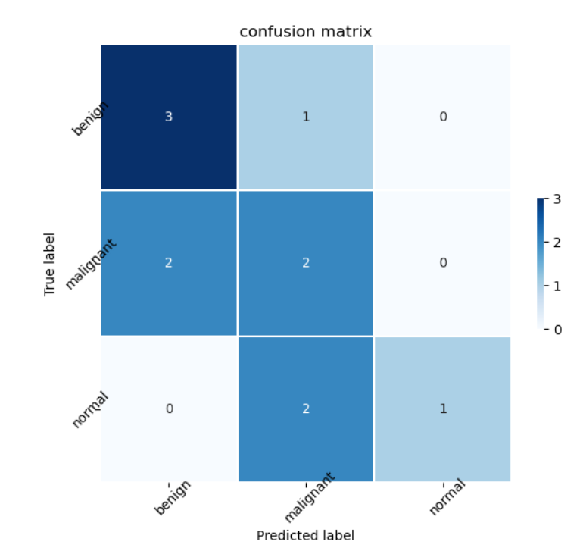
Implementation
Breast cancer : 1 shot images

Slide 23
References
[,1] Chiesa-Estomba C, M, Graña M, Medela A, Sistiaga-Suarez J, A, Lechien J, R, Calvo-Henriquez C, Mayo-Yanez M, Vaira L, A, Grammatica A, Cammaroto G, Ayad T, Fagan J, J: Machine Learning Algorithms as a Computer-Assisted Decision Tool for Oral Cancer Prognosis and Management Decisions: A Systematic Review. ORL 2022;84:278-288. doi: 10.1159/000520672
[2] K. Wada and B. Chakraborty, "Performance Study of Image Data Augmentation by Generative Adversarial Networks," 2021 IEEE 12th Annual Information Technology, Electronics and Mobile Communication Conference (IEMCON), Vancouver, BC, Canada, 2021, pp. 1022-1026, doi: 10.1109/IEMCON53756.2021.9623117.
[3] Gheshlaghi SH, Nok Enoch Kan C, Ye DH. Breast Cancer Histopathological Image Classification with Adversarial Image Synthesis. Annu Int Conf IEEE Eng Med Biol Soc. 2021 Nov;2021:3387-3390. doi: 10.1109/EMBC46164.2021.9630678. PMID: 34891966.
[4] J. Nalepa, M. Myller and M. Kawulok, "Training- and Test-Time Data Augmentation for Hyperspectral Image Segmentation," in IEEE Geoscience and Remote Sensing Letters, vol. 17, no. 2, pp. 292-296, Feb. 2020, doi: 10.1109/LGRS.2019.2921011.
[5] Gardezi SJS, Elazab A, Lei B, Wang T. Breast Cancer Detection and Diagnosis Using Mammographic Data: Systematic Review. J Med Internet Res. 2019 Jul 26;21(7):e14464. doi: 10.2196/14464. PMID: 31350843; PMCID: PMC6688437.

Slide 24


