Slide 1

Study on Approaches for Meta Learning
Team O7
Team Members
Name USN
Shreeya Goggi 01FE19BCS045
Sahana Bhasme 01FE19BCS072
Sneha Kashetti 01FE19BCS112
Guide : Dr. Shantala Giraddi.

Slide 2
PROBLEM STATEMENT
A systematic study on various approaches for meta learning.
We apply meta learning methods to address small dataset problem which is the common problem encountered in medical applications.
We apply augmentation techniques to avoid overfitting and increase accuracy on meta learning algorithms.

Slide 3
MOTIVATION
A good machine learning model often requires training with a large number of samples however it is not the case in medical domain. Most often datasets are small the accuracy obtained by training with smaller datasets is not good. This is what meta learning aims to solve.
People who know how to ride a bike are likely to discover the way to ride a motorcycle fast with little or even no demonstration. Is it possible to design a machine learning model with similar properties

Slide 4
OBJECTIVES
To study novel image augmentation methods and apply them on oral cancer and breast cancer images .
To study ensemble meta learning techniques and apply them on oral cancer and breast cancer.
To compare performance of augmentation with ensemble method.

Slide 5
SCOPE
Meta learning techniques can be used when dataset is limited.
Augmentation techniques can be used in other meta learning approaches.
Meta learning techniques can be used to reduce Generalization error.

Slide 6
LITERATURE SURVEY Paper 1
Name of the paper:Convolutional Neural Network Design for Breast Cancer Medical Image Classification.
Author :Yongbin Yu; Ekong Favour; Pinaki Mazumder
Year of Publication : 2020.
Implications : Aims at employing image classification and medical image segmentation based on deep learning to detect medical issues on time. In this paper, a 15-layer CNN model is designed to classify and recognize medical images; especially, breast cancer cells, by using relevant CNN classification techniques.
Results : The accuracy obtained is about 98.50.

Slide 7
Paper 2
Name of the paper : Melanoma Skin Cancer Detection using CNN AlexNet Architecture.
Author :Shikha Rai A, Joswin Mark Monteiro, Namitha, Valentina Laira Veigas.
Year of Publication : 2020.
Implications :The authors paper proposes a convolutional neural network model using AlexNet architecture that classifies the skin lesion images into melanoma and non-melanoma skin cancers..
Results : The accuracy achieved was about 70.

Slide 8
Paper 3
Name of the paper : A review of medical image data augmentation techniques for deep learning applications
Author :Phillip Chlap, Hang Min, Nym Vandenberg, Jason Dowling, Lois Holloway, Annette Haworth
Year of Publication : 2021.
Implications : To address limited dataset problem, Data augmentation uses images in the training set and applies modifications to these cases to generate further representative samples which simulate changes in acquisition and anatomical variation of patients.
Results : Data augmentation techniques can help to generalise the model.

Slide 9
Paper 4
Name of the paper : Automatic Diagnosis of Early-Stage Oral Cancer and Precancerous Lesions from ALA-PDD Images Using GAN and CNN
Author : Taro Fujimoto, Eiji Fukuzawa, Seiko Tatehara, Kazuhito Satomura
Year of Publication : 2022.
Implications : This paper proposes a method for automatically classifying oral cancer severity stages into three classes: Normal, Low-Risk, High-Risk. Here they augment a small image dataset by training GAN (Generative adversarial networks) with Differentiable Augmentation, and then train CNN for the classification by the augmented dataset.
Results : The accuracy achieved was about 89.2.

Slide 10
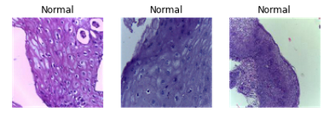
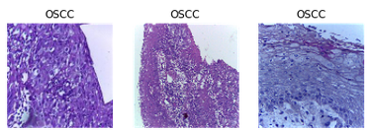
Dataset
1. OSCC image dataset
Contains two classes: Normal, OSCC
Total images : 5192
Normal : 2494
OSCC: 2698

Slide 11
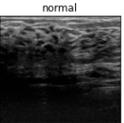
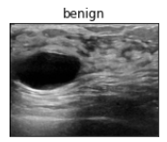
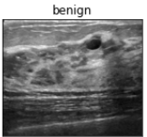
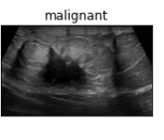
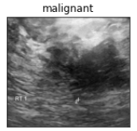
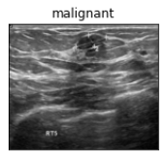
Dataset
2. Breast ultrasound images dataset
Contains two classes Normal, Benign, Malignant
Total images :1578
Normal : 266
Benign: 891
Malignant: 421

Slide 12
References
[1] Chiesa-Estomba C, M, Graña M, Medela A, Sistiaga-Suarez J, A, Lechien J, R, Calvo-Henriquez C, Mayo-Yanez M, Vaira L, A, Grammatica A, Cammaroto G, Ayad T, Fagan J, J: Machine Learning Algorithms as a Computer-Assisted Decision Tool for Oral Cancer Prognosis and Management Decisions: A Systematic Review. ORL 2022;84:278-288. doi: 10.1159/000520672
[2] K. Wada and B. Chakraborty, "Performance Study of Image Data Augmentation by Generative Adversarial Networks," 2021 IEEE 12th Annual Information Technology, Electronics and Mobile Communication Conference (IEMCON), Vancouver, BC, Canada, 2021, pp. 1022-1026, doi: 10.1109/IEMCON53756.2021.9623117.
[3] Gheshlaghi SH, Nok Enoch Kan C, Ye DH. Breast Cancer Histopathological Image Classification with Adversarial Image Synthesis. Annu Int Conf IEEE Eng Med Biol Soc. 2021 Nov;2021:3387-3390. doi: 10.1109/EMBC46164.2021.9630678. PMID: 34891966.
[4] J. Nalepa, M. Myller and M. Kawulok, "Training- and Test-Time Data Augmentation for Hyperspectral Image Segmentation," in IEEE Geoscience and Remote Sensing Letters, vol. 17, no. 2, pp. 292-296, Feb. 2020, doi: 10.1109/LGRS.2019.2921011.
[5] Gardezi SJS, Elazab A, Lei B, Wang T. Breast Cancer Detection and Diagnosis Using Mammographic Data: Systematic Review. J Med Internet Res. 2019 Jul 26;21(7):e14464. doi: 10.2196/14464. PMID: 31350843; PMCID: PMC6688437.

Slide 13
Thank You!

