Slide 1
THINKAI 26 | NIGERIA | IMAGINE CUP MVP
SafeNaija
Protects students and small businesses on WhatsApp, email, and GitHub — explaining scams in plain English and Pidgin before money or secrets are lost.
Hackathon pitch | about 8 minutes | 14 slides
Notes:
Open with the one-line pitch. We sit on chats people already use.

Slide 2
OPENING HOOK
A WhatsApp bank agent emptied her account
• A Plateau woman complained about ALAT by Wema on X.
• A WhatsApp number then claimed to be bank customer care.
• She opened a lookalike login link. N102,000 left her account.
• Source: Foundation for Investigative Journalism (FIJ), 20 Feb 2025.
SafeNaija | ThinkAI 26 | Nigeria
2 / 14
Notes:
https://fij.ng/article/alat-by-wema-fraudster-steals-plateau-womans-n102000/

Slide 3
THE PROBLEM IN NIGERIA
Fraud is rising on channels people trust
N52.3bn
+45%
lost to bank fraud in 2024 (Punch citing NIBSS / FITC, Jul 2025)
attempted fraud in 2023; mobile and online most hit (Premium Times / NIBSS, Oct 2025)
SIM swap
47 apps
Katsina police arrested a 4-person SIM-swap syndicate, Jan 2025 (Vanguard / NAN)
unregistered loan apps delisted by May 2024; many moved to APK links (Nairametrics)
SafeNaija | ThinkAI 26 | Nigeria
3 / 14
Notes:
Cite every number on slide.

Slide 4
REAL CASES
Two more documented stories
SIM-swap syndicate — Katsina
Police arrested four suspects who swapped SIMs to drain bank accounts.
Recovered: 32 SIM cards, phones, victim data.
Source: Vanguard / NAN, 16 Jan 2025.
Forced loan via digital lender app
Ijeoma asked for N100,000; the app disbursed N1 million.
She was told to repay N1.118m within three days.
Source: Nairametrics, 14 Feb 2025.
SafeNaija | ThinkAI 26 | Nigeria
4 / 14
Notes:
Vanguard Jan 2025; Nairametrics Feb 2025

Slide 5
WHO IS AFFECTED
Students and small businesses first
Students and campus founders
Live on WhatsApp and Instagram.
Ship school and startup code to public GitHub.
GitGuardian: 23.8M new secrets on public GitHub in 2024 (+25% YoY).
Small businesses
Sell and collect payments on WhatsApp.
No security team; refunds are often slow.
Premium Times (2025): SIM-swap losses often hard to recover.
SafeNaija | ThinkAI 26 | Nigeria
5 / 14

Slide 6
WHAT ALREADY EXISTS
Useful tools — still a gap for Nigerian chat
• Norton Genie: paste check for scams — not Nigeria/Pidgin-first
• WhatsApp / Meta alerts: some warnings — not a full OTP/BVN coach
• Airtel Spam Alert: network SMS/call spam — not WhatsApp body text
• Prembly FraudLens / Reporta: mostly institutional fraud intel
• GitHub secret scanning: great for repos — not WhatsApp OTP scams
• Gap we fill: one local decision layer across WhatsApp + email + GitHub, in Pidgin
SafeNaija | ThinkAI 26 | Nigeria
6 / 14

Slide 7
OUR SOLUTION
One decision everywhere
SAFE
CAREFUL
DANGER
Looks okay — still verify big payments
+ plain-language next step
Warning + why + what to check
+ plain-language next step
Stop. Do not send OTP or money
+ plain-language next step
SafeNaija | ThinkAI 26 | Nigeria
7 / 14

Slide 8
FEATURES
What SafeNaija does
• WhatsApp scanner — ALLOW / WARN / BLOCK in English and Pidgin (Hausa, Yoruba, Igbo too)
• Email / paste checker — subject, body, links (Gmail App Password connect works)
• Link and fake loan-app / APK checker — visits the live website
• OTP and bank-impersonation phrase pack (OTP, BVN, NIN, share bank details)
• GitHub repo scanner — keys, .env, bad-code picture
• Student Risk Passport — score + top 3 fixes
• Phone chat demo (WhatsApp + Instagram) like NABD
SafeNaija | ThinkAI 26 | Nigeria
8 / 14

Slide 9
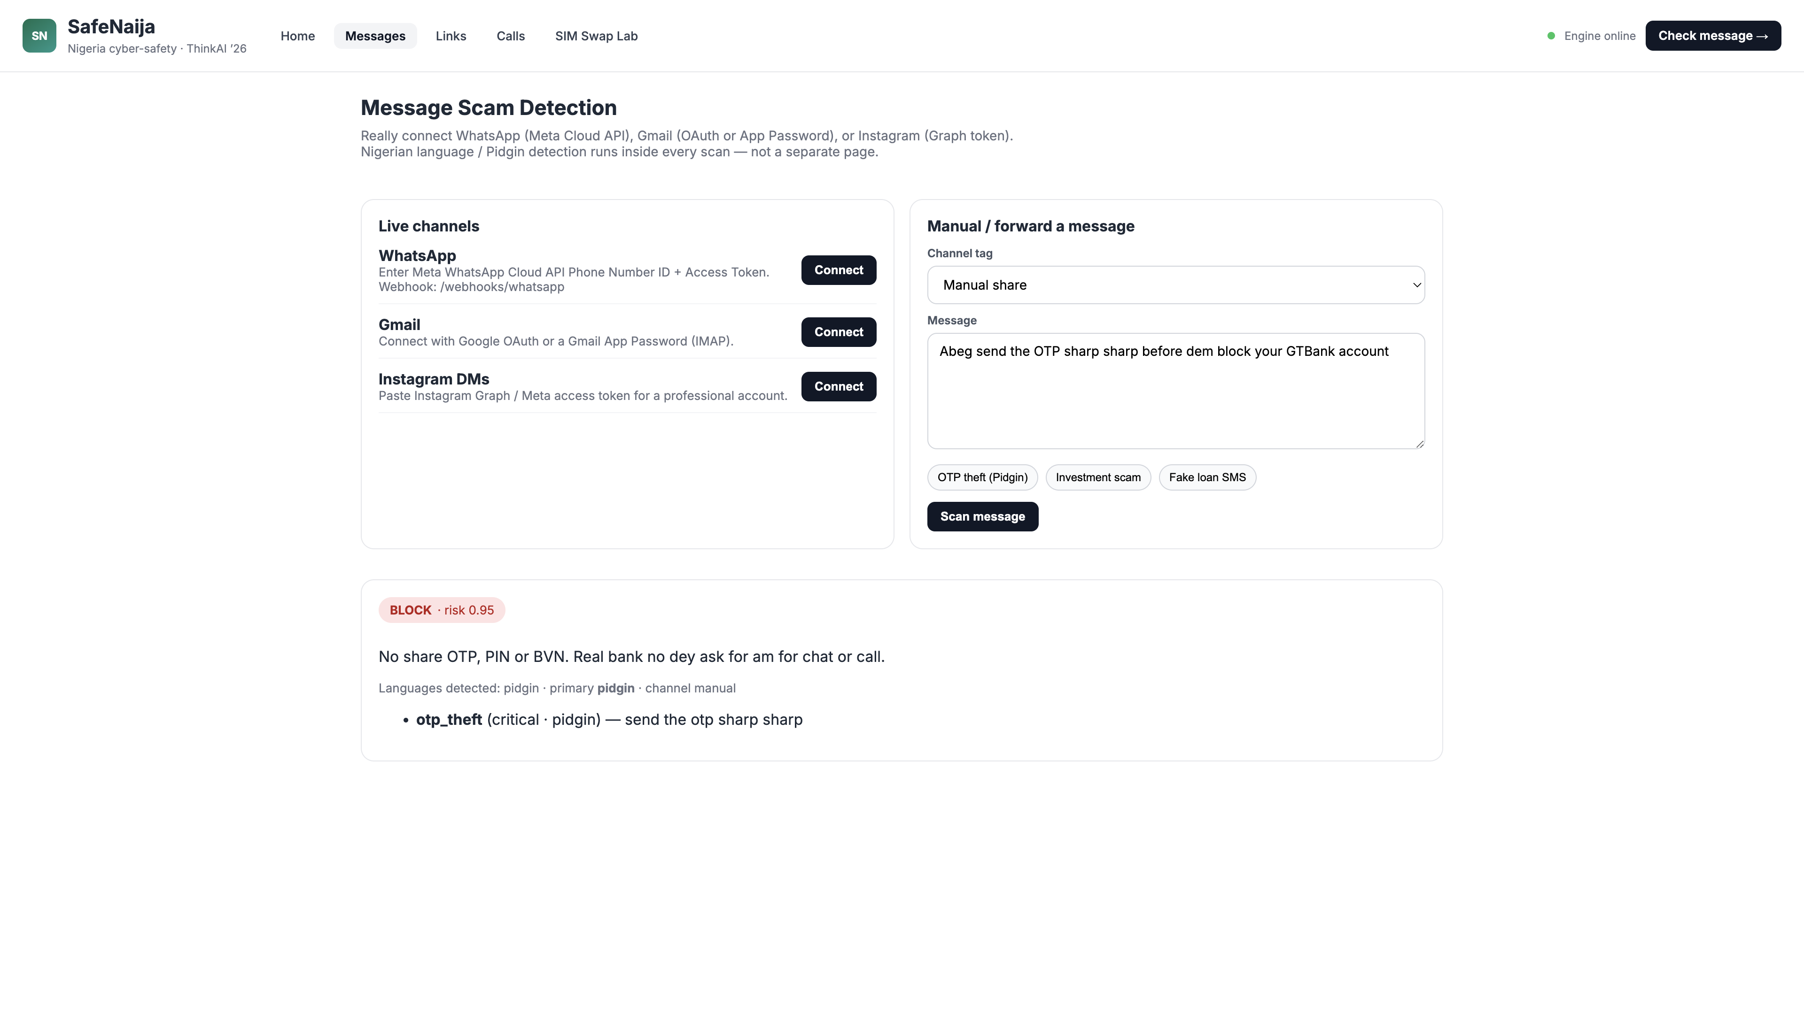
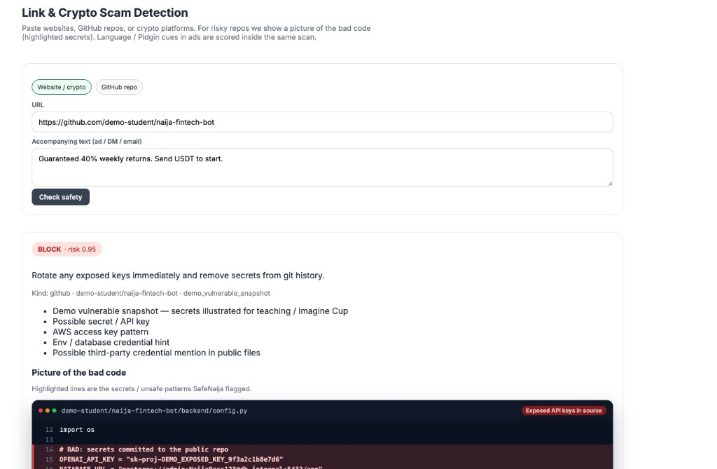
DEMO
Three screens judges should see
1. WhatsApp BLOCK
2. GitHub critical findings
3. Live path
/chat-demo — Hausa OTP in phone
/messages — Scan Gmail inbox
/links — visit website + GitHub
SafeNaija | ThinkAI 26 | Nigeria
9 / 14

Slide 10
HOW WE MEASURE IT
Internal Nigerian-style phrase benchmark
44+
100%
0 / 20
7 / 44
scam phrases across EN, Pidgin, Hausa, Yoruba, Igbo
scam set flagged (BLOCK or WARN)
false BLOCKs on benign campus texts
caught by a naive English keyword baseline
SafeNaija | ThinkAI 26 | Nigeria
10 / 14
Notes:
Honest: phrase-pack regression set, not a national dataset.

Slide 11
LIMITATIONS
What can still go wrong
• Attackers change wording faster than any fixed list.
• Hausa / Yoruba / Igbo coverage is smaller than Pidgin and English today.
• Scanning messages needs clear user permission.
• Website visits can fail on blockers; we still score URL + pasted text.
• We do not replace banks, telcos, or the police.
SafeNaija | ThinkAI 26 | Nigeria
11 / 14

Slide 12
ROADMAP
Next steps
• Now: campus demo + Gmail / WhatsApp chat lab
• Q1: pilot with student founders and one SMB WhatsApp Business line
• Q2: live SEC.gov.ng verification hook + wider language packs
• Later: offline mobile pack for low-connectivity users
SafeNaija | ThinkAI 26 | Nigeria
12 / 14

Slide 13
Closing ask
Mentor us on a campus pilot, and help us put SafeNaija in front of students before the next OTP scam lands.
SafeNaija | ThinkAI 26 | open SafeNaija_diagrams.md for Mermaid charts
Notes:
Offer live chat demo.

Slide 14
SOURCES
Cited on this deck
• Punch, 2 Jul 2025 — N52.3bn bank fraud 2024 (NIBSS / FITC)
• Premium Times, 22 Oct 2025 — NIBSS attempted fraud +45% in 2023
• Vanguard / NAN, 16 Jan 2025 — Katsina SIM-swap arrests
• FIJ, 20 Feb 2025 — ALAT WhatsApp phishing, N102,000 loss
• Nairametrics, 12 Jun 2024 and 14 Feb 2025 — loan apps / APK / Ijeoma case
• GitGuardian Secrets Sprawl 2025 — 23.8M new GitHub secrets in 2024
SafeNaija | ThinkAI 26 | Nigeria
14 / 14

