Slide 1
THINKAI ’26 · NIGERIA · CYBERSECURITY
SafeNaija
Prototype live: WhatsApp · Gmail · links · GitHub → Safe / Careful / Danger
in English + Pidgin (and Hausa / Yoruba / Igbo packs).
Customers → students & SMBs · Market strategy → campus then WhatsApp commerce · Twist: Norton Genie standalone
Demo video (Google Drive) →
https://drive.google.com/drive/folders/1D3imdRD2F6wBZ5q_iGs_-SKUMQxebVHh?usp=sharing
GitHub repo →
https://github.com/Shreeya1-pixel/SafeNajia.git
Notes:
Open with demo promise; click Drive + GitHub links. Cite FIJ / Punch / Vanguard on problem slides.

Slide 2
ASSIGNED BRIEF
Nigeria × Cybersecurity — trust where people already chat
Country
Domain
Customers
Twist
Nigeria
Mobile-first · WhatsApp commerce · digital payments
Cybersecurity
Consumer trust layer — not a bank SOC
Students & SMBs
No security team · OTP / BVN / NIN risk
Norton Genie failed
Global paste-bot · weak localisation
SafeNaija · ThinkAI ’26 · Nigeria · Cybersecurity · M8 palette
2 / 18

Slide 3
THE PROBLEM
Social engineering still wins on chat
₦25.85bn
₦250bn+
WhatsApp
SIM-swap
digital-payment fraud losses 2025
(NIBSS / Punch)
yearly cybercrime estimate
(NITDA / Guardian)
fake bank-care OTP theft
(FIJ Feb 2025)
syndicates drain accounts
(Vanguard Jan 2025)
Open source →
Open source →
Open source →
Open source →
Banks catch cards. Victims still hand OTPs on WhatsApp / SMS / Instagram — especially in Pidgin and local languages global tools miss. Full link list on News Sources slide.
SafeNaija · ThinkAI ’26 · Nigeria · Cybersecurity · M8 palette
3 / 18

Slide 4
WHO WE SERVE
Customers — clear segments
Customer
Pain today
How they buy
What they need
University students
OTP / loan-app / GitHub secret scams
Free campus plan
Pidgin chat check + GitHub passport
WhatsApp SMBs
Fake buyer / payment proof / phishing links
₦ low monthly SaaS
Fast Safe/Careful/Danger on chat
Campus clubs / NGOs
Awareness with no SOC budget
Pilot / grant pack
Demo lab + case library
Later: banks / telcos
Need consumer education layer
B2B API / white-label
NDPA-safe local language packs
Beachhead = students + WhatsApp SMBs (no security team). Upsell path = campus licence → SMB SaaS → bank/telco API.
SafeNaija · ThinkAI ’26 · Nigeria · Cybersecurity · M8 palette
4 / 18

Slide 5
MARKET PITCH — WHY PEOPLE BUY
Real stories → real willingness to pay
Student / consumer
Plateau woman lost ₦102,000 after a fake ALAT/Wema WhatsApp ‘care’ link asked for login / OTP.
Buys: chat check that says DANGER before OTP is shared.
FIJ →
Anyone with a SIM + bank app
Katsina SIM-swap ring arrested; 32 SIMs used to drain accounts — refunds are slow/hard.
Buys: SIM-swap risk cues + ‘don’t trust SMS OTP alone’ advice.
Vanguard →
SMB / investor-curious user
CBEX promised extreme short-term returns then collapsed; SEC said it was never registered.
Buys: link/crypto scan + SEC verify cue before depositing.
TechCabal →
WhatsApp-heavy users
NCC-CSIRT warned on ‘free data & airtime’ phishing that spreads via WhatsApp shares.
Buys: paste/forward check before tapping promo links.
NCC-CSIRT →
SafeNaija · ThinkAI ’26 · Nigeria · Cybersecurity · M8 palette
5 / 18
Notes:
Judges check research: each buyer motivation maps to a published Nigerian story with a live URL.

Slide 6
MARKET STRATEGY
How we win customers (GTM)
1. Seed
2. Prove
3. Monetise
4. Scale
Campus ambassadors
Demo Chat + GitHub
in 2–3 universities
Measure blocked OTP
attempts & false alarms
Case Library stories
SMB WhatsApp plan
₦2–5k / month starter
Inbox scan add-on
SEC / CBN advice hooks
White-label for fintech
NCC-CSIRT report path
Nigeria cybersecurity market ≈ USD 230m (2025) → USD 415m (2031, ~10% CAGR). We take the empty consumer/SMB trust layer — not enterprise SIEM.
SafeNaija · ThinkAI ’26 · Nigeria · Cybersecurity · M8 palette
6 / 18

Slide 7
GO-TO-MARKET FLOWCHART
From first user → revenue
Awareness
Campus demo day
Activation
Chat Demo BLOCK
Retention
Weekly scam digest
Revenue
SMB SaaS / API
Feedback → phrase packs
+ Case Library
Partner channel
Clubs · NGOs · fintech
Compliance path
NDPA · EFCC advice
Strategy: prove trust on campus → sell to WhatsApp SMBs → license language packs to larger platforms.
SafeNaija · ThinkAI ’26 · Nigeria · Cybersecurity · M8 palette
7 / 18

Slide 8
SOLUTION
One decision everywhere: Safe / Careful / Danger
SAFE
CAREFUL
DANGER
Looks okay
Still verify big payments
Warning + why
What to check next
Stop now
No OTP · no transfer
SafeNaija · ThinkAI ’26 · Nigeria · Cybersecurity · M8 palette
8 / 18

Slide 9
HOW IT WORKS
Scan engine flowchart
WhatsApp
Gmail
Link / crypto
GitHub
Phrase packs (EN · Pidgin · Hausa · Yoruba · Igbo) + link visit / SEC + secret patterns
Risk score → SAFE / CAREFUL / DANGER
Plain advice (EN + Pidgin) · Trust Chain · next step (call bank / don’t send OTP)
SafeNaija · ThinkAI ’26 · Nigeria · Cybersecurity · M8 palette
9 / 18

Slide 10
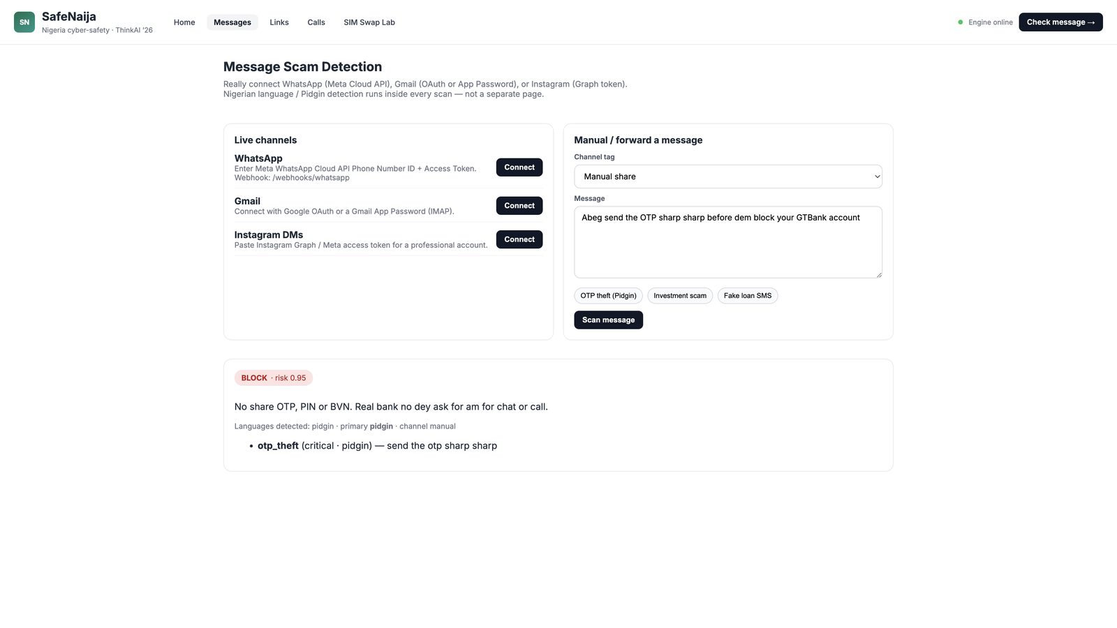
PROTOTYPE — LIVE UI
Messages: Pidgin OTP scam → BLOCK
What judges see
• Real channel connect (WhatsApp / Gmail / IG)
• Paste Pidgin OTP sample
• Decision: BLOCK · 0.95
• Advice in Pidgin: no share OTP / PIN / BVN
• Finding: otp_theft · pidgin
URL: http://127.0.0.1:5174/messages
SafeNaija · ThinkAI ’26 · Nigeria · Cybersecurity · M8 palette
10 / 18

Slide 11
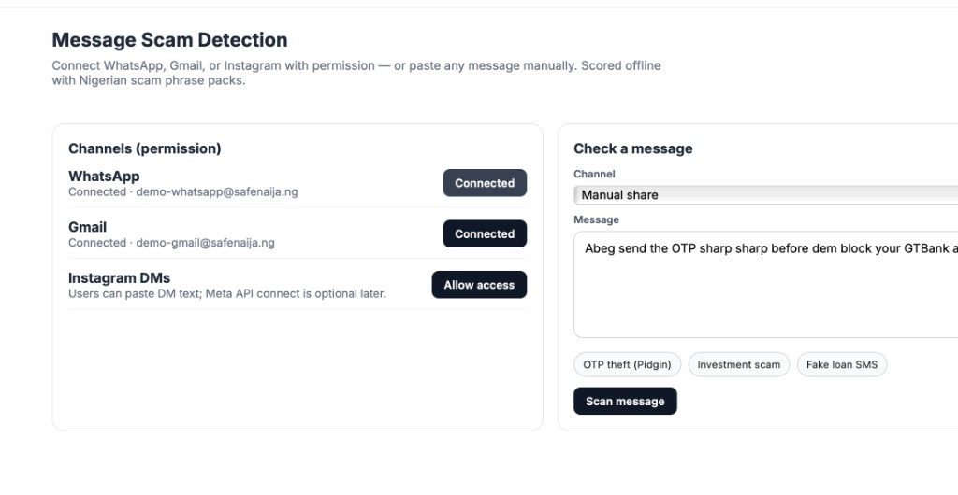
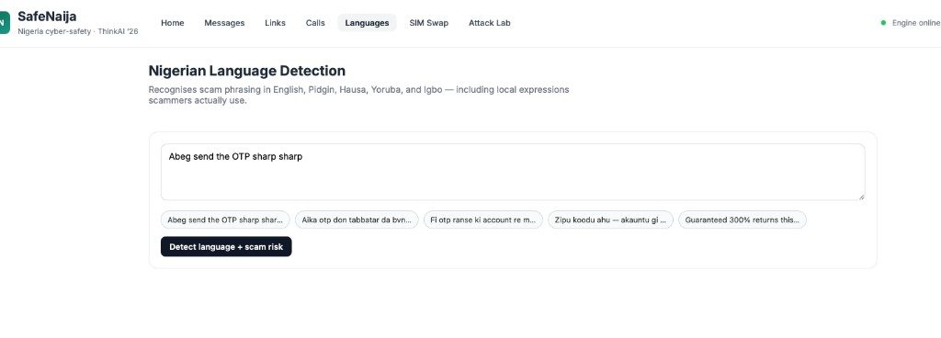
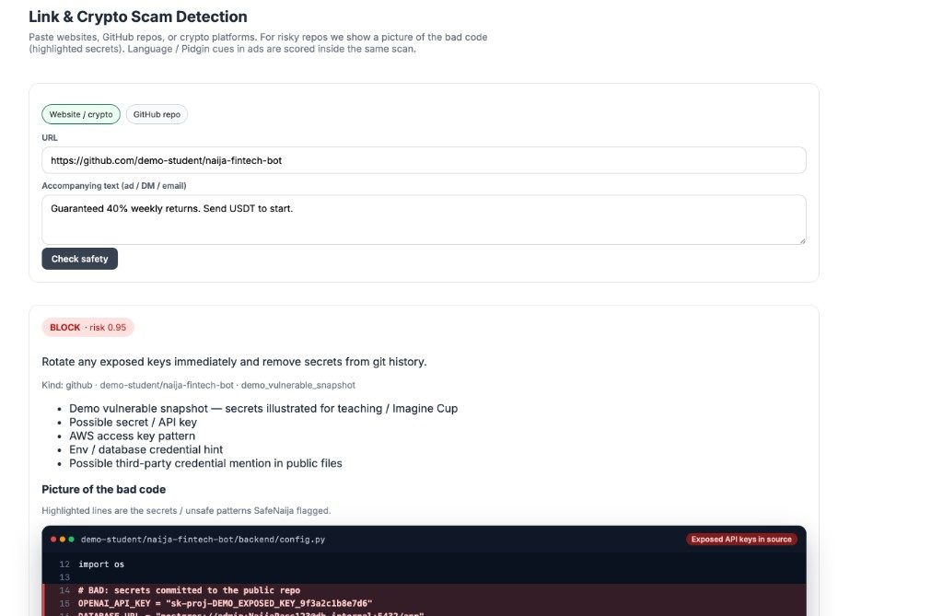
PROTOTYPE — MORE SCREENS
Connect channels · language packs · GitHub bad-code picture
Connect WhatsApp / Gmail
EN · Pidgin · Hausa · Yoruba · Igbo
GitHub secrets → BLOCK + code frame
SafeNaija · ThinkAI ’26 · Nigeria · Cybersecurity · M8 palette
11 / 18

Slide 12
WHY US
Clear comparison table
Need in Nigeria
Norton Genie standalone
SafeNaija
Local languages
English-centric
EN + Pidgin + Hausa/Yoruba/Igbo
Where scam happens
Paste-only app
WhatsApp · Gmail · IG · links
Student builders
Not covered
GitHub Risk Passport + bad-code pic
Regulator cues
Generic
SEC demo pack · bank helpline advice
Business model
Free → paywall / pulled
Campus free → SMB SaaS → API
Privacy (NDPA)
Cloud paste unclear
Offline packs · permissioned inbox
SafeNaija · ThinkAI ’26 · Nigeria · Cybersecurity · M8 palette
12 / 18

Slide 13
FEASIBILITY
Fits Nigeria’s rules & systems
NDPA 2023
Minimise data · local scan · user permission for inbox
Cybercrimes Act
Advise report paths (EFCC / police / NCC-CSIRT)
CBN / NIBSS
Align with NeFF fraud trends (SIM-swap, social eng.)
SEC Nigeria
Warn on unregistered investment / crypto pitches
SafeNaija · ThinkAI ’26 · Nigeria · Cybersecurity · M8 palette
13 / 18

Slide 14
FUTURE STEPS
Clear roadmap — what we do next
Now (MVP)
+90 days
+6 months
+12 months
• Chat Demo + Messages live
• Gmail App Password connect
• GitHub bad-code frames
• Phrase packs EN/Pidgin + NG langs
• Campus pilot 2–3 unis
• WhatsApp Cloud production
• Measure blocked OTP shares
• Ambassador playbook
• SMB WhatsApp SaaS trial
• Live SEC registry hook
• Expand Hausa/Yoruba/Igbo
• Offline mobile pack
• Bank/telco API talks
• White-label language packs
• NCC-CSIRT report assist
• West Africa localisation
SafeNaija · ThinkAI ’26 · Nigeria · Cybersecurity · M8 palette
14 / 18

Slide 15
FUTURE STEPS FLOWCHART
Build → pilot → product → partners
Build
MVP demo
Pilot
Campuses
Product
SMB SaaS
Partners
Bank / telco API
Success metrics we track
1) % of OTP scam samples correctly BLOCKED 2) False BLOCK rate on clean chat 3) Campus weekly active users
4) SMB paid conversions after 30-day trial 5) Time-to-advice < 2 seconds on offline packs
SafeNaija · ThinkAI ’26 · Nigeria · Cybersecurity · M8 palette
15 / 18

Slide 16
EVIDENCE
What the prototype already proves
Capability
Status
Demo proof
Pidgin / local OTP detection
Working
Messages → BLOCK 0.95 on GTBank OTP sample
Gmail inbox scan
Working
App Password connect · HDFC phishing BLOCK
GitHub secret picture
Working
demo-student repo → highlighted keys
Chat Demo (WA / IG)
Working
Hausa / Yoruba / Igbo / Pidgin scenarios
Link / website visit
Working
Live fetch + SEC demo cues
SafeNaija · ThinkAI ’26 · Nigeria · Cybersecurity · M8 palette
16 / 18

Slide 17
LINKS JUDGES WILL CHECK
Demo · GitHub · news sources (all clickable)
Demo video (Google Drive) →
drive.google.com/…/1D3imdRD2F6wBZ5q_iGs_-SKUMQxebVHh
GitHub — Shreeya1-pixel/SafeNajia →
https://github.com/Shreeya1-pixel/SafeNajia.git
FIJ — ALAT/Wema WhatsApp theft ₦102k (20 Feb 2025)
Nairametrics — loan apps / shady practices concerns (14 Feb 2025)
Vanguard / NAN — Katsina SIM-swap syndicate arrests (16 Jan 2025)
NCC-CSIRT — “free data & airtime” WhatsApp phishing advisory
Punch — digital-payment fraud losses ₦25.85bn / −51% (NeFF 2026 data)
NCC-CSIRT — rogue cellular / SMS banking fraud advisory
Punch — protecting bank apps from hackers (fraud context)
SEC Nigeria — verify investment platforms
Premium Times — CBN alerts on fraudulent messages / cyber attempts
CBN — official site / helpline verification
TechCabal — CBEX collapse (15 Apr 2025)
Guardian / NITDA — ~₦250bn yearly cybercrime estimate (Aug 2025)
SafeNaija · ThinkAI ’26 · Nigeria · Cybersecurity · M8 palette
17 / 18
Notes:
Must-open: Demo Drive · GitHub · FIJ ₦102k · Vanguard SIM-swap · Punch ₦25.85bn · TechCabal CBEX · NCC-CSIRT · sec.gov.ng

Slide 18
CLOSING ASK
Mentor a campus pilot so SafeNaija reaches
students before the next OTP scam.
Customers: students & WhatsApp SMBs first.
Strategy: campus proof → SMB SaaS → bank/telco API.
Why they buy: real FIJ / Vanguard / CBEX / NCC-CSIRT losses — not theory.
Demo video →
https://drive.google.com/drive/folders/1D3imdRD2F6wBZ5q_iGs_-SKUMQxebVHh?usp=sharing
GitHub →
https://github.com/Shreeya1-pixel/SafeNajia.git
Q&A · Case Library · News + project links (slide 17)
Notes:
End on ask + open Demo Drive / GitHub / FIJ if challenged.

