Slide 1



COMPUTER NETWORKS PROJECT
Distance Vector
Routing
Router0 | Router1 | Router2 | RIP version 2
How routers learn paths from their neighbours
Cisco Packet Tracer
Notes:
This project shows distance vector routing with RIP version 2 in Cisco Packet Tracer, using three Router-PT routers, three Switch-PT switches and six PCs. The cover image is an illustration of this network with the PC0 to PC4 route highlighted; the Packet Tracer screenshot is on the next slide.

Slide 2
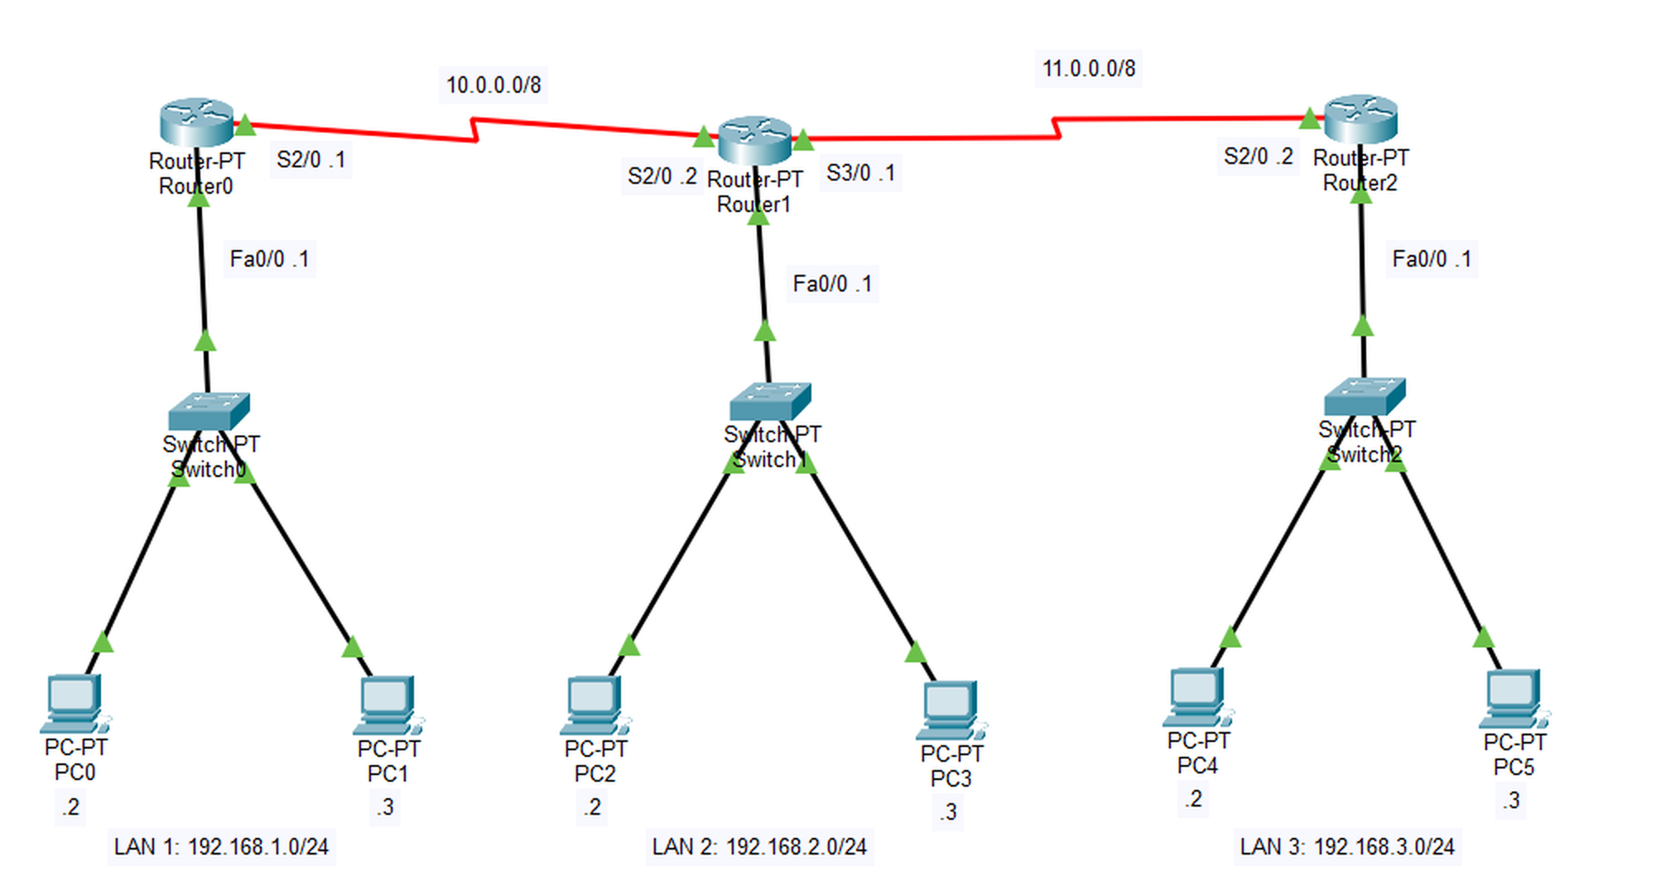
Project topology
3 routers · 3 switches · 6 PCs · RIP version 2
02
Notes:
LAN 1 is 192.168.1.0/24, LAN 2 is 192.168.2.0/24 and LAN 3 is 192.168.3.0/24. Each gateway ends in .1 and the PCs end in .2 and .3. Serial link 10.0.0.0/8 joins Router0 and Router1. Serial link 11.0.0.0/8 joins Router1 and Router2.

Slide 3

How routers learn routes
Example: PC0 pings PC4 on another router
01
Routers start with what they know
02
Neighbours share routes
Each router knows only its directly connected networks.
RIP version 2 sends each router’s table to its neighbours every 30 seconds.
03
Routers keep the lowest hop count
04
Packets follow the learned route
Router0 reaches LAN 3 in 2 hops through Router1.
The ping travels from PC0 through all three routers to PC4.
Bellman-Ford: D(x, y) = min { c(x, v) + D(v, y) }
03
Notes:
Bellman-Ford: a router takes the lowest value of link cost plus the distance its neighbour reports. Router0 reaches LAN 3 at 1 + 1 = 2 hops through Router1. Count-to-infinity is the main risk: routers can keep trusting a stale route. RIP limits it with a maximum of 15 hops (16 means unreachable), split horizon, route poisoning and hold-down timers.

Slide 4
Benefits and results
Why use it
Seen in Packet Tracer
No static routes
Adapts to change
3 RIP routes
Routers learn every network through RIP.
Routes update when a link or network fails.
Learned by Router0
Ping crosses all routers
PC0 to PC4, TTL 125
Simple to configure
Low overhead
LAN 3 is 2 hops away
Each router lists only its own networks.
Needs little CPU and memory on small networks.
[120/2] via 10.0.0.2
on Router0
Limit: RIP allows at most 15 hops and ignores link speed.
04
Notes:
Seen in Packet Tracer: Router0 show ip route lists three R routes, including 192.168.3.0/24 at [120/2] via 10.0.0.2. A ping from PC0 to 192.168.3.2 lost the first packet, then got three replies with TTL 125, which is 128 minus three routers. The first packet is normally lost while ARP resolves. Unlike link-state protocols such as OSPF, RIP converges slowly and does not see the whole network.

Slide 5
Thank you
Questions & discussion
Distance Vector Routing
Computer Networks Project
Notes:
Invite questions about RIP, Bellman-Ford, hop count and count-to-infinity.

