Slide 1



COMPUTER NETWORKS PROJECT
Office
Network
Management | HR | IT | Server Room
VLAN segmentation and shared server services
Cisco Packet Tracer
Notes:
This Computer Networks project simulates a small office with Management, HR, IT and Server VLANs. It uses one Cisco 2911 router, four Cisco 2960 switches, six PCs and one Server-PT. The cover is decorative AI-generated artwork; the actual project appears on slide 3. Source: Four_Department_Office/README.md and the saved Packet Tracer lab.

Slide 2
Group members
Computer Networks
Name | Class | ER No. | Roll No.
Shreeya Bhatt | A4 | 24002171310159 | 150
02
Notes:
Five group members. The presenter will enter each member’s name, class, ER number and roll number in the blank editable table, as requested.

Slide 3
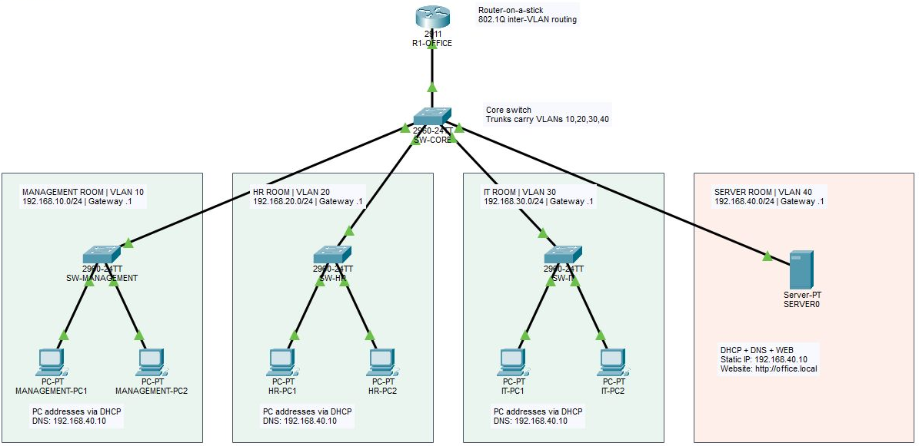
Network topology
1 router · 4 switches · 6 PCs · 1 central server
03
Notes:
Actual project screenshot: Four_Department_Office/Topology_Preview.png. The image is cropped only to remove application chrome and unused space. Management uses VLAN 10 and 192.168.10.0/24; HR uses VLAN 20 and 192.168.20.0/24; IT uses VLAN 30 and 192.168.30.0/24; Server uses VLAN 40 and 192.168.40.0/24. Each VLAN gateway ends in .1. SERVER0 is 192.168.40.10. The core-to-router and switch uplinks are 802.1Q trunks carrying all four VLANs. The server connects to a core access port in VLAN 40.

Slide 4

How the network works
Example: an employee opens http://office.local
01
DHCP supplies network settings
The central server assigns an IP address, gateway and DNS server.
02
DNS finds the office server
The name office.local resolves to 192.168.40.10.
03
The router connects the VLANs
Traffic crosses the core trunk and the matching router subinterfaces.
04
HTTP delivers the intranet page
SERVER0 returns the webpage to the employee’s browser.
802.1Q trunks carry VLANs 10, 20, 30 and 40 over shared uplinks
04
Notes:
At startup, DHCP broadcasts stay inside each VLAN. Router subinterfaces 10, 20 and 30 use ip helper-address 192.168.40.10 to relay those requests to the server. The DHCP ranges are .100–.149 in each client subnet. DNS maps office.local and www.office.local to the server. Router-on-a-stick uses one physical GigabitEthernet0/0 interface with four dot1Q subinterfaces. HTTP then delivers the static demonstration page. Source: Four_Department_Office/configs/R1-OFFICE.txt, README.md, index.html and topology.xml.

Slide 5
Advantages and validation
Why this design helps
Verified in Packet Tracer
Less broadcast traffic
6 DHCP leases
VLANs keep local broadcasts within each department.
Two PCs in each client VLAN
Simpler PC configuration
Central DHCP replaces manual IP address entry.
Website loads by name
Shared office resources
http://office.local
All departments use the same DNS and Web server.
Cross-VLAN tests passed
Easy expansion
Management–Server, HR–IT
and IT–Management
Add PCs to available department switch ports.
Current scope: all VLANs may communicate. ACL restrictions can be added later.
05
Notes:
The final saved lab has two DHCP leases in each of Management, HR and IT. Interactive verification succeeded for Management DHCP renewal, a Management browser opening http://office.local, Management-PC1 to SERVER0 ICMP, HR-PC1 to IT-PC1 ICMP, and IT-PC1 to MANAGEMENT-PC1 ICMP. Initial ARP warm-up packets may fail before a repeated test succeeds. VLANs separate broadcast domains; this lab does not impose department-blocking ACLs. The webpage is static and is not an employee database. Source: Four_Department_Office/Validation_Results.json and README.md.

Slide 6
Thank you
Questions & discussion
Small Office Network
Computer Networks Project
Notes:
Thank the audience and invite questions about VLANs, router-on-a-stick, DHCP relay, DNS, HTTP and connectivity testing. Decorative background generated with the built-in image generation tool.

