Slide 1


Payroll Management System
Submitted By:
Name: Shreeya Samir Bhatt
Roll number: 68
Enrollment Number: 24002171310159
Batch: C3
Branch: CST (Computer Science and Technology)

Slide 2
Project Outline
Introduction
System design diagram
Functionalities
3.1 Class Structure Overview
3.2 Input Validation
3.3 Key Features
3.4 Formatting and User Experience
3.5 Data Handling
4. Merits and Demerits
5. Future Enhancements

Slide 3
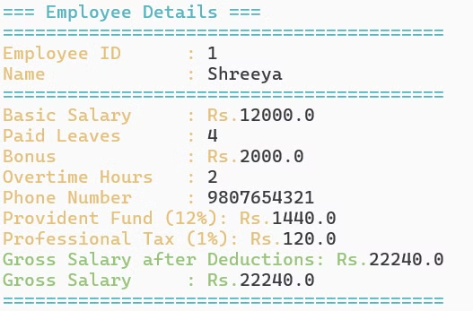
Introduction
The Payroll Management System is a Java-based project that helps manage employee salaries, automate payroll processes, and ensure accurate salary calculations. It follows Object-Oriented Programming (OOP) principles, making it easy to expand and maintain.
This project simplifies payroll tasks by automating salary calculations, tax deductions, employee records, and report generation. The system features a menu-driven interface, allowing users to access different functions easily and efficiently.

Slide 4
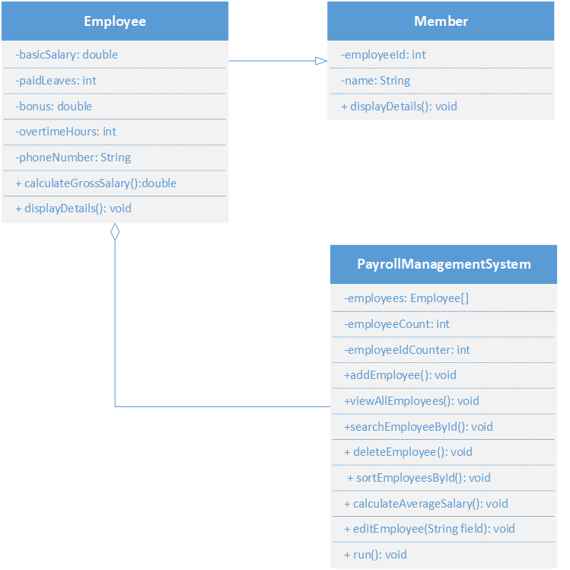
Class Diagram for Payroll Management System

Slide 5
Functionalities
Class Structure Overview
Member Class
Employee Class
PayrollManagementSystem Class
This base class defines fundamental employee attributes such as ID and name. These attributes are inherited by the Employee class.
Extending the Member class, the Employee class adds crucial payroll-related information like basic salary, paid leaves, bonus, overtime hours, and phone number. It also includes methods for calculating gross salary and displaying employee data.
Acting as the core of the system, this class manages all operations related to employees. It provides functionality to add, delete, edit, sort, and search for employees. It also offers an interactive menu for user input and navigation.

Slide 6



Input Validation
Phone Number
Menu Choices
Numerical Values
The program ensures that phone numbers entered by the user are valid. This involves checking that the phone number is 10 digits long and starts with either 6, 7, 8, or 9.
User input for menu options is validated to ensure that the chosen value falls within the allowed range. This prevents errors caused by unexpected or invalid input.
Salary inputs and other numerical values are appropriately parsed to avoid errors and ensure that only valid numbers are processed.

Slide 7
Key Features
1
Employee Details Storage
2
Gross Salary Calculation
Each employee is uniquely identified by an ID, name, basic salary, paid leaves, bonus, overtime hours, and phone number. The program stores this information in an array, accommodating up to 100 employees.
The system determines an employee's gross salary by adding their basic salary, house rent allowance (HRA), dearness allowance (DA), overtime pay, leave allowance, and any bonuses earned. It also includes deductions like provident fund (PF) and professional tax.
3
Menu-Driven Interface
4
Operations Available
Upon execution, the program displays a welcoming message and launches the payroll system. A continuous loop allows users to select options from a displayed menu to perform various operations on employee data.
The user can choose from several options: adding an employee, viewing all employees, searching by ID, editing details, deleting an employee, sorting by ID, calculating average salary, or exiting the system.

Slide 8
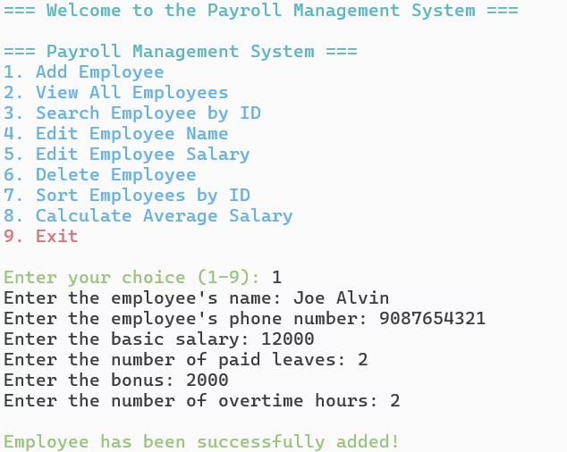


Formatting and User Experience
Color Coding
Section Dividers
ANSI escape codes are employed to enhance readability and provide visual organization to the console output. Different sections, such as the menu and employee details, are highlighted with specific colors.
Section dividers are used to clearly separate different elements of the menu and employee details, making the output more organized and user-friendly.

Slide 9
Data Handling
1
Array-Based Storage
The program uses an array to store employee objects. This limits the number of employees to a maximum of 100. As new employees are added, they are stored sequentially in the array.
2
Dynamic Management
Employee data is managed dynamically. When an employee is deleted, the following entries in the array are shifted to fill the gap, ensuring that the array remains efficient and organized.

Slide 10
Pros | Cons
Object-Oriented Design – Uses inheritance and encapsulation for better code reusability and structure. | Lack of Database Integration – Stores employees in an array, which is not persistent.
Modular Approach – Functions are well-structured (addEmployee (), deleteEmployee(), etc.) for easy maintenance. | Limited Scalability – Fixed-size array (100 employees) restricts dynamic expansion.
Accurate Salary Calculation – Implements HRA, DA, PF, Overtime Pay, and Bonus for gross salary computation. | Limited Security – Lacks authentication or role-based access control.
Complete CRUD Operations – Supports Add, View, Edit, Search, Sort, and Delete functionalities. | No Exception Handling – Does not handle invalid inputs gracefully, leading to potential crashes.
Input Validation – Ensures valid phone numbers and restricts menu input errors. | Tightly Coupled Code – UI (console printing) is mixed with logic, making modifications harder.
Enhanced Readability – Uses ANSI color codes for better console display. | No Multi-User Access – Cannot be accessed by multiple users simultaneously.
Notes:
CRUD : Create, Read, Update, and Delete

Slide 11
Future Enhancements
Database Integration – Incorporate MySQL, MongoDB, or SQLite to ensure reliable and persistent employee data storage.
Graphical User Interface (GUI) – Develop a user-friendly interface using JavaFX or Swing for a more intuitive experience.
Cloud Integration – Store payroll data on cloud services to allow remote access and better data management. It can be done using cloud databases (Firebase, AWS, or Azure) to store payroll data and enable remote access.
Data Security & Encryption – Strengthen security measures by encrypting sensitive information such as salaries and personal details. Declaring sensitive attributes (like salary, phone number, and employee ID) as private prevents direct modification from outside the class, ensuring controlled access.
Web or Mobile Application – Extend the system’s functionality by developing a web or mobile app using Spring Boot.

Slide 12
Thank you!

