Slide 1
TechFootPrint
AI-Driven Coding Analytics &
Academic Performance Intelligence
Vinay Kamble · Shreeya Dhond · Shrejal Bhosale · Aisshwarya Gurav
Dept. of Computer Science & Engineering (AI & ML)
6
Platforms
Integrated
3
User
Roles
AI
Transformer
Recommender
99%
Cluster
Purity

Slide 2




What Colleges Face Today
THE PROBLEM
No Coding Visibility
Manual Tracking Overhead
Faculty see only final submissions. The learning journey — time spent, mistakes, attempts — is completely invisible to them.
Spreadsheets and spot-checks create inconsistent CIE evaluations, massive administrative overhead, and zero scalability.
No Personalized Guidance
Curriculum–Industry Gap
Students get generic practice sheets. Without adaptive paths, individual weaknesses go unaddressed until it's too late.
Slow curriculum updates mean graduates lack the exact DSA and programming skills that companies like Infosys and TCS demand.

Slide 3
TechFootPrint serves
Three Key
Stakeholders
Faculty
College Management
Students

Slide 4




FACULTY BENEFITS
Empowering Faculty with Real Intelligence
Real-Time Cohort Dashboard
📖 REAL SCENARIO
See every student's solve count, streak, difficulty level and topic coverage — live. No more waiting for end-semester reports.
Prof. Sontale opens the dashboard before a CIE.
One-Click CIE Report Generation
8 students flagged at-risk
Auto-generate Continuous Internal Evaluation reports per student from actual coding activity data — saving hours of manual work.
Batch avg: 42 problems solved
At-Risk Student Alerts
Weak topic: Dynamic Programming
Automatic flags when a student has low streak, poor topic coverage, or is falling behind peers — so you can intervene early.
CIE report downloaded in 1 click
Direct Messaging & Discussion
Message students individually or post to discussion forums. Peer collaboration and faculty mentoring in one unified platform.
⏱ Hours of manual work → 1 click

Slide 5




MANAGEMENT BENEFITS
Strategic Insights for HODs, Deans & Administrators
Curriculum Gap Analysis
OBE Compliance Tracking
Identify which DSA topics are consistently weak across batches. Back curriculum review meetings with evidence, not assumptions.
Map coding activity to course outcomes. Generate outcome attainment reports to satisfy NAAC/NBA accreditation requirements automatically.
Data-Driven Decisions
Accreditation Ready
Placement Readiness Index
Batch-vs-Batch Benchmarking
Know exactly how ready each student is for campus interviews at Infosys, TCS, and Wipro — before they walk into the placement office.
Compare performance across batches, sections and semesters. Identify which faculty interventions are working and replicate them.
Industry Aligned
Institutional Intelligence

Slide 6




STUDENT BENEFITS
Personalized Learning Powered by AI
AI-Personalised Problem Suggestions
From
Generic Lists
to a Personal
Learning Path
The Transformer engine suggests the next problem based on their history, skill level and weak topics.
Unified Progress Dashboard
All platforms (LeetCode, Codeforces, GFG) in one view — streaks, topics, difficulty distribution.
Placement Readiness Roadmap
1. Login
Know exactly which topics to focus on to crack Infosys/TCS interviews. AI-generated study plan.
2. AI Analysis
3. Custom Problems
Shareable Public Portfolio
4. Track Progress
One link that shows total problems solved, platforms used, and achievements — for any recruiter.
5. Placement Ready

Slide 7
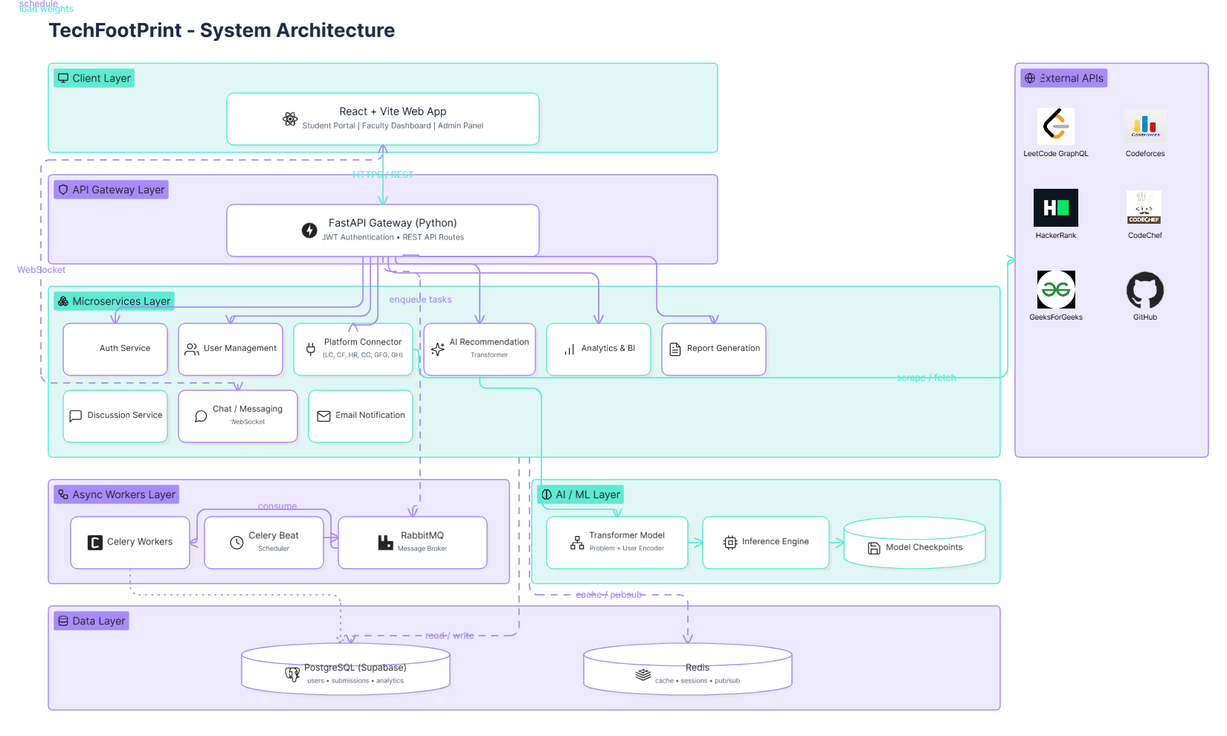
SYSTEM ARCHITECTURE

Slide 8
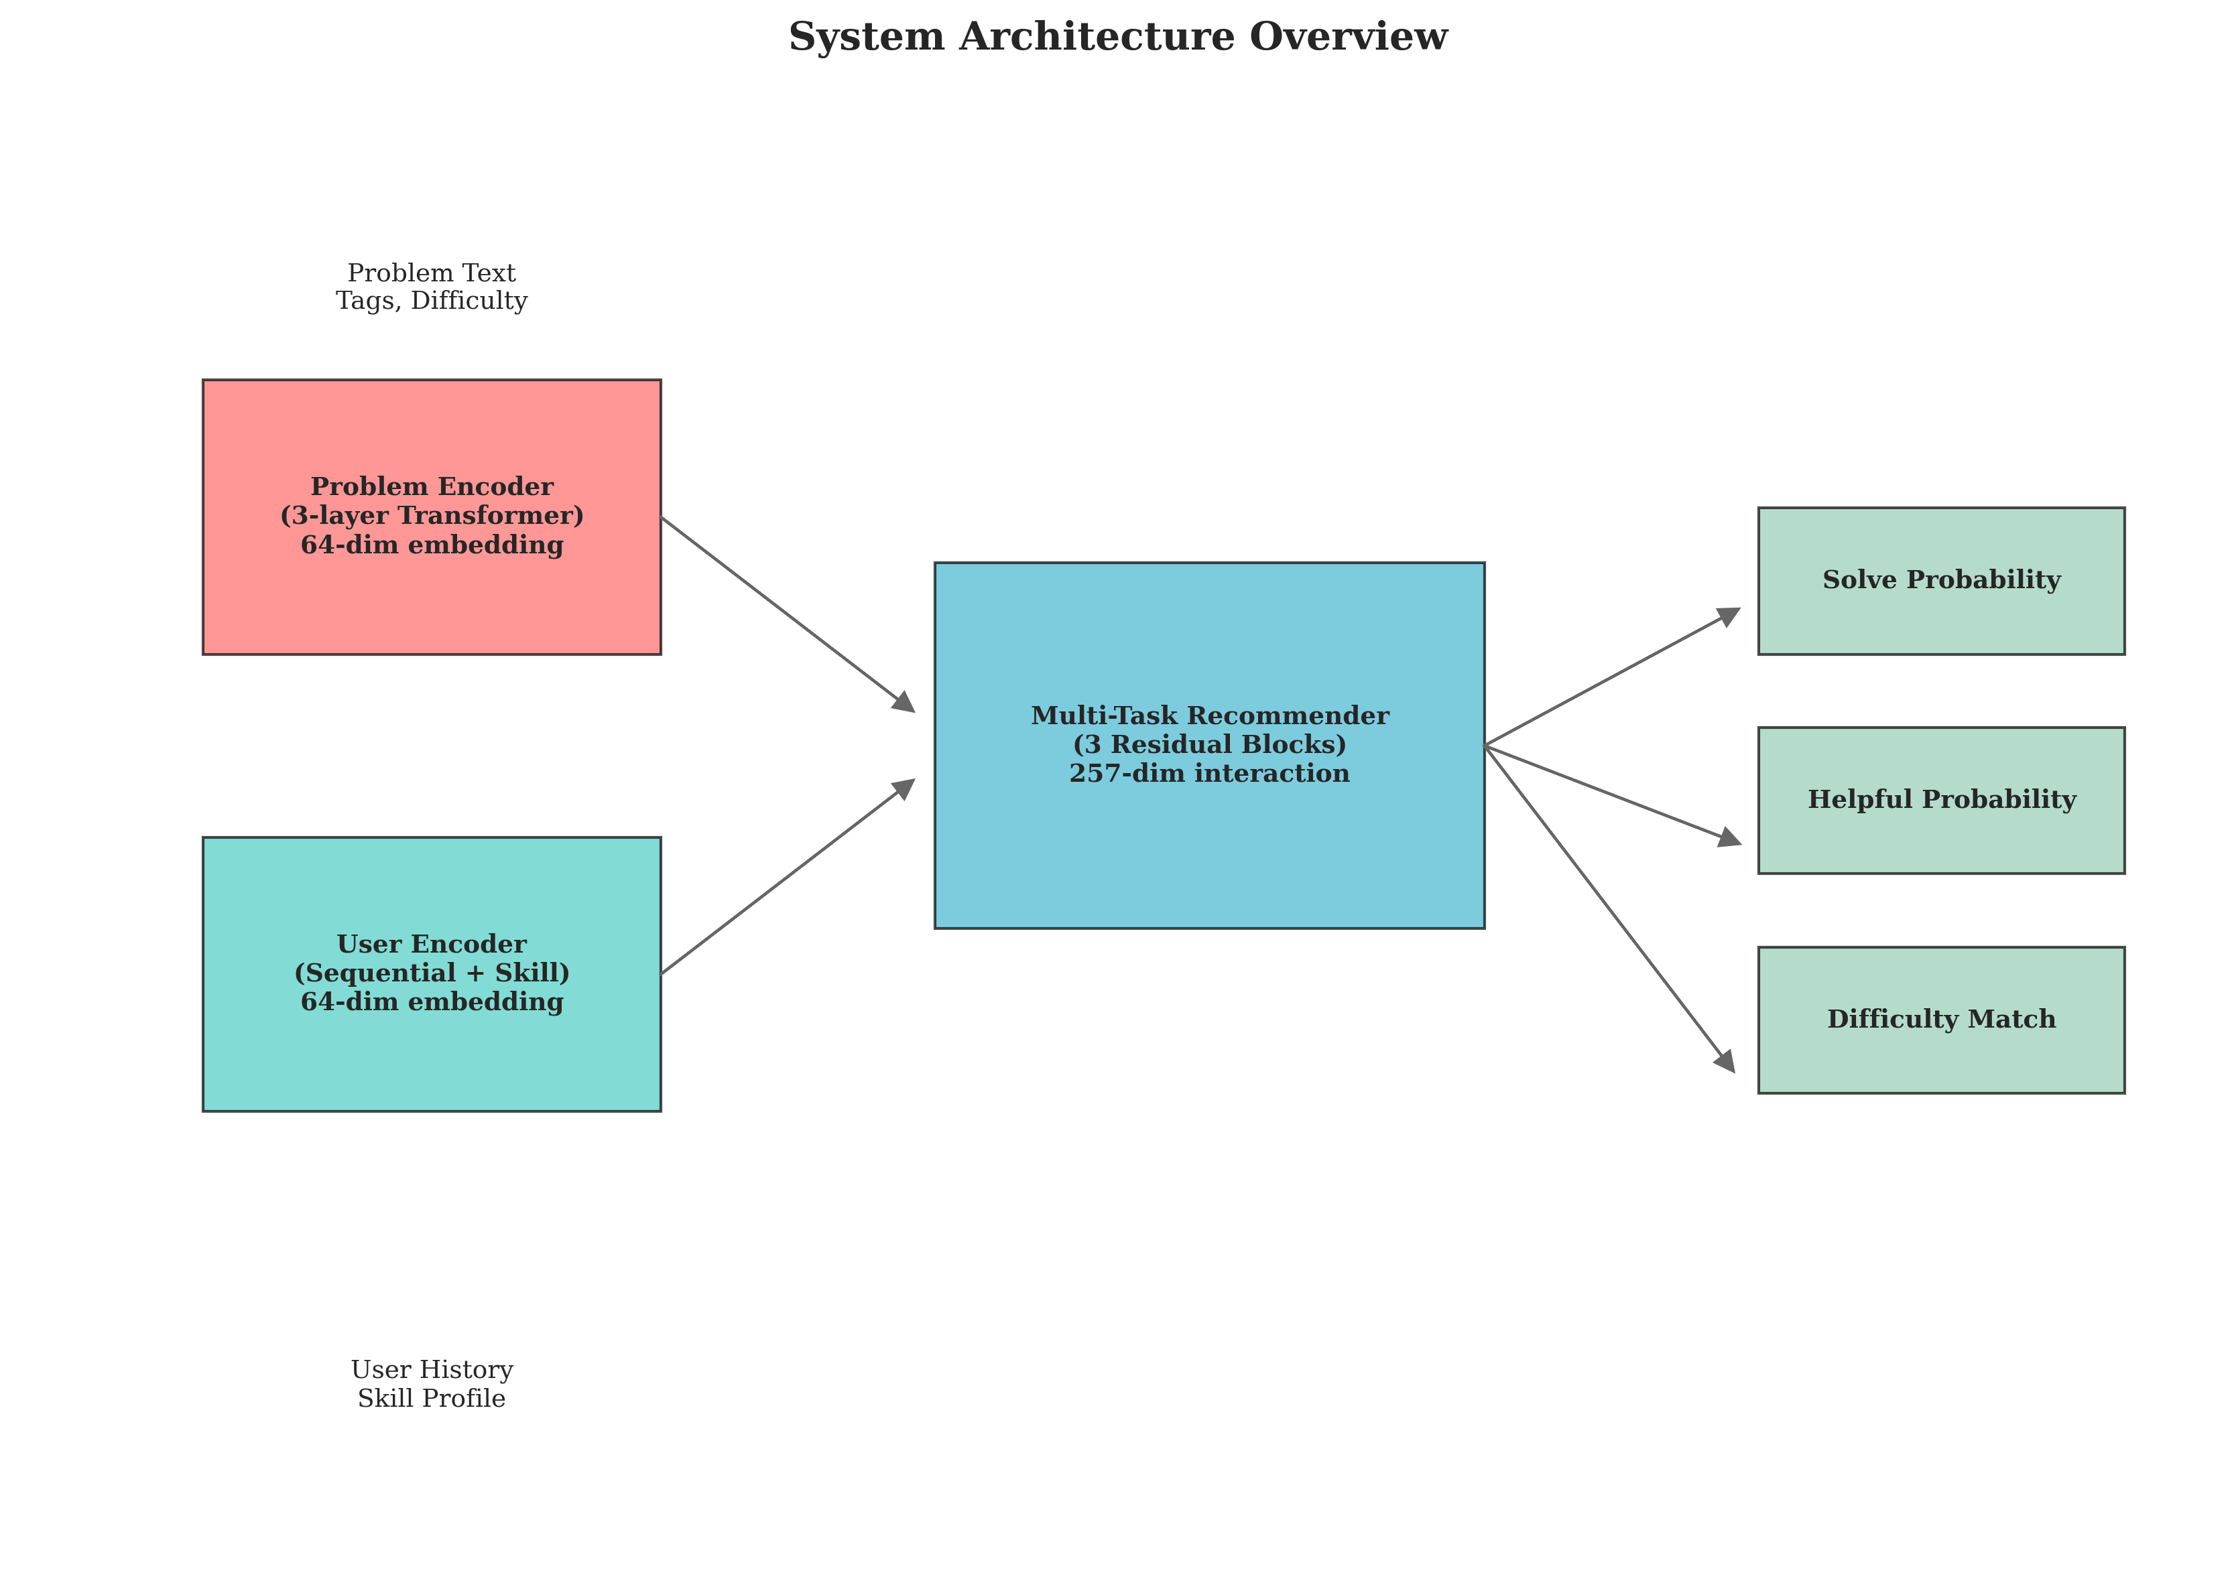
AI ENGINE
Self-Trained AI.
Trained on 3,433 real LeetCode problems
Understands problem content, tags, difficulty
Learns from each student's history
Sequential transformer tracks skill progression
Predicts what to solve next
Solve probability · Helpfulness · Difficulty fit
11 topic clusters, 99.22% purity
Semantically organised — problems grouped by concept
Ranks problems, not just lists them
NDCG@10: 75.48% · MRR: 89.66%

Slide 9
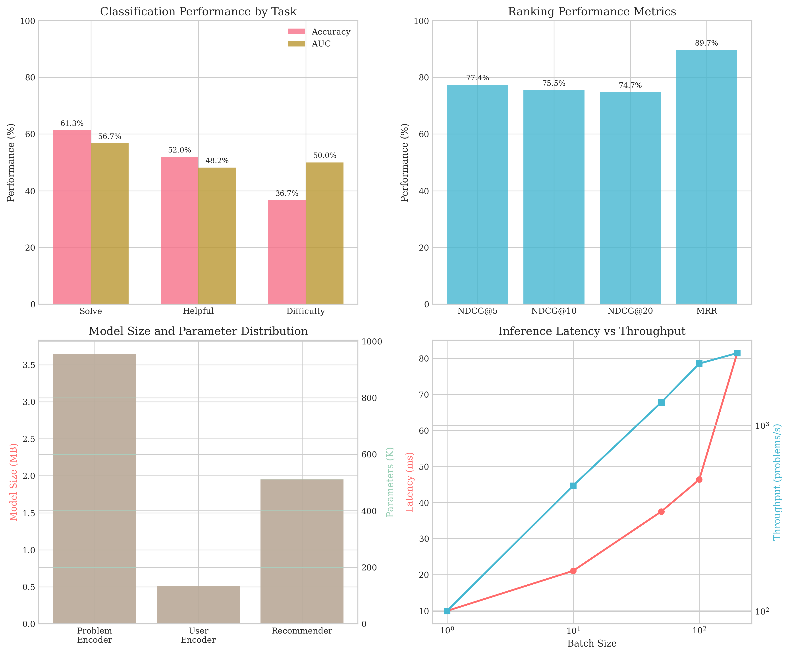
PERFORMANCE METRICS
99.22%
89.66%
75.48%
6.10 MB
Cluster Purity
MRR Score
NDCG@10
Model Size
10 of 11 topic clusters at 100%
Relevant problem always near top
Strong ranking performance
Compact — deployable on any server

Slide 10


What Is Built & Working Right Now
✓ Implemented & Working
⏳ In Progress
CodeChef, HackerRank, GFG connectors (framework ready, connectors in progress)
Multi-role authentication (Student / Faculty / Admin / Super Admin)
Live scraping from LeetCode, Codeforces & GitHub (3 platforms fully live)
Faculty BI Dashboard with cohort-level analytics and batch comparisons
Background Celery workers — automatic nightly sync with retry & rate-limit handling
Automated CIE report PDF generation
Analytics dashboard — total solved, streaks, topic distribution, 365-day heatmap
Real-time direct messaging via WebSockets
Self-trained Transformer DSA Recommender (1.6M params, 6.10 MB, CPU-ready)
Tech Stack at a Glance
PostgreSQL schema with Alembic migrations + Redis caching (1hr TTL)
› FastAPI + React 18 + TypeScript
› PostgreSQL · Redis · RabbitMQ · Celery
Public shareable portfolio with view tracking
› Docker · Kubernetes · PyTorch (from scratch)

Slide 11
Thank You
Questions Welcome
Vinay Kamble · Shreeya Dhond · Shrejal Bhosale · Aisshwarya Gurav
Dept. of Computer Science & Engineering (AI & ML)
3 Roles
6 Platforms
99.22%
Phase 1
Student · Faculty · Admin
Unified Tracking
AI Cluster Purity
Fully Implemented

