Slide 1
Electric Vehicle Population data
Group Members:
Abhijeet Hariyani
Bhavik Chopra
Chitra Dusane
Prachi Holkar
Shreeya Desai
Yogesh Gemani

Slide 2
Agenda
Introduction
About Data
Data Cleaning
Data Visualization
ML Model (KNN Model)
Conclusion

Slide 3
Introduction
The "Electric Vehicle Population Data" dataset available on Data.gov provides information about registered electric vehicles (EVs) in the United States.
The dataset aims to capture the growing adoption of electric vehicles and includes various details about these vehicles.
This dataset shows the Battery Electric Vehicles (BEVs) and Plug-in Hybrid Electric Vehicles (PHEVs) that are currently registered through the Washington State Department of Licensing (DOL).
Objectives:
Analyze trends in EV adoption
Explore geographic distribution
Assess electric range variations
Identify popular EV models
Understand demographic patterns

Slide 4
About Data
Variables
VIN, County, City, State, Postal Code, Make, Model, EV Type, Model Year, Electric Range, Base MSRP, Legislative District, DOL Vehicle ID, Vehicle Location, Electric Utility, 2020 Census Tract
Use Cases
The dataset is valuable for studying the distribution and characteristics of electric vehicles, analyzing trends in adoption over time, understanding geographic patterns, and exploring factors such as electric range and manufacturer popularity.
Potential Analyses
Analysts can perform exploratory data analysis, visualize trends in electric vehicle adoption, identify popular electric vehicle models, assess the average electric range by manufacturer, and investigate the geographic distribution of electric vehicles.

Slide 5
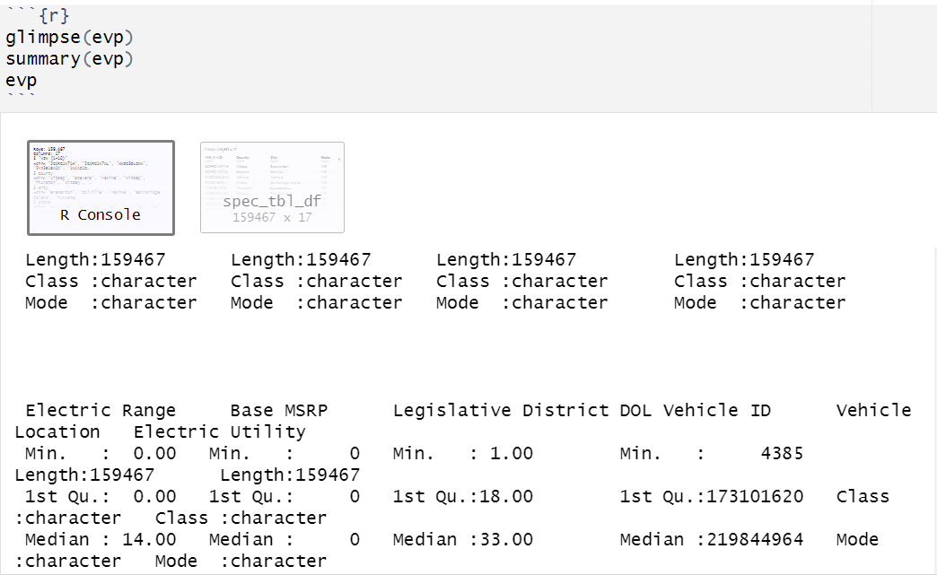
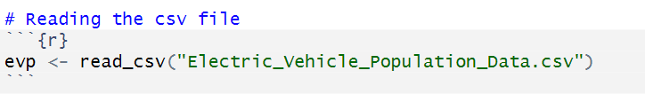
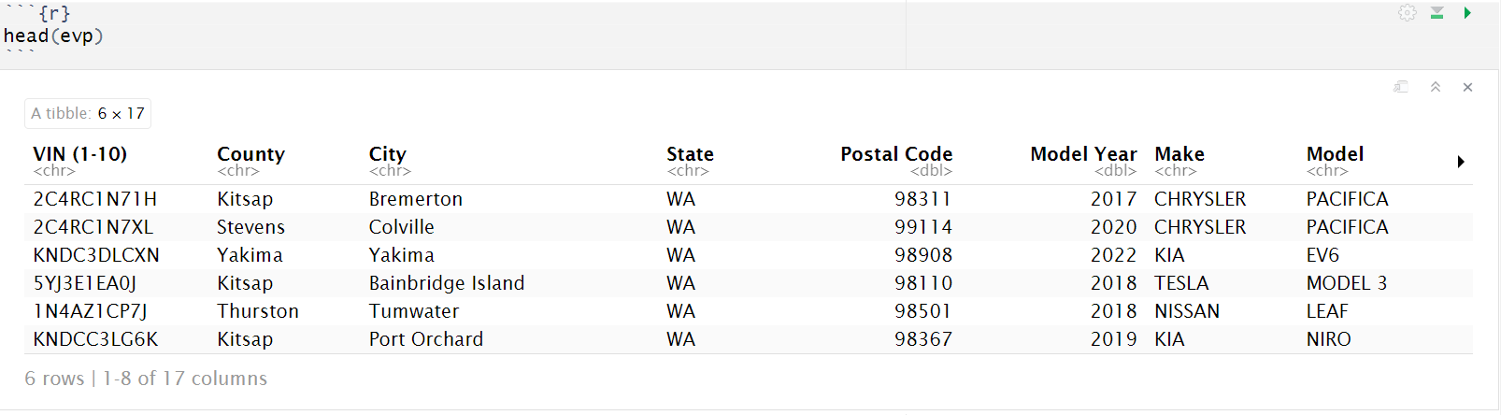
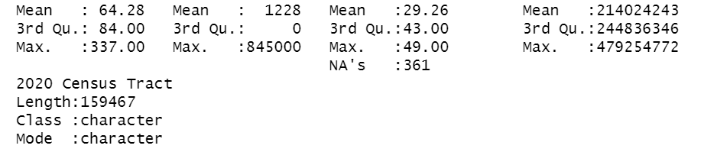
Data Loading

Slide 6
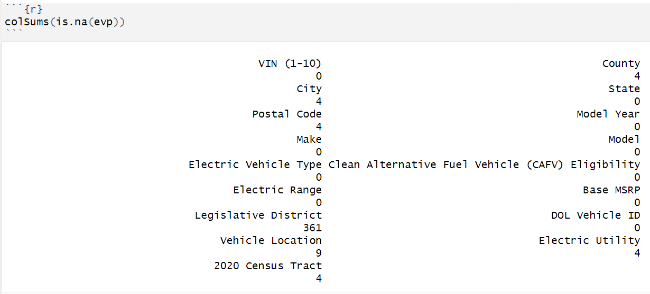
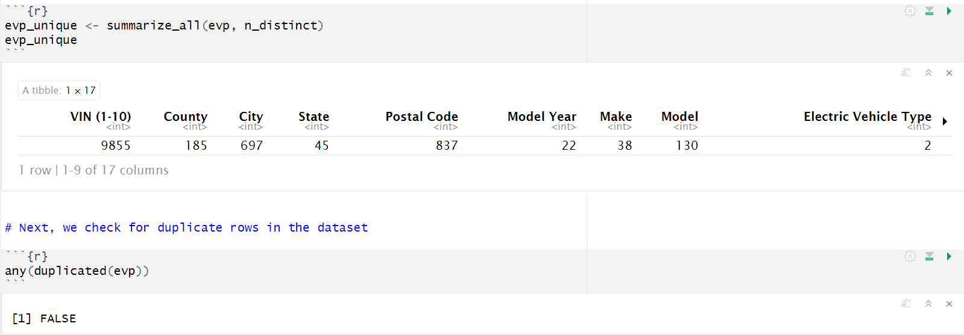
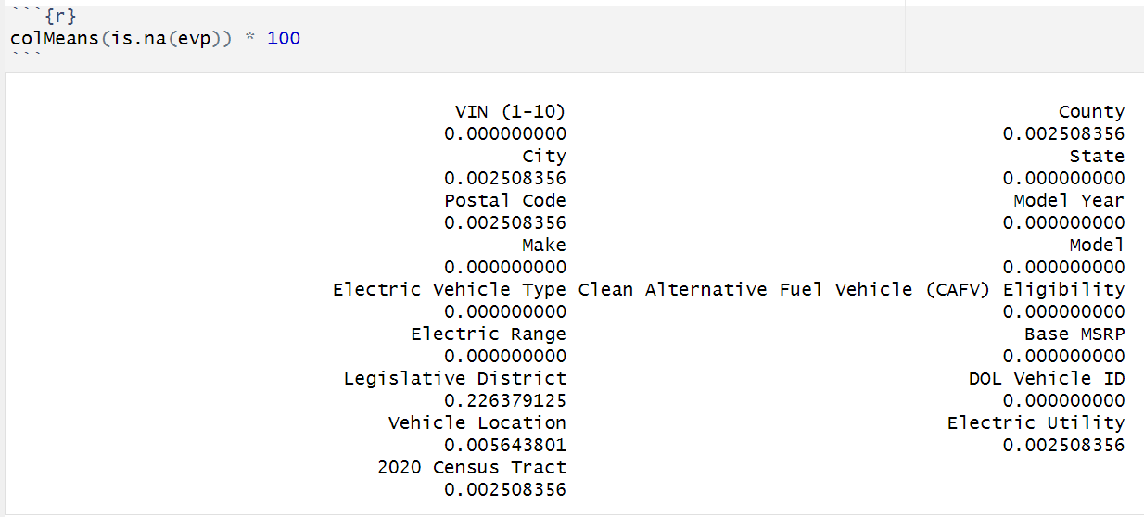
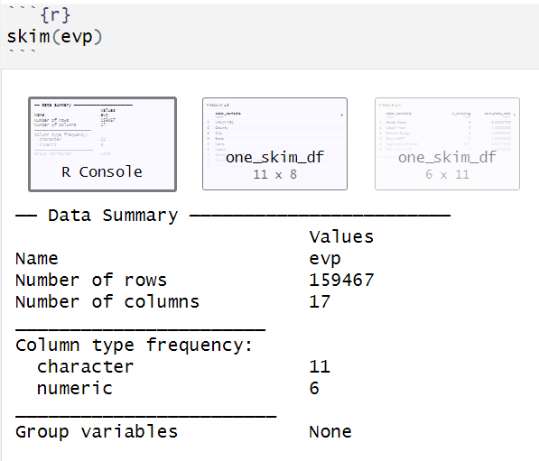
Data Cleaning
The dataset has a few missing values in the County, City, Electric Utility , Postal Code, Legislative District, and Vehicle Location columns.
Counting the number of unique values in each column of the dataset

Slide 7
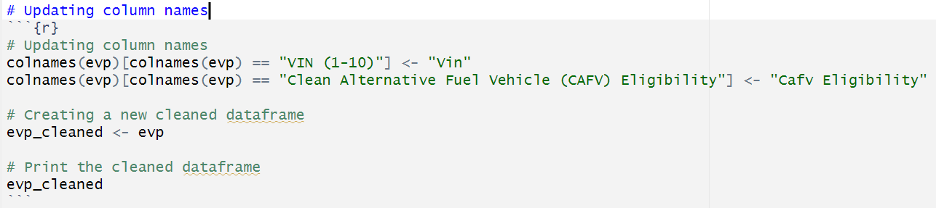
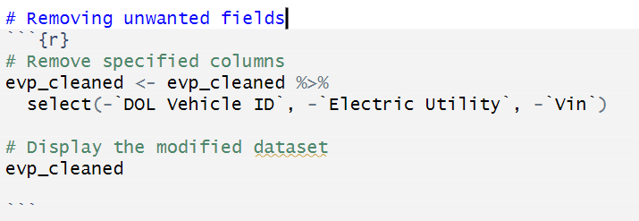
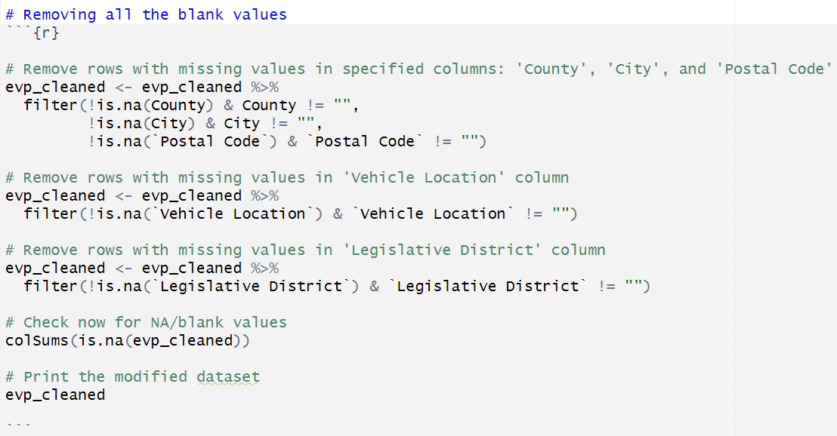
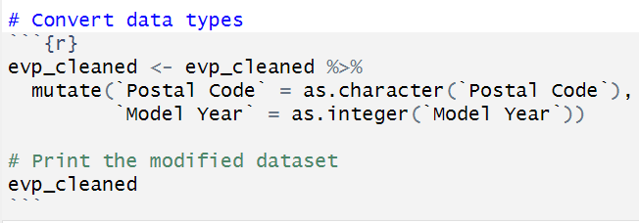
Data Cleaning

Slide 8
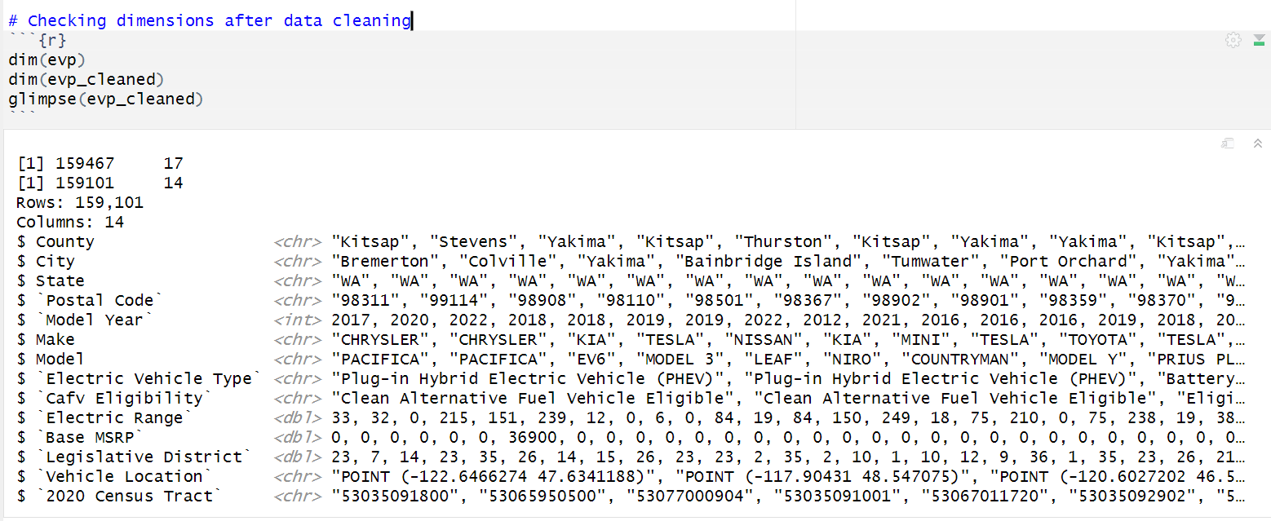
Data Cleaning

Slide 9
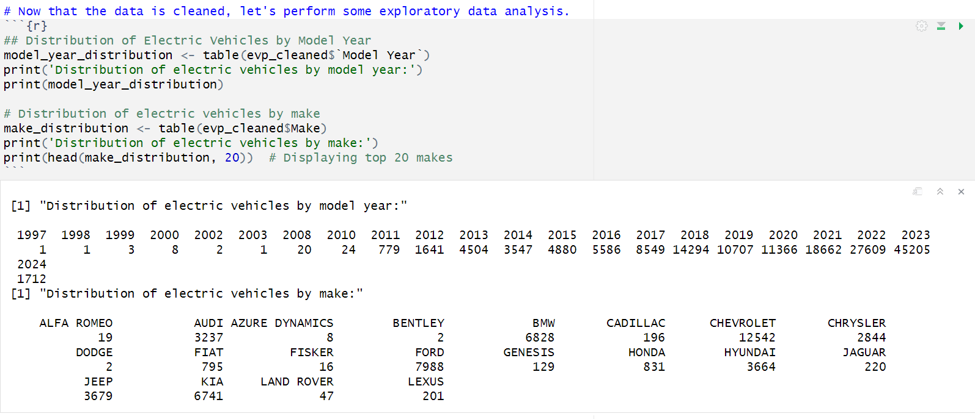
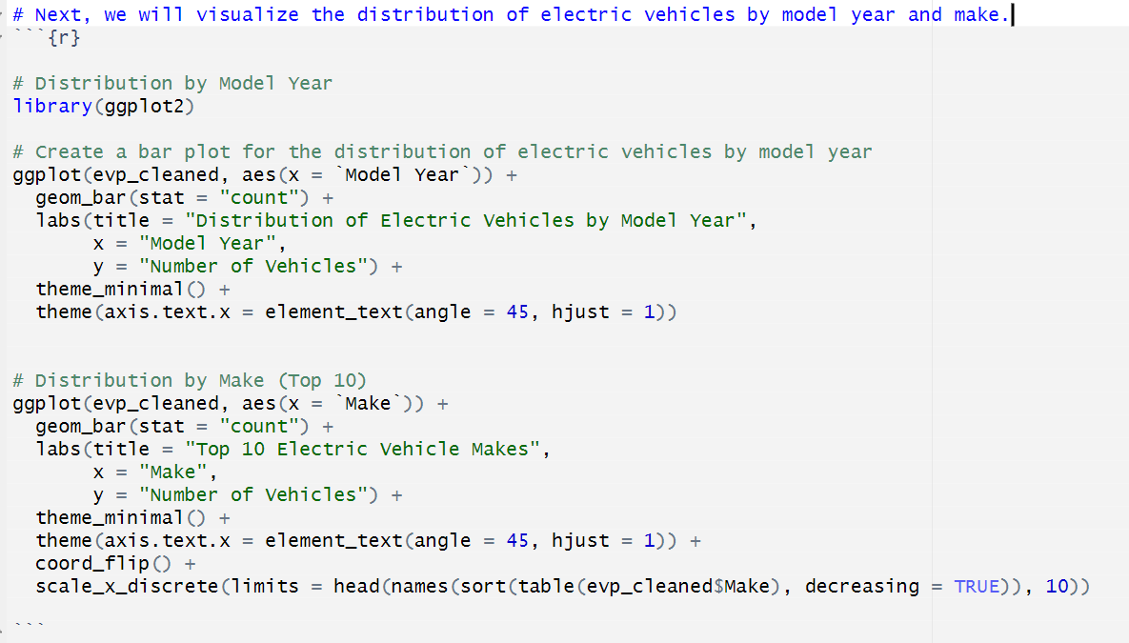
Exploratory Data Analysis (EDA)

Slide 10
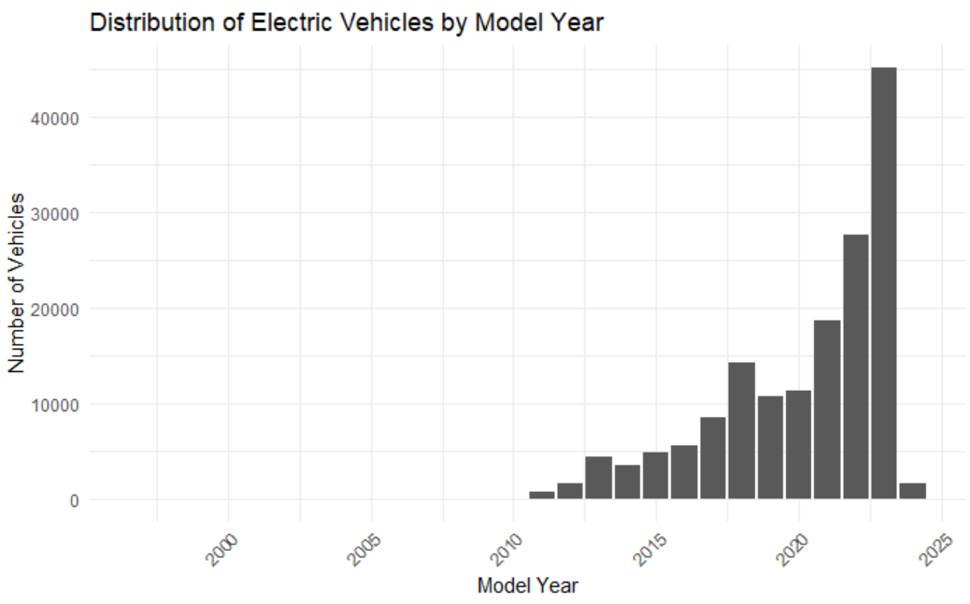
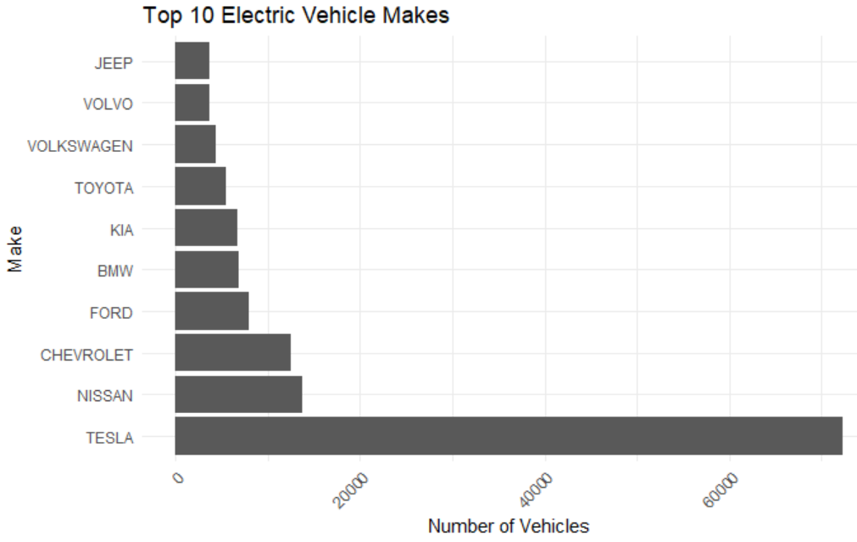
Exploratory Data Analysis (EDA)

Slide 11
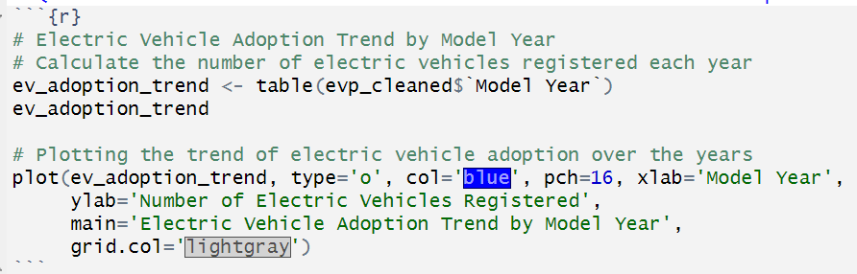
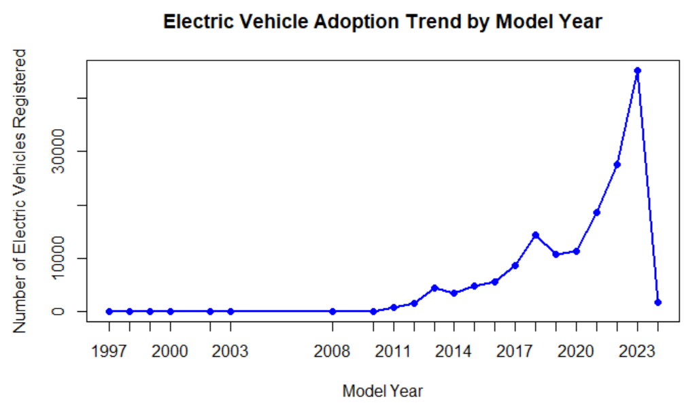
Q1: What are the current trends in electric vehicle adoption in the dataset's region?
The trend data and the corresponding line chart show the progression of electric vehicle registrations by model year, indicating a general increase in EV adoption over time, with notable growth starting from 2011 onwards.

Slide 12
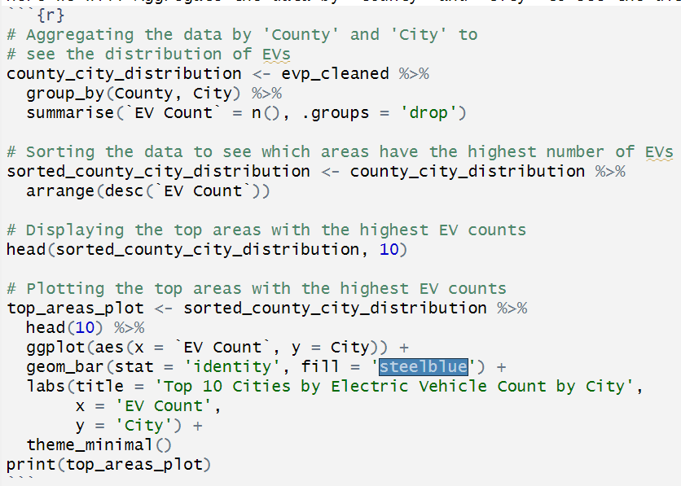
Q2: Are there demographic patterns that influence EV adoption?
To explore demographic patterns that may influence electric vehicle (EV) adoption, there are multiple ways.
We can analyze the dataset based on various demographic-related features such as 'County', 'City', 'Postal Code', and '2020 Census Tract’.
Additionally, we can look at the 'Electric Utility' as a proxy for infrastructure availability.
Here we will Aggregate the data by 'County' and 'City' to see the distribution of EVs.

Slide 13
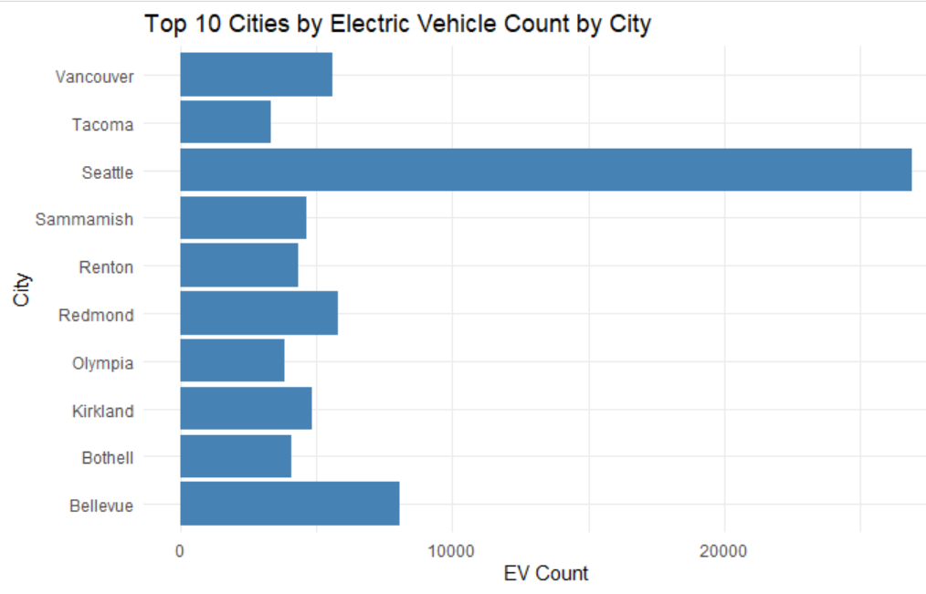
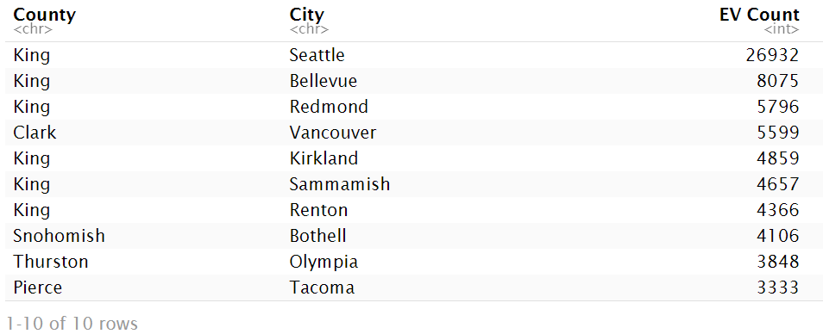
Q2: Are there demographic patterns that influence EV adoption?
The top areas with the highest counts of electric vehicles are predominantly in King County, with Seattle leading, followed by Bellevue and Redmond.
This suggests a strong geographic pattern in EV adoption within this dataset, with certain cities showing significantly higher EV counts.

Slide 14
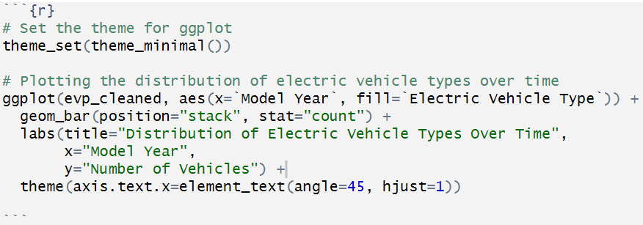
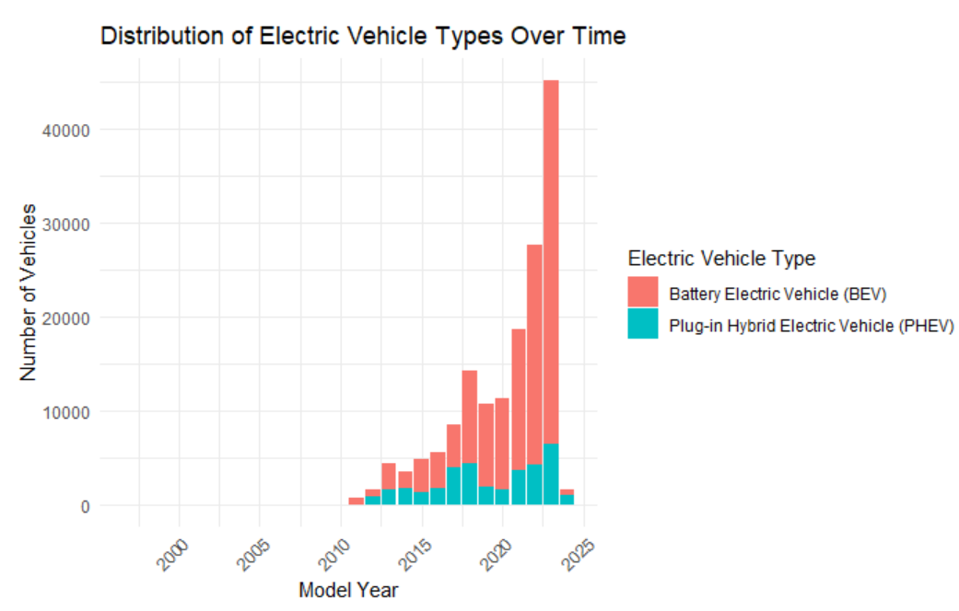
Q3: What is the distribution of electric vehicle types (e.g., Battery Electric Vehicle, Plug-in Hybrid Electric Vehicle) in the dataset, and how has it evolved over time?
Overall, the graph shows that electric vehicles are becoming increasingly popular. This is likely due to several factors, including rising gas prices, concerns about climate change, and government incentives.
The number of BEVs has increased by more than 30 times since 2000, while the number of PHEVs has increased by more than 20 times. The number of electric vehicles on the road is expected to continue to grow in the coming years.

Slide 15
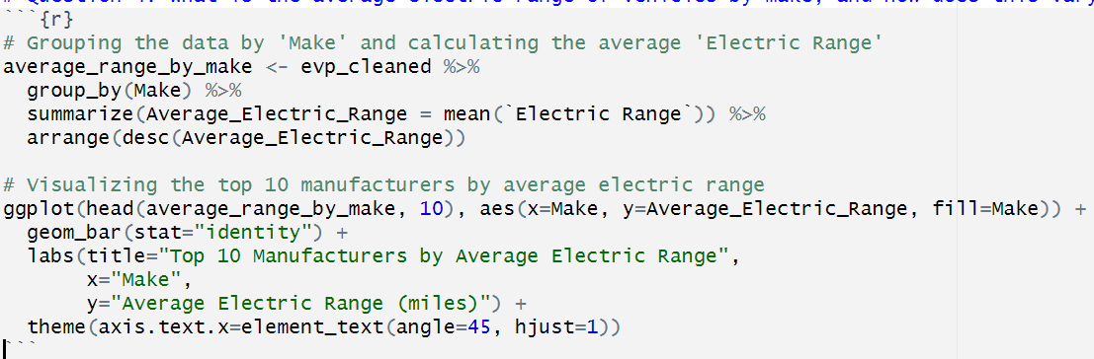
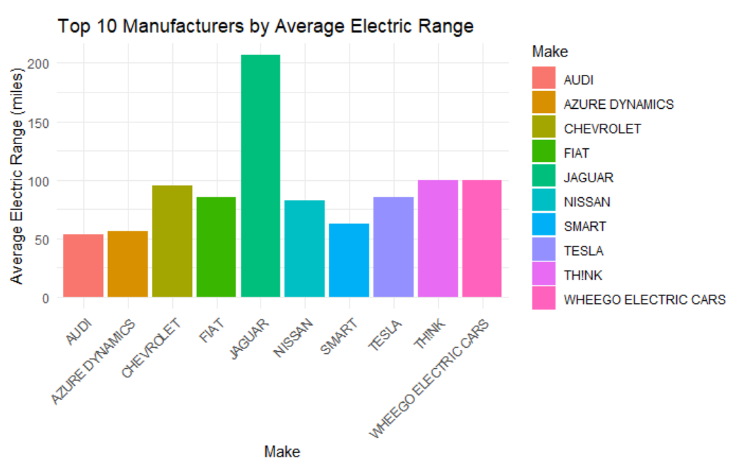
Q4: What is the average electric range of vehicles by make, and how does this vary among the top manufacturers?
Each bar represents the average electric range of vehicles produced by that manufacturer.
Jaguar leads with the highest average electric range, slightly above 200 miles.

Slide 16
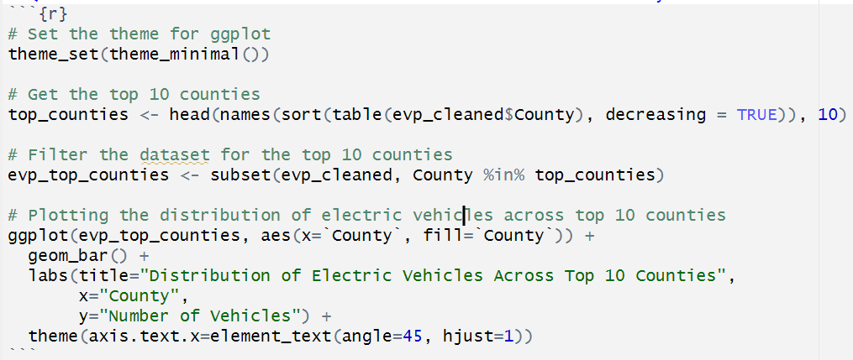
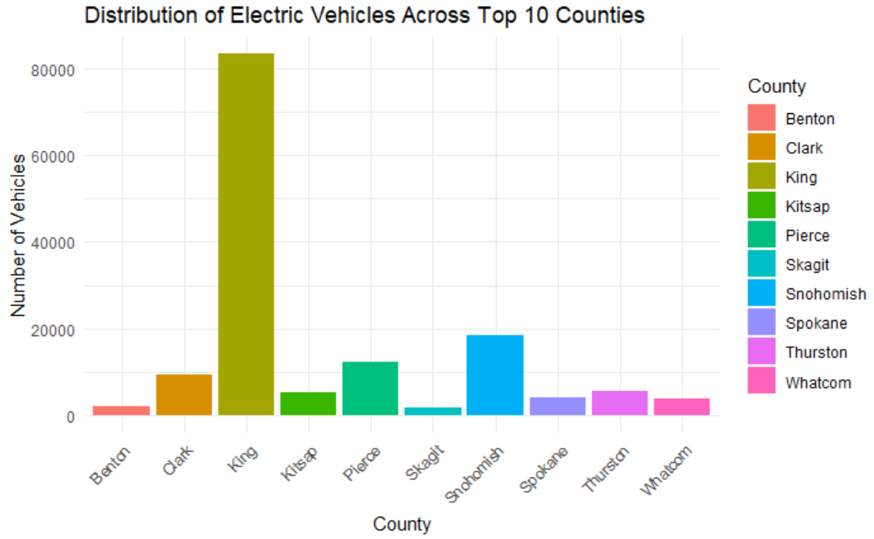
Q5: How does the distribution of electric vehicles vary across different counties and cities within the dataset's region?
This chart provides a clear visual representation of the disparity in electric vehicle distribution among these counties, with one county leading by a substantial margin.
The key takeaway is that King County has by far the most electric vehicles, with almost 80,000. Snohomish County has the second most with around 20,000 vehicles.
The distribution is highly skewed towards King County.

Slide 17
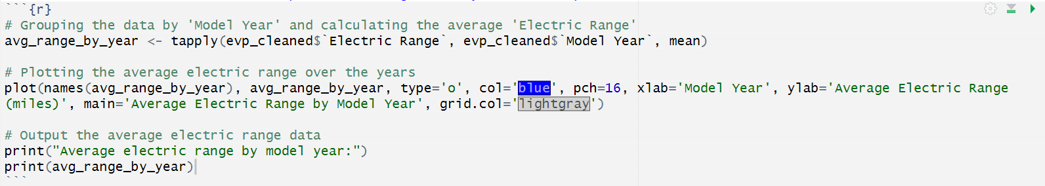
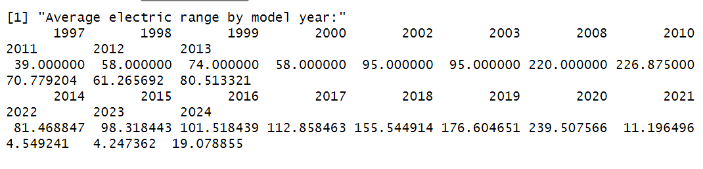
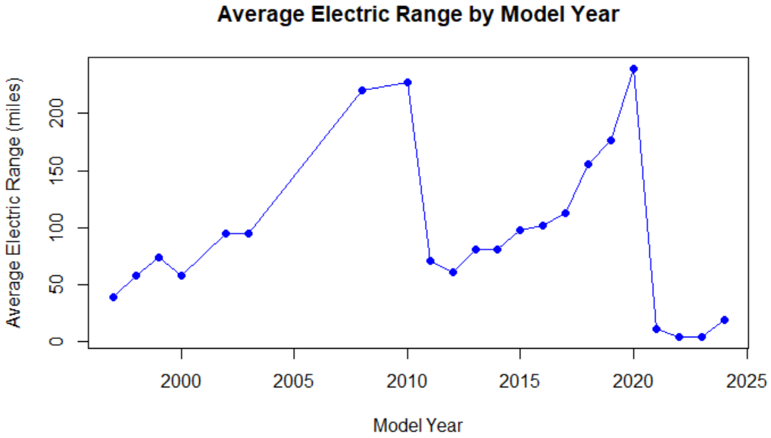
Q6: Is there a relationship between "range anxiety" and EV adoption?
A general upward trend indicating improvements in electric vehicle technology over time.
These trends suggest that while there has been progress in electric vehicle technology, resulting in increased ranges, there are also periods of regression or stagnation.
The sharp decline after the peak could indicate a variety of factors, such as changes in the types of electric vehicles being produced, market shifts, or other external influences not explained by the graph alone.

Slide 18
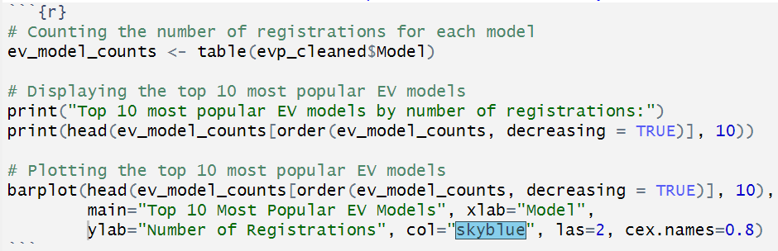
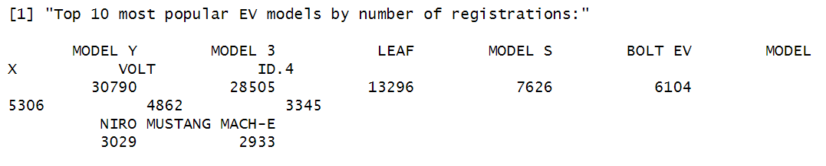
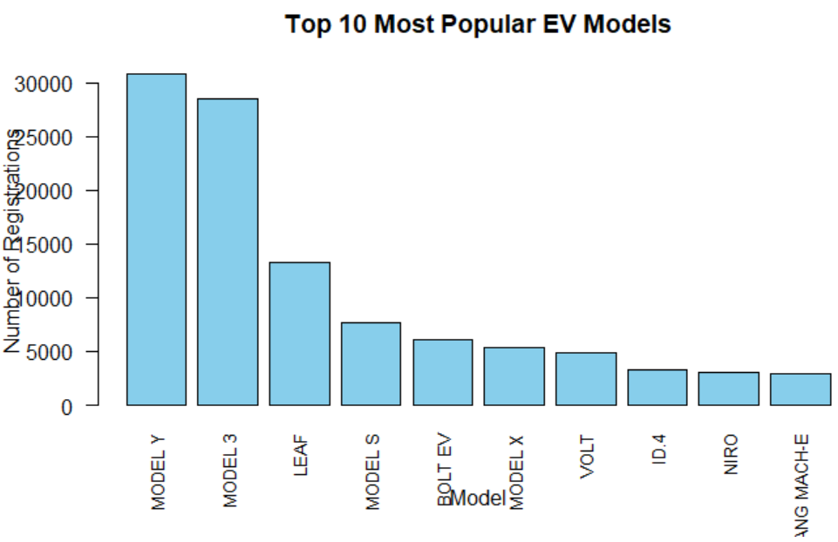
Q7: Are certain EV models preferred over others by consumers?
We identify the most popular EV models based on registration counts.
The top 10 most popular EV models by number of registrations have been identified.
"MODEL Y" and "MODEL 3" are the most popular EV models based on the number of registrations, with a significant lead over the other models listed.
There is a clear drop in popularity after the top three models, with the remaining seven models having relatively similar but lower numbers of registrations.

Slide 19
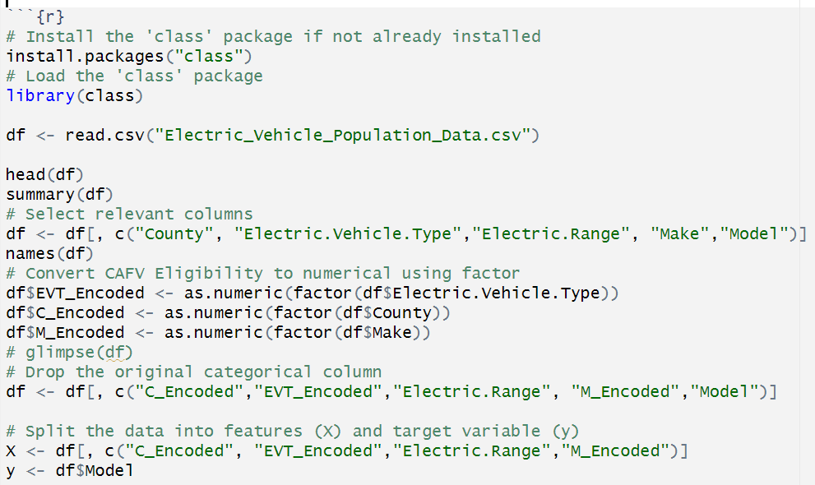
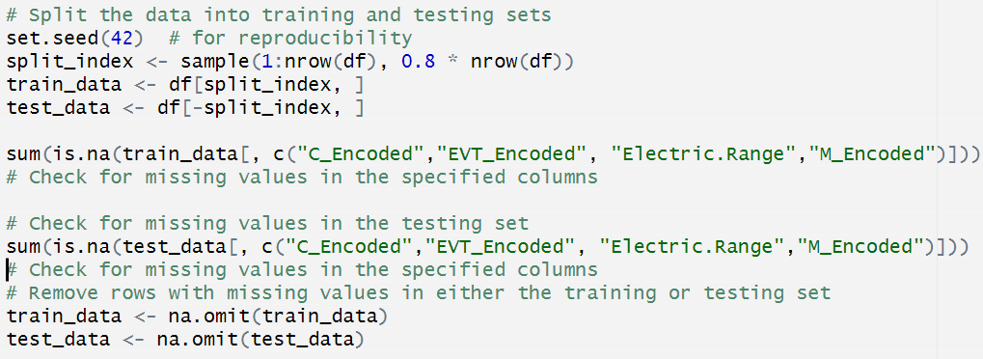
Predictive Analysis

Slide 20
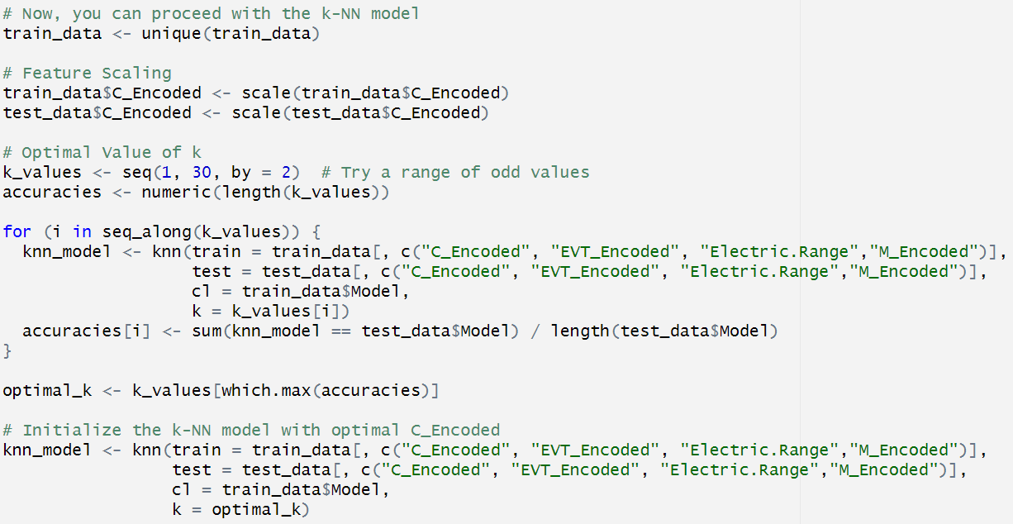
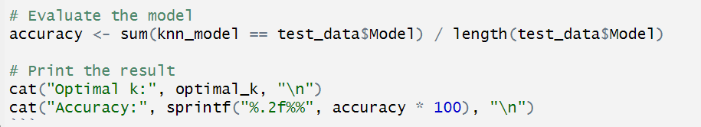
Predictive Analysis

Slide 21
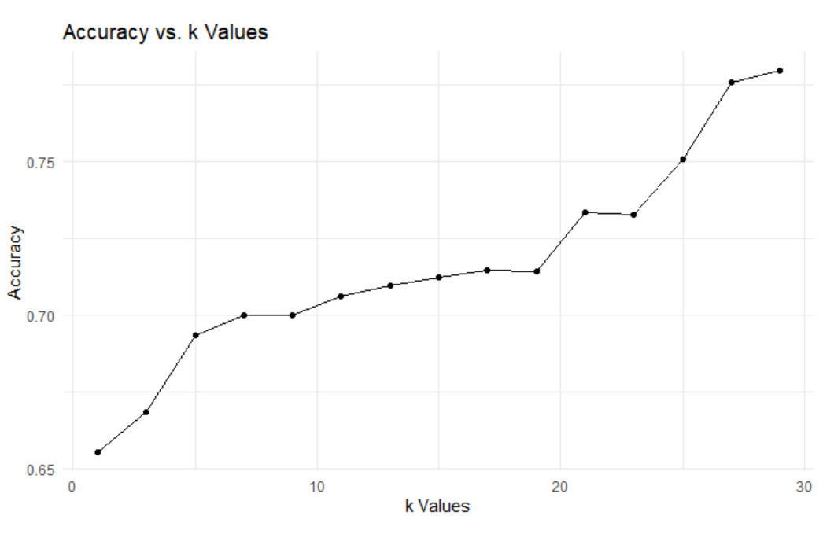
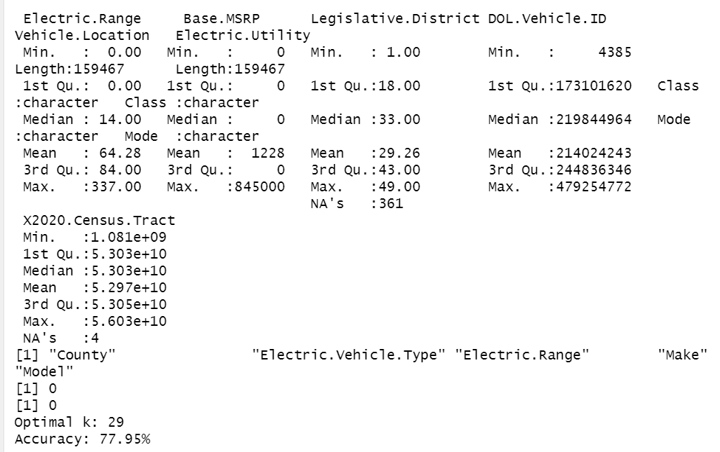
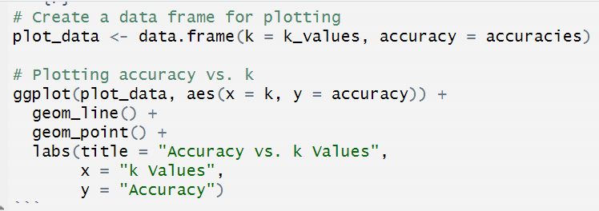
Predictive Analysis
A line plot showing how the accuracy changes as 'k' varies.
The accuracy of the KNN model increases from 0.65 to 0.72 as the number of nearest neighbors increases from 0 to 10.
After that point, the accuracy of the model begins to decrease. This suggests that the optimal value of K for this dataset is between 10 and 15.
Based on the plot, it is likely that the KNN model is overfitting the training data when the number of nearest neighbors is greater than 10.
This is because the model is becoming too complex and is learning the noise in the training data.

Slide 22
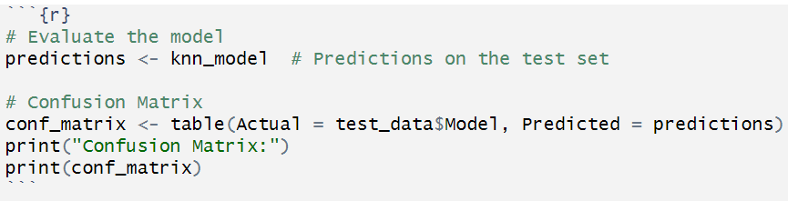
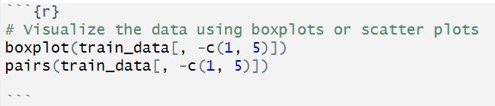
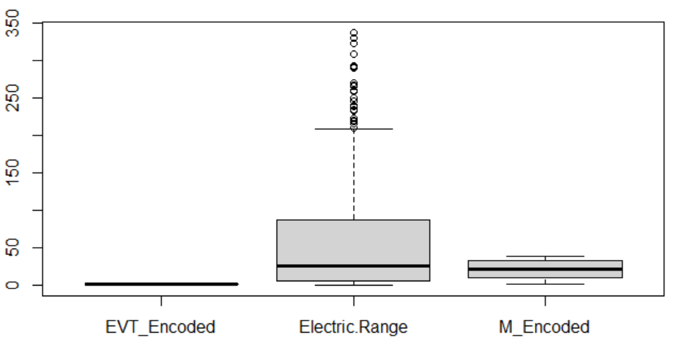
Predictive Analysis
This image shows a box and whisker plot of electric range vs EVT encoded.
The box represents the middle 50% of the data, with the whiskers extending to the most extreme points that are still within 1.5 times the interquartile range (IQR).
The plot shows that there is a positive correlation between the electric range and EVT encoded. This means that as EVT encoded increases, so does the electric range.
However, there is also a lot of variation in the electric range for each given value of EVT encoded. This is shown by the large size of the boxes.
One possible explanation for this variation is that other factors also affect electric range, such as the type of vehicle, the weight of the vehicle, and the driving conditions
Overall, the plot suggests that EVT encoded is a good predictor of electric range, but it is not the only factor that affects it.

Slide 23
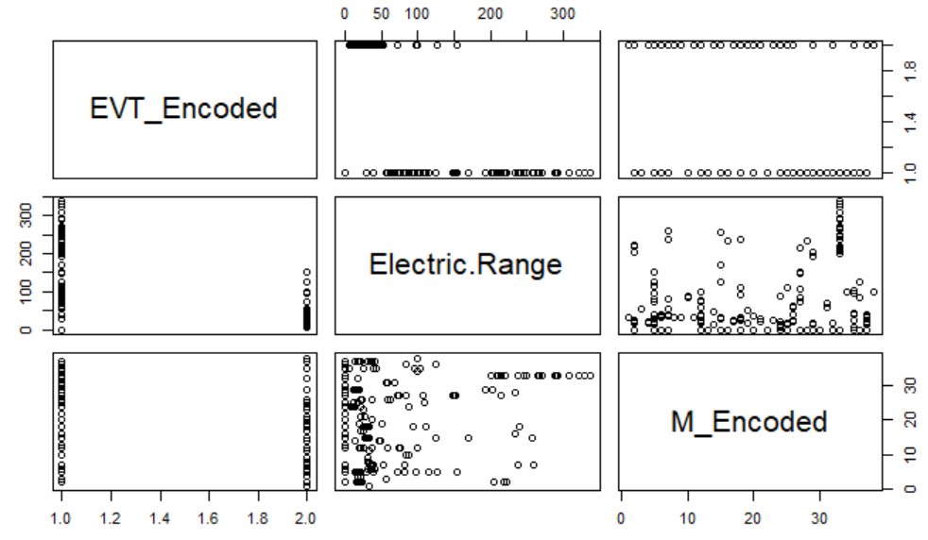
Predictive Analysis
The plot also shows there is a negative correlation between M_Encoded and Electric Range.
This means that as M_Encoded increases, the Electric Range decreases. However, the correlation between M_Encoded and Electric Range is weaker than the correlation between EV_Encoded and Electric Range.
Overall, the plot suggests that EV_Encoded is a better predictor of Electric Range than M_Encoded.
However, it is important to note that other factors may also affect the Electric Range, such as the type of vehicle, the weight of the vehicle, and the driving conditions.

Slide 24
Conclusion
In conclusion, the analysis offers a comprehensive perspective on the electric vehicle population, combining descriptive insights, visualizations, and actionable recommendations to inform future decisions and research in the realm of electric vehicle adoption.

Slide 25
THANK YOU !

