Slide 1
Database Management System
Healthcare Data Management

Slide 2
AGENDA
Introduction
Benefits of Healthcare Data Management
Meet Our Team
Plan for Database
Tables
Queries
ER Diagram
Few of our Business Rules

Slide 3




MEET OUR TEAM
Yogesh Bawale
Saylee Pawar
Shreeya Desai
Unmesha Kupekar

Slide 4
INTRODUCTION
The aim of this project is to design and develop a database for the hospital to maintain the records of all patients, and their appointments with doctors, departments, rooms, etc. in the hospital. It also maintains details of usual patient visits, patients being admitted to the hospital, operated patients, and their discharge.
Managing the wealth of available healthcare data allows health systems to create holistic views of patients, personalize treatments, improve communication, and enhance health outcomes.

Slide 5
Benefits of Healthcare Data Management
Create 360-degree views of consumers, patients, and households. Deploy personalized, guided interactions by integrating data from all available sources.
Enhance patient engagement with predictive modeling and analysis based on healthcare data.
Improve population health outcomes in specific geographic areas by tracking current health trends and predicting upcoming ones.
Make informed, high-impact business decisions based on data insights.
Understand physician activity and align them with the organization’s goals

Slide 6
PLAN FOR Database
PLANNING
Requirement gathering and Analyzing
ARCHITECTURE
Report and Database Design
DESIGN
Coordinate e-business applications
Creating DB, Loading data and Writing queries and
TESTING
BUILDING DB
Performing Testcases

Slide 7
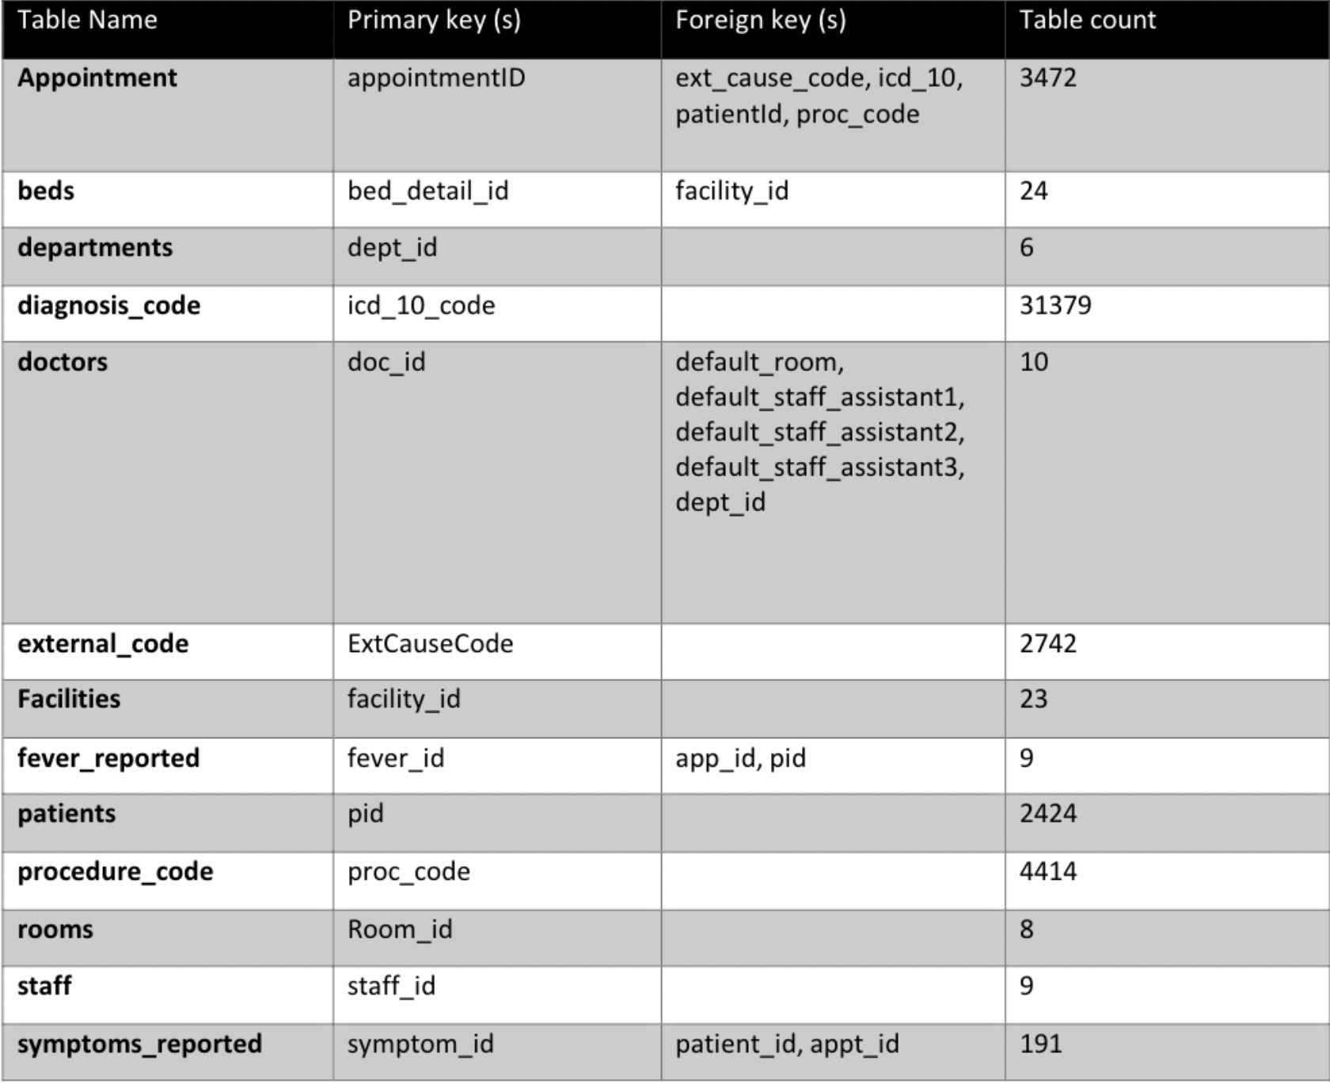
TABLES in SQL Healthcare management studies

Slide 8
Queries
Display the active providers(doctors) in the application:
Query: select * from doctors where status=0;
2. Display the providers(doctors) and staffs details who are set as default assistant 1 for the provider, ordering by staff id in descending:
Query: select d.doc_fname, d.doc_lname, d.position, d.dept_id, s.staff_fname, s.staff_lname, s.staff_type from doctors d inner join staff s on d.default_staff_assistant1 = s.staff_id order by s.staff_id desc ;
3. Display the patients with specific bloodtype and weight greater than 195 , ordering by patient id in descending order:
Query: select * from patients where bloodtype='B+' and weight>195 order by pid desc;
4. Display the appointment and patient details with any type of “fall” included in the external cause of injury in order of the cause description:
Query: select p.fname, p.lname, p.primaryphone, a.appointmentid, a.appointment_day, a.ext_cause_code, e.extcausedesc from patients p inner join appointments a on p.pid = a.patientId inner join external_code e on a.ext_cause_code = e.ExtCauseCode order by p.fname, p.lname desc;
5. Display the count per patients appointment with more than 1 appointment:
Query: select count(*),patientId from appointments group by patientId having count(*) > 1;
6. Display the contact details (primary phone numbers), excluding the blank details if any, and hours for the facility which has bed capacity more than 100 : Query: select f.facility_id, f.facility_name, f.phone1, f.hours, b.bed_detail_id, b.bed_capacity_type, b.bed_capacity from facilities f join beds b on f.facility_id = b.facility_id where b.bed_capacity >100 and f.phone1!='' order by f.facility_id;

Slide 9

ENTITY-RELATIONSHIP DIAGRAM

Slide 10
Few of OUR BUSINESS RULES
All patients must provide a valid government-issued ID when checking in for treatment.
All medical records must be kept confidential and secure and can only be accessed by authorized personnel.
Patients must provide at least 24 hours' notice for any appointment cancellations or rescheduling.
Prescription medication must be dispensed in accordance with the prescribing physician's instructions and any applicable laws and regulations.
Patients must provide their insurance information before receiving treatment.
Insurance claims must be submitted within a certain timeframe (e.g., 30 days) to be eligible for reimbursement.
Patients must be notified of any changes to their treatment plan.
Healthcare providers must have a valid license to practice.
Patients must be given the option to consent to or decline treatment.
Healthcare providers must maintain confidentiality and protect the privacy of patient information.

Slide 11
THANK YOU

