Slide 1
Navigating NYC's Job Market: Insights from Exploratory Data Analysis to Predictive Modeling
Team Members
Arib Mirza
Kunal Sanghvi
Prachi Holkar
Priyam Sheth
Sejal Arora
Shreeya Desai

Slide 2
Agenda
Introduction
Exploratory Data Analysis
Prediction Model
Conclusion

Slide 3
INTRODUCTION
This project uses the Jobs NYC Postings dataset available on Data.gov.
The dataset contains current job postings available on the City of New York’s official jobs site. Internal postings available to city employees and external postings available to the public are included.
There are nine numerical variables and twenty-one categorical variables in this dataset.
We aim to analyze this comprehensive dataset and gain insights into the factors influencing the salary ranges in NYC.

Slide 4
DATA CLEANING
Usual Drill
Handling Missing Values
Dropped rows with missing values in the 'Full-Time/Part-Time indicator' and 'Minimum Qual Requirements' columns.
Replaced blanks in the 'Work Location 1' and 'Preferred Skills' columns with 'NA'.
Mapping Attributes
Defined a function to map the attribute 'residency requirements' to broader categories and stored it in a new attribute 'Residency'.
Adding Custom Attributes
Created a new column 'Avg Salary' as the average of 'Salary Range From' and 'Salary Range To'.
Descriptive Statistics: Describe the central tendency, dispersion, and shape of the data distribution.
Identified and removed non-English characters from the attributes 'Business Title', 'Job Description', 'Preferred Skills', 'Work Location' and 'Residency'.
Non-English characters
Defined a function to map original 'job categories' to broader categories and created a new attribute 'Domain'.
Load: Created a new Data Frame with specific columns relevant to the analysis.
Load Data
Summarization: summarizing the main characteristics of the dataset, such as its size, dimensions, and data types.
Removed Columns like jobID, Title code no, Work Location, Division/work unit, additional information, To Apply, Hours, recruitment contact, post until, posting updated, processed date

Slide 5
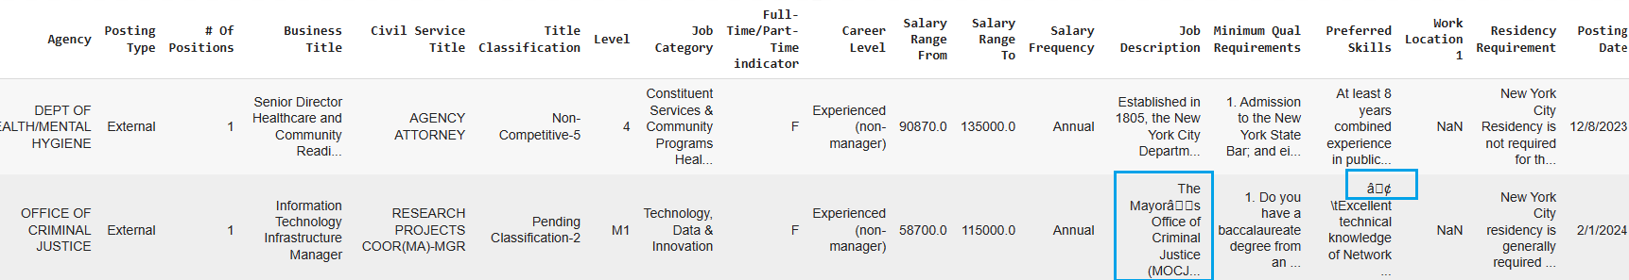
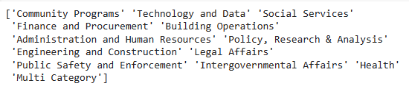

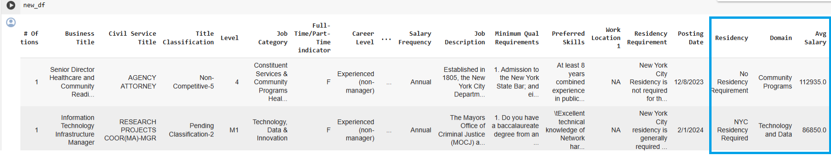
DATA CLEANING
Before
After

Slide 6

Let's Explore Data
Q1
Salary Analysis
Q2
Q3
Requirements and Qualifications
Job Distribution and Trends

Slide 7
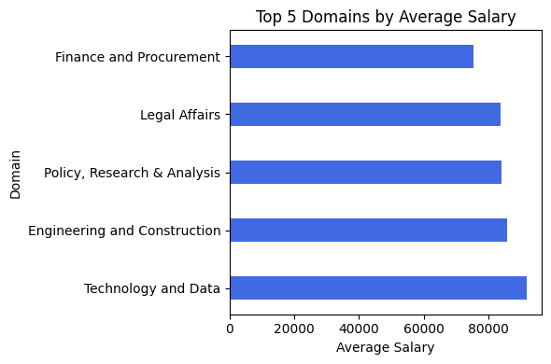
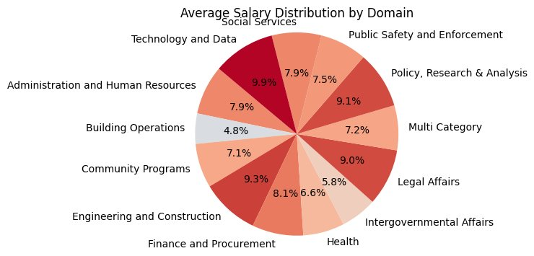
Salary Analysis
The bar chart shows the top highest-paying job domains based on average salary in our data.
Domains with the longest bars offer the highest average salaries.
The pie-chart gives a complete overview of how the salary is distributed throughout all the domains.
These domain are clubbed based on the Job Category attribute.
The color keeps fading as the salary lowers.
Here we can see how the salaries of Admin, HR, Finance, and public safety fall into middle tire while the building operations and intergovernmental affairs fall in lower tire.

Slide 8
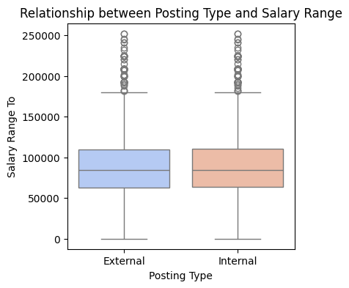
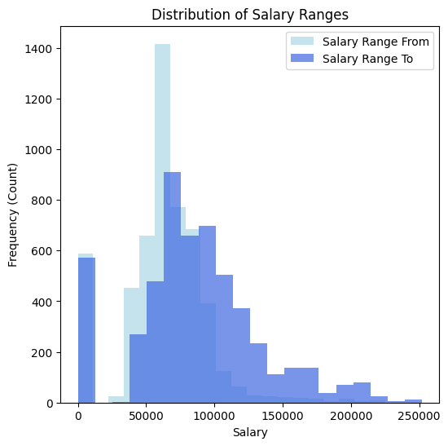
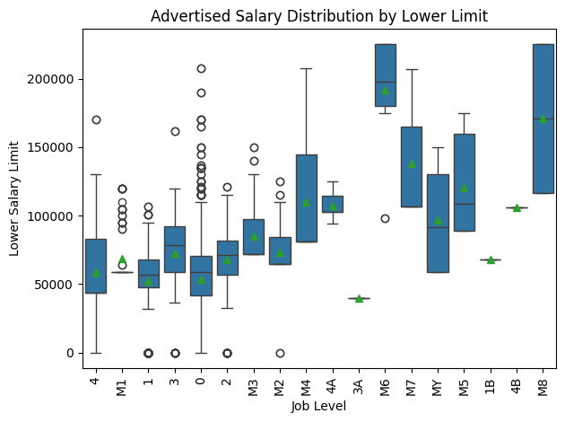
Salary Analysis
The 1st box plot depicts the relationship between job posting type and salary range. The horizontal line in the middle of each box represents the median salary within that posting type.
The box itself depicts the interquartile range (IQR), which represents the middle 50% of the salary data for that posting type. The bottom and top edges of the box extend to 1.5 times the IQR from the median.
The whiskers extend from the top and bottom of the box to the most extreme data points within 1.5 times the IQR. Any data points beyond these whiskers are considered outliers and are plotted as individual circles. The plot shows similarity between the external and internal job postings in terms of upper limit of the salary range.
The 2nd plot visualizes the distribution of advertised lower salary ranges by job level. The small diamonds scattered across the boxes represent the mean salary (average) for each job level. Higher Managerial job levels tend to have higher median salaries.
The histogram visualizes the distribution of salary ranges in the dataset. The data suggests that a salary range between $80,000 and $100,000 is most frequently advertised across the job postings we analyzed.
1
2

Slide 9
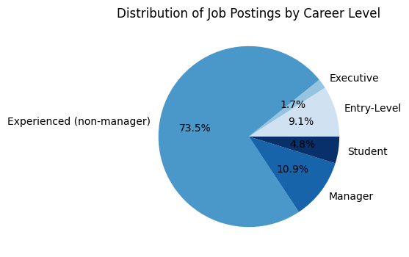
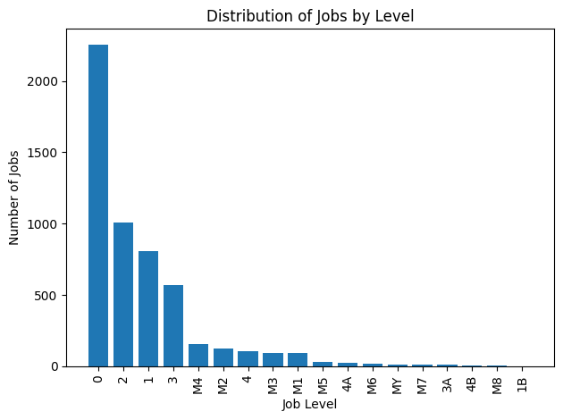
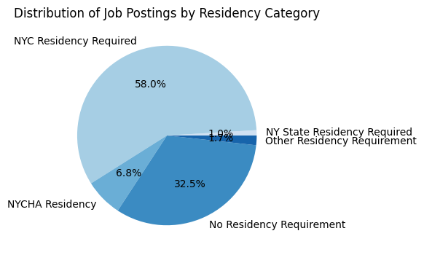
Job Distribution and Trends
1
The 1st pie chart shows the distribution of job postings across various career levels in our data.
Each slice represents a career level, and its size corresponds to the proportion of job postings in that category.
The data shows that Experienced (non-manager) level positions are the most common type of job posting in our dataset.
The 2nd pie chart shows the distribution of job postings across residency requirements in our data.
The data shows that most job postings in our dataset require "NYC residency".
The bar chart depicts how many job postings exist for each job level in the data set.
The level 0 with the tallest bar has the most job postings.
3
2

Slide 10
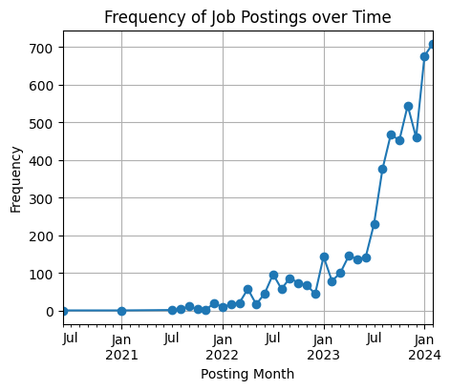
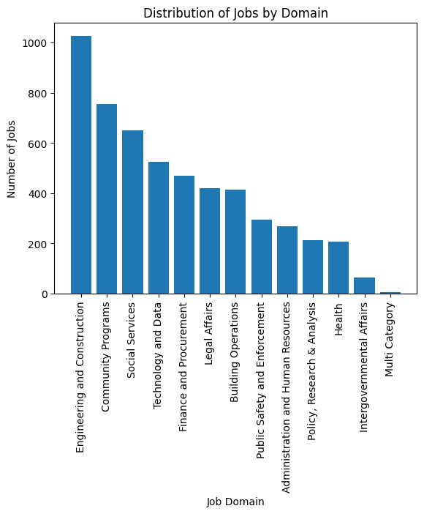
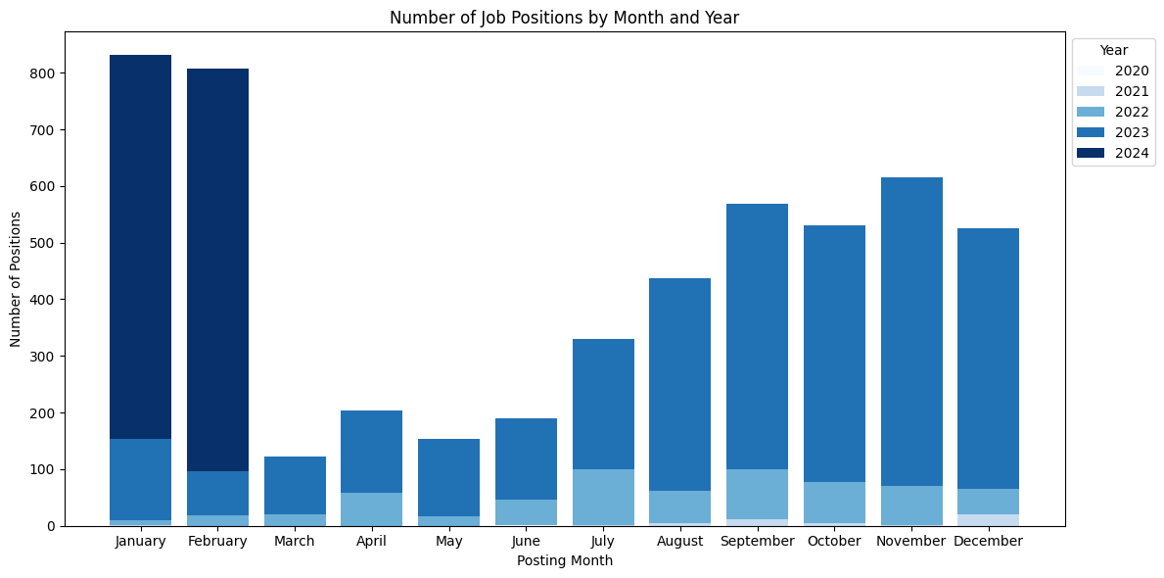
Job Distribution and Trends
The line plot depicts the frequency of job postings over time (by month) in your dataset.
The circular markers connected by a line represent the trend in the number of postings over time.
The 1st bar graph represents the number of job postings added each month across various years in the data set.
We see a surge in postings towards the end of the year in 2023.
The 2nd bar chart depicts how many job postings exist for each job domain in your data set.
The "Engineering & Construction", followed by "Community Programs" and "Social Services" domains have the most job postings.
1
2

Slide 11

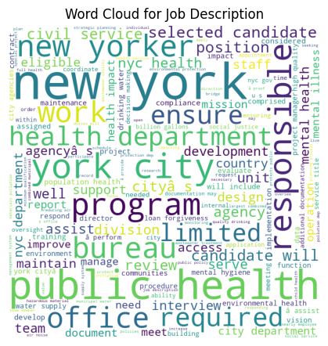
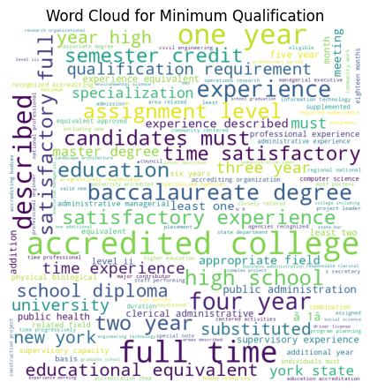
Job Requirements and Qualifications
1
The 1st word cloud depicts the most sought-after skills mentioned in the Preferred Skills within our data set. The larger a word appears, the more frequently it is mentioned across the job postings.
Some of the most prominent skills include Microsoft office, communication skills and written communication highlighting the importance of these skills for the jobs we analyzed.
The 2nd word cloud depicts the most sought-after Minimum Qualifications mentioned in the Min Qualifications Requirement within our data set.
Some of the most prominent qualifications include college, full time, four-year, school diploma and university highlighting the importance of these qualifications.
The 3rd word cloud visualizes the most frequently used words listed in the Job Description.
We can see trend of 'new yorker' , 'new york' , 'york city' being a big part of the job descriptions, even though we have a separate attribute/field for it as 'residency req'
Apart from that we have domain specific words as bureau, health, civil services etc.
Skills/ keywords that could be identified are responsible, assist etc. One would have to check the minimum qualifications or preferred skills
3
2

Slide 12
Prediction Model with Random Forest Regression
Feature Selection: We identified relevant features such as 'Business Title', 'Title Classification', 'Job Category', and 'Career Level' from the dataset.
Data Preprocessing: Rows with missing values in the selected features were dropped to ensure data integrity.
Encoding Categorical Variables: Categorical variables were encoded using one-hot encoding to convert them into numerical format suitable for the model.
Model Training: Random Forest Regression was initialized with 100 trees and trained on the preprocessed data.
Model Evaluation: The trained model was used to make predictions on the test set to predict Average Salary, and the accuracy was 89%.
Model Evaluation Metrics:
R-squared (R2) Score: 0.89
Root Mean Squared Error (RMSE): 12,502.16
Accuracy Percentage: 89.16%

Slide 13
Conclusion & Future Scope
Current Usage:
Decision Support: The analysis of average salary prediction using Random Forest Regression can serve as a valuable decision support tool for human resource departments, policymakers, and job seekers.
Resource Allocation: Organizations can utilize the insights gained from this analysis to optimize resource allocation, budget planning, and talent acquisition strategies.
Future Scope:
Enhanced Feature Engineering: Exploring additional features such as education level, years of experience, and geographical location could further enhance the predictive power of the model.
Integration with HR Systems: Integrating the predictive model with existing HR systems can streamline the recruitment process and improve workforce planning.
Real-time Monitoring: Implementing a real-time monitoring system to track changes in salary trends and market dynamics can provide timely insights for decision-making.
Potential Benefits:
Cost Savings: Optimized resource allocation based on accurate salary predictions can lead to cost savings for organizations.
Talent Retention: Insights gained from the analysis can help identify factors influencing employee satisfaction and retention, leading to improved talent management strategies.
Competitive Advantage: Leveraging advanced predictive analytics can provide a competitive edge in talent acquisition and workforce planning.

Slide 14
Thank you

