Slide 1
Fairness Preservation under Computational Budgets in Probabilistic Decision Systems
ICT 5143: AFGML Capstone — Problem 9
Shreeya Kamath, 261090830022 Misha, 261090830020
7 November 2026

Slide 2
Research question and decision context
Context and stakeholders: bank outreach scored by a Bayesian network under a compute limit; affected are customers, outreach teams, serving engineers and auditors.
Y = 1: recorded term-deposit subscription; D = 1: selected for hypothetical pre-contact outreach (top 20% of scores).
Question: at a fixed operation budget, does choosing the fallback by validation worst-group deviation from the exact decision give a smaller ΔEOpp than a global fallback, utility-only selection and post-budget threshold adjustment?
Hypothesis: yes, within 0.01 AP loss. Refuted if any Holm-adjusted paired 95% interval contains 0 or is positive.

Slide 3
Closest work and proposed contribution
Established result: reducing neural-network compute (fewer ReLUs) lowers accuracy more for minority groups (Das et al., ICML 2024); assumes neural models, accuracy parity.
Open issue: no study found of budget-triggered approximate PGM inference and decision fairness (quick search only; novelty not claimed).
Contribution: operation-count budget with evidence-dependent trips; simulation isolating group-dependent evidence availability, with a no-dependence control; fairness-aware fallback selection.
Evidence needed: comparison with global fallback, utility-only selection and Hardt-style post-processing; ablations.

Slide 4
Data and evaluation population
UCI Bank Marketing (dataset 222), bank-additional-full.csv: 41,188 contacts, 4,640 positives; Y = 1 iff y = yes; no duration.
Protected: age band (<30, 30–59, ≥60) × marital status (audit only, not a model input).
Split (positional, date-ordered, no customer id): 24,712 / 8,238 / 8,238; positive rate 4.8% / 11.1% / 30.8%.
Prediction-time inputs: age band, job, education, default, housing, loan, pdays bin, previous bin, poutcome; unknown ⇒ unobserved evidence (any unknown: 13.6% of ages <60, 20.9% of ≥60).
Test groups: 7 supported (≥70 positives), 5 exploratory (1–8 positives, n = 2–34).

Slide 5
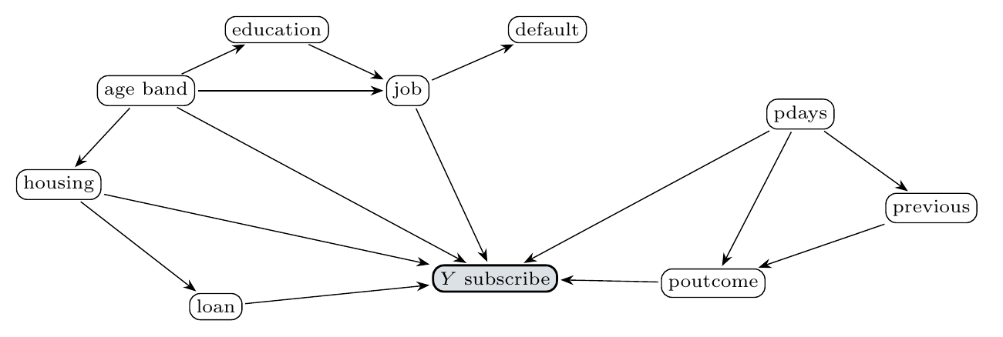
Graphical model and inference
p(·) = p(A) p(E|A) p(J|A,E) p(F|J) p(H|A) p(L|H) p(Pd) p(Pr|Pd) p(O|Pr,Pd) p(Y|A,J,H,L,O,Pd)
Query and algorithm: P(Y=1 | e), e = observed variables; exact VE (min-fill, min-weight, min-degree) and clique tree (treewidth 6); cost = factor-entry mult + add.
Assumptions: associational model, no latent variables; unknown treated as unobserved (A4).
Validation: VE vs clique tree vs enumeration, max error 2.2 × 10⁻¹⁶ (tolerance 10⁻⁶), 600 evidence patterns.

Slide 6
Fairness criterion and proposed method
Primary fairness criterion: ΔEOpp = max_g t_g − min_g t_g, t_g = P(D=1 | Y=1, G=g); a missed responder is the harm to the group.
Primary utility and allowed loss: average precision (AP), loss ≤ 0.01 vs exact (fixed before test).
Proposed change: if exact elimination would exceed budget B operations, answer by table lookup; choose f* = argmin_f max_g flip_g(f) s.t. validation AP loss ≤ 0.01.
Protected attribute at prediction time: age band is a model variable (yes); routing is group-unaware; marital status unused.
Diagnostics: ΔDP, ΔEOdds, fallback-rate gap, decision flips, log loss, Brier.

Slide 7
Experimental protocol
Baselines: exact; global fallback; threshold adjustment after budget; fair-adjusted exact; logistic regression; gradient-boosted trees.
Matched information and tuning: same variables and splits; thresholds, tables, selection from train/validation only; budget = natural validation op-count quantile (primary 75%: 11 ops).
Selection: capacity 0.2; test protocol frozen in docs/protocol.md.
Runs and intervals: 5 seeds (masks, networks, GBT); paired moving-block bootstrap, 1,000 replicates, blocks of 50 date-ordered rows; Holm over 3 comparisons.
Mechanism tests: exact agreement; synthetic networks (width × availability, with control); ablations A1–A4; robustness R1–R6.

Slide 8
Main result and uncertainty
Method | AP ↑ | ΔEOpp ↓ | Worst-group flip ↓ | Log loss / Brier ↓
Exact (reference) | 0.421 | 0.465 | 0 | 0.709 / 0.223
Global fallback (baseline) | 0.350 | 0.303 | 0.303 | 0.852 / 0.260
Proposed | 0.421 | 0.423 | 0.038 | 0.710 / 0.223
Utility-only (A1) | 0.354 | 0.717 | 0.198 | 0.825 / 0.254
Threshold adj. | 0.350 | 0.317 | 0.319 | 0.852 / 0.260
Natural workload, n = 8,238, 11 ops, capacity 0.2; ΔEOpp over 7 supported groups.
Paired ΔEOpp effect, proposed − comparator (negative favours proposed), 95% interval: global +0.120 [0.015, 0.226], Holm p = 0.036; utility-only −0.294 [−0.370, −0.210], p = 0.006; threshold adj. +0.106 [−0.006, 0.251], p = 0.080.
Answer: hypothesis refuted. Proposed keeps exact decisions (98.3% agreement, AP loss 0), but global and threshold baselines reach lower ΔEOpp only by levelling down (AP −0.071).

Slide 9
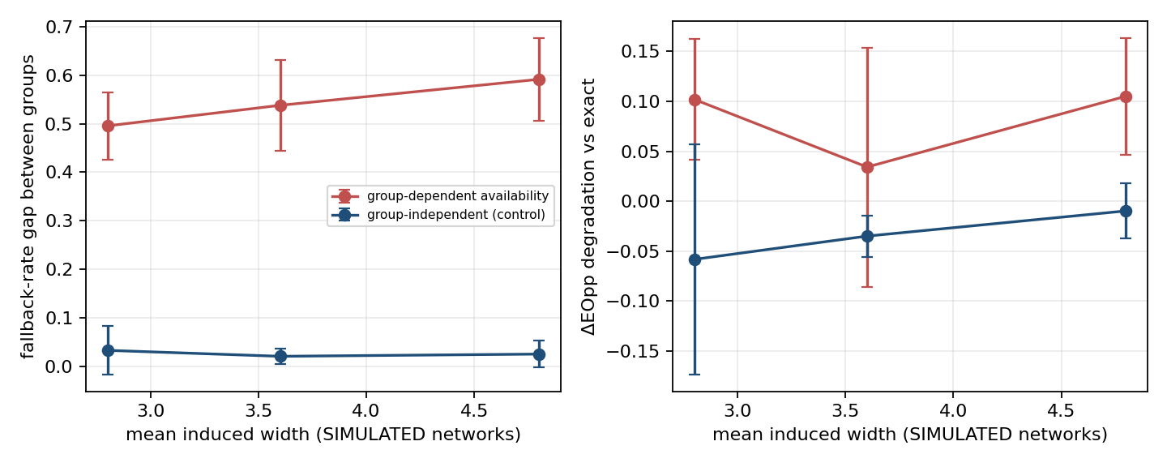
Ablation, robustness and failure case
Ablation A1 (no fairness-aware selection): worst flip 0.038 → 0.198, ΔEOpp 0.294 worse. A3 (no simplification): fallbacks 20.1% → 26.2%, AP 0.421 → 0.356. A4 (258 ops): no fallbacks, exact behaviour.
Robustness: capacity 0.1/0.3 and elimination orders keep the pattern; dense / sparse networks raise proposed worst flip to 0.206 / 0.133.
Failure case (synthetic dependent masks, exploratory): proposed picks the age-based fallback in 3 of 5 seeds, AP loss 0.046, ΔEOpp +0.493 [0.397, 0.569] vs exact; group-unaware variant loses 0.003 AP.
Interpretation: bootstrap intervals are sampling uncertainty of fixed models; seed and scenario variation is separate; the simulation is not customer fact.
SIMULATED networks: fallback-rate gap 0.542 (group-dependent) vs 0.026 (control).

Slide 10
Conclusion and reproducibility
Conclusion: fairness-aware selection preserves exact decisions at a tight budget, but does not give the smallest ΔEOpp; the confirmatory hypothesis is refuted.
Limits and ethics: base rate drifts 4.8% → 30.8% (test selection 38.3% vs 20%); no customer ids; contacted-only sample; 5 exploratory groups; simulations labelled.
Reproduce: scripts/run_experiments.py --mode real, evaluate.py --out results, make_results.py --out results --mode real; configs/main.yaml; commit [hash].
Shreeya Kamath: implementation (inference, baselines, experiments, notebook) and slide alignment.
Misha: debugging, report writing and slides. [cross-check of each other's work]

Slide 11
Backup: mandatory evidence and references
ID | Requirement | Artifact (results/metrics/) | Status
C-GM | VE = clique tree = enumeration | exp1_exact_agreement.json, cgm.json | complete
C-STAT | Paired block bootstrap, Holm | bootstrap.csv | complete
Exp 2 | Cost, peak factor, memory | exp2_complexity.csv | complete
Exp 3–4 | Budgets, matched utility, baselines | main_results.csv, group_table.csv, predictive_baselines.csv | complete
Exp 5 | Synthetic networks with control | exp5_aggregate.csv, exp5b_factorial.csv | complete
A1–A4, R1–R6 | Ablations, robustness | main_results.csv (tags) | complete
Latency | Wall-clock, separate | latency.csv | complete
Das, Romanelli, Fioretto, ICML 2024 (arXiv:2402.03629); Hardt, Price, Srebro, NeurIPS 2016 (arXiv:1610.02413); Moro, Rita, Cortez, UCI dataset 222; Koller & Friedman, Probabilistic Graphical Models, MIT Press 2009. Full table: docs/related_work.md; manifest: results/manifest.csv.

Slide 12
Backup: inference and statistical validation
Factor scopes: every CPD normalises over its child (checked). Maximal cliques (min-fill): {A, E, J} 288 entries; {A, H, J, L, Pd, Y} 3,888; {F, J} 36; {Pd, O, Pr} 12; treewidth 6.
Exact agreement: max |VE − CT| = 2.2 × 10⁻¹⁶, vs enumeration 1.1 × 10⁻¹⁶ (tolerance 10⁻⁶); 20 random 8-node networks × 10 queries × 3 heuristics also pass.
Cost (natural evidence): VE mean 24.7 ops, peak factor 96; clique-tree calibration 44,790 ops per evidence (+29,337 preprocessing); wall-clock 0.225 vs 1.09 ms per query.
Test denominators (positives / n): 30–59 married 932/3,152; <30 single 502/1,525; 30–59 single 451/1,631; ≥60 married 309/659; 30–59 divorced 176/650; ≥60 divorced 70/160; <30 married 79/384. Exploratory: <30 divorced 6/34; ≥60 single 8/25; 30–59 unknown 5/14; two unknown cells 1/2.
Bootstrap: moving blocks of 50, 1,000 replicates, 95% percentile, statistic ΔEOpp over the 7 supported groups; Holm family = 3 comparisons (natural workload). All-group sensitivity intervals are wide (e.g. vs global −0.167 [−0.385, 0.554]).

Slide 13
Backup: demonstration and individual defence
Command: python scripts/evaluate.py --out results && python scripts/make_results.py --out results --mode real regenerates the bootstrap table and main table from saved runs (about 40 s); the full run took 1,307 s (Python 3.13, Linux).
Saved trace (most expensive natural query; observed: age 30–59, default no, housing no, loan no, poutcome failure): min-fill eliminates previous_bin (6 ops), education (180), job (140), pdays_bin (8); total 339 ops; P(Y=1 | e) = 0.1683.
Order and posterior: same posterior by min-degree order (339 ops) and by clique-tree calibration (41,325 ops); order changes cost, never the posterior.
Be ready to: trace one operation count; justify ΔEOpp and why levelling down matters; critique the claim given base-rate drift and tiny groups.

